Slide 1

Expanding on Alcohol Harm Reduction:
Building your own
Managed Alcohol Program

Slide 2
Presenters
Bryce Bridges, LCSW, UCSF Citywide Stop Program, San Francisco Sobering Center
Devora Keller, MD, MPH, Medical Director, Medical Respite and Sobering Center, San Francisco Department of Public Health
Megan Kennel, RN, Charge Nurse, Sobering Center, San Francisco Department of Public Health
Alice Moughamian, RN, Nurse Manager, Medical Respite and Sobering Center, San Francisco Department of Public Health

Slide 3
Learning Objectives:
Define the scope and purpose of Managed Alcohol Programs
Identify the target population for your Managed Alcohol Program
Develop a strategic plan to advocate for the development of your Managed Alcohol Program
Design an initial care model for your Managed Alcohol Program
Generate a list of criteria to track for programmatic evaluation

Slide 4
Workshop schedule
Part 1: (15 min) Setting the stage: What is Managed Alcohol and Introduction to case study
Part 2: (15 min) Breakout session 1: Identifying your target population
Part 3: (20 min) Facilitated discussion: Barriers to implementing MAP
Part 4: (20 min) Breakout session 2: Developing your care model
Part 5: (15 min) Facilitated discussion: Designing program evaluation criteria
Part 6: (5 min) Wrap up

Slide 5
Alcohol Harm Reduction Strategies
Sobering Center
Housing First/Wet Housing
Managed Alcohol
Wet Shelters
Moderation Management
Sober Living Environment
Residential Treatment
10 Step Programs
Mandated Treatment Prgm
MAT
Abstinence Based
Non-Abstinence Based

Slide 6
Managed Alcohol Programs:
Philosophical Framework
Goal is to decrease harm NOT to decrease volume of alcohol consumed
Prevent withdrawal and associated complications
Decrease acute alcohol related harms
  Health
  Legal
  Interpersonal
Improve safety and Quality of Life
Decrease acute care and criminal justice episodes
Promote safer use of alcohol overall

Slide 7
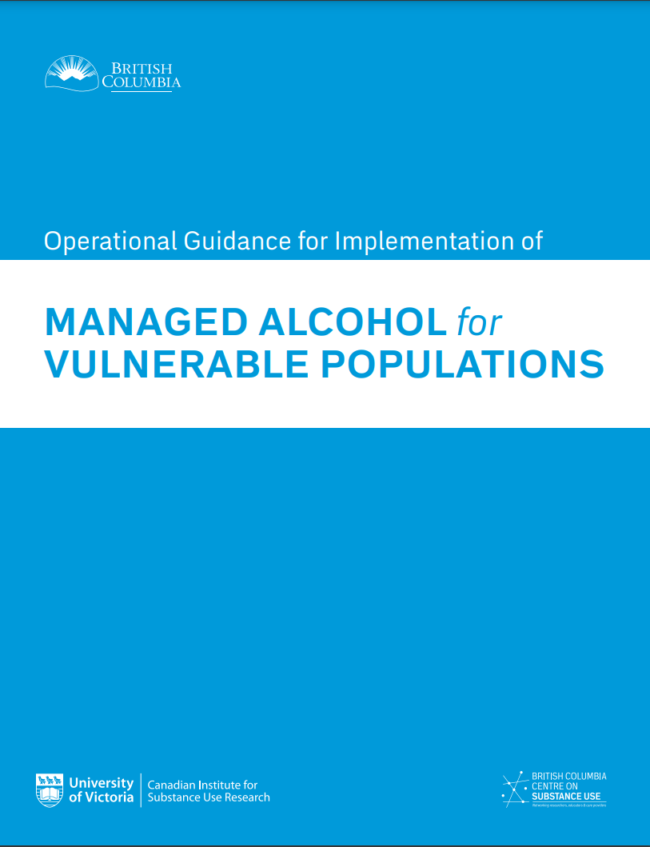
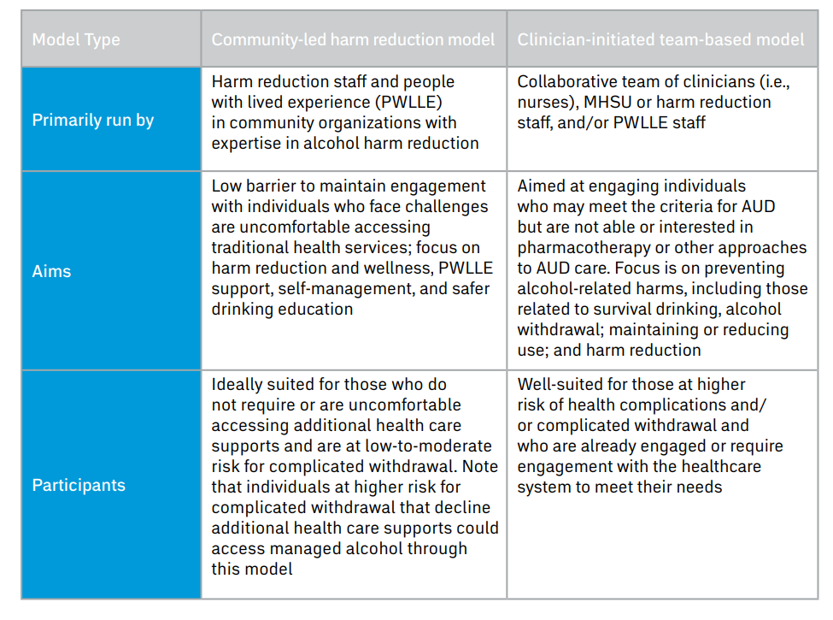
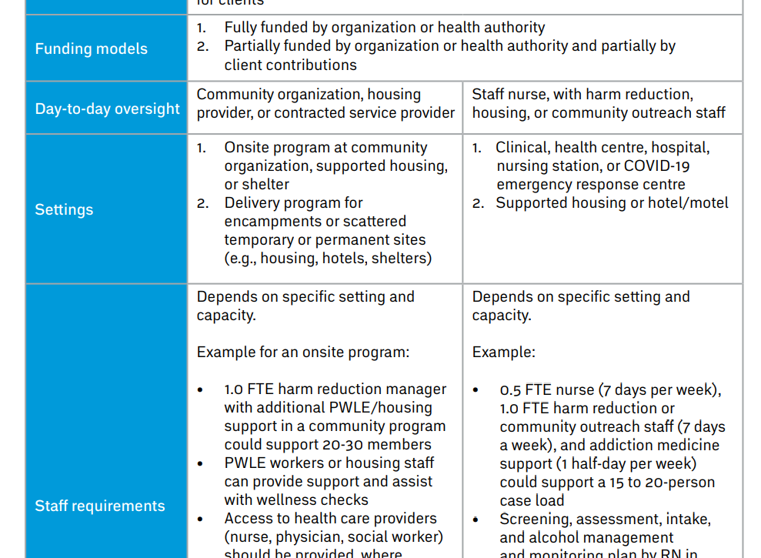
Peer Based vs. Clinician Initiated Models
https://www.uvic.ca/research/centres/cisur/assets/docs/provincial-guidance-managed-alcohol.pdf

Slide 8
Core Components of MAP to be Presented in Today's Workshop
Clinician based model
Housing/accommodations provided
Regulated amounts of alcohol are dispensed in a controlled setting
Integrated programming designed to mitigate the harms of alcohol use
Linkage to behavioral health and physical health services for participants who are interested

Slide 9
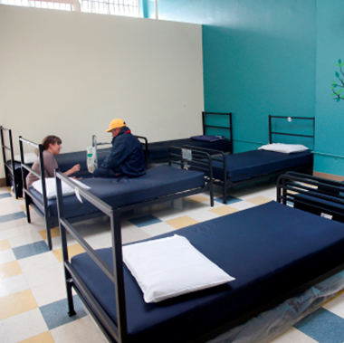
Intro to the Case Study:
San Francisco DPH Sobering Center:
12 beds
5000+ visits/year
State EMSA alternative destination pilot
COVID Response:
May 2020 - COVID+ exposure resulted in 23 PUIs among heavy alcohol users
Quickly created a I&Q supported MAP to support higher SDE clients that did not qualify for existing I&Q support

Slide 10
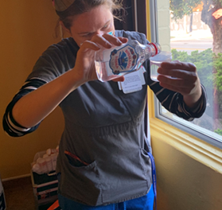
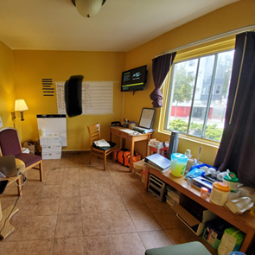

Intro to the
Case Study
I&Q Pilot
11 individuals served
23 EMS activations averted
Enrolled clients demonstrated new-found stability
Continuity MAP Established
SIP hotel identified to host co-located Sobering Center + 10 bed MAP program
Focus on programmatic development
  Admission criteria
  Clinical protocols
  Stakeholder engagement

Slide 11
Breakout Session #1:
Target Populations and Stakeholders
1. Think about your community – what populations/individuals do you think would benefit from a Managed Alcohol Program?
2. Who are the community stakeholders to engage with during your MAP planning and implementation process?

Slide 12
Example From the Sobering Center Case Study:
Eligibility Criteria:
Has diagnosis of Alcohol Use Disorder
EMS High Utilizer due to Alcohol Use Disorder
  o >4 911 activations in the previous 30 days
  o >10 utilizations in the past 12 months
  o >10 documented clinical engagements with EMS6 staff in 3 months
Independent with ADLs
Agrees to follow terms and rules of the Managed Alcohol Program
Agrees to Shelter in Place at the Managed Alcohol Program
San Francisco resident
Key Stakeholders:
San Francisco Department of Public Health Leadership
EMS-6 Community Paramedics
Local ED/Hospitals
Sobering Center High Utilizing Clients
PEH individuals with severe alcohol use disorder

Slide 13
Common Eligibility Criteria in the Literature
Has not had success in abstinence based programs
Chronically experiencing homelessness
Meet Severe Alcohol Use Disorder by DSMV
Has experienced acute alcohol related harms
Engages in high risk drinking

Slide 14
Barriers to Implementing a Managed Alcohol Program
What are your concerns about setting up a Managed Alcohol Program?

Slide 15
Ethical Considerations
Pattern of risky drinking** | Heavy episodic drinking/Drinking in unsafe settings | Alcohol consumed over long term
Potential harms | Accidents and Injury, seizure, unstable housing, legal issues, medical issues, interpersonal conflict | Chronic sequella of alcohol use including cirrhosis, GI complications, cancer, premature death.
Potential MAP benefits | Decreased injury, seizures, acute medical complications, improved QoL, sense of safety, social connectivity. | Potential to reduce consumption in supportive setting, ability to link with medical providers, respecting client autonomy
Potential MAP risks | Drinking larger amounts of alcohol than in the community, unhealthy weight gain, supporting alcohol use after acute alcohol related medical issues | Few abstainant days by virutue of stability in MAP, program supporting alcohol use in setting of advancing alcohol related medical complications
Remedial Strategies | Protocols to discourage outside alcohol use, integrating wellnes and nutrition into program, iterative discussions with participants about goals using ethical framework | Interative discussions about goals with patients using ethical framework, continued engagement with clinical staff around alternative harm reduction strategies
Core Tennets of Medical Ethics
Autonomy:
Respecting the client’s right to make choices/self determination
Beneficence:
Acting in the clients's best interests/proceeding in a manner that will provide benefit
Non-maleficence:
Risk reduction/"do no harm"
Equity:
The recognition of structural disadvantages and barriers and the resulting responsibility to attempt to attain the standard of health and related resources available to the most socially advantaged group
**Adapted from:Stockwell T, Pauly BB. Managed alcohol programs: Is it time for a more radical approach to reduce harms for people experiencing homelessness and alcohol use disorders? Drug Alcohol Rev. 2018 Apr;37 Suppl 1:S129-S131.

Slide 16
Breakout Session #2:
Developing Your Care Model
Group #1:
Developing a staffing model
Group #2:
Adapting a MAP protocol to your setting
Group #3:
Integrating behavioral health into MAP
Group #4:
Milieu management

Slide 17
Developing Your Staffing Model
Prompt #1:
What disciplines do you have available for your staffing model? What roles can they each play?
Prompt #2:
What regulatory issues need to be considered during programmatic development?
Prompt #3:
What are your funding streams? What are the values of your different funding streams?

Slide 18
Adapting a Managed Alcohol Protocol to Your Setting
Prompt #1:
What assessment should be done prior to acceptance/enrollment?
Prompt #2:
What monitoring parameters should be included in your protocols?
Prompt #3:
How will you structure longitudinal client monitoring?

Slide 19
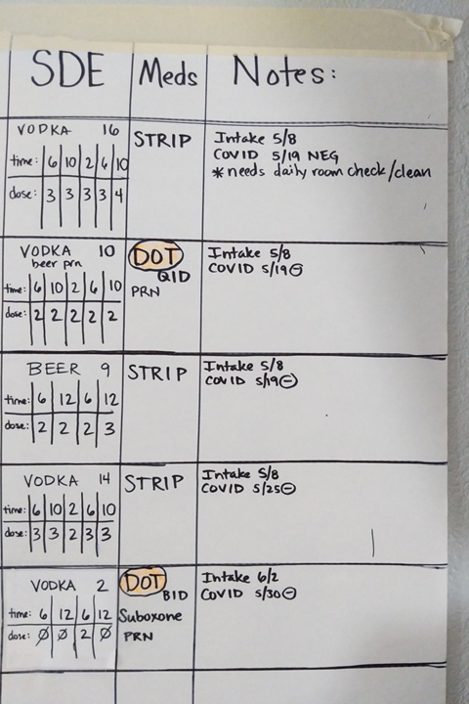
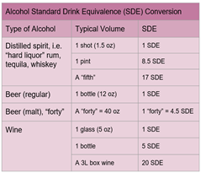
Examples of Dispensing Schedules
On demand dispensing of 1-2 SDE every 1-2 hours between 7am-11pm with intoxication assessment prior to dispensing
Daily dispensing of set amount of alcohol
Individualized dosing schedule split into 3-4 times a day dispensing

Slide 20
Integrating Behavioral Health Into a MAP Program
Prompt #1:
How will your MAP build an assessment of mental health/behavioral health needs into the programmatic model?
Prompt #2:
How will you integrate continued reassessment of participants' motivation around substance use into a harm reduction model that is not focused on an abstinence or 'cutting back' framework?
Prompt #3:
What social/cultural programming will you integrate into your MAP program?

Slide 21

Examples of Social and Cultural Activities to Integrate into MAP Programs
Life skills
Crafts
Music
Writing
Exercise/Movement
Traditional activities

Slide 22
Milieu Management
Prompt #1:
How will your program respond to consumption of outside alcohol?
Prompt #2:
How will your MAP program foster a sense of community?
Prompt #3:
How will your program utilize staff members' time and expertise to address behavioral challenges?
Prompt #4:
What details should be included in the client agreement for program participation?

Slide 23
Approaches to Addressing Outside Alcohol Use
Closed program design
Participants need to be onsite a set amount of time prior to alcohol dispensing (eg. 60 minutes)
Dispensing staff member assesses for intoxication prior to dispensing alcohol
Programmatic rules link repeat use of outside alcohol with discharge
Rules and protocols that prevent storing of outside alcohol onsite

Slide 24
Developing Your Care Model:
Report Out to the Group
First up:
Developing a staffing model
Second up:
Adapting a managed alcohol protocol to your setting
Third up:
Integrating behavioral health into a MAP program
Last up:
Milieu Management

Slide 25
Designing Program Evaluation Criteria
Patient level information?
Qualitative data?
Programmatic level details?

Slide 26
Potential Outcomes to Follow
Change in pattern of drinking
  Daily alcohol consumption
  Pattern of unsafe drinking
  Starting MAT to support alcohol reduction
Improvement in QoL
  Social connectivity
  Familial relationship
  Sense of safety/security
  Housing stability
Physical Health Indicators
  Short vs. long term health consequences of alcohol use
Changes in Patterns of Utilization
  Decrease acute care/EMS utilization
  Linkage to longitudinal ambulatory behavioral health and physical health providers

Slide 27
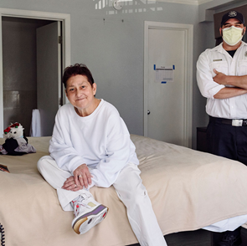
Wrap Up and Questions:
Photo used with client permission

Slide 28
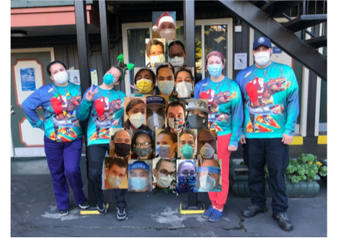
Acknowledgements
San Francisco COVID Command Center
SFDPH Leadership
EMS 6 leadership and staff
Community Forward San Francisco
Citywide STOP Case Management Program
Sobering Center Staff
Street Medicine Team
UCSF Primary Care Addiction Medicine Fellowship

Slide 29
References
Brooks HL, Kassam S, Salvalaggio G, Hyshka E. Implementing managed alcohol programs in hospital settings: A review of academic and grey literature. Drug Alcohol Rev. 2018 Apr;37 Suppl 1:S145-S155.
Carver H, Parkes T, Browne T, Matheson C, Pauly B. Investigating the need for alcohol harm reduction and managed alcohol programs for people experiencing homelessness and alcohol use disorders in Scotland. Drug Alcohol Rev. 2021 Feb;40(2):220-230.
Chow C, Wettlaufer A, Zhao J, Stockwell T, Pauly BB, Vallance K. Counting the cold ones: A comparison of methods measuring total alcohol consumption of managed alcohol program participants. Drug Alcohol Rev. 2018 Apr;37 Suppl 1:S167-S173.
Canadian Managed Alcohol Programs Study: https://www.uvic.ca/research/centres/cisur/projects/map/index.php
Crabtree A, Latham N, Morgan R, Pauly B, Bungay V, Buxton JA. Perceived harms and harm reduction strategies among people who drink non-beverage alcohol: Community-based qualitative research in Vancouver, Canada. Int J Drug Policy. 2018 Sep;59:85-93.
Erickson RA, Stockwell T, Pauly BB, Chow C, Roemer A, Zhao J, Vallance K, Wettlaufer A. How do people with homelessness and alcohol dependence cope when alcohol is unaffordable? A comparison of residents of Canadian managed alcohol programs and locally recruited controls. Drug Alcohol Rev. 2018 Apr;37 Suppl 1:S174-S183.
Evans J, Semogas D, Smalley JG, Lohfeld L. “This place has given me a reason to care”: Understanding ‘managed alcohol programs’ as enabling places in Canada. Health & Place. 2015;33:118-124. .
Ezard N, Cecilio ME, Clifford B, Baldry E, Burns L, Day CA, Shanahan M, Dolan K. A managed alcohol program in Sydney, Australia: Acceptability, cost-savings and non-beverage alcohol use. Drug Alcohol Rev. 2018 Apr;37 Suppl 1:S184-S194.
Gaetz S. Commentary: Harm reduction, managed alcohol programs and doing the right thing. Drug Alcohol Rev. 2018 Apr;37 Suppl 1:S195-S196.

Slide 30
References
Gaetz S. Commentary: Harm reduction, managed alcohol programs and doing the right thing. Drug Alcohol Rev. 2018 Apr;37 Suppl 1:S195-S196.
Hill M, Vipler S, Sutherland C, Nolan S. Challenges of treatment of acutely ill patients enrolled in a managed alcohol program. Drug Alcohol Rev. 2018 Apr;37 Suppl 1(Suppl 1):S143-S144.
Ivsins A, Pauly B, Brown M, Evans J, Gray E, Schiff R, Krysowaty B, Vallance K, Stockwell T. On the outside looking in: Finding a place for managed alcohol programs in the harm reduction movement. Int J Drug Policy. 2019 May;67:58-62.
Magwood O, Salvalaggio G, Beder M, Kendall C, Kpade V, Daghmach W, Habonimana G, Marshall Z, Snyder E, O'Shea T, Lennox R, Hsu H, Tugwell P, Pottie K. The effectiveness of substance use interventions for homeless and vulnerably housed persons: A systematic review of systematic reviews on supervised consumption facilities, managed alcohol programs, and pharmacological agents for opioid use disorder. PLoS One. 2020 Jan 16;15(1):
Mehtani NJ, Ristau JT, Eveland J. COVID-19: Broadening the horizons of U.S. harm reduction practices through managed alcohol programs. J Subst Abuse Treat. 2021 May;124:108225.
Muckle J, Muckle W, Turnbull J. Operating principles from Ottawa's managed alcohol program. Drug Alcohol Rev. 2018 Apr;37 Sup
Parappilly BP, Garrod E, Longoz R, Eligh E, van Heukelom H, Fairgrieve CK, Pauly B. Exploring the experience of inpatients with severe alcohol use disorder on a managed alcohol program (MAP) at St. Paul's Hospital. Harm Reduct J. 2020 May 12;17(1):28.
Pauly B, Brown M, Evans J, Gray E, Schiff R, Ivsins A, Krysowaty B, Vallance K, Stockwell T. "There is a Place": impacts of managed alcohol programs for people experiencing severe alcohol dependence and homelessness. Harm Reduct J. 2019 Dec 16;16(1):70.
Pauly BB, Gray E, Perkin K, et al. Finding safety: a pilot study of managed alcohol program participants' perceptions of housing and quality of life. Harm Reduct J. 2016;13(1):15. Published 2016 May 9.
Pauly BB, Vallance K, Wettlaufer A, Chow C, Brown R, Evans J, Gray E, Krysowaty B, Ivsins A, Schiff R, Stockwell T. Community managed alcohol programs in Canada: Overview of key dimensions and implementation. Drug Alcohol Rev. 2018 Apr;37 Suppl 1:S132-S139.

Slide 31
References
Podymow T, Turnbull J, Coyle D, Yetisir E, Wells G. Shelter-based managed alcohol administration to chronically homeless people addicted to alcohol. CMAJ. 2006;174(1):45-49.
Ristau J, Mehtani N, Gomez S, Nance M, Keller D, Surlyn C, Eveland J, Smith-Bernardin Successful implementation of managed alcohol programs in the San Francisco Bay Area during the COVID-19 crisis. S. Subst Abus. 2021;42(2):140-147.
Room R. Managed alcohol programs: Reducing social and injury harm, but what about long-term health harm? Drug Alcohol Rev. 2018 Apr;37 Suppl 1:S197-S198. doi: 10.1111/dar.12690.
Stockwell T, Pauly BB. Managed alcohol programs: Is it time for a more radical approach to reduce harms for people experiencing homelessness and alcohol use disorders? Drug Alcohol Rev. 2018 Apr;37 Suppl 1:S129-S131.
Stockwell T, Pauly BB, Chow C, Erickson RA, Krysowaty B, Roemer A, Vallance K, Wettlaufer A, Zhao. Does managing the consumption of people with severe alcohol dependence reduce harm? A comparison of participants in six Canadian managed alcohol programs with locally recruited controls. J. Drug Alcohol Rev. 2018 Apr;37 Suppl 1:S159-S166.
Stockwell T, Zhao J, Pauly B, Chow C, Vallance K, Wettlaufer A, Saunders JB, Chick J. Trajectories of Alcohol Use and Related Harms for Managed Alcohol Program Participants over 12 Months Compared with Local Controls: A Quasi-Experimental Study. Alcohol Alcohol. 2021 Jan 9:agaa134.
Vallance K, Stockwell T, Pauly B, et al. Do managed alcohol programs change patterns of alcohol consumption and reduce related harm? A pilot study. Harm Reduct J. 2016;13(1):13. Published 2016 May 9.

