Slide 1

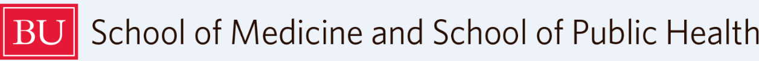

A Podcast for Fetal Alcohol Spectrum Disorders (FASD) Education: Using Alternative Educational Delivery for Provider Training
JS German¹, A Harlowe¹, CA Bangham², JA Greece², DP Alford^{1,3}
Clinical Addiction Research and Education Unit, Section of General Internal Medicine, Boston Medical Center, Boston, MA
Boston University School of Public Health, Boston, MA
Continuing Medical Education Office, Boston University School of Medicine, Boston, MA
The Boston Sustainable Models for unhealthy Alcohol use ReducTion (B SMART) Program is funded by a cooperative agreement from the US DHHS, CDC, NU84DD000002
Notes:
I am Jacqueline German and I am with Boston University School of Medicine and Boston Medical Center. I am presenting “A podcast for A Podcast for Fetal Alcohol Spectrum Disorders (FASD) Education: Using Alternative Educational Delivery for Provider Training

Slide 2
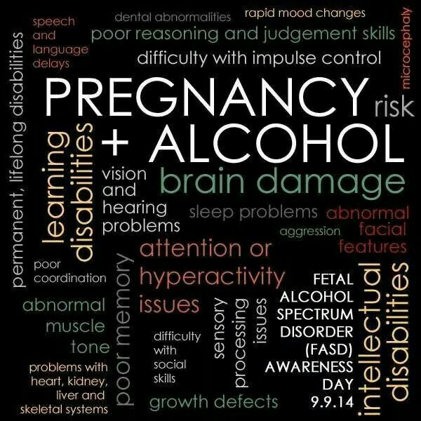
Background
FASDs are a range of conditions attributable to prenatal alcohol exposure (PAE) that have lifelong effects, that include behavior, learning and physical problems¹
Alcohol is a teratogen which adversely affects normal brain development throughout all gestational stages
FASDs are permanent¹ and the most common preventable developmental disabilities in the US
In the US, an estimated 1-5% of 1st grade children may have FASDs²
There is no known safe amount, no safe time, and no safe type of alcohol use during pregnancy.
1. SAMHSA. Treatment Improvement Protocol (TIP) 58. (2014). HHS Publication.
2. May PA et al. JAMA. 2018
Notes:
First I would like to talk about Fetal Alcohol Spectrum Disorders, because they are while quite prevalent, they are underappreciated and not fully understood by most medical providers.

Slide 3

Background (cont.)
Alcohol use during pregnancy
  30% reported drinking during their pregnancy¹
  9.8% reported past 30-day drinking²
  4.5% reported past 30-day binge drinking²
Lack of FASD education in health professional training
Misinformation from media, community, and medical providers³
  “more than the occasional drink is likely perfectly fine...” Emily Oster in Expecting Better
Ethan MK et al. Matern Child Health J. 2009
Lucinda J, et al. MMWR. 2020
Elek E, et al. American Journal of Health Education. 2012
Notes:
Despite what we know about the effects of PAE, there is still a lot of alcohol use during pregnancy. Pregnant people get Misinformation from media, their communities and families, as well as some medical providers. A popular pregnancy book states that……more than the occasional drink is likely perfectly fine...”
The B SMART Program is funded by the CDC and aims to prevent FASD by providing education, SBIRT training and technical assistance within Boston HealthNet (Boston Medical Center, 14 Community Health Centers)

Slide 4
Methods: B SMART Program
Boston Sustainable Models for unhealthy Alcohol use ReducTion
  Aims to prevent FASDs by providing in-person and virtual training and technical assistance
  Developed a podcast, as they are becoming more prevalent in health professional continuing education¹
    Hired producer, wrote scripts, recruited experts, individuals with lived experience, and standardized patients
    Disseminated by multi-faceted promotional campaign including hospital and university social media, listserv outreach, partner-agency collaborations and meetings/trainings
    Free continuing education credit through Boston University CME/CNE office
1. Berk J. Gen Intern Med. 2020
Notes:
B SMART created a podcast during the pandemic as a way to reach a broader audience. Podcasts are becoming more prevalent among all learners in general, including in medicine for medical students, residents and CME. We are only beginning to appreciate the extent and degree of the changing landscape regarding podcasts in education.
For the podcast, we Interviewed an FASD expert, a patient advocate, a mother whose child has an FASD, and a public health social worker including two simulated provider-patient brief intervention enactments
Our promotion campaign has included multi-faceted media campaign, hospital and university social media, list-serve outreach, partner-agency collaborations and virtual trainings
There is free continuing education credits (CME and CNE) through Boston University

Slide 5
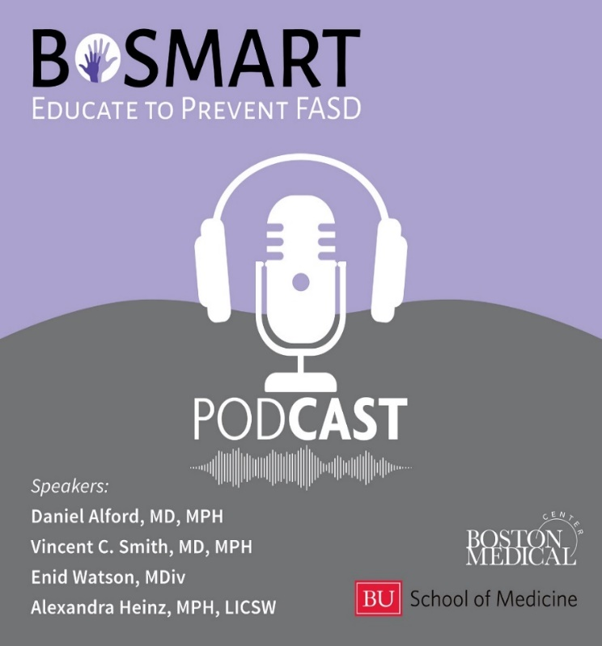
Methods: Podcast
“Alcohol and Pregnancy: The More You Know”: three 20-minutes episodes
Episode 1: Medical expert discusses foundational science of FASDs and a conversation with a mother whose child is affected by prenatal alcohol exposure
Episode 2: Patient advocate explores the implications of FASDs and their impacts on children and families. Continues conversation with the mother who discusses the shame and stigma of having a child with an FASD
Episode 3: Public health social worker discusses unhealthy alcohol use, as well as the SBIRT model. Hear two standardized patient counseling sessions followed by a debrief and commentary
Alcohol and Pregnancy: The More You Know
Notes:
B SMART created a podcast during the pandemic as a way to reach a broader audience. Podcasts are becoming more prevalent among all learners in general, including in medicine for medical students, residents and CME. We are only beginning to appreciate the extent and degree of the changing landscape regarding podcasts in education.
For the podcast, we Interviewed an FASD expert, a patient advocate, a mother whose child has an FASD, and a public health social worker including two simulated provider-patient brief intervention enactments
Our promotion campaign has included multi-faceted media campaign, hospital and university social media, list-serve outreach, partner-agency collaborations and virtual trainings
There is free continuing education credits (CME and CNE) through Boston University

Slide 6
Methods: Evaluation Plan
Evaluation Dimension | Data Collection Methods | Outcomes Assessed
Reach | Podcast downloads (Megaphone) CME post-survey | Download Number Timing Location Demographics
Effectiveness | CME post-survey Qualitative and Quantitative | Self-reported: Knowledge Perceived skill Intent to change practice
Notes:
.
There are 2 dimensions to the evaluation: Reach and Effectiveness. For reach we looked at the number and timing of downloads as well as the geographic spread, though a platform called megaphone. For effectiveness, we gave a post-test survey to those participants who took the course for continuing educational credit. We collected minimal demographics, and both Qualitative and Quantitative data on self-reported Knowledge, Self-efficacy and Practice Change. We included some case-based knowledge questions.

Slide 7
Results: Reach
6 months (3/2021-8/2021)
Total downloads n=916
  Episode 1: n=397
  Episode 2: n=260
  Episode 3: n=259
  41 U.S. states
  18 countries
CME claimants n=84
  34% Nurse
  26% Physician
  23% NP
  6% PA
  4% Behavioral Health
  7% Other
Notes:
Explain more orally about thespecific distribution campaigns and the spikes that follow them.

Slide 8
Results: Effectiveness n=84
Knowledge: 10 questions
Content Area | % Correct
1. Universal alcohol screening | 97%
2. Definition of risky alcohol use (quantity, frequency) | 76%
3. Characteristics of alcohol use disorder | 85%
4. Facts about prenatal alcohol exposure | 92%
5. Facts about prenatal alcohol exposure | 92%
6. Facts about FASD | 68%
7. FASD clinical features | 100%
8. Case: How to start the conversation about alcohol and pregnancy | 91%
9. Case: How to counsel about prenatal alcohol exposure | 100%
10. Case: How to assess for readiness to change using a readiness ruler | 49%
Notes:
3 areas very well
3 areas less well
3 areas…
First attempt
Universal Screening
2. Definition of Unhealthy Alcohol use
3. Definition of AUD
4. PAE science
5. PAE Clinical
6. Definition and Prevalence of FASD
7. FASD Features
8. Case based: Alcohol and pregnancy advice
9. Counselling around PAE
10. Using a readiness ruler

Slide 9
Results: Effectiveness n=84
Perceived skill
As a result of this activity, do you feel you are better able to…
Yes
Partially
Notes:
Attribute changes to listening to podcast

Slide 10

Results: Effectiveness n=84
Intent to change practice¹
64.5% (54/84) plan to make changes in their practice based on what they learned
Most common changes:
26% Incorporate motivational interviewing skills
19% Screen for alcohol use/prenatal alcohol exposure
11% Educate patients about prenatal alcohol exposure and/or FASDs
1. Lockyer JM, et al. Journal of Continuing Education in the Health Professions. 2001
Notes:
Intent to change has been shown to predict practice change - put in reference
2001 locklear
Mute the image

Slide 11
Conclusions
Reach of podcast in 6 months was widespread and multidisciplinary, however there was a decrease in downloads for episodes 2 and 3
Substantial number claimed CME/CNE credits and completed post-survey
  Scored high levels of knowledge for most content areas
  Reported high level of ability in communicating, counseling, and educating patients as a result of the podcast
  2/3 reported intention to change their practice based on what they learned
Notes:
AAP implementing screening

Slide 12
Limitations
Creating and disseminating a podcast is time-intensive
Evaluation of podcasts is limited
    Data is limited by Megaphone collection variables (date, episode, geographic location)
    Data from CME participants is limited by post-survey design and self-reported data
Notes:
Limited data collection – people doing CME are not expecting to do pre-survey – not typical so we are limited byt CNE standrard for getting credit
People are allowed to take CME post survey many times…….in order to get credit. Is this the first attempts?

Slide 13
Implications
Podcasts provide an innovative means of education given the broad reach and ease of access, especially as healthcare providers rely more on virtual education
Questions remain… “does convenience of these modalities [podcasts] facilitate learning while multitasking or take away from focused study?”¹
1. Berk J. Gen Intern Med. 2020

Slide 14

Questions
jacqueline.german@bmc.org

