Slide 1

Substance Abuse Research Education and Training (SARET) Program
Program and Curricula Evaluation
AMERSA 2021
Mia Malone; Kathleen Hanley, MD; Jennifer McNeely, MD; Danielle Ompad, PhD; Jennifer Manuel, PhD; Michelle Knapp, DNP; Lukasz Witek, PhD; Marc Gourevitch, MD MPH
Notes:
My name is Mia Malone and I’m the Project Manager of the NYU Grossman School of Medicine substance abuse research education and training program or SARET.

Slide 2
Supported by NIDA Grant R25 DA022461
No conflicts of interest to disclose

Slide 3
SARET Overview
Partnership: Medicine, Nursing, Dentistry, Social Work, & Public Health
Goal: activate students’ interest in future careers in substance use research
Three components:
  Web based modular curriculum
  Mentored research placements(8-weeks, summer)
  Visiting Mentor Development Program
    Started in 2019
Year 15
Notes:
Today I will tell you a bit about SARET and report on the evaluation of two of our primary goals for this phase of the grant: early career outcomes of participants in our summer mentored research program and outcomes for our visiting mentor development program.
SARET is a collaboration between the NYU schools of dentistry, medicine, nursing, social work, and public health to activate students’ interest in future career in substance abuse research in the hope of increasing the number of interdisciplinary researchers in this field.
SARET has three main components: web based modular curriculum, research mentorships, and the visiting mentor development program.
We currently have 7 online web modules covering the following topics: epidemiology, personal impact, screening for substance use, neurobiology, exploring substance use research, treatment modalities, and global public health. All are free and open access to any learner.
Our research mentorship program accept students from our partner NYU graduate schools of medicine, nursing, social work, dentistry, and public health and is an 8-week summer program. Students are paired with a research mentor, also from one of the participating NYU schools, currently conducting research in the field of substance use. The program culminates with a research presentation day, where students present a poster of their summer research.
Lastly, we implemented a visiting mentor development program, or VMDP, beginning in 2019 where we invite 5 faculty mentors from institutions across the U.S. to participate in a 4-day intensive program geared at promoting the development of SARET-esque substance use research programs at their home institutions. The visiting mentors also reflect the disciplines included in the SARET program: medicine, nursing, social work, dentistry, and public health.

Slide 4
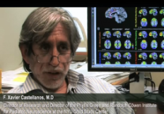
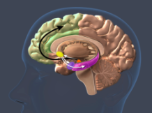

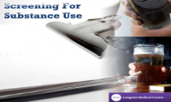
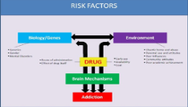
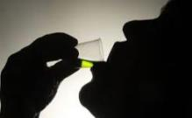

SARET Modules
Exploring SA Research
Personal Impact
Epidemiology
Public Health
Neurobiology
Screening
Treatment
2009-2020
35,745 total module completions
Notes:
Our 7 interactive multimedia web modules cover core topics relating to substance use disorders along with some fundamental concepts in research methodology such as how to design a research question or the criteria for evaluating a screening test.
They are freely accessible via the web and can each be completed in about 40 minutes,
Their positive impact on students’ attitudes towards research and treatment of substance use disorders was studied previously using module embedded surveys.
They are a core component of the summer research curriculum and are also used in courses at the participating schools
Since modules were developed in 2010 there have been over 35,000 module completions

Slide 5
Mentored Research Participants
    156 summer students
      41 SOM, 34 COD, 34 CON, 34 SSW, 13 CGPH
 | Applicants | Participants
Gender | 70% Female, 28% Male, 1% Other | 69% Female, 29% Male, 2% Other
Ethnicity | 12% Hispanic/Latinx | 11% Hispanic/Latinx
Race | 21% Asian 8% Black/African-American 9% Multi-Racial 63% White 1% Other | 18% Asian 12% Black/African-American 7% Multi-Racial 64% White 1% Other
*2013-2021
Notes:
Thus far, 156 students have participated in the summer research mentorship
CGPH joined SARET in year 11 and this is reflected in their lower number or student participants
Demographics of participants. We began tracking this data in 2013.

Slide 6
Evaluation: Summer Mentored Research Program
Primary outcome
  Ascertain impact of participation in summer mentored research program on health professional students’ future engagement in SUD research
Approach
  Longitudinal follow-up survey of SARET summer program participants
  Bibliometric analysis

Slide 7
Evaluation
Long term follow-up survey was sent to 126 participants having valid emails, and 91 responses were collected (72% response rate).
Notes:
The survey was sent to 126 participants having valid emails, and 91 responses were collected (72% response rate.

Slide 8
RESULTS
SARET participation increased self-reported:
  Interest in SUD research (n=86, 95%)
  Knowledge about SUD and SUD research (n=88, 97%)
  Expanded research skills (n=85, 93%)
  Inter-professional appreciation (n=86, 95%)
  Communication skills with professionals outside their field (n=78, 86%)
42% (n=38) remain in contact with SARET mentor
Notes:
As you can see, students reported that participation in SARET increased their interest in substance use research, knowledge about substance use and substance use research, expanded their research skills, fostered an appreciation of interprofessional collaboration, and increased comfort with communication with other disciplines.
Of note, 42% of the students are still in contact with their SARET mentor.

Slide 9
RESULTS: Qualitative
Main impact of SARET on career:
  “Increased appreciation for substance use research and the need for further study as it pertains to population and public health.”
  “Increased awareness of substance use disorders in patients.”
  “appreciated the interdisciplinary teamwork and the experience cemented my desire to pursue addiction medicine work going forward”
  “Learning the process of writing a paper and getting it published.”
  “…As an emergency medicine physician, many of our patients come in during their most vulnerable state and this program helped me realize a lot of the limitations my patients face outside of the hospital, especially when trying to access treatment.”
Notes:
Here I have displayed some of the qualitative data we received regarding the impact of SARET on student careers.
Nearly all students reported both increased knowledge and awareness of substance use disorders and highlighted the importance of interdisciplinary research regarding the treatment of substance use.
.

Slide 10
RESULTS: Qualitative
Main impact of SARET outside of career:
“Increased awareness about the systemic effects of substance use ”
“Empathy and compassion for those struggling with substance use.”
“…helped me to unpack the unconscious biases that I hold around addiction …”
“provided a foundational knowledge in how to conduct research and actually have hands on experience with really great mentoring.”
“The interdisciplinary nature, both in terms of collaboration with my mentor, as well as with classmates who were in the program from a variety of different healthcare backgrounds, really opened my eyes to the ways in which people in all sectors and backgrounds are actively contributing to this issue and can have great impacts (both clinical and beyond) on patients lives.”
Notes:
Here I have recorded some of the qualitative data collected regarding the influence of SARET outside of student careers.
The most common theme was a not only increased knowledge of substance use disorders but also empathy and compassion for persons with substance use disorders. Many students reported that SARET was able to highlight systemic effects of substance use and the unconscious bias that many providers hold toward persons who use drugs.

Slide 11
RESULTS: Career Outcomes
44% (n=40) report being somewhat or very involved in research
24% (n=22) report involvement in SUD-related research
Notes:
44% of past participants reported being somewhat or very involved in research and 24% were involved in substance use related research

Slide 12
RESULTS: Publications and Presentations
Student Publications/Presentations:
  68 SUD-related peer-reviewed journal articles
  2 book chapters
  45 oral/poster presentations
Student Funding:
  17 participants have received funding* to support their career activities
* (e.g., scholarships, research fellowships, grants, education awards, special project support)
Notes:
Presentations--
We were able to assess participants’ publications both based on the survey and through a Bibliometric analysis (automated monthly search of journal articles via pubmed)
Thus far, past SARET students have published 68 research articles related to substance use, two book chapters and 45 oral or poster presentations at academic conferences. Additionally, 17 participants have received funding to support their career activities.

Slide 13
Evaluation: Visiting Mentor Development Program (VMDP)
Primary outcome
  Assess impact of participation in VMDP on the development of SUD-related research programs at faculty’s home institutions
Approach
  Follow-up meetings
Notes:
Today I will discuss the results of our evaluation ot the summer research program for students and our early evaluation of the visiting mentor development program
I will report on the findings from our second longterm follow up survey and our ongoing bibliometric searches

Slide 14
Visiting Mentor Development Program
    Building SARET Champions at other schools.
2019 | 2020 | 2021
Florida Atlantic University (Nursing) Central Michigan University (Medicine) University of Texas-Arlington (Social Work) Stony Brook University (Medicine) SUNY Cortland (Public Health) | Tarleton State University (Social Work) East Tennessee State University (Pubic Health) Wayne State University (Medicine) Edinboro University (Social Work & Nursing) | Northwell Health (Medicine) Kaiser Permanente (Medicine) Colorado Mesa University (Counseling) Indiana University (Social Work)
Notes:
Here you can see the institutions and disciplines of our participating visiting mentors thus far. To refresh, VMDP is a 4-day intensive program where visiting mentors both attend targeted seminars regarding building and implementing a substance use research program and observe several of the SARET student seminars in order to gain insight into how the NYU SARET programs structures our curriculum.

Slide 15
RESULTS: VMDP
14 VMDP participants, 2019-2021
3/14 (21%) have already implemented pilot inter-disciplinary SU mentored research programs at their home institutions.
  Edinboro University (2 VMDP faculty)
  East Tennessee State University
Notes:
Of the 14 visiting mentors that have participated since 2019, 3 have developed pilot interdisciplinary substance use research programs at their home institutions, one program at Edinboro University in Pennsylvania and one at East Tennessee State University.

Slide 16

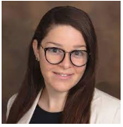

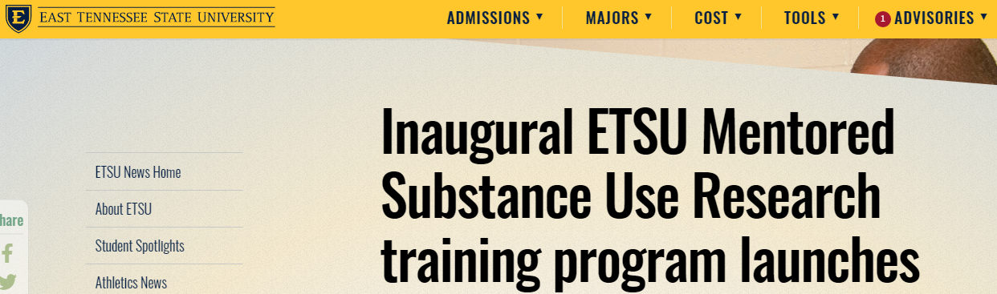
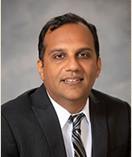
Stephanie Diez-Morel, PhD, LCSW, IGDC, MCAP
Susan Maloney, PhD, MSN, FNP-BC, PMHNP-BC
Manik Ahuja, PhD MA
Notes:
An excerpt from both program announcements is included here.
The program implemented at Edinboro University is titled: Substance Use and Behavioral Health Interdisciplinary Research and is led by Drs. Stephanie Diez-Morel and Susan Maloney. Both participated in the 2020 cohort of VMDP with Dr. Diez-Morel representing Social Work and Dr. Maloney representing Nursing. Their inaugural program ran during summer 2021 and included 5 interdisciplinary students. Feedback thus far has been positive and Drs. Diez-Morel and Maloney recently applied for a grant to support their program from the Center for Rural Pennsylvania.
The program at East Tennessee State University is led by Dr. Manik Ahuja also a 2020 VMDP participant from the field of Public Health and is titled the ETSU Mentored Substance Use Research Program. The pilot program had its inaugural session in summer 2021. Dr. Ahuja partnered with the ETSU Addiction Science Center to distribute his program information. While originally intended to accept only 5 students, the response received was so overwhelming he expanded his program to include 10 interdisciplinary students. He has received institutional support to continue to offer his program.

Slide 17
SARET: Looking forward
Integrate greater focus on health equity and racial justice
Gradually expand reach of VMDP and support for new programs at participants’ home institutions
Continually refresh modular content and summer mentored research opportunities
Notes:
Of the 14 visiting mentors that have participated since 2019, 3 have developed pilot interdisciplinary substance use research programs at their home institutions, one program at Edinboro University in Pennsylvania and one at East Tennessee State University.

Slide 18
Thank you!
Mia Malone,
SARET Project Manager
Mia.Malone@nyulangone.org
Kathleen Hanley, MD
SARET Curriculum Director
Kathleen.Hanley@nyulangone.org
Visit our website: http://www.med.nyu.edu/pophealth/divisions/saret

