Slide 1
The Stimulant Resurgence:
Prevention and Treatment Efforts
Nora D. Volkow, M.D.
Director
National Institute on Drug Abuse

Slide 2
Evolution of Drivers of Overdose Deaths, All Ages
Analgesics Heroin Fentanyl Stimulants
70,630 Deaths in 2019
49,860 from Opioids (Prescription and Illicit)
Source: The Multiple Cause of Death data are produced by the Division of Vital Statistics, National Center for Health Statistics (NCHS), Centers for Disease Control and Prevention (CDC), United States Department of Health and Human Services (US DHHS).

Slide 3
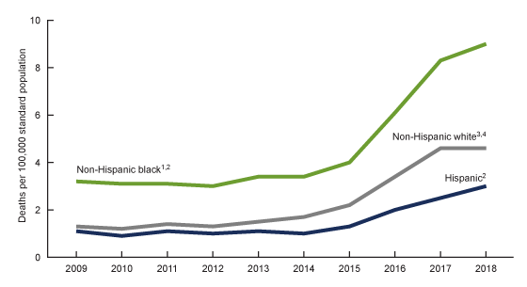
Age-adjusted Rates Of Drug Overdose Deaths Involving Cocaine and Methamphetamine By Race And Ethnicity: US, 2009–2018
Cocaine
Methamphetamine
CDC, NCHS Data Brief No. 384, October 2020

Slide 4
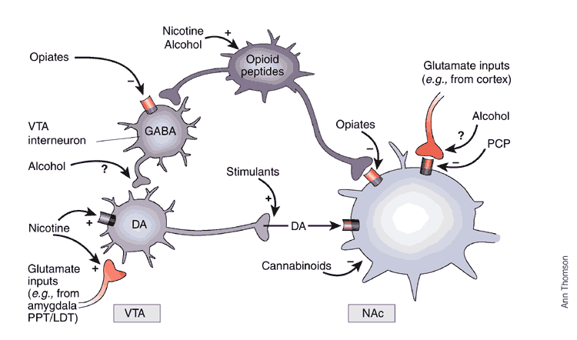
Drugs Increase Dopamine (DA) in Accumbens (NA_{C}) Main Brain Reward Region
DA

Slide 5
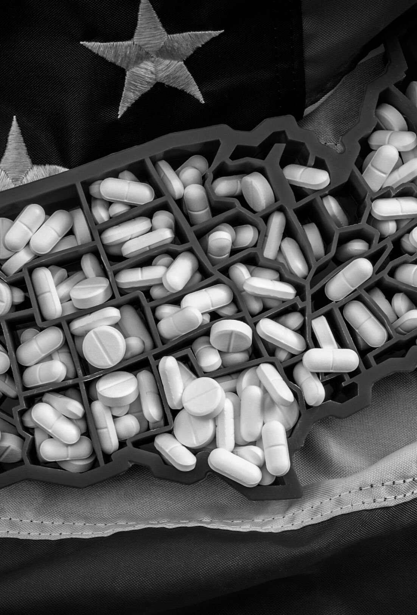
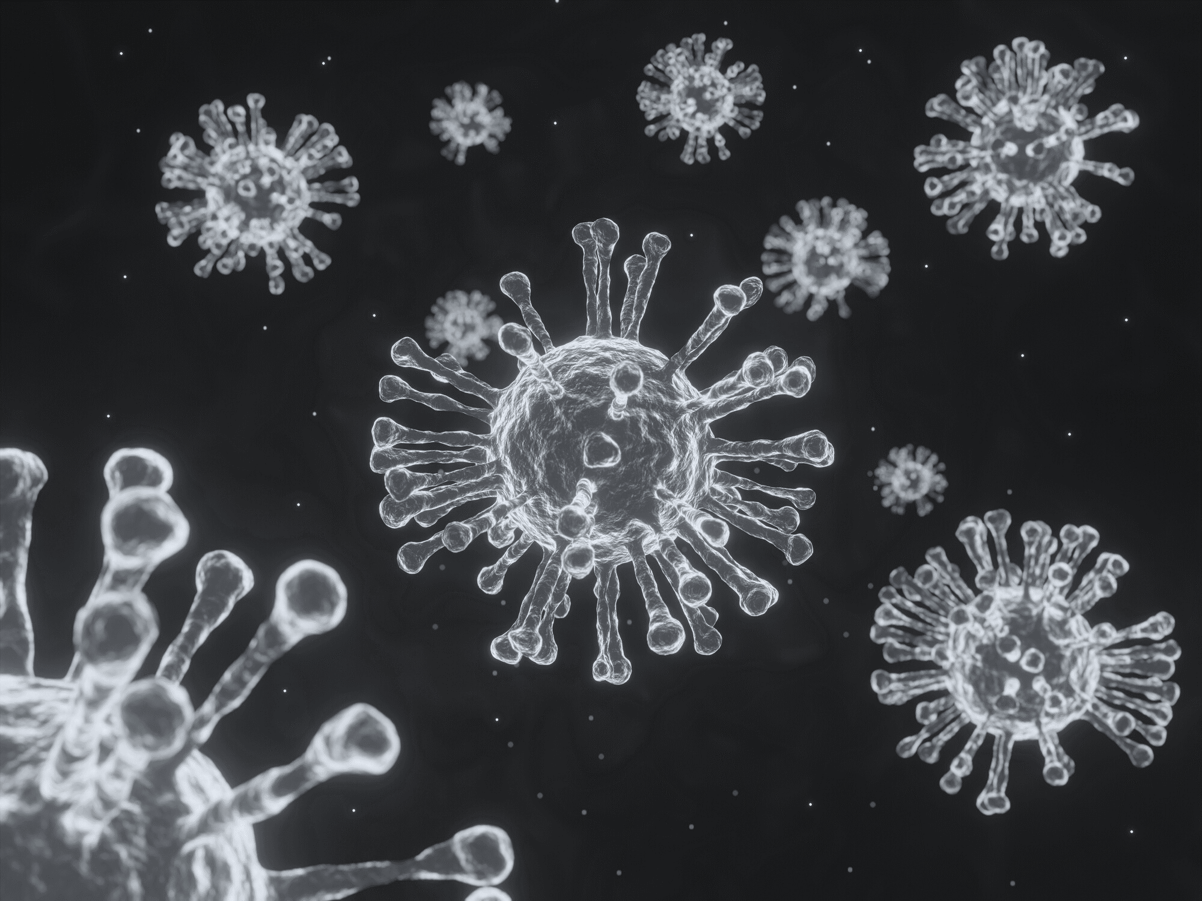
Intersection
Between
Drug Crisis and COVID-19

Slide 6
TOTAL DRUG SEIZURES NATIONWIDE
Office of Field Operations (FY14 to FY20) + US Border Patrol (FY14 to FY20)
+ Air and Marine Operations (FY17 to FY 20)
Office of Field Operations Nationwide Drug Seizures

Slide 7
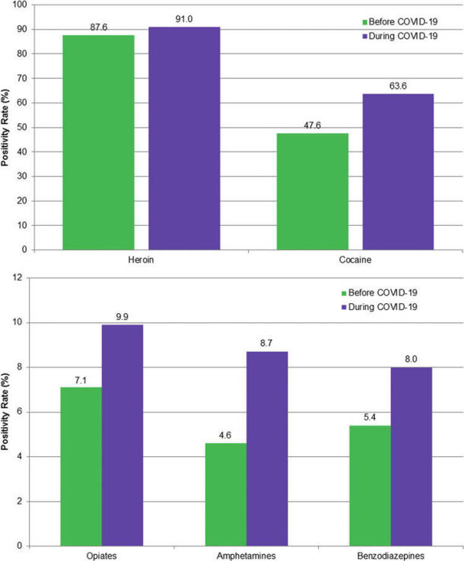
Drug Use Increase During COVID
Fentanyl Positivity with Other Drugs Before and During COVID
31.96%
19.96%
10.06%
12.52%
Millennium Health Signals Report™ COVID-19 Special Edition: Significant Changes in Drug Use During the Pandemic Volume 2.1 Published July 2020
Niles JK et al., Population Health Management, 2020.

Slide 8
Drug-involved Overdose Deaths* Continue to Increase
 | ALL DRUGS | HEROIN | NAT & SEMI –SYNTHETIC | METHADONE | SYNTHETIC OPIOIDS | COCAINE | OTHER PSYCHO-STIMULANTS (mainly meth)
1/2020* | 72,757 | 14,183 | 12,118 | 2,793 | 38,071 | 16,537 | 16,888
7/2020* | 86,502 | 14,640 | 13,274 | 3,329 | 50,703 | 19,757 | 21,279
1/2021* | 95,230 | 13,182 | 13,699 | 3,677 | 59,420 | 20,076 | 25,300
Percent Change 1/20-1/21 | 30.9% | -7.1% | 13.0% | 31.7% | 56.1% | 21.4% | 49.8%
*NCHS Provisional drug-involved overdose death counts are PREDICTED VALUES, 12 months ending in select months.
https://www.cdc.gov/nchs/nvss/vsrr/drug-overdose-data.htm

Slide 9
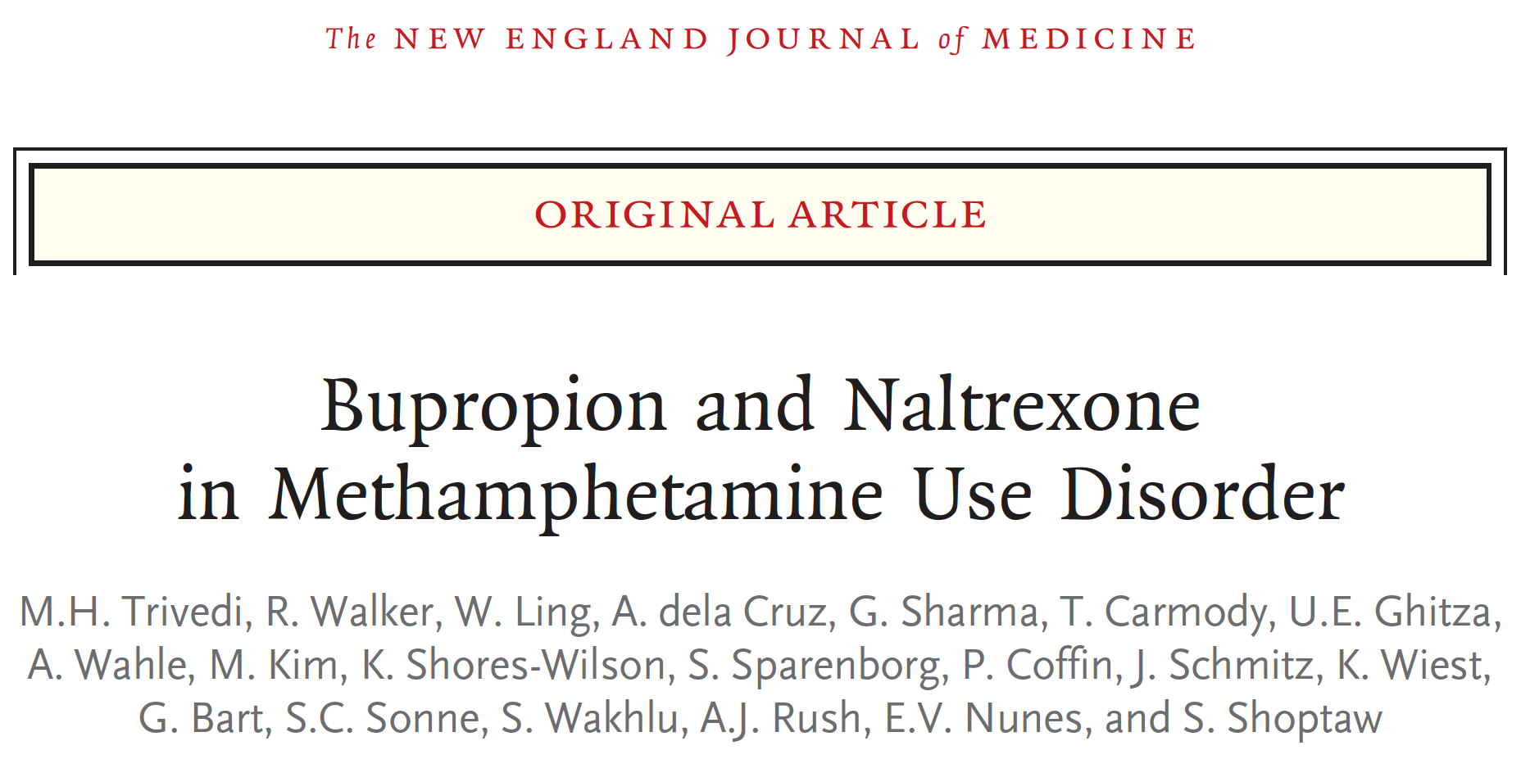
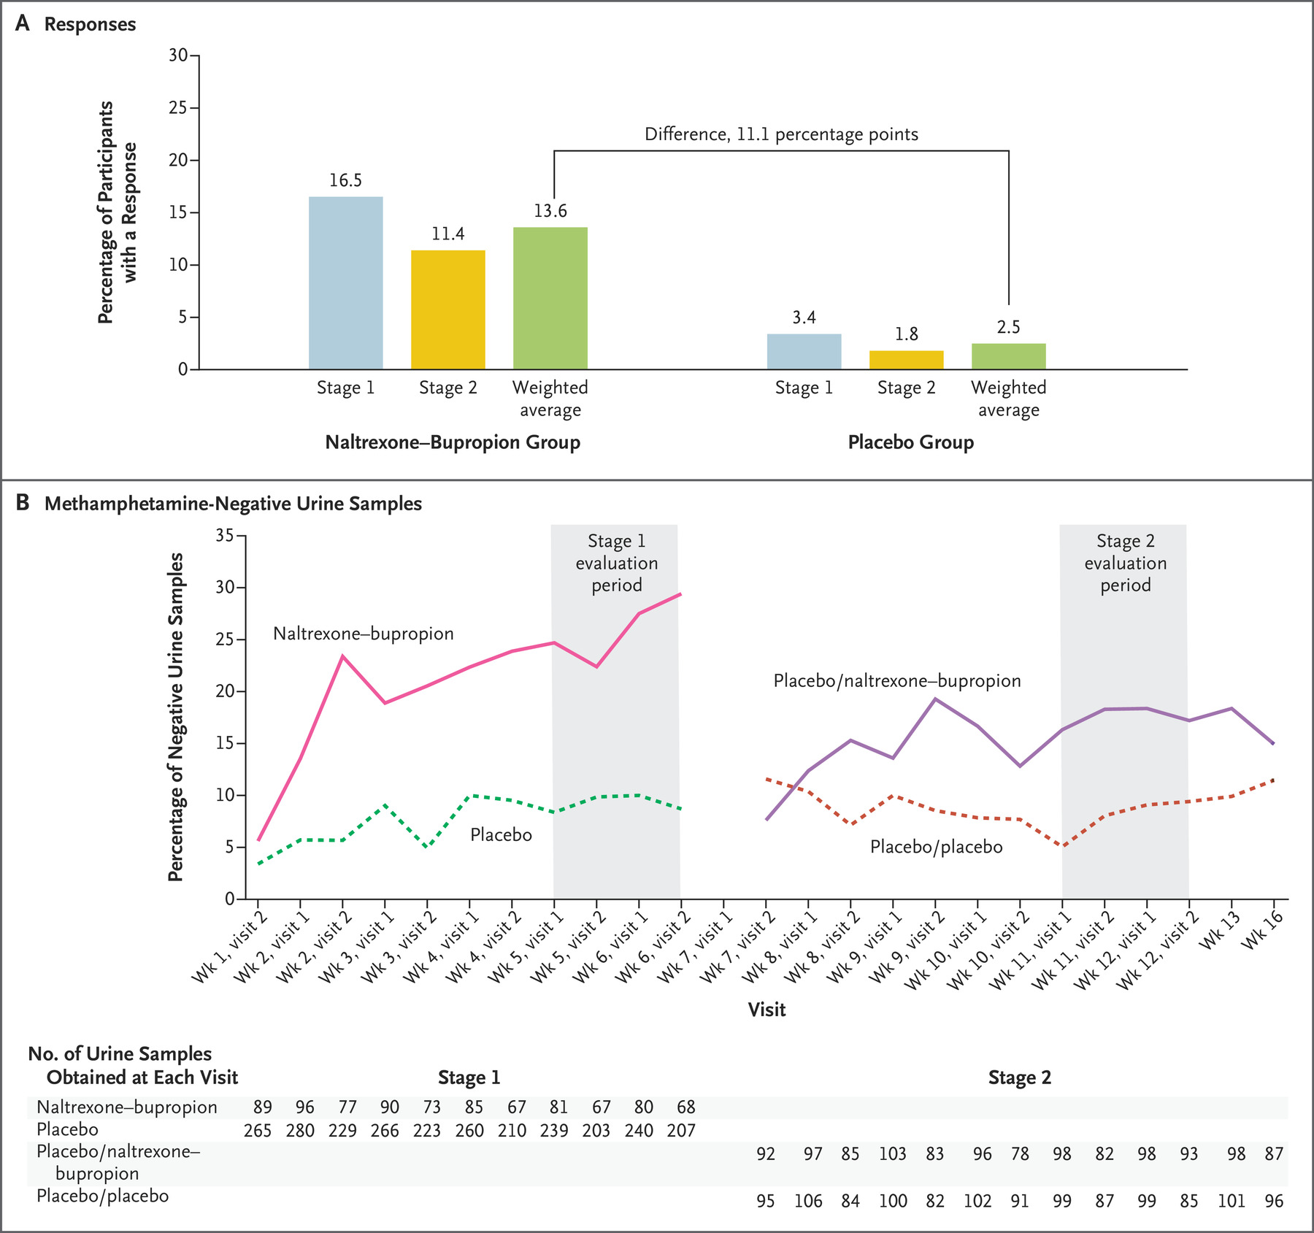
Treating Psychostimulants Use Disorder & Overdoses
No FDA approved medications for cocaine or methamphetamine use disorder
Behavioral therapies: contingency management combined with a community reinforcement approach (De Crescenzo et al., 2018).
No overdoses reversal medications available for methamphetamine or cocaine use disorder

Slide 10
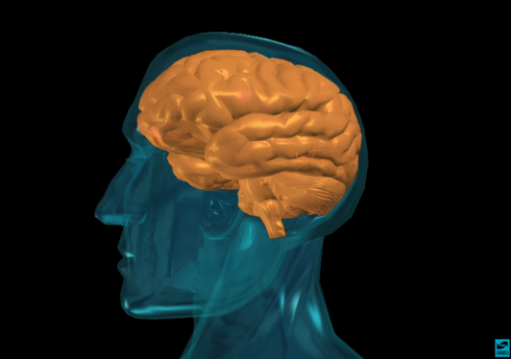
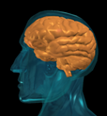
Treating Cocaine Addiction: Vaccines
Antibodies reduce amount of drug in the brain
Vaccine
Antibodies
Targets drugs,
not receptors
Binding sites
Capillary
Blood Flow
Capillary
Blood Flow
Brain
Brain
Notes:
From 2014 - but it appears NIDA won’t be using it this year.

Slide 11
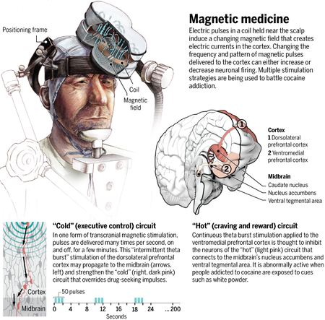
Transcranial Magnetic Stimulation: Methamphetamine Addiction
Wadman, Science 2017.

Slide 12

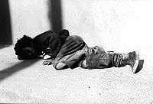



RISK
PROTECTION
Early Substance Abuse
Early Aggressive Behavior
Poor Social Skills
Lack of Parental Supervision
Drug Use in Family
Drug Availability
Poverty
Self Control
Parental Monitoring & Support
Positive Relationships
Academic Competence
Anti-Drug Use Policies
Strong Neighborhood
Individual
Family
Peer
School
Community

Slide 13

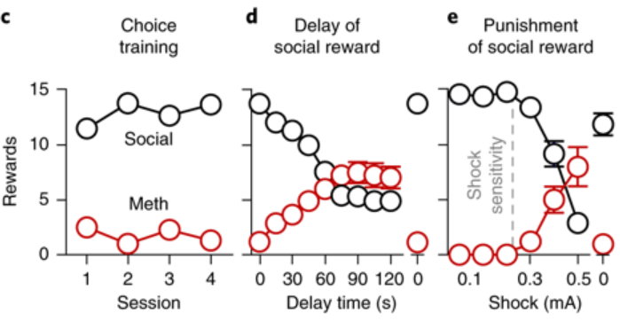
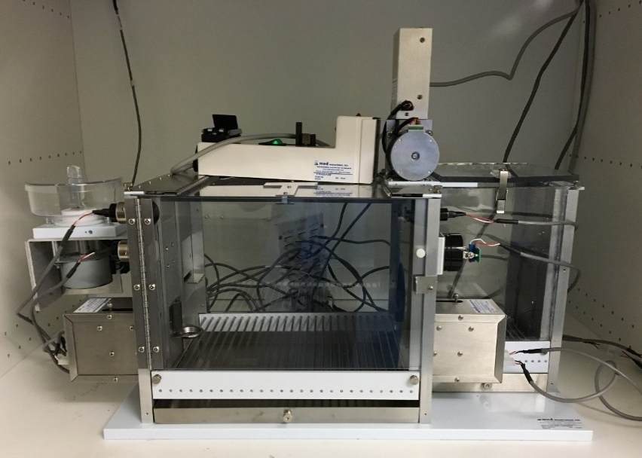
Social Interaction Preferred Over Methamphetamine
Drug preference increases when
social reward is devalued by
delay or punishment
Sliding
door
Partner
chamber
Resident
self-administration chamber
Drug lever
Social lever
Venniro et al., 2018

Slide 14
THANK YOU!

Slide 15
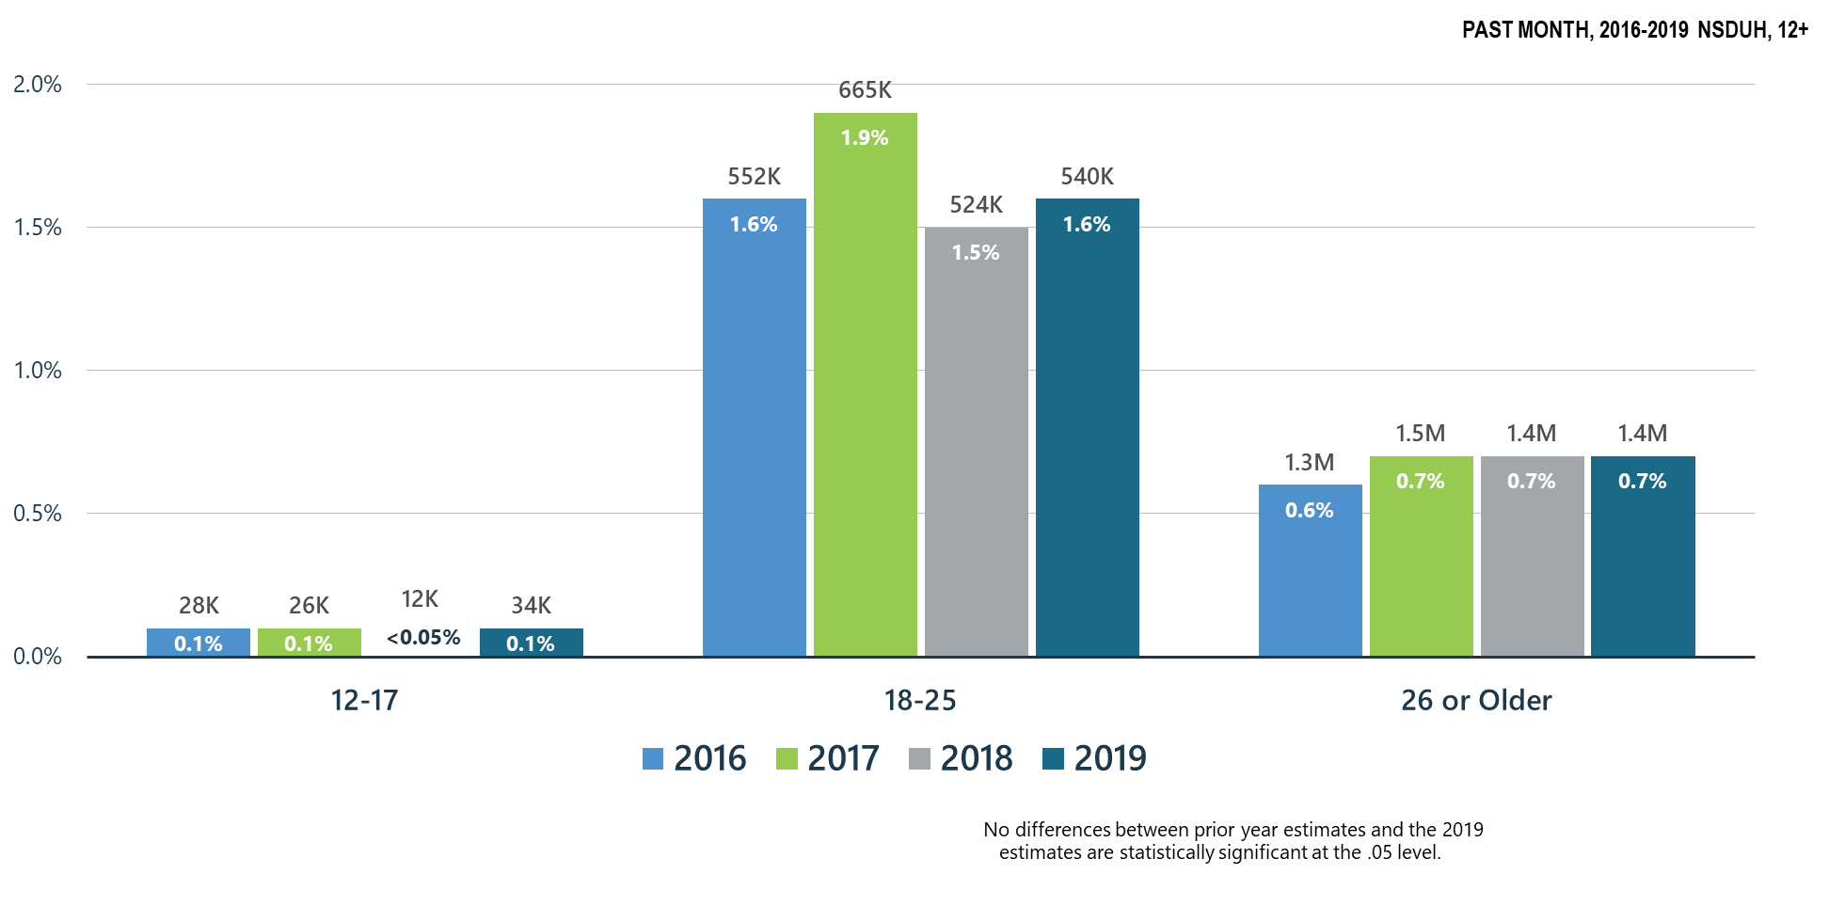
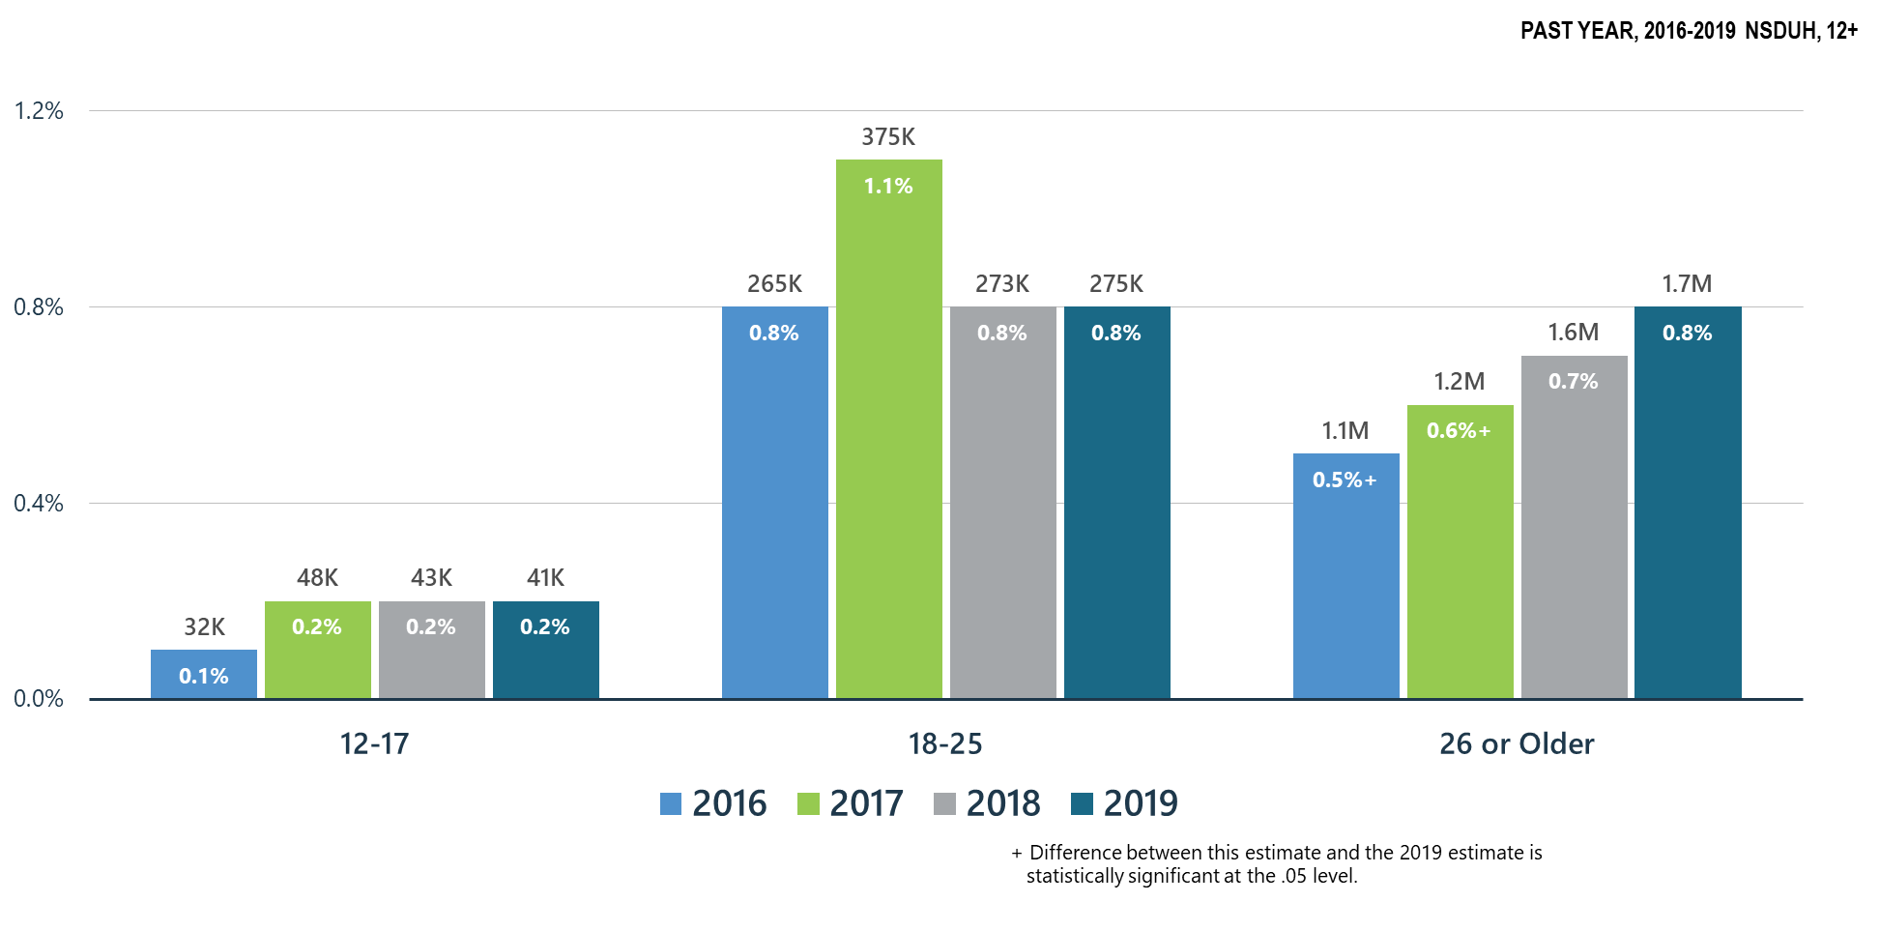
Methamphetamine Use
Cocaine Use
Notes:
Slide ID: Nat19-30
SOURCE: 2019 DT 7.6, 7.12, and 7.15

Slide 16
Analysis of Drug Test Results Before and After the US Declaration of a National Emergency Concerning the COVID-19 Outbreak
Proportion of Specimens Testing Positive
JAMA October 27, 2020 Volume 324, Number 16 (

Slide 17
Children (1-18 years old) from Parents who were in Raising Healthy Children Intervention in Grades 1-6 (n=72) Compared to Controls (n=110)
Hill KG et al., JAMA Pediatr. 2020

Slide 18
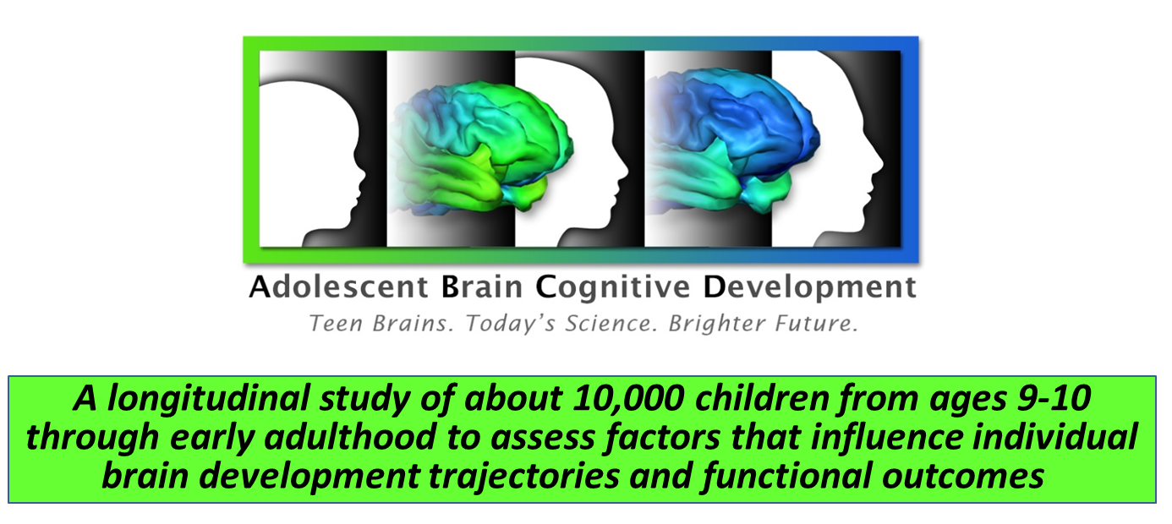
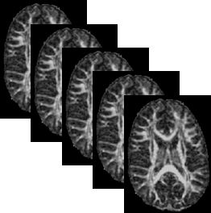

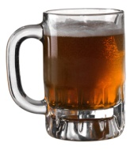
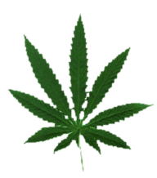
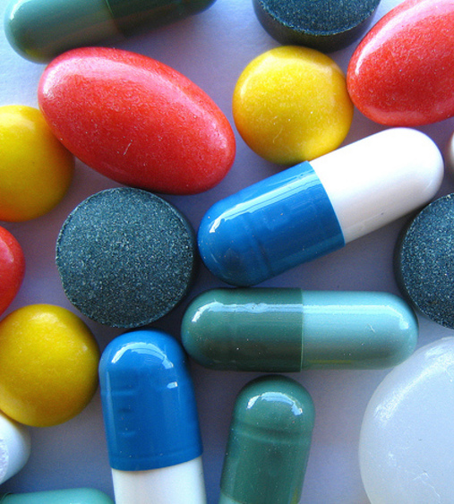


Adolescent Brain Cognitive Development (ABCD) Study
Time

