Slide 1
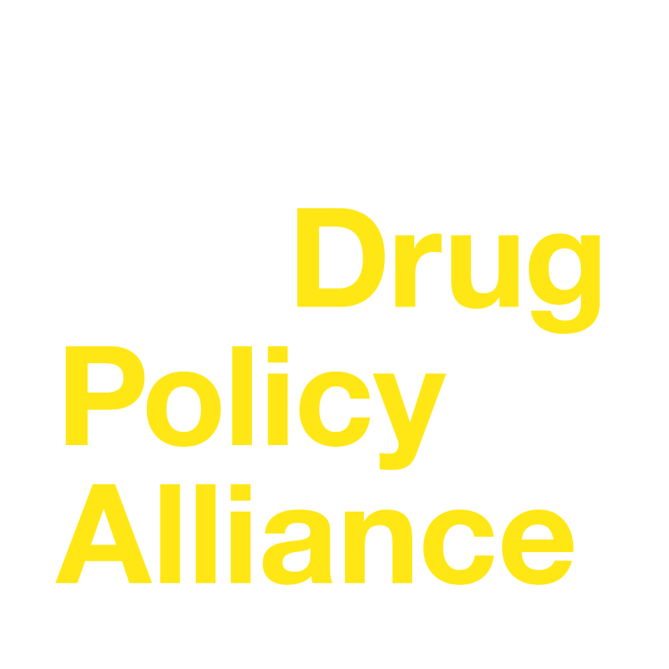
Stimulants:
Evidence and Policy Considerations to Save Lives in the Fourth Wave
Sheila P. Vakharia PhD MSW
Deputy Director, Department of Research and Academic Engagement

Slide 2

People use stimulants for reasons.

Slide 3
Policy proposals to reduce stimulant-related harms must:
Address Social Determinants of Health that can exacerbate harms,
Increase access to health services (incl. harm reduction and treatment), and
Reduce contact between marginalized people who use stimulants and law enforcement

Slide 4
Social Determinants of Health and Risk Environments
Understanding drivers for use:
Housing instability¹;
Job or income insecurity²;
Performance-enhancement³;
Internalized and Institutional Homophobia and transphobia⁴;
Lack of health insurance⁵ and untreated health concerns⁶.

Slide 5
Policy Solutions for SDoH and Risk Environments
Low-threshold housing, including Housing First;
Medicaid expansion in states;
Waive state and federal barriers to SNAP and public benefits;
Decriminalize sex work;
Improved worker protections, paid leave and sick time policies;
Fund LGBTQIA+ programs, centers, services.

Slide 6
Access to harm reduction and treatment
“Our harm reduction playbook was built around opioids”
Shilo Jama, Executive Director
People’s Harm Reduction Alliance
Seattle, WA

Slide 7
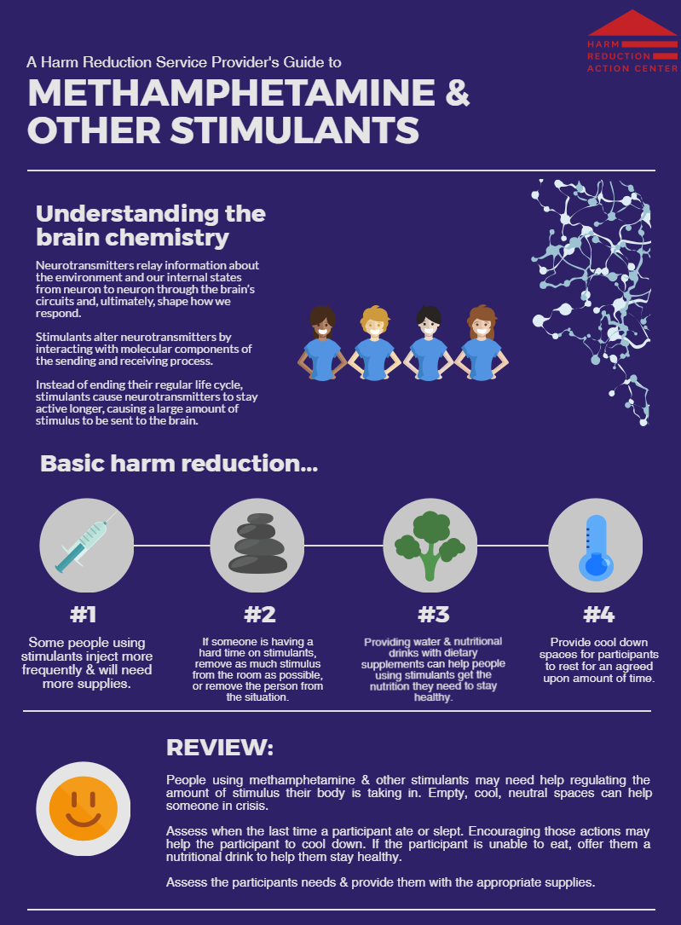
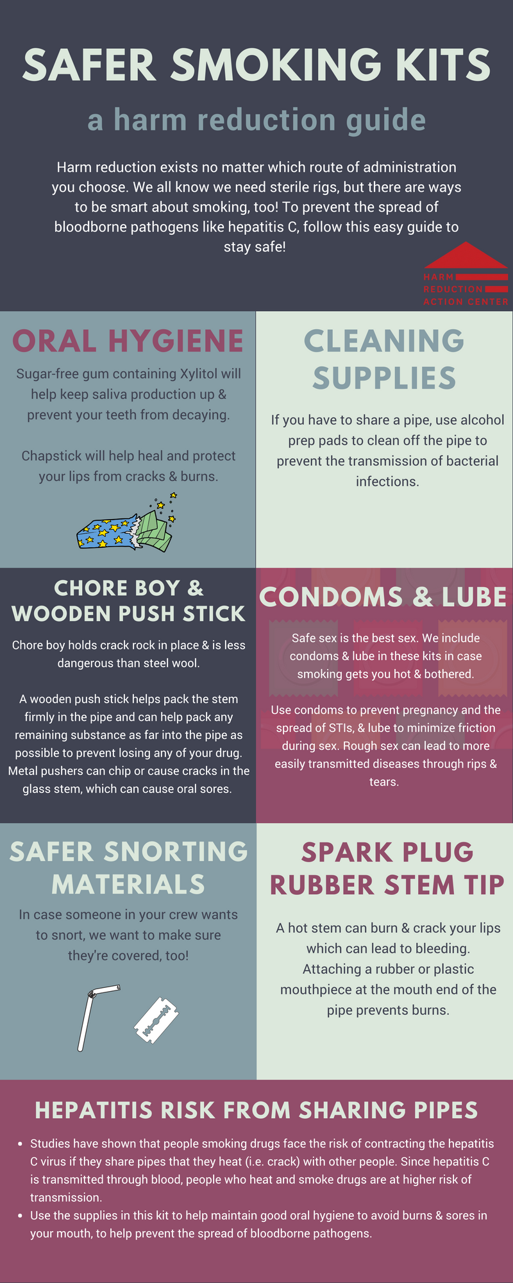
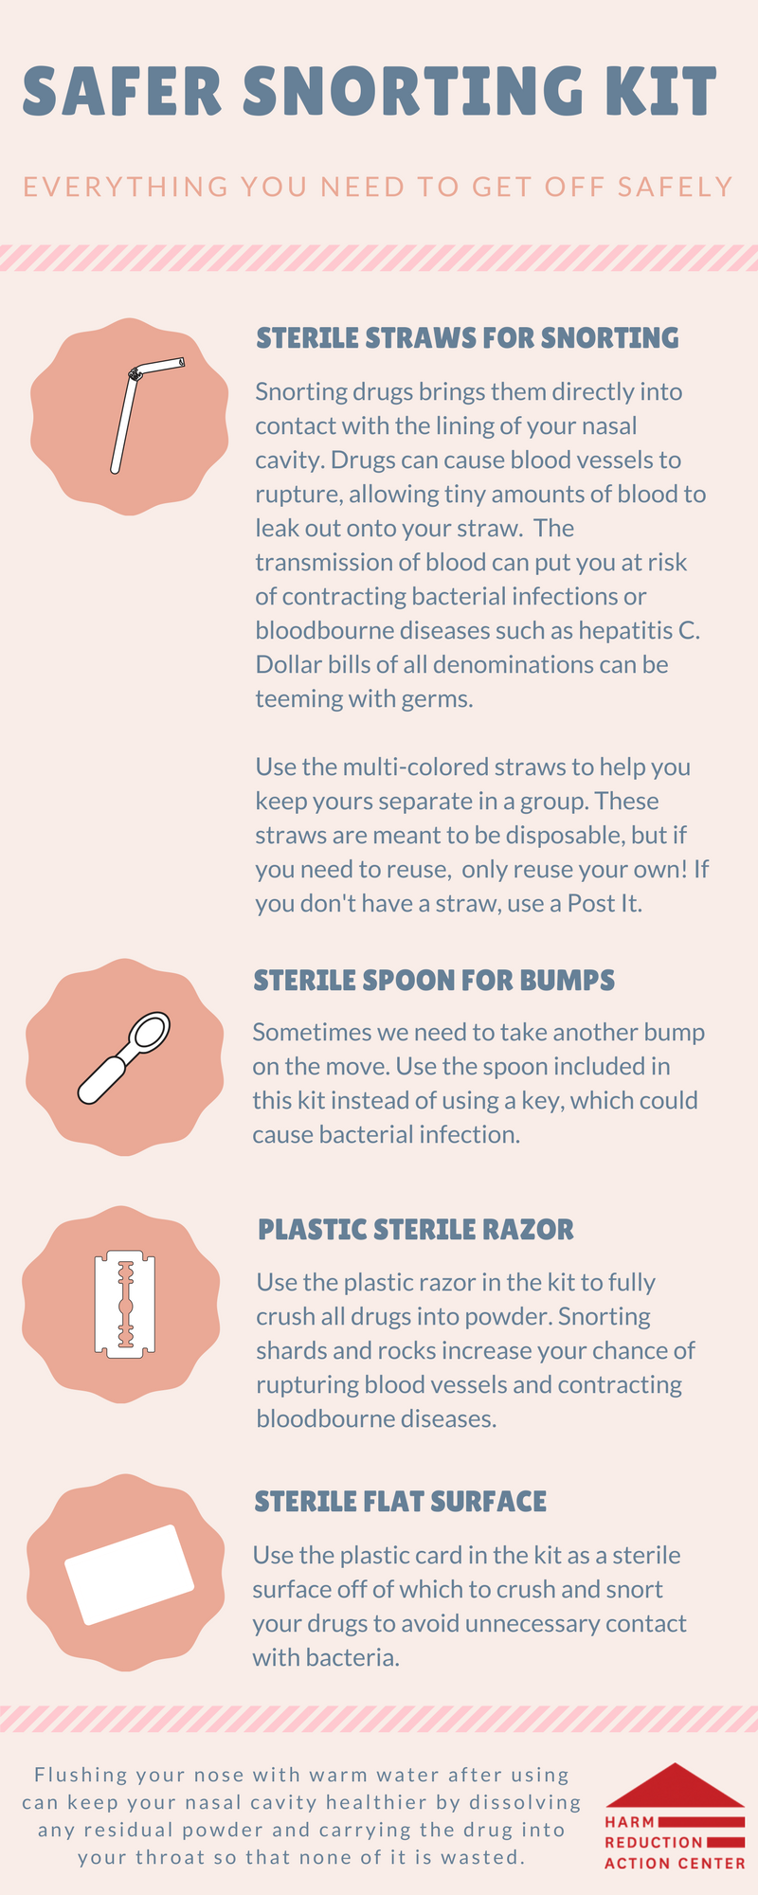
*Thanks to Kat Humphries, Harm Reduction Action Center, Denver CO

Slide 8
Access to harm reduction and treatment
Stimulant-specific resources and support
  “Law of attraction” or “if you build it they will come”;
  Culturally-specific outreach efforts;
  Overamping education and resources.
“Twin epidemics” and the interconnectedness between opioids and stimulants^{7,8,9,10}
  Underdosing and lack of access to MOUDs

Slide 9
Policies for harm reduction and treatment
Decriminalize and fund all drug using and checking equipment/supplies;
  Safer injecting equipment; Safer smoking equipment; Drug-checking equipment
Overdose Prevention Centers;
Insurance reimbursement for Contingency Management;
Explore safe supply and medications;
Over-the-counter naloxone;
Decriminalize diverted MOUD;
X-the-X and expand mobile and pharmacy-dispensed methadone;
Fund stimulant-specific research.

Slide 10
Reduce contact with law enforcement
Decriminalize drugs;
Explore regulatory models and safe supply models, including medication options;
Divest funding from enforcement towards health-promoting options;
Medical and mental health first responders to emergencies/overdoses; and
Invest in community-building and response to crisis.

Slide 11
References:
1 Han, Beth, Wilson M. Compton, Christopher M. Jones, Emily B. Einstein, and Nora D. Volkow. 2021. “Methamphetamine Use, Methamphetamine Use Disorder, and Associated Overdose Deaths Among US Adults.” JAMA Psychiatry, September. https://doi.org/10.1001/jamapsychiatry.2021.2588.
2 Chawarski, Marek C., Kathryn Hawk, E. Jennifer Edelman, Patrick O’Connor, Patricia Owens, Shara Martel, Edouard Coupet, et al. 2020. “Use of Amphetamine-Type Stimulants Among Emergency Department Patients With Untreated Opioid Use Disorder.” Annals of Emergency Medicine 76 (6): 782–87. https://doi.org/10.1016/j.annemergmed.2020.06.046.
3 Fast, Danya, Thomas Kerr, Evan Wood, and Will Small. 2014. “The Multiple Truths about Crystal Meth among Young People Entrenched in an Urban Drug Scene: A Longitudinal Ethnographic Investigation.” Social Science & Medicine 110 (June): 41–48. https://doi.org/10.1016/j.socscimed.2014.03.029.
4 Li, Michael J., Chukwuemeka N. Okafor, Pamina M. Gorbach, and Steve Shoptaw. 2018. “Intersecting Burdens: Homophobic Victimization, Unstable Housing, and Methamphetamine Use in a Cohort of Men of Color Who Have Sex with Men.” Drug and Alcohol Dependence 192 (November): 179–85. https://doi.org/10.1016/j.drugalcdep.2018.07.039.
^{5 Han, B. et al., 2021}
6 Han, Benjamin H., and Joseph J. Palamar. 2021. “Multimorbidity Among US Adults Who Use Methamphetamine, 2015–2019.” Journal of General Internal Medicine, June. https://doi.org/10.1007/s11606-021-06910-6.

Slide 12
References
7 Cano, Manuel, and Ying Huang. 2021. “Overdose Deaths Involving Psychostimulants with Abuse Potential, Excluding Cocaine: State-Level Differences and the Role of Opioids.” Drug and Alcohol Dependence 218 (January): 108384. https://doi.org/10.1016/j.drugalcdep.2020.108384.
8 Ellis, Matthew S., Zachary A. Kasper, and Theodore J. Cicero. 2018. “Twin Epidemics: The Surging Rise of Methamphetamine Use in Chronic Opioid Users.” Drug and Alcohol Dependence 193 (December): 14–20. https://doi.org/10.1016/j.drugalcdep.2018.08.029.
9 Silverstein, Sydney M., Raminta Daniulaityte, Kylie Getz, and William Zule. 2021. “‘It’s Crazy What Meth Can Help You Do’: Lay Beliefs, Practices, and Experiences of Using Methamphetamine to Self-Treat Symptoms of Opioid Withdrawal.” Substance Use & Misuse 0 (0): 1–10. https://doi.org/10.1080/10826084.2021.1949612.
10 Lopez, Andrea M., Zena Dhatt, Mary Howe, Marwa Al-Nassir, Amy Billing, Eleanor Artigiani, and Eric D. Wish. 2021. “Co-Use of Methamphetamine and Opioids among People in Treatment in Oregon: A Qualitative Examination of Interrelated Structural, Community, and Individual-Level Factors.” International Journal of Drug Policy 91 (May): 103098. https://doi.org/10.1016/j.drugpo.2020.103098.

