Slide 1
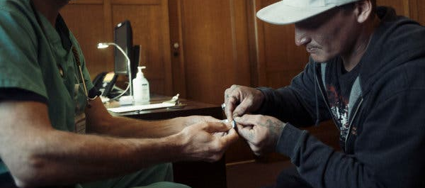
Effectiveness of Substance Use Navigation for Emergency Department Patients with Substance Use Disorders
An Implementation Study
Erik S. Anderson, MD
Highland Hospital
Emergency Medicine & Addiction Medicine
Erik Anderson, Evan Rusoja, Joshua Luftig, Monish Ullal, Ranjana Shardha, Henry Schwimmer, Alexandra Friedman, Christian Hailozian, Andrew Herring

Slide 2
No conflicts of interest

Slide 3
Emergency Department an Entry Point for SUD Services
Large body of evidence for ED-based interventions
SBIRT model
Buprenorphine initiation
Many institution utilize substance use navigators (SUNs), less evidence around widespread implementation for multiple SUDs

Slide 4
Methods
Implementation study of Substance Use Navigator (SUN) - delivered intervention for ED patients with SUD-related diagnosis within an integrated public health system in Alameda County, California
Implementation of SUN Program for all patients with SUD diagnosis
Effectiveness evaluation of patients discharged from ED with opioid, alcohol, methamphetamine, or cocaine related diagnoses between 9/2021-1/2022
Notes:
This was an implementation study and we follow the STAR-I guidelines for reporting implementation research.

Slide 5
Methods
Implementation Outcomes:
Reach: proportion of ED visits with SUN intervention
Sustainability of program
Effectiveness Outcomes:
Primary – engagement in addiction treatment within 30 days of ED discharge
Secondary – SUD medications administered and prescribed; logistic regression & propensity score analysis
Notes:
This was an implementation study and we follow the STAR-I guidelines for reporting implementation research.

Slide 6
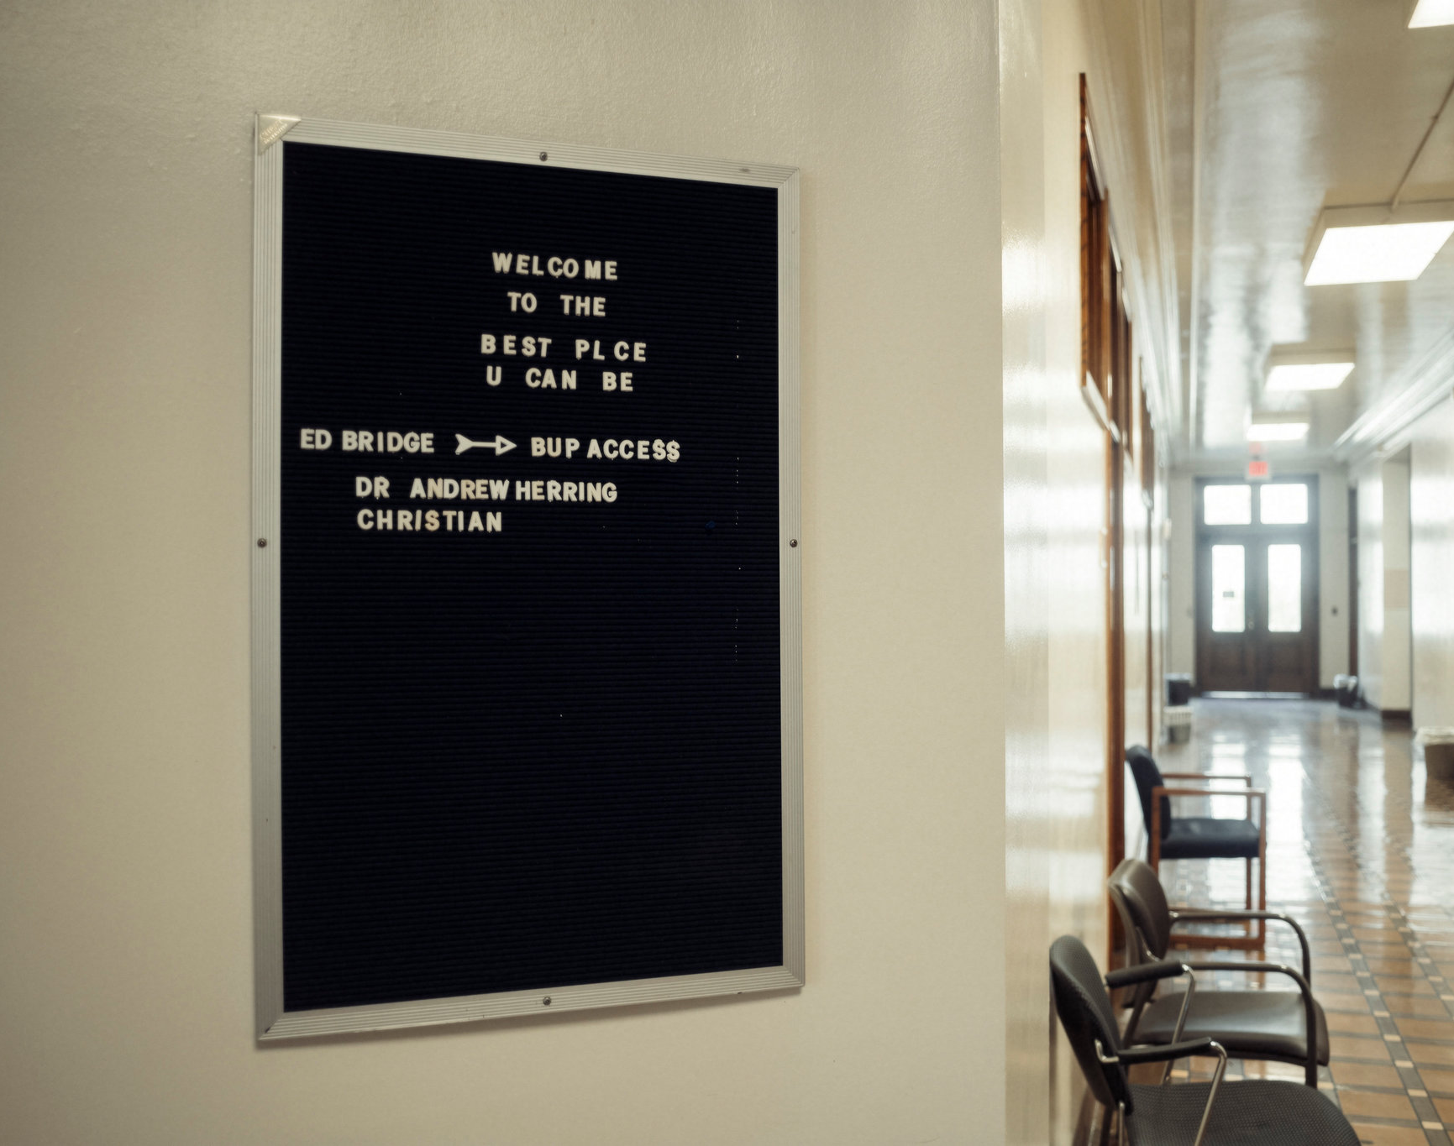
Control: Standard Care for ED patients with SUDs
SBIRT model
Training for providers on medication treatment for opioid, alcohol, cocaine and methamphetamine use disorders
Low-threshold Bridge Clinic accessible to any patient M-F

Slide 7
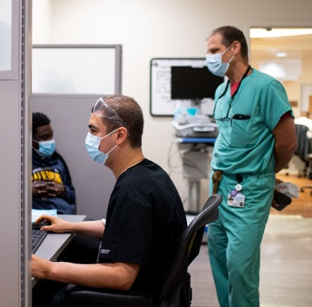
Implementation of Intervention Delivered by Substance Use Navigators
Training and initial funding through CA Bridge
Development of ED protocols for opioid, alcohol, methamphetamine, and cocaine related diagnoses
Led by a lead SUN and Clinician champions
Mature program, continuous growth since 2017
Notes:
Alameda Health System has 5 SUNs that together cover 10 hours a day, 6 days a week at three acute care hospitals; additionally, they also assist during business hours Monday through Friday at the Bridge Clinic.
Training through CA Bridge, implementation with clinical champions.

Slide 8
Implementation of Intervention Delivered by Substance Use Navigators
Informed by Whole Person Care model
Person-focused & relationship-based
CA Bridge facilitated trainings
Bedside Intervention
Motivational interviewing, strengths-based counseling
Harm reduction approach
Vertically Integrated Treatment
Shared clinical responsibilities across ED, inpatient, ambulatory care settings
Notes:
Alameda Health System has 5 SUNs that together cover 10 hours a day, 6 days a week at three acute care hospitals; additionally, they also assist during business hours Monday through Friday at the Bridge Clinic.
Training through CA Bridge, implementation with clinical champions.

Slide 9
Effectiveness Analysis: Study population
1,328 discharged with SUD diagnosis; 446 discharged while SUN available, 119 (27%) received SUN intervention
Mean age 41
27.5% identified as female
36.7% identified as Black; 27.9% Latinx; 22.3% White
52% alcohol diagnoses; 24% opioids; 19% methamphetamine; 5% cocaine
Notes:
Mean age: 41
27.5% identified as female
36.7% identified as black
27.9% identified as Latinx
22.3% identified as White
51.9% Alcohol dx
24.2% Opioid dx
18.8% Meth dx
5% cocaine dx
119 received SUN visits
We pre-speciﬁed the regression model to contain follow up at 30 days as the dependent variable, with the following predictor variables: race and ethnicity, age, gender, assigned primary care provider, substance use diagnosis category (opioids, alcohol, methamphetamine, cocaine), homelessness, ED site, SUN consult, medications for addiction treatment administered in the ED, and medications for addiction treatment prescribed at ED discharge.

Slide 10
Effectiveness Analysis: Primary and secondary outcomes
30 Day Engagement in Addiction Treatment:
50% with SUN vs 16% without SUN
Medication for SUD administered:
40% with SUN vs 17% without SUN
Medication for SUD prescribed at discharge:
47% with SUN vs 21% without SUN
Notes:
Mean age: 41
27.5% identified as female
36.7% identified as black
27.9% identified as Latinx
22.3% identified as White
51.9% Alcohol dx
24.2% Opioid dx
18.8% Meth dx
5% cocaine dx
119 received SUN visits
We pre-speciﬁed the regression model to contain follow up at 30 days as the dependent variable, with the following predictor variables: race and ethnicity, age, gender, assigned primary care provider, substance use diagnosis category (opioids, alcohol, methamphetamine, cocaine), homelessness, ED site, SUN consult, medications for addiction treatment administered in the ED, and medications for addiction treatment prescribed at ED discharge.

Slide 11
Notes:
Overall, 60/119 (50.4%) of patients who had SUN consults attended follow up within 30 days after ED discharge, compared with 192/1,228 (15.9%) of without SUN consults (difference in proportions: 34.5%, 95% confidence interval [CI]: 25.3-43.8%, p<0.001)
35.7% difference overall at 7 days post-discharge
34.5% difference overall at 30 days post-discharge
Largest difference with alcohol dxs
Opioids: 21.9% difference
Not significantly different for methamphetamine dxs

Slide 12
Factors associated with 30-day follow-up
Notes:
We pre-speciﬁed the regression model to contain follow up at 30 days as the dependent variable, with the following predictor variables: race and ethnicity, age, gender, assigned primary care provider, substance use diagnosis category (opioids, alcohol, methamphetamine, cocaine), homelessness, ED site, SUN consult, medications for addiction treatment administered in the ED, and medications for addiction treatment prescribed at ED discharge.

Slide 13
Propensity Score Analysis
Nearest neighbor matching without replacement
2 cohorts of 119 patients, all on-support
17.6% improvement in follow up with SUNs
Associated with 2.1 (1.2-3.5) higher odds of 30-day treatment engagement

Slide 14
Implementation and Sustainability
Collaboration with California Quality Incentive Program
Multidisciplinary committee to oversee ongoing implementation and alignment with institutional goals and metrics
Access to validated electronic health data
Alignment with metrics tied to supplementary funding
SUNs are now funded by health system
Alignment with quality outcomes and demonstration of effectiveness

Slide 15
Conclusions
SUN Intervention associated with higher rates of engagement in outpatient addiction treatment
Most effective for alcohol and opioid related diagnoses
Administration of SUD (opioid, alcohol, methamphetamine, or cocaine) medications in the ED associated with higher rates of engagement in outpatient addiction treatment
Hospital systems should consider similar approaches to SUD navigation for ED patients

Slide 16
Thanks! Questions?

Slide 18
