Slide 1
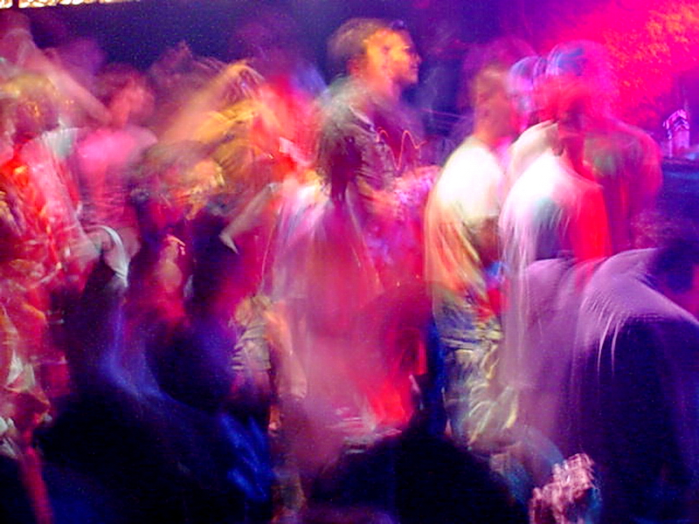
A Special K-ase:
Exploring recreational ketamine use and associated harms
November 10, 2022
AMERSA Annual Conference, Boston, MA
Presenter: Maya Appley, MD, MPH
With significant contributions from Jessica Gray, MD
Notes:
Thank you all for joining today, I am excited to be here with you to discuss this very “special case”
This is a case from last year when I was a fellow here in Boston working with Jess Gray in our Bridge clinic that revealed a major knowledge gap for me and the rest of our clinical team and was a reminder of how much our patients have to teach us
It also highlighted a perk of living in the digital age, which is that we have access to global resources, and we really did not have any expertise in this area and had a hard time finding resources, but were able to connect with a team of experts in the UK, where ketamine use is much more common, who provided really valuable guidance and resources for further learning that I will share with you
So with that, lets dive in…

Slide 2
DISCLOSURES
I have no disclosures to report

Slide 3
LEARNING OBJECTIVES
At the conclusion of this talk, participants will be better be able to:
Recognize ketamine as a rare, but increasingly common, recreational substance
Describe risks associated with non-medical ketamine use and identify opportunities for harm reduction
Identify resources for further learning on this topic
Notes:
Recognize ketamine as a rare, but increasingly common, recreational substance that many addiction providers have limited awareness of
Describe risks associated with non-medical ketamine use and identify opportunities to practice harm reduction
And since this is just a short presentation and there is so much to say, learning where to find resources on this topic is possibly the most important objective

Slide 4
KETAMINE BASICS
Rapid onset, short acting dissociative anesthetic with analgesic, amnestic and hallucinogenic properties
Minimal respiratory depressant effect, mild circulatory stimulant
Medical uses: anesthesia, increasing use in mental health tx, pain mgmt, ?tx of SUDs
Effects vary depending on dose, tolerance, setting
Pleasant mental/body high → impairment/complete detachment from reality (k-hole)
NEPTUNE Guide, 2015. http://neptune-clinical-guidance.co.uk/.
Notes:
So, to go over some basics that will help contextualize the case,
Ketamine is a dissociative anesthetic with analgesic, amnestic and hallucinogenic properties
it is especially useful as an anesthetic because it is rapid onset, short acting and has minimal impact on respiratory drive and actually is a mild circulatory stimulant, in contrast to other anesthetics which tend to depress the circulatory system. Many other applications of ketamine are currently being explored currently and I think will be touched on in the next talk, so I will save that for them
Like with most drugs, the experience depends on dose, a persons tolerance and setting, and a person can experience wide range of effects from a pleasant high to pretty profound physical impairment including ataxia, total numbness, and complete dissociation/detachment from reality, which is known as the “k hole”

Slide 5
EPIDEMIOLOGY AND DEI
Ketamine use rare in US, but prevalence rising (Palamar, 2021)
Limited data, but addiction seems to be rare
Use most common among gay men
prev in last year ~ 0.13% in gen pop vs 1.15% among gay men (Yockey, 2022)
must educate ourselves on this topic to provide quality care for LGBTQ pts
Ketamine use may be increasing among other vulnerable groups
Notes:
So data on recreational ketamine use is limited, but what we do know is that that ketamine use is becoming more common, but still fairly rare overall in the US, and addiction to ketamine seems to be very rare as well
However, ketamine use is much more common in the LGBTQ community, particularly among people who identify as gay men, with prevalence of use in the last year estimated at 1.15% in this group vs .13% in the general population
For some context, that is a little higher than estimated prevalence of use of methamphetamine in the last year in the general public
So, this topic really is important for all of us to be comfortable with in order to provide care that is responsive to the needs all of our patients, esp LGBTQ patients
anecdotally, colleagues in the UK have noted increasing numbers of young women with significant trauma history, many also with chronic pain who are using ketamine to self treat and then experiencing complications of use, which is a nice segue into the case

Slide 6
CASE PRESENTATION
ID: 32 year-old woman presents for assistance with ketamine cessation.
PMHx: anxiety, depression, PTSD, chronic abdominal pain, recurrent UTI
Meds/treatment: lorazepam 0.5 mg TID PRN
Substance use: daily IN ketamine daily, occasional EtOH and stim use
Social Hx: white, cis/het woman, ++trauma hx, housed, loss of career → $ stress, limited social support
Exam: normal vitals, anxious, restless, irritable
Notes:
So finally, lets dive into the case…
Our patient was a 32 yo woman who came our low barrier substance use clinic for help with ketamine cessation.
She had a hx of anxiety, depression, PTSD, chronic abdominal pain and recurrent UTI like symptoms
She was taking prescribed lorazepam as needed for anxiety
ketamine daily and occasionally drinking alcohol and using cocaine and prescription stimulants
Regarding social history, she is a young white, cis gender, heterosexual woman, she does have significant trauma hx from childhood and more recently, and she recently lost her job, partially due to worsening mental health and increased ketamine use which has caused increased financial stress, and she has become more isolated socially in recent years
On exam, she had normal vitals, she was very restless and noted that she was feeling very anxious and irritable

Slide 7
KETAMINE USE HISTORY
Began with casual use at raves years ago
Use escalated following trauma, using daily for 9 months, 5-8g IN, occasionally PR
Driven by desire to dissociate from psychological distress, also relief for chronic abdominal pain
Use exacerbated financial stress, interfering with daily life
Unable to stop on own; severe cravings, insomnia, worsening mood/PTSD
Notes:
Diving deeper into her ketamine use history, she started using casually at raves years ago, but her use escalated following a traumatic event.
At presentation, she had been using daily for 9 months, and currently was using 5-8 grams per day intranasally, which is the most common route of recreational use, and sometimes she would alternate to rectal use when she was experiencing nasal irritation.
To qualify this, 5-8 grams a day is over 100x a typical anesthetic dose for a person of her size, but tolerance develops rapidly, so with daily use, it is not unusual to need to use this amount to achieve the desired effects, which becomes very expensive and for this patient was really exacerbating her financial stress and was a motivation to cut back
For her, use was primarily driven by desire to dissociate from the psychological distress she was experiencing. She also sometimes found ketamine helpful for abdominal pain, but noted that heavy use sometimes triggered intense suprapubic and epigastric pain.
Overall, she was at the point where she felt the harms were really outweighing the benefits for her, and she had been struggling to make changes on her own for months, which is why she ultimately decided to take a chance and come see us

Slide 8
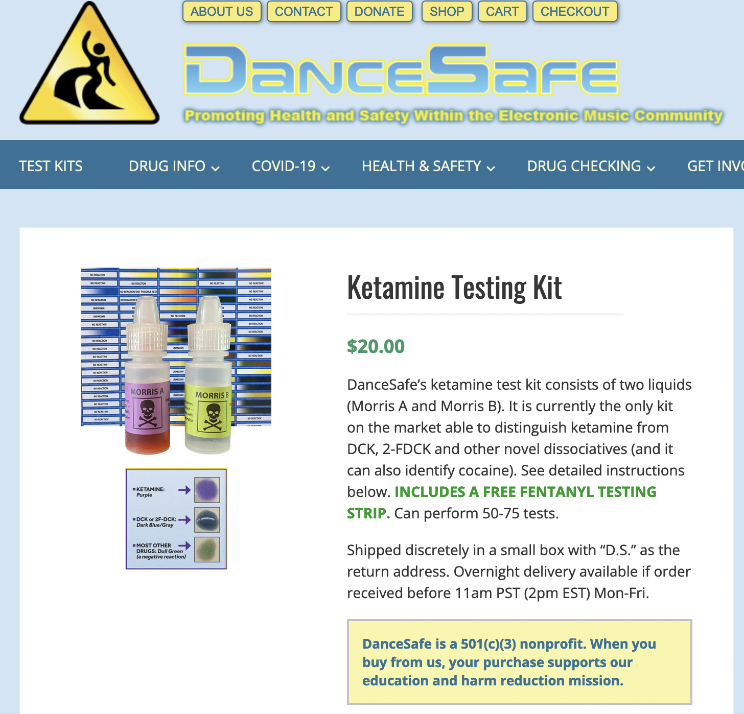
Potential harms | Harm reduction measures
Increased risk of accident and injury | Inquire about situational safety Discuss unique risks due to changes in perception, anesthetic effects, dissociation and physical impairment Strategize with pt for how to mitigate risk
Increased risk of STI | Inquire about sexual practices/chemsex Offer STI testing, viral infection screenings, PrEP as indicated
Overdose, unexpected effects due to co-ingestion, contaminants | Discuss effects of common co-ingestants/contaminants Discuss drug testing options Provide naloxone
NEPTUNE Guide, 2015. http://neptune-clinical-guidance.co.uk/.
Notes:
So, we will come back to the case, but I wanted to pause here to discuss how we might approach harm reduction for ketamine use
This is not an exhaustive list by any means, but points out a few key areas to discuss with patients to help them be safe while using
Given the changes in perception, decreased sensation and physical impairment a person might be experiencing, there is increased risk of accidents and injury
Even something mundane, like a hot shower, could be risky if you can’t sense pain properly
so it can be helpful to inquire about situations that your patients are using in and take time to strategize with patients about how to minimize risks
It’s also important to note that Ketamine is commonly used to enhance sexual experiences which can put people at increased risk of STI, so it’s important to be able to talk openly about this with your patients and ensure you are offering STI testing and PrEP as indicated
Another important area to discuss would be the risk of overdose or adverse effects particularly with intentional or unintentional congestion of other substances that act synergistically with ketamine
While overdose is quite rare with ketamine used alone, it is very often used with other substances and there can be an additive effect with both respiratory depressants and circulatory stimulants that can increase risk
And similarly, given our toxic drug supply, drug testing can be very helpful, this is one example here of a kit that our patient was using, which is one of the only ones on the market that can distinguish ketamine from other novel psychoactive substances and the kit also includes a fentanyl test strip, which is always useful

Slide 9
HARMS ASSOCIATED WITH CHRONIC KETAMINE USE
Uropathy* (direct toxicity → irritative sympt)
GI toxicity (K-cramps, LFT abn, bil dil)
Neurotoxicity/cognitive impairment
Worsening mood symptoms
Inform
Screen
Counsel
*UA, urgent referral to urology if c/f uropathy
NEPTUNE Guide, 2015. http://neptune-clinical-guidance.co.uk/.
Notes:
So there are a few potential harms related specifically to chronic use that are important to be aware of so that we can share information with our patients and help them to make informed decisions around their use and know what symptoms to look out for and when to seek help
The one that shows up on the boards is uropathy, which is actually very common, affecting 20-30% of people who use regularly and 100% of those who use 5g or more daily, it is, you might have heard it called “ketamine bladder”, but it can affect any part of the urinary tract, and can be very serious to the point that people have lost their entire bladders, so you should ask about and counsel patients to look out for any irritative urinary symptoms, dysuria, urgency, frequency or hematuria and have a low threshold to refer to urology for further workup, unfortuantely, cessation is really the only way to stop this from progressing
As our patient alluded to, severe abdominal cramping, or “k cramps” can be an effect of heavy ketamine use, you may also see LFT abnormalities, biliary dilation, but it is not clear how clinically significant these are
It is also important to be aware that chronic ketamine use can be associated with cognitive impairment and depression

Slide 10
MANAGEMENT
Withdrawal management
psychosocial support +/- long acting benzodiazepines as needed
Ketamine addiction management
psychosocial support
no pharmacotherapy, treat mental and physical symptoms that trigger use
education around chronic harms and referrals if needed
Pt was able to reduce use to ~q2 weeks, but had return to heavy use iso trauma
Notes:
So in terms of management, our first concern was withdrawal, and as it turns out, ketamine withdrawal is not well defined, but does not appear to be life threatening
most people describe intense craving, irritability, anxiety, depression and insomnia, all of which our pt had experienced when she had tried to quit in the past
Psychosocial support is essential through the withdrawal phase and long acting benzodiazepines can be helpful as well to alleviate distress
Managing ketamine addiction, we learned, requires a longitudinal multidisciplinary approach
There is no specific pharmacotherapy for ketamine addiction, so treatment should focus on addressing mental health, and symptoms that trigger use
so for our patient this meant she connected with our psychiatrist for pharmacotherapy to address anxiety, depression and improve sleep, and worked with our psychologist to address PTSD
As discussed, education around chronic harms is important and referrals if needed, our patient was referred to urology given frequent urinary symptoms, has not yet connected
With this approach, Pt was able to reduce use to ~ q2 weeks, no binges, returned to work, but then return to heavy use iso traumatic event and has been out of touch in recent months

Slide 11
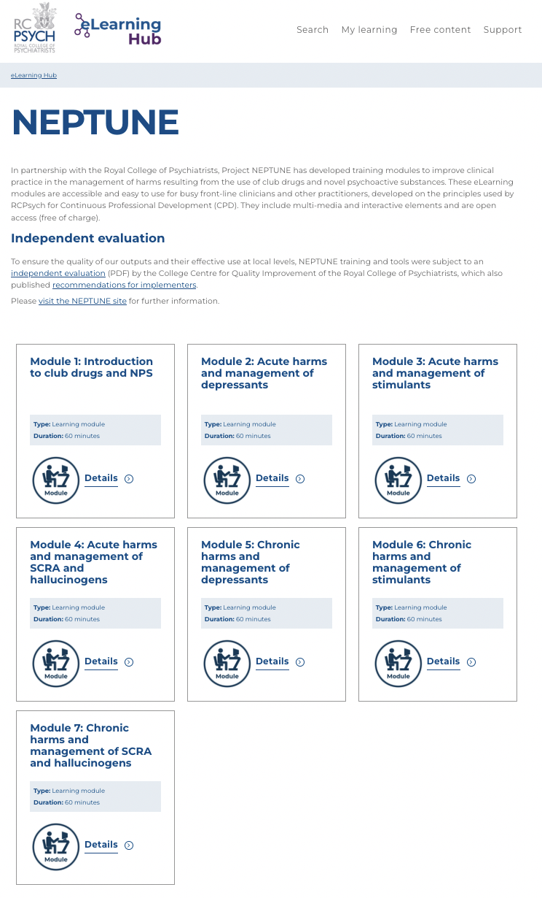
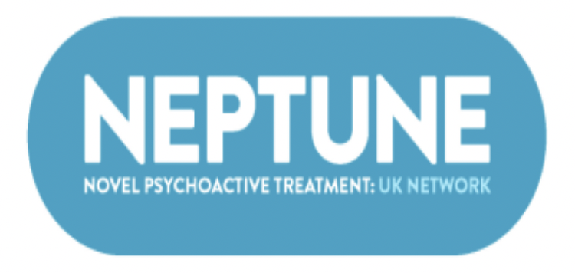
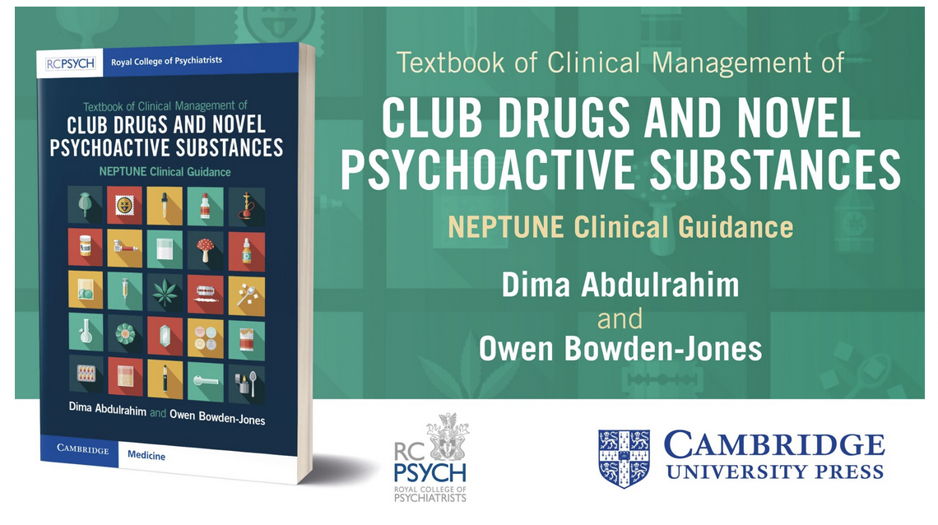
RESOURCES
http://neptune-clinical-guidance.co.uk/
https://elearninghub.rcpsych.ac.uk/
Notes:
This is this fabulous group out of the UK that has a ton of free clinical resources, I would just google neptune clinical guide and it will lead you to all of their resources, if you take one thing away from this it should be knowing where to find these resources

Slide 12
TAKE HOME POINTS
Ketamine use is rare, but increasing
This topic is a blind spot for many providers, must educate ourselves and normalize discussing ketamine and club drug use with our pts
Harm reduction should focus on situational safety, sexual health, minimizing co-ingestion and screening for harms of chronic use
Longitudinal, multidisciplinary care is needed for effective management of ketamine addiction
Don’t be afraid to reach out to experts for guidance!
Notes:
This topic is a blind spot for many providers, we should be educating ourselves and there are great free resources available
Situational safety, sexual health, minimizing coingestsion and screening for harms of chronic use, esp uropathy are harm reduction priorities
Longitudinal, multidisciplinary care is essential for management of ketamine addiction
If you don’t have expertise in your network, reach out!

Slide 13
ACKNOWLEDGEMENTS
Jessica Gray, MD
Owen Bowden Jones, FRCPsych, MSc, MBChB
Dima Abdulrahim, PhD

Slide 14
REFERENCES
Novel Psychoactive Treatment UK Network: Guidance on the Clinical Management of Acute and Chronic Harms of Club Drugs and Novel Psychoactive Substances. 2015. http://neptune-clinical-guidance.co.uk/.
Palamar, Joseph J, Caroline Rutherford, and Katherine M Keyes. “Trends in Ketamine Use, Exposures, and Seizures in the United States up to 2019.” American Journal of Public Health 111, no. 11 (November 2021): 2046–49. https://doi.org/10.2105/AJPH.2021.306486.
Wang, Jessica W., Violetta Kivovich, and Laurie Gordon. “Ketamine Abuse Syndrome: Hepatobiliary and Urinary Pathology Among Adolescents in Flushing, NY.” Pediatric Emergency Care 33, no. 8 (August 2017): e24–26. https://doi.org/10.1097/PEC.0000000000000502.
Yockey, R. Andrew (2022) Past-Year Ketamine Use: Evidence from a United States Population, 2015-2019, Journal of Psychoactive Drugs, DOI: 10.1080/02791072.2022.2058896

