Slide 1
Integrating Contingency Management Into an Academic Outpatient Addiction Clinic for Patients With Cocaine Use Disorder
Nicholaus Christian, MD, MBA
Dana Cavallo, PhD
Stephen Holt, MD, MS
AMERSA, 11/12/22

Slide 2
Conflicts of Interest
The authors have no conflicts of interest to disclose.

Slide 3
Question:
What was the most common non-prescribed substance present in urine drug screens in primary care from 2013-2019?

Slide 4
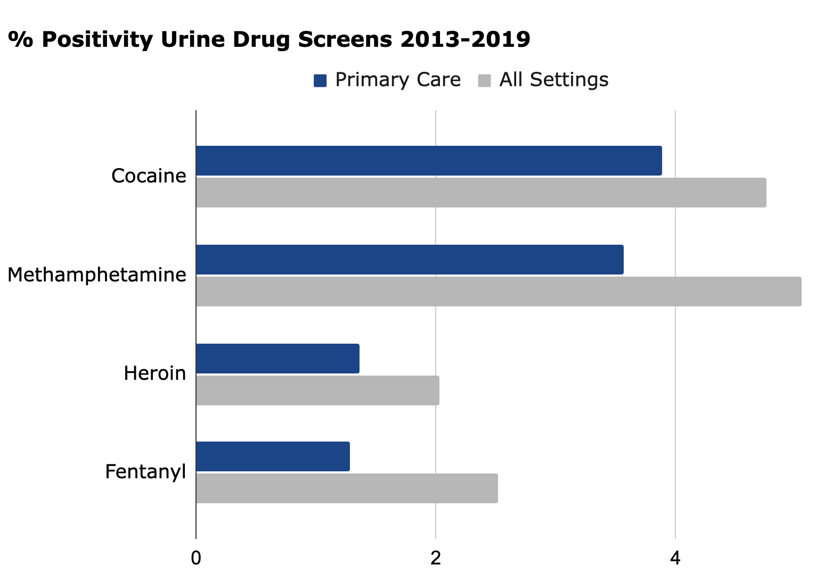
Answer: Cocaine
Twillman et al, (2020)

Slide 5
Cocaine Use & Institutional Racism
White
Black
Rate of lifetime cocaine use by race | 18.3% | 8.5%
Rate of drug violations by race | 0.43% | 0.91%
FBI (2020); NSDUH (2020); Jones, CP (2000)
Notes:
Dr. Camara Phyllis Jones, MD, MPH, PhD, “The Gardener’s Tale”, We can’t keep blaming flowers for not growing, and need to re-evaluate the institutional factors that have separated the soil into different pots and not put them in a situation to thrive.
“I think this clearly highlights the implications of the racist war on drugs, as well as Dr. Camara Phyllis Jones’ plant metaphor. Until we start to change the soil that black communities are planted in we will not address the blaring health and social disparities that this population faces.”
Cocaine comprises 23.8% of drug violations 2019
Drug abuse violations Total- 1,052,101 White- 748,874 Black- 274,670
Total drug abuse violations black: 274,670
Total number black people 2019: 29,865,596
% 0.91
Total drug violations white: 748,874
Total number white people 2019: 172,301,516
%0.43
https://ucr.fbi.gov/crime-in-the-u.s/2019/crime-in-the-u.s.-2019/topic-pages/tables/table-43

Slide 6
This Treatment for Cocaine Use Disorder…
NNT between 3-8 for sustained remission
The Biden-Harris administration & HHS has pledged to address policy barriers to expand access
Meta-analysis of 50 clinical studies (6,943 participants)
 | Abstinence at 12 Weeks | Abstinence End of Treatment
Treatment vs TAU | OR 2.29 (1.62-3.24) | OR 2.22 (1.59-3.10)
Treatment + Community Reinforcement Approach vs TAU | OR 7.60 (2.03-28.37) | OR 2.84 (1.24-6.51)
Contingency Management (CM)
???
Schierenberg, (2012); De Crescenzo (2018); Ronsley, (2020)
Notes:
Buprenorphine NNT to prevent one death is less than 3.
SSRIs in depression NNT
CM vs TAU At longest follow-up OR 1.10 (0.83-1.46)
CM + CRA At longest follow-up OR 3.08 (1.33-7.17)

Slide 7
What is CM?
Frequently monitor target behavior
Urine/saliva drug screens
Clinic attendance
Provide incentive when target behavior occurs
Cash/Voucher
Points/privileges
Fish-bowl (Petry)
Remove incentive when target behavior does not occur
Vermont Center for Behavioral Health (2021)

Slide 8
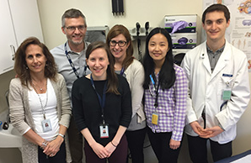
Addiction Recovery Clinic (ARC)
An addiction specialty clinic embedded within Yale’s Primary Care Internal Medicine Residency Program, located within a Federally Qualified Health Center.
Dual purpose:
Addiction clinical services
Educational venue for treatment of addiction
In 2015, received $5k gift to implement CM into the ARC.

Slide 9
1. Frequently Monitor Target Behavior
Patient Eligibility
Age > 18 and patient at the primary care clinic
Diagnosis of cocaine use disorder
Presence of cocaine on at least one UDS, and
Willingness to attend twice-weekly (eventually once-weekly) clinic appointments
Sign Patient Agreement
Outlines program, example here
Initiation and maintenance phases
Urine Drug Testing
Only monitor cocaine

Slide 10
2. Incentivize When Target Behavior Occurs
Original Payment Schedule
+$1.25
WEEK | 1 |  | 2 |  | 3 |  | 4 |  | … | 12
VISIT | 1 | 2 | 3 | 4 | 5 | 6 | 7 | 8 | … | 23 | 24
MAX EARNINGS | $2.50 | $3.75 | $5.00 | $6.25 | $7.50 | $8.75 | $10.00 | $11.25 | … | $30.00 | $31.25
CUMULATIVE EARNINGS | $2.50 | $6.25 | $11.25 | $17.50 | $25.00 | $33.75 | $43.75 | $55.00 | … | $373.755 | $405
Post-COVID Payment Schedule
+$5.00
WEEK/VISIT | 1 | 2 | 3 | 4 | … | 11 | 12
MAX EARNINGS | $5.00 | $10.00 | $15.00 | $20.00 | … | $55.00 | $60.00
CUMULATIVE EARNINGS | $5.00 | $15.00 | $30.00 | $50.00 | … | $330.00 | $390
Notes:
High ”escalating rewards”

Slide 11
3. Remove Incentive When Target Behavior Does Not Occur
-
-
+
WEEK/VISIT | 1
MAX EARNINGS | $5.00
CUMULATIVE EARNINGS | $5.00
2
$10.00
$15.00
3
?
?
WEEK/VISIT | 1 | 2 | 3 | 4 | … | 11 | 12
MAX EARNINGS | $5.00 | $10.00 | $15.00 | $20.00 | … | $55.00 | $60.00
CUMULATIVE EARNINGS | $5.00 | $15.00 | $30.00 | $50.00 | … | $330.00 | $390

Slide 12
Results (2015-2021)
29 patients
4 completed 12-weeks (14% completion)
Avg engagement 33 days
-”Visits too frequent”
Avg earnings $117
Total program cost $3,394.50

Slide 13
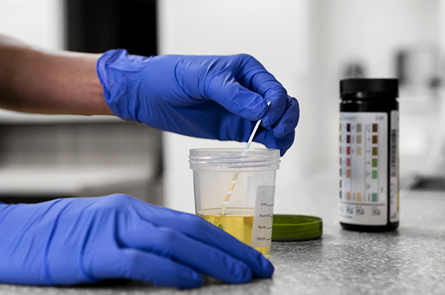
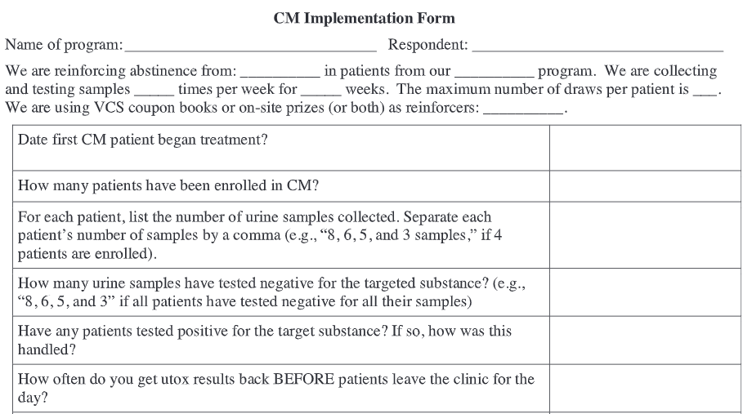
Challenges
Challenges starting program due to sensitive UDS
Retention rates lower than most CM studies
-Fidelity?
-Selection bias?
Track % neg screens
Sustainability
DePhilippis, Petry (2018)
Notes:
Nancy Petry has a Contingency Management Competency Scale, rolled in project MIMIC
Real world intervention, rather than a research study in which research assistants are checking on patients every week, following up on missed appointments, etcetera.

Slide 14
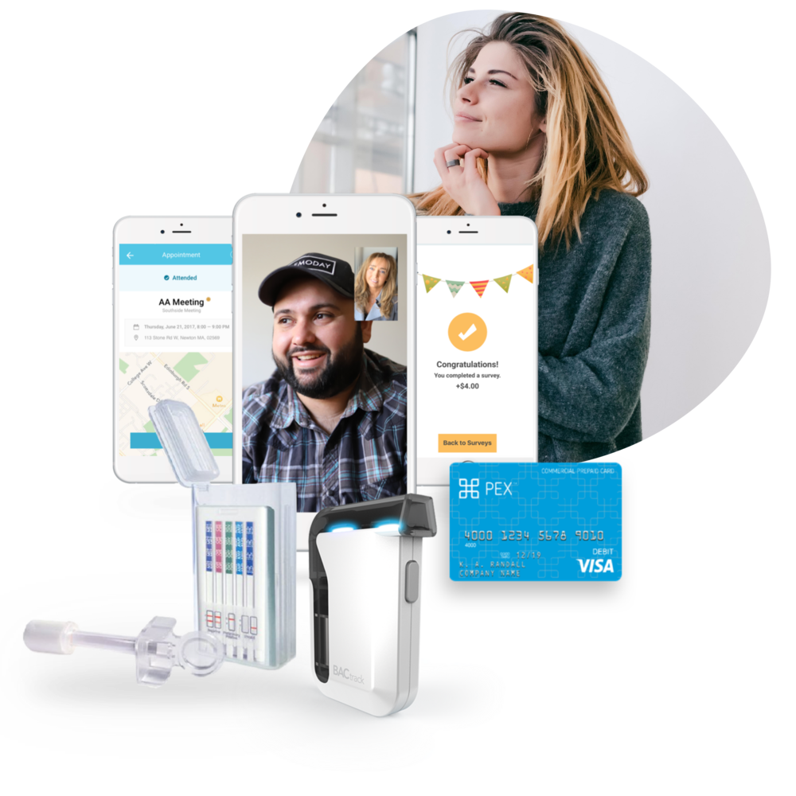
Next Steps
Apply for further funding
Expand treatment to other SUDs
Incentivize health behaviors (pro-social behaviors)
Consider telehealth options

Slide 15
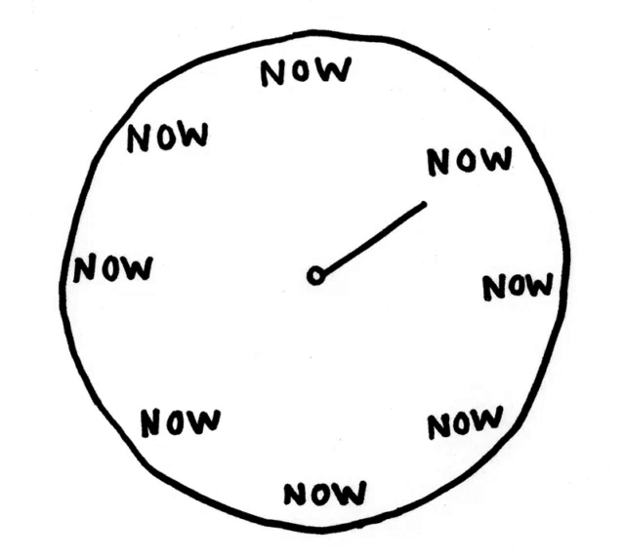
Conclusions
Contingency management is effective and evidence-based.
The ARC is proof that CM can be utilized in residency-based outpatient clinics
-Exposed over 120 residents to CM
-Inexpensive
We must increase access to this evidence-based treatment!
Thank you!
Nick Christian, MD, MBA
Nicholaus.Christian@yale.edu
Notes:
ARC sustained a CM program with minimal funding and administrative support, providing a model that could be implemented at academic (residency based) outpatient clinics throughout the United States. Exposed ## residents (17 per year since 2015) to CM, not to mention other multidisciplinary learners Integrating CM programs into academic outpatient clinics and FQHCs will be critical to expanding patient accessibility to this evidence-based treatment.

Slide 16
References
Center for Behavioral Health Statistics and Quality. (2020). Results from the 2019 National Survey on Drug Use and Health: Detailed tables.
De Crescenzo, F., Ciabattini, M., D'Alo, G. L., De Giorgi, R., Del Giovane, C., Cassar, C., Janiri, L., Clark, N., Ostacher, M. J., & Cipriani, A. (2018). Comparative efficacy and acceptability of psychosocial interventions for individuals with cocaine and amphetamine addiction: A systematic review and network meta-analysis. PLoS Med, 15(12), e1002715.
Dominick DePhilippis, Nancy M. Petry, Marcel O. Bonn-Miller, Sarah B. Rosenbach, James R. McKay, The national implementation of Contingency Management (CM) in the Department of Veterans Affairs: Attendance at CM sessions and substance use outcomes, Drug and Alcohol Dependence, Volume 185, 2018, Pages 367-373.
Federal Bureau of Investigation. (2020). Crime in the United States, 2019. https://ucr.fbi.gov/crime-in-the-u.s/2019/crime-in-the-u.s.-2019/topic-pages/tables/table-43
Holt, S. R., Segar, N., Cavallo, D. A., & Tetrault, J. M. (2017). The Addiction Recovery Clinic: A Novel, Primary-Care-Based Approach to Teaching Addiction Medicine. Acad Med, 92(5), 680-683.
Jones, C. P. (2000). Levels of racism: a theoretic framework and a gardener's tale. Am J Public Health, 90(8), 1212-1215.
Ronsley, C., Nolan, S., Knight, R., Hayashi, K., Klimas, J., Walley, A., Wood, E., & Fairbairn, N. (2020). Treatment of stimulant use disorder: A systematic review of reviews. PLoS One, 15(6), e0234809.
Schierenberg, A., van Amsterdam, J., van den Brink, W., & Goudriaan, A. E. (2012). Efficacy of contingency management for cocaine dependence treatment: a review of the evidence. Curr Drug Abuse Rev, 5(4), 320-331.
Twillman, R. K., Dawson, E., LaRue, L., Guevara, M. G., Whitley, P., & Huskey, A. (2020). Evaluation of Trends of Near-Real-Time Urine Drug Test Results for Methamphetamine, Cocaine, Heroin, and Fentanyl. JAMA Netw Open, 3(1), e1918514.

Slide 17
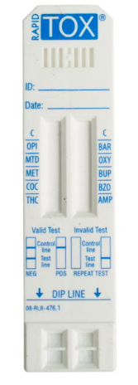
Link for POC UDS

Slide 18
Reimbursement
CM encounters were billed using standard E&M billing codes, according to how much time was spent with the patient:
Established patient encounter:
99213: 20-29 min ($90.00)
99214: 30-39 min ($107.20)
99215: 40-55 min ($144.80)

