Slide 1
Low Incidence of Precipitated Withdrawal in ED-initiated Buprenorphine
Gail D'Onofrio MD, MS
Department of Emergency Medicine
Yale University School of Medicine
Nov 10, 2022
3UG1DA015831

Slide 2
Disclosure Statement
No disclosures except funding sources.

Slide 3
Background
Evolution of Drivers of Overdose Deaths, All Ages Analgesics Heroin Fentanyl Stimulants
106,854 Overdose Deaths from all Drugs
Anecdotal and limited reports cite concerns regarding precipitated withdrawal with standard buprenorphine induction among those using fentanyl
12 months ending 11/21
*NCHS Provisional drug-involved overdose death counts are PREDICTED VALUES, 12 months ending in select months.
https://www.cdc.gov/nchs/nvss/vsrr/drug-overdose-data.htm

Slide 4
Precipitated Withdrawal
Rapid onset of withdrawal symptoms within 1-hour of administration of buprenorphine (described for SL-BUP)
Assessment is based on rapidity of onset of withdrawal symptoms and clinical factors, similar to when a patient receives full naloxone rescue. COWS scores reflect this rapid deterioration and skyrocket to moderate/severe levels.
(e.g., timing since last use, duration and use of opioid agonist(s))
Rosado, Alcohol Depend 2007;90(2-3):261-269 https://doi.org/10.1016/j.drugalcdep.2007.04.006
Comer S, et al. National practice guideline for the use of medications in the treatment of addiction involving opioid use. American Society for Addiction Medicine. 2015;66.
Notes:
PI/C0-I should notify the lead team asap along with filling out the form

Slide 5
Objective
To determine the incidence of PW in an ongoing trial of ED-initiated buprenorphine

Slide 6
Hybrid Type 1 Effectiveness-Implementation Design
ED INNOVATION
ED-INitiated BupreNOrphine VAlidaTION Network Trial
Implementation
To use implementation facilitation and training to achieve competence in ED-initiated XR-BUP and SL-BUP inductions in approximately 30 diverse ED sites
Effectiveness
To compare the effectiveness of XR-BUP and SL-BUP induction in approximately 2000 patients with untreated OUD in the ED on the primary outcome of engagement in formal addiction treatment at 7 days
D'Onofrio, Contemporary Clinical Trials, 2021
Notes:
Explain that in a Hybrid Type 1 design, Effectiveness is the most important component - Type 1 hybrid designs rigorously test the clinical intervention and secondarily gather data to inform subsequent implementation research trials - I added a red box!

Slide 7
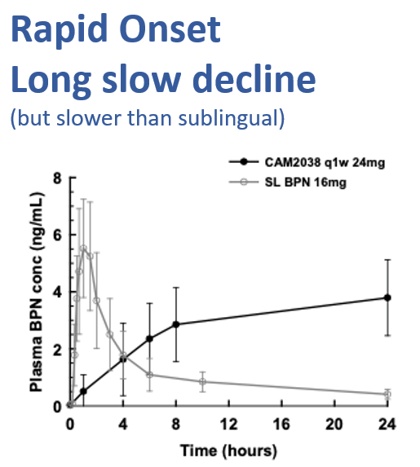
ED INNOVATION
CAM2038 24mg XR-BUP 7-day injectable vs 16mg SL-BUP per day
Pharmacokinetics of XR- & SL- Buprenorphine
Upon injection CAM2038 forms into a viscous liquid crystalline gel, producing a sustained, non-fluctuating levels of buprenorphine in the blood avoiding the peaks and troughs of daily dosing
3UG1DA015831

Slide 8
Patient Eligibility
Inclusion
Exclusion
18 years or older
Meet DSM-5 diagnostic criteria for moderate to severe OUD
Have a COWS score of > 4
Have a urine toxicology test that is positive for opioids (opiates, oxycodone, buprenorphine, fentanyl)
Able to speak English sufficiently
Urine toxicology positive for methadone
Pregnancy
Medical/psychiatric condition that requires hospitalization or opioid administration at the index ED visit, prior to randomization
Actively suicidal or severely cognitively impaired
Require continued prescription opioids for pain
A prisoner or in police custody at the time of index ED visit
Enrolled in formal addiction treatment (anytime within the past 14 days) including by court order. Patients enrolled in formal addiction who are not receiving MOUD are eligible

Slide 9
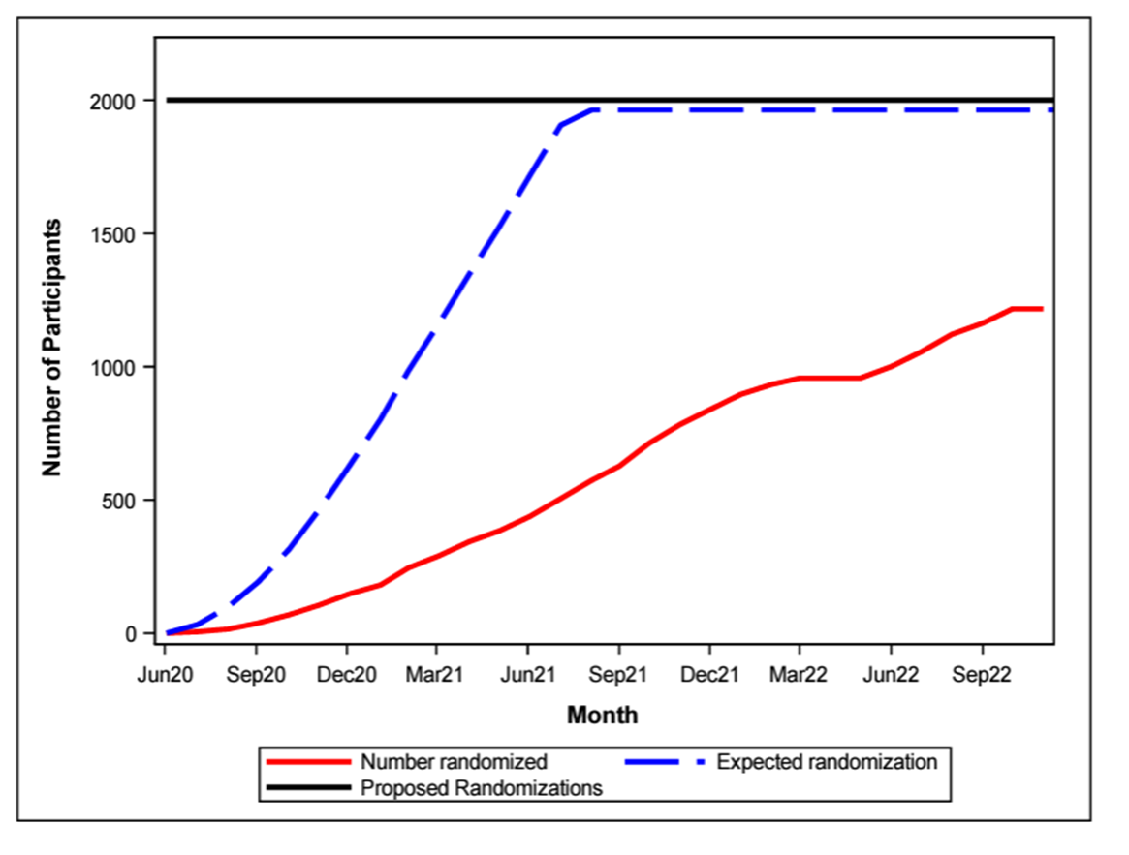
Results
1200
60% of Enrollment goal 2000

Slide 10
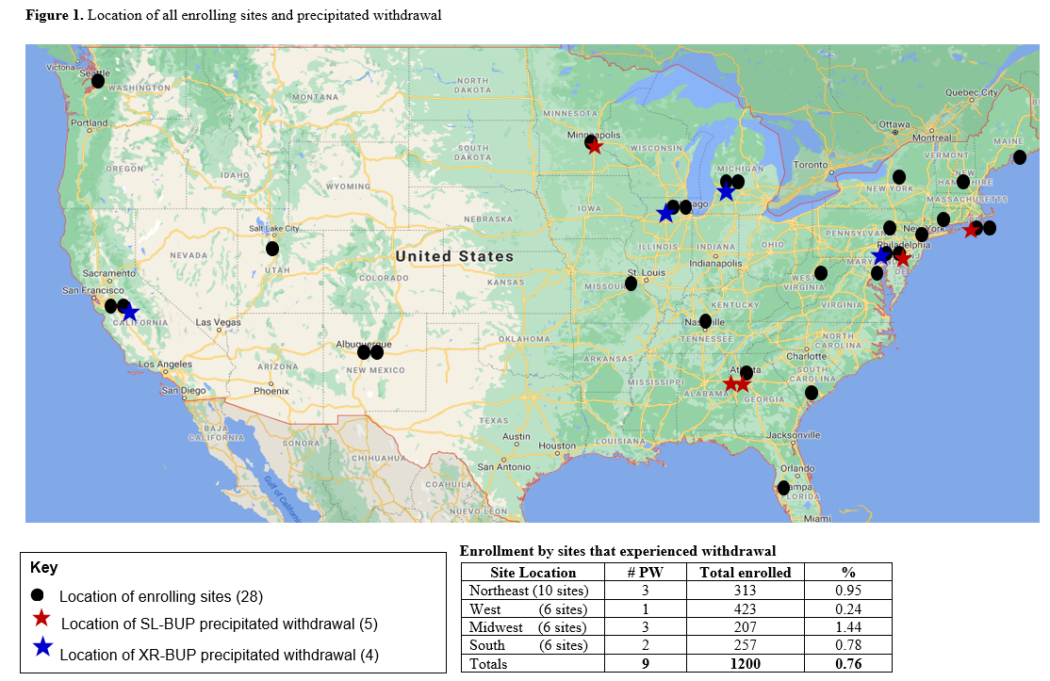
Location of all Enrolling Sites and Precipitated Withdrawal
0.76% (95%CI:0.35-1.43)

Slide 11
Results: Patient Characteristics
Total Enrolled to Date (n=1200)
Patients with PW (n=9)
Male 67%
Age (Mean) 38
Race: 56% White, 30% Black, Multiracial 2% American Indian
Urine Drug Screen
84% Multiple Drugs
76% Fentanyl
33% Cocaine
46% Marijuana
45% Opiates
Male 67%
Age (Mean) 38
Race: 2 (22%) White, 4 (60%) Black, 2 (22%) Multiracial 1 (10%) American Indian
Urine Drug Screen
68% Multiple Drugs
100% Fentanyl
67% Cocaine
44% Marijuana
22% Opiates

Slide 12
Characteristics of Patients with Precipitated Withdrawal
Enrollment Date | Location | Age | Race | Gender | Severity of Use Days/wk | Last Use (hours) | Route | Baseline COWS | Urine Drug Testing | BUP SL vs XR | Disposition | ED LOS (hours/min)
12/20 | Northeast | 50 | Black | Woman | 7 | 16 | IV | 13 | OPI FEN | SL | Discharged | 6.40
01/21 | West | 29 | White | Woman | 7 | 8 | smoking | 15 | FEN | XR | Discharged | 2.50
02/21 | Northeast | 47 | White | Man | 7 | 8 | nasal | 12 | FEN | XR | Observationª Discharged | 7.50
04/21 | Midwest | 61 | Black | Woman | 7 | 24 | nasal | 8 | COC, OPI, THC, FEN | XR | AMA | 1.41
05/21 | Northeast | 30 | Muti-racial | Man | 6 | >24 | IV | 17 | COC, THC, FEN | SL | Discharged | 7.24
8/21 | South | 32 | Multi-racial | Man | 6 | 24 | smoking | 16 | COC, FEN | SL | Observationª Discharged | 22.39
9/21 | Midwest | 49 | Black | Man | 7 | 12 | nasal | 13 | COC, THC, FEN | XR | Discharged | 8.50
11/21 | Midwest | 22 | AI/AN | Man | 7 | 16 | smoking | 10 | COC, THC, FEN | SL | Discharged | 8.43
12/21 | South | 25 | black | Man | 7 | 15 | IV | 29 | COC, FEN | SL | Observationª Discharged | 20.00

Slide 13
Lessons Learned: Treatment of PW
More Buprenorphine 24-32 mg
Ancillary Medications
Muscle aches and pains: Acetaminophen, NSAIDs: Ibuprofen, ketorolac
Abdominal cramps and diarrhea: Dicyclomine, Loperamide
Nausea: Antiemetics
Elevated blood pressure, tachycardia and/or anxiety/restlessness: Clonidine
Consider IV Fluids & small doses of lorazepam
Best to find a dark quieter place or send home if possible
If you get distressed, call for help

Slide 15
Conclusion
<1% of patients experienced PW despite high prevalence of fentanyl use
There are NO consistent similarities among the individuals experiencing Precipitated Withdrawal!

Slide 16
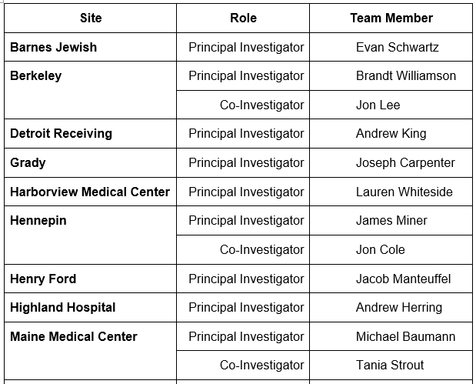
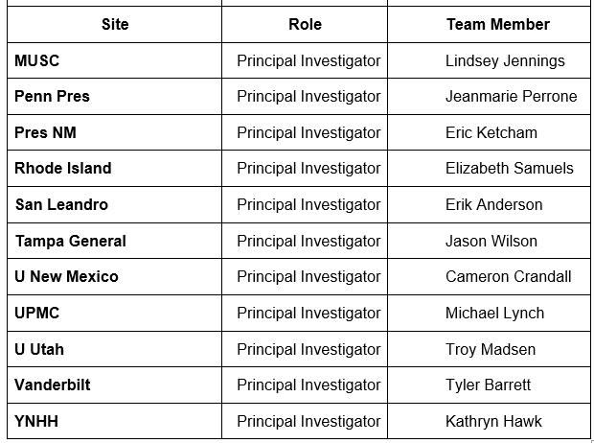
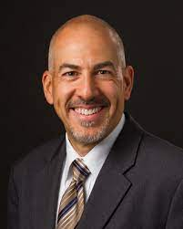
0099 Team
ED INNOVATION Site Investigators
David Fiellin MD | Ryan McCormack MS, MS
Marek Chawarski PhD | Edward Melnick MD, MHS
Edouard Coupet MD, MHS | Sean Murphy PhD
Ethan Cowan MD | Patrick G. O’Connor MD, MP
James Dziura PhD | Patricia Owens MS
E Jennifer Edelman MD, MHS | Michael V. Pantalon PhD
Kathryn Hawk, MD, MHS | Jeanmarie Perrone MD
Andrew Herring MD | Andrew Taylor, MD
Kristen Huntley PhD | Arjun Venkatesh, MD
Michelle R. Lofwall MD | Sharon Walsh, PhD
Shara Martel MPH, MS

Slide 17
Thank You

