Slide 1
Process and Outcome Evaluation of Recovery Opioid Overdose Team Plus (ROOT+): A Post-Overdose Community Outreach Program Utilizing Peer Recovery Coaches
Gina Dahlem
School of Nursing
Brianna Dobbs
Home of New Vision
Mary Dwan
School of Nursing
Notes:
The total time period for each paper presentation is 15 minutes. Please plan a 10-minute oral presentation allowing 5 minutes for questions. Please note, the abstract session moderators are under strict instructions to keep each speaker to 10 minutes.
An effective 10-minute presentation typically consists of 10-14 slides; with no more than 6 lines of text per slide and font sizes no smaller than 24 points.
The room will be preset with a computer, LCD projector, screen and laser pointer. Presenters are responsible for bringing their presentation on a USB to the conference.

Slide 2
Conflict of Interest
Brianna Dobbs and Mary Dwan have no conflict of interest that pertains to the information discussed in this lecture.
Gina Dahlem receives royalties as a co-inventor for Rapid Assessment for Adolescent Preventive Services health risk assessment tool – but has nothing to do with this lecture.

Slide 3
Background
Growing number of post-overdose interventions to connect overdose (OD) survivors to recovery and treatment support services
Different models exist
Small teams composed of peers, first responders, behavioral health, faith members
Goal
Engage with OD survivor and networks usually within 72 hours post-OD
Connect survivors to recovery supports and treatment services

Slide 4
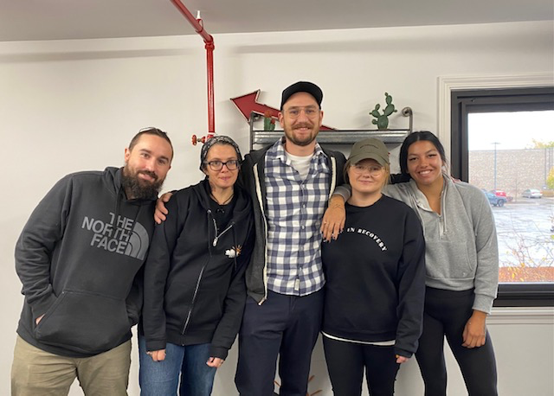
Objective
To examine the process and outcomes of a community post-overdose program, Recovery Opioid Overdose Team Plus (ROOT+) using peer recovery coaches

Slide 5
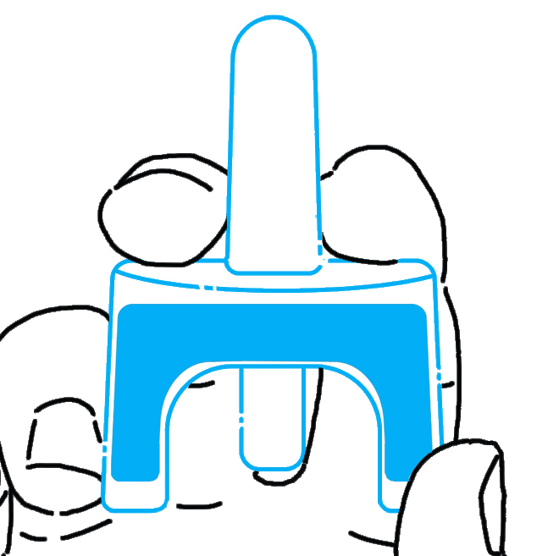
Methods
ROOT and ROOT+ Protocol
Reversal
Activation
Recovery Supports
Peer notified to ED
Engagement
Screening
Law Enforcement
24/7 Line
EMS Reports

Slide 6
Methods
Utilized RE-AIM framework to evaluate ROOT+
Multi-Phase Mixed Methods Study
Data collection
Quantitative data through REDCap:
December 1st, 2020- December 1st, 2021
At 6 months (June 2021), conducted face to face interviews with stakeholders (N=16) via zoom to explore implementation processes of ROOT+ and experiences with ROOT+
Rapid Analysis used for qualitative analyses

Slide 7
Reach – Who participated? And Not?
December 1, 2020-December 1, 2021
8.4%
(19/227)
Family
49.4% (112/227)
Survivors
+
57.7% (131/227) Engaged
299 probable overdoses
264 referrals received
(39 repeat ODs)
227 unique survivors
42.3%
(96/227) Unengaged
Notes:
Final outcomes for repeat ODs:
In treatment = 4; Incarcerated = 1; Deceased = 3; unengaged = 11; In recovery = 2; Engaged = 1; Unknown = 3
Who was referred?
88.3% = 264 client referrals received/ 299 total number of OD within County
Who participated?
Engaged (Did you see or talk to the client/family?)
58.2% = 131 of clients who engaged/ 225 total clients referred
Who did not participate?
Unengaged
41.8% = 94 of clients who did not engage/ 225 total clients referred
Reasons for unengagement
Individual level:
Are there demographic differences between the 2 groups (engaged vs unengaged)?

Slide 8
Community
OD business or public location, checked out from motel
Client
deceased, incarcerated, not interested, claimed no OD
Hospital
unresponsive, d/c, no show, ED refused
Address
Wrong, unknown
Phone
no answer, invalid #

Slide 9
Demographics
 | Median | Range
Age In Years (n=222) | 36.5 | 19-72
# of ODs in the past year (n=40) | 2 | 0-3
Motivation to seek treatment (n=34) | 8 | 0-10
Modified recovery capital scale (n=39) | 3.2 | 1.42-5.5
Notes:
MRCS: case management : financial, transportation, housing, safe, ID, access to medical PCP; SDOH
PEER: - goals, supports, enjoyment about recovery
If 3 or less – weekly contact.
12/22 are on the street

Slide 12
Notes:
Engagement refers to if the person had an OD and had any engagement with ROOT, even outside of month

Slide 13
Implementation
So, sometimes we go to call (agency), and no one answers the phone. Say that happens one out of every two or three times I call (agency), no one answers, and that kind of puts you guys in a trick bag because you are obviously dealing with, um, the pressure of time.” -Law Enforcement Officer
Challenges
ROOT Activation from all stakeholders
“I'm on the ROOT listserv too and they’ll like send the paper into the listserv and it will say did you contact ROOT? No. And it's like why not?”
- ROOT+
Notes:
Implementation – How was ROOT+ adapted? HOW much will (did) it cost? Barriers and facilitators to engagement

Slide 14
Implementation
We had a [hospital] staff member, it was reported to us, that they called the access line to activate the ROOT team because it had already made it through the first responders, and no one had been notified. Called Crisis Line and the person that answered the phone had no idea what ROOT was. And they didn't know who to refer them to or how to even start that process.”
-ROOT+ Program Manager
Challenges
Lack of ROOT Awareness
Notes:
Implementation – How was ROOT+ adapted? HOW much will (did) it cost? Barriers and facilitators to engagement

Slide 15
Implementation
That's the biggest thing is not being able to have like accurate contact information or you know, we do have like a phone number and we're able to connect with that person and then it's out of service. I would say the other thing that has been challenging which there's not really anything we can do about is, um, confidentiality and trying to find a person without kind of exposing them or stating anything about who we are, because it could, yeah it's just kind of skirting around that confidentiality.” -ROOT+ Coordinator
Outreach Challenges
Incorrect or missing contact info
Issues of confidentiality
Inconsistent housing
Lack of access or working phone
Resistance to engagement
Notes:
Implementation – How was ROOT+ adapted? HOW much will (did) it cost? Barriers and facilitators to engagement

Slide 16
Implementation
“So that that was another huge, huge thing is sometimes I’d show up and whoever was at the front door would be like no visitors no matter what you can't be here. And then I’d show up the next day and they’d be like oh yeah, the ROOT team come on in.”
-ROOT+ Case Manager
COVID 19
Inconsistent access to clients in the ED and in the community
Notes:
Implementation – How was ROOT+ adapted? HOW much will (did) it cost? Barriers and facilitators to engagement

Slide 17
Maintenance
Recommendations from Stakeholder Interviews
Create direct line to contact ROOT
Hold meetings with partner agencies to increase awareness
Create written informational brochures for dissemination
Create a ROOT video to share with clients if unable to enter ED
Continue re-visit incident locations and resident addresses
Incorporate family support coach
Create a resource bag and list of resources that goes beyond treatment

Slide 18
THANK YOU!!
Gina Dahlem: ginayi@umich.edu
Brianna Dobbs:
bdobbs@homeofnewvision.org
Mary Dwan:
marydwan@umich.edu

Slide 19
Adoption
Notes:
How well did the program fit with other organizational priorities and existing workflows?

