Slide 1
More Money? MO-FTS
Findings from a pilot Fentanyl Test Strip distribution program using Missouri’s substance use workforce
Rachel Winograd, PhD., Rithvik Kondai., Elizabeth Connors, MSW, LCSW., Katherine Brown, MPA, MSW, LCSW, Aaron Ruiz, CPS, Christine Smith

Slide 2
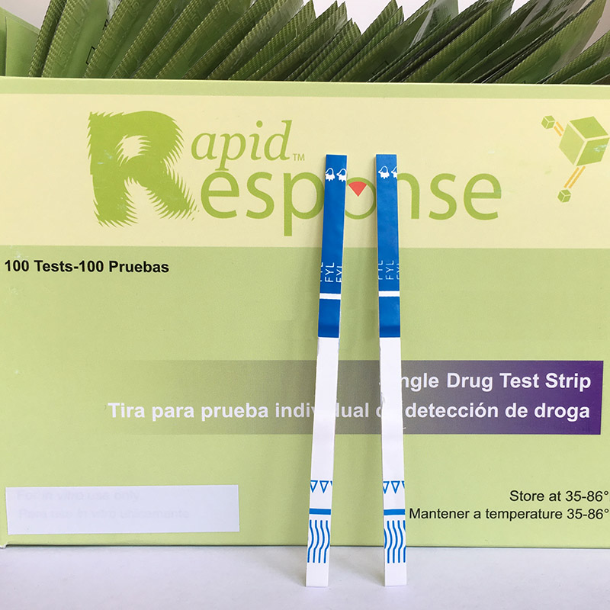
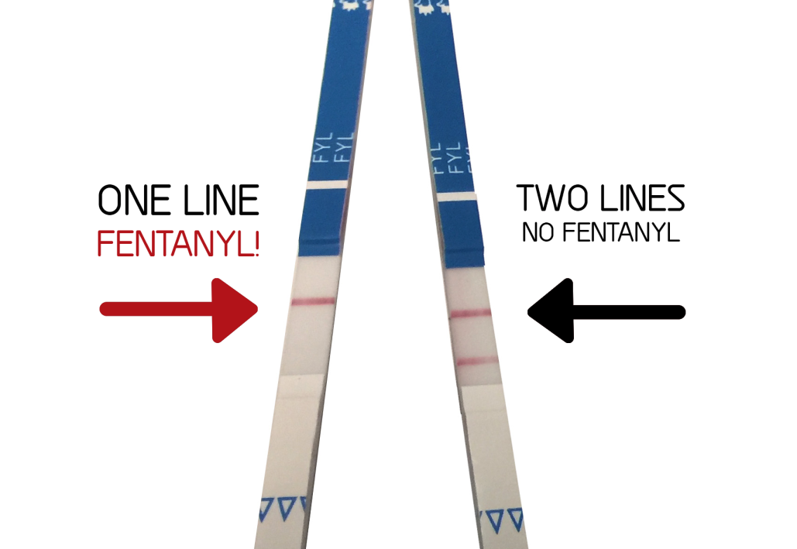
What are Fentanyl Test Strips (FTS)?
Harm reduction tool to detect fentanyl (& some analogues) in various substances
April 2021: SAMHSA gives grantees permission to purchase and distribute FTS
In MO:
Partnered with DanceSafe
Using the BTNX Rapid Response strip
Notes:
What are FTS? Well, FTS are harm reduction tools that allow people to detect the presence of fentanyl and certain analogues in various substances. What substances are we talking about? FTS, specifically the brand that we’re using, BTNX Rapid Response, are FDA approved for testing the presence of fentanyl in urine. However, there is also an off-label use of checking for fentanyl in drugs, that these strips have been used for as well. There is a well documented history and rich literature pointing to the support of FTS use to effect positive behavior change in PWUD.
I mentioned earlier that this is a tool. The results from this strip tell us either yes/positive fentanyl or no/negative fentanyl. It does not tell you how much fentanyl is in the substance, and it is also susceptible to false positives and negatives depending on the substance and test sample concentration. It is merely a tool that provides a certain kind of information that PWUD deserve to know, especially in the age of an unstable supply. The results from these tools also depend heavily on if they are used correctly.
FTS are extremely important as we move forward in the overdose crisis as fentanyl dominates the opioid supply in MO and also nationally, and now opioid+stimulant combined deaths are on the rise as we enter what some people are calling the 4th wave of the overdose crisis. We are providing people a tool to help make decisions, and especially if people want to use FTS for off-label use, we want to ensure they do it correctly to save lives.

Slide 3
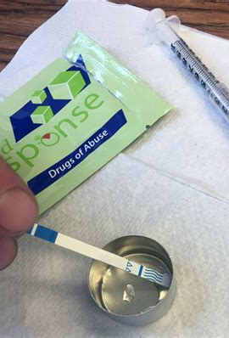
How & Why to use fts?
Post consumption
Test urine after using substance
Provides info about what they’ve already consumed
Inform what/how/how much to use NEXT time
Pre consumption (ideal)
Test drugs for fentanyl before you use – present or no?
Informs what/how/how much to use THIS time
Notes:
So how does this work? For post-consumption, someone who uses cocaine may use and feel something is not right with their high/drug experience after using, so the next morning they test their urine to see if it comes up positive for fentanyl. If it does, then maybe they get to understand a little bit of why they felt differently the last time they used and to use less next time or get rid of the bag or notify their dealer/other people they know who bought from this dealer and spread the information. If pre-consumption, someone checks for the presence of fentanyl before they use, and if it tests positive, they might still use but use a little less, or they might ensure that they have naloxone handy and let a trusted person know where it is in case it needs to be used.
To be honest, they can be a little tricky to use and the results are not meant to be taken as the 100% truth. We still want people to take appropriate precautions to prevent overdose and have naloxone available at all times, using with someone or if you like to use alone, using either the NUA hotline or asking a trusted friend or person to check-in with you in a certain amount of time. FTS are important tools and have their place in harm reduction, so I want to make sure we ground ourselves in this fact as state programs start to grow and expand FTS distribution. Naloxone distribution and making sure people’s basic needs are being met with housing, food, employment should still be at the forefront of our harm reduction efforts.

Slide 4
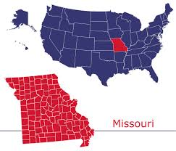
Missouri’s political and legal climate
Murky Legality: In MO, drug checking for purpose of consumption is not legal… but no rules about testing urine! (original purpose of FTS)
Our goal: Stay in accordance with MO’s paraphernalia law while providing max harm reduction benefit of FTS
Messaging: Use these for urine testing (original purpose) but provide instructions for both methods “just in case”
Notes:
To understand a little bit about what, why, and how we did what we did in terms of FTS distribution, I want to provide you some context about a factor that we had to consider every step of the way – Missouri’s drug paraphernalia laws. In MO, it is illegal to use FTS as drug checking instruments.
We are distributing FTS for the FDA approved use, but also recoginze that people will still use the strips for off-label use and we want them to do it safely. This is similar to how we encourage healthcare workers to share safe use tips for PWUD. We are not saying you have to use, but if you do, here’s how you can do it in a way that doesn’t harm you.
Another point to note, is that it is not illegal to own FTS. It is not illegal to have FTS, and I say that because that was a response that we got initially due to the paraphernalia laws. The FTS is not illegal just in the same way a syringe itself is not illegal. Using it for drug purposes, or in the case of FTS, drug checking purposes, is what makes it illegal, so I want to make that point clear.
As we need to stay within the legal landscape of MO, we cannot encourage people to use the FTS to check their drugs, but as harm reductionists we recognize that it is important to share the safe way to use FTS so they can be an effective tool. If you are considering exploring this option for your state, I would recommend checking out the specific legal language for your state and finding the specific statute that references drug paraphernalia to see how you might have to approach your distribution.

Slide 5
Goal: Design and implement a data-driven strategy for FTS distribution in Missouri using multiple sectors of the substance use services workforce as distributors

Slide 6
Methods
Time period: August 2021-March 2022
FTS availability publicized through multiple statewide channels
Organizations sent requests to our team via email
Eligible groups:
treatment agencies, harm reduction orgs, public health departments, recovery community centers, and individuals who do street outreach
Notes:
Requests were accepted during August and September of 2021. Those serving people who use stimulants, conducting direct outreach with PWUD, and operating in parts of the state outside St. Louis, where drug supplies are less saturated with fentanyl, were prioritized for FTS distribution.

Slide 7
How we made allocation decisions
In our bid for requests, we asked the following questions:
How many kits you are requesting?
1 kit = 5 FTS wrapped in pre- and post-consumption instructions
An estimate of how many individuals who use stimulants you serve on a monthly basis.
What type of org are you?
Does your organization conduct street outreach?
We prioritized orgs that:
Served more people who use stimulants & conduct street outreach
Areas with higher rates of stimulant-involved deaths
Areas outside of STL (where fentanyl has fully saturated most of supply)

Slide 8
Pre and post consumption instructions

Slide 9
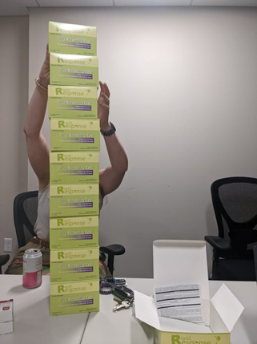
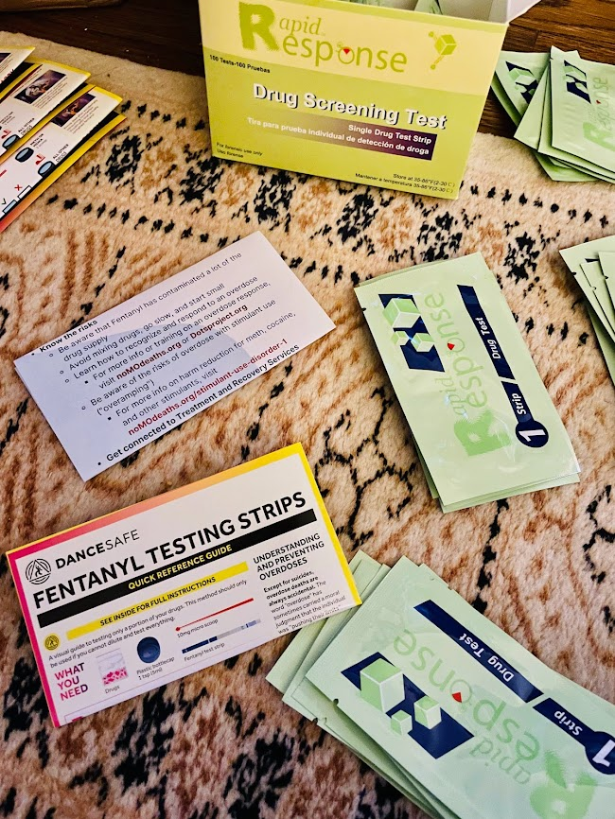
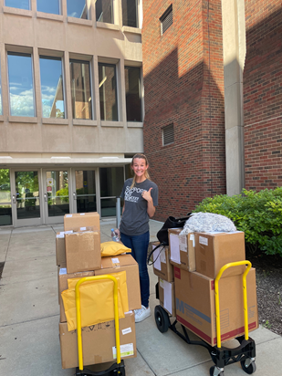
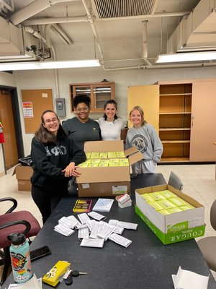
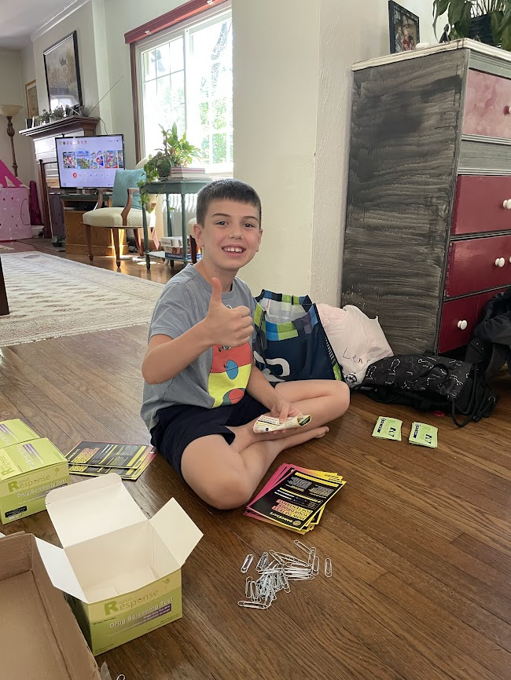
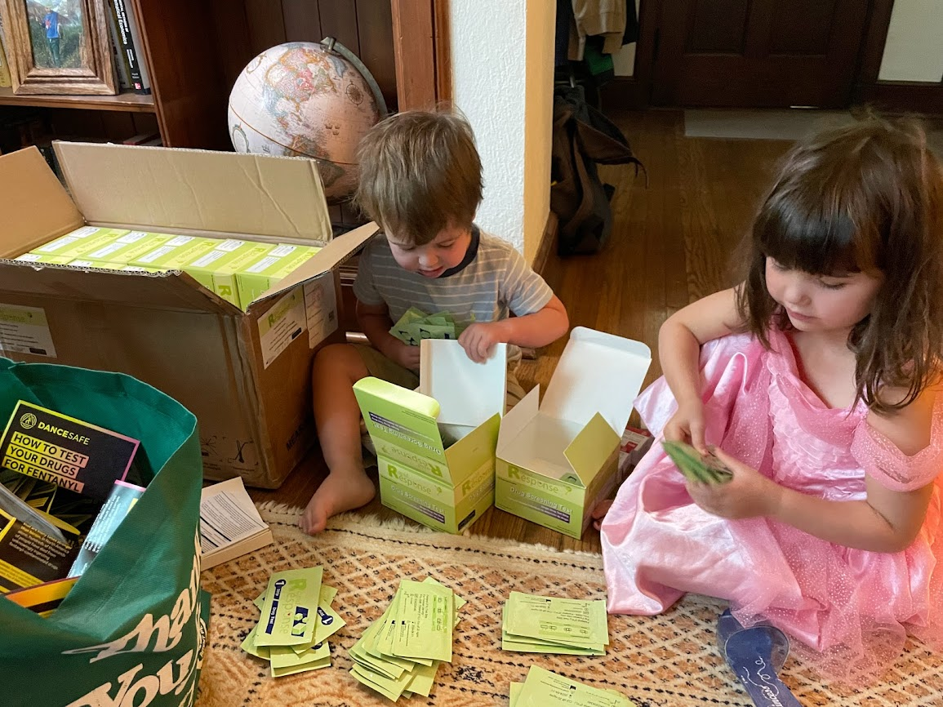
Then came packing, delivering, & shipping!

Slide 10
FTS Distributed in initial pilot
65 entities submitted requests
4,118 FTS kits (20,590 strips)
41.8% of what was requested was supplied (funding was limited)
Orgs:
Avg of 139 people who use stimulants served/mo
69% conduct street outreach

Slide 11
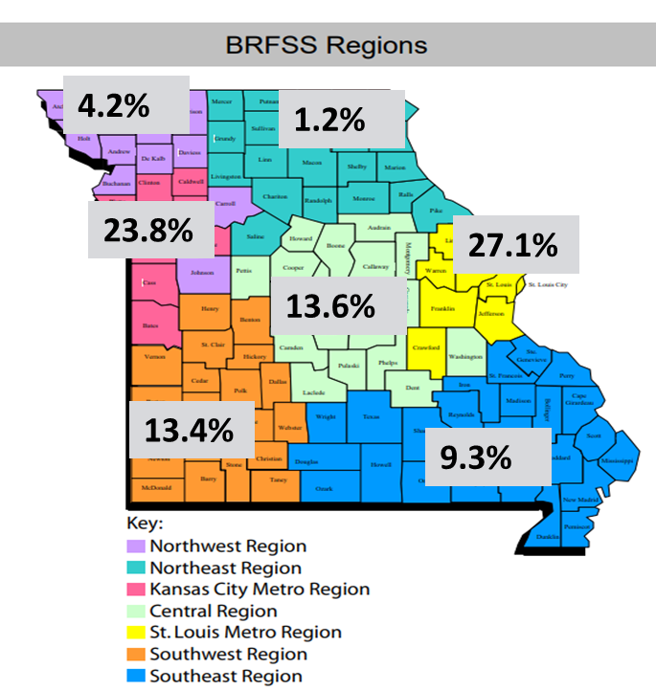
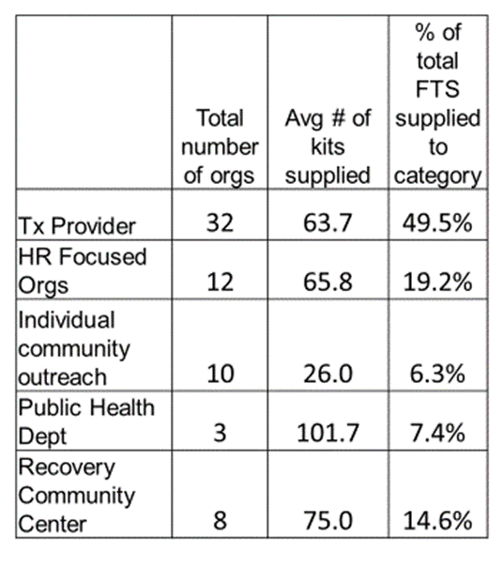
Regional Breakdown of pilot FTS distribution
Statewide Distribution
August 2021-March 2022
*ALL OF THIS INFORMED OUR LATER DEVELOPMENT OF A DISTRIBUTION DECISION-MAKING “ALGORITHM”*
Winograd, R. P., Weinstock, J., Ruiz, A., Coffey, B., Brown, K., Kondai, R., Connors, E., & Smith, C. (2022). Addressing stimulant use disorder through state opioid response grants from the substance abuse and mental health services administration: Missouri’s initial approach. The American Journal of Drug and Alcohol Abuse, 1–7. https://doi.org/10.1080/00952990.2022.2097917
Notes:
This is what our regional breakdown looked like after our pilot. Highlighted in grey are the %s of total FTS that we gave to each region. This was a great place to start our efforts but also a good reminder of the fact that we have a lot of room to grow in terms of expanding harm reduction efforts across the state of MO.

Slide 12
Addressing inequities
Biggest growth in combo opioid+stimulant deaths in Black population in MO
Prioritize on-the-ground community organizations that are working directly with PWUD who are actively using
Used mortality data to prioritize geographic regions most impacted
Know we need to increase stimulant harm redux efforts to better reach Black PWUD
Notes:
We took the learnings from this pilot and put it towards figuring out a more equitable and fair way of distribution FTS. We created this algorithm which we used for our official distribution this year...

Slide 13
Conclusions
State laws around drug paraphernalia
Careful wording needed – but there may be loopholes to explore
Messaging
Substance
Yes: People who use stimulants and pressed pills, without an opioid tolerance
Not worth it: Opioid users who are expecting fentanyl (FTS already “old news”)
Instructions and Sensitivity
Meth and MDMA: false positives common, follow instructions re: dilution
Do not forget: It takes a LOT of time to make kits!

Slide 14
Future directions
When resources are limited, must make even more rigorous data-driven decisions on FTS allocation
Study how FTS distribution is perceived in more “traditional” SUD contexts
Remove drug checking from Missouri’s paraphernalia statute so we can distribute FTS to TEST ACTUAL DRUGS!
Increase FTS receptivity to grease the wheels for bigger drug checking interventions

Slide 15
Thank you!
Rithvik Kondai
Elizabeth Connors, MSW, LCSW., Katherine Brown, MPA, MSW, LCSW Aaron Ruiz, CPS
Christine Smith
Lauren Green, MSW
Miles Hoffman, CPS
Zach Budesa, PhD
EVERYONE IN ST LOUIS WHO HELPED PACK FTS KITS!!!!

