Slide 1
A Nation-Wide Emergency Department Quality Initiative to Improve Care of Patients with Opioid Use Disorder
AMERSA
November 10, 2022
Kathryn Hawk MD, MHS
Department of Emergency Medicine

Slide 2
Disclosures: Kathryn Hawk
I have no conflicts of interest or
disclosures to report
Research Support:

Slide 3
Disclosures: Scott Weiner
Employment: Bicycle Health, Inc.
Acute Pain Steering Committee: Vertex, Inc.
Research Support:

Slide 4
ACEP E-QUAL Opioid Network
Kathryn Hawk
Scott Weiner
Craig Rothenberg
Dhruv Sharma
Pawan Goyal
Melissa Finch
Cindy Mendez-Hernandez
Arjun Venkatesh (PI)

Slide 5
Background
National trends of ED care for patients with OUD and opioid overdose are not well documented.
In 2018, the U.S. Surgeon General released an advisory supporting naloxone distribution/prescription to patients at risk of overdose
Despite evidence of improved outcomes, the proportion of EDs initiating medications for OUD treatment nationwide is unknown.

Slide 6
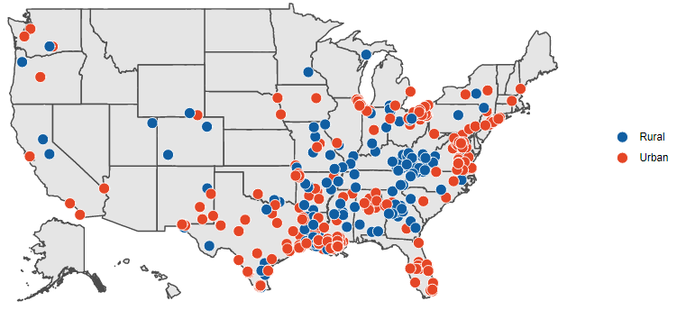
ACEP E-QUAL Opioid Collaborative
Mission:
“Engage emergency clinicians and leverage emergency departments to improve clinical outcomes and coordination of care”
Enrollment
Enrollment questionnaire
Learning Collaborative
(6-9 months)
Webinars/toolkit
Collect CME
Wrap Up
Follow-up benchmarking data
Baseline benchmarking data
Online portal activities
CMS MIPS credit

Slide 7
Study Objectives
To design and test the collection of quality measures for ED patients with OUD and overdose.
To evaluate quality improvement among participating EDs.

Slide 8
Methods
EDs participating in the 2021 EQUAL Opioid Initiative were requested to abstract charts from 30 randomly selected ED visits before (pre) and after (post) participation in the 6-month learning collaborative
Charts selected based ICD-10 code of OUD or opioid overdose
Pre: September 2020 - February 2021
Post: July 2021- October 2021

Slide 9
Methods
Measures:
- Substance use evaluation in the ED
- OUD Treatment referral
- Overdose prevention provision documented
- Methadone or buprenorphine administration in the ED
- Buprenorphine prescription at discharge
- Naloxone offer/provision to patient
Analysis:
Descriptive statistics and student’s t-test were used to evaluate responses from sites providing both pre and post data

Slide 10
Participating Emergency Departments
ED Patient volume | Number n=266 | Percent Total
<20K | 157 | 59.0%
20-60K | 101 | 38.0%
>60 K | 8 | 3.0%
ED Location
Rural | 142 | 53.4%
Urban | 124 | 46.6%

Slide 11
Results: OUD Care
Pre Post
 | # charts meeting measure | charts reviewed | % charts Pre | # charts meeting measure | charts reviewed | % charts Post | p-value (pre v post)
Substance Use Evaluation Documented | 4036 | 4470 | 90.3% | 4798 | 5168 | 92.8% | <0.001
OUD treatment referral | 2813 | 4470 | 62.9% | 4354 | 5168 | 84.2% | <0.001
Overdose Prevention Documentation | 2993 | 4470 | 67.0% | 3097 | 5168 | 59.9% | <0.001
*Charts reviewed with OUD or opioid overdose

Slide 12
Results: OUD Care
Pre Post
 | # charts meeting measure | charts reviewed | % charts Pre | # meeting measure | charts reviewed | % charts Post | p-value (pre v post)
ED provision of buprenorphine or methadone | 79 | 4346 | 1.8% | 202 | 4908 | 4.1% | <0.001
Discharge prescription for buprenorphine | 56 | 3469 | 1.6% | 107 | 3851 | 2.8% | <0.05
Discussion or provision of naloxone | 1208 | 3610 | 33.5% | 1141 | 4152 | 27.5% | <0.001
*Charts reviewed with OUD or opioid overdose

Slide 13
Results: ED visit for Opioid Overdose Only
Pre Post
 | # charts meeting measure | charts reviewed | % charts Pre | # charts meeting measure | charts reviewed | % charts Post | p-value (pre v post)
Substance Use Evaluation Documented | 3783 | 4104 | 92.2% | 2725 | 2940 | 92.7% | 0.45
OUD treatment referral | 2608 | 4104 | 63.5% | 2475 | 2940 | 84.2% | <0.001
Overdose Prevention Documentation | 2832 | 4104 | 69.0% | 1885 | 2940 | 64.1% | <0.001

Slide 14
Results: ED visit for Opioid Overdose Only
Pre Post
 | # meeting measure | charts reviewed | % Pre | # meeting measure | charts reviewed | % Post | p-value (pre v post)
ED provision of buprenorphine or methadone | 24 | 4022 | 0.6% | 30 | 2894 | 1.0% | 0.06
Discharge prescription for buprenorphine | 17 | 3181 | 0.5% | 37 | 2299 | 1.6% | <0.001
Discussion or provision of naloxone | 1164 | 3273 | 35.6% | 1014 | 2352 | 43.1% | <0.001

Slide 15
Limitations
Short period between evaluations
Could not ensure that clinicians actually saw or used our resources
Changes likely reflect other influences in addition to just learning collaborative participation
If it wasn’t documented, it didn’t mean that it wasn’t done
Possible selection or reporting bias by sites
Proportion of patients reported with overdose vs OUD was much higher for baseline than follow-up period (may reflect an increase in OUD diagnosis)

Slide 16
Diversity, Equity and Inclusion
Has not been a focus in this prior work
Greater focus on rural/community sites
Prioritized for our next learning collaborative

Slide 17
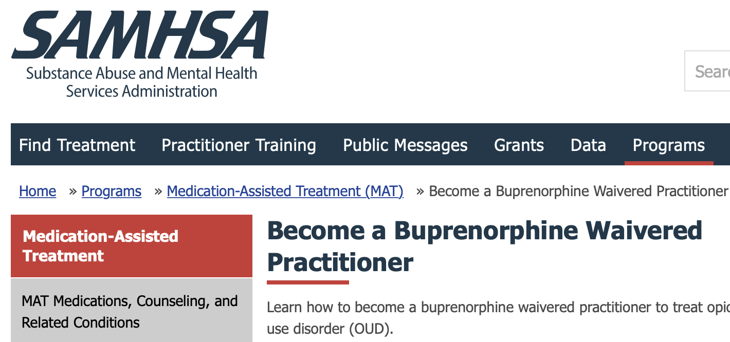
Conclusions
EDs participating in a national practice-based learning network demonstrated improvement in several measures of ED OUD care.
Overall, rates of naloxone distribution remain low (~ 30%)
Rates of OUD treatment initiation remain low, but are increasing
ED administration: 0.6-4.1%
Buprenorphine prescription: 0.5%-2.8%
This study demonstrates the feasibility assessment of collection of OUD measures from a nationwide sample
Don’t have an X-Waiver??? Apply for your NOI now!!
https://buprenorphine.samhsa.gov

Slide 18
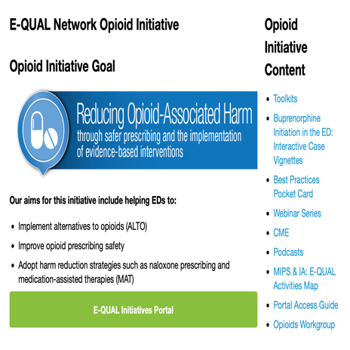
kathryn.hawk@yale.edu
@kathryn_hawk
sweiner@bwh.harvard.edu
@scottweinermd
Don’t have an X-Waiver??? Apply for your NOI now!!

