Slide 1
Complex Care Utilization for a Patient in Novel Managed Alcohol Program (MAP)
Megan Kennel, RN
Elizabeth Abbs, MD
Devora Keller, MD
Notes:
Elizabeth

Slide 2
No disclosures

Slide 3
Learning Objectives:
We aim to:
Define the managed alcohol care model
Explore the role of MAP in the care of a high-risk individual with severe AUD
Discuss interplay of patient autonomy, quality of life, and discharge goals for a high risk MAP participant
Notes:
Define the framework behind the managed ETOH care model
Explore the role of MAP in caring for a vulnerable person living with severe AUD
Within this context --Discuss the complex interplay of patient autonomy, quality of life, and safety as it pertains to d/c goals

Slide 4
MAP Philosophical Framework Goal is to decrease harm NOT to decrease volume of alcohol consumed
\
Supportive option for individuals not currently interested in abstinence-based options and/or have failed prior attempts at abstinence-based programs
Prevent withdrawal and associated complications
Decrease acute alcohol related harms
Decrease acute care and criminal justice episodes
Promote safer use of alcohol overall
Improve safety and quality of life
Notes:
Megan
--
Unlike many of the other alcohol harm reduction strategies, the primary goal of managed alcohol is not to decrease the volume of alcohol being consumed, rather to mitigate many of the health, legal, and interpersonal harms associated with unsafe alcohol use.
This includes dangerous alcohol withdrawal symptoms, physical injuries and accidents, as well as EMS/ED and criminal justice encounters. MAPs also focus on improving participants sense of safety, security, and overall QoL. While this philosophical shift is fundamental to the MAP model, I do not was to minimize how difficult this philosophical shift can be for even the most seasoned harm reduction focused program staff. Our team's weekly case conference routinely revisits this philosophical framework, questioning the tradeoff between structuring our program as participant driven verse our desire to more aggressively promote safer alcohol use in line with our wishes for clients.

Slide 5
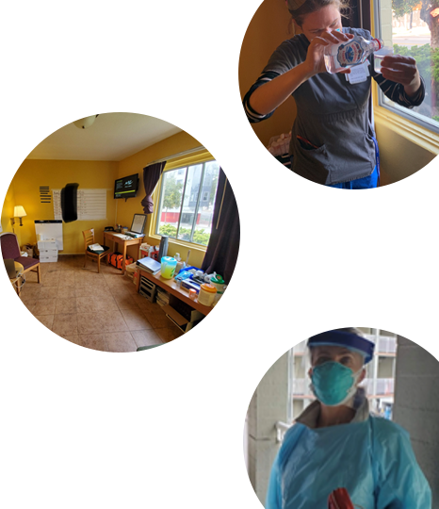
San Francisco Department of Public Health MAP
2020 COVID response to reduce emergency utilization among people with severe alcohol use disorder (AUD)
2022 funded longitudinal program
10 new beds earmarked to serve the LatinX/indigenous population
Increase staffing to meet program size and structure goals
Notes:
Megan
Background: The San Francisco Department of Public Health created a Managed Alcohol Program (MAP) in 2020 as a COVID-19 response to curb emergency care utilization among individuals with severe alcohol use disorder (AUD). The MAP program provides participants individual motel rooms, three meals daily, nurse administered standard dose equivalents of alcohol, and connection to primary care and mental health services. To date, the program has served 27 patients for 33 total episodes and demonstrated modified healthcare utilization, reduced alcohol related complications, and improved perception to quality of life.ion, reduced alcohol related complications, and improved perception to quality of life.
Room & Board (motel room)
RN administered standard dose equivalent (SDE) of alcohol*
Connection to Primary Care/Mental Health/SW
First I/Q pilot

Slide 6
Core Components of MAP (*to date)
Regulated alcohol in a controlled setting via individualized dosing
Priority Populations:*
Severe AUD
Unstable housing
High system utilizer
LatinX or marginalized community member
Linkage opportunity to behavioral health, case management and primary care services
Accommodations:
Private room with bathroom
3 meals per day
Cleaning support
Medications and alcohol moderation skills
Closed program*
Notes:
Megan
Managed alcohol does not mean open access to as much alcohol as clients want. The model hinges on regulated amounts of alcohol dispensed by Registered Nurses in a controlled setting with clinical assessments done at each dosing. T
The goal is to find an individualized dosing schedule that works for both the client and MAP staff – in terms of client comfort and safety. shared decision between client and MAP staff
We also we offer housing, 3 meals a day, and support with cleaning rooms. Due to COVID it has so far been a closed model with clients only going out on escorted walks and activities. This has been a challenge during this time to create community
We would be happy to share our clinical protocols with anyone who is interested

Slide 7
Participant Demographics and Early Outcomes
Age range 28-72
Age Average 54
Sex/Gender:
Male 32
Female 4
Non-binary 1
Preferred anguage:
English 29
Spanish 7
Sango 1
Ethnicity:
White 16
Black/AA 6
Latinx 13
NA/IM 1
API 1
Average length of stay: 129 days for completed episodes/171 days for enrolled clients
Impact of enrollment on acute care utilization:
4x decrease in ED utilization
2x decrease in EMS activation
2x decrease in hospitalizations
Participants report improved sense of health, hope, safety and stability
(n = 37)
Median age: 54
Range 28-72
86% male identifying
78% preferred English language
43% White
35% LantinX
16% Black/AA
Notes:
Megan
The program has served 38 patients for51 total episodes. The majority of clients
Most participants remain in the program for at least 4 months, many have enrolled for much longer. An early analysis comparing acutre care utilization 6 months prior to MAP enrollment and the 6 months after enrollment demonstate a 4 fold decrease in ED utilization, 2 fold decrease in EMS activiation, and a 2 fold decrease in medical hospitalizations. The majority of participants are male (>85%), 16% are AA, 38% of participants to date are latinx/indigenous mayan with goal of increasing this to 50% moving forward. 22% clients are non-english speaking, with the majority monolingual spanish speakers.
Figure*
Add housing on intake
* Episodes = number of intakes; think about ‘unduplicated clients’

Slide 8
Case Presentation:
59-year-old woman with prior stroke, pulmonary emboli, post-traumatic stress, bipolar disorder, at-risk stimulant use, 20 years of homelessness, and severe AUD complicated by frequent falls with more than 90 emergency utilizations in the 6-months prior to MAP.
Top EMS utilizer in San Francisco for several years
Describes self living in “crack alley” socially isolated from family and friends
Notes:
Elizabeth
Her story included in application:
Living in tent in “crack alley” using and drinking heavily going to ED frequently.
Now has hearing aids and glasses, participated in appts, art therapy, community programs
- More chaotic, disorganized

Slide 9
Utilization the Month Prior to MAP
4
ED visits
Sobering visits
Primary Care
1
Hospital Admission
14
17
Notes:
Elizabeth

Slide 10
Two years in MAP…
Connected to Primary Care, intensive case management
Bipolar being treated for first time
Stopped using methamphetamines
Using dentures, reading glasses, engages in art therapy, and community programs
Modified drinking patterns from binge to pattern less likely to cause harm
15 x reduction in emergency utilization
Notes:
Elizabeth
In the 22 months she was enrolled in MAP, she connected to primary and mental health providers,
started psychiatric medications, stopped stimulant use, modified her drinking patterns, and reduced her falls and emergency utilization (24 visits while in MAP). The patient opted to transition to an independent permanent supportive ho
Less falls
Modified drinking patterns
6 ED visits in 6 mo vs 90 in 6 mo prior to MAP
24 in 2 years from 90 in 6 months* (change to same time frame)
*11 from one week when left MAP

Slide 11
Utilization during MAP, goals/desires
Patient desires “own room with a kitchen and bathroom”
SW worked with client on steps for Supportive Housing
Client turned down several units, sought highly supported unit with on-site RN and SW.
Staff attempted to explore how patient would continue safer drinking pattern and ADL support in housing
declined stating “I’ve always been fine before”
Patient ultimately struggled with her ETOH consumption from day 1 in housing.
Notes:
Elizabeth
Initially MAP was ‘temporary’ program thus all patients needed dispo plans.
Client identified goal of wanting her “own room with a kitchen and bathroom”
SW worked with client on steps for Supportive Housing. Client turned down several units that didn’t seem like the right fit with a goal of having a highly supported unit with both on-site RN and SW.
Staff attempted to work with client on a transition plan to housing but she always declined stating “I’ve always been fine before”
Client ultimately struggled with her ETOH consumption from day 1 in housing

Slide 12
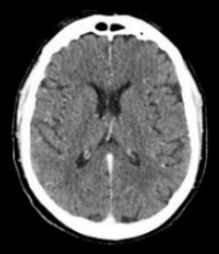
Twenty days in the community after 24 months in MAP
EVENT
DAY
1
2-4
5-6
7
8
9-11
11
12
13-19
20
Notes:
Elizabeth
using (PSH). Despite team support to honor patient autonomy and prepare her to self-manage alcohol, the patient had countless falls, 11 hospital presentations and five head computed tomoDgraphy scans within the first two weeks in PSH after leaving MAP.
Day 1: ED, (UCSF) - CT
Day 2-4: ED (GH), Hosp (UC) x 2 days - CT, CT
Day 5-6: ED (UCSF) - CT
Day 7: ED, (sutter) - CT
DAY 8: ED (UC) - CT
Day 9-11: ED, Hosp (GH) -CT
Day 11: ED, ED (Sutter, St. Mary’s) - CT
Day 12: ED (GH) - CT
Day 13-19: Hosp -CT
Day 20: ED (UC) 4/4
Since return 4/21, only 1ED/hospital stay
Return to PSH on 8/29..

Slide 13
Cycles in and out of MAP
Frequent returns to MAP for short stays; consistent goal to return to housing
“since I pay rent there”
“I want to drink as much as I want”
MAP attempts at skill-building for independent living,
client resistant: “I’ll just be more careful next time”
Tension between client’s autonomy and desire for independent living vs. staffs’ belief that MAP is safer
Notes:
Megan
Back and forth
Hasn’t been easy

Slide 14
Discussion: How do you honor a patient’s goals and wishes when you face concerns about safety and feasibility?
Medical-Psycho-Social Support and Stability
Independence and Autonomy
Notes:
Megan
MAP provides stabilizing medical-psycho-social support for high-risk people with AUD with direct value to the individual and the healthcare system. Despite patient interest in independence via PSH, her trajectory poses question of existing limitations in present housing models in managing high-risk patients struggling with severe AUD. Future PSH and MAP design must be tailored to integrate medical, social and cultural programming to foster risk reduction and long-term enhancement in quality of life.

Slide 15
Discussion:
Is housing the right goal for all patients?
Why or why not?
Notes:
Megan
Any data about cycles of chronic homelessness? Who fails in housing?

Slide 16
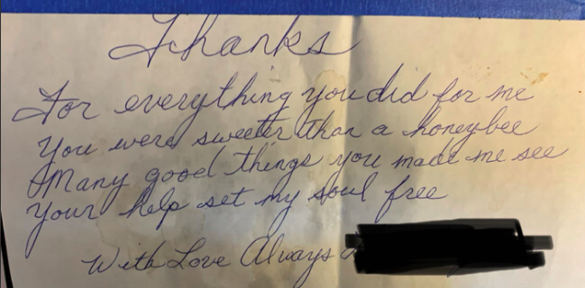
Thank you!
Thanks
For everything you did for me
You were sweeter than a honeybee
Many good things you made me see
Your help set my soul free
With love always

Slide 17
Supplementary

Slide 18
One week back in the community…
EVENT
DAY
1
2
3
4
5
6
Notes:
using (PSH). Despite team support to honor patient autonomy and prepare her to self-manage alcohol, the patient had countless falls, 11 hospital presentations and five head computed tomoDgraphy scans within the first two weeks in PSH after leaving MAP.
Day 1: ED, - fall and fx (St. Mary’s) – CT 4/16
Day 2: ED, Hosp (GH, UCSF) - CT
Day 3: ED, ED, ED (3 diff hospital) (GH, UC, SUTTER) - CT
Day 4: ED, ED, (GH, UC) -CT
DAY 5: ED (sutter) “ has had 4-5 CT scans in the last 3 days, prefer to avoid furthe radiation fiven no e/o head trauma”
Day 6: ED, ED (sutter, sutter) - CT
Since return 4/21, only 1ED/hospital stay
Return to PSH on 8/29..

