Slide 1
Utilization of Medication for Opioid Use Disorder Treatment During Hospitalization at Six New York City Public Hospitals with an Addiction Consultation Service
Carla King, MPH, PhD Student
NYU Grossman School of Medicine
November 10, 2022
Notes:
Carla King, MPH, NYU Grossman School of Medicine and NYC Health + Hospitals;
Medha Mazumdar, MS, NYU Grossman School of Medicine;
Noa Appleton, MPH, NYU Grossman School of Medicine;
Jasmine Fernando, MPharm, NYU Grossman School of Medicine;
Johanna Dolle, MPA, NYC Health + Hospitals;
Caroline Cooke, MPH, NYC Health + Hospitals;
Roopa Kalyanaraman Marcello, MPH, NYC Health + Hospitals;
Charles T. Barron, MD, NYC Health + Hospitals;
Jennifer McNeely, MD, MS, NYU Grossman School of Medicine;

Slide 2
Disclosures
No conflicts of interest

Slide 3
Medications for Opioid Use Disorder prevent poor outcomes in hospital
Prevent withdrawal
Premature discharge
Increase post-discharge engagement
Notes:
- Heavy burden of OUD among hospital patients
- Essential component of medical and addictions care

Slide 4
Consult for Addiction Care and Treatment in Hospital (CATCH)
Multidisciplinary addiction consultation service
Medical providers (MDs, NPs)
Social workers, addiction counselors, mental health counselors
Peers with lived experience
Improve care for hospital patients with substance use disorder
Prioritize initiation/continuation of MOUD
Notes:
Implemented at 6 NYC public hospitals since 2018
Evaluation and treatment for patients who use substances

Slide 5
1. Who received MOUD? 2. Are there areas of improvement in MOUD utilization?
Objectives

Slide 6
Case Definition
Length of stay <1 day
n=187
Inpatient admissions with opioid-related problem list diagnosis
n=3532
Non-CATCH departments
n=44
Final sample
n=3301
MOUD
No MOUD
Notes:
During first year of CATCH program at each hospital
MOUD = at least 1 inpatient order of buprenorphine, methadone, or naltrexone

Slide 7
Who received MOUD?
 | MOUD (N=1789) | No MOUD (N=1512) | Total (N=3301) | P-value
Age |  |  |  | < 0.001
Mean (SD) | 50.96 (12.23) | 49.48 (13.00) | 50.28 (12.61)
Sex (male) | 1348 (75.3%) | 1181 (78.1%) | 2529 (76.6%) | 0.068
Race
Alaskan Native/ American Indian/ Pacific Islander | 5 (0.3%) | 2 (0.1%) | 7 (0.2%) | 0.608
Asian | 5 (0.3%) | 12 (0.8%) | 17 (0.5%) | 0.064
Black | 431 (25.2%) | 496 (35.0%) | 927 (29.7%) | < 0.001
White | 371 (21.7%) | 311 (21.9%) | 682 (21.8%) | 0.913
Other Race | 896 (52.5%) | 596 (42.1%) | 1492 (47.7%) | < 0.001
Insurance
Commercial | 18 (1.6%) | 30 (4.3%) | 48 (2.7%) | 0.001
Medicaid | 794 (72.2%) | 452 (64.8%) | 1246 (69.3%) | 0.001
Medicare | 238 (21.6%) | 177 (25.4%) | 415 (23.1%) | 0.077
Other | 50 (4.5%) | 39 (5.6%) | 89 (4.9%) | 0.378
Notes:
96.3% have OUD/dependency on problem list
3.7% OUD poisoning

Slide 8
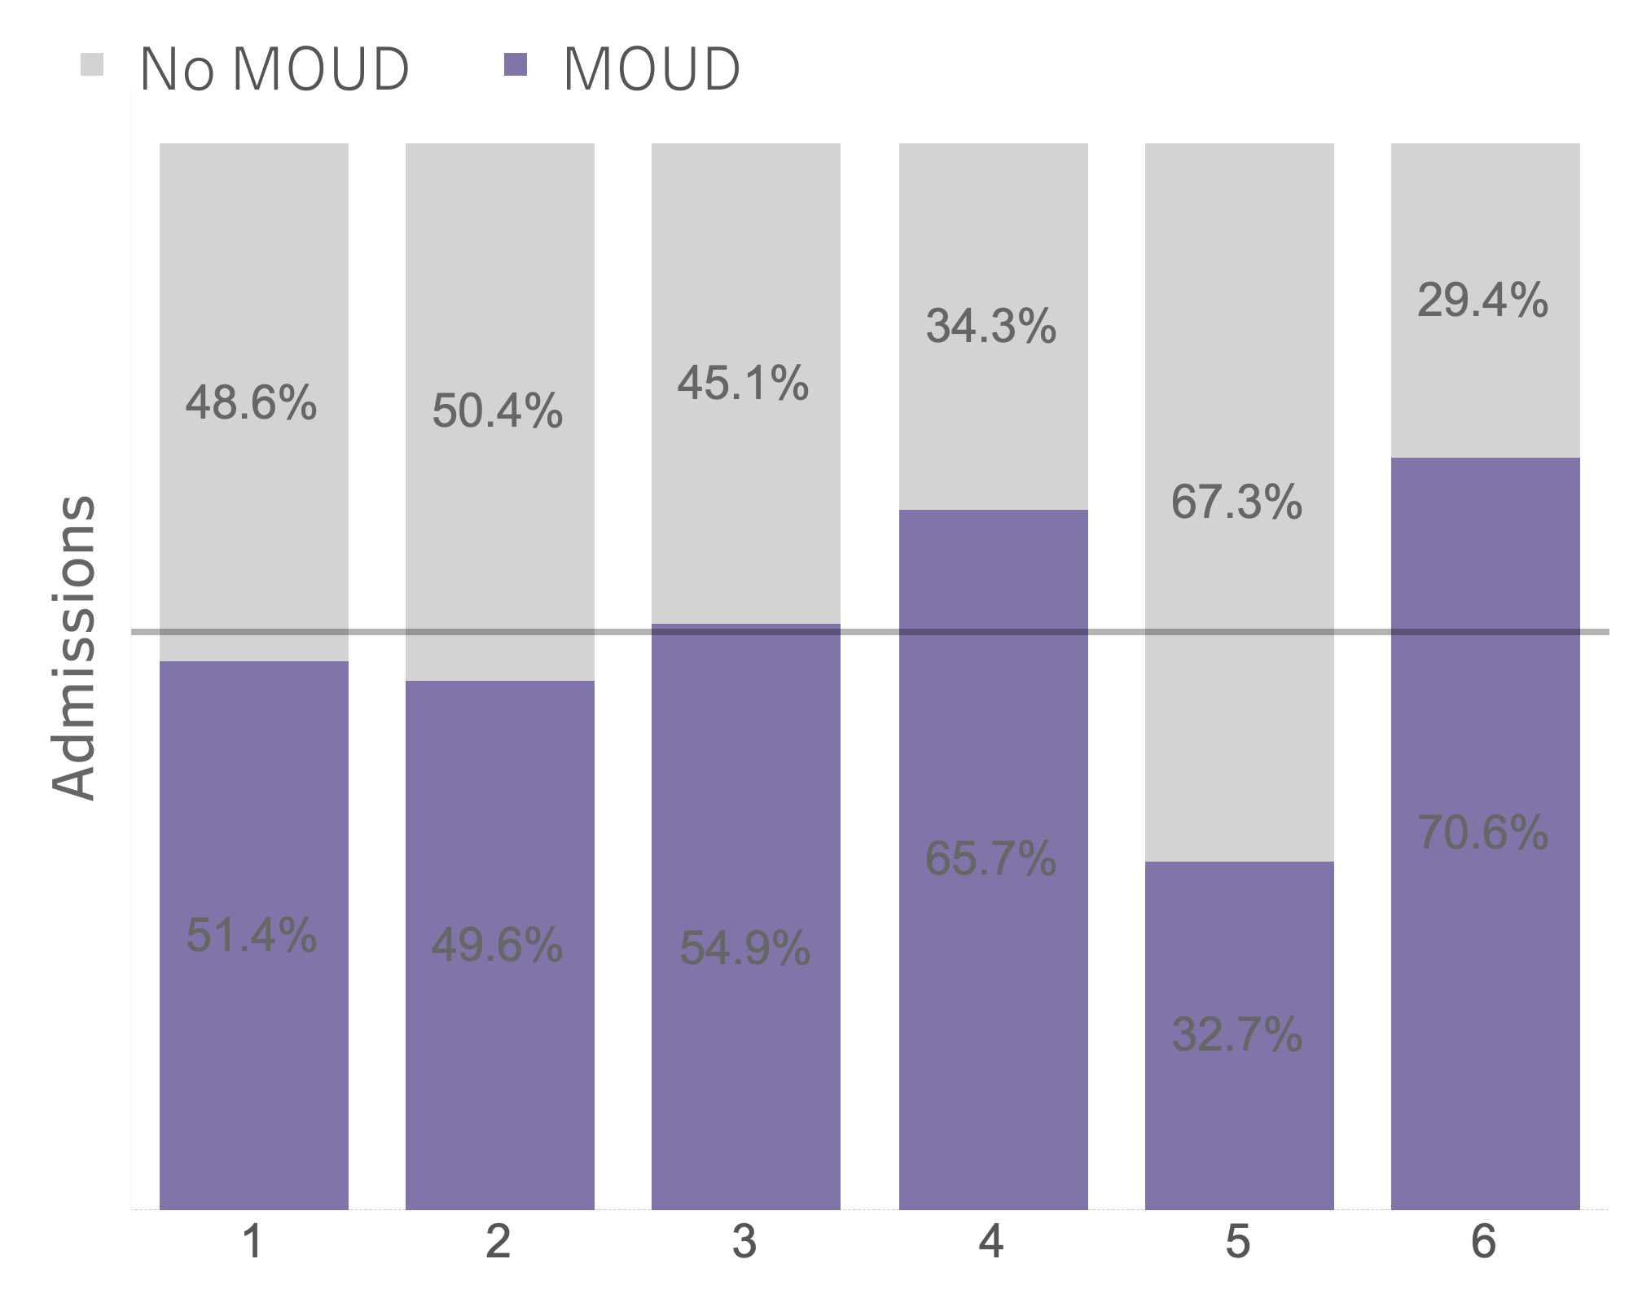
Across all hospitals, 54% received MOUD
66%
51%
33%
71%
50%
55%
P<0.001
Notes:
-All patients, irrespective of CATCH consult; 54.2% received MOUD
-Majority of MOUD was methadone (77%), 22% bupe
-CATCH consults also varied across hospitals
- ranging from 33% of patients to 58% of patients
-Hospital 5 -fewest consults, also least patients with MOUD

Slide 9
75% of patients with CATCH Consult received MOUD
P<0.001

Slide 10
Limitations
Problem list does not differentiate between active and historical diagnoses
Those with a CATCH consult may be more likely to have an active OUD diagnosis (and therefore require MOUD)
MOUD defined as 1 or more doses
No measure of appropriate dose, duration
Ethnicity data is inaccurate/not captured
No comparison between Hispanic/Latinx

Slide 11
Key Take-Aways
Addiction consultation services (ACS) may increase MOUD uptake among patients admitted with opioid-related diagnoses
MOUD treatment may still vary across hospital, despite presence of ACS
System-level and provider-level barriers need to be explored and addressed
Notes:
Addiction consultation services may increase MOUD uptake among patients admitted with opioid-related diagnoses
MOUD treatment may still vary across hospital
- especially if an addiction consult isn’t completed for that patient
System-level and provider-level barriers need to be explored and addressed –goal to understand how decision to order consult, MOUD etc. is made
- among med/surg providers who call the ACS
- among CATCH providers

Slide 12
Acknowledgements
Medha Mazumdar, MS, NYU Grossman School of Medicine
Noa Appleton, MPH, NYU Grossman School of Medicine
Jasmine Fernando, MPharm, NYU Grossman School of Medicine
Johanna Dolle, MPA, NYC Health + Hospitals
Caroline Cooke, MPH, NYC Health + Hospitals
Roopa Kalyanaraman Marcello, MPH, NYC Health + Hospitals
Charles T. Barron, MD, NYC Health + Hospitals
Jennifer McNeely, MD, MS, NYU Grossman School of Medicine
NYC Health + Hospitals CATCH teams
Funder –NIH/NIDA R01DA045669

