Slide 1
Bridge Clinic Management of Benzodiazepine Use Disorder: Intensive Outpatient Benzodiazepine Tapers
AMERSA 2022 Conference
Jordana Laks, MD MPH, Section of General Internal Medicine, Boston University
Collaborators: Theresa W. Kim MD, James Evans RN, Jessica Kehoe NP, Morgan Younkin MD, MPH, Jessica L. Taylor MD

Slide 2
Disclosures
No conflicts of interest to disclose.

Slide 3
Benzodiazepines: Risks and Rewards
Activate the GABA receptor → anxiolytic and hypnotic effects
Regular use for 2-4 weeks can cause physiologic dependence
Rarely misused alone
High risk of overdose when combined with opioids and other sedating meds
Soyka NEJM 2017; Votaw et al. DAD 2019
Notes:
I want to ground this talk in thinking about why people use benzodiazepines:
Benzodiazepines activate the GABA receptor, reducing anxiety and causing sedation. Effective for anxiety in the moment! However.. Regular use for only a few weeks causes physiologic dependence
Benzos are rarely misused alone- usually cooccur with other SUDs
People who use benzos are at particularly high risk of overdose when combining them with opioids or other sedating medications

Slide 4
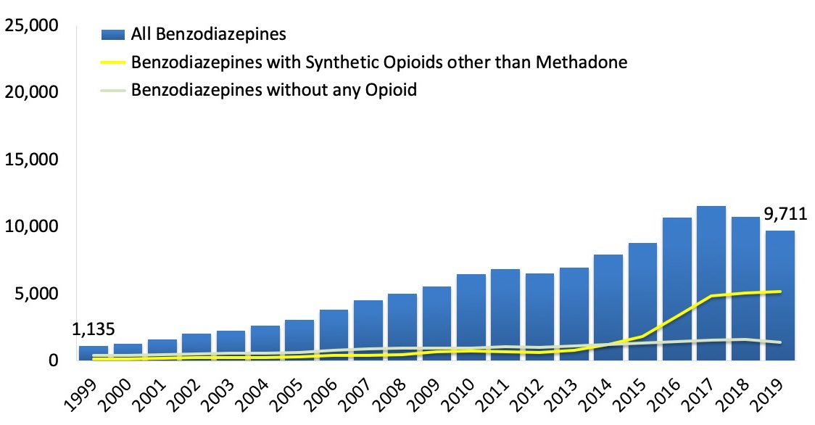
Benzodiazepine overdose deaths increased from 2012-2017, driven by benzo and synthetic opioid co-involved overdoses
Benzodiazepine-involved overdose deaths increased in Black individuals and decreased in non-Hispanic white population from 2017 to 2019 (Kleinman & Weiss JGIM 2022)
Source: CDC WONDER database
Notes:
Benzodiazepine overdose mortality rose from 2012 to 2017, then stayed fairly stable through 2019. As you can see, the rise in overdose deaths was driven by a combination of benzodiazepines and synthetic opioids (meaning fentanyl and fentanyl analogs)
While benzodiazepine use has always been more common among non-Hispanic white people, this is a growing cause of death in the Black population. From 2017-2019, Benzo-involved overdose deaths increased in Black individuals but decreased in the non Hispanic white population.

Slide 5
Pressed pills complicate management of benzodiazepine use disorder
Drug supply is flooded with counterfeit pills containing non-FDA approved benzodiazepines and fentanyl analogs
Drug checking study in British Columbia, 2017-2020: among 139 samples sold as alprazolam, 24% contained alprazolam; 72% contained a benzo
Other agents: etizolam, flubromazolam, amantadine, synthetic cannabinoids, antihistamines, caffeine, fentanyl, others!
Tobias et al. DAD 2021
Notes:
Managing benzodiazepine use disorder and withdrawal is complicated by the use of pressed pills, counterfeit pills that contain non-FDA approved benzodiazepines, fentanyl, and other active cuts. Makes it difficult to estimate what someone is actually taking
In one study in British Columbia between 2017-2020, among 139 drug samples expected to be alprazolam, only 24% contained alprazolam and 72% tested positive for benzodiazepines. These included novel benzodiazepines like etizolam, flubromazolam, as well as all these other active agents – not just fentanyl but amantadine, synthetic cannabinoids, and others

Slide 6
Existing options for treating benzo use disorder and withdrawal are lacking
Inpatient medically managed benzo withdrawal (5-7 days)
Extended taper (> 1 month) with outpatient PCP or psychiatrist
Challenges:
Lack of regular outpatient prescriber
Other SUD and co-occurring mental health disorders
Housing insecurity, transportation barriers, lack of phone
Notes:
Currently, options for managing benzodiazepine withdrawal are typically: short-term inpatient tapers, or an extended taper from a regular provider.
There is evidence supporting greater longer gradual tapers, as especially use of longer-acting benzodiazepines can have protracted withdrawal syndromes lasting weeks to months. Relapse is common after short inpatient tapers.
-However: many patients using nonprescribed benzos do not have a regular prescriber willing to do such a taper.
-Other substance use disorders and co-occurring mental health disorders can interfere with tapering
-As well, housing insecurity, transportation barriers, lack of phone for follow-up 🡪 all make it difficult to complete outpatient taper

Slide 7
Study Objectives
Describe the development of an intensive outpatient protocol to treat benzodiazepine withdrawal for persons with benzodiazepine use disorder in an addiction bridge clinic
Describe preliminary outcomes of the pilot protocol
Why implement this in a bridge clinic?
Notes:
Starting in April 2021, we developed a pilot protocol of benzodiazepine tapers to treat benzo withdrawal within Faster Paths, Boston Medical Center's low-barrier bridge clinic. OUr objectives in this project are to:
Describe the development of a protocol for treating benzodiazepine withdrawal for persons with benzodiazepine use disorder in an addiction bridge clinic
Describe preliminary outcomes of the pilot protocol
In the first year: implemented the protocol, learned from challenges, gathered feedback, and also collected data on some preliminary outcomes that we will present. Adapted the protocol based on this

Slide 8
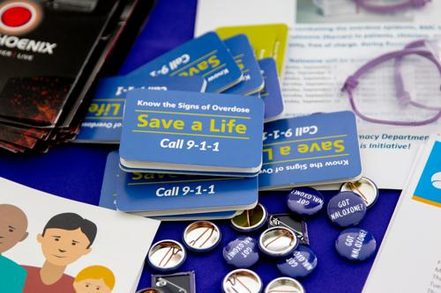
Setting: Faster Paths to Treatment
Low-barrier addiction bridge clinic located within Boston Medical Center, safety net hospital
Offers same-day access to medications for substance use disorders, harm reduction services, and infection screening and prevention
Nurse care manager anchor with rotating providers
Patient population with high rates of homelessness and polysubstance use

Slide 9
Eligibility
Inclusion criteria:
Diagnosis of benzodiazepine use disorder with current benzo withdrawal
Shared treatment goal of stopping benzo use
Willing to present to Faster Paths daily
Willing to abstain from alcohol and non-prescribed benzos
Symptom capture (CIWA<10) on max diazepam 40 mg in first 24 hours
Baseline urine drug test documenting benzo use
For patients with OUD, taking MOUD for at least 1 week before starting taper
Exclusion criteria:
Current benzodiazepine prescriber, concurrent alcohol withdrawal, unable to do daily visits
*Protocol adaptations starting May 2022
Notes:
Now we will go through our actual protocol – as well as adaptations (in blue) we made about 1 year into the protocol based on challenges we discussed and feedback from clinic staff
Patient population with very high rates of ongoing opioid use, stimulant use.
Review inclusion criteria and exclusion criteria
Added baseline urine testing documenting benzo use – after initiating taper for a patient who was not actually experiencing benzo withdrawal.

Slide 10
Benzo taper protocol
First visit: assess eligibility, gather history; set expectations, baseline urine toxicology and benzo gas chromatography (GC-MS)
Determine total daily benzo use and convert to diazepam equivalent (max 40 mg in first 24 hours)
Days 1-3: daily in-person visits with CIWA assessment
Administer in-clinic diazepam 10-20 mg for CIWA 10-20
Evaluate patients at least twice on day 1, reassess after diazepam administered to ensure symptom capture
Refer patients with CIWA>20 to inpatient level of care
Sources used for protocol: Soyka NEJM 2017;; VA National Center for PTSD 2015
Notes:
Recognizing the potential risk of overreporting, as well as difficulty estimating total daily benzo use due to variable consumption and use of counterfeit pills containing unknown substances we set 40 mg as the maximum total dose in first 24 hours
We adapted the protocol to require two assessments on day 1 to assess response to diazepam administered in clinic

Slide 11
Benzo taper protocol (continued)
5. Prescribe diazepam to pharmacy to cover next 24 hours
6. Once stabilized, reduce total daily dose by ~20% every 5-7 days
7. Repeat urine drug testing with benzo GC-MS at least weekly
Days​ | Total Daily Dose​
1-5​ | Diazepam 30 mg daily​
6-10​ | Diazepam 20 mg daily​
11-15​ | Diazepam 15 mg daily​
16-21​ | Diazepam 10 mg daily​
22-28​ | Diazepam 5 mg daily​

Slide 12
Preliminary outcomes: patients treated from April 2021-March 2022
49 unique patients (44% female, 88% non-Hispanic White; 5 Hispanic patients, one Black/African-American)
Lower proportions of Black and Hispanic patients than the overall clinic population
9 patients completed taper
Stopped attending visits (n=30)
49 unique patients
40 patients did not complete
Referred to higher level of care (n=9)
Decided to stop taper (n=1)
Notes:
We looked at the patients treated with an outpatient benzo taper in FP during the first year of implementing the protocol
Only looked at basic demographic data, taper completion, and disposition- what happened at the end of the taper.
Low taper completion, only 18% tapered down to diazepam 10mg or less. Take away from this is not that this does not work; we were not selecting the right patients for this treatment.
patients who did not want to stop using benzos, were looking for easy access to benzos. Also patients who were not able to participate in daily visit requirement due to other barriers: unstable substance use (e.g. those with untreated OUD), homelessness (although some people experiencing homelessness able to make daily visits)
Mean taper duration 39 days in those who completed. Take-away: those who completed taper had the stabilizing factor of extended period of follow-up in Faster Paths, daily visits (at least for period in the beginning), with notable benefits –e.g. HIV/STI testing, bridge to psych and primary care.

Slide 13
Primary outcome: Taper completion
18% (n=9) completed the taper​ (down to diazepam 10 mg/day or less)
Among those who completed, median taper duration was 39 days (IQR 23-42 days)
Why did people stop coming? Possibilities:
Too demanding: high-barrier protocol in a low-barrier clinic
Continued non-prescribed benzo use
Other substance use (opioids, stimulants)

Slide 14
“I’m here for my 40 and 40”
Implementation challenges:
Reputation for “easy benzos”
Distinguishing opioid and benzo withdrawal in patients with OUD starting medications for OUD
Selecting appropriate patients (have benzo withdrawal, want to stop)
Whether to exclude people with uncontrolled opioid or stimulant use
Ambivalence about cessation due to benefits of benzodiazepines for untreated anxiety disorders and trauma
Notes:
Challenges in implementing benzo protocol:
I’m here for my 40 and 40 – refers to 40 of diazepam, 40 of methadone. Implemented at the same time as we were rolling out 72 hour methadone and linkage to OTPs! Word of mouth spread about what we were offering
Became essential to select appropriate patients for the taper: First confirming someone is actually using benzos, particularly in an area with high prevalence of counterfeit pills that contain fentanyl. Unable to confirm exactly what they are consuming, if they actually are experiencing benzo withdrawal.
Want to stop use (vs access to prescribed benzos)
Also started methadone for opioid withdrawal with linkage to OTP at this time. Getting patients who had concurrent opioid and benzo withdrawal– difficult to distinguish withdrawal syndromes, titrating doses of methadone and diazepam simultaneously.
Ambivalence about wanting to stop is common – as we collect more data, looks like most patients who go through this protocol report being prescribed benzos for anxiety disorders in the past. We care for a highly traumatized population with high prevalence of street homelessness – patients can find benzos effective both for self-managing anxiety and numbing the daily traumas of homelessness and criminalization of drug use
he challenges was whether to add uncontrolled opioid or stimulant use disorder as an exclusion criteria -
Reasons to have this as exclusion criteria - risk of fentanyl + benzo regarding benzos, difficulty with overlapping withdrawal syndromes for opioids and benzos)

Slide 15
Take-home points
Treating benzodiazepine withdrawal with an intensive outpatient taper is feasible, beneficial for select patients, and fills a major treatment gap
In the first year of the pilot protocol, 18% of patients completed the taper -- low percentage but potential strong benefit
Research on patient outcomes and experience is needed to optimize eligibility criteria, achieve equitable access, and guide longer-term treatment of benzodiazepine use disorder
Notes:
Relatively low percentage of patients completing the taper, but could be a major benefit to those individuals well suited to the taper.
Limitation – lack of long term outcomes, return to benzo use.
We really need research guiding longer term treatment of benzodiazepine use disorder (eg would these patients do better on a low-dose benzodiazepine for anxiety disorder, closely managed by a psychiatrist or addiction specialist? Vs non-benzodiazepine treatments

Slide 16
Bridge Clinic Management of Benzodiazepine Use Disorder: Intensive Outpatient Benzo Tapers
Thank you to the Faster Paths Clinic Team!
Collaborators: Theresa W. Kim MD, James Evans RN, Jessica Kehoe NP, Morgan Younkin MD, MPH, Jessica L. Taylor MD

