Slide 1


Adapting a Virtual Urgent Care Model to Provide Low-Threshold Buprenorphine Transitional Care: Feasibility and Early Outcomes
Maggie Lowenstein, MD, MPhil, MSHP
AMERSA Annual Meeting
November 10, 2022
Notes:
Hi, I’m Maggie Lowenstein, assistant professor at Penn in general internal medicine and with the penn CAMP
Excited to share out team’s work titled:
Adapting a Virtual Urgent Care Model to Provide Low-Threshold Buprenorphine Transitional Care: Feasibility and Early Outcomes

Slide 2
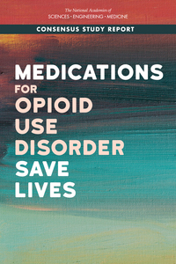
MOUDs Improve Outcomes But Many Barriers
Opioid agonist therapy reduces all-cause and overdose mortality
Shorter wait times associated with higher retention in many settings
Barriers to rapid treatment access
NASEM, 2019; D’Onofrio 2015; Hadland 2018; Jakubowski 2020; Roy 2021
Notes:
is aware, MOUDs improve outcomes for patients including reducing overdose and all-cause mortality
We have also seen in a number of studies across settings that shorter wait times for medication are associated with treatment retention
But flexible models for rapid medication access are not available in many places and we see ineuquitable distribution of OUD care

Slide 3

Telehealth for OUD Treatment
COVID-19 Public Health Emergency
      March 16, 2020: DEA allows for telehealth for buprenorphine rx
      March 31, 2020: Video or audio-only allowed
      Waivers still temporary
Notes:
Telehealth has offered an opportunity to change this
As you know, during the PHE we were able to initiate bupe for the first time without an in person visit
Waivers applied initially to video and soon to audio-only visits
These are still not permanent, but creates opportunities for new care delivery models for rapid, flexible access to care.

Slide 4
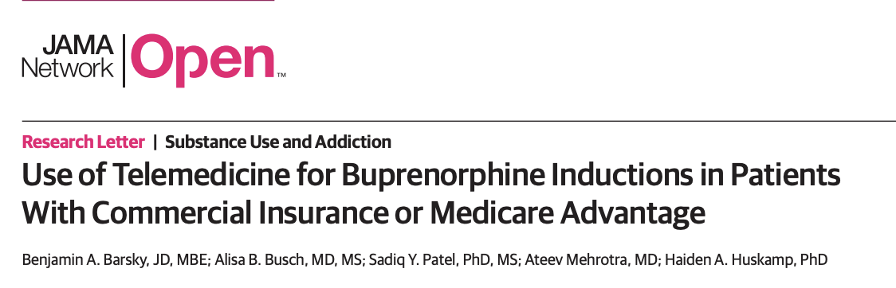
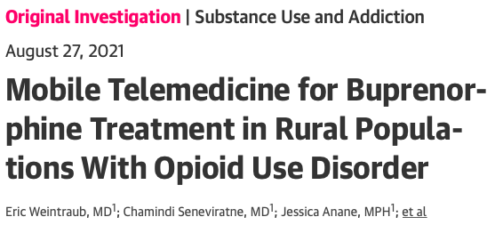
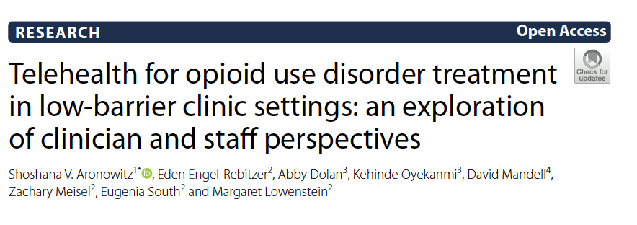
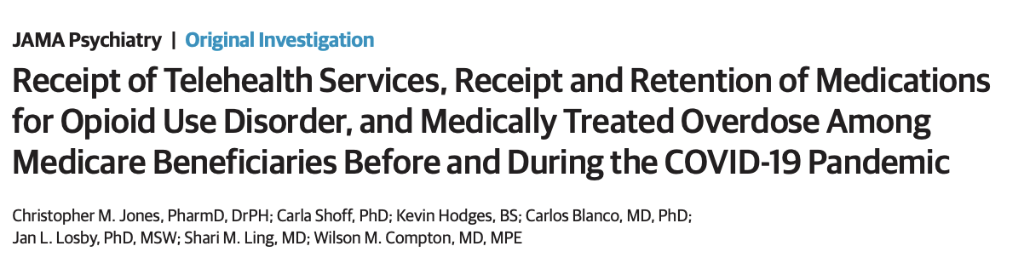
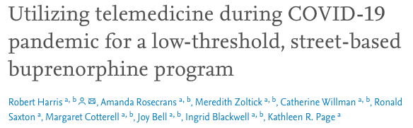
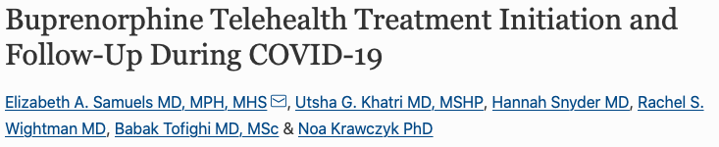
Growing evidence for telehealth modalities
Notes:
ADD a few more
We’re also seeing growing evidence supporting the feasibility and safety of these models and the association of telehealth with improved treatment retention and reduced overdose rates

Slide 5



Aim
Describe implementation and early outcomes from CareConnect virtual bridge program.
Notes:
So in this environment, I’m going to tell you about the virtual bridge model that our team developed in Philadelphia in partnership with our health system and PDPH
Specifically, I’m going to describe implementation and early outcomes from CareConnect, started to increase treatment access in Philadelphia

Slide 6
CareConnect
Challenge:
  Same-day access to OUD care requires infrastructure, staff, flexible care model
Solution:
  Leverage generalist clinicians in virtual urgent care program
  Substance use navigators support clinicians and patients
Notes:
We were doing telehealth care for established clinic pateints, but we wanted to leverage new regulatory flexibilities to allow us to initiate treatment for new patients
BUT doing so at scale required infrastructure for documentation, registration, billing etc ; staff to provide care, and a model nimble enough to accommodate ebbs and flows of patients
While bridge clinics models that many of you may work in or be familiar with help to meet this need, we didn’t have this infrastructure
SOLUTION:
We wanted to work with what had, which was a fully staffed virtual urgent care program that treated all sorts of general medical conditions 24 horus a day and had the infrasturcutre at the ready
We also realized that that additional support would be necessary to navigate barriers and support linkage and follow-up, so we hired SUNs to support both the patients and the clinicians

Slide 7
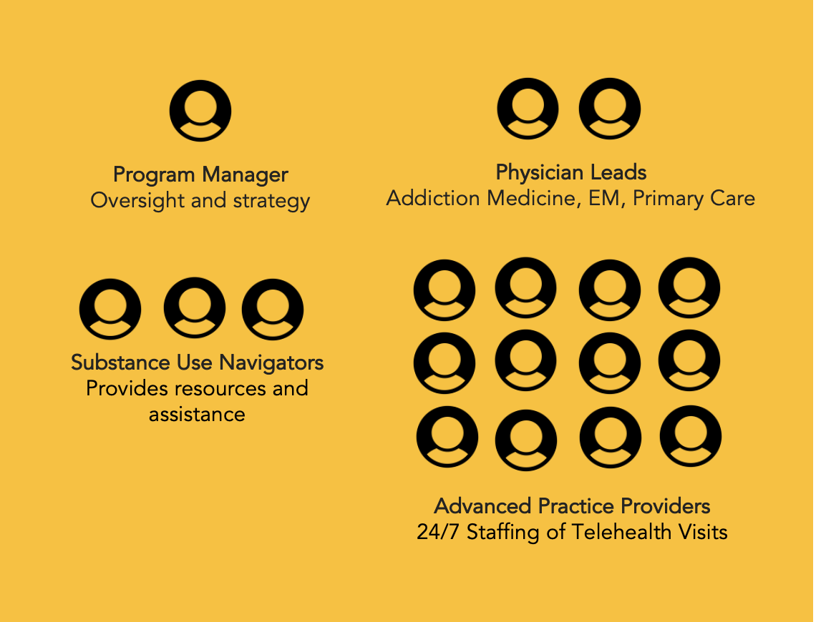
CareConnect Model
Notes:
Here’s what the full team looks like
We worked with leadership to get 14 generalist providers (APPs and MD) X-waivered. Provided 2 hours of focused training and ongoing support from SUNs and addiction medicine leadership.
SUN – program manager, peer navigator herself, led multiple initiatives in our health system and trained and recruited additional SUNs with lived ecpeirence or CM backgrounds
3 SUNs staff the line 9am-9pm
Referrals from community and academic partners
Visits are billable
Funding for SUNs and uninsured comes from health dept

Slide 8






Getting the word out

Slide 9
Workflow
Notes:
Typical visit looks like this
Work is supported by SUNs who answer the phone, assist with triage, support clinicians and patients, and facilitate linkage to longitudinal care.
If rx is needed, connected to clinician for telehealth visit and bupe rx
Suns also provide care linkage, short term CM (ID, benefits, etc)

Slide 10
Methods
Retrospective chart review Nov 2021-Sept 2022
Collected patient characteristics at intake and outcomes from treatment encounters
30-day follow-up using the state PMP
Notes:
To evaluate our model, we conducted retrospective chart review of the first 10 months of data
Pulled patient characteristics, clinical care from HER
30-day f/u from PDMP

Slide 11
Growth
371 Total Encounters
122 Non-Prescription Calls
249 Prescription Encounters
Notes:
Soft launch Nov 2021, full launch Jan 2022
First 10 months fielded nearly 400 encounters
122 non-rx
249 rx
Steady growth each month

Slide 12
Non-Prescription Calls (n=122)
Patients and Families (55%)
Providers (45%)
Recovery support
Harm reduction resources
Start methadone
Inpatient treatment
Many other requests
Questions about resources
Patient referrals
Help making follow-up
Notes:
Of the non-rx calls, about half were from patients or families not needin medication but needing a variety of other supports
Providers called about half the time looking for help with referrals, follow-up and resources

Slide 13
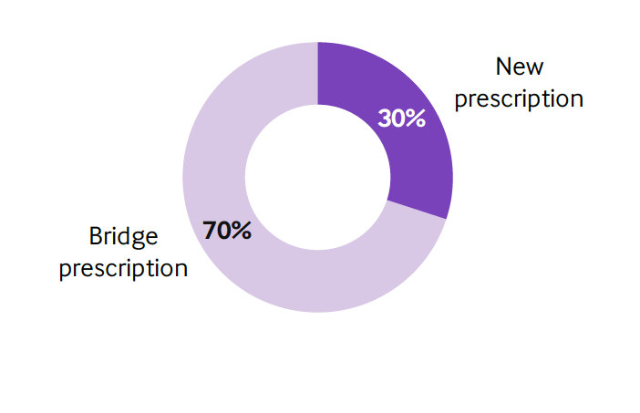
Prescription Encounters (n=249)
Mean Age | 40 yr
Male Gender | 59%
Race
Black | 34%
White | 53%
Other/Unknown | 13%
Hispanic Ethnicity | 23%
Insurance
Medicaid | 76%
Commercial | 7%
Medicare | 4%
Other/None | 13%
Unstable Housing | 20%
Inpatient Rehab within Past 90d | 15%
Release from incarceration in past 30d | 9%
Notes:
Of those who received rx, 70$ were for bridge (indicating patients had a script within last 2 weeks)
- Care transitions (acute care, rehab, jail, loss of provider or insurance)
30% new starts
Of those receiveing meds, largely male, middle-aged, diverse racial and ethnice background, and largely Medicaid or uninsured
About 20% unstable housing
15% recently in inpatient, 9% recent jail

Slide 14
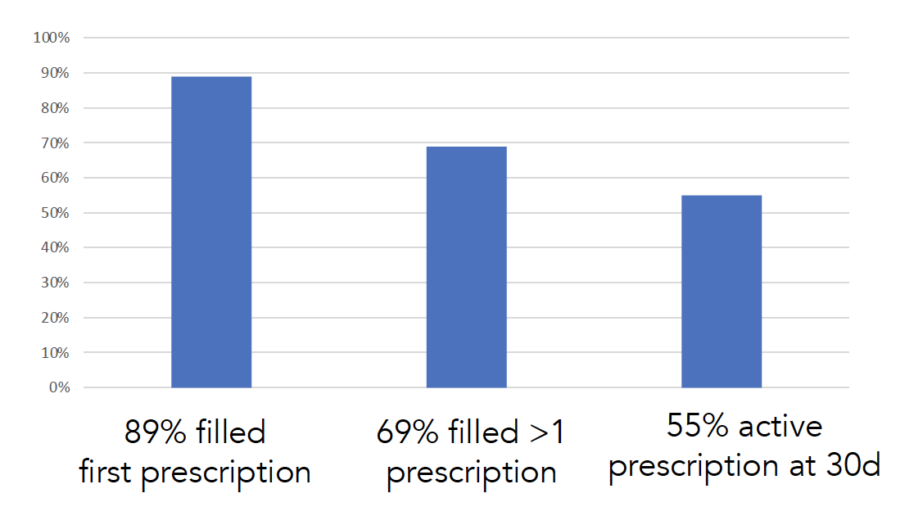
Early Outcomes

Slide 15
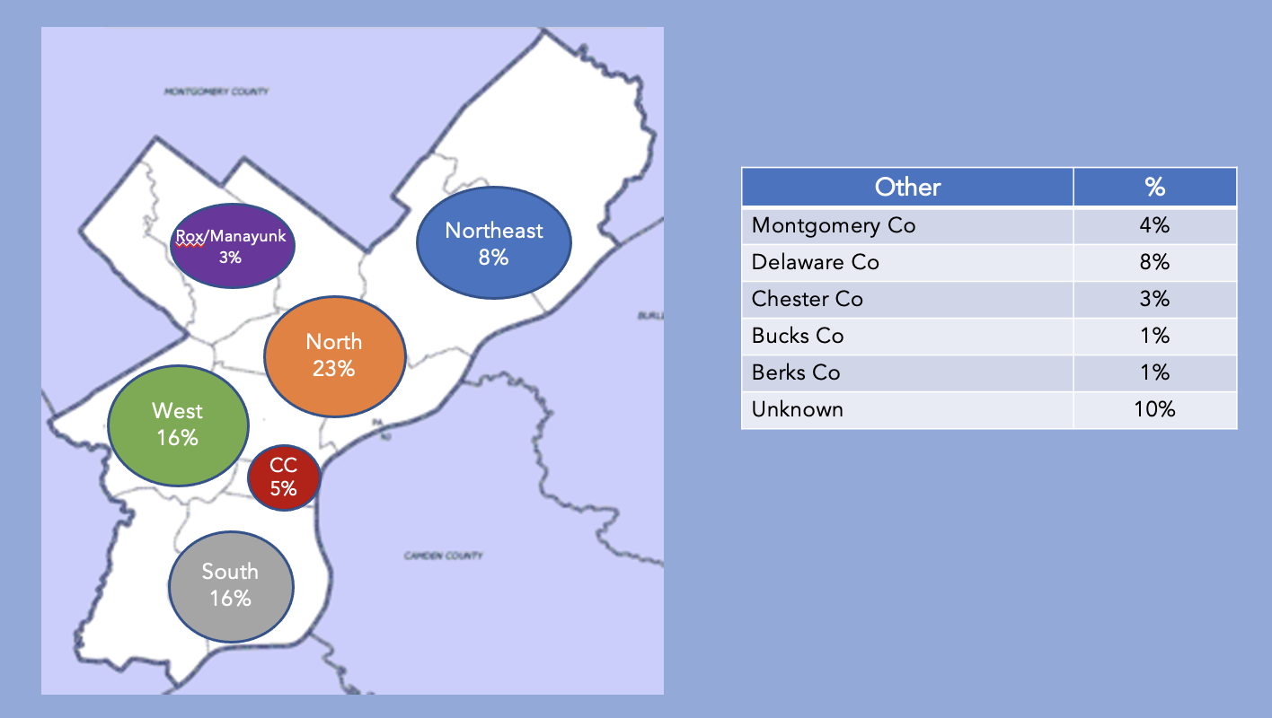
Equity
Access to technology
Diversity of patients
Geographic reach
Notes:
Key issues in equity –
Reaching people with access to a phone, so we’re missing some of the most marginalized
Visits were primarily audio which reduced barriers, Many patients challenged to access via AV modalities and this would be a limiting factor
Reached a cohort of high prevalence of minorities and in neighbohroods across philly that are impacted by OD and have limited services disproportionately impacted by overdose and lower availability of services

Slide 16
Limitations
Descriptive study with no control group
Single program
Limited information about follow-up beyond buprenorphine prescriptions
Notes:
Descriptive study w/o control group
Single program – partner with a culture of innovatin that may not apply everywhere

Slide 17
Conclusions
Telehealth can fill care gaps with flexible, rapid treatment access
Feasible and scalable to integrate buprenorphine bridging services into a virtual urgent care infrastructure
Substance use navigators critical, but these services harder to fund
Room to grow to promote equity
Notes:
Telehealth creates opportunities fill care gaps with flexible, rapid treatment access - We were surprised that most of our rx’s were for bridges rather than new starts – speaks to all the holes in the current treatment system and the places things can go wrong
supports the need for services like this
Our model it was feasible and scalable to integrate bupe bridging services into virtual urgent care staffed by generalist clinicians – this approach may be appealing for places without existing bridge clinic models because it doesn’t require full specialized staff
However, we couldn’t do it without SUN services
But these are harder to fun
Telehealth can advance equity but we need at the very least to preserve audio-only care and look for ways to bring marginazlied groups in – outreach to jails, harm reduction orgs, community orgs is part of future work

Slide 18

Acknowledgements
Penn CAMP
  Nicole O’Donnell, BA, CRS
  Jasmine Barnes, MPH
  Gilly Gehri
  Jeanmarie Perrone, MD
  Kathryn Gallagher, MPH
  Rachel French, PhD, RN
  Brittany Salerno
  Nicole Ellis
  M Holliday-Davis
Funding
  Philadelphia Dept Public Health
  Independence Blue Cross
PMOD
  Susan McGinley MSN, CRNP
  Emily Cubbage
  Krisda Chaiyachati, MD
  Jon Pomeroy, DO, FAMIA
  PMOD Team
November 2022
Notes:
I would like to acknowledge the whole team
Particicularly Nicole o’donnell our program manager and lead SUN, gilly and jasmine our other SUNs and my mentor JP
Collaborators at PMOD and funding from PDPH and IBC
If you want to learn more, this work is coming out next week in NEJM catalyst

Slide 19
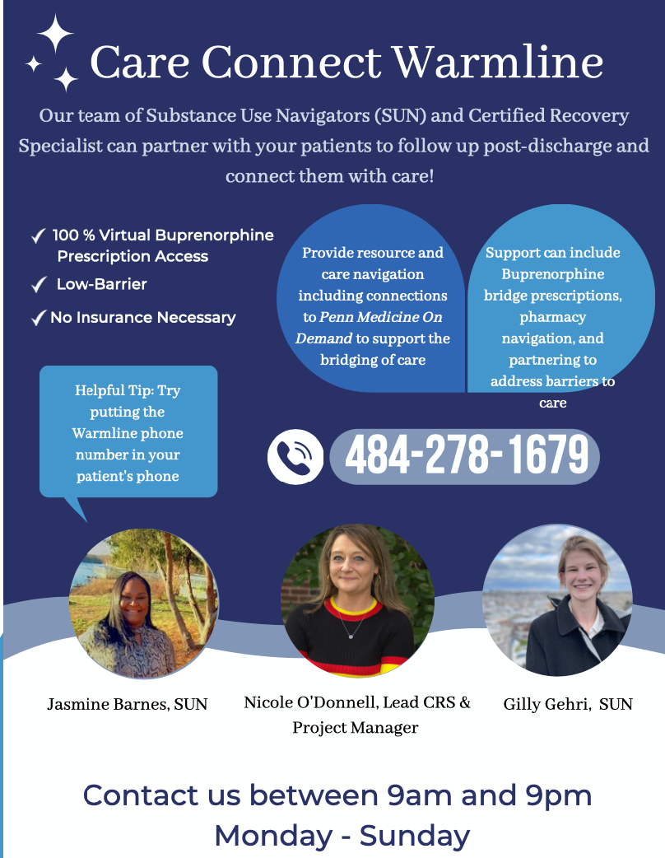

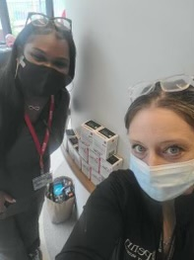
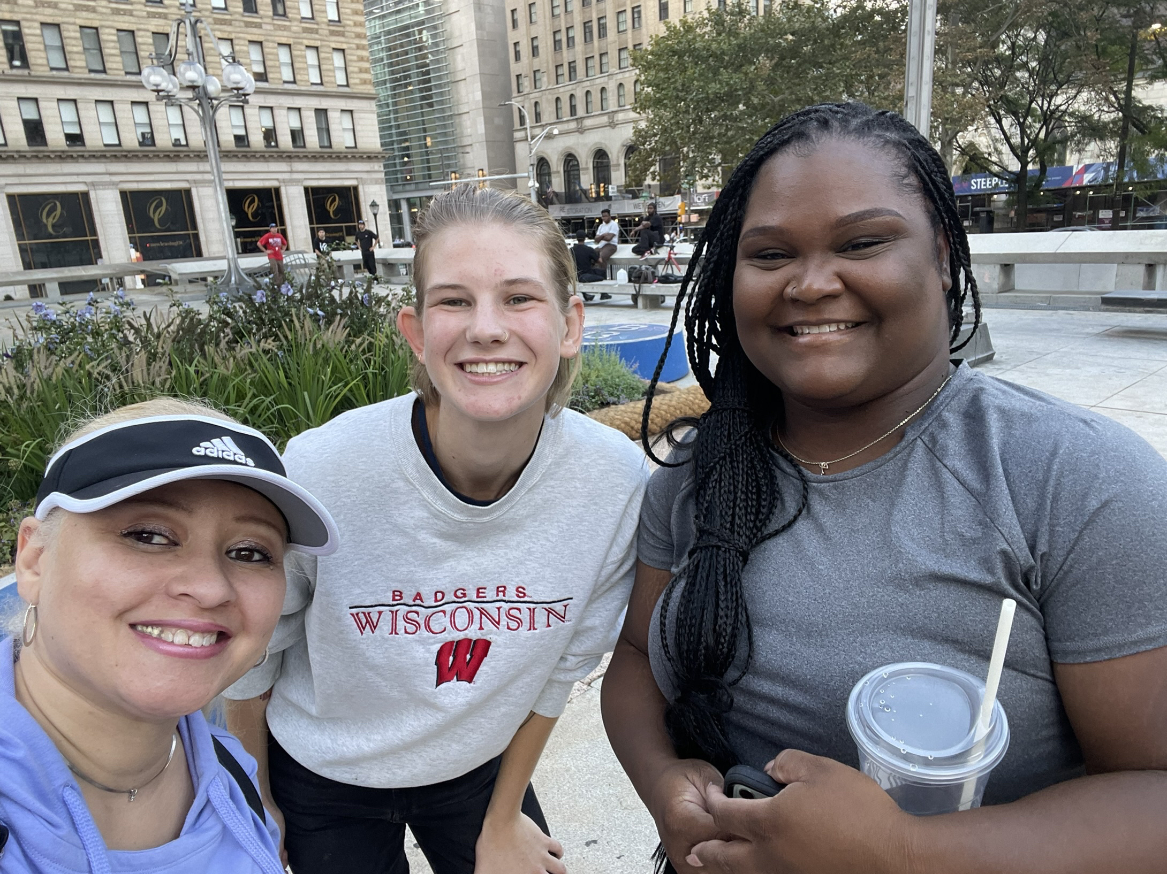
Questions?
margaw@pennmedicine.upenn.edu
@mlowenstein
Notes:
With that, thank you and I would love to take your questions

Slide 20
Training and Implementation
PMOD clinicians obtained X-waiver
2 hours of training from team leadership
Ongoing support from SUNs, feedback, follow-up and support from addiction specialists
Outreach to partners across Philadelphia in health system and community

Slide 21
Patient Locations

Slide 22


How did you hear about CareConnect?
63%
From a health care provider
28%
Word of Mouth

