Slide 1
Implementation of Mirtazapine for Methamphetamine Use Disorder in CA Bridge Emergency Departments A Quality Improvement Project
Amy Liang, Erik Anderson, Arianna Campbell, Andrew Herring

Slide 2
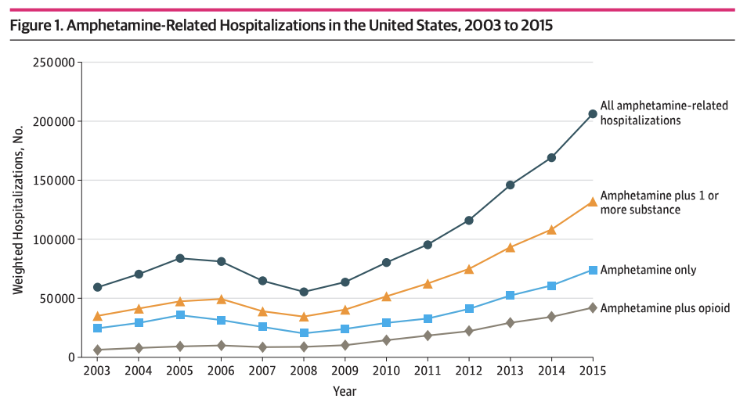
Epidemiology
2.0 million report past-year use (2019)
1.1 million with use d/o (55%)
Increase ~50% 2015-2019
Notes:
Amphetamine related hospitalizations have been increasing between 2003 and 2015, despite a dip between 2005 and 2008, making, pharmacologic and nonpharmacologic therapies for amphetamine use disorders and a coordinated public health response needed to curb these rising rates.

Slide 3
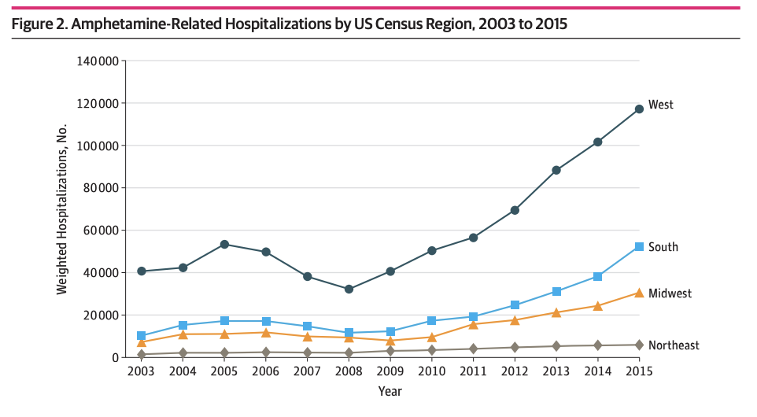
Epidemiology
2.0 million report past-year use (2019)
1.1 million with use d/o (55%)
Increase ~50% 2015-2019
More West Coast
Notes:
When stratified by region of the US, we see a disproportionate amount of amphetamine use on the west coast, that is also rising at a higher rate

Slide 4
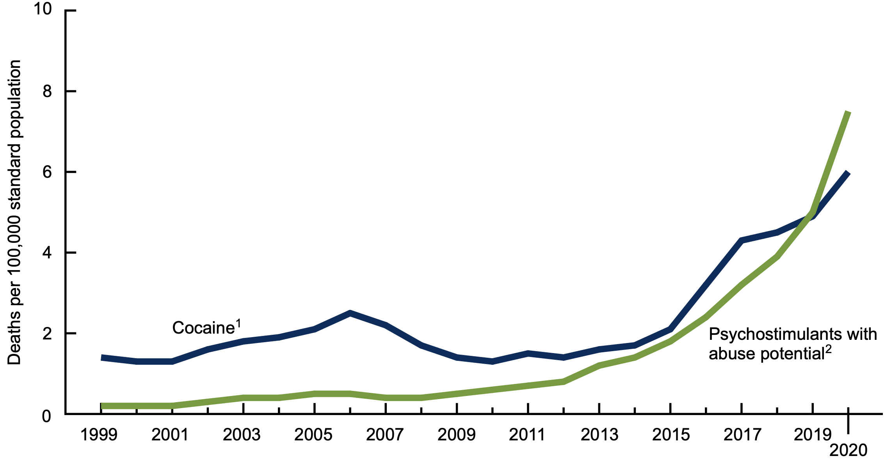
Cause of Death
Cardiac
Cerebrovascular
Traumatic
Opioid overdose
Hedegaard, NCHS Data Brief No. 428, 2021
Notes:
In looking at age-adjusted deaths associated with stimulant use, we see that rates are also increasing. Causes of death cited as cardiac, cerebrovascular, traumatic, and concurrent opioid use leading to overdose

Slide 5
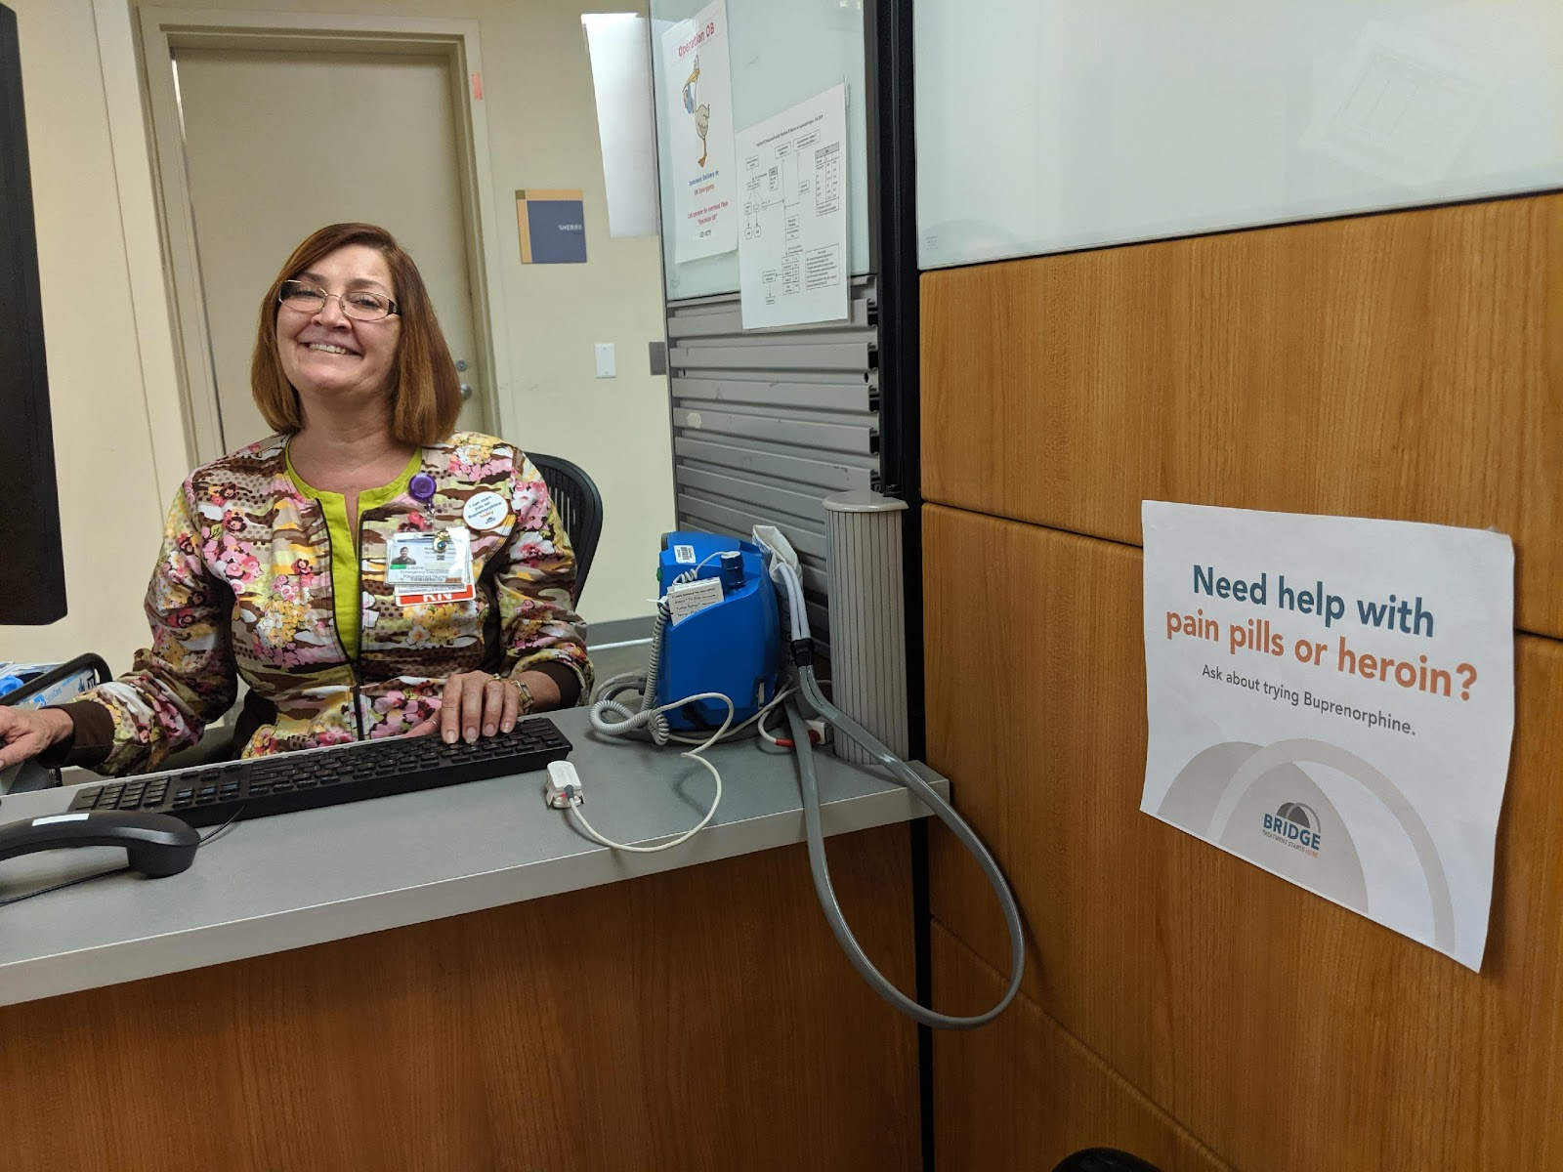
How can EDs improve care for this population?
Notes:
Given this public health need, how can we engage emergency departments in improving care for a growing population of patients using amphetamines?

Slide 6
Background
SBIRT
Rapid adoption of buprenorphine in CA Bridge EDs
Providers frustrated with lack of toolkit for meth
Integration of medications for methamphetamine use disorder could act as a vehicle for intervention
Notes:
As we have heard throughout this conference, brief interventions have efficacy for treatment of substance use disorders in the ED
[CLICK] We’ve seen this through the rapid adoption of bup in EDs participating in the CA bridge program
[CLICK] And overall, many clinicians are frustrated with the lack of a similar toolkit for methamphetamine use. And in hospitals located in areas without the benefit for community/hospital based contingency programs, [CLICK] the integration of medications to treat methamphetamine use disorder could act as a vehicle for ED-based interventions

Slide 7
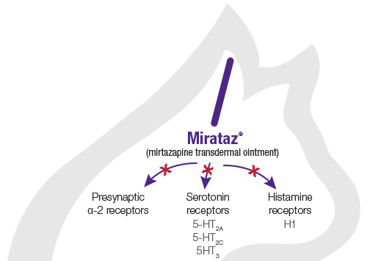
Off-label medications – what could be used in the ED?
Mirtazapine
Psychostimulants
Buproprion
Mirtazapine ( alpha-2 antagonist)
XR-Naltrexone (MOR antagonist)
Notes:
Mirtazapine as an alpha-adrenergic antagonist, a serotonergic antagonist, a histamine antagonist has been shown to have a small but significant effect on reducing methamphetamine use, an effect postulated to be due to reducing depressive symptoms and improving sleep. Reduced methamphetamine use itself has been associated with reduced depressive symptoms, and thus the observed effect on depressive symptoms may be attributable to reduced methamphetamine use or a direct effect of mirtazapine. Methamphetamine
withdrawal has been associated with sleep onset delay, increased nighttime awakenings, and reductions in sleep quality,49 and thus sleep improvements observed in the mirtazapine arm suggest a potential benefit to this medication.

Slide 8
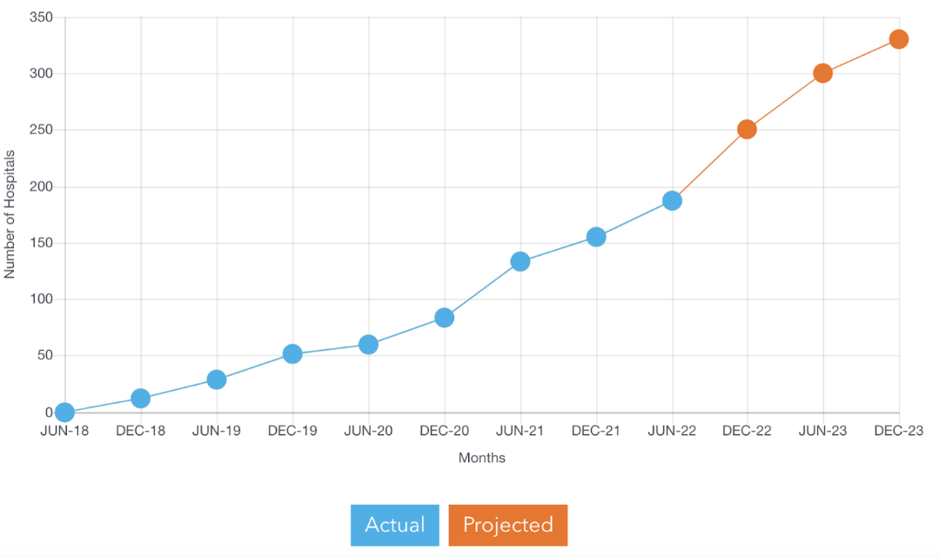
Setting
Notes:
California Bridge Program (CA Bridge) initiated a state wide program that granted funding to hospitals to have a patient navigator (or substance use navigator) and train ED hospital providers in engaging in OUD diagnosis and treatment with buprenorphine

Slide 9
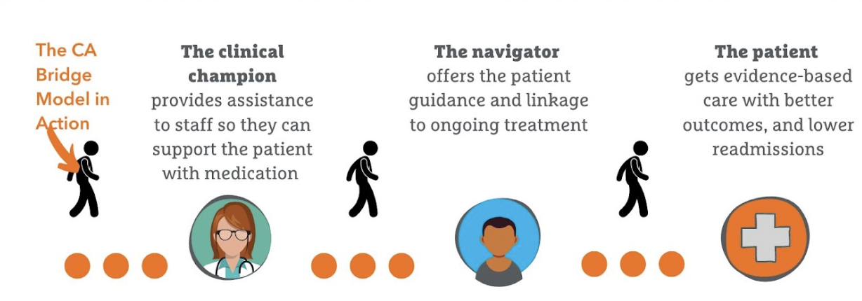
Notes:
This model embodies a system of care that facilitates low-barrier access to treatment. It provides a clinical champion to assist ED staff to support patients with use disorders, including starting medications and connection to community care centers.
This model embraces a culture of harm reduction.
As of the last tally, hospitals participating in this program reported over 58000 ED encouters where MAT was prescribed or administered during the ED visit

Slide 10
6 EDs in CA Weekly champion meetings 1. Brainstorm QI Ideas 2. Discuss barriers/facilitators 3. Track progress
Protocol development
- Brief intervention, screen for med
interactions, offer meds if no
contraindication
- Administer 30mg Mirtaz in ED
- Rx Mirtaz 30mg at night
Notes:
For this protocol, we had 6 EDs in California participating through weekly meetings to champion a protocol for starting the conversation with patients about methamphetamine use, by using mirtazapine as a possible tool to intervene.
[CLICK] with a QI framework and taking into account different barriers and facilitators unique to the ED and surrounding communities, we implemented a brief protocol
[CLICK] Clinician led identification of patients with methamphetamine use disorder was followed by a brief intervention (which was assessment of willingness to try a medication for treatment), screening for potential medication interactions, and offering mirtazapine if no contraindications. The dose we gave was 30mg.

Slide 11
Study Objective
To describe the characteristics and clinical outcomes among ED patients treated with mirtazapine for methamphetamine use disorder at 6 EDs participating in the CA Bridge, Centers of Excellence Program (COE).
Notes:
Our objective was to describe the characteristics and clinical outcomes among patients who received this intervention

Slide 12
Results
Who?
53 patients identified
Most (83%) were men
Age(yrs) was evenly distributed:
20-29 (19%), 30-39 (28%),
40-49 (32%),
≥50 (21%).
Race ethnicity
15% Black/African American,
15% White,
62% Hispanic/Latino,
8% other.
Notes:
53 patients were identified by clinicians during their ED visit

Slide 13
Results
Chief complaint:
32% psychiatric
23% of visits mentioned meth
Mirtazapine
(81%) 30mg dose
(19%) visits at and at a lower 15mg dose
(96%) were provided prescription
Antipsychotic
Most (62%) of patients were also administered an antipsychotic medication
(36%) were also provided a prescription.
Notes:
In terms of presentation chief complaints for their ED visit, many were for psychiatric complaints, and others were extracting during this chart review, from visits that had “methamphetamine use disorder” as a diagnosis or which mentioned methamphetamine in their visit
[click] 81% of patients identified received the 30mg dose of mirtazapine, 19% received a lower dose at 15 mg. 96% received a prescription at discharge
[click] due to the high percentage of patients presenting with concurrent psychiatric complaints, 62% were also administered an antipsychotic medication (mostly olanzapine) during their ED visit and 36% with a prescription for the antipsychotic at discharge

Slide 14
Outcomes
There were no reported adverse events such as excessive sleepiness or agitation worsened by mirtazapine.
At 30 days, (43%) of ED patients initiated on mirtazapine in the ED were engaged in outpatient addiction treatment.
Notes:
There were no reported adverse events during the ED visit – such as excessive sleepiness or agitation that was worsened by administration of mirtazapine
[CLICK] At 30 days, we saw 43% of the patient who were started on mirtazapine in the ED engaged in outpatient treatment
We note that we did not collect data on other side effects of mirtazapine, such as weight gain was not collected or able to be fully assessed with 30 day follow up.

Slide 15
Conclusions
A large diverse group of 6 EDs in California were able to develop and implement a QI project that aimed to initiate medication treatment for methamphetamine use disorder.
Medications may act as a vehicle to nudge providers to counsel and intervene for methamphetamine use
These observations suggest prospective randomized study of ED interventions with mediations for methamphetamine use disorder is warranted.

