Slide 1
Medical Student Experiences and
Perceptions of Substance Use Among
Healthcare Workers
Presenter:
Tabitha Moses (she/hers), MD/PhD Candidate
Department of Psychiatry & Behavioral Neurosciences
Wayne State University School of Medicine
Funding: NIDA F30DA052118 Conflicts of Interest: None
tmoses@med.wayne.edu
@back2brains
Authors: Tabitha E. Moses MS^{1,2}, Taylor Harrison²,
Eva Waineo MD^{1,2}, Mark K. Greenwald PhD^{1,2,3}
1 - Wayne State University School of Medicine
2 - Department of Psychiatry & Behavioral Neurosciences, Wayne State University
3 - Department of Pharmacy Practice, Wayne State University
4 - Department of Internal Medicine, Wayne State University
Notes:
Abstract: https://docs.google.com/document/d/1dhnDr_H50c5k9UiawI6YjtlL9pDf_rw-uvw7l7DzwJo/edit
Hello, I am Tabitha Moses, an MD/PhD candidate at Wayne State.
We have been working to improve the undergraduate medical curriculum surrounding harm reduction and SUDs.
In this study we wanted to explore medical student experiences and perceptions of substance use among healthcare workers and trainees.
Thank you for the opportunity to share our findings and discuss their implications for medical education.

Slide 2
Conflicts of Interest: None
Current Funding:
NIH/NHLBI U01 HL150551 (MKG)
NIH/NIDA F30 DA052118 (TEHM)
NIH/NIDA R34 DA053758 (MKG)
NIH/NIDA R21 DA044946 (MKG)
Notes:
First, we have no COI to declare and here is a list of the current funding associated with the authors.

Slide 3
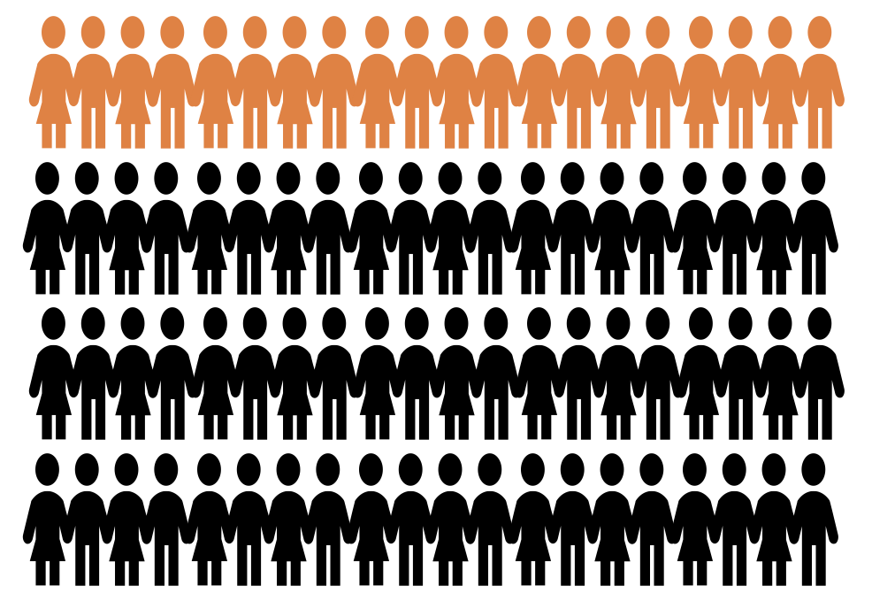
Background
~20%
Past year use of an illegal drug
~70%
Past year use of alcohol
Notes:
For a little background, we know that approximately 20% of US adults report past-year use of an illegal drug, and most report past year alcohol or nicotine use.
These rates of substance use are no different in medical professionals and trainees but often individuals in these fields view themselves differently.

Slide 4
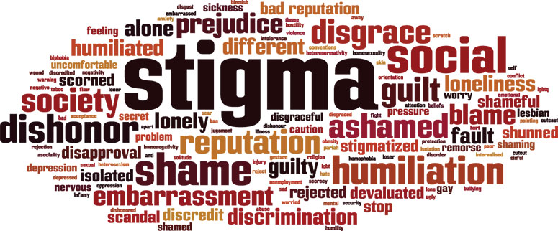
Background
Notes:
This “othering” mentality that is seen by many medical professionals when considering people who use drugs can contribute to significant levels of stigma and bias
Although we know that the majority of those who use drugs do not develop a substance use disorder (SUD) and generally recreational use does not impact professional behavior, drug-use misperceptions can foster stigma and bias both towards patients who use drugs and towards colleagues who may use drugs.
Due to the major harms of this stigma among medical professionals it is vital to improve understanding of substance-use patterns and attitudes among medical trainees that are entering the profession.

Slide 5
Objectives
Examine medical students’ exposure to different types of substance use
Identify medical students’ beliefs surrounding the impacts of substance use and substance use disorders on physicians
Explore students’ responses to potentially impaired physicians and what factors may contribute to these approaches
Notes:
The main objectives of this project were to:
Examine medical students’ exposure to different types of substance use
Identify medical students’ beliefs surrounding the impacts of substance use and substance use disorders on physicians
Explore students’ responses to potentially impaired physicians and what factors may contribute to these approaches

Slide 6
Methods: Measures & Analysis
Substance Use Exposure
Alcohol
Cannabis
Illegal Drugs
“Do you know a medical student or physician who have used these recreationally outside of work?”
Impairment Exposure:
Substance Use Disorder
Gone to work impaired
“Do you know a medical student or physician who has either of the following?”
Impaired Physician Response
Safety of Patient/Physician
Professional Responsibility
Fear of Repercussions
Physician Career Concern
Lack of Knowledge
9 potential responses to impairment, binary yes/no
12 potential reasons, 5 categories, 4-point Likert scale
Data analysis:
SPSS v. 26
T-tests
Chi-square
Conditions Impacting the Practice of Medicine
6 statements, 4-point Likert scale
Notes:
These data were collected as part of a longitudinal study on substance use knowledge and attitudes where students are surveyed annually throughout the medical school training. The data presented here are from the annual survey sent to every student in the class of 2024 at the start of third year of medical school (M3).
This survey included general demographics, knowledge of harm reduction, and attitudes plus questions about:
Exposure to substance use in medical students and physicians
Exposure to impaired physicians
How they would respond to seeing an impaired physician and what factors impacted those responses
And their views about certain medical conditions and how they might impact medical practice
We used SPSS v26 data analysis we and t-tests of chi-squares to compare responses between groups, where relevant.
It is worth noting that although this survey was confidential and it was not fully anonymous so we never explicitly asked about their own personal substance use, only about the use of others.

Slide 7
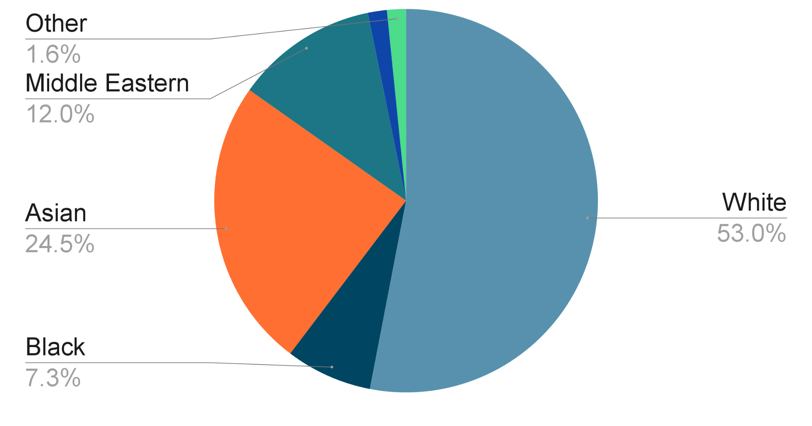
Participant Demographics
290 students started M3
171 students completed survey
Average age: 25.1±2.8 yrs (range: 23-43 yrs)
53.8% identified as female
5.3% Spanish, Hispanic, or Latino
Wayne State University School of Medicine is committed to the promotion of diversity, equity, and inclusion within the student body and university staff. All participants in this study were admitted to WSU SOM for Fall 2020 and represent a variety of cultures and backgrounds at the most diverse medical school in Michigan.
Notes:
Just a quick overview of the sample demographics.
Of the 290 students starting M3, over 2/3s completed the survey.
The average student was a 25 year old white woman although as you can see, other races and ethnicities are represented and our student demographics align with those of the state of Michigan.

Slide 8
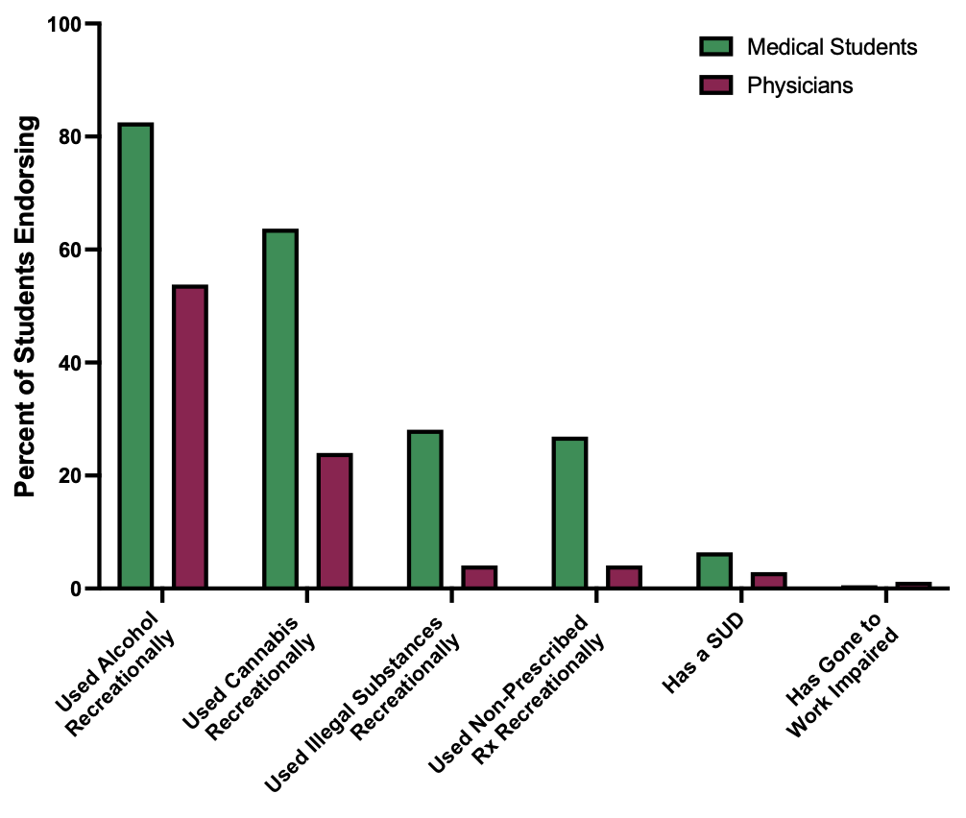
Results:
Substance Use Exposure
Do you know a medical student or physician who has…?
Notes:
The first question we asked was whether they knew a medical student or a physician who had used alcohol, cannabis, or illegal substances recreationally.
Or if they knew anyone who had a SUD or who had gone to work impaired.
This graph shows the % of students endorsing knowing either a medical student (shown in green) or a physician (show in purple) who has used the following…
As you can see, recreational alcohol and cannabis use are both most common but a quarter knew medical students who had used illegal drugs or Rx medications recreationally.
Very few students believed that they knew any other medical student or physician with an SUD or who had gone to work impaired.

Slide 9
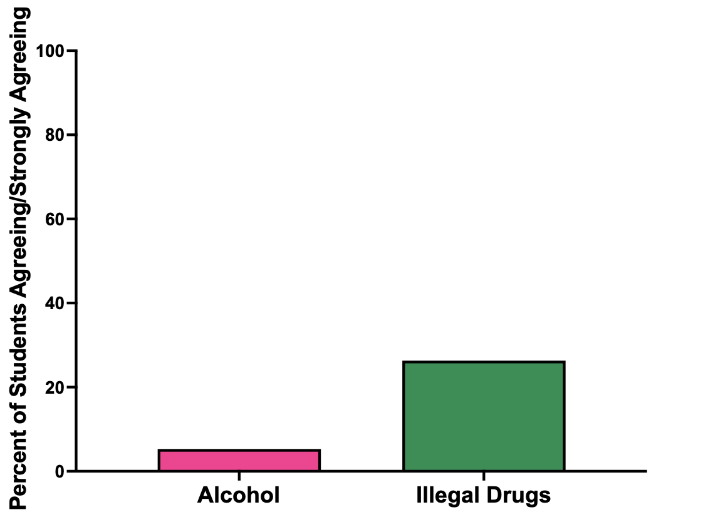
Results:
Physician Impairment
“Physicians who use these substances recreationally outside of work only should no longer be allowed to practice medicine”
Notes:
Next, we wanted to see what students thought about recreational use of different substances.
They were asked how much they agreed with this statement on a 4-point Likert scale.
Graph shows % of students who stated either agree or strongly agree to this statement for alcohol and illegal drugs. Unfortunately, we did not separate cannabis out in this question but we have corrected that for the future.
We had hypothesized that answers to the previous questions (about knowing others who used these drugs) would impact their views on this question.
We did find that knowing someone who drinks alcohol was associated with being less likely to agree with this statement about alcohol
However, knowledge of anyone who used other drugs did not impact responses to these questions.
Stats:
Knowing someone who drinks (previous slide) impacts view of drinking only
Knowing someone who uses cannabis (previous slide) does not impact any of the views
Knowing someone who uses illegal substances (previous slide) impacts view of drinking only

Slide 10
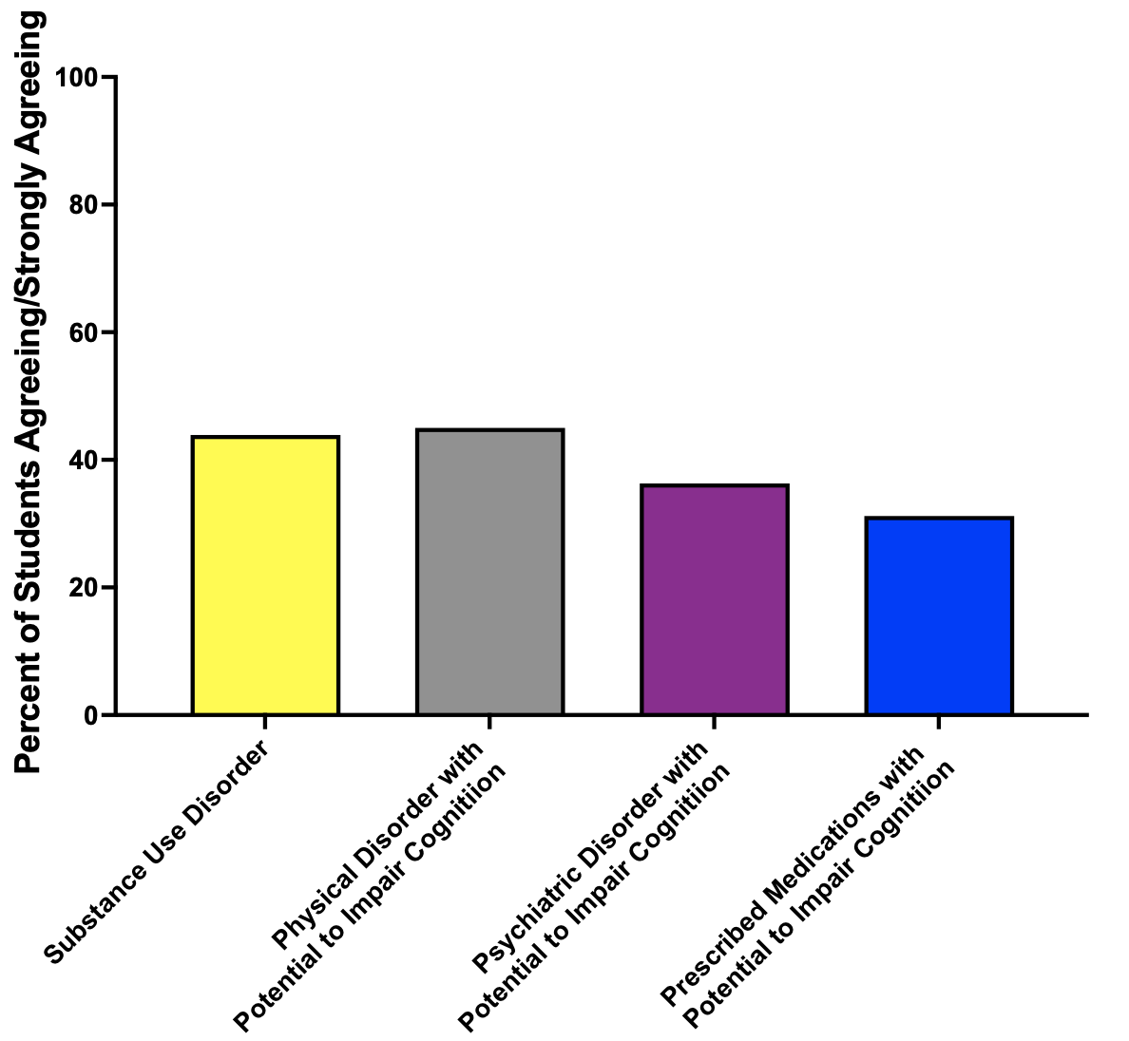
Results:
Physician Impairment
“Physicians with these disorders should permanently be no longer be allowed to practice medicine”
Notes:
Given the social acceptability of alcohol, it is not surprising that most students were okay with physicians who drank outside of work but we also wanted to explore how students viewed physicians with them much stigmatized SUDs.
Students were asked how much they agreed with this statement on a 4-point Likert scale. We found just over 40% of students agreed with this statement about SUDs.
We went on to ask this question about psychiatric and physical disorders and medications that might impact cognition.
We had expected that stigma against SUDs and psychiatric disorders would result in more students agreeing with this statement as it pertained to those disorders compared to physical disorders and medications but we were surprised to find similar responses across all conditions.
This highlights a key area for further exploration and education.

Slide 11
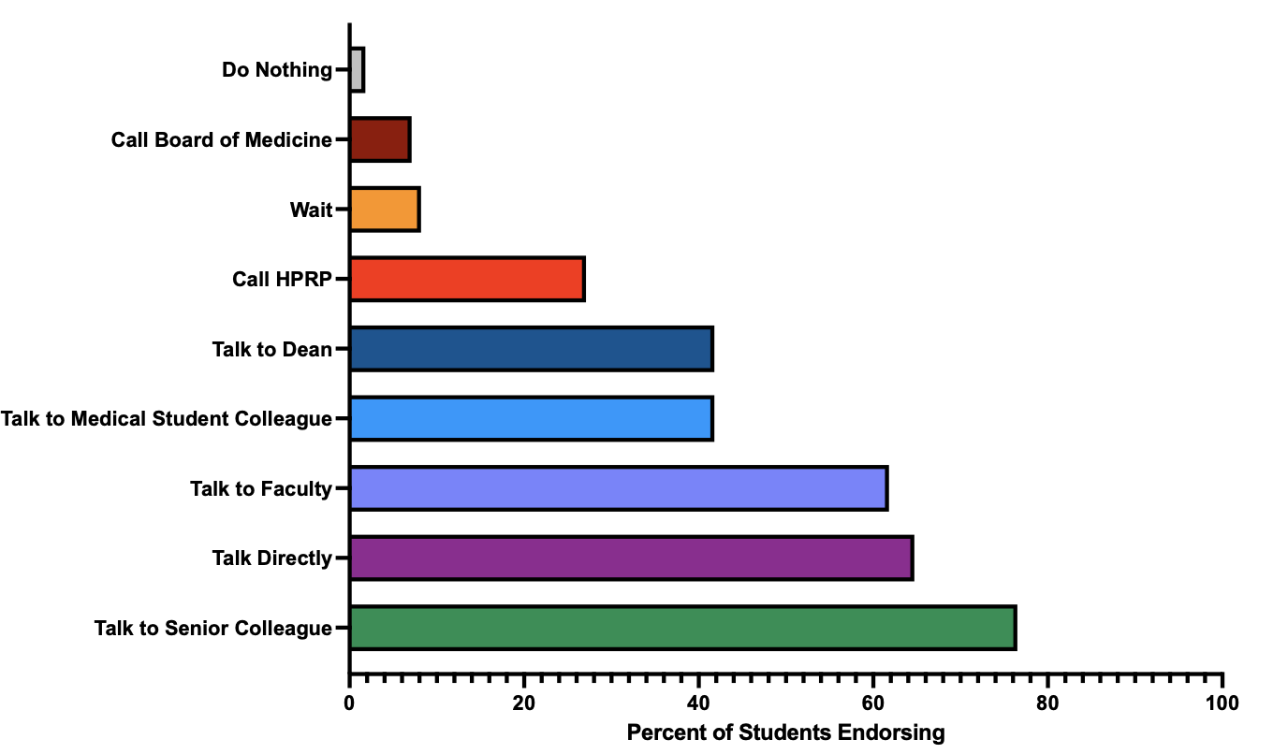
Results:
Response to Impairment
* Students could select “all that applied”
As a medical student, what would you do if
you thought you noticed an impaired physician?
Notes:
Finally, we asked students what they would do if they noticed an impaired physician?
They were given 9 different options and asked to select all that applied.
As you can see, very few would do nothing and most would talk to a senior colleague of faculty member about their concerns.
They were then asked to indicate how much 12 different of factors impacted their choices. These factors fell into 5 categories and we will go over each very briefly on the next few slides.
Safety of Patient/Physician
Professional Responsibility
Fear of Repercussions
Physician Career Concern
Lack of Knowledge

Slide 12
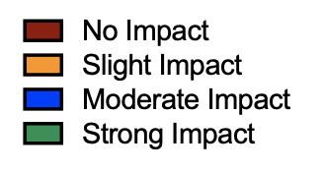
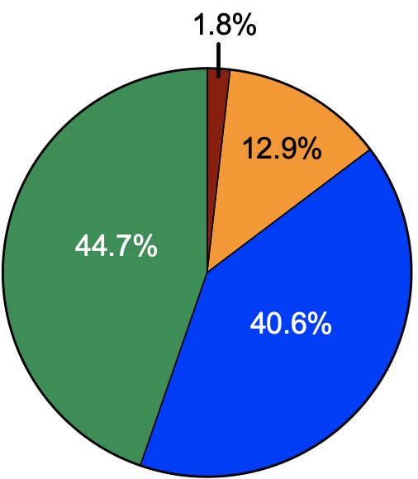
Results:
Safety Concerns
Addressing the impairment will lead to that person getting help
I am concerned about
patient safety
I’m concerned about the health of the physician
Notes:
Each category included 2 or 3 statements and these slides will show a pie chart of the responses to each statement.
Students were asked how much of an impact each item had on their response to the previous question about how they would respond to seeing an impaired physician.
Red meant that it had no impact on their choices, orange that it had a slight impact, blue a moderate impact, and green a strong impact.
We can see here that safety concerns, both for the physician and the patient, played the strongest role in their decisions.

Slide 13
Results:
Professional Responsibility
It is my responsibility
It is my professional obligation
Notes:
The next most important factor in their response was their sense of professional obligation or personal responsibility.

Slide 14
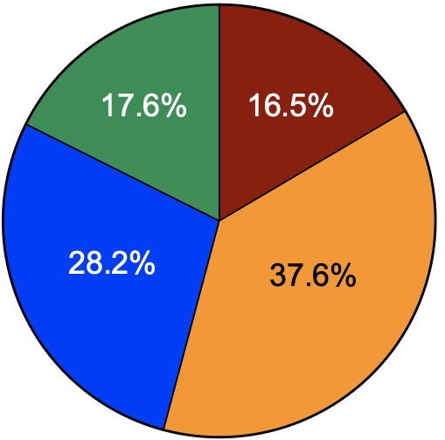
Results:
Fear of Retaliation
I fear it could worsen my chances of matching into a residency program
I fear retribution
Notes:
The third category with the largest impact was fear of retaliation.
Although we were pleased to see that this didn’t have a massive impact of what students would do; however it is clear they are still concerned with 2/3s of students indicating that it had a moderate or strong impact.

Slide 15
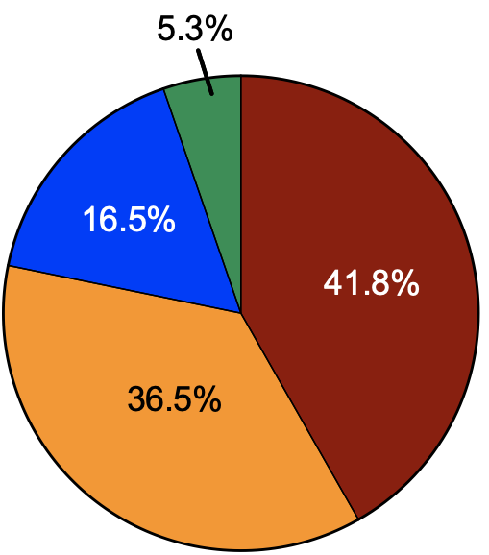
Results:
Concern for Physician
I do not want to jeopardize someone’s career
The punishment for the medical professional will be too excessive
I believe I could one day be in this person’s position
Notes:
Interestingly though, students showed more concern for the impact of reporting on themselves than on the physician they were reporting.
Concern for the impaired physician and their career did not have a major impact on their decision.
We were also interested by the fact that the majority of respondents did not seem to believe that they could be in that same position one day despite the fact that we know that approximately 6% of physicians have substance use disorders and that 14% have an alcohol use disorder.

Slide 16
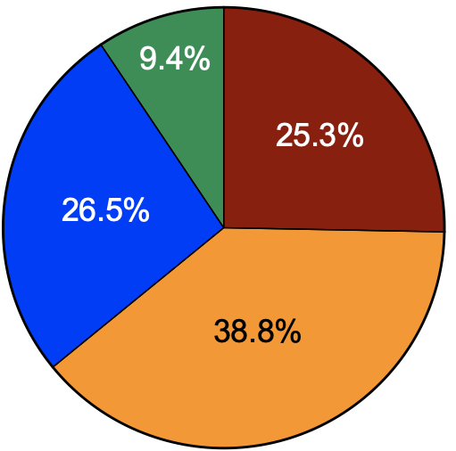
Results:
Lack of Knowledge
I do not know what kind of impairment is reportable
I do not know who to turn to
Notes:
Finally, we were pleased to see that lack of knowledge about what to do and what counts as impairment was not a major problem for these students and only a quarter indicated that this had a moderate or strong impact on their choices.
As these students were about to enter their clinical rotations and had received a lecture on this topic, it is good to see that they retained knowledge on how to respond.

Slide 17
Conclusions
Most medical students know someone who uses substances recreationally
Consistent beliefs that legal substances are less harmful than illegal ones
Exposure to illegal substances does not change views about physician harms
Most medical students feel confident about what to do if their colleague is impaired
Almost half believe physicians with SUDs should never practice medicine
Consistent disapproval across any disorder that might impair cognition
Notes:
As you can see this was a very cursory exploration of medical student beliefs, experiences, and knowledge in these areas with the goal of helping direct more focused future studies on these topics.
Unsurprisingly, most medical students know someone who uses substances recreationally, and the most commonly used drug was alcohol.
There is a consistent beliefs that legal substances are less harmful than illegal ones but there is very little evidence to support these assumptions.
In contrast to what we had expected, exposure to illegal substance use does not change views about the potential harms of physicians using those drugs.
We did find that most medical students felt confident about what to do if their colleague is impaired, although we know that there is a clear difference between knowing what to do and actually doing it in the appropriate circumstances.
Concerningly, almost half of students believe that physicians with SUDs should not be allowed to continue to practice medicine and there is a consistent disapproval of any physician working with any disorder that might impair cognition whether it is physical or psychiatric.
This highlights key areas where increased education and efforts to reduce stigma are necessary.

Slide 18
Limitations
Notes:
Although this study provides some interesting initial data, there are some limitations:
Data were gathered at one medical school, limiting generalizability
Cross sectional design
All data were self-reported, may result in a bias toward social desirability
And as I mentioned, this wasn’t a fully anonymous survey so that may have also impacted responses

Slide 19
Future Directions
Examine impact of these experiences & attitudes on patient care
Identify key learning objectives on substance use & impairment in physicians
Explore other factors that may impact knowledge & attitudes
Consider education on types of physician impairment & treatment outcomes
Notes:
The next steps for this work will be to:
Examine impact of these experiences & attitudes on patient care
Identify key learning objectives on substance use & impairment in physicians
Explore other factors that may impact knowledge & attitudes
Consider education on types of physician impairment & treatment outcomes with an effort to reduce stigma against physicians with SUDs or any other type of chronic condition.
As I mentioned, these data were all collected as part of a larger project and the goal of these analyses was to provide direction to future research and educational interventions on these topics.

Slide 20
Thank you!
All students in the Class of 2024
Many other medical students
Faculty advisors: Drs. Greenwald & Waineo
Wayne State School of Medicine
Students of Detroit vs. Addiction
Questions?
tmoses@med.wayne.edu
@back2brains
Notes:
Thank you to everyone for listening and of course many thanks to the students who completed survey and provided their feedback and everyone else who has helped with this project.
Now I think i have some time for questions and also here is my contact information if you have any additional questions or feedback later.

