Slide 1
Barriers and Facilitators to Collaboration Between Community-Based Medication for Opioid Use Disorder Providers & Drug Courts
Ekaterina Pivovarova, Ph.D., Faye Taxman, Ph.D., David Smelson, Psy.D., Alexandra Boland, B.A., Stephenie Lemon, Ph.D., & Peter Friedmann, M.D., MPH
Research supported by the NIH/National Institute of Drug Abuse K23DA049953 and K23DA049953 supplement
Notes:
Hello, my name is Kate Pivovarova and I am an assistant professor in the department of family medicine and community health at UMass Chan Medical School. Today I’ll be sharing some of our findings from my K23 that seeks to examine a way to improve collaborations between drug courts (also know as specialty or recovery courts) and medication for opioid use disorder treatment providers. Of note, my K23 is chaired by the Mentor Award recipient earlier today Dr. Peter Friedmann.

Slide 2
Drug courts and MOUD
Drug courts are diversionary programs that leverage legal sanctions in exchange for mandatory and court-monitored substance use disorder treatment¹⁻³
More than 3,400 nationwide⁴
In recent years, there have been changes in courts’ perceptions of MOUD. A survey of 849 drug courts found that 86% were willing to refer participants to MOUD⁵
Yet, based on one study, only 14% of those with OUD were receiving MOUD⁶
If courts are willing to refer, why are so few people in need receiving MOUD?
Notes:
For those of you unfamiliar, drug courts are diversionary programs that leverage legal sanctions, usually time in jail, in exchange for mandatory and closely monitored substance use disorder treatment. Since the late 1980s, when drug courts first emerged as way to use the law to mandate treatment, they have multiplied and expanded to include variety of types. Here is Massachusetts we have 35 drug courts but more than 50 specialty courts, including family and mental health courts. In recent years, the courts have shifted their thinking in acceptance of drug court participants on MOUD. This was driven by variety of changes, including introduction of Vivitrol, requirements for acceptance of MOUD to receive federal funds, and national guidelines that encourage provision of MOUD to participants. Reflective of this is a finding from this year that majority of drug courts are willing to refer (and accept) participants on MOUD.
Unfortunately, the massive gap is that only 14% of those with OUD in drug courts were actually receiving MOUD. Of note, the composition of drug court participants ranges regionally and while most courts will have participants with OUD, not all will necessarily have it. In New England, the overwhelming majority of people in drug courts struggle with OUD (over 80%) where as in the southwest there are many individuals with stimulant disorders.
The big question for us of course is why are so few people in need of MOUD actually getting it?

Slide 3
Contextual Factors around Recovery Courts and Service Access
Drug courts rely on the ”referral and brokerage” model for their participants to access treatment
No funds available for direct services
Limited by local availability of services and relationships with providers
Typically, relationships between recovery courts and providers are lacking and inadequate. Research around what accounts for this is limited.
Notes:
Unsurprisingly, the answer is context. One piece of this is that courts do not have services that they are able to provide themselves and so must rely on providers to have their participants receive this. Accordingly, referral and access to treatment is limited by availability and relationships with those providers. Limited research has examined those relationships – as most research has looked at who gets what and not why or how. The few studies that have examined, recognized that relationships are often inadequate. Here we explore more deeply exactly why and how those relationships are impacted.

Slide 4
Interviews with Drug Court staff
CFIR framework to query about collaborations with and referral to MOUD services
~1-hour interviews
Recruited with the assistance of the Executive Office of the Trial Court
Data collection between March 2021 and June 2022
All data double coded and organized in Dedoose
Notes:
To this end, we conducted interviews with 21 recovery court staff from 7 different courts around MA. We used the Consolidated Framework for Impelmentation Research as the basis of the interviews, which lasted approximately one hour. To assist in our recruitment, we worked with the Executive Office of the Trial Court that oversees all of the Specialty Courts in MA. We double coded our data

Slide 5
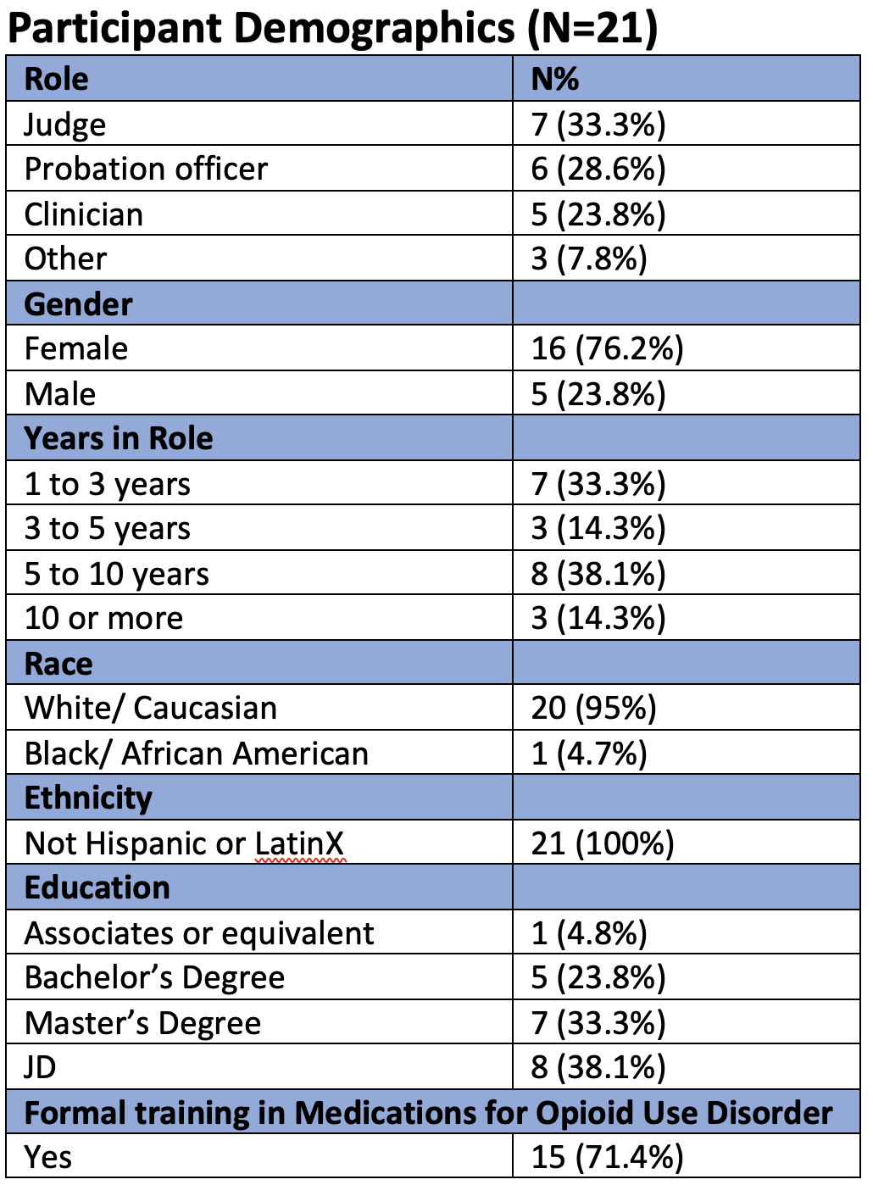
Notes:
Points of note – we were able to speak with typical team members of a drug court – including judges, probation officer, clinicians, and case managers. Our sample was almost exclusively white and predominantly female. I’ll speak to this in the implications section. Most had what they categorized as fairly extensive training in MOUD.

Slide 6
Facilitators
Importance of comprehensive services agencies (e.g., one-stop shopping)
I like to go with agencies that offer co-occurring [MOUD treatment services] because waitlists for mental healthcare are so long…We're gonna need it in some capacity, even if it's not for crisis…but just for trauma-informed issues…I like to use an agency that's big enough that they can help out with that (Probation Officer, Site C)
Provision of MOUD in jails
[Local jail is] probably the most phenomenal at this because we really do have such a good relationship with them…The coordination of care is simplified given the team of people we have between the courts and the jail…The jail is pivotal in helping us with setting it up because the [methadone] clinic hours are so minimal. (Court coordinator, Site A)
Notes:
To start with facilitators, the interviewees repeatedly mentioned that working with providers that provided comprehensive trauma centered services helped to ease referrals and communications. Many of their participants dealt not only with mental health but also medical conditions and accordingly sending their participants to many providers complicated relationshisp and reduced likelihood of actually accessing services.
MA is in a unique position where nearly all of our jails now provide (generally maintain) MOUD. It was important to hear that services in jail actually alleviated some of the pressures and referral difficulties on other legal partners. This is not surprising given how closely intertwined different pieces of the legal system are.

Slide 7
Facilitators - continued
Established relationships
You need to have those relationships in the community. Because it's so hard to access services in general. But when someone knows who you are…and why you're calling, it just makes it a little easier (Court coordinator, Site A)
To be honest with you…I [had] a negative feeling towards methadone…Our [Court Coordinator] had a doctor from [MOUD agency] come over…to speak about methadone, and she just explained it more…It was different…I would be more open to [methadone] since she came. I [now] realize that I don't know as much as [I thought]…[that was] my ignorance. (Probation Officer, Site D).
Provider responsiveness
Notes:
This was a key facilitor – established relationships with provider – once they worked with an agency one (and established a relationship) they were more likely to do so again. What was fascinating to hear was that those relationships didn’t simply impact referral and access but also how drug court staff thought about MOUD. Ill read the second quote…
Finally, provider responsiveness was key. The courts often have to make on the spot decisions about detaining or releasing and individual and having access to provider and knowledge about how treatment is going was critical.

Slide 8
Barrier: Logistical Limitations
Resource-rich versus resource-poor areas
“monopoly on treatment”
Waitlists
Limited operating hours
Restrictions by the clinics:
One of the providers here…to see their [MOUD provider], you have to see your therapist X amount of times. You have to be compliant with your therapy. And then they can put the referral in for [MOUD provider]…and then you get on a list. If you’re struggling and you’re telling your therapist ‘I’m struggling’ and...you have to wait two or three weeks, you may relapse before that. (Probation Officer, Site E)
Notes:
On the other hand, there were several logical limitations mentioned. Some discussed concerns about how the only provider in the area could be seen as having a monopoly treatment and making it difficult to refer patients. Another was what the courts perceived as hoops that the patients had to jump through to start treatment -

Slide 9
Barrier: Problematic communication
There are a lot of communication barriers. I would say more so with methadone clinics than buprenorphine and naltrexone providers… I might need to call multiple times. They need a release. I send the release. They didn't get it. I have to send it again. (Clinician, Site E)
Our biggest barrier as far as trying to communicate with these programs…it's hard because I don't know the reason why…they're hesitant to provide us more information…We're all in this person's life. You're [MOUD provider] treating them for substance use. We're trying to help them succeed and maintain their recovery…Why not all be on the same page? (Probation Officer, F)
There's no reason that [lack of communication about a document] should be a reason…why I'm not referring somewhere. But that is one of the factors. I will be honest with you.
Notes:
We heard a lot about problematic communication – specifically non-response by the providers and hesitation by providers to share information about how the participants were doing. The second issue is not providing information they need. The courts were often mystified because they believed that the providers and they wanted the same outcome – patient in treatment (and recognized that relapses) were common but felt the providers were not on the same page.
When communication was bad, courts didn’t refer patients to those program.

Slide 10
Barrier: Lack of confidence in prescribing practices
What questions do [MOUD providers] ask before they prescribe this medication? [Probation officer, Site D]
The problem I have with [MOUD] is not with [MOUD]. I'm a strong believer in it. It's the randomness with which some doctors prescribe the medication with no real patient input. (Judge, Site F)
Notes:
Just like the providers might have been, the court staff were protective of their patients – they felt that their participants may not have been getting top of the line care and were not listening to the patients. They also didn’t understand know how MOUD decisions were made and were concerned decisions were not being made thoroughly.

Slide 11
Barrier: Inability to provide feedback to and interact with clinicians
It's so difficult…we have one client who…right before…court would [go] to the clinic to get his dose…By the time he got to…court, he'd be nodding. And it's like we need to…change your appointment time or whatever. But this is not appropriate to be coming into drug court looking like you…just used heroin (Clinician, Site B)
MOUD] often becomes an issue when they're also prescribed a million other things. And it's…the combination of [psych meds] with the suboxone, you're going to get high.
Notes:
Relatedly, the courts were very concerned that they often could not provide information about how the participants were doing to the providers. The courts monitored their participants very closely, often seeing them multiple times a week (for urine screens and visiting their residences) and believed they were observing things that providers didn’t see. They also couldn’t talk to anyone with medical training to get some of their questions answered for instance about prescription of MOUD and psychiatric medications.

Slide 12
Summary & Implications
Effective communication practices are lacking between drug courts and MOUD providers
Established relationships are key to referral
Lack of knowledge about what providers and limited communication may impact patient care and legal outcomes
There is a need for strategies that will improve collaboration and communication between drug courts AND providers
Notes:
In summary, speaking with the courts revealed that there were notable barriers in communications between providers are lacking, resulting in further limitations of providers available and reporting of what may potentially be important clinical information.
Relationships were key to referrals but also in educating drug court providers.
Lack of knowledge about how providers do things and communication may impact patient care and legal outcomes.
These findings suggest the need for strategies that will help to improve collaboration and communication between these two agencies.

Slide 13
Limitations and Diversity in Specialty Courts
Diversionary programs have fewer BIPOC participants than expected, given overrepresentation in the legal system
Systemic issues (offers to enroll, inclusion criteria) and individual preference (unwillingness to enroll in ”set up”, stigma) impact engagement
Increased legal supervision can be problematic, but also can offer more opportunities for engaging in treatment
Here, we did not directly address if barriers and facilitators differed for BIPOC participants, but future research should examine those differences. It will also be important to examine relationships and access to care within health equity frameworks

Slide 14
Thank you
Email: Ekaterina.Pivovarova@umassmed.edu
References:
1. Marlowe, D. B., Hardin, C. D., & Fox, C. L. (2016). Painting the current picture: A national report on drug courts and other problem-solving courts in the United States. Alexandria, VA: National Drug Court Institute.
2. Rodriguez‐Monguio, R., Montgomery, B., Drawbridge, D., Packer, I., & Vincent, G. M. (2021). Substance use treatment services utilization and outcomes among probationers in drug courts compared to a matched cohort of probationers in traditional courts. The American Journal on Addictions, 30(5), 505-513.
3. Taxman, F. S., & Bouffard, J. (2002). Treatment inside the drug treatment court: The who, what, where, and how of treatment services. Substance Use & Misuse, 37(12-13), 1665-1688. https://doi.org/10.1081/ja-120014426
4. U.S. Department of Justice Office of Justice Programs. (2021). Drug Courts Flyer. https://www.ojp.gov/pdffiles1/nij/238527.pdf
5. Farago, F., Blue, T. R., Smith, L. R., Witte, J. C., Gordon, M., & Taxman, F. S. (2022). Medication-Assisted Treatment in Problem-solving Courts: A National Survey of State and Local Court Coordinators. Journal of Drug Issues, 00220426221109948. https://doi.org/10.1177/00220426221109948
6. Marlowe, D. B., Theiss, D. S., Ostlie, E. M., & Carnevale, J. (2022). Drug court utilization of medications for opioid use disorder in high opioid mortality communities. Journal of substance abuse treatment, 141, 108850. https://doi.org/10.1016/j.jsat.2022.108850
Notes:
3

