Slide 1

“Dead Baby” Messaging, a
Billion-Dollar “Product Hop” & the Buprenorphine
Public Health Campaign That Wasn’t
A Prescription Drug Illegal Marketing Case:
Oral Abstract Presentation: AMERSA National Conference,
Boston, Nov. 10, 2022
Gail Groves Scott, MPH
Health Policy Network, LLC, Doctoral student in Health Policy
gail@healthpolicynetwork.com @Gail_G_Scott

Slide 2
Disclosures / COI
False Claims Act relator:
DOJ vs. Reckitt Benckiser Pharmaceuticals (2019)
DOJ vs. Indivior (2020)
Fact witness: federal Purdue Pharma investigation
Sales rep: RBP/Indivior (2005-2012)
Purdue Pharma (2003-2004, 2014-2016)
Disclaimer: Financial settlement w/RB Group & Indivior:
No finding or admission of wrongdoing or liability. Expressly denied all claims & allegations of retaliation
Not directly employed by RB Group (employed by Reckitt Benckiser Pharmaceutical Inc, which became Indivior in 2014 )
Notes:
USA vs Indivior, Inc. (a/k/a Reckitt Benckiser Pharmaceuticals Inc) and Indivior PLC, Superseding Indictment, 1:19-cr-00016 (U.S. District Court for the Western District of Virginia August 14, 2019).
U.S. Department of Justice (DOJ). (2019). Justice Department Obtains $1.4 Billion from Reckitt Benckiser Group in Largest Recovery in a Case Concerning an Opioid Drug in United States History. US DOJ Office of Public Affairs; Press Release 19-749. https://www.justice.gov/opa/pr/justice-department-obtains-14-billion-reckitt-benckiser-group-largest-recovery-case
U.S. Department of Justice (DOJ), (2020a). Indivior Solutions Pleads Guilty To Felony Charge And Indivior Entities Agree To Pay $600 Million To Resolve Criminal And Civil Investigations As Part Of DOJ’s Largest Opioid Resolution. The Department of Justice (DOJ) Office of Public Affairs; Press Release 20-697. https://www.justice.gov/opa/pr/indivior-solutions-pleads-guilty-felony-charge-and-indivior-entities-agree-pay-600-million
She was a former sales representative at Reckitt Benckiser Pharmaceuticals /Indivior (2005-2012)… She received a financial settlement related to the False Claims Act from Indivior and from RB Group, in which the companies
settled without admitting to any finding or admission of wrongdoing or liability and expressly denied claims and allegations of retaliation. Scott was not directly employed by RB Group.

Slide 3
Abstract Presentation Objectives:
1. Analyze 1st illegal pharma marketing case - addiction medicine -- alleged anticompetitive actions from 2009-14
2. Gain insights: regulatory gaps, ethics/ equity, industry tactics, policy implications
Methods:
        Case study & policy synthesis +analysis.
        Data collection: legal, regulatory & publicly available pharmaceutical industry documents, academic literature, media reports /// auto-ethnographic data
Notes:
Objective: Analyze the first illegal marketing case to be prosecuted against an addiction medicine company, focusing on the alleged anticompetitive actions from 2009-14. Gain insights to regulatory gaps, ethical lapses, industry tactics, and policy implications.
Methods: Case study. Analyze and synthesis data from legal, regulatory, and industry documents, government hearings, and academic literature, informed by auto-ethnographic data.

Slide 4
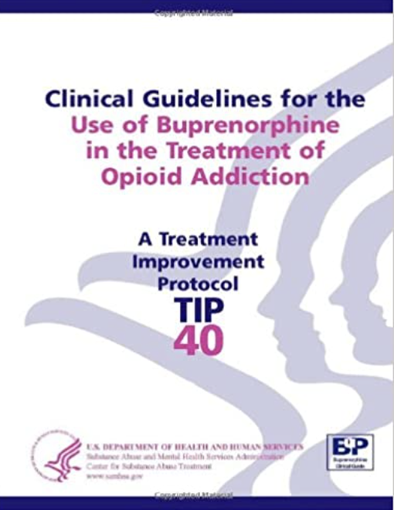
DATA 2000 → Office-based buprenorphine
Paradigm shifts
ACCESS: equity & capacity
Pharma Marketing goals:
ACCESS: ⬆ market share /profits
⬆ metrics: prescribers/RXs
- formulary & reimbursement
- regulations /regulators
- market exclusivity
"Clinical Liaisons” – trusted advisors
Public health breakthrough
Notes:
1st office-based OUD treatment
1st block-buster RX ($1 billion/annual).
Paradigm shifts
criminalization vs. treatment of OUD
Integrate /mainstreaming SUD care

Slide 5
Implementing a Product hop:
Public health claims & “Mission Protect”
Maintaining Market Share
Pricing changes
Regulatory strategies
Marketing changes: “Mission Protect”
  Child poisoning -- “dead baby” sales story
“DISC: Diversion, Interactions, Safety, Children”
False public health superiority claims
DEA audit “scare tactics”
Altered/ misleading use of poisoning center research
Notes:
A multi-pronged company strategy coerced patients and doctors to switch to a new formulation through a false public health "sales story." pricing changes, and other tactics. A disingenuous FDA citizen petition sought to further delay generic market entry. Sales messages included “dead baby” child poisoning stories, and false public health superiority claims.

Slide 6
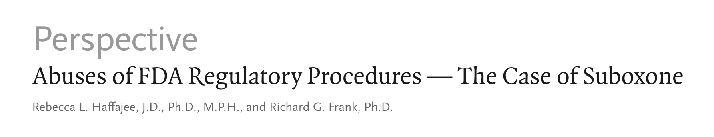

Implementing a Product Hop:
Exploiting Regulatory Weaknesses
Feb. 6, 2020
Orphan drug designation (2002) - 7 years exclusivity
2012 Product hop – “hard switch” tablets to film
“sham” citizen petition to FDA
REMS data sharing/ obstruction- delay generics
9 month delay worth ~ $1 billion sales
(2020, Haffajee & Frank)
Notes:
2012 petition- re; pediatric safety
Haffajee, R. L., & Frank, R. G. (2020). Abuses of FDA Regulatory Procedures—The Case of Suboxone. New England Journal of Medicine, 382(6), 496–498. https://doi.org/10.1056/NEJMp1906680
“So the introduction of a generic buprenorphine–naloxone film in 2017 to compete with Suboxone film, which garnered $1.90 billion in sales that year, might have saved approximately $703 million overall and $203 million for Medicaid alone.”
Page 77, 2nd Amended Complaint, G.Scott
“With the Suboxone tablet smear campaign in full swing, in late 2012, RBP faced the real, and imminent threat of generic competition. Pending before the FDA at that time were two (2) ADNAs for generic Suboxone on the verge of FDA approval.
With its heyday as the exclusive manufacturer of Suboxone dwindling, RBP launched its final assault on Suboxone tablet with the intent to escalate physician conversions to Suboxone Film. Specifically, on September 25, 2012, RBP publicly announced its withdraw of Suboxone tablets from the US market within 6 months, ostensibly due to pediatric safety concerns. The very same day, RBP submitted a Citizen’s Petition to FDA requesting that the agency withhold approval of any pending applications for the approval for generic Suboxone tablets. The principal ground upon which RBP founded its Petition was Suboxone Tablet's increased risk of pediatric exposure. In effect, RBP asked FDA to ban generic versions of its tablet, while its patented drug Suboxone film remained on the market to enjoy a decade more of sales exclusivity.”
REMS data obstruction: ““There are many components in their REMS, and these can be very stringent, but Reckitt won’t tell us what they are. They’ve seized upon this and used the situation to their advantage. And no progress has been made,” one industry source told Forbes. Reckitt denied obstruction of the process, claiming that it was “actively engaged in these multiparty discussions.””
“

Slide 7
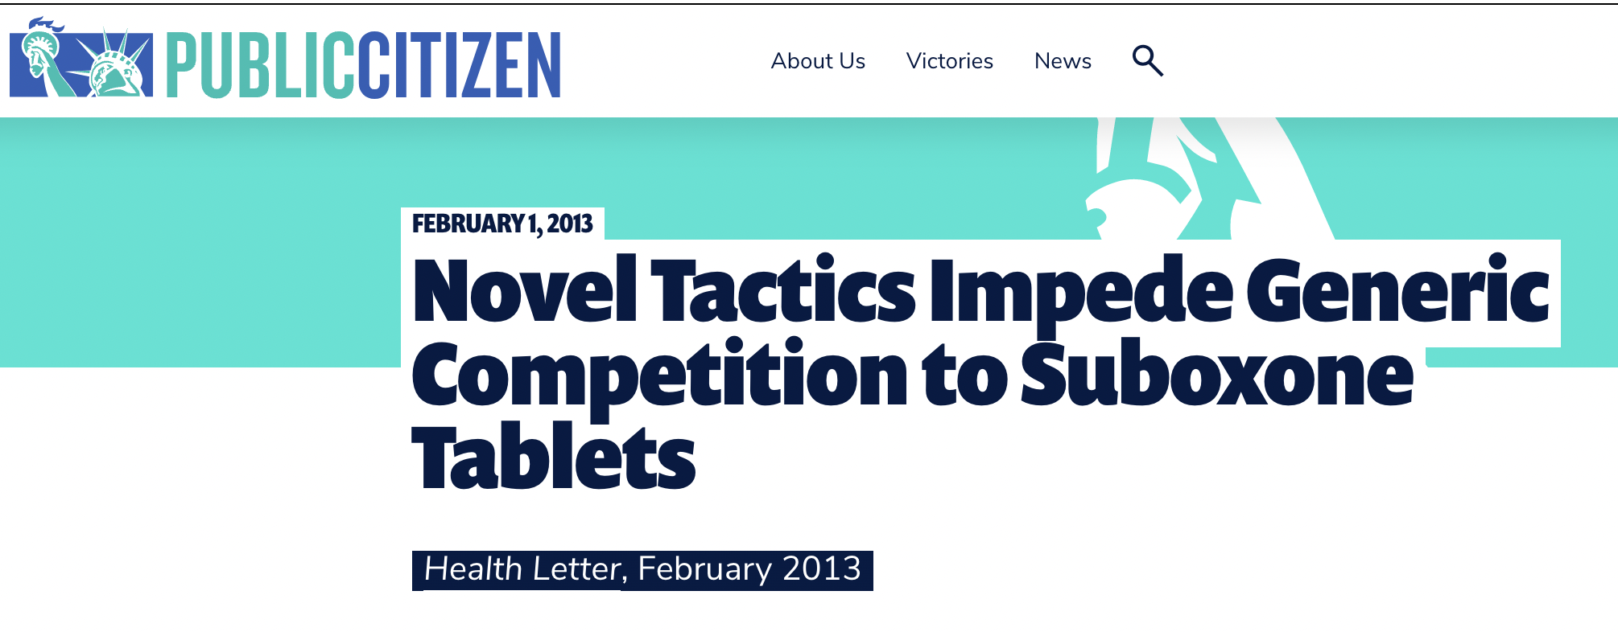
Rocky Mountain Poison and Drug Center (RMPDC) data – commissioned to support pediatric safety /public health claims
Abruptly discontinuing tablet
“conversion” to Film formulation success – 70% by Sept.2012 (eventually 85% /industry record)
“patients paying monopoly prices”
Public Citizen Health Letter, Feb. 1, 2013
Public Citizen Health Letter. Feb. 1, 2013
Notes:
Novel Tactics Impede Generic Competition to Suboxone Tablets. (2013, February 1). Public Citizen Health Letter. https://www.citizen.org/news/novel-tactics-impede-generic-competition-to-suboxone-tablets/

Slide 8
No evidence of superiority- new formulation vs. old formulation
Oct. 2009: Manufacturer letter to FDA:
Can we promote public health benefits of Film packaging?
March 2010: FDA response:
NO on pediatric safety. No comment on diversion (ask DEA)
Nevertheless, DOJ indictment quotes CEO :
“‘We will be making the most of every minute between now & generic approval to convert our tablet business to film,’ including a ‘Full Blitz campaign for salesforce’
… to raise ‘diversion and misuse and pediatric safety’ in sales presentations to physicians.”
USA vs Indivior, Inc. a/k/a Reckitt Benckiser Pharmaceuticals Inc & Indivior PLC, Superseding Indictment, line 27-29, 1:19-cr-00016, U.S. District Court, Western District of VA, August 14, 2019
Notes:
line 29: "· On or about August 30, 2010, the FDA approved Suboxone Film, including the REMS and prescribing information for the drug. None of these materials stated that Suboxone Film was safer than alternative drugs such as tablets, or reduced the risk of misuse, abuse, diversion, or accidental child exposure. Nevertheless, INDIVIOR's chief executive officer told Company A executive~ including its chief executive officer and chief financial officer, "We will be making the most of every minute between now and generic approval to convert our tablet business to film," including a "Full Blitz campaign for salesforce through Thanksgiving." For the full blitz campaign, IND I.VI OR salespeople planned to raise "diversion and misuse and pediatric safety" in sales presentations to physicians, even though there were no scientific studies . ' to establish that Suboxone Film was safer with regard to diversion, misuse, or pediatric safety.”
USA vs Indivior, Inc. (A/k/a Reckitt Benckiser Pharmaceuticals Inc) and Indivior PLC, Superseding Indictment, 1:19-cr-00016 (U.S. District Court for the Western District of Virginia August 14, 2019). https://www.justice.gov/opa/press-release/file/1153066/download

Slide 9
False public health claims
Misleading sales charts:
“Helping to Reduce Pediatric Exposure”
“Associated with Reduced Rates of Diversion & Abuse”
omitted relevant study results
Citizen Petition to FDA , Sept. 25, 2012
company executives altered 5-page study summary
Public announcement / Patient & Prescriber letters
    “ The decision to take Suboxone Tablets off the market was a voluntary choice
    as a result of recent information the company received showing higher rates of accidental pediatric exposure”
Notes:
company executives altered 5-page executive summary of study results to remove cautionary language

Slide 10
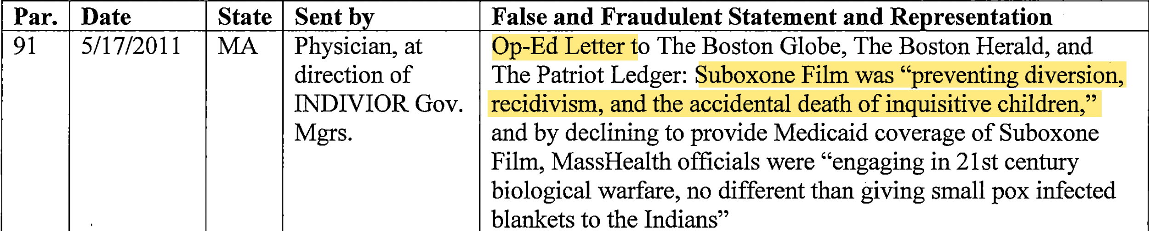
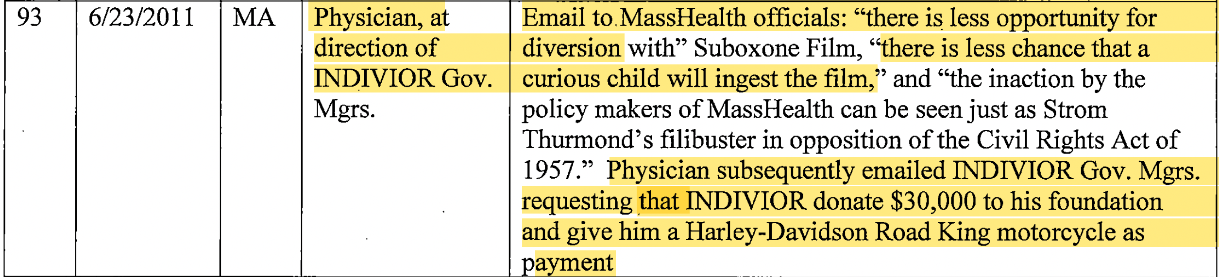
Ethical lapses: industry & clinician relationships
USA vs Indivior, Inc. /Reckitt Benckiser Pharmaceuticals Inc, Superseding Indictment, 2019
Notes:
Examples of ethical lapses extended outside of the company: Addiction physicians were recruited by company sales reps and medical liaisons to influence insurance formulary coverage (especially Medicaid). One example: legal documents quote a Massachusetts doctor requesting gifts from the manufacturer as payment, including a Harley Davidson motorcycle and donation to his foundation.

Slide 11
Industry Speaker program example:
DEA “scare tactic”
“They all spoke about the DEA audits & Dr C. shared his experience with the others as he is the only one at the table that experienced a [DEA] visit.
They spoke about the fear of loosing [sic] Schedule III status.
Dr F. said then clearly putting all patients on the Film is the best way to protect our ability to continue to care for patients.”
-- RBP Sales representative report to manager, Nov. 9, 2010
(page 72, 2nd Amended complaint, Scott, 2007)
Notes:
(second amended complain, page 72, Gail Scott)

Slide 12
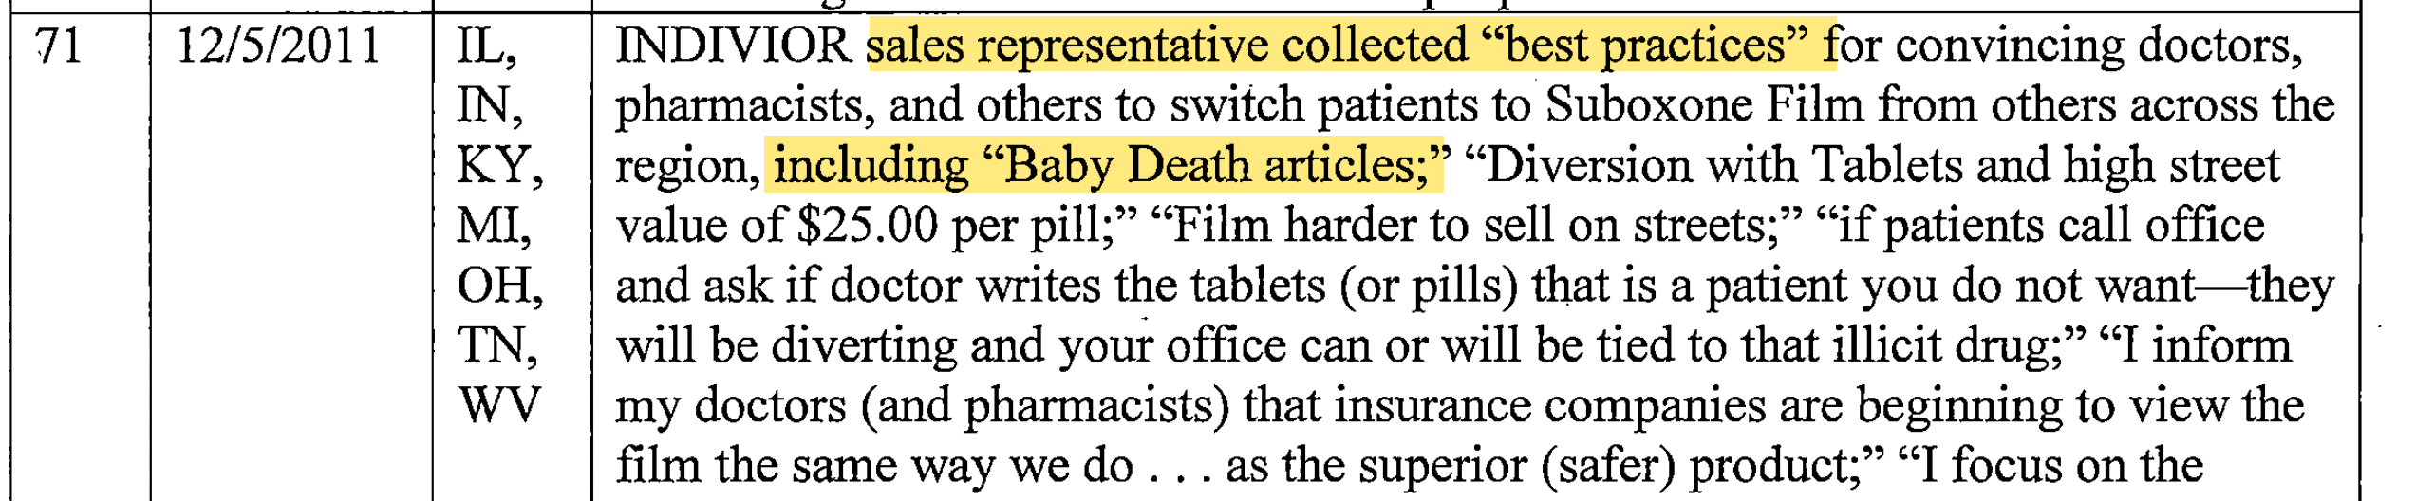
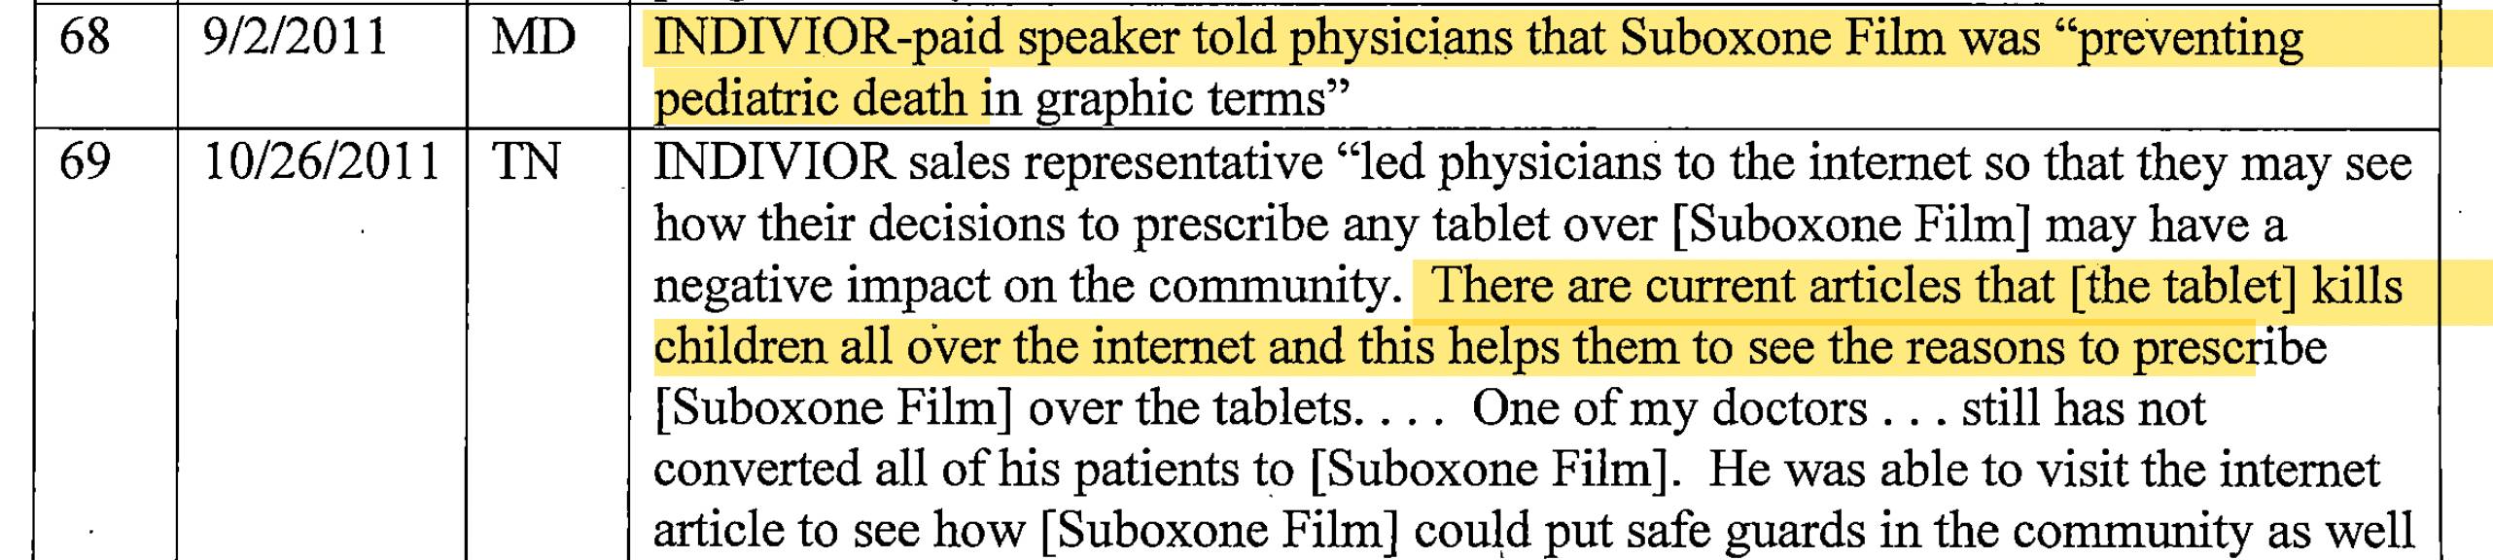
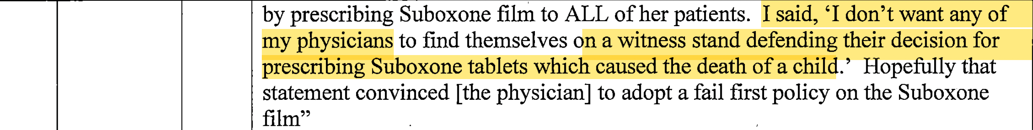
“Baby death articles”
USA vs Indivior, Inc. /Reckitt Benckiser Pharmaceuticals Inc, Superseding Indictment, 2019

Slide 13

July 24, 2020
Indivior Solutions Pleads Guilty to Felony…
Indivior Entities Pay $600 Million to Resolve Criminal & Civil Investigations
July 11, 2019
Department of Justice Obtains $1.4 Billion from Reckitt Benckiser Group
in Largest Recovery Concerning Opioid Drug in U.S. History
Notes:
U.S. Department of Justice (DOJ). (2019). Justice Department Obtains $1.4 Billion from Reckitt Benckiser Group in Largest Recovery in a Case Concerning an Opioid Drug in United States History. US DOJ Office of Public Affairs; Press Release 19-749. https://www.justice.gov/opa/pr/justice-department-obtains-14-billion-reckitt-benckiser-group-largest-recovery-case
U.S. Department of Justice (DOJ), (2020a). Indivior Solutions Pleads Guilty To Felony Charge And Indivior Entities Agree To Pay $600 Million To Resolve Criminal And Civil Investigations As Part Of DOJ’s Largest Opioid Resolution. The Department of Justice (DOJ) Office of Public Affairs; Press Release 20-697. https://www.justice.gov/opa/pr/indivior-solutions-pleads-guilty-felony-charge-and-indivior-entities-agree-pay-600-million

Slide 14
Settlements
Reckitt Benckiser Group
Settled (without liability) -- promoting Suboxone™️ for “unsafe, ineffective, & medically unnecessary” uses
Indivior
Guilty pleas -- Subsidiary - Indivior Solutions - felony
CEO & Medical Director – misdemeanors /fines / JAIL
Settled 3 key allegations
$10 million payment paid to FTC for patient refunds
+ compliance reporting + req’s
Notes:
The Indivior, Inc. settlement included a specific provision requiring the company “ to remove health care providers from their promotional programs who are at a high risk of inappropriate prescribing” but does not reference whether the company has a responsibility to report suspicions to authorities (US DOJ, 2020a.)
3 KEY ALLEGATIONS:
Illegally blocked generics causing federal plans to overpay
Knowingly promoted to offices: breaking federal reg’s or w/unsafe RXs
Lied to health plans re: “child poisoning” data to promote Film vs. tablet
https://www.policymed.com/2020/07/indivior-agrees-to-ftc-settlement-over-suboxone-claims.html

Slide 15
Public health harms
Anti-competitive behavior /illegal marketing
→ Artificially higher cost of treatment
→ cost impact & equity -- “two tiers” of treatment increased # cash clinics /racialized access
(Hansen, Roberts, Netherland, 2012; Van Zee & Fiellin, 2019)
→ Reputation /trust re: office-based treatment /buprenorphine
→ negative publicity, stigma
Notes:
Conclusions: The buprenorphine product hop was among the most successful in pharma history (85% market share). The artificially higher cost, for an effective treatment in the midst of an opioid overdose crisis, harmed patients, plans, and tax payers. The reputation of office-based treatment with buprenorphine was impacted as well, due to negative publicity and stigma resulting from the illegal marketing case, a true public health loss.
Policy changes have been proposed, but may be difficult to implement. Criminal charges and financial penalties provide unknown efficacy for deterrence.
Van Zee, A., & Fiellin, D. A. (2019). Proliferation of Cash-Only Buprenorphine Treatment Clinics: A Threat to the Nation’s Response to the Opioid Crisis. American Journal of Public Health, 109(3), 393–394. https://doi.org/10.2105/AJPH.2018.304899

Slide 16
Policy levers
(efficacy /deterrence unknown)
Regulatory changes – patents, FDA, FTC
Increased enforcement/ penalties
Civil litigation / Criminal charges
Marketing: sunshine laws /disclosure
PharmedOut approach to industry - ”no free lunch”
Occupational licensing -- pharma sales reps-
Notes:
Conclusions: The buprenorphine product hop was among the most successful in pharma history (85% market share). The artificially higher cost, for an effective treatment in the midst of an opioid overdose crisis, harmed patients, plans, and tax payers. The reputation of office-based treatment with buprenorphine was impacted as well, due to negative publicity and stigma resulting from the illegal marketing case, a true public health loss.
Policy changes have been proposed, but may be difficult to implement. Criminal charges and financial penalties provide unknown efficacy for deterrence.
Occupational licensing -- pharma sales reps-
Ethical codes- define public health responsibilities
Independent Continuing Ed.

Slide 17
Citations
Carrier, M.A. & Shadowen, S.L. (2016) Product Hopping: A New Framework, Notre Dame Law Review 92 (1) 167–230.
Haffajee, R. L., & Frank, R. G. (2020). Abuses of FDA Regulatory Procedures—The Case of Suboxone. New England Journal of Medicine, 382(6), 496–498. https://doi.org/10.1056/NEJMp1906680
Hansen Helena & Roberts Samuel K. (2012). Two Tiers of Biomedicalization: Methadone, Buprenorphine, and the Racial Politics of Addiction Treatment. In Julie Netherland (Ed.), Critical Perspectives on Addiction (Vol. 14, pp. 79–102). Emerald Group Publishing https://doi.org/10.1108/S1057-6290(2012)0000014008
Netherland, J. C. (2011). Becoming Normal: The Social Construction of Buprenorphine and New Attempts to Medicalize Addiction. 288, dissertation.
Oldani, M. J. (2004). Thick Prescriptions: Toward an Interpretation of Pharmaceutical Sales Practices. Medical Anthropology Quarterly, 18(3), 325–356. https://doi.org/10.1525/maq.2004.18.3.325
Novel Tactics Impede Generic Competition to Suboxone Tablets. (2013). Public Citizen Health Letter. https://www.citizen.org/news/novel-tactics-impede-generic-competition-to-suboxone-tablets/

Slide 18
Citations
Mulinari, S. (2016). Unhealthy marketing of pharmaceutical products: An international public health concern. Journal of Public Health Policy, 37(2), 149–159. https://doi.org/10.1057/jphp.2016.6
Santoro, M., & Gorrie, T. M. (2015). Ethics and the Pharmaceutical Industry. Cambridge University Press.
Van Zee, A., & Fiellin, D. A. (2019). Proliferation of Cash-Only Buprenorphine Treatment Clinics: A Threat to the Nation’s Response to the Opioid Crisis. American Journal of Public Health, 109(3), 393–394. https://doi.org/10.2105/AJPH.2018.304899
USA vs Indivior, Inc. (a/k/a Reckitt Benckiser Pharmaceuticals Inc) and Indivior PLC, Superseding Indictment, 1:19-cr-00016 (U.S. District Court for the Western District of Virginia August 14, 2019)
U.S. Department of Justice (DOJ). (2019). Justice Department Obtains $1.4 Billion from Reckitt Benckiser Group in Largest Recovery in a Case Concerning an Opioid Drug in United States History. DOJ Office of Public Affairs; Press Release 19-749.
U.S. Department of Justice (DOJ), (2020a). Indivior Solutions Pleads Guilty To Felony Charge & Indivior Entities Agree To Pay $600 Million To Resolve Criminal & Civil Investigations As Part Of DOJ’s Largest Opioid Resolution. The Department of Justice (DOJ) Office of Public Affairs; Press Release 20-697.
Notes:
U.S. Department of Justice (DOJ). (2019). Justice Department Obtains $1.4 Billion from Reckitt Benckiser Group in Largest Recovery in a Case Concerning an Opioid Drug in United States History. US DOJ Office of Public Affairs; Press Release 19-749. https://www.justice.gov/opa/pr/justice-department-obtains-14-billion-reckitt-benckiser-group-largest-recovery-case
U.S. Department of Justice (DOJ), (2020a). Indivior Solutions Pleads Guilty To Felony Charge And Indivior Entities Agree To Pay $600 Million To Resolve Criminal And Civil Investigations As Part Of DOJ’s Largest Opioid Resolution. The Department of Justice (DOJ) Office of Public Affairs; Press Release 20-697. https://www.justice.gov/opa/pr/indivior-solutions-pleads-guilty-felony-charge-and-indivior-entities-agree-pay-600-million

Slide 19


Questions?
gail@healthpolicynetwork.com
Twitter: @Gail_G_Scott

