Slide 1
Addressing Clinician Stigma Toward Perinatal Substance Use Through Art Proof of Concept and Initial Feasibility of ArtSpective™
Clayton J. Shuman, PhD, MSN, RN
University of Michigan School of Nursing
AMERSA
November 12, 2022

Slide 2
Acknowledgements & Disclosures
This work received in-kind support from the University of Michigan Museum of Art.
Some of the data presented were collected from projects funded by the University of Michigan School of Nursing Early Investigator Grant and the University of Chicago Center for Healthcare Delivery Science and Innovation Nursing Solutions grant
No conflicts of interest to disclose.
David Choberka, PhD

Slide 3
Clinician Stigma Toward Pregnant and Birthing Patients with SUD
Decreased or altered reproductive and prenatal care
Separation of mothers and infants
Failure to link hospital and community services
MacAfee, O&G, 2020; MacAfee, SU&M, 2020; Stone, H&J, 2015; Smid, AJOG, 2020

Slide 4
Stigmatizing Attitudes at the Bedside
Perinatal RN Stigma towards Perinatal Substance Use (N=408)
Unit Type | Identified Stigma (%)
Labor (n=113) | 52.2
Postpartum (n=72) | 55.4
NICU (n=148) | 49.3
Pediatrics (n=75) | 66.7
Modified Attitudes About Drug Use in Pregnancy; 4 Midwestern Hospitals; 17 units
Items with the highest levels of stigma:
81% - manipulative and unreliable
69% - solely responsible for the effect on infants
64% - guilty of child abuse
61% - should go to jail
More than an individual problem - stigma is entrenched in the culture and climate of healthcare organizations (high agreement found within units and hospitals)
Stigma may also stem from clinical assessment and a desire to help
Shuman, JOGNN, 2022; Shuman, ANC, 2020; Shuman, BMC Ped, 2021

Slide 5
Clinician stigma impedes implementation of nonpharmacologic treatment for NAS
Infants born in hospitals with higher levels of RN stigma were:
65% less likely to be chest fed
64% less likely to receive skin-to-skin care
Lack of knowledge is associated with heightened stigma -> educational interventions
**BUT**
Heightened stigma is a barrier to receptive learning and application
Mom is Medicine Study (PI Shuman); Corrigan, PS, 2012; Shuman, ANC, 2020; Shuman, BMC Ped, 2021

Slide 6
Theory-informed: Corrigan’s Model of Stigma and the Emancipatory Theory of Compassion
AHA! Moment
Curated Art Exhibits
Perspective Flipping
Creative Narrative
Writing & Comparison
Vignettes,
Strategies, & Certificate
Corrigan, AP, 2004; Georges, ANS, 2013

Slide 7
Proof of Concept and Feasibility
Recruited 11 participants for synchronous delivery via Zoom (1 hour)
Senior BSN and midwifery students interested in maternal-infant health
Acceptability: 6-item satisfaction post-intervention questionnaire (1-5 agreement scale)
Demand & Practicality: post-intervention focus groups (N=2)
Preliminary evaluation of efficacy: Modified Attitudes About Drug Use in Pregnancy scale pre and post (22 items, 1-5 scale; paired t-test, Cohen’s d)
Feasibility dimensions adapted from Bowen, AJPM, 2009

Slide 8
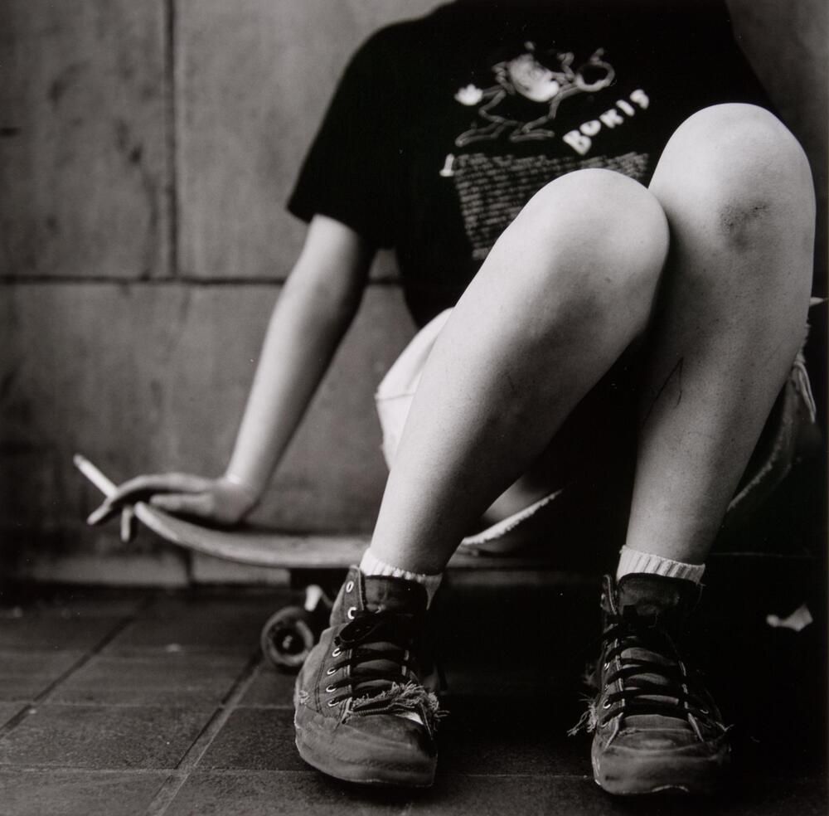
Perspective Flipping Example 1
Clinician Perspective
Scraped knees = lack of appropriate protective gear
Tattered shoes = low-income family, child’s needs ignored
Cigarette = rebellious child or from a “bad family”
1st Person Perspective
Scraped knees = perseverance, learning new tricks
Tattered shoes = demonstrates hard work and dedication to the sport; identity as a “skater”
Cigarette = trying to fit in, make friends, “holding it for someone”
“Skateboard Knees” by David Rosen
Photo used with permission
Notes:
I see a young adult/teenager sitting on a skateboard alone with roughed up knees and scratches on their legs, smoking a cigarette. Their shoes are very worn down. I wonder if the person is possibly struggling financially. The shoes are old, and the person has really scraped knees - did they not have money to buy protective gear - or maybe they don't care if they get constantly scraped up and hurt? From my perspective, I feel a bit worried for them. On one hand, I am happy they have found an activity for exercise and enjoyment, but they should be taking precautions to be safe.

Slide 9
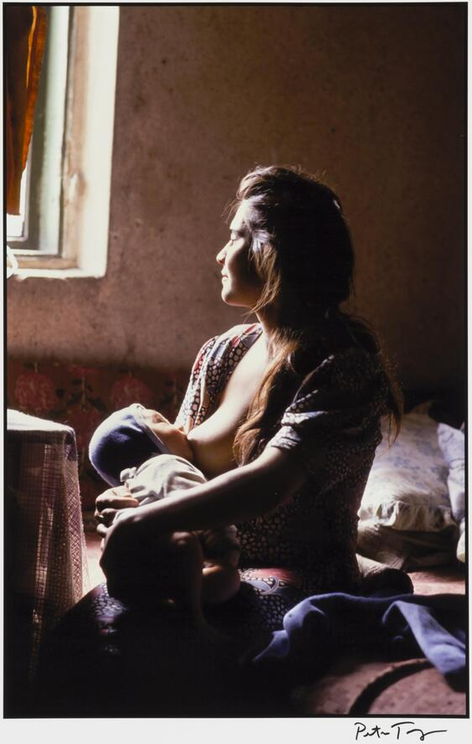
Perspective Flipping Example 2
Clinician Perspective
Maternal psychiatric diagnosis = unsafe for infant
Open window = psychosis; throw infant out of window
Chest feeding = medications transmitted in milk; unsafe
1st Person Perspective
Maternal psychiatric diagnosis = not alone
Open window = hopeful, sun shining
Chest feeding = supporting mother’s choices; maternal-infant bonding; agency
“Patient at a psychiatric hospital, Moscow, Russia, 1992” by Peter Turnley
Photo used with permission
Notes:
I see a young adult/teenager sitting on a skateboard alone with roughed up knees and scratches on their legs, smoking a cigarette. Their shoes are very worn down. I wonder if the person is possibly struggling financially. The shoes are old, and the person has really scraped knees - did they not have money to buy protective gear - or maybe they don't care if they get constantly scraped up and hurt? From my perspective, I feel a bit worried for them. On one hand, I am happy they have found an activity for exercise and enjoyment, but they should be taking precautions to be safe.

Slide 10
Results: Acceptability, Demand, & Practicality
 | M(SD)*
The overall experience was beneficial to me. | 4.6 (0.5)
I have a better understanding of compassion for mothers & infants affected by perinatal substance use. | 4.5 (0.7)
I have a better understanding of maternal agency related to caring for mothers & infants affected by perinatal substance use. | 4.6 (0.7)
Because of this experience, I will be more compassionate to mothers and infants affected by perinatal substance use. | 4.7 (0.5)
The experience was unique – unlike other training I’ve received. | 4.8 (0.4)
I would recommend this experience to other nurses. | 4.6 (0.5)
*On a 1-5 pt Likert-type agreement scale; higher scores indicate greater agreement.
Focus Group Recommendations: Program for individual and remote completion; high demand; ”Aha!” moment surprised them

Slide 11
Results: Preliminary Efficacy
Significant improvement in stigmatizing attitudes
t=4.11, p=.002, d=.633
Modified Attitudes About Drug Use in Pregnancy Scale

Slide 12
Limitations
Proof of concept study
Small, homogenous sample with limited clinical practice experience
Did not measure effect on practice change or sustainability of improvement
Conclusions
ArtSpective™ is a feasible and favorable intervention with preliminary evidence of efficacy and has high demand
Barriers to scalability = adapting to asynchronous and digital platform (currently funded by NIDA 1R21DA055067-01)
Testing approach to address other stigmas/biases: other substance using populations, HIV/AIDS, race, gender, PMADs, obesity

Slide 13
Thank you!
Clayton J. Shuman, PhD, MSN, RN
clayshu@umich.edu
artspective@umich.edu

