Slide 1
Self Reported Xylazine Exposure and Experiences: A Mixed Methods Study of Reddit Users
Tony Spadaro, MD MPH
Hospital of the University of Pennsylvania, Dept of Emergency Medicine
Anthony.Spadaro@pennmedicine.upenn.edu
@TSpadaro91

Slide 2
Conflicts of Interest
I have no financial conflicts of interest to disclose

Slide 3
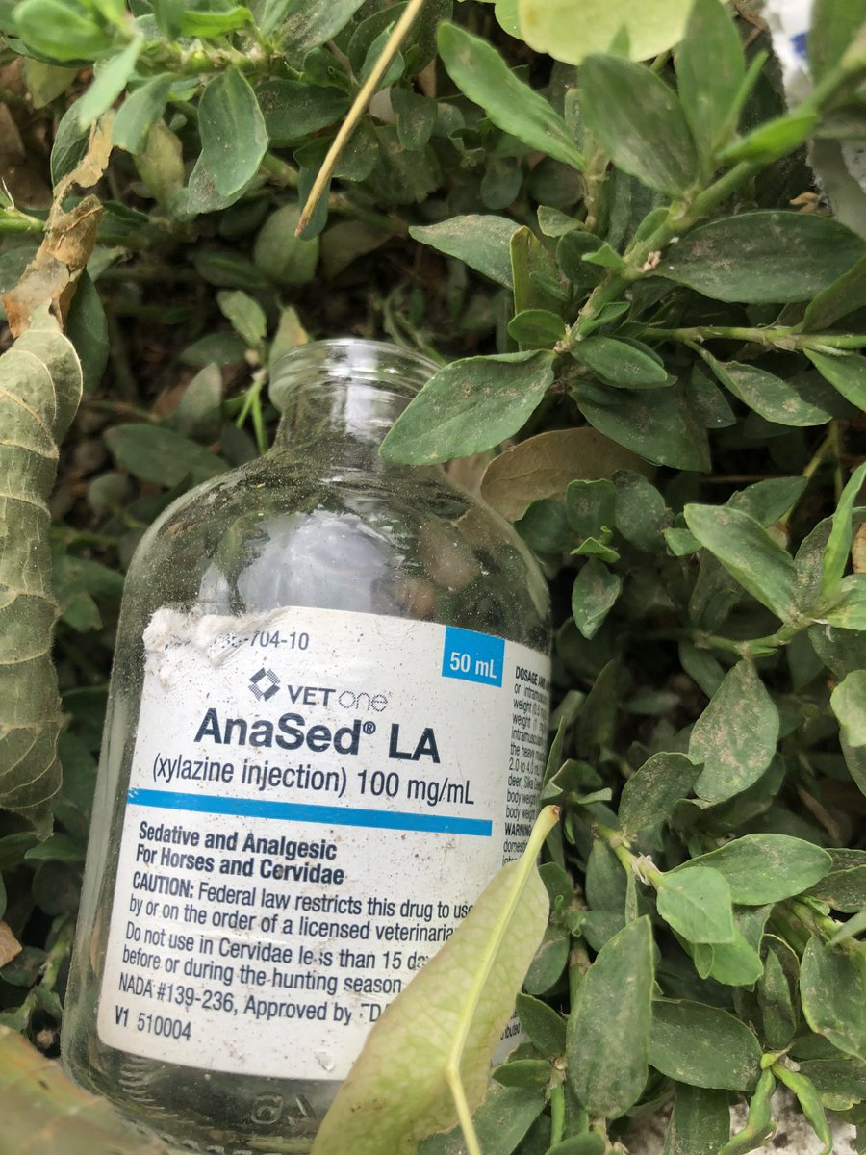
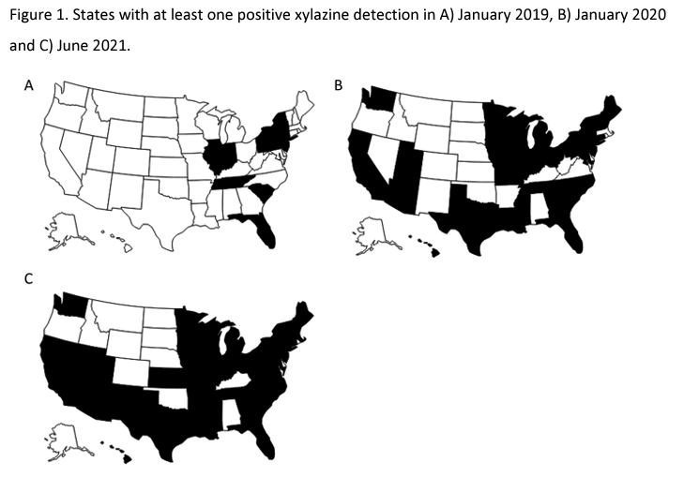
Background: Xylazine
Xylazine is an A₂-agonist and analog of clonidine that is approved for use in veterinary medicine as a sedative-hypnotic.
Increasingly present in illicit drug supply
Potentially can cause sedation not responsive to naloxone
Reports of increased skin ulcers as far back as 2012
Image from @moraffreports
From: https://doi.org/10.1093/jat/bkac049

Slide 4
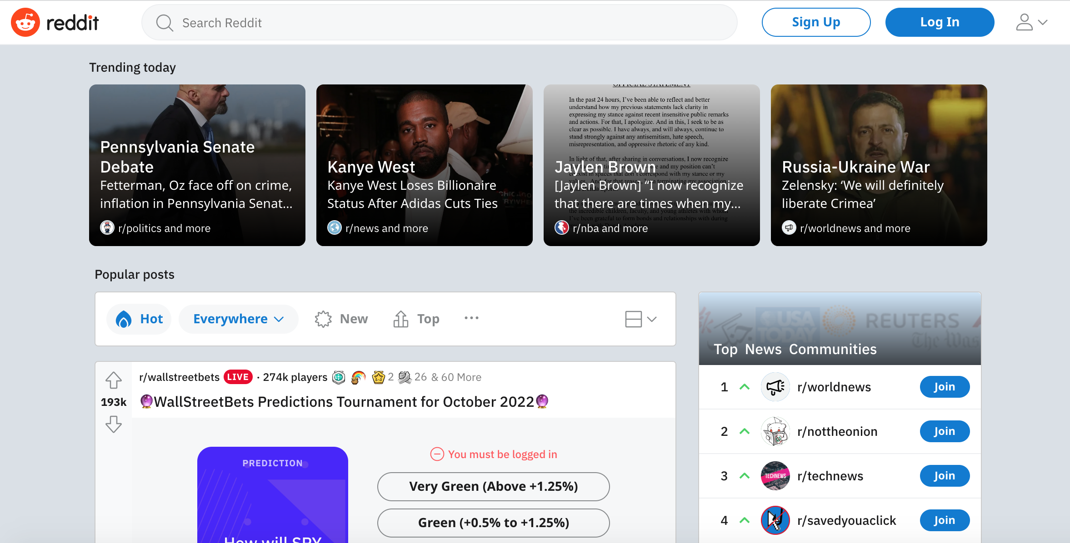
Background: Reddit
Has more monthly active users than Twitter
Posts are completely anonymous
Allows for longer form posts
Organized into Subreddits

Slide 5
Objectives
What is the chatter around xylazine in Reddit
What are the demographics of people who use xylazine on Reddit
What impact does Xylazine have on withdrawal syndromes
What are the complications of xylazine use that people are reporting

Slide 6
Methods
Natural Language Processing (NLP) was used to retrieve mentions of “xylazine” from posts by Reddit subscribers who also posted on opioid-related subreddits.
Posts were qualitatively evaluated for xylazine-related themes.
An anonymous survey was also developed to gather demographic information, use patterns of other drugs, and experiences with xylazine.
This study was exempted from Institutional Review Board.

Slide 7
NLP results
Subreddit | Quote
r/heroin | The sleep aid is called xylazine. Here in northeast it will out you right to sleep. Like car running,, at stop light or watching TV show and 2 hours goes by like 2 mins. It's very strange stuff because it's not like a sleep nod, it's like unconcious sleep.
r/fentanyl | Tell tale symptoms are cold limbs especially your feet hands, fingers, numbness in limbs, Low HR, low BP, heart palpitations, It also has a weird feeling a lot of people first mistake it for the stuff just being a little strong or it being a RC, but usually they'll do it and either fall asleep
r/HeroinHeroines | Are you sure your h is actually h? Could be xylazine- in my area, huge open air market
A total of 76 posts mentioning xylazine were extracted via NLP from 765,616 posts by 16,131 subscribers (January 2018 to August 2021)

Slide 8
Survey Results: Demographics
Demographics (N=58)
Age (Media, Range) | 30-39
Race (%)
White | 81
African American | 3.4
Other | 15.6
Geography (%)
Northeast* | 47
Southeast | 0
Midwest | 16
Southwest | 14
West | 8
Other Country** | 14
*Pennsylvania was most common answer (25% of total)
**Other countries included Canada, Sweden and Ecuador

Slide 9
Diversity Equity and Inclusion
Reddit Users are not representative of general population
Reddit Users might not be representative of PWUD
Requires internet access
Requires knowledge of these subreddits
If xylazine is more commonly present in some drugs (fentanyl) than other drugs (cocaine), exposure may be unequally distributed

Slide 10
Survey Results: Patterns of use
Most Common Routes of Use:
Intranasal
Injection
Inhalation
Oral

Slide 11
Survey Results: Withdrawal

Slide 12
Survey Results: Complications of Xylazine Use
Increased skin and soft tissue infections (25%)
Increased overdoses (15%)
Increased ED visits (8%)
”Extreme wounds and necrosis”
“Scars all over”
“Very high blood pressure, can feel heart beat”

Slide 13
Conclusions
People are posting on Reddit that xylazine is an unwanted adulterant in opioid supply
Xylazine use among people who use Reddit seems to be more prevalent in the Northeast
People who use fentanyl are probably the most exposed to xylazine
More study is needed to confirm the effects of xylazine use and possible withdrawal syndromes
Concern for increased skin wounds and autonomic effects

Slide 14
Questions/Acknowledgements
Mentors: Jeanmarie Perrone, Abeed Sarker,
Co-authors: Sahithi Lakamana, Karen O’Conner, Rachel Wightman, Jennifer Love

