Slide 1
Medication for opioid use disorder treatment continuity post-release from jail: A qualitative study with community-based treatment providers
Thomas J. Stopka, PhD, MHS,ª Rebecca Rottapel, MPH, MS,ª Warren J. Ferguson, MD,^{b} Ekaterina Pivovarova, PhD,^{b} Lizbeth Del Toro-Mejias, MS,^{c} Peter D. Friedmann, MD, MPH,^{c} and Elizabeth A. Evans, PhD, MA^{d}
Department of Public Health and Community Medicine, Tufts University School of Medicine
Department of Family Medicine and Community Health, University of Massachusetts Chan Medical School
Office of Research, University of Massachusetts Chan Medical School–Baystate, and Baystate Health
Department of Health Promotion and Policy, School of Public Health and Health Sciences, University of Massachusetts Amherst
AMERSA, November 10, 2022

Slide 2
Conflict of Interest; Funding
The authors have no conflicts to disclose.
Our research is supported by the National Institute on Drug Abuse (NIDA) 1UG1DA050067-01 (Friedmann, Evans); K23DA049953 (Pivovarova).

Slide 3
Background
Opioid overdose deaths in the U.S. reached the highest level yet in 2021.¹
People who use opioids have a high risk of incarceration. In Massachusetts (MA), risk of overdose death is 120 times higher for people with histories of incarceration.²
Medications for opioid use disorder (MOUD) are FDA-approved, evidence-based treatments shown to reduce the deleterious effects of opioid use disorder and the risk of overdose.
There is disproportionate representation of people of color in jails & prisons and racial/ethnic disparities with community access to MOUD
Greater MOUD access in corrections facilities and post-release might help mitigate these inequities
National Center for Health Statistics: Drug overdose deaths in the U.S. top 100,000 annually.2021.Centers for Disease Control and Prevention Updated November 17, 2021. Accessed December 15 https://www-cdc-gov.ezproxy.library.tufts.edu/nchs/pressroom/nchs_press_releases/2021/20211117.htm
Massachusetts Department of Public Health. (2017). An Assessment of Fatal and Non-Fatal Opioid Overdoses in Massachusetts: 2011-2015. Accessed: Jan 15, 2022. Available at: http://www.mass.gov/eohhs/docs/dph/stop-addiction/legislative-report-chapter-55-aug-2017.pdf .
Larochelle MR, Bernson D, Land T, Stopka TJ, Wang N, Xuan Z, Bagley SM, Liebschutz JM, Walley AY. Medication for Opioid Use Disorder After Nonfatal Opioid Overdose and Association With Mortality: A Cohort Study. Ann Intern Med. 2018 Aug 7;169(3):137-145. doi: 10.7326/M17-3107. Epub 2018 Jun 19. PMID: 29913516; PMCID: PMC6387681.

Slide 4
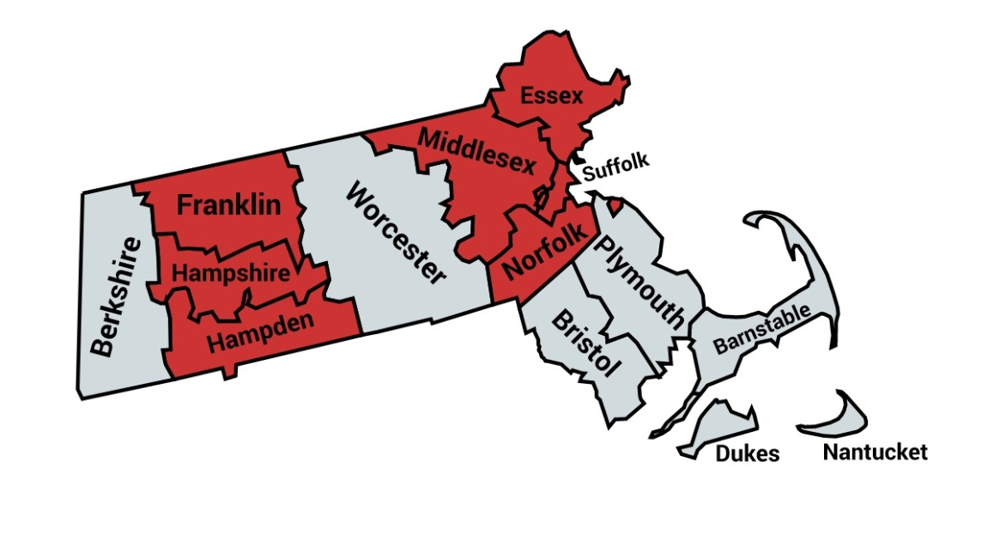
CARE Act of 2018
Legislative mandate created MA Chapter 208
Required DPH to “implement a pilot program for MAT in five Houses of Correction no later than September 1, 2019.”
Two additional counties joined
MA JCOIN Study
Evaluating 4-year pilot program
BUP-NX, XR-NTX, Methadone (maintenance & induction w/in 30 days of release)
Continuation of MOUD in community
Type 1 hybrid effectiveness-implementation study

Slide 5
Methods: Sample, Recruitment and Data Collection
Sample: n= 36 community MOUD treatment program staff
Recruitment: Purposive sampling frame across Massachusetts
Participants: Medical staff, clinical supervisors, and senior administrators

Slide 6
Methods: Coding and Data Analysis
Coding
Inductive and deductive strategies
Dedoose qualitative analytic software (v9)
Analysis
Six codes related to community reentry were analyzed
Modified Grounded Theory analytical approach to identify themes
Notes:
Six codes: community reentry, perception of MOUD, community treatment program and jail collaboration, general MOUD treatment, barriers and facilitators, perceptions of jails.

Slide 7
Exploration, Preparation, Implementation, Sustainment (EPIS) Framework
Exploration
Bridging Factors
Courts
Probation
Police
Community Care
Inner Context
Outer Context
Criminal Justice
Leadership
Resources
Staff engagement, buy-in & training
Government
Political support
Funding esp. Medicaid post-release
Interagency collaboration
Screening
MOUD Treatment
Care Coordination
Sustainment
Health Care
Leadership
Successful piloting
Adequate staffing
Workflow
Preparation
Community
Partnership with care providers
Relationships with academic partners
Community MOUD initiation, engagement and retention
Geography
Catchment area
Facilities
Recognition
Media, press
Treatment outcomes
Implementation
Ferguson, W.J. et al. Health Justice 7, 19 (2019). https://doi.org/10.1186/s40352-019-0100-2

Slide 8
Results: Demographic characteristics of interview participants at community-based MOUD treatment programs (n=36)
Characteristic | Count (%)
Age, mean (SD) | 47.8 (10.8) Missing= 10
Female, n (%) | 27 (79.4) Missing= 2
Race, Hispanic/Latino Ethnicity n (%) White, Non-Hispanic Person of Color | 28 (82.4) 6 (17.6) Missing=2
Education, n (%) High school diploma or equivalent Some college, Associate’s or Bachelor’s degree Master's degree Doctoral degree or equivalent | 0 (0.0%) 15 (44.1%) 13 (38.2%) 6 (17.6%) Missing=2
Role at MOUD program, n (%) Senior administrator Supervisor Clinical supervisors and staff Medical supervisors and staff | 9 (25.0%) 3 (8.3%) 12 (33.3%) 12 (33.4%)
Years working for your current agency, n (%) <1 year 1-3 years 4-9 years ≥10 years | 2 (6.1%) 4 (12.1%) 13 (39.4%) 14 (42.4%) Missing=3

Slide 9
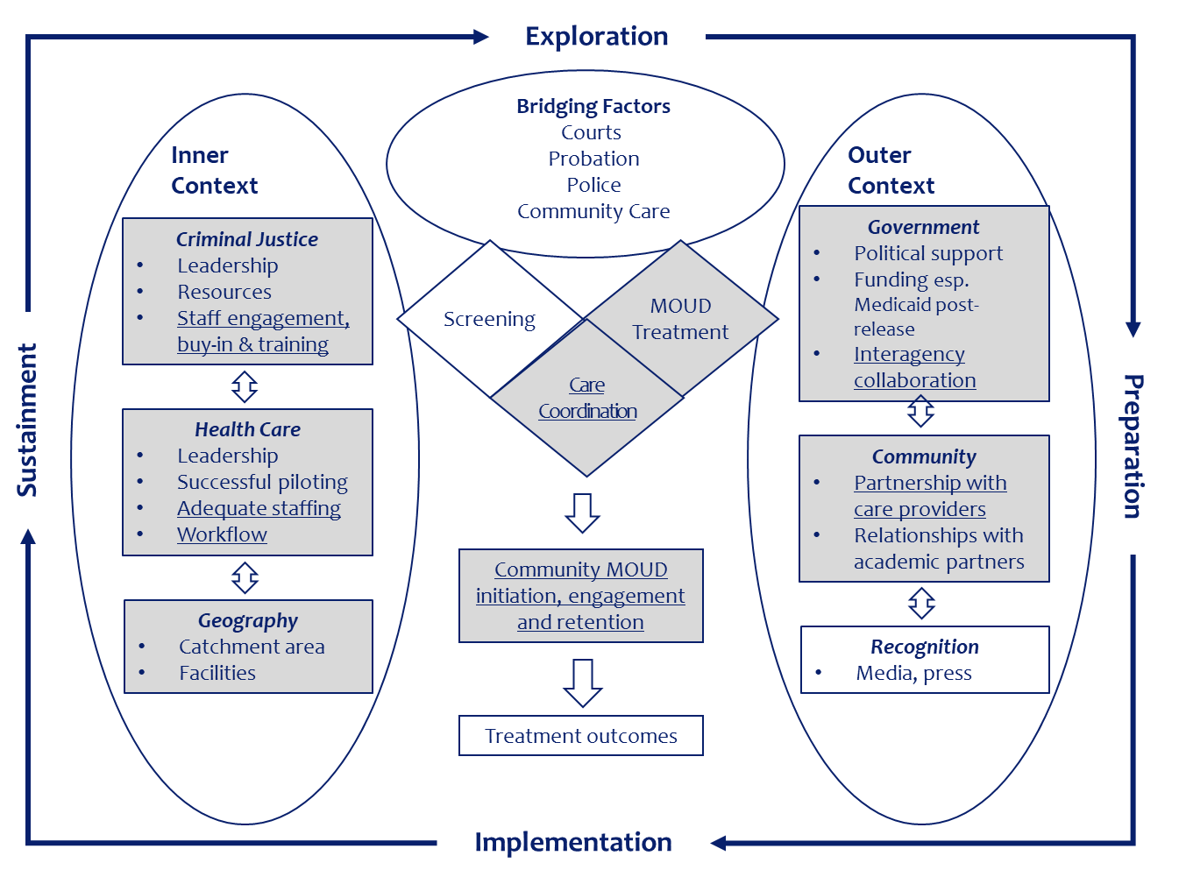
Results: Salient EPIS-related themes
Inner context (within jails)
Staff engagement and training
Workflow and collaboration needed
Bridging factors
Care coordination: Release planning
MOUD engagement and retention in community settings
Outer context (in local communities)
Partnership with care providers
Health insurance and IDs
Social Determinants of Health (SDoH)

Slide 10
Findings: Inner context barriers and facilitators
Jail staff stigma → need for education (OUD is a disease; treat like other chronic disease)
Combined MOUD treatment and counseling is preferred
Strong collaboration = successful coordination
“...we have a contact person, [PROGRAM ADMINISTRATOR]…over at the House of Corrections. And so, my role is that [PROGRAM ADMINISTRATOR] will either call, email and say, ‘Hey, I have a person. They’re going to be released with the suboxone.’ It’s very urgent. So, she calls me the same day, and I really try to get the person in either that day or the next day…”

Slide 11
Findings: Bridging barriers and facilitators
Staffing for release planning (esp. pre-trial population/unplanned releases)
“They could go from the jail to court and the judge can say you’re free to go. Well, where’s all the discharge planning there? They’re just let go.”
Care coordination as key
Communication
Sharing of medical information (e.g., last dose letter)
Trained workforce
MOUD engagement and retention in community settings
Importance of 1st visit
Transportation, flexible hours of service, cell phones, bridge prescriptions

Slide 12
Findings: Outer Context Barriers
Health insurance re-initiation and IDs
“You need an ID to pick up a federal narcotic at a pharmacy. So, then what happens when they don’t have an ID. So, now they have no money, no ID, and they’ve been given suboxone for today, and they’re really worried and concerned about tomorrow…”
Social determinants of health
Employment, food security, probation follow-up, mental health care for dual diagnoses, family re-connections, childcare, shelter, transportation
“…they’re going from being in jail or losing their kids, losing their jobs, being homeless to: well now I’m in a shelter, oh well now I’m in an apartment, well now my wife is talking to me again, and now I can see my kids.”

Slide 13
Stopka et al. IJDP. PMID: 35965159
MOUD in Jail
(Inner Context)
Unplanned Release
“Lot of times we have folks that I’m working that I don’t know when they go to court, if someone goes to court on Tuesday, they may be…getting out on Tuesday or they may be coming back in. So, the planning for connecting people with resources and appointments in the community gets a little – definitely trickier with those – with that population....Then we need to just kind of hustle to get him connected,” (ID11).
Referral to Community
(Bridging Factors)
Communication Between Jail
& Community MOUD
“It’s a very closed system,” (ID45).
“Contact with clinical care teams in corrections is always challenging,” (ID16).
Transportation
“We used to do bus passes, but now we do something called [TRANSPORTATION PROGRAM]… and that’s at no cost to the patient..,” (ID16).
Housing
“In discharge planning – so we’re always worried about if – is there a good solid home plan…We do worry about the individuals who are homeless going to shelters and being able to access and continue care in the community,” (ID17).
Access To Phones
“Phones are an issue, especially in people who are being released from incarceration. So, we really struggle to get in touch with people,” (ID30).
Geography
“I would say that most of the folks that leave [HOC] end up going back to their home program. They don’t necessarily live in this area…So, it’s a small portion of folks that stay with us. Only a handful I would say that end up settling in this area and stay with us.” (ID12).
Community- Based MOUD (Outer Context)
Schedule Times
“We have had the experience where they send over the paperwork late on Friday or a holiday weekend, and our managers…then respond swiftly to do what we’ve got to do to continue their treatment. It’s not in our contract that we have to respond that quickly. It’s just something that – it’s a best practice, and we do it. Typically, we wouldn’t have to respond until the next business day, but we kind of –a lot of our staff go above and beyond and will do whatever work is necessary on the weekend to get that person to be able to continue his methadone treatment and get his medication,” (ID13).
Patient MOUD Preference
“… I think we try really hard to just support people where they’re at. I always just want to make it clear that the option still exists,” (ID25).
Insurance
“…It’s difficult to coordinate follow-up care if you can’t even get your prescription on the day of release and are like struggling to figure out how to get your health insurance back on…that’s really difficult,” (ID25)
MOUD Rx & Pharmacy Pick-up
“You don’t actually get the physical medication. You have to go to a pharmacy and fill it. And so, you need two things for that. You need your health insurance, and then you need a photo ID to pick it up because it’s a controlled substance. Which many people leave without an ID,” (ID24)

Slide 14
Limitations and Strengths
Limitations
Strengths
Single time period
Early phase of a pilot program
Sample from one US state
COVID-19 pandemic
Novel data in the US context
Theoretical framework
Triangulation with other analyses

Slide 15
Conclusions and Next Steps
People who are newly released from jails at very high risk for OD
Findings highlight barriers and facilitators to MOUD treatment continuity post-release and strategies to enhance continuity in local communities that can help to reduce OD rates
Findings point to the need to invest in care coordination, staffing, and funding to reduce barriers and support continuous MOUD treatment during the high-risk transition to the community
Upcoming MA JCOIN research will focus on:
Long-term experiences with MOUD provision in jails
Experiences among recently released and incarcerated MOUD patients

Slide 16
For additional information on:
MOUD continuity post release from MA jails:
Stopka et al. Medication for opioid use disorder treatment continuity post-release from jail: A qualitative study with community-based treatment providers. International Journal of Drug Policy, 2022, vol. 109, https://doi.org/10.1016/j.drugpo.2022.103803.
Matsumoto et al. Jail-Based Reentry Programming to Support Continued Treatment with Medications for Opioid Use Disorder: Qualitative Perspectives and Experiences Among Jail Staff in Massachusetts. International Journal of Drug Policy, 2022, vol. 109, https://doi.org/10.1016/j.drugpo.2022.103823.
MA JCOIN papers on: Study protocol, MOUD program implementation, and MOUD diversion in jails
Evans et al. Uncommon and Preventable: Perceptions of Diversion of Medication for Opioid Use Disorder in Jail. Journal of Substance Abuse Treatment. 2022, vol. 138, pp. 108746–108746, https://doi.org/10.1016/j.jsat.2022.108746.
Pivovarova et al. Legislatively Mandated Implementation of Medications for Opioid Use Disorders in Jails: A Qualitative Study of Clinical, Correctional, and Jail Administrator Perspectives. Drug and Alcohol Dependence. 2022, vol. 234, pp. 109394–109394, https://doi.org/10.1016/j.drugalcdep.2022.109394.
Evans et al. Massachusetts Justice Community Opioid Innovation Network (MassJCOIN). Journal of Sub Abuse Treatment, 2021, vol. 128, pp. 108275–108275, https://doi.org/10.1016/j.jsat.2021.108275.

Slide 17
Thank you!
For more information:
Thomas J. Stopka, PhD, MHS,
Tufts University School of Medicine
thomas.Stopka@tufts.edu
Twitter: @StopkaThomas

