Slide 1
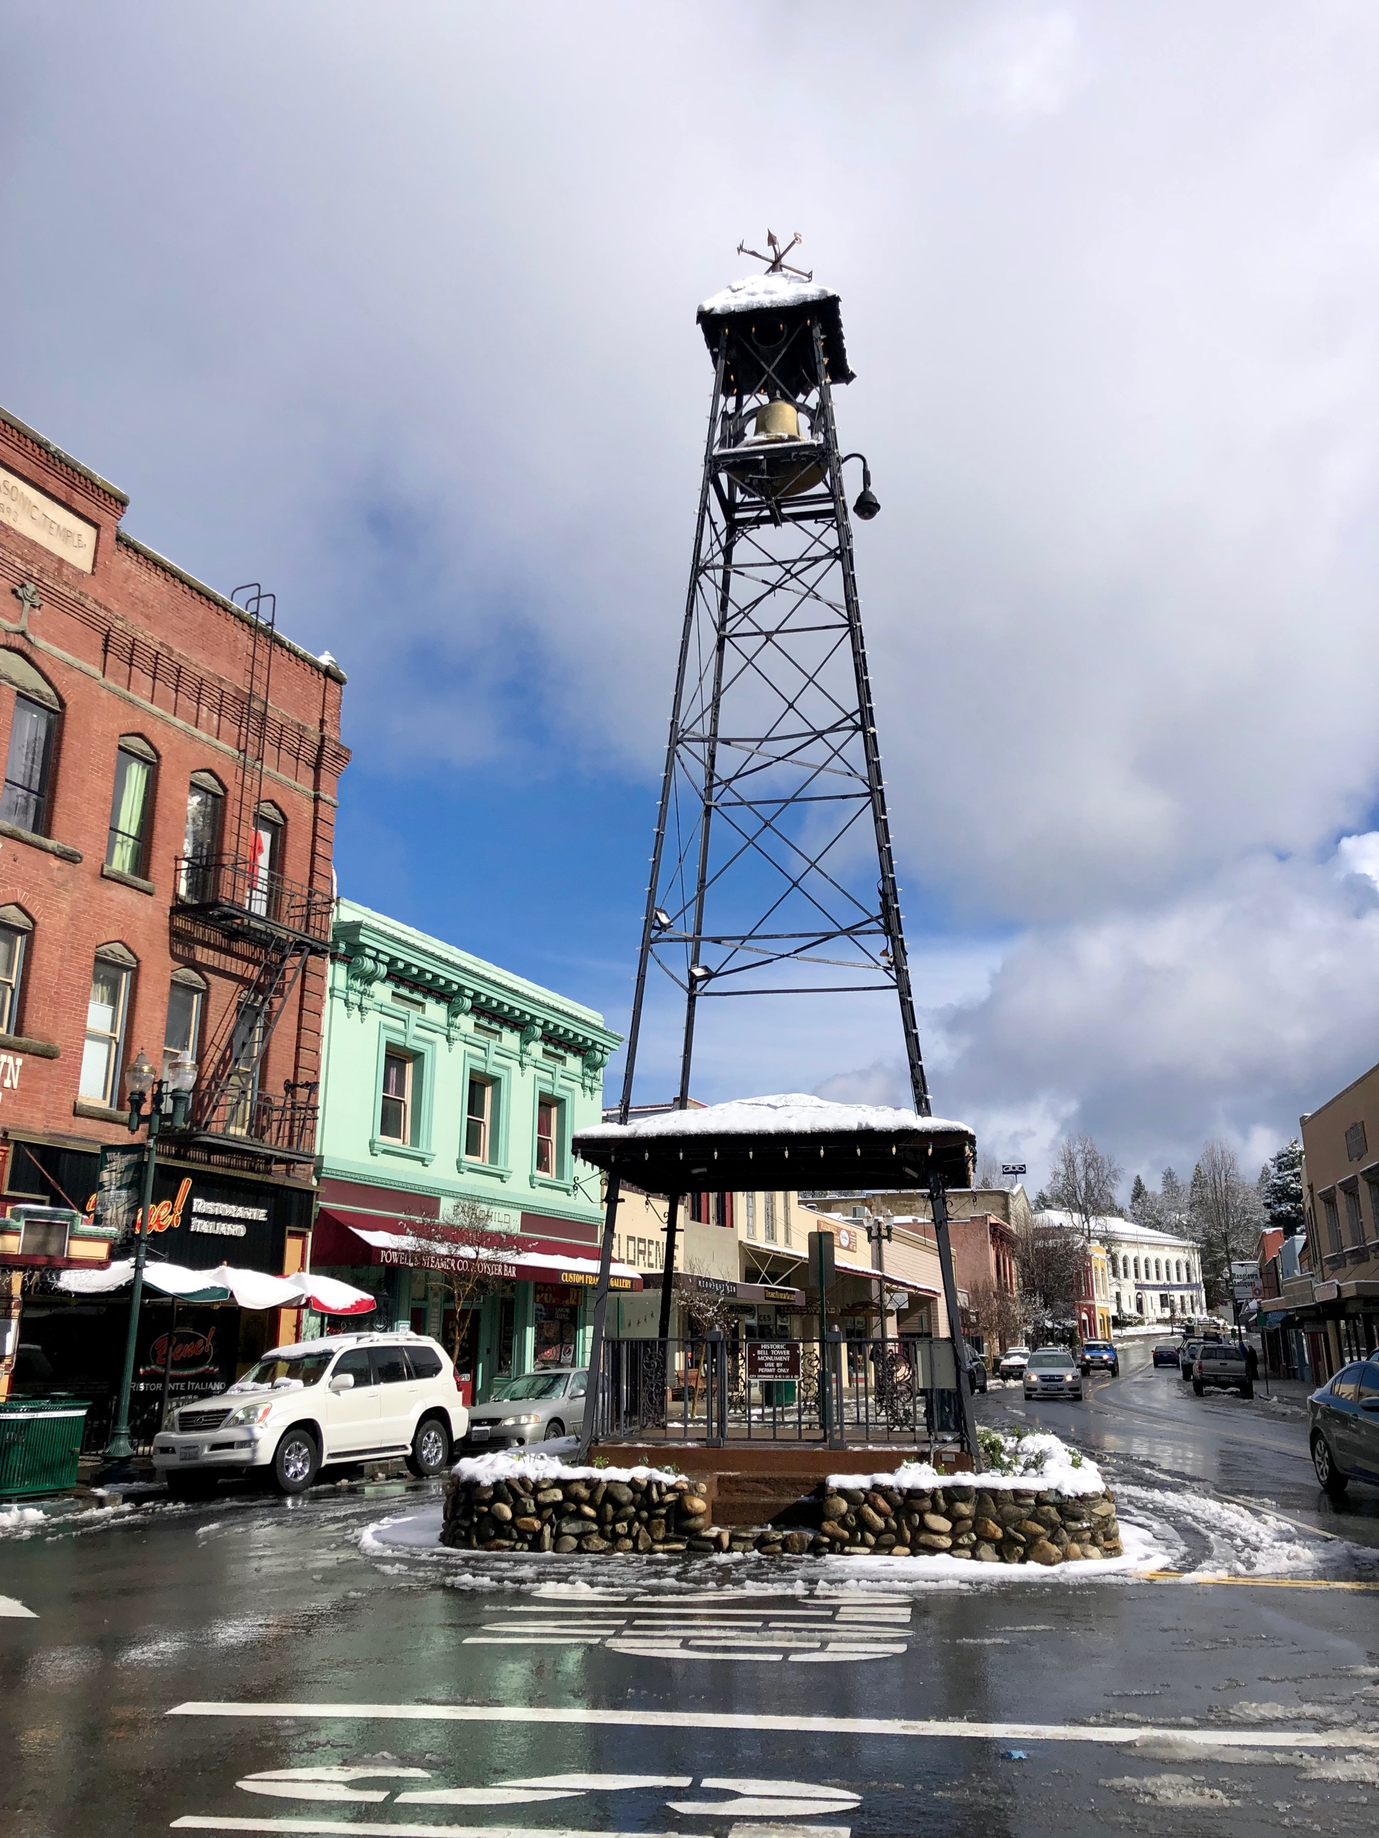
Question: “What are we doing when we identify opioid use disorder?” Response: 1. “__________” 2. ED-initiated buprenorphine 3. SUD Committee
Photo Credit: Arianna Campbell

Slide 2
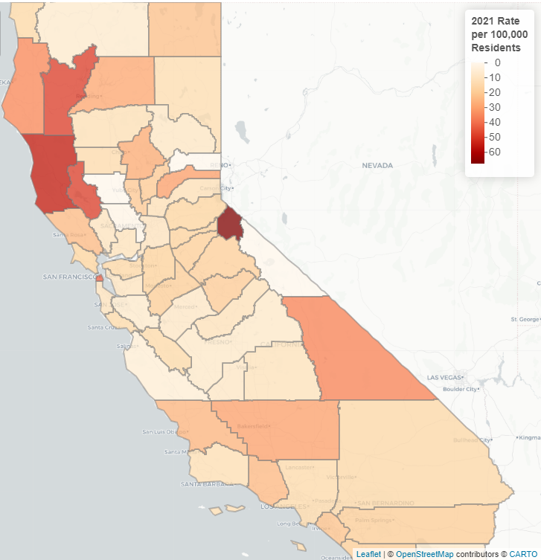
Marshall Hospital System for SUD treatment prior to 2017
Long waits for treatment
Long distances to treatment
One X-waivered Primary Care MD & PA
Requirement to discontinue substance prior to treatment
Only ED intervention was “the list”
Residential treatment was abstinence model
El Dorado County
Notes:
Long waits for treatment
Long distances to treatment
Complex assessments before meds
Requirement to discontinue substance prior to treatment
Only ED intervention was “the list”
Loads of stigma and moral judgement

Slide 3
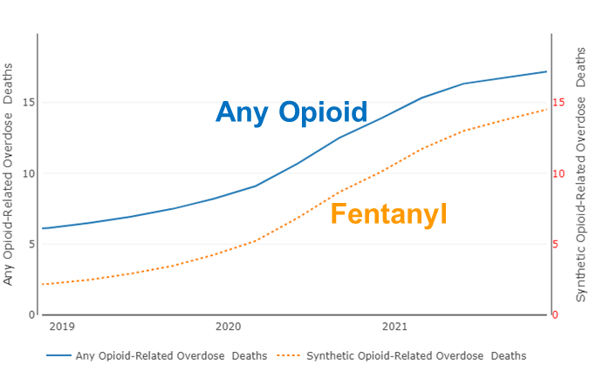
California Overdose Rates
https://skylab.cdph.ca.gov/ODdash/?tab=Home
Notes:
El Dorado experienced 30 opioid-related overdose deaths in 2021, the most recent full year of data available (preliminary death data - rates/counts may change). The annual crude mortality rate for 2021 was 15.1 per 100k residents, an increase of 189% from 2019.

Slide 4
Number of Opioid Overdose Deaths in El Dorado County
Expect > 40 overdoses 2022
10
30
30
22
10
https://skylab.cdph.ca.gov/ODdash/?tab=Home
EDC Opioid Coalition Coroner Report
Notes:
30 overdose deaths reported by Coroner’s office 8/2022
8/2022 - waiting on toxicology for +10 suspected fentanyl overdoses

Slide 5
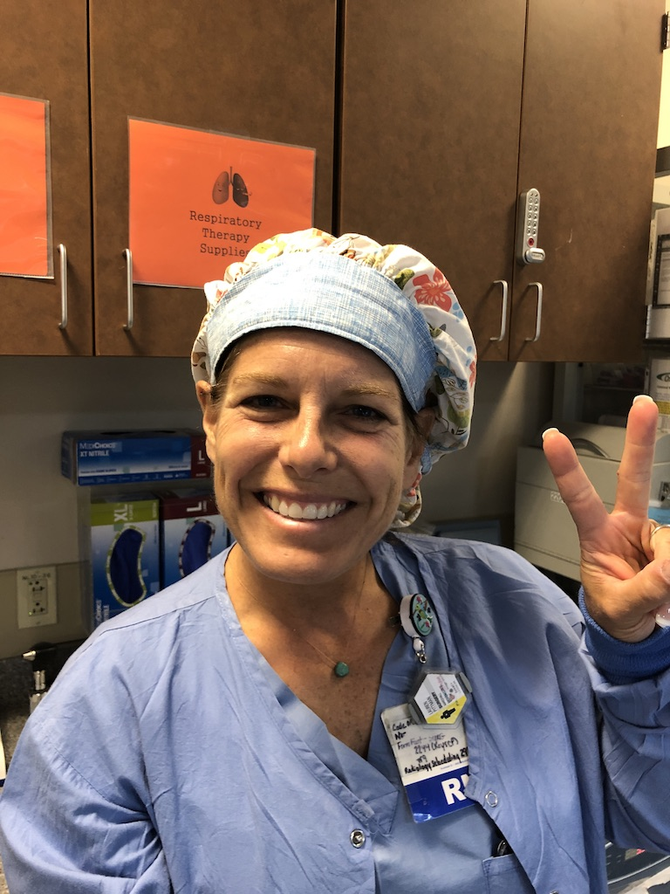
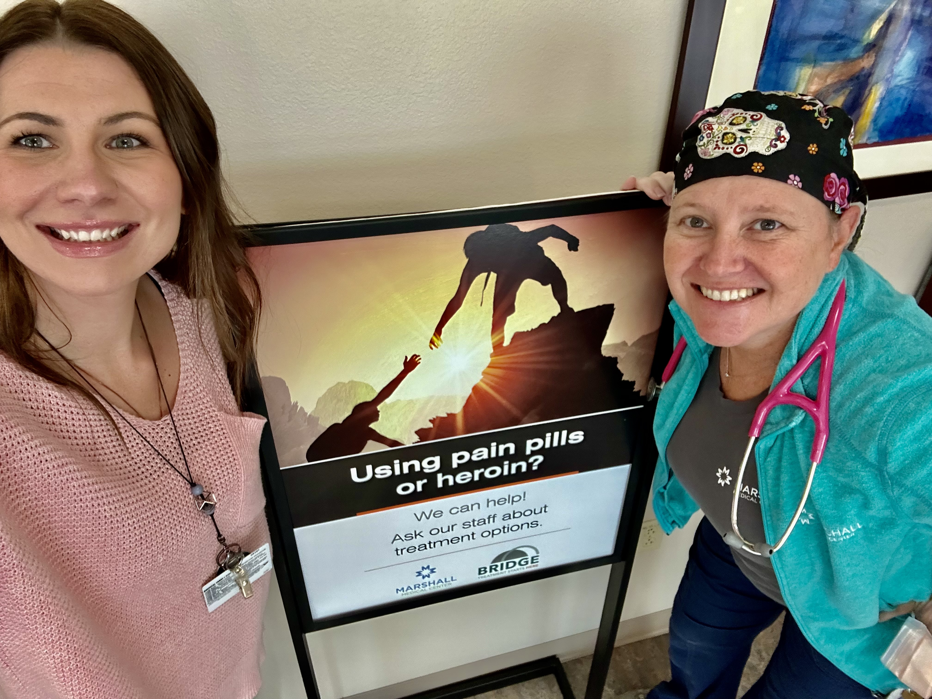
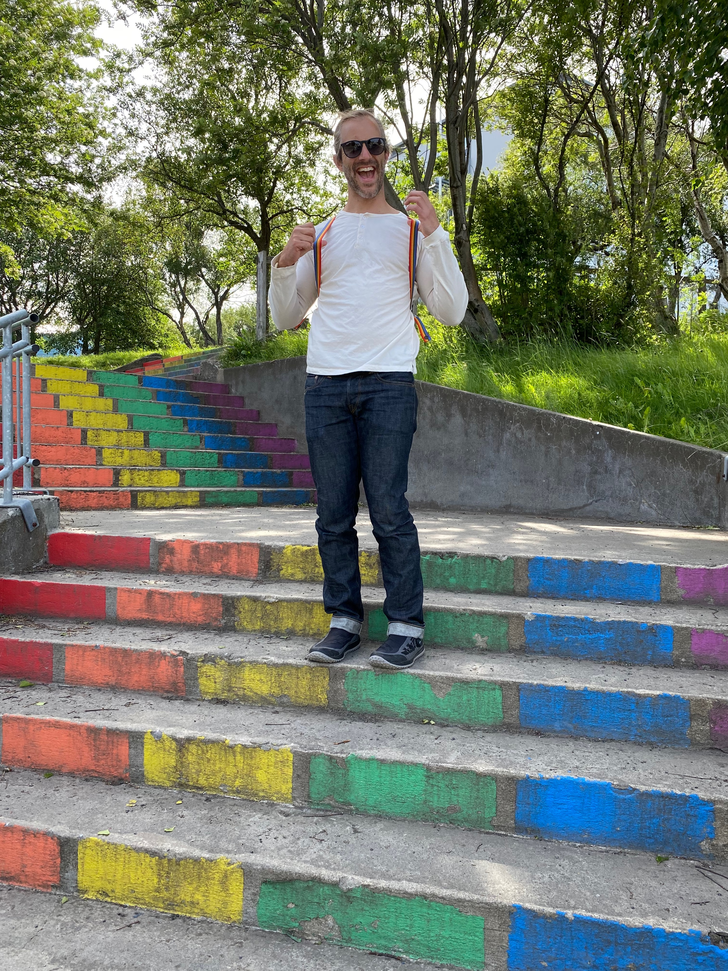
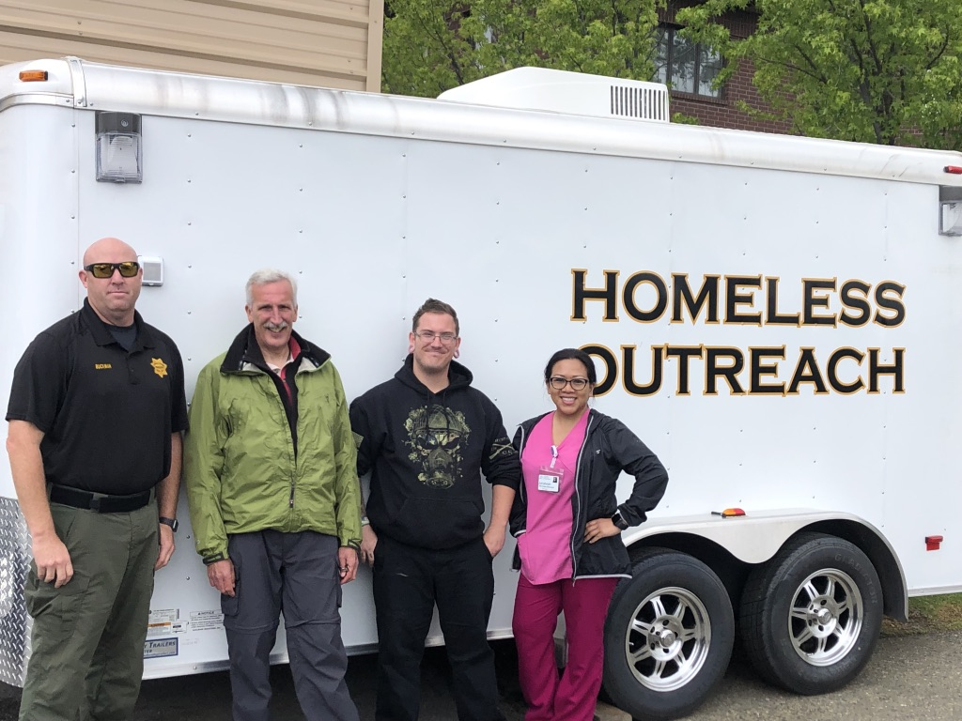
Who is included on the Committee?
Photo Credit: Arianna Campbell
Notes:
Hospital Champion
RN Champion
ED Director
Project Coordinator
Substance Use Navigator
Social Work Champion
Case Management Champion
Vulnerable Populations Program Manager
Bridge Clinic Manager
Executive Director of Quality and Education
Associate Chief Medical Officer/ Vice President Population Health
Department Champions: Hospitalist, Surgery, Emergency Department, Bridge Clinic, Anesthesia, Pediatrics, OB/GYN, Primary Care
Invites to Community Organizations

Slide 6
Treating All SUD
Marshall Medical Center CA Bridge Center of Excellence Data

Slide 7
Removing barriers: MAT Follow-Up Rates
Marshall Medical Center CA Bridge Center of Excellence Data

Slide 8
Disparities in Care? LatinX Survey
Participants That Use Illicit Drugs
Participants That Have Ever Received MAT services
EDC Latinx Point in Time Survey Project, Marshall Medical center
Notes:
EDC Latinx Point in Time Survey Project
collaboration between Marshall Medical Center, El Dorado Community Health Center, Public Health, New Morning Youth and Family Services
Why?
Latinx community is ~13% of El Dorado County (largest minority population).
Disproportionate number of overdose deaths among Latinx identifying community members.
Lack of representation of Latinx community among patients seeking MOUD in the ED and at MAT clinics.
Want to survey community to understand community needs and barriers to healthcare, primary care, mental health, MAT, and harm reduction services
How
Work with outreach workers to the Latinx community with local FQHC, Public Health, and Family Services.
Collectively working with community for over 40-years
All outreach workers represent diverse members of the Latinx community (Chicana/o, Mexicana/o, El Salvadorian, etc)
Did Q/A sessions with community leaders: other outreach workers, church leaders, medical providers, etc
Developed English and Spanish PiT surveys based on feedback
Distributed in diverse settings: clinics, on-site at grocery stores, churches, homes, multi-family living units, etc
$30 gift card for groceries/gas for each participant
101 survey participants!
What now?
Just received the dataset! Larger analysis still needed.
Use results to inform organization policies, staffing and to advocate for community needs
Formed a community wide Latinx workgroup as part of the El Dorado Opioid Coalition for continued work

Slide 9
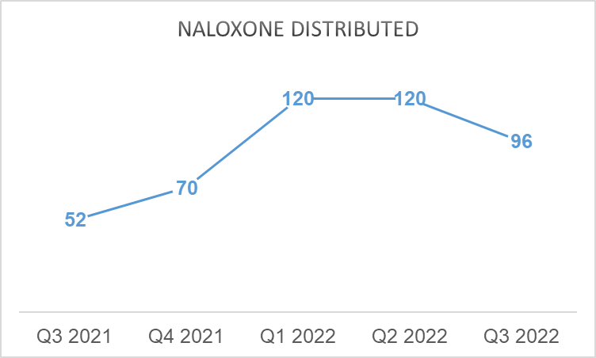
Naloxone Distribution post Stigma Trainings
Initiation of stigma reduction classes
458 units naloxone distributed
58 overdose reversals reported
Marshall Medical Center CA Bridge Center of Excellence Data
Notes:
Add naloxone in every school through outreach

Slide 10
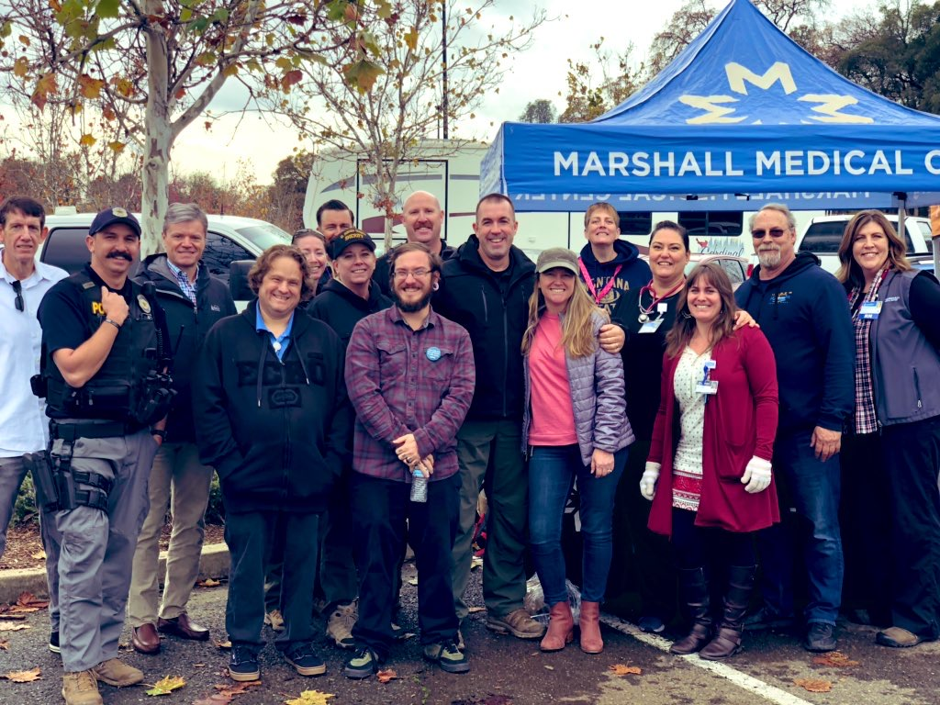
The Future is Bright
Quality Metrics/Case Reviews
Youth/School Outreach
Behavioral Health Navigation with “Caring Cards”
Expansion of Bridge Clinic
Inpatient Navigator
HIV/ Hep C screening with PrEP
Social Medicine Committee
Photo Credit: Arianna Campbell
Notes:
Change to “Social Medicine Committee”: reproductive health access, housing projects, youth projects, etc
Quality Subcommittee Designation with quality metrics
Integrate ED screening and navigation for HIV, Hep C
Behavioral Health Access and Navigation
Caring Cards, outreach post ED visit for SUD/MH
Expanded Navigation Department
Research projects and publishing
Expansion of Bridge Clinic
Expansion to stable patients managed in Primary Care

Slide 11
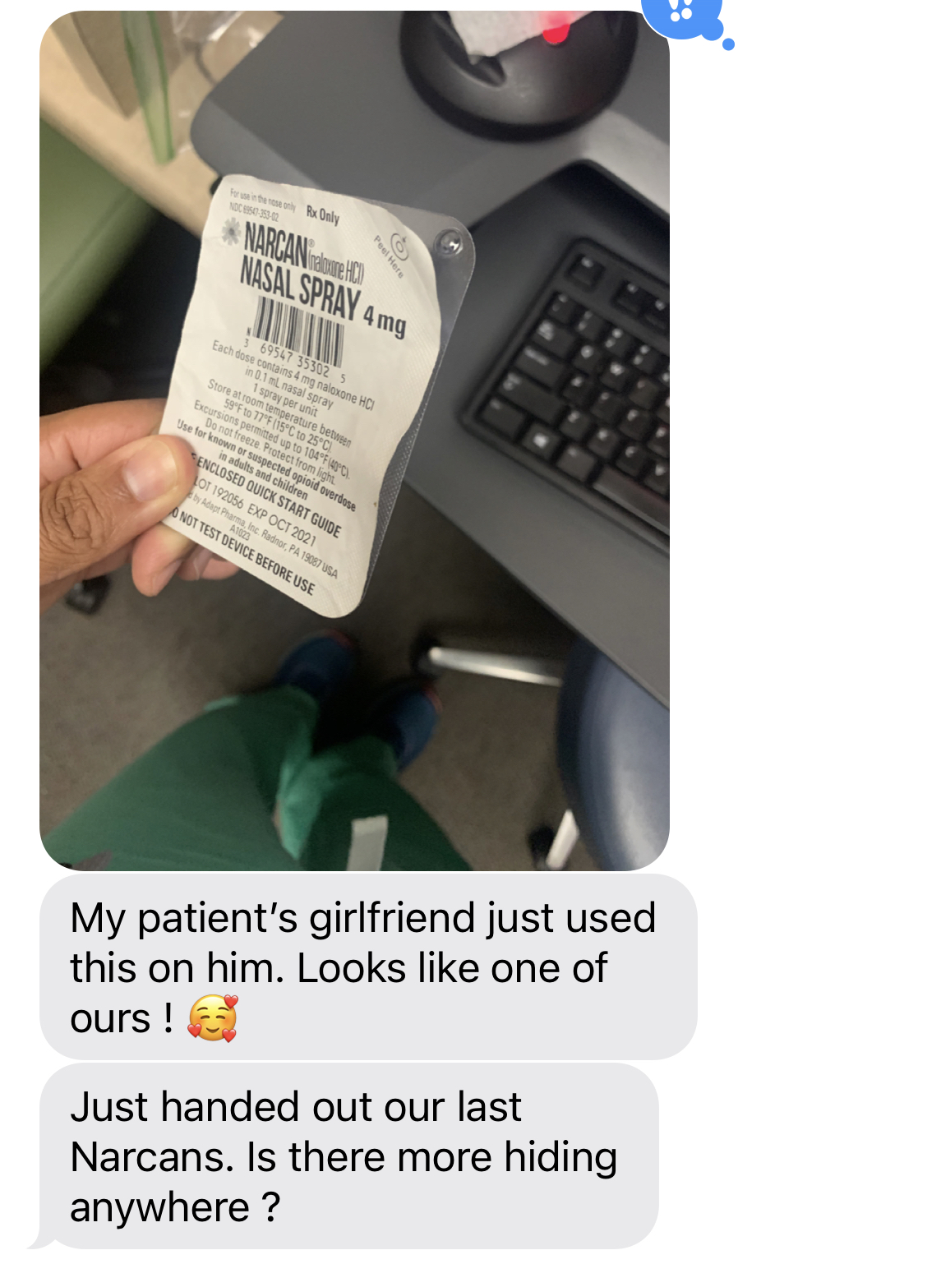
Prioritize Saving Lives

