Slide 1
What about nights, weekends, and wait times?
Adding an on-demand mobile telemedicine component to a community-based, post-overdose peer support outreach program
Rachel P. Winograd. PhD, Katherine Brown, LSCW, Zach Budesa, PhD, Bradley Wing, PhD, Chelsey Wilks, PhD, Devin Banks, PhD, Ryan W. Carpenter, PhD, Wendy Orson., Christie Becker-Markovich, Meghan Zychinski,, Rithvik Kondai, Sarfaraz Jasdanwala, MD
The authors have no conflict of interest to report
Notes:
Question: Would you like everyones names spelled out? If so, I’ve written out the names of everyone that I do know–I don’t know the rest (apart from Vik).
Winograd, R.P, Brown, K., Wilks, C., Banks, D., Carpenter, R.W., Orson, W., Becker-Markovich, C., Zychinski, M., Wing, B., Kondai, R., Jasdanwala, S.

Slide 2
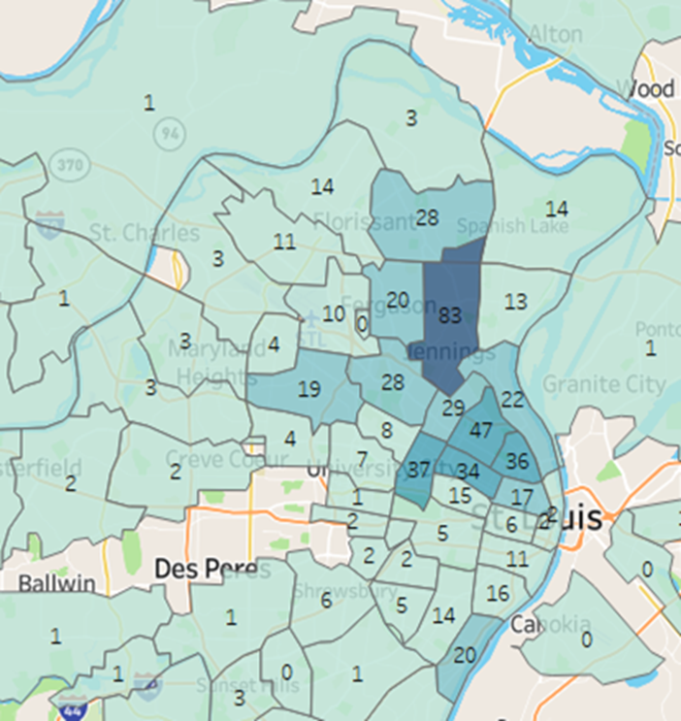
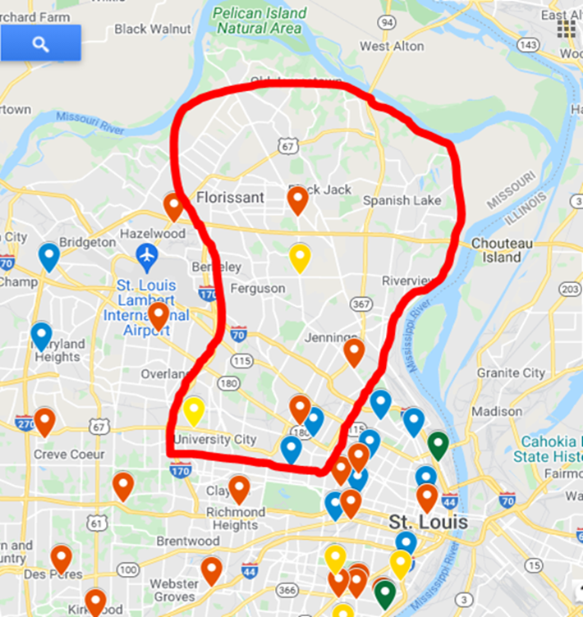
The Problem(s)
Difficult to make immediate connections to buprenorphine at critical intervention points
Nights, weekends, long clinic wait times
Racial disparities in access, engagement, and overdose
Resource deserts in North St. Louis
Notes:
https://www.stlouisfed.org/open-vault/2020/august/racial-inequality-looms-large-missouri-other-states
https://ascpjournal.biomedcentral.com/articles/10.1186/s13722-021-00256-4 (racial disparities in substance use treatment)

Slide 3
Local + National Context
Local STL peer intervention program (EPICC) connects people to SUD treatment post-overdose (and in other situations)
Sometimes people get started on meds in the hospital
BUT multiple logistical barriers to fast clinic appointments remain
In 2020, buprenorphine induction rules were loosened due to COVID-19
First appointments via telemed now permitted
Notes:
https://www.deadiversion.usdoj.gov/GDP/(DEA-DC-022)(DEA068)%20DEA%20SAMHSA%20buprenorphine%20telemedicine%20%20(Final)%20+Esign.pdf

Slide 4
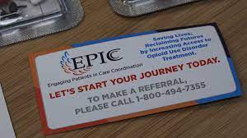
Introducing… EPICC Rapid Access MAT Pilot
Combining Components:
Peer outreach coaches to connect with person seeking MAT - provided tablets and wifi hotspots
+
Addiction Medicine physician available 24/7 and willing to do 3-5 day “bridge prescriptions” until 1st clinic appointment

Slide 5
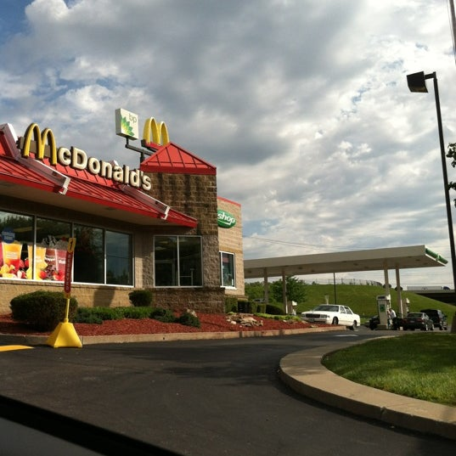
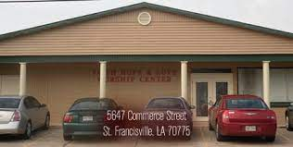
Rapid Access Mobile
Telehealth Locations
Outside hospitals
Fast food locations
Gas stations
Community Churches

Slide 6
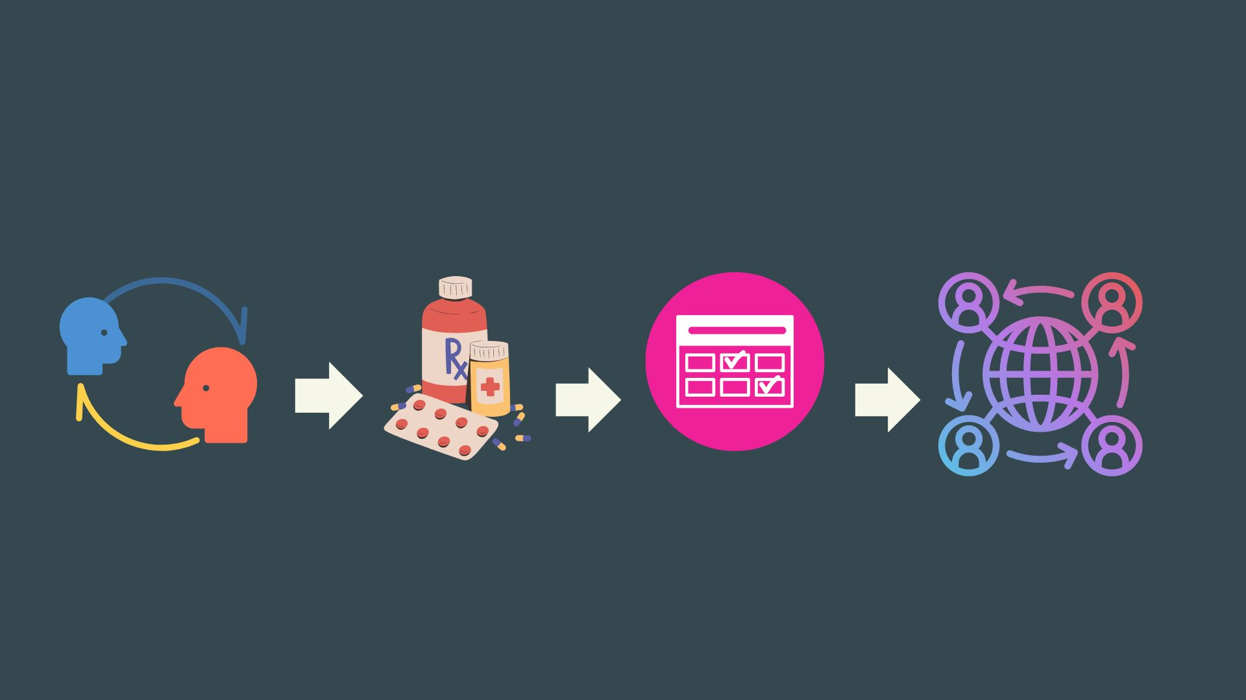
Ideal EPICC Rapid Access Path
Connect to peer outreach coordinator
3-5 day bridge prescription via tablet telemed
Soonest SUD treatment
appointment follow-up
Continued MAT

Slide 7
Research Question
Does rapid access to MAT via telemedicine, within a community-based peer outreach post-overdose program, improve 1 and 3 month ‘formal treatment’ and MAT retention?

Slide 8
Dataset
Time Period:
All EPICC peer outreaches from 12/1/2020 - 6/30/2022
Data source:
EPICC’S Efforts to Outcomes (ETO) data tracking system
Includes SUD treatment service claims
Notes:
They verified through episodes of care billing data in CIMOR but also would cross check in corresponding agency EHRs as sometimes billing claims did not keep up with EPICC form timelines
Once engagement was verified through those systems, they would answer the y/n question in ETO regarding treatment engagement -- which is what we ultimately used.

Slide 9
Analytic Methods
Outcomes Variables of interest at 1 month & 3 months:
Engaged in treatment
On MAT
Propensity scoring to account for different likelihood of being in the Rapid Access group:
Estimated based on:
Demographics, Engagement variables, Insurance Status, Housing Status
Comparison groups:
Rapid Access (N = 51)
Matched Control Treatment As Usual (TAU) (Overall N = 4,936; Matched n = 102)
Additional comparisons
Hospital Bridge
Notes:
Propensity scores estimated using a logistic regression.
Treatment Variables: Outreach Coach, Referring Agency, Initial Treatment Path (MAT, Recovery Coach, etc.), Previous SU Treatment, Referral after Overdose
Matched control group constructed using a nearest neighbor algorithm on propensity scores.
2:1 ratio for TAU to increase the control group to increase estimate precision (Austin, 2010)
22 total variables.

Slide 10
Table 2. Comparing Rapid MAT matched controls
 | Rapid MAT n=51 |  |  | Matched Controls n=102
Outcome | N | % |  | N | % | Est | OR | p
Client still engaged formal treatment 1 month | 28 | 54.90% |  | 35 | 34.31% | .846 | 2.331 | .016
Client still engaged MAT 1 month | 27 | 52.94% |  | 35 | 34.31% | .767 | 2.154 | .028
Client still engaged formal treatment 3 months | 17 | 33.33% |  | 23 | 22.55% | .541 | 1.717 | .155
Client still engaged MAT 3 months | 14 | 27.45% |  | 24 | 23.53% | .207 | 1.230 | .597

Slide 11
Table 3. Comparison of all groups to Rapid MAT with matched controls
 | Rapid MAT n=51 |  |  | Hospital Bridge Match n=111 |  |  |  |  |  | TAU Match n=93
Outcome | N | % |  | N | % | Est | OR | p |  | N | % | Est | OR | p
Client still engaged formal treatment 1 month | 28 | 54.90% |  | 35 | 31.53% | -.23 | .79 | <.01 |  | 30 | 32.26% | -.23 | .80 | .01
Client still engaged MAT 1 month | 27 | 52.94% |  | 34 | 30.63% | -.22 | .80 | .01 |  | 29 | 31.18% | -.22 | .80 | .01
Client still engaged formal treatment 3 month | 17 | 33.33% |  | 23 | 20.72% | -.13 | .88 | .08 |  | 19 | 20.43% | -.13 | .88 | .08
Client still engaged MAT 3 month | 14 | 27.45% |  | 23 | 20.72% | -.07 | .93 | .34 |  | 20 | 21.51% | -.06 | .94 | .42
Notes:
Using RA as the reference group (as opposed to TAU)
21% less likely – 20% less likely

Slide 12
Racial Makeup
 |  | Rapid Access | Treatment as Usual | Matched TAU
Total Served |  | N = 51 | N = 4,934 | N = 102
Race
Black |  | 31.37% | 48.14% | 42.16%
White |  | 66.67% | 49.37% | 55.88%
Not Black or White |  | 1.90% | 1.64% | 1.96%
^{j}𝞆2= 5.92 (1, N = 4986); p = .015
**White people more likely to receive Rapid Access intervention**
Notes:
Chi Square = 5.92
p= .015

Slide 13
Conclusions
Compared to the standard EPICC program, the community based, peer-run rapid access telehealth program was associated with greater likelihood of:
Being engaged in treatment at 1 month
Still being on MAT at 1 month
No associations at 3 months
Fewer Black people were served in Rapid Access compared to treatment as usual
Notes:
https://ascpjournal.biomedcentral.com/articles/10.1186/s13722-021-00256-4 (racial disparities in substance use treatment)
Burlew, K., McCuistian, C. & Szapocznik, J. Racial/ethnic equity in substance use treatment research: the way forward. Addict Sci Clin Pract 16, 50 (2021). https://doi.org/10.1186/s13722-021-00256-4

Slide 14
Limitations & Things we still don’t know
Outcome measures are not ideal
Formal treatment engagement does not = “Success” (and vice versa)
Many unmeasured variables at play
Which treatment agency did they land at? How did the pharmacy Rx pickup go?
What are the reasons behind the racial disparities in access to the intervention?
Black individuals offered less often, are less receptive, something else?

Slide 15
Verbal Feedback from Peer Coaches
“ I could make this phone call for you right now and we could get the process going. And that for me was just readiness and a way to get people engaged into something right now”
“Oh, my God, I would love when I could get someone on Fridays, because… can get that rapid access, and they know that they they're not going to be just sick, you know"
“[Clients] were shocked at first that it was that easy and that they could ya’know get the medication that they needed without being in a hospital or in a treatment facility”
“I would love to see methadone incorporated”
“Hell yes continuing it, expanding it even, statewide or even nationally… But yea, a bridge, a live, living bridge script 24/7 available via phone or tablet, absolutely necessary. Very helpful.”
“I would like to see that it continues because.. to me that empowers people way more then they could imagine.”

Slide 16
SPECIAL THANKS TO
UMSL
Zach Budesa, PhD
Katie Brown, LCSW
Schyler Newman
UMSL Addiction Science team
Behavioral Health Network
Brad Wing, PhD
Wendy Orson
Peer Coaches!!!
Notes:
Who helped with this

Slide 17
Questions?

Slide 18
Introducing… EPICC Rapid Access MAT Pilot
The Idea:
Connect people to bupe within hours not days
Increase peer outreach to North St. Louis to increase engagement in predominantly Black neighborhoods with highest OD rates and service deserts

Slide 19
Take-aways
Adding mobile telemedicine to peer outreach post-overdose intervention programs shows promise
Combines 2 key elements: Peer connections + Fast(er) medical relief
Racial disparities in access despite intentions to improve engagement among Black participants.
Efforts should focus on reaching and connecting with Black people who use drugs in resource-limited settings
Notes:
As enrollment is ongoing, we will be better able to detect significant impacts on MOUD maintenance and treatment retention by Fall of 2022. Additionally, more work is needed to increase engagement with Black overdose survivors.
Add thank you slide and names of everyone youre thanking - addiction science team people who weren't on abstract, the peer specialists

