Slide 1
The 72-Hour rule An Underutilized Pathway to Methadone Treatment Entry
James Evans, BSN RN
Nurse Care Manager, Faster Paths
Boston Medical Center
William E. Soares, MD MS
Director of Harm Reduction
Emergency Medicine
Baystate Medical Center
Daniel Greer, LMHC
Regional Vice President
Health Care Resource Centers
Baymark Health
Natalija Farrell, PharmD
Department of Pharmacy, Emergency Medicine
Chobanian & Avedisian School of Medicine
Boston Medical Center
Jessica L. Taylor, MD
Medical Director, Faster Paths
Chobanian & Avedisian School of Medicine
Boston Medical Center

Slide 2
Introductions

Slide 3
Disclosures & Funding
No financial conflicts of interest
Funding
INTF2301M03163724179 (MDPH BSAS, PI: Taylor)
Christine: T25HP37593 (HRSA, PI: Walley)

Slide 4
Objectives
Define the “72-hour rule” for emergency opioid withdrawal management
Describe the use of 72-hour rule methadone in an outpatient bridge clinic and early outcomes
Discuss implementation of 72-hour rule methadone
Regulatory considerations
Clinical approach
OTP referral and direct admissions
Emergency department

Slide 5
Background

Slide 6
Methadone
Methadone is a first-line medications for OUD¹⁻⁵
Fentanyl has complicated buprenorphine inductions, making methadone more important than ever ^{6,7}
Methadone for OUD treatment is limited to highly-regulated opioid treatment programs (OTP)⁸
The number and capacity of OTPs is insufficient⁹⁻¹¹
Racial and socioeconomic inequities in OTP entry and retention¹²⁻¹³
Alavian 2013. 2. Bruce 2010. 3. Mattick 2014. 4. Gowing, JGIM, 2006, 2022. 5. Taylor & Samet, Annals, 2022. 6. Antoine 2021. 7. Silverstein 2019
8. Certification and Treatment Standards for OTPs 9. Jones 2015. 10. Rosenblum 2011. 11. Sigmon 2014. 12. Gryczynski 2011. 13. Lo 2018.

Slide 7
The 72-Hour Rule
Allows non-OTP physician to administer “narcotic drugs to a person for the purpose of relieving acute withdrawal symptoms”¹
Permitted for up to 3 days while arranging ongoing treatment
Medications must be administered, not prescribed
No more than 1 day’s medication administered at one time*
72-hour period cannot be renewed or extended
Title 21, CFR, Part 1306.07b
* New Guidance in March 2022 allows providers to apply to dispense up to a 3-day supply

Slide 8
72-Hour Rule Potential
Pathway to withdrawal management in emergency departments, bridge clinics, and other outpatient settings
Withdrawal management on demand, capitalizing on moments of readiness
Can be paired with direct OTP admission to expedite treatment entry
Allows use of clinically appropriate methadone doses

Slide 9
72-Hour Rule: Published Examples
ED administration during Hurricane Sandy
IM administration of methadone in ED for opioid withdrawal
March 2021 case report in outpatient, low-barrier bridge clinic
54-year-old woman with severe OUD, prior overdose referred from ED
Buprenorphine/naloxone only partially effective for cravings
Initial COWS 12
Opioid withdrawal treated with 20 mg methadone
Returned the next day, COWS 11, treated with 40 mg methadone
Successfully linked to OTP on day 3
Remained enrolled over 3 months later, stable dose 80 mg
McClure et al., J Urban Health 2014; Su et al, Am J Em Med, 2018; Laks, et al, Addict Sci Clin Pract, 2021

Slide 10
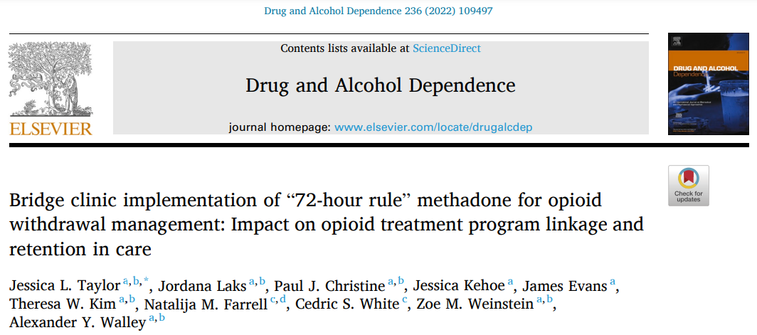
72H Methadone: Early Data

Slide 11
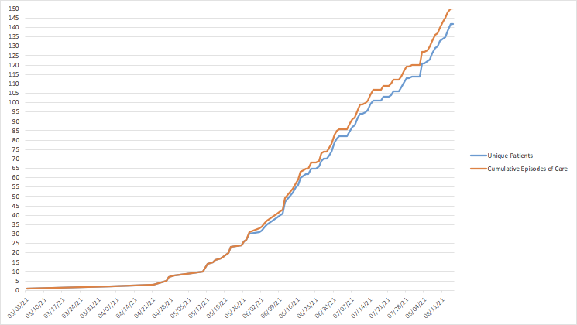
72-Hour Methadone: High Demand
Signed agreement with OTP 2 + OTP 3
Signed agreement with OTP 1
Methadone added to med cabinet
Pilot case
Unique Patients Treated & Cumulative Episodes of Care in Faster Paths, March 3 – Aug 15, 2021
Taylor, et al, DAD, 2022.

Slide 12
72H Methadone Patient Characteristics
First 150 episodes of care included 142 unique patients
73% male
67% white, 15% Black, 20% Hispanic, per EMR fields
40.1 years, mean age
93% Medicaid, 4% Medicare
Majority using fentanyl + stimulant
HIV prevalence 15%
Mean past-12-month ED visits: 4.3
Top referral source: Boston Healthcare for the Homeless Program
Taylor, et al, DAD, 2022.

Slide 13
72H Methadone: COWS + Dose
Taylor, et al, DAD, 2022.

Slide 14
72H Methadone: Referral Completion
Plans for Ongoing Care for 72H Methadone Treatment Episodes in Faster Paths, March 3 – Aug 15, 2021
Taylor, et al, DAD, 2022.

Slide 15
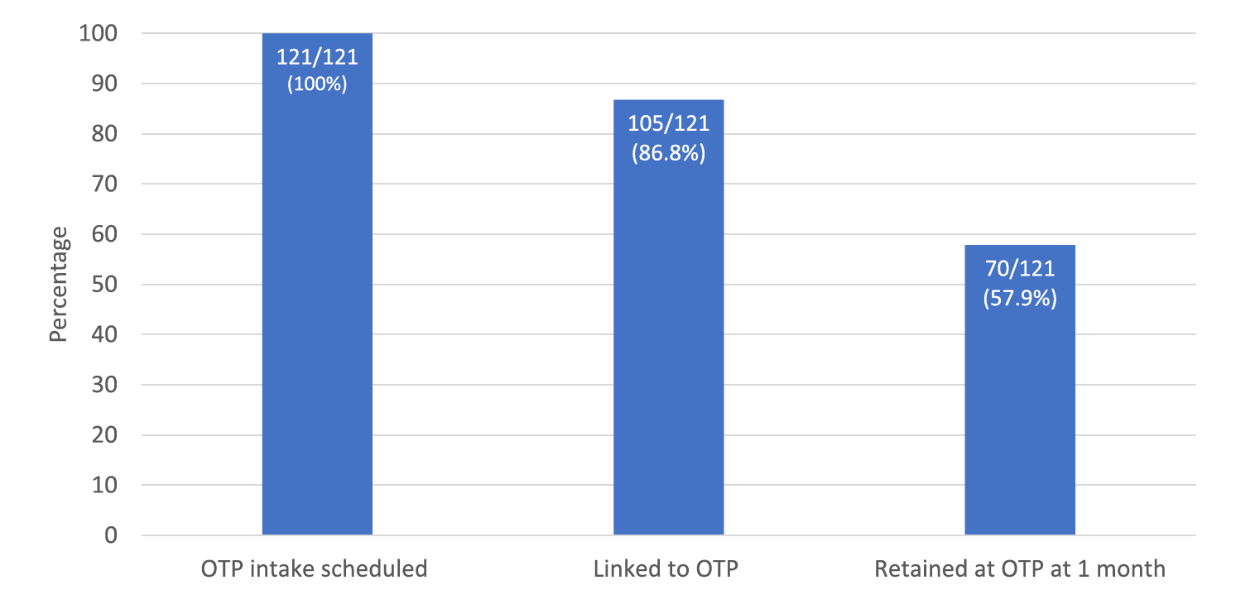
72H Methadone: OTP Linkage & Retention
Among the 121 referrals to two primary OTP partners:
87% (105/121) successfully linked
Of those who linked, 67% retained at OTP at one month.
Overall, 58% (70/121) retained at OTP at one month
OTP Intake, Linkage, and 1-mo Retention at 2 primary OTP Partners, March 3 – Aug 15, 2021
Taylor, et al, DAD, 2022.

Slide 16
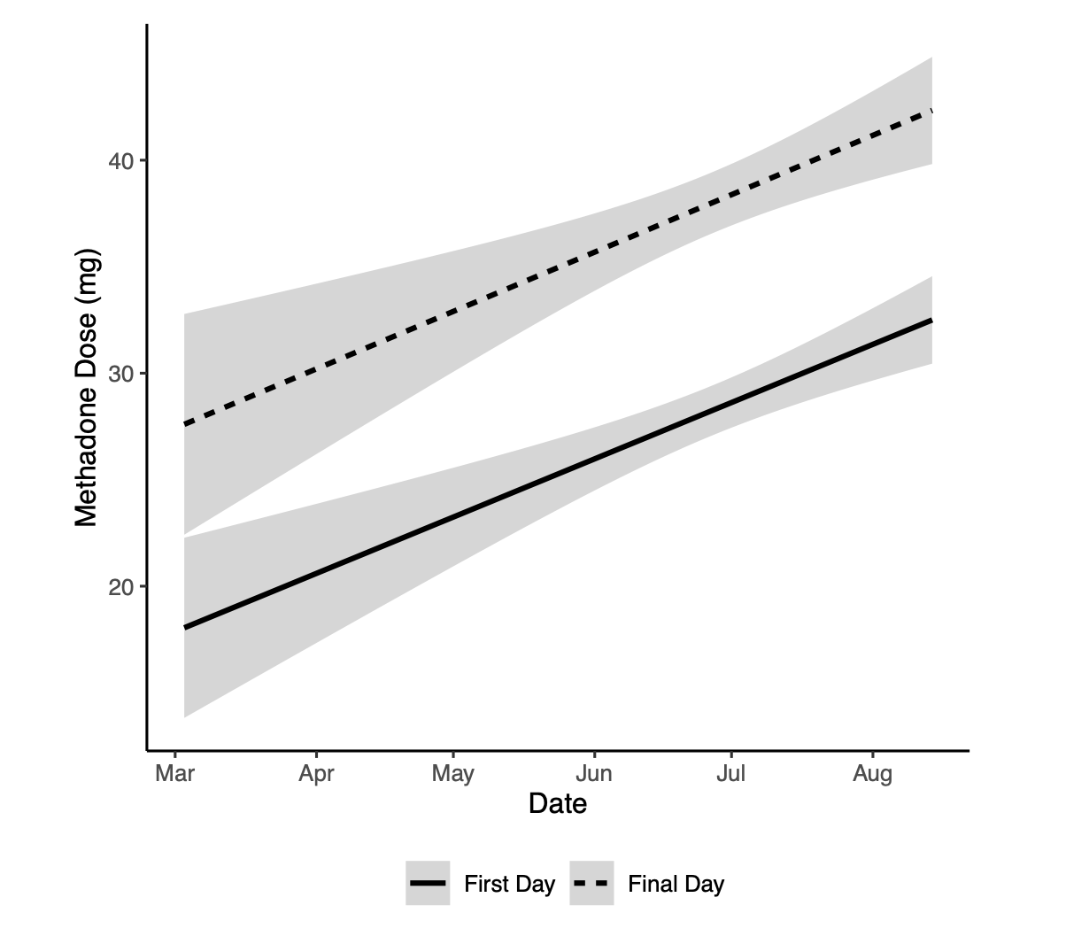
72H Methadone: Dose Trends
Methadone doses increased over time
Increasing provider comfort
Challenges with inadequate withdrawal symptom control
Patients with high fentanyl tolerance and no risk factors for over-sedation now commonly treated with 40-50-60 mg
Temporal Trends in Methadone Dosing for Opioid Withdrawal at Faster Paths, March 3 – Aug 15, 2021
Taylor, et al, DAD, 2022.

Slide 17
Regulatory & compliance considerations
Not legal advice, consult local counsel!

Slide 18
Collaboration Essential for Implementation
72 Hour Rule
SUD Bridge Clinic
Emergency Department
Pharmacy Department
Legal
Internal Medicine Department
Addiction Consult
Nursing
Information Technology
Key Internal/
Institutional Partners

Slide 19
Joint Commission & DEA Requirements
High-alert and hazardous medications
Reporting on diversion and loss of controlled substances
Medication storage and security
Medication orders, order review, and administration
Medication management system evaluation
Collect and trend data, identify risk points
Maintain an automated dispensing cabinet policy including override review
Identify opportunities for improvement
The Joint Commission. 2022 Comprehensive Accreditation Manual for Hospitals (CAMH)

Slide 20
Methadone Formulations
 | Pro’s | Con’s
Methadone 1 mg/ml Oral Solution | Customizable Doses Compound Fixed Doses | Volume Taste Inventory Count (Bulk Bottle) Waste (Bulk Bottle vs Oral Syringe)
Methadone 10 mg/ml Oral Solution | Customizable Doses Compound Fixed Doses Consistent with OTPs | Taste Inventory Count (Bulk Bottle) Waste (Bulk Bottle vs Oral Syringe)
Methadone Injectable | Compliance Alternative Administration Route | Conversion Errors Cost Clinical resources for injection
Methadone 5 mg & 10 mg Tablets | Inventory Counts Cost | Diversion Potential Dissimilar to OTPs
Methadone 40 mg Dispersible Tablets | Inventory Counts Less Diversion Potential than Regular Tablets | Cost Can’t Customize Doses

Slide 21
Clinical Approach & Collaboration

Slide 22
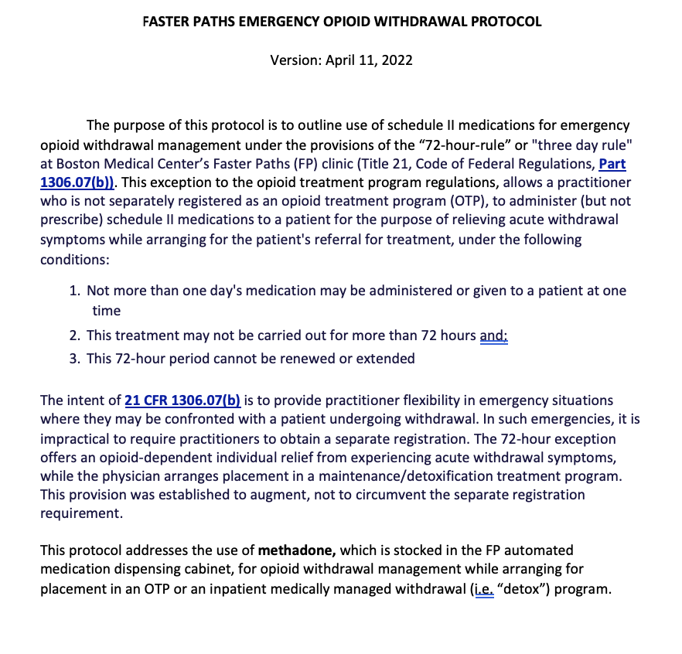
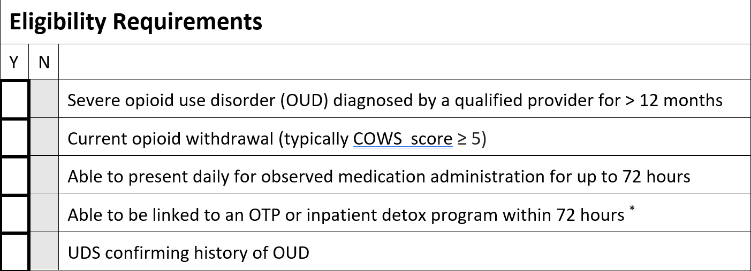
Who’s Eligible?
Taylor, et al, DAD, 2022.

Slide 23
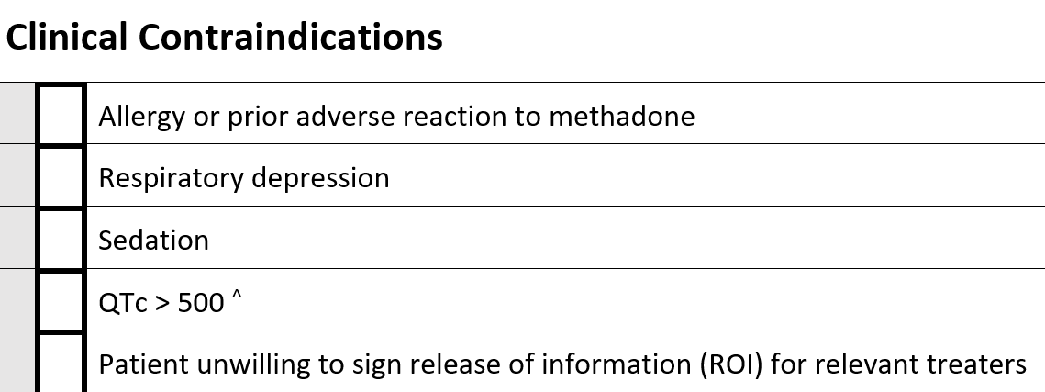
Who’s Eligible?
Taylor, et al, DAD, 2022.

Slide 24
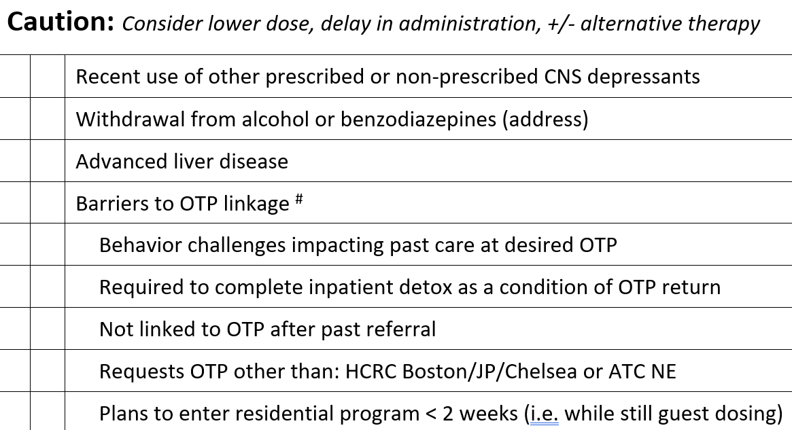
Who’s Eligible?
Taylor, et al, DAD, 2022.

Slide 25
OTP Perspective & Direct Admissions

Slide 26
Engagement with OTP Program
Patients must be eligible for OTP including able to present 7 days/week during dosing hours and participate in treatment requirements
Care coordination with specified staff “point-person” who has knowledge of all potential direct admissions in process
Review and approval of potential referrals- communication is key!
Patient information entered to create “host-dose” chart
Admission appointments scheduled - must be done quickly
Patient doses daily in a manner consistent with a “host doser” after initial meeting with staff

Slide 27
OTP Treatment: Important Information
Agreeing to the commitment of OTP
Daily on-site dosing – take homes must be earned over time
Required counseling – individual and group
Medical appointments
Tox screens – urine or oral swab
Appropriate behavior in the treatment environment
Understanding impact of housing & transportation on location of OTP
Dosing methadone once daily in the morning (specific dosing hours vary by site)

Slide 28
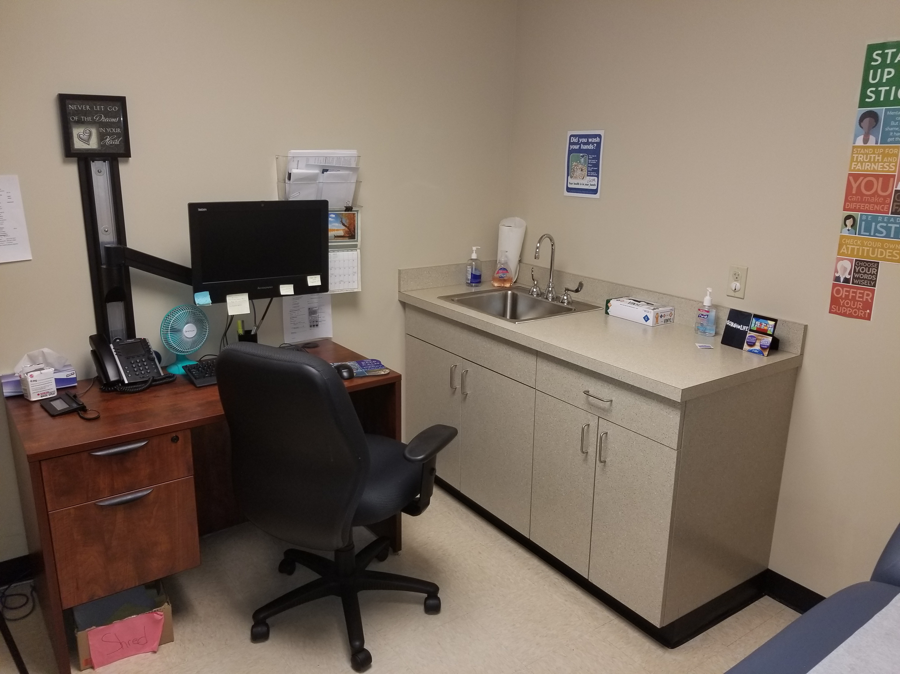
Admission
Patients must meet with Doctor or qualified Nurse Practitioner in person to complete admission physical and be fully admitted
This is final appointment in admission process
Initial orders submitted by provider to enable patient’s dose to be adjusted as needed
Must be done quickly - there is no home clinic

Slide 29
Emergency Medicine Implementation

Slide 30
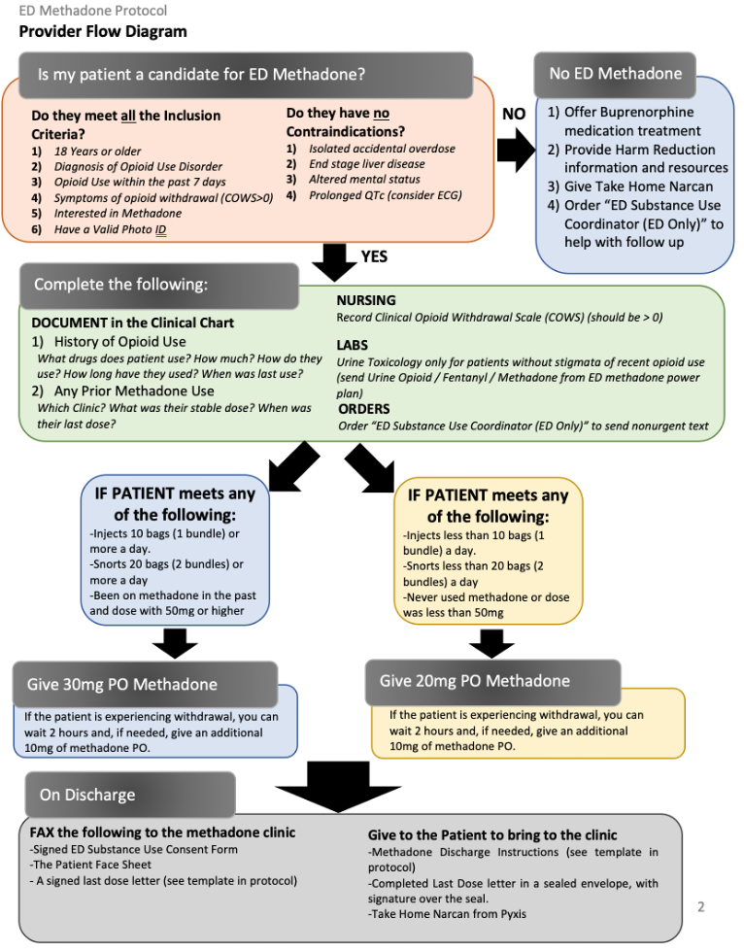
ED Protocol

Slide 31
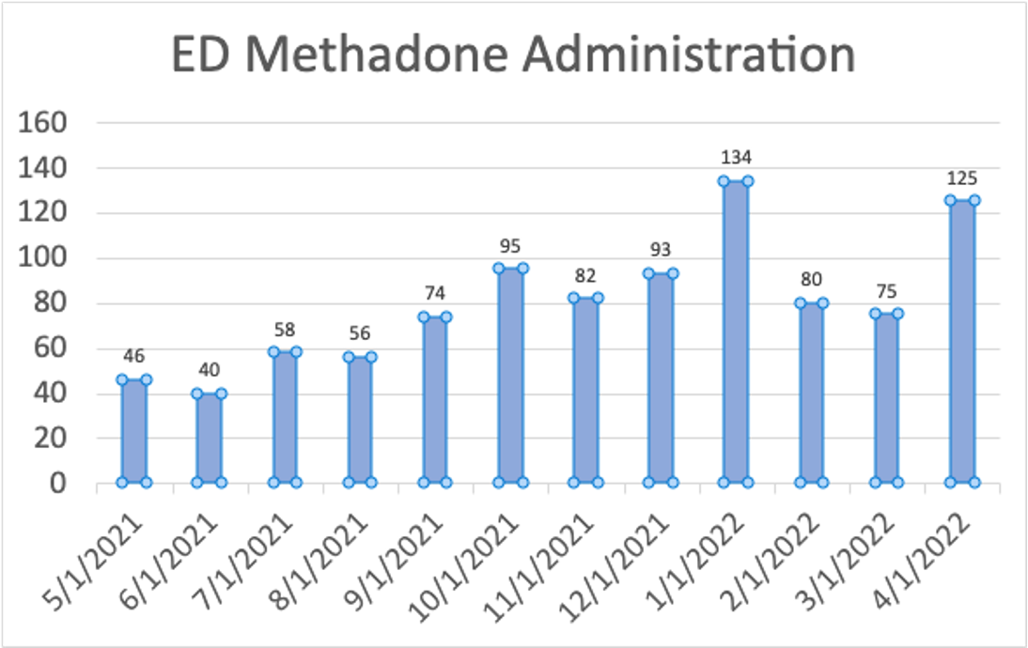
Harm Reduction in the ED

Slide 32
72H Methadone: ED Utilization
Preliminary data suggests decreased ED utilization
First 142 patients had 200 fewer BMC ED visits in 6 months post-72H methadone compared to 6 months pre-
Current work led by fellow Dr. Paul Christine analyzing ED utilization in larger cohort
Faster Paths, unpublished data

Slide 33
Novel Uses & Clinical Challenges

Slide 34
Novel Uses of 72H Methadone
Treatment of opioid withdrawal while linking to ongoing buprenorphine care via low-dose induction
Reduces use of fentanyl during transition
Case report in preparation
Treatment of opioid withdrawal to facilitate linkage to inpatient admission (e.g., endocarditis, abscess) with direct OTP admission from hospitalization
Day | 1 | 2 | 3 | 4 | 5
Buprenorphine | 0.25 mg QD | 0.25 mg BID | 0.5 mg BID | 1 mg BID | 2 mg BID
Methadone | N/A | N/A | 40 | 30 | 20

Slide 35
What’s next

Slide 36
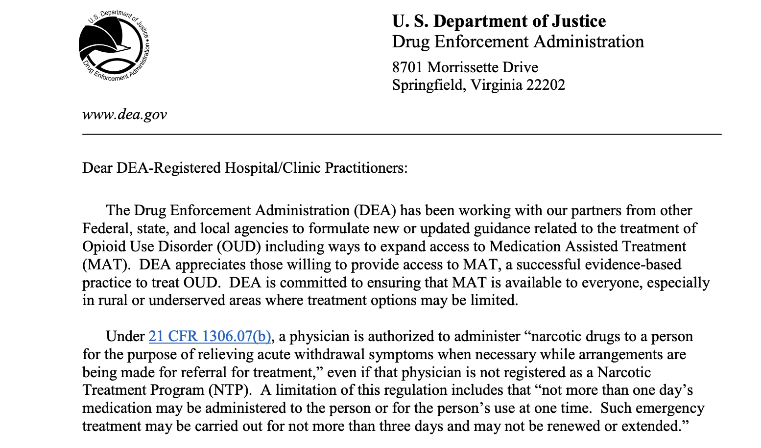
March 2022: 72H Expansion
DEA amended regulation to allow dispensing of a three-day supply of medication to treat withdrawal symptoms
Specifies buprenorphine & methadone included
Individual providers must receive an exception
Email ODLP@dea.gov
Subject line ”Request for Exception to Limitations on Dispensing for OUD”
Include DEA number, address
www.dea.gov

Slide 37
What’s Next
Consider use of short acting opioids under expanded 72H regulation to facilitate low-dose buprenorphine inductions
Evaluate outcomes for patients treated with high vs low dose methadone strategy
Consider role for OTP license vs satellite in clinical spaces
Leverage 72H methadone experience in advocacy

Slide 38
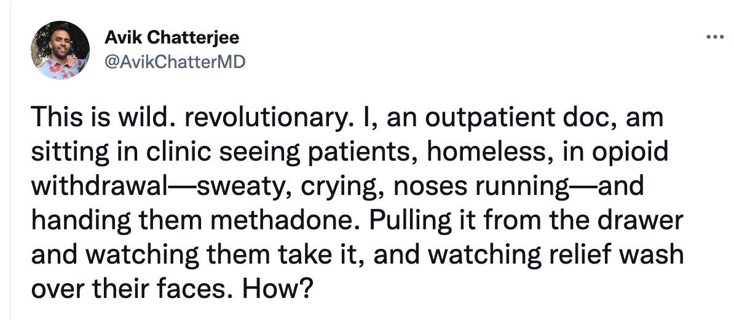
72H Methadone
Something we can do NOW
Twitter.com

Slide 39
Thank you! Questions, comments?

