Slide 1
Addiction Nursing: Some things change; some things stay the same
Donna Beers, MSN, RN-BC, CARN

Slide 2
THANK YOU
Justin Alves
Sarah Bagley
Jimmy Evans
Jason Fox
Amy Fitzpatrick
Nancy Gaden
Colleen Labelle
Christine Pace
Annie Potter
Glory Ruiz
Jessica Taylor
Alex Walley
Kristin Wason
Zoe Weinstein
Courtney Urick

Slide 3
I am an addiction nurse
Engagement and retention for persons with substance use disorders, primarily opioid use disorders
Doing what it takes to help people find “steady ground”
Have witnessed successes, struggles, joy and pain

Slide 4
Ray Bryant, late-1980’s
Patient-centered care
Respectful inquisitiveness
Strengths-based approach
Motivational interviewing
Harm reduction

Slide 5
Jeffrey Samet, January 2002
“Figure out how to get people what they want. Don’t get hung up on obstacles.”
Notes:
.

Slide 6
Jane and Alex
Jane Liebschutz
Alex Walley

Slide 7
Two days at an HIV conference, ~ 2003
Hospitality:
Autonomy, Hospitality, and Nursing Care (Matzko,1996)
Hospitality as sustained attention, comfort and a sense of continuity
Enter as strangers
Diminished sense of agency
Nurses welcome patients

Slide 8
Day 2: Kathy, Mimi, Kristin
Hope:
Relief of suffering and better future
Essential in healing
One of the 10 fundamental components for recovery:
Can be fostered
A catalyst for change
Inspiring hope as nursing competency
SAMHSA (2012), ALBC (2017), Laranjeira (2022)

Slide 9
Early days at BMC—TOP
Hope
Hospitality
Harm reduction

Slide 10
TOPCARE
Pre-fentanyl Donna
Post-fentanyl Donna
“How about giving MOUD a try? You can still attend AA or NA meetings.”
“Let’s talk about that next time.” “Why would you stop a medication that’s working?”
“Just sign here, we can fill these out later. Let’s get you some medication.”
“You don’t have to stop using. If you’re continuing to use, it’s safer to be on MOUD.”
“Sure, give abstinence-based treatment a try.”
“I’m happy to help you figure out a taper.”
Appointment book
“You’re not ready for treatment? No problem. Give me a call when you are.”

Slide 11
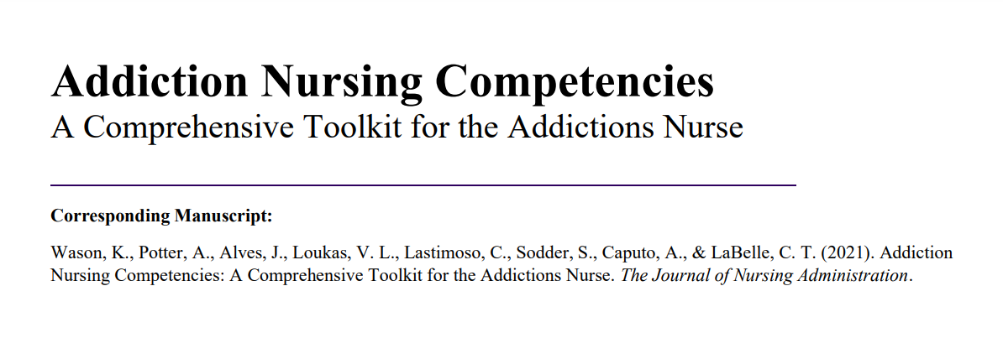
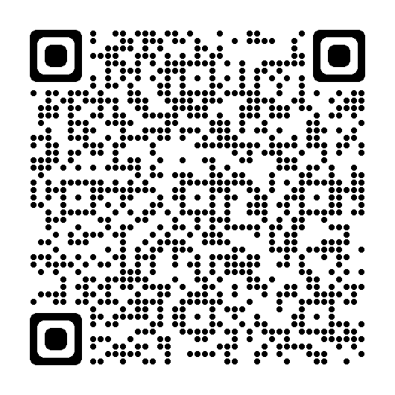
A new sense of urgency—Colleen Labelle
“What is so funny? People are dying out there.”

Slide 12
Opportunities and Obligations
Recruit, support and retain a diverse workforce
People have a right to be treated by people who look like them
Recruit, support and retain a workforce of persons in recovery
People have the right to be treated by people with similar life experiences

Slide 13
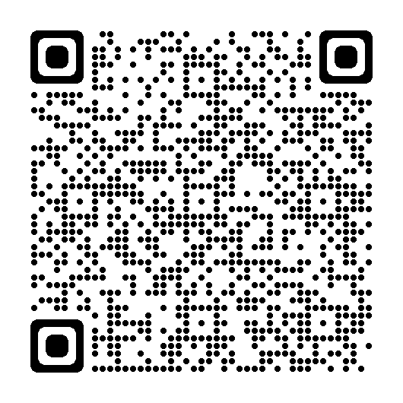
On a diverse workforce: Maya and Audrey
More than 60% of nurses who identify as belonging to an ethnic minority have personally experienced an act of racism in the workplace
Organization of Nurse Leaders: A Tool Kit for Addressing Racism in Nursing and Healthcare (2022)
ANA (2021)

Slide 14
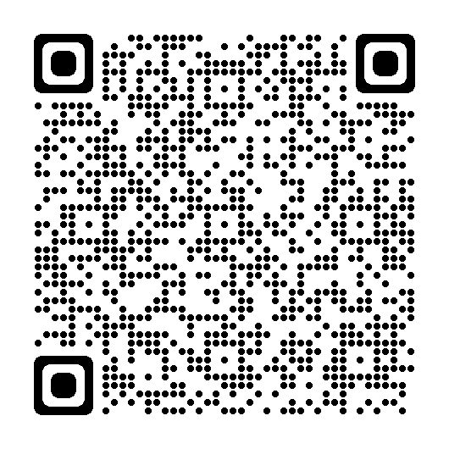
On a recovery workforce: Leo
Persons in recovery provide services to vulnerable people while balancing their own recovery needs
Resource Guide:
Substance Use Disorders Recovery with a Focus on Employment and Education (SAMHSA 2021)
Scannell (2021)

Slide 15
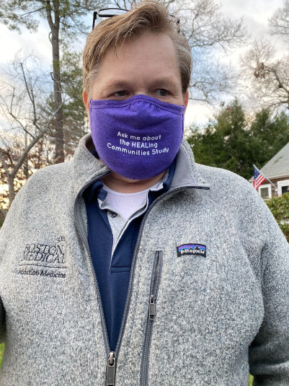
Paul Bowman and Nathan Chase

Slide 16
References
ALBC, R. Healing and Hope Transforming Nursing Care: A Commentary.
American Nurses Association. (2021). National commission to address racism in nursing.
Laranjeira, C. A., & Querido, A. I. F. (2022). The multidimensional model of hope as a recovery-focused practice in mental health nursing. Revista Brasileira de Enfermagem, 75.
Matzko, D. M. (1996). Autonomy, hospitality, and nursing care. Journal of religion and health, 35(4), 283-294.
Organization of Nurse Leaders: A Tool Kit for Addressing Racism in Nursing and Healthcare (2022)
Scannell, C. (2021). By helping others we help ourselves: insights from peer support workers in substance use recovery. Advances in Mental Health, 1-10

Slide 17
References
Substance Abuse and Mental Health Services Administration. (2012). SAMHSA’s working definition of recovery.
Substance Abuse and Mental Health Services Administration: Substance Use Disorders Recovery with a Focus on Employment and Education. HHS Publication No. PEP21-PL-Guide-6 Rockville, MD: National Mental Health and Substance Use Policy Laboratory. Substance Abuse and Mental Health Services Administration, 2021.
Wason, K., Potter, A., Alves, J., Loukas, V. L., Lastimoso, C., Sodder, S., ... & LaBelle, C. T. (2021). Addiction Nursing Competencies: A Comprehensive Toolkit for the Addictions Nurse. JONA: The Journal of Nursing Administration, 51(9), 424-429.

