Slide 1
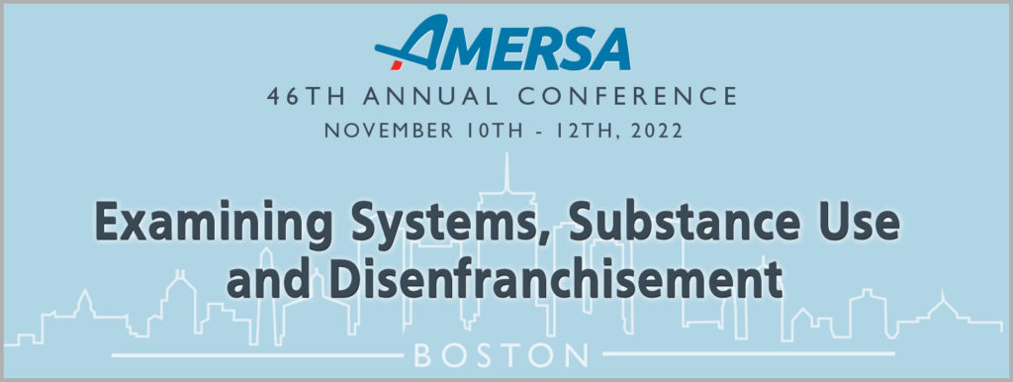
Beyond the Evidence Base: Preserving Dignity and Countering Discrimination in Pregnancy and Parenting
Lisa Sangoi, JD - Movement for Family Power
Mishka Terplan, MD, MPH - Friends Research Institute
Nikki Bell Peña - Living In Freedom Together-LIFT Inc
Moderator: Davida Schiff, MD, MSc - Massachusetts General Hospital

Slide 2
Movement for Family Power Exists to Fight the Foster System’s Policing and Punishment of Families.
\
Our Areas of Work Include:
Building out a loving, healthy community with and amongst people working to contract the Foster system;
Raising social consciousness around the harms of the Foster System and forced family separation;
Dismantling systems that surveil, control and destroy families.
Notes:
Introduce the org

Slide 3
Notes:
Next several slides will look at some uncontested facts about the foster system.
It targets Black children and families

Slide 4
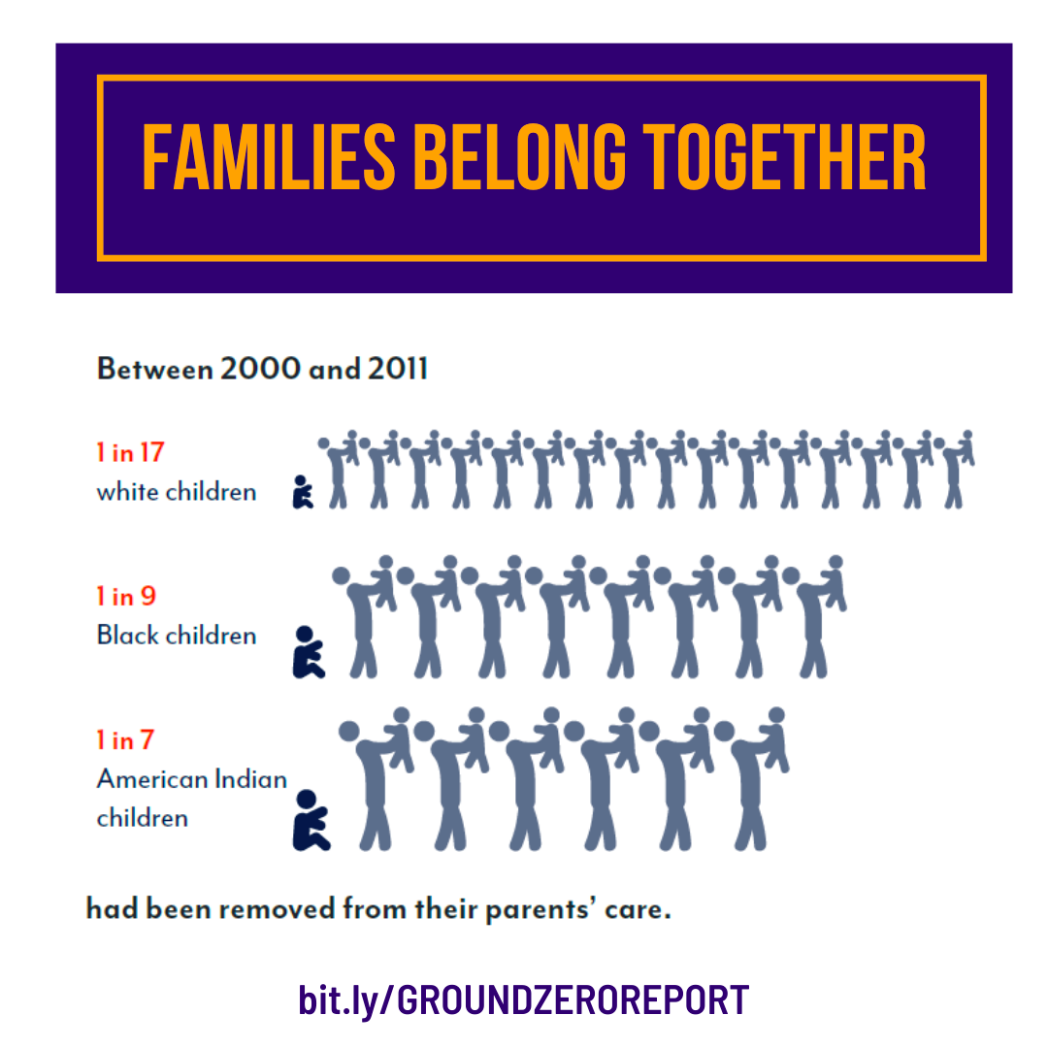
Notes:
11% of black children 14% of indigenous children

Slide 5
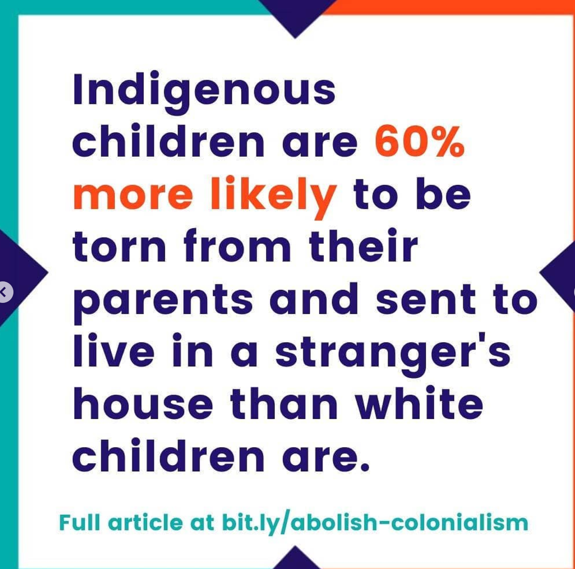
Notes:
Let’s look at some basic stats about child welfare system. It targets Black children and families

Slide 6
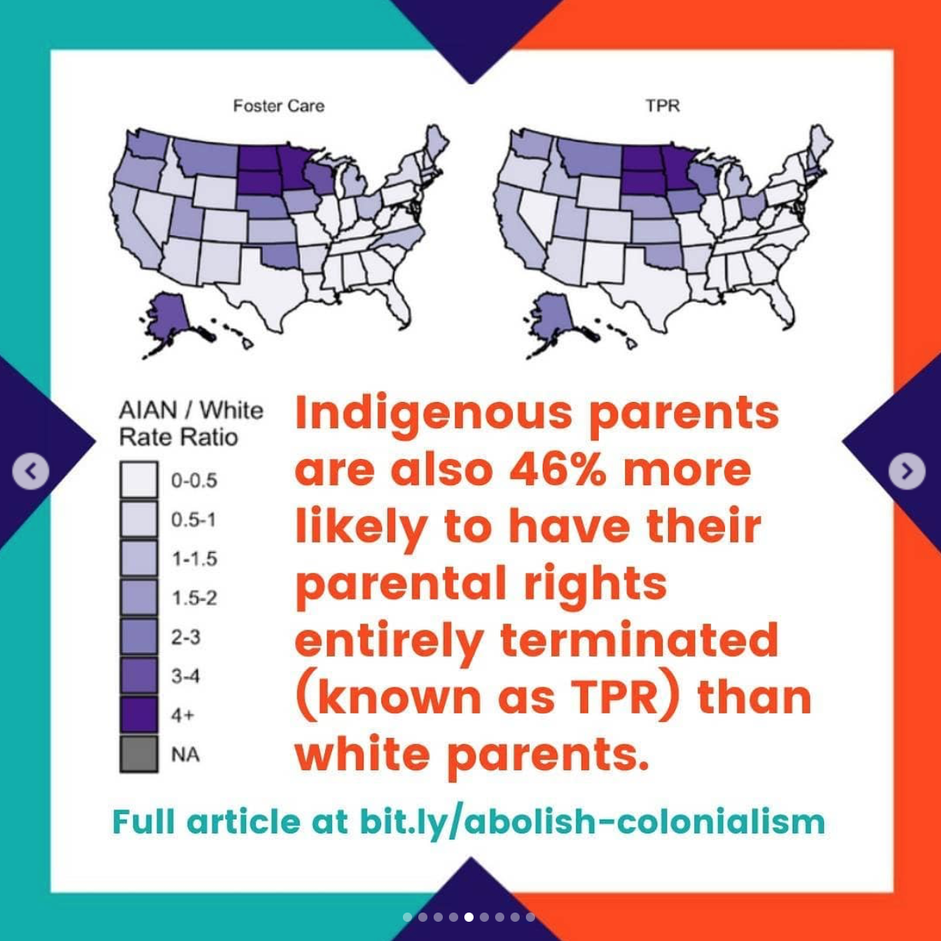
Notes:
First, according to the 2016 estimate, 1 in 100 U.S. children will experience the termination of parental rights by age 18. Second, the risk of experiencing this event is highest in the first few years of life. Third, risks are highest for Native American and African American children. Nearly 3.0% of Native American children and around 1.5% of African American children will ever experience this event.

Slide 7
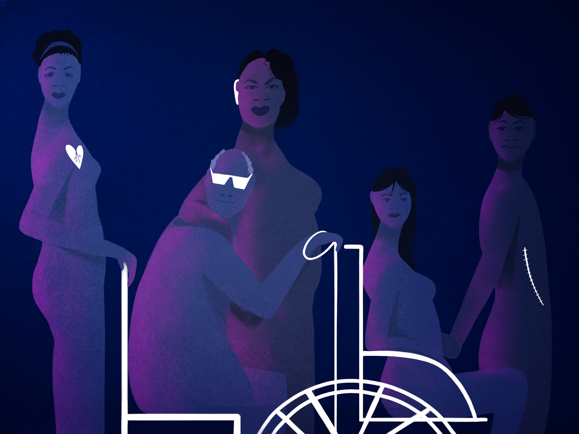
IN 2012, APPROXIMATELY 80% OF PARENTS WITH REPORTED INTELLECTUAL DISABILITIES HAD THEIR CHILDREN REMOVED AND PARENTS WITH A DISABILITY ARE MORE THAN THREE TIMES MORE LIKELY TO HAVE THEIR CHILDREN PERMANENTLY TAKEN (From report titled Rocking the Cradle by National Council on Disabilities)

Slide 8
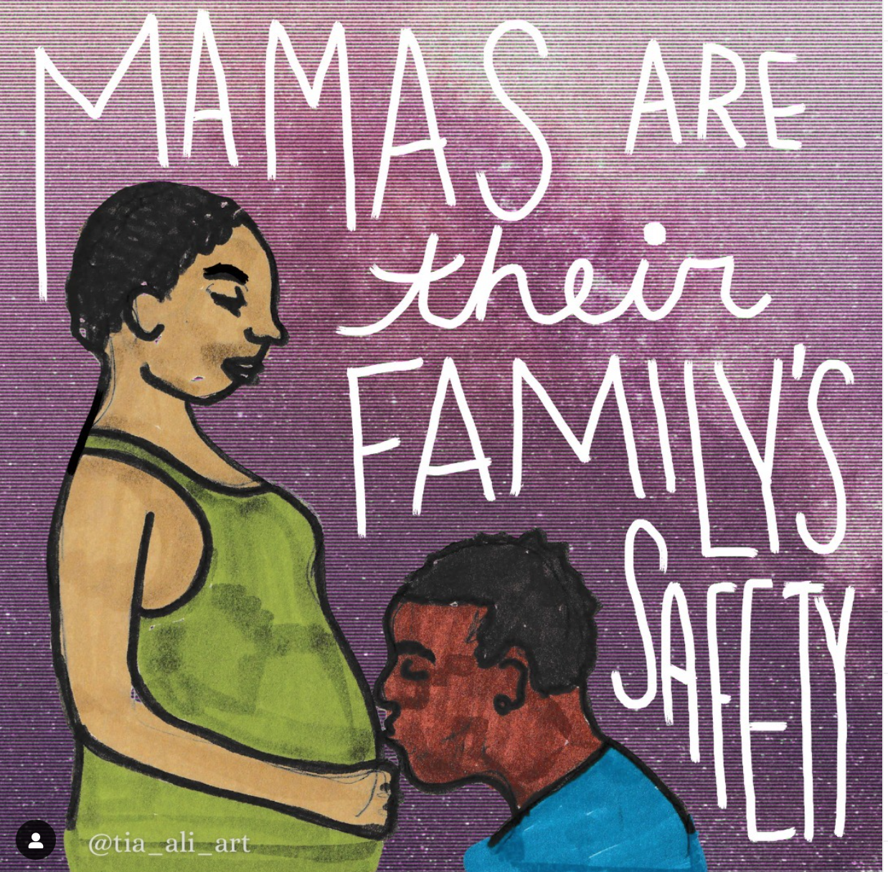
Virtually all families in the child welfare system are low income or poor.

Slide 9
What is the history of Child “Protective” Services in the United States?
Notes:
Abolition teaches us another place to go to understand an injustice is history

Slide 10
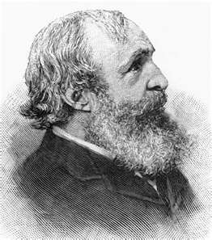
Social control over Safety
Notes:
The Irish and Italian Catholic immigrant children targeted by the “Orphan Train” movement, established by a New York Protestant minister, Charles Loring Brace, in 1852, were not viewed as white when they were forcibly taken from their families and placed on farms all over the country, in the hundreds of thousands.[1] The foster system wanted to protect “decent society” from not just the “menace” their poverty posed but also their “otherness” too, forcibly placing them in middle class Protestant households to socialize them to white middle class ways.[2]
Brace had seen the revolutions in Europe of 1848, and they terrified him. In particular, he was terrified of poor immigrant Catholics, whom he branded a “stupid, foreign criminal class” and the “scum and refuse of ill-formed civilizations.” He worried that “some demagogue might arouse their passions and fuse all the elements for a Parisian scene of riot and blood.”
And, of course, Brace explained, these Catholic immigrant parents were genetically inferior, passing bad “gemmules” on to their children. Fortunately, these ill effects could be reversed – by taking away the children and shipping them out to middle class Protestant farmers in the countryside.

Slide 11
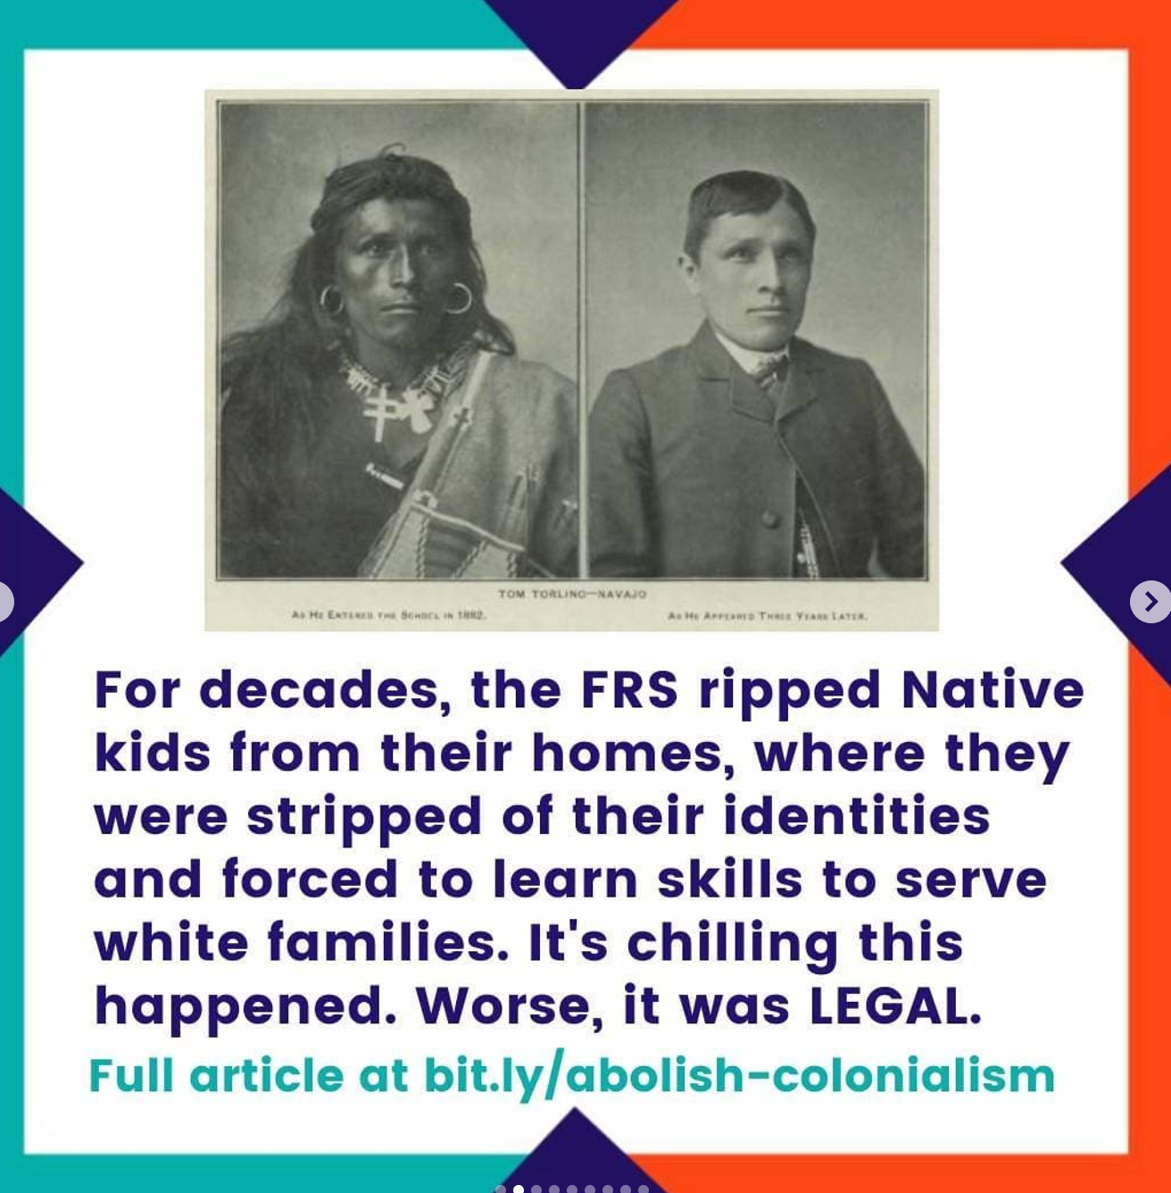
Social Control over Safety
Notes:
the foster system played an instrumental role in the mass removal of American Indian children from their homes and communities to white families, another effort at assimilation and social control. By the 1970s, up to two-thirds of American Indian children no longer lived with their families or even in their own communities.7

Slide 12
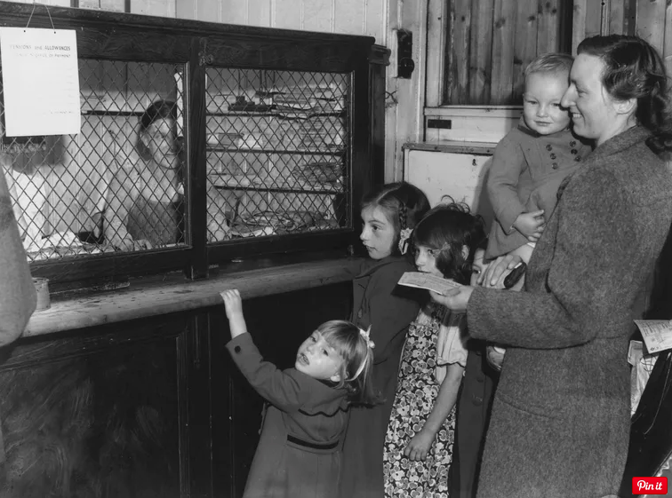
The foster system served the distinct function of identifying and responding to poor parents who were “undeserving” of cash assistance they otherwise qualified for by removing their children from their care. (See Roberts, Shattered Bonds)

Slide 13
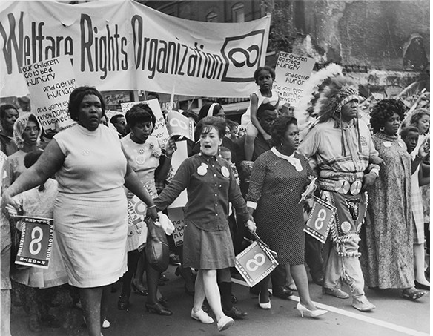
By 1967…. a grassroots movement composed of welfare mothers secured entitlements to benefits, raised benefit levels, and increased availability of benefits to families headed by women. As a result, "by 1967, a welfare caseload that had once been eighty-six percent white had become forty-six percent nonwhite." (paper link)
By 1967...49 states had passed child abuse laws with a mandatory reporting requirement, which were additionally expanded with the 1973 passage of the Child Abuse Prevention and Treatment Act.
Notes:
Indicate that they were self proclaimed welfare mothers

Slide 14
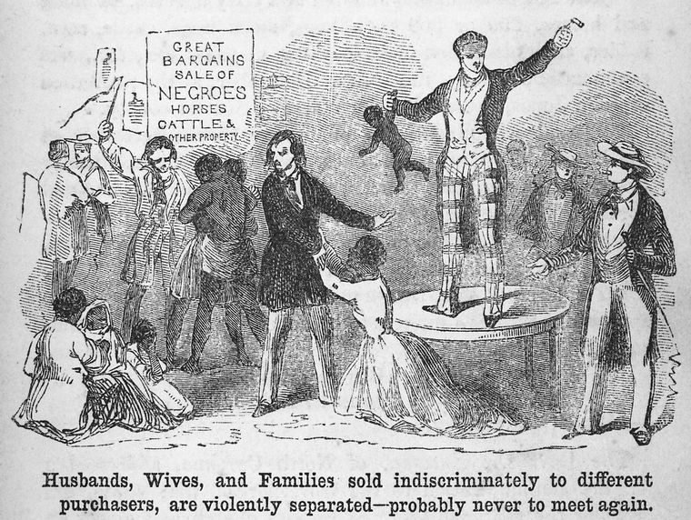
Notes:
Lisa
As William Pryor Letchworth, the most famous advocate of children’s causes at the time, declared in 1874, “If you want to break up pauperism, you must transplant [the child].... When parents cannot protect their child, cannot feed, cannot clothe it,cannot keep it from evil in uence, and are perhaps degrading it by their own example, it is the duty of every true man to step forward to save it.”
One of the roots of the modern child welfare system were mid and late 19th century orphanages and child saving operations, undertaken by elite, what was understood then to be white, men who identified as progressives. They went into poor immigrant communities and literally extracted children from their families and put them in orphanages and on trains sending them out west to lives of enslaved labor. Bc this was viewed as a public service, Black families were spared these “child saving”.
In the latter half of the 20th century, the system directed its attentions to socializing Black families, and, unsurprisingly, as the foster care system became Blacker, its intervention became increasingly more punitive--established open ended federal entitlement for foster care that now is 15 billion dollars a year. In its current form, the foster care system has matured into its own mechanism of racialization, “in that it reinforces and recreates racial stereotypes; disrupts the ability of parents of color to care for their children, further justifying state supervision.”
“Removing Native children from their families and tribes of origin was once federal government policy in the United States.
One of the key aspects of assimilation is found in the phrase “kill the Indian, save the man,” which was uttered in 1892 by Capt. Richard Henry Pratt, an army officer best known as the founder and superintendent of Carlisle Indian Industrial School in Carlisle, Pennsylvania. The school served as the model for boarding schools across the U.S. and Canada. Pratt preached that education — with a curriculum determined by white people — could be used to “civilize” the Natives.
By the 1970s, research found that approximately 25% to 35% of all Native children in the U.S. were being placed in foster homes, adoptive homes, or institutions, and 85% of these children were being placed outside of their families and communities, even when fit and willing relatives were available to care for them. Research has shown that Native children in foster care who stayed connected to their culture did better, and those who weren’t were at greater risk for behavioral and mental health problems.
The Indian Child Welfare Act (ICWA) was enacted in 1978 in response to a crisis affecting American Indian and Alaska Native children, families, and tribes. Studies revealed that large numbers of Native children were being separated from their parents, extended families, and communities by state child welfare and private adoption agencies..

Slide 15
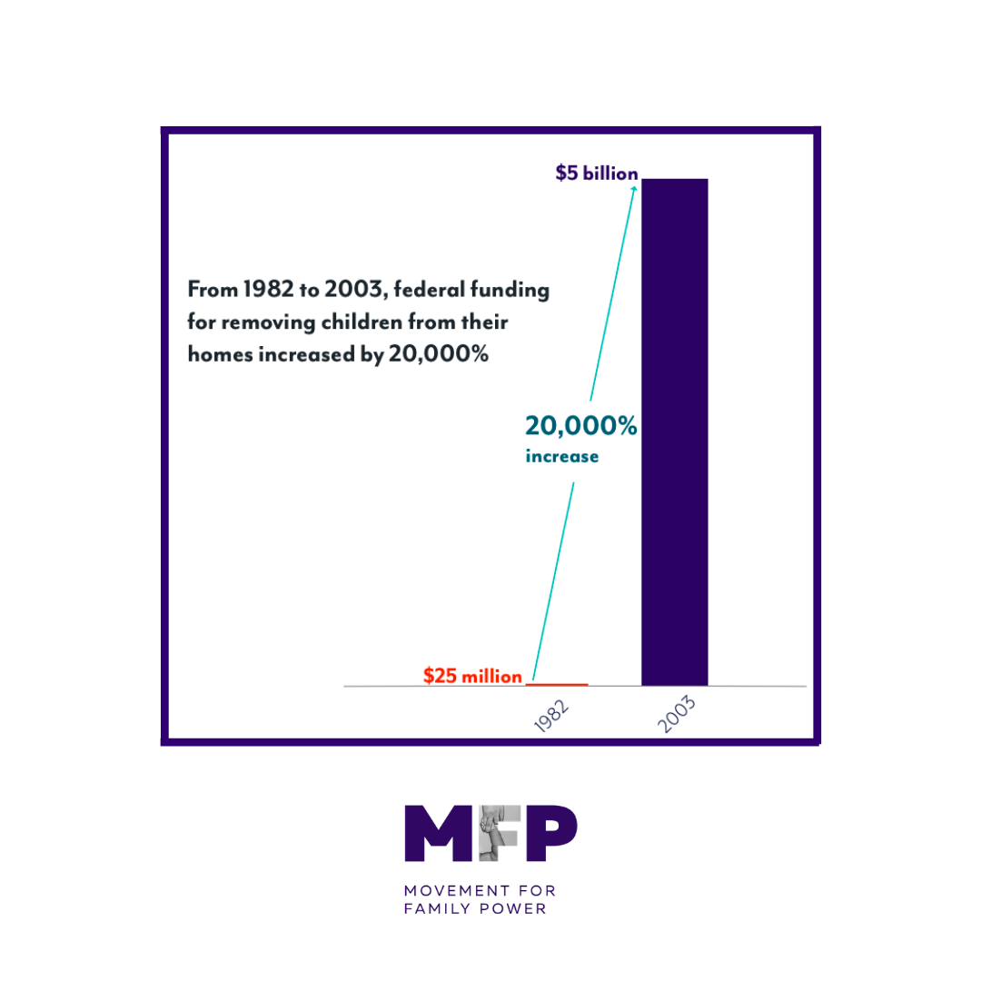

Slide 16
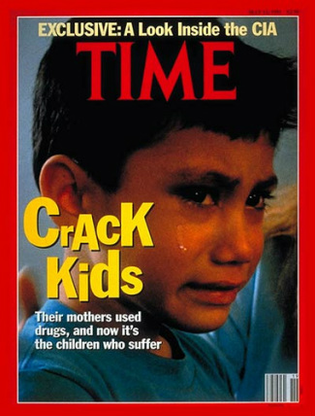
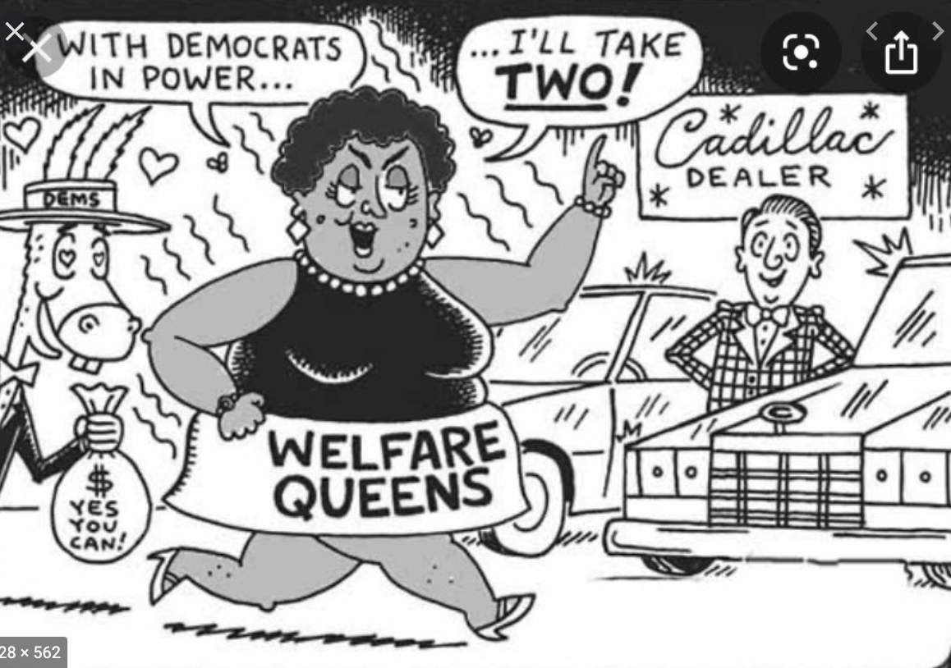
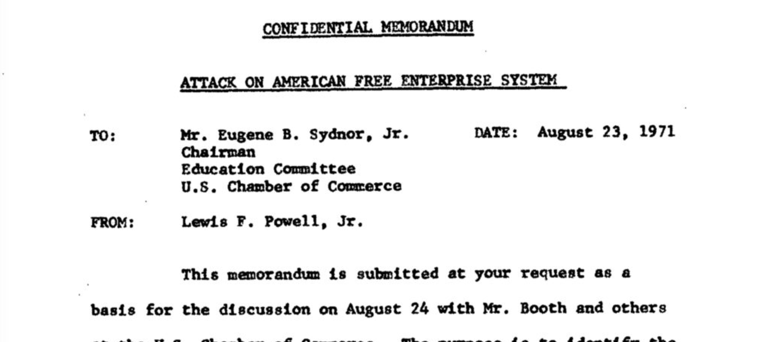

Slide 17
Punitive
War on Drugs
Notes:
ASFA was not enacted in a legal vacuum. It was cultivated within a larger federal and state legal framework that used the drug war to discriminate against Black/poor/Brown families. It is critical not only to understand ASFA as a legal construct, but also in the time period in which it was enacted. Impossible that it could have been designed for good, where the world was fear

Slide 18
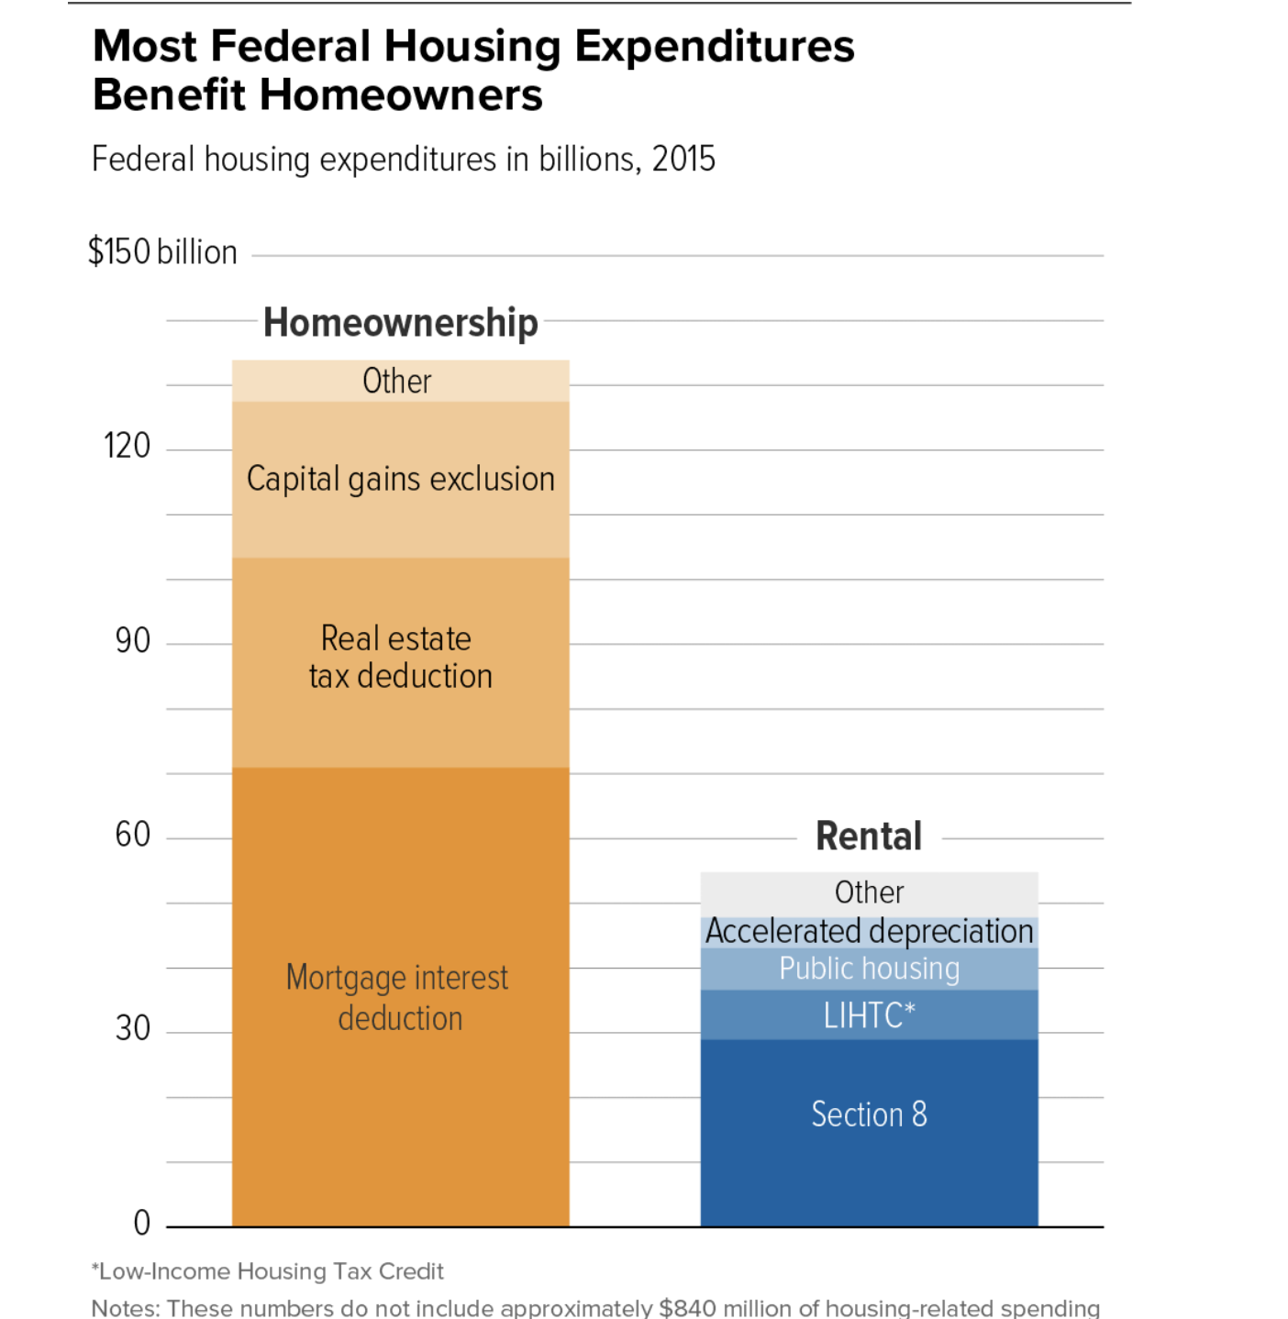
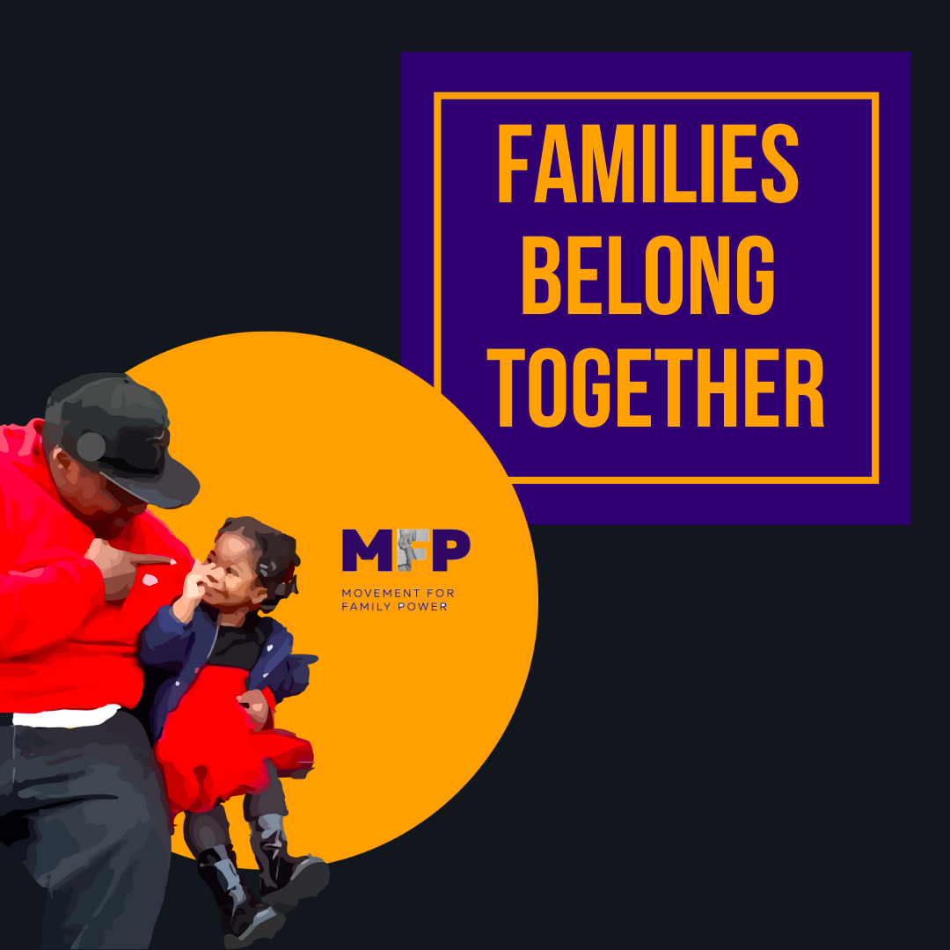
\

Slide 19
Child Abuse Prevention Treatment ACT (CAPTA)
1971 – Nixon vetoes the bipartisan Comprehensive Child Development Act
1974 – CAPTA enacted: consecrates in federal law the child welfare system, a system that is now one of the largest open ended entitlement programs for low income children
Notes:
Child welfare re-emerges on federal stage in great society – as discussion rather than legislation
Federal requirement: States enact laws mandating reports of known or suspected child abuse to a child welfare agency

Slide 20
CAPTA
States must have: "policies and procedures (including appropriate referrals to child protection service systems and for other appropriate services) to address the needs of infants born with and identified as being affected by substance abuse or withdrawal symptoms resulting from prenatal drug exposure , or a Fetal Alcohol Spectrum Disorder [FASD], including a requirement that health care providers involved in the delivery or care of such infants notify the child protective services system of the occurrence of such condition in such infants.”
Notes:
The history of child welfare grounded in racism and exclusion – so to is the history of CAPTA

Slide 21
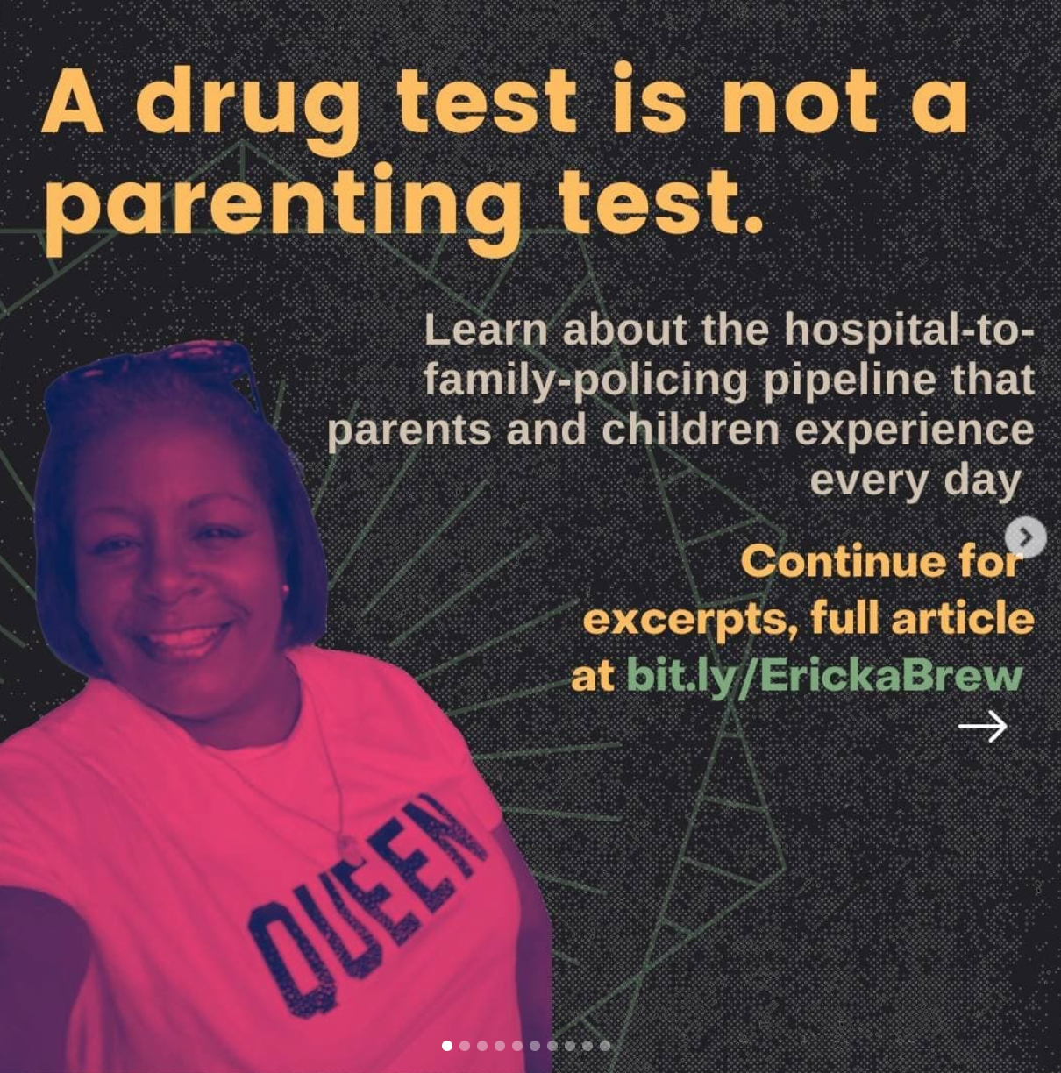
CAPTA
Notes:
The history of child welfare grounded in racism and exclusion – so to is the history of CAPTA

Slide 22
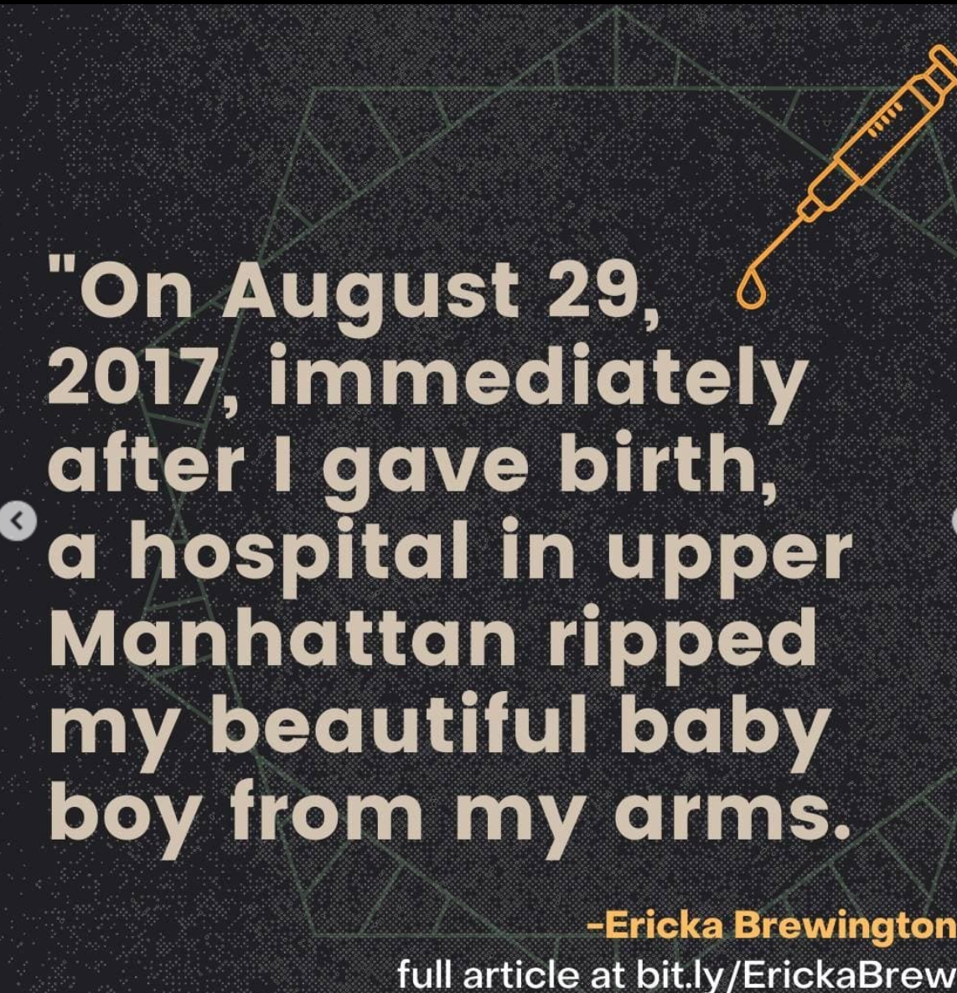
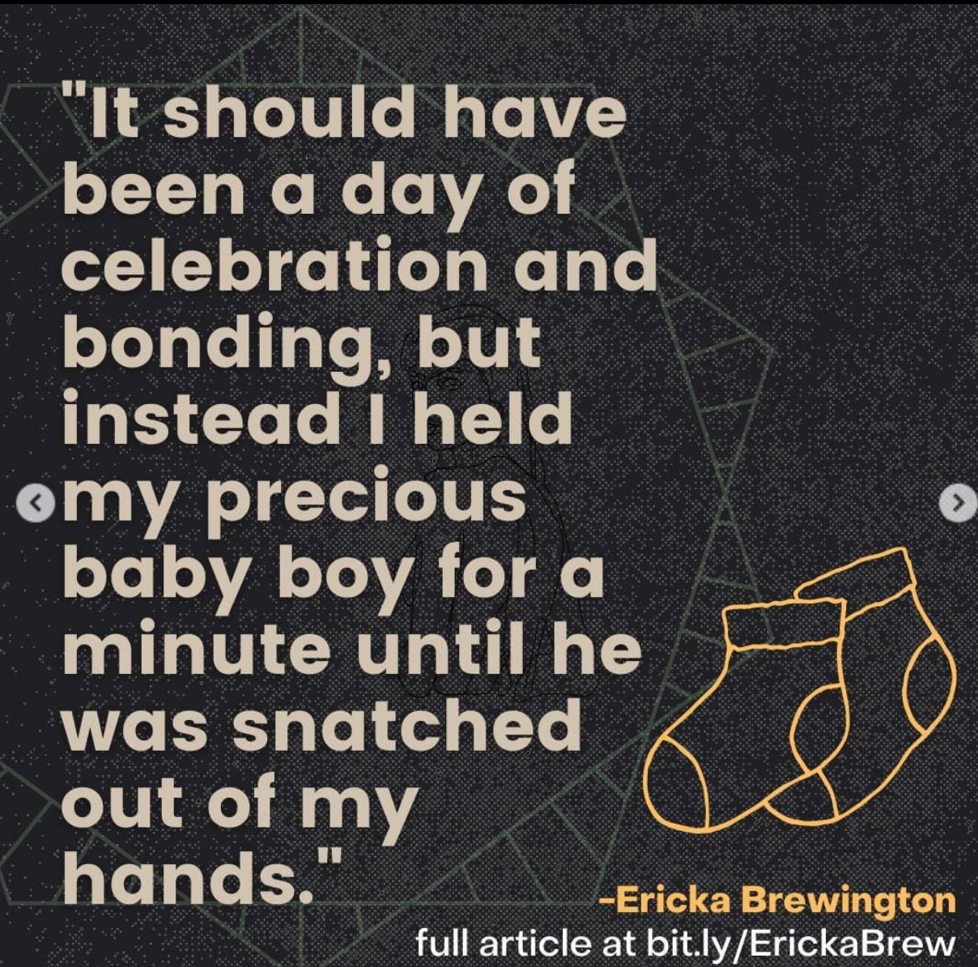
CAPTA
Notes:
The history of child welfare grounded in racism and exclusion – so to is the history of CAPTA

Slide 23
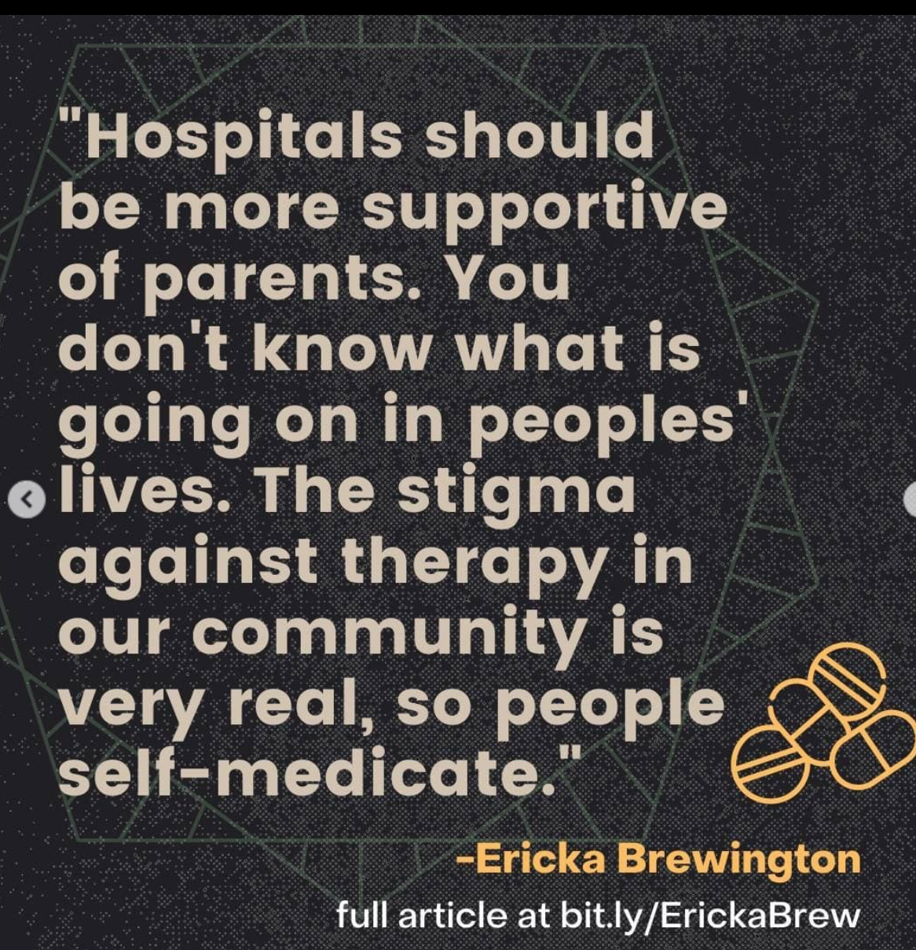
CAPTA
Notes:
The history of child welfare grounded in racism and exclusion – so to is the history of CAPTA

Slide 24
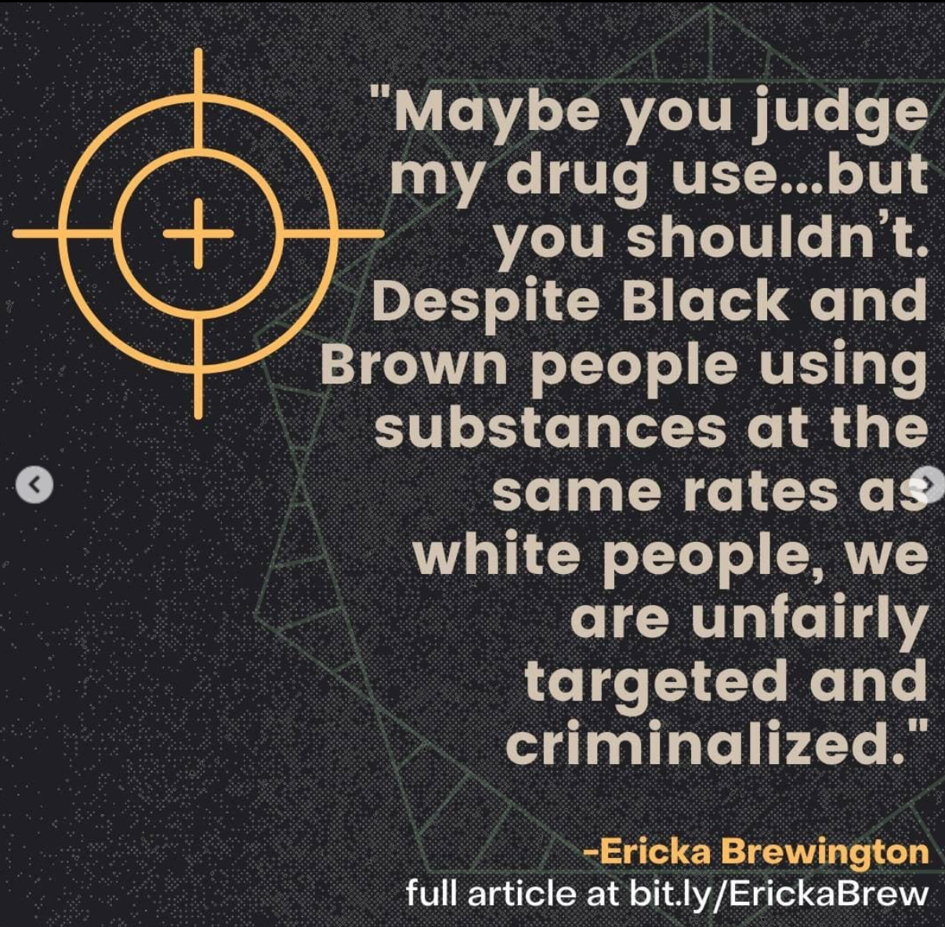
CAPTA
Notes:
The history of child welfare grounded in racism and exclusion – so to is the history of CAPTA

Slide 25
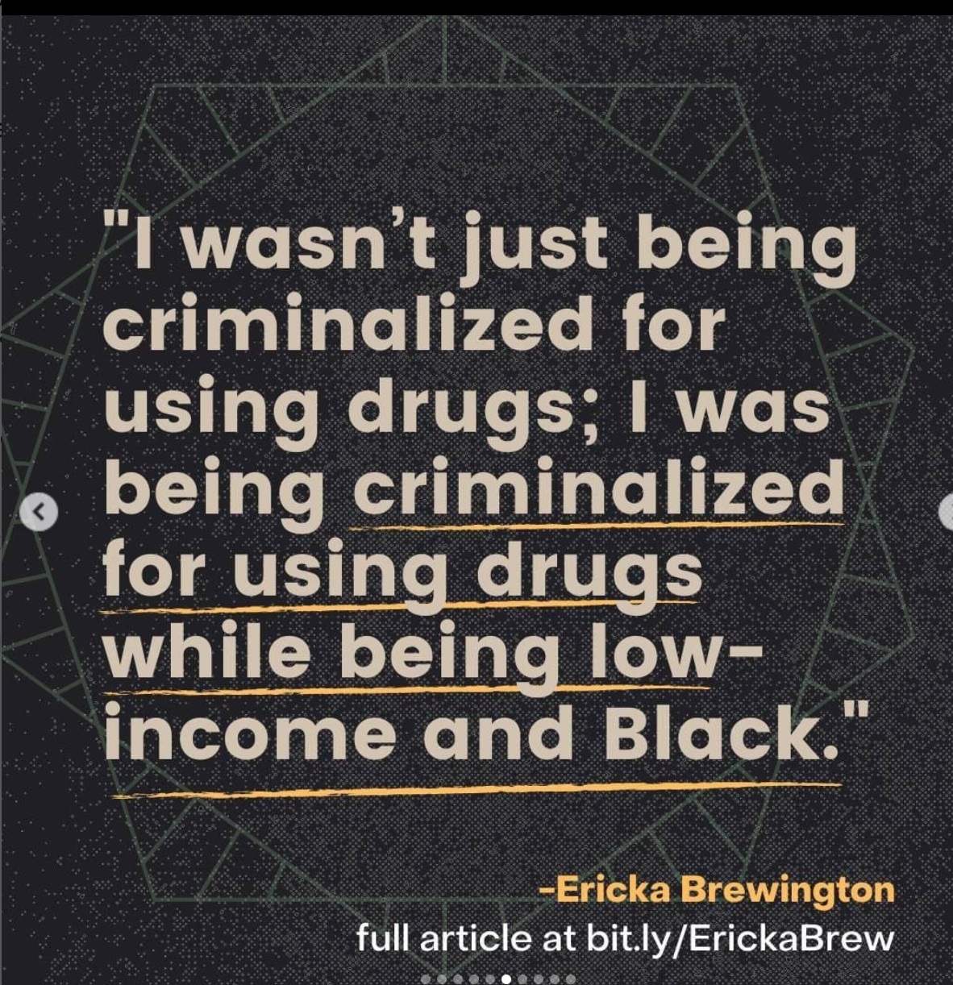
CAPTA
Notes:
The history of child welfare grounded in racism and exclusion – so to is the history of CAPTA

Slide 26
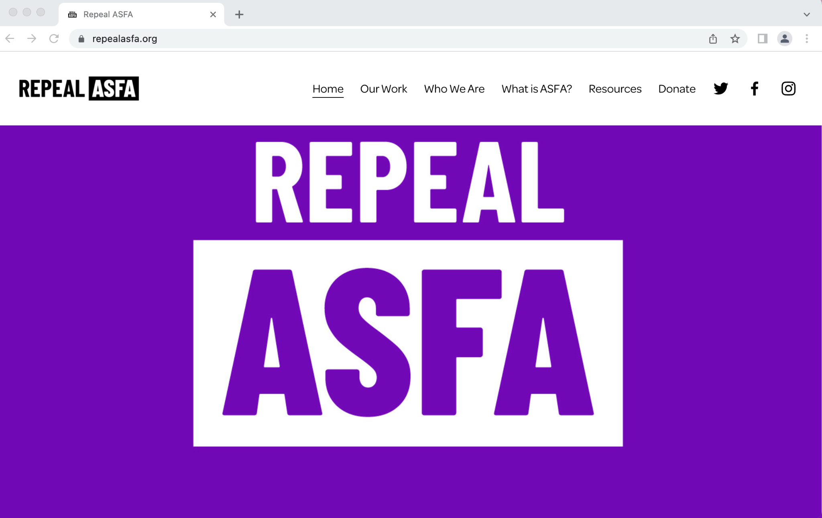
Notes:
Institutions working for change

Slide 27
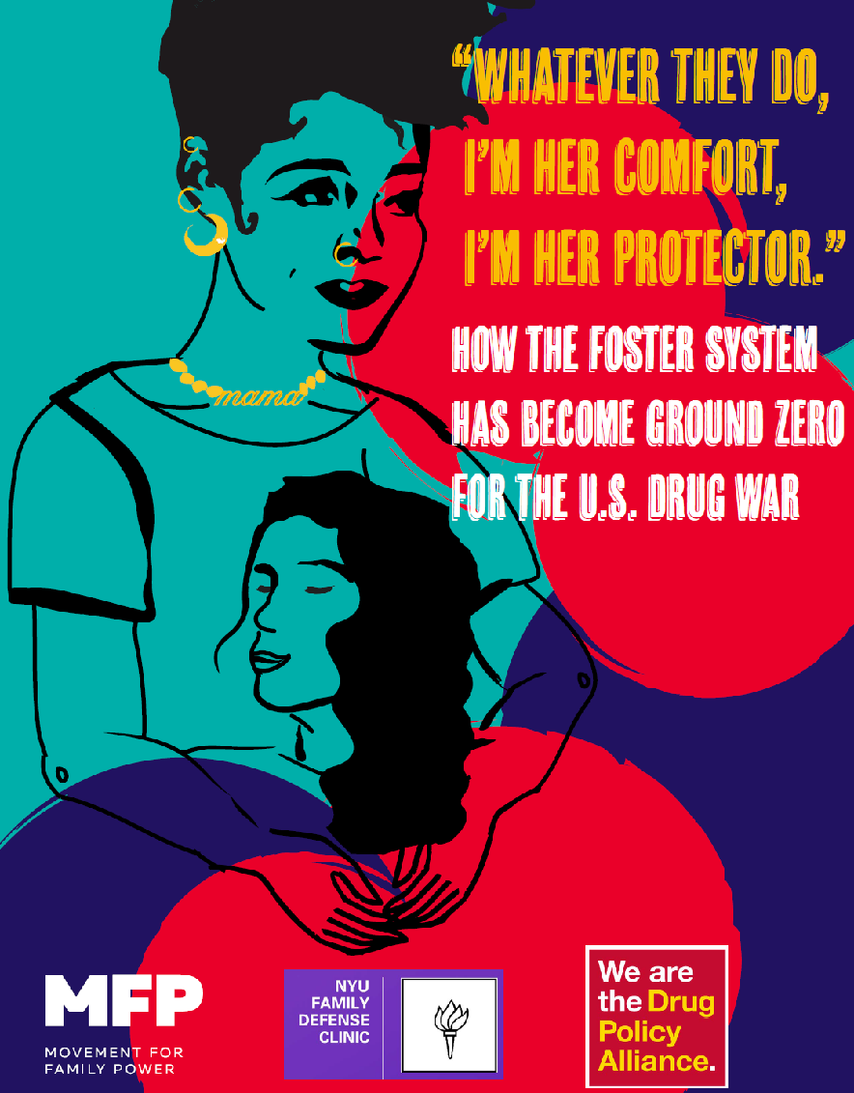
bit.ly/GROUNDZEROREPORT
Notes:
Institutions working for change

Slide 28
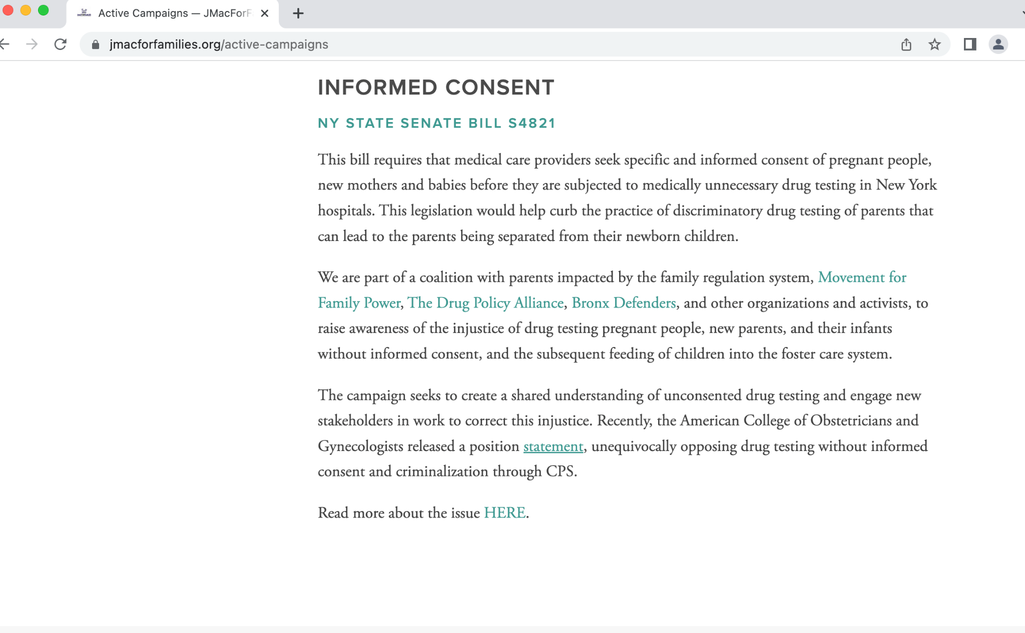
Sign letter of support https://bit.ly/NYInformedConsent
And for medical professionals: https://bit.ly/ICMedical
Notes:
Institutions working for change

Slide 29
Beyond the Evidence Base: Preserving dignity and countering discrimination in pregnancy and parenting
The Provider Perspective Mishka Terplan MD MPH Medical Director, Friends Research Institute Substance Use Warmline Clinician, UCSF AMERSA 2022

Slide 30
Screening vs. Testing: Professional Society Recommendations
Universal Screening:
Recommended (ACOG, ASAM, SMFM, AAP, SAMHSA, CDC)
Voluntary (ACOG, SAMHSA, CDC)
Testing:
Not Recommended
Not an appropriate measurement of addiction (ACOG, ASAM, SAMHSA)
Positive test = exposure, neither indication of health or ill-health, not injury or harm, not mentioned in discharge criteria (AAP)
Consent required (ACOG, ASAM, SMFM, SAMHSA)

Slide 31
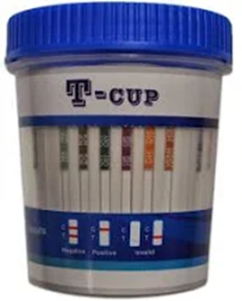
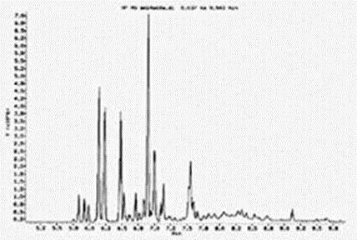
What is a Drug Test?
Presumptive
Definitive
Point-of-care
Elisa
Rapid and Cheap
Results Binary
Gas Chromatography / Mass Spectrometry
Costly and Timely
Results specific and quantified
Definitive testing required “when the results inform decisions with major clinical or non-clinical implications for the patient” (ASAM)
Notes:
Presumptive – elisa, point of care --- definitive mas spec gas chromotography

Slide 32
What is the Clinical Utility of Routine Drug Testing during the Birthing Hospitalization?
Do health professionals properly interpret drug test results?
Is Drug testing required by CAPTA?
Does universal testing reduce inequities?
Notes:
Medical student teaching only oreder a tests that 1) changes clinical care and 2) that you can interpret the results of
A positive drug test is snot the same as “affected by” and CAPTA is clear that a demonstrable health impact (or ssafety concern) is needed beyond a drug tests for a report (except for in MN)

Slide 33
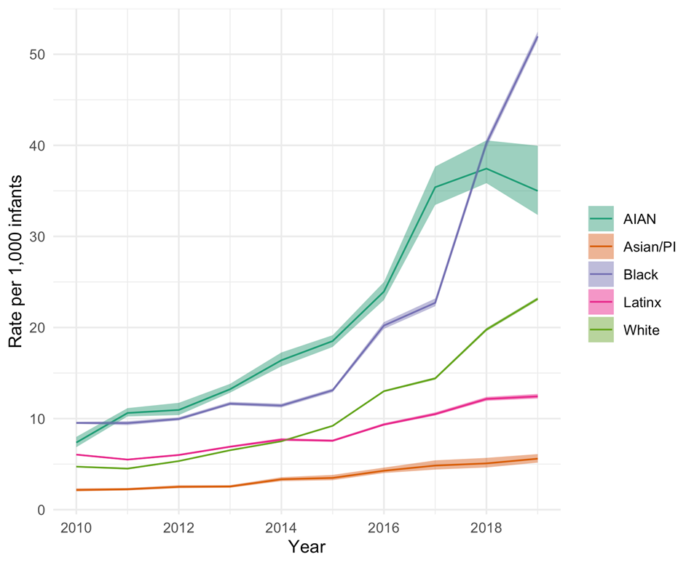
“Test and Report” -- Provider Culpability
Rate of Screened-in Reports from Medical Professionals
Most child welfare reports (<1yr) are from medical professionals during birthing hospitalization
Medical Professional Reporting increased 400% in past decade
Driven by (misuse of) urine drug testing
Compounds racial inequities
Manuscript in preparation by Edwards F, Terplan M, Roberts S, Raz M Data from the NCANDS
HHS 2020 https://www.childwelfare.gov/pubs/factsheets/cpswork/
AAP 2015 https://pediatrics.aappublications.org/content/135/5/948
Notes:
Health professionals are the primary feeder of the child welfare system (both reports and separations) primarily due to misuse and overuse of drug testing is driving child welfare reports and family separation
Marked racial inequities along the pathway
Proximity of policing to clinical care no where closer than during the birthing hospitalization
Rates of separation – vary – but in several places >5% of infants are not discharged to care of their mother – primary driver of this increase is substance use – primarily detected from a urine drug test, with or without newborn withdrawal – the results of which are reported to child welfare
Most child welfare reports for infants <1yr are from the healthcare system – marked racial inequities
“Test and report” called out by ACOG “Policies that require practitioners to respond to substance use and substance use disorder in a primarily punitive way, require health care providers to function as agents of law enforcement”
This happens for methadone – non-differentiation in federal statute between MOUD and recovery and untreated SUD
ACOG proximity of policing – happens for methadone – do not differentiate in policy MOUD and recovery from untreated SUD and etc

Slide 34
Logical Tautologies, Ideology, and Misinformation
Notes:
Provider reports reflect this ideology of substances
Illegal things aren’t in and of themselves more harmful – it is their illegality that creates the harm
And reflect misinformation (that drug use in pregnancy is associated with subsequent child maltreatment)
An assumption that is literally codified in state statute – and is a logical tautology
When we state that that drug use = child abuse we are making a formally undecidable, hence an unscientific statement, ie one that cannot be disproven

Slide 35
Notes:
Consensus is – if you drug test you must get informed consent
So I want to turn to a critical examination of the history and assumptions underlying informed consent
This image - From aamc webpage – 2 white men – I altered image as it may be under copyright – illustrates how embedded gendered and racilized hierarchies are – the insidious and prevalent white male supremacy is

Slide 36
Informed Consent
Hippocrates
Nuremburg Code of Ethics (1947): Voluntary
Autonomy
US President’s Commission 1979
Relational Conceptions of Autonomy
Natalie Stoljar: “Informed consent is an “opportunity” concept whereas autonomy is an “exercise” concept … informed consent requires merely weak evaluation and not strong evaluation.”
Protection
“Conceal most things from the patient… Give necessary orders with cheerfulness and serenity… revealing nothing of the patient’s future or present condition.”
John Stuart Mill: “Over himself, over his own body and mind, the individual is sovereign”
Beauchamp and Childress: “The autonomous individual acts freely in accordance with a self-chosen plan, analogous to the way an independent government manages its territories and establishes its policies”
Notes:
The concept of informed consent is quite modern
Hippocrates – “conceal most things … reveal nothing”
Informed consent (in both research and clinical care) emerges in the response to jewish and other genocides perpetrated by nazi Germany and focused on protection – reached back to enlightenment to ground it in a particular ethical frame illustrated here by Mills quote – which supports the voluntariness of participation
In 70s informed consent begins to mean less about protection more about individual competence and increasingly stresses autonomy
Principles laid out in presidents commission and highly influenced by the work of bauchamp and childress – classic liberal nation state view of autonomy
But this is a really simplistic world view – we are not nation states – we are social – hence autonomy is relational – and to be certain that someone iss indeed acting autonomously in decision making requires (stoljar’s words) exercise

Slide 37
Informed Consent, “Empty Ethics”, and Oppression
Oonagh Corrigan: “The dualistic opposition between liberal concepts of freedom and autonomy versus powerful autocratic medical practices fails to recognise that power is not just a phenomenon that is exercised as an external constraint, but that prevailing cultural norms, values and systems of expertise shape the field of choice.”
Recognize biopolitics and biopower: The intricate relations between State power and biomedical technologies, and how biomedicine is used to exercise control and domination over organic bodies
Oppression (Iris Young): A deeply embedded set of everyday practices of a usually well-intentioned liberal society that turn out to inhibit the ability of certain groups to exercise their capacities and express their feelings, thoughts, or needs. Absence of connection between intentions and consequences.
Corrigan O, Sociology of Health & Illness, 2003
Stoljar N, J Medicine and Philosophy, 2011
Young IM, Justice and the politics of difference, 1990
Notes:
Hence beuachamp and childress ( and ezeke emmaual …) have been critizied for promulgating an “empty ethics” – one that neglects power, in particular of institutions such as healthcare, and neglect structural sexism, racism, and other forms of oppression
Autonomy – relational and relationally constrained- and in the context of healthcare – patients are often become the objects of the bureaucratic machinery – and this organizational structure impinge upon moral and ethical decision making – and denudes actual autonomy (JSS Mills)
Medical sociology and feminist bioethics
Oppression displays itself in a variety of forms or faces, of which Iris Young highlights five: exploitation, marginalization, powerlessness, cultural imperialism and violence, where if a given social group suffers from at least one, then the group can be said to be oppressed (Young 1990).

Slide 38
“Better Safe Than Sorry”? Child Welfare Report and Consequence for Drug Exposure
20% children experience abuse or neglect in out-of-home placement
Mental health and somatic conditions greater among children in foster care compared to general population
Toxic stress: The physiologic result of physical of dangerous, recurrent, or prolonged experience of trauma caused by the initiation of the stress response without the protective existence of a compassionate adult
Non-death Loss and Grief in Foster Care
Dorsey S, Journal of Child & Family Studies, 2012; Jonkowski MK, Child Maltreatment, 2019
Forkey HC, J of Child & Family Studies, 2016; Mitchell MB, Child Adolesc Soc Work J, 2018
Notes:
I want to revisit child welfare reporting in the context of this critique of informed consent - Iris young – oppression emerges from well-intention everyday practices that play out in landscape of biopower – within capatalist structures of contemporary medicine - the health care institution
The motivation for a report - Most reports aren’t willfully harmful – but most health professionals do not understand the consequence of reporting
Perspect Psychol Sci
. 2021 Mar;16(2):225-246. doi: 10.1177/1745691620950690. Epub 2020 Oct 2.
Better Safe Than Sorry: A Common Signature of General Vulnerability for Psychopathology
Omer Van den Bergh 1, Jos Brosschot 2, Hugo Critchley 3, Julian F Thayer 4, Cristina Ottaviani

Slide 39
Healthcare is not Safe, Especially for Pregnant People who use Drugs; Discrimination is a Patient Safety Issue
Notes:
Are health professionals able to diagnose system weaknesses? – what is our structural competence (Helena Hansen)
I have tried to illustrate structural thinking in the domain of drug testing and informed consent
We have to recognize that healthcare is not safe – especially for pregnant people who use drugs
Urge us to think of Discrimination is a Patient Safety Issue

Slide 40
The Body Politic and Healthcare-Induced Violence: Information Sharing Contributes to the (Further) Criminalization of the Female Body
“Equating a positive toxicology test with child abuse or neglect is scientifically inaccurate and inappropriate, and can lead to an unnecessarily punitive approach, which harms clinician-patient trust and persons’ engagement with healthcare services.” ASAM Public Policy Statement on Substance Use and Substance Use Disorder Among Pregnant and Postpartum People, 10, 2022
“The laws, regulations, and policies that require health care practitioners and human service workers to respond to substance use and substance use disorder in a primarily punitive way, require health care providers to function as agents of law enforcement.”
ACOG, Opposition to Criminalization of Individuals During Pregnancy and the Postpartum Period: Statement of Policy, 11, 2020
Notes:
Borrowing from Nancy Krieger – that which does not reside in the body resides in the body politic –
Public Health vs. Criminalization – can’t be both
Conflict between providing health care and mandatory reporting
Drug screening, testing, and lack of (or poor) consent erodes provider/patient trust
Creates a climate of “mutual mistrust”
And contributes directly to provider moral injury

Slide 41
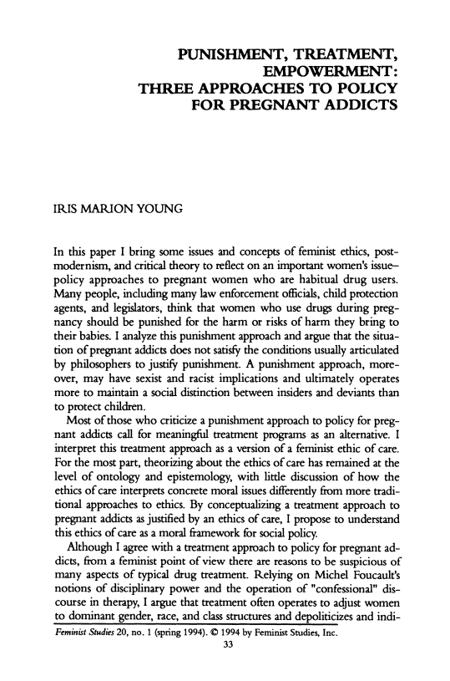
Begin by Decriminalizing Healthcare
Institutions concerned with the promotion of public health possess a duty of justice
Hence – Decriminalize Health Care
Drug Tests and Informed Consent – Tools not Solutions
Both embedded in structures of oppression
Recognize and Resist False Dichotomies
Notes:
Decriminalize health care –
Informed consent and drug testing are tools not solutions –not a magic wand - can be wielded to further oppression
Iris Young – resists false dichotomy – space full of them – fetus versus mother, punishment versus treatment - let’s widen our horizon of possibility – iris young - empowerment

Slide 42
Shared Values
People who use drugs should be treated with dignity and respect when they seek health care.
Parenting is hard, and we support non-punitive approaches that allow the parent, infant, dyad, and family to thrive together.
Notes:
Begin w articulating what I hope are our shared valued

Slide 43
Thank you

Slide 44
Beyond the Evidence Base: preserving dignity and countering discrimination in pregnancy and parenting
Nikki Bell-Pena
Founder and Chief Executive Officer
Living In Freedom Together-LIFT

Slide 45
Who am I?
I am a mother in long term recovery from both substance use disorder and mental health disorders, a survivor of many forms of gender based violence, have previously system involvement as a child and adult, an advocate, activist, Founder and Chief Executive Officer and human being deserving of being treated with dignity and respect.

Slide 46
DCF Interactions
1994
2011
2016
2020
Child in need of support
Birth of son
Birth of Son
Birth of daughter
Screened Out
Screened in: Child Removed
Screened in: Closed in 6 weeks
Screened In:
Closed in 8 weeks

Slide 47
Trauma caused by reporting
As a child involvement with DCF caused great fear I would be removed from my home due to violence I was experiencing.
With untreated SUD instead of resources being offered my child was removed
With four years of sustained recovery I was terrified my child would be removed.
With six years of sustained recovery I was still terrified and traumatized

Slide 48
Immediate Impact
Inability to be present and bond with our baby who need and deserve our attention and care.
Activates a trauma response causing hypervigilance impacting ability to sleep, nurse, console a newborn.
Hospital staff who are in the NICU heavily police parents on MOUD. Frequently filing additional 51’s due to mother being tired, emotional, and distressed.
Takes physical time away from newborn as you are required to interview with DCF, often before you can take newborn home from the hospital, as well as coordinate a home visit.
These are ABUSE and NEGLECT ALLEGTIONS filed by your healthcare provider for taking a medication to treat a medical condition.
Lose trust in those providing healthcare and social supports.
Notification to other children in your care’s daycare and school causing further humiliation and shame.

Slide 49
Long Term Impact
Prevents me from accessing medical care for my children in emergencies due to fear of being reported
Prevents me from involvement in children's school (Field trips, PTO)
Caused my nieces to remain unnecessarily in foster care instead of being placed with kin
Prevents me from involvement in extra curricular activities (Coaching soccer, Girl Scouts)
Caused long term trust issues with healthcare providers
Caused deep rooted shame about my medication and recovery path
Can lead to overreach by schools, daycares, and other places where children go.
Cause severe anxiety when I make a small mistake (forget my kids snack, or glasses)

Slide 50
What’s wrong with Plan of Safe Care?
Only mothers with SUD are required to demonstrate a safety plan to parent their child
Suggested to prepare a binder to bring for delivery to prove to Social worker you have the resources and support to care for your child. (Don’t forget to pack in your Go bag!!)
Can be weaponized against mothers if created by an inexperienced advocate
A tool to limit liability on behalf of providers not to assist new mothers
We make mothers with SUD doubt their ability to safely parent their children
These outdated practices are discriminatory against women as men who are on MOUD aren’t required to prove their capability.
Everything!

