Slide 1
Centering the disadvantaged: Reflections on community partnership and solidarity in educational and research praxis
Ricky Bluthenthal
Associate Dean for Social Justice
Vice Chair for Diversity, Equity, and Inclusion
Professor, Department of Population and Public Health Sciences
Keck School of Medicine
University of Southern California

Slide 2
Funding Disclosure
NIDA R01DA046049, U2CDA050098; RO1DA036267; Los Angeles County Office on Diversion and Rentry
Dr. Bluthenthal has consulted with ETR Associates, Scotts Valley CA, IAPHS, Idaho, RAND Corporation, Santa Monica, CA, RTI International, Research Triangle, NC, and UCLA on research related to drug use epidemiology, syringe service programs, and opioid use epidemiology in the last 12 months

Slide 3
Overview
Highlight the limitations of our current approach to health challenges among people who inject drugs
Share my own lessons learned from listening closely and deeply to what people who use drugs share
Argue for solidarity with people who use drugs as a more effective approach to addressing the harms of substance use

Slide 4
Limitations (1)
Multiple national and regional epidemics and outbreaks
  National HCV, bacterial infection, and overdose death epidemic
  Local and regional HIV outbreaks
Growing physical immiseration of people who use drugs will make improvements harder to achieve
Growing backlash against harm reduction approaches to substance use problems
Notes:
See
Capizzi, J., Leahy, J., Wheelock, H., Garcia, J., Strnad, L., Sikka, M., Englander, H., Thomas, A., Korthuis, P.T., Menza, T.W., 2020. Population-based trends in hospitalizations due to injection drug use-related serious bacterial infections, Oregon, 2008 to 2018. PLoS One 15(11), e0242165.
McCarthy, N.L., Baggs, J., See, I., Reddy, S.C., Jernigan, J.A., Gokhale, R.H., Fiore, A.E., 2020. Bacterial Infections Associated With Substance Use Disorders, Large Cohort of United States Hospitals, 2012-2017. Clin Infect Dis 71(7), e37-e44PMC7900878.
Lyss, S.B., Buchacz, K., McClung, R.P., Asher, A., Oster, A.M., 2020. Responding to Outbreaks of Human Immunodeficiency Virus Among Persons Who Inject Drugs—United States, 2016–2019: Perspectives on Recent Experience and Lessons Learned. The Journal of Infectious Diseases 222(Supplement_5), S239-S249.
Gonsalves, G.S., David Paltiel, A., Thornhill, T., Iloglu, S., DeMaria, A., Jr., Cranston, K., Monina Klevens, R., Walensky, R.P., Warren, J.L., 2021. The Dynamics of Infectious Diseases Associated With Injection Drug Use in Lawrence and Lowell, Massachusetts. Open Forum Infect Dis 8(6), ofab128PMC8231383.
Gray, M.E., Rogawski McQuade, E.T., Scheld, W.M., Dillingham, R.A., 2018. Rising rates of injection drug use associated infective endocarditis in Virginia with missed opportunities for addiction treatment referral: a retrospective cohort study. BMC Infectious Diseases 18(1), 532.
Kadri, A.N., Wilner, B., Hernandez, A.V., Nakhoul, G., Chahine, J., Griffin, B., Pettersson, G., Grimm, R., Navia, J., Gordon, S., Kapadia, S.R., Harb, S.C., 2019. Geographic Trends, Patient Characteristics, and Outcomes of Infective Endocarditis Associated With Drug Abuse in the United States From 2002 to 2016. Journal of the American Heart Association 8(19), e012969PMC6806029.
https://www.medlabmag.com/article/1803 by Joe M. El-Khoury Oct. 2021
Hotton, A., Mackesy-Amiti, M.E., Boodram, B., 2021. Trends in homelessness and injection practices among young urban and suburban people who inject drugs: 1997-2017. Drug Alcohol Depend 225, 108797.
Arum, C., Fraser, H., Artenie, A.A., Bivegete, S., Trickey, A., Alary, M., Astemborski, J., Iversen, J., Lim, A.G., MacGregor, L., Morris, M., Ong, J.J., Platt, L., Sack-Davis, R., van Santen, D.K., Solomon, S.S., Sypsa, V., Valencia, J., Van Den Boom, W., Walker, J.G., Ward, Z., Stone, J., Vickerman, P., 2021. Homelessness, unstable housing, and risk of HIV and hepatitis C virus acquisition among people who inject drugs: a systematic review and meta-analysis. Lancet Public Health 6(5), e309-e323PMC8097637 work. JA reports grants from National Institutes of Health (NIH) during the conduct of the study. SSS reports grants from NIH during the conduct of the study, and grants from Gilead Sciences and Abbot Diagnostics outside of the submitted work. VS reports grants, personal fees, and non-financial support from Gilead Sciences and AbbVie and personal fees from Janssen outside of the submitted work. JGW reports grants from Gilead Sciences outside of the submitted work. All other authors declare no competing interests.

Slide 5
Limitation (2) Great medications that we have a hard time getting to people who need them
How it started - 1991 | How its going
No effective treatment for HIV | Effective treatments beginning in 1996
No effective treatment for HCV | Treatments beginning in 1998; 90% + effective treatments beginning in 2014
No effective pre-exposure prophylaxis for HIV prevention | PrEP approved in 2012
No long-acting HIV prevention medication | Approved in Dec. 2021; Recommended by WHO in 2022
Methadone available mostly in urban clinics | Still mostly not available in rural areas; COVID deregulation helping
Buprenorphine not available in US | Access expanded, but underutilized by most prescribers
https://www.cdc.gov/hiv/basics/prep.html
https://www.fda.gov/news-events/press-announcements/fda-approves-first-injectable-treatment-hiv-pre-exposure-prevention
https://www.who.int/news/item/28-07-2022-who-recommends-long-acting-cabotegravir-for-hiv-prevention
Carter, W., Connelly, S., Struble, K., 2017. Reinventing HCV Treatment: Past and Future Perspectives. The Journal of Clinical Pharmacology 57(3), 287-296.

Slide 6
Most PWID are not receiving MOUD & racial disparities exist among those who do

Slide 7
BIPOC consistently found to not benefit as much as whites from biomedical interventions

Slide 8
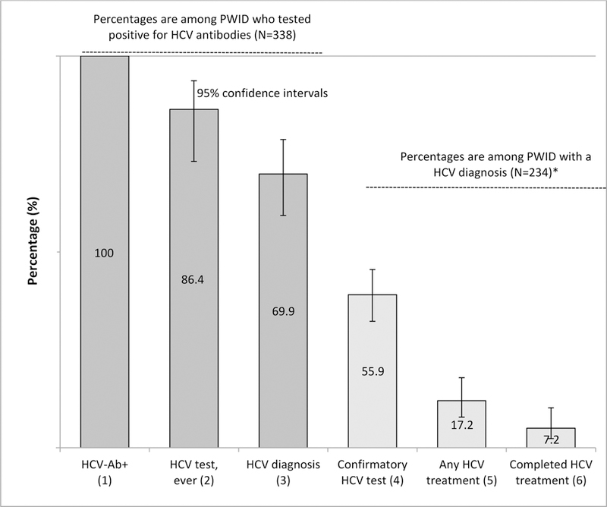
HCV treatments are not reaching PWID

Slide 9
PWID interest in PrEP is high but use is low

Slide 10
Other concerns
Chronic heart health (for opioid users) and dietary problems are substantial yet have not been widely studied
Discrimination against PWID in society in general and health systems is widespread
Political indifference to well-being for PWID is well known and remains even as there has been wider adoption of harm reduction approaches

Slide 11
Summary of conventional research approaches to health promotion among PWID
Evidence-based interventions not widely available to vulnerable populations
Most interventions focused on individual behavior and not midstream or upstream interventions
Current efforts are not likely to overcome existing health challenges

Slide 12
What I have learned by trying to listen to people who use drugs

Slide 13
Humility in all things
Acknowledge your own positionality
Develop a praxis that allows you to reduce the social distance between participants and yourself
Consider your participants lives to be as precious as your own

Slide 14
Published first study documenting 20%+ HIV infections among PWID west of the Mississippi

Slide 15
Co-founded an illegal syringe service program during the HIV era

Slide 16
Law enforcement impeded HIV prevention among PWID

Slide 17
More harm reduction is associated with lower HIV risk

Slide 18
Documenting the impact of opioid withdrawal symptoms on health risk among PWID
Table 6: Multivariate logistic regression models of receptive syringe sharing and nonfatal overdose among regular opioid using people who inject drugs in Los Angeles and San Francisco, CA 2016-2017.
 | Model 1 Opioid withdrawal in the last 6 mos. AOR (95% CI) | Model 2 Extreme or very painful opioid withdrawal AOR (95% CI) | Opioid withdrawal frequency Less than monthly | Monthly to almost weekly AOR (95% CI) | Weekly or more AOR (95% CI)
Receptive syringe sharing in the last 30 days (1) | 2.75* (1.52, 5.00) | 0.86 (0.60, 1.23) | Referent | 1.30 (0.82, 2.06) | 1.94* (1.26, 3.00)
Nonfatal overdose in the Last 6 months (2) | 1.71* (1.04, 2.81) | 1.53* (1.08, 2.16) | Referent | 1.46 (0.95, 2.24) | 1.69* (1.12, 2.55)

Slide 19
Growing houselessness among PWID means growing health risk

Slide 20
Displacement during COVID-19 (n=309)
Participants reported being unhoused in the last 3 months
&
Having to move location
 | Los Angeles & Denver PWID, 2021 N (%)
Housed | 68 (22%)
Not housed & not moved | 52 (17%)
Not housed & moved at least once | 190 (62%)
Preliminary data from R01DA046049 (Bluthenthal[contact]/Corsi)

Slide 21
Health risk are high and basic needs are not met for PWID, Los Angeles & Denver, 2021 (n=309)
 | Overdosed | Receptive syringe sharing | Any rushed injection | No difficulty eating | No difficulty washing | No difficulty finding restroom
Housed | 9% | 9% | 48% | 85% | 91% | 88%
Not housed & not moved | 18% | 26% | 61% | 55% | 37% | 29%
Not housed & moved | 28% | 30% | 70% | 30% | 20% | 25%

Slide 22
Exposure to violence among PWID in the last 3 months, Los Angeles & Denver, 2021 (n=309)
 | Threatened | Punched | Belongings Stolen | Attacked by stranger | Raped*
Housed | 15% | 12% | 35% | 6% | 0%
Not housed & not moved | 35% | 31% | 82% | 22% | 8%
Not housed & moved | 48% | 40% | 88% | 36% | 8%
* 24% of women, transgendered, and non-binary people were raped

Slide 23
Essential items are often discarded/lost during camp clearances, LA/Denver 2021 (n=309)

Slide 24
Displacement as a predictor of health risk among people who inject drugs, 2021 (n=309)
Nonfatal overdose* in the last 3 months | Adjusted Odds Ratio (95% Confidence Interval) |  | Receptive syringe sharing** in the last 3 months | Adjusted Odds Ratio (95% Confidence Interval)
Housed | Referent |  |  | Referent
Not housed, not moved | 2.38 (0.78, 7.30) |  | Not housed, not moved | 2.94 (1.01, 8.53)
Not housed, moved | 4.33 (1.72, 10.92) |  | Not housed, moved | 3.32 (1.31, 8.37)
* Controlling for race
** Controlling for police contact in the last 3 months
Encampment clearance and ongoing displacement of unhoused PWID independently contributes to health risk in this population.

Slide 25
What’s next
We need to focus on political and social determinants of health that are an existential threat to PWID
Solutions require addressing fundamental inequalities in our political, social, and economic organization
We need to listen, uplift and empower people who use drugs to identify solutions.
  Act in solidarity with people who use drugs
  Support drug user unions and other organizing efforts
  Hire people with lived experience and active use when ever possible

Slide 26
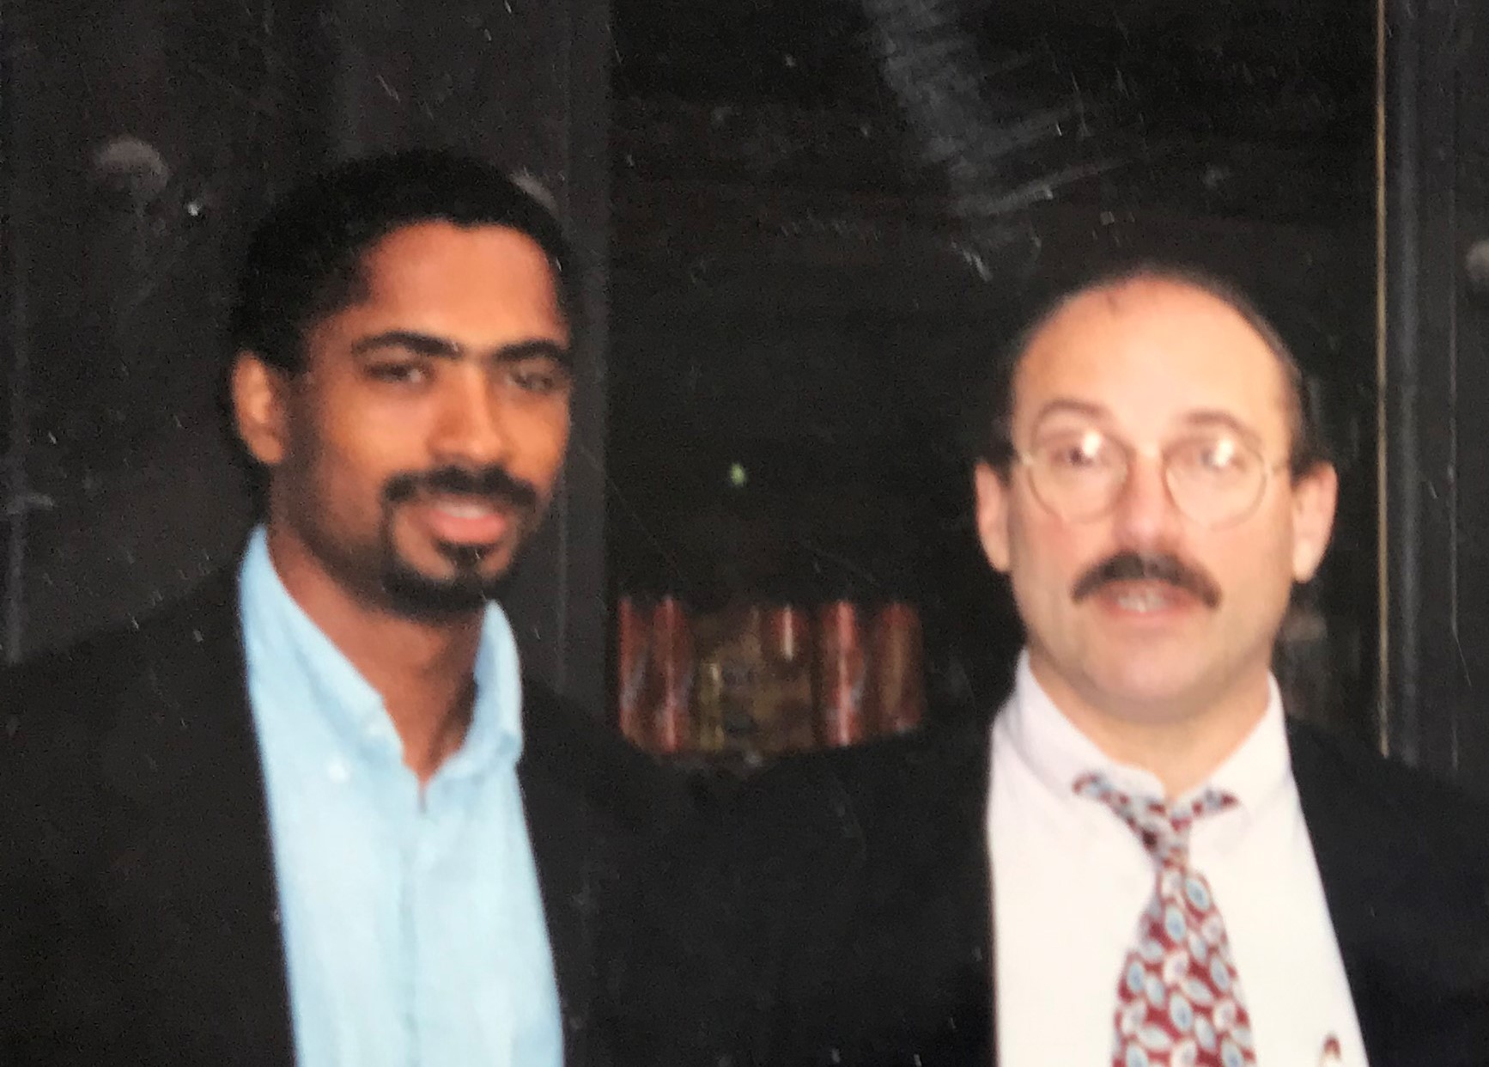
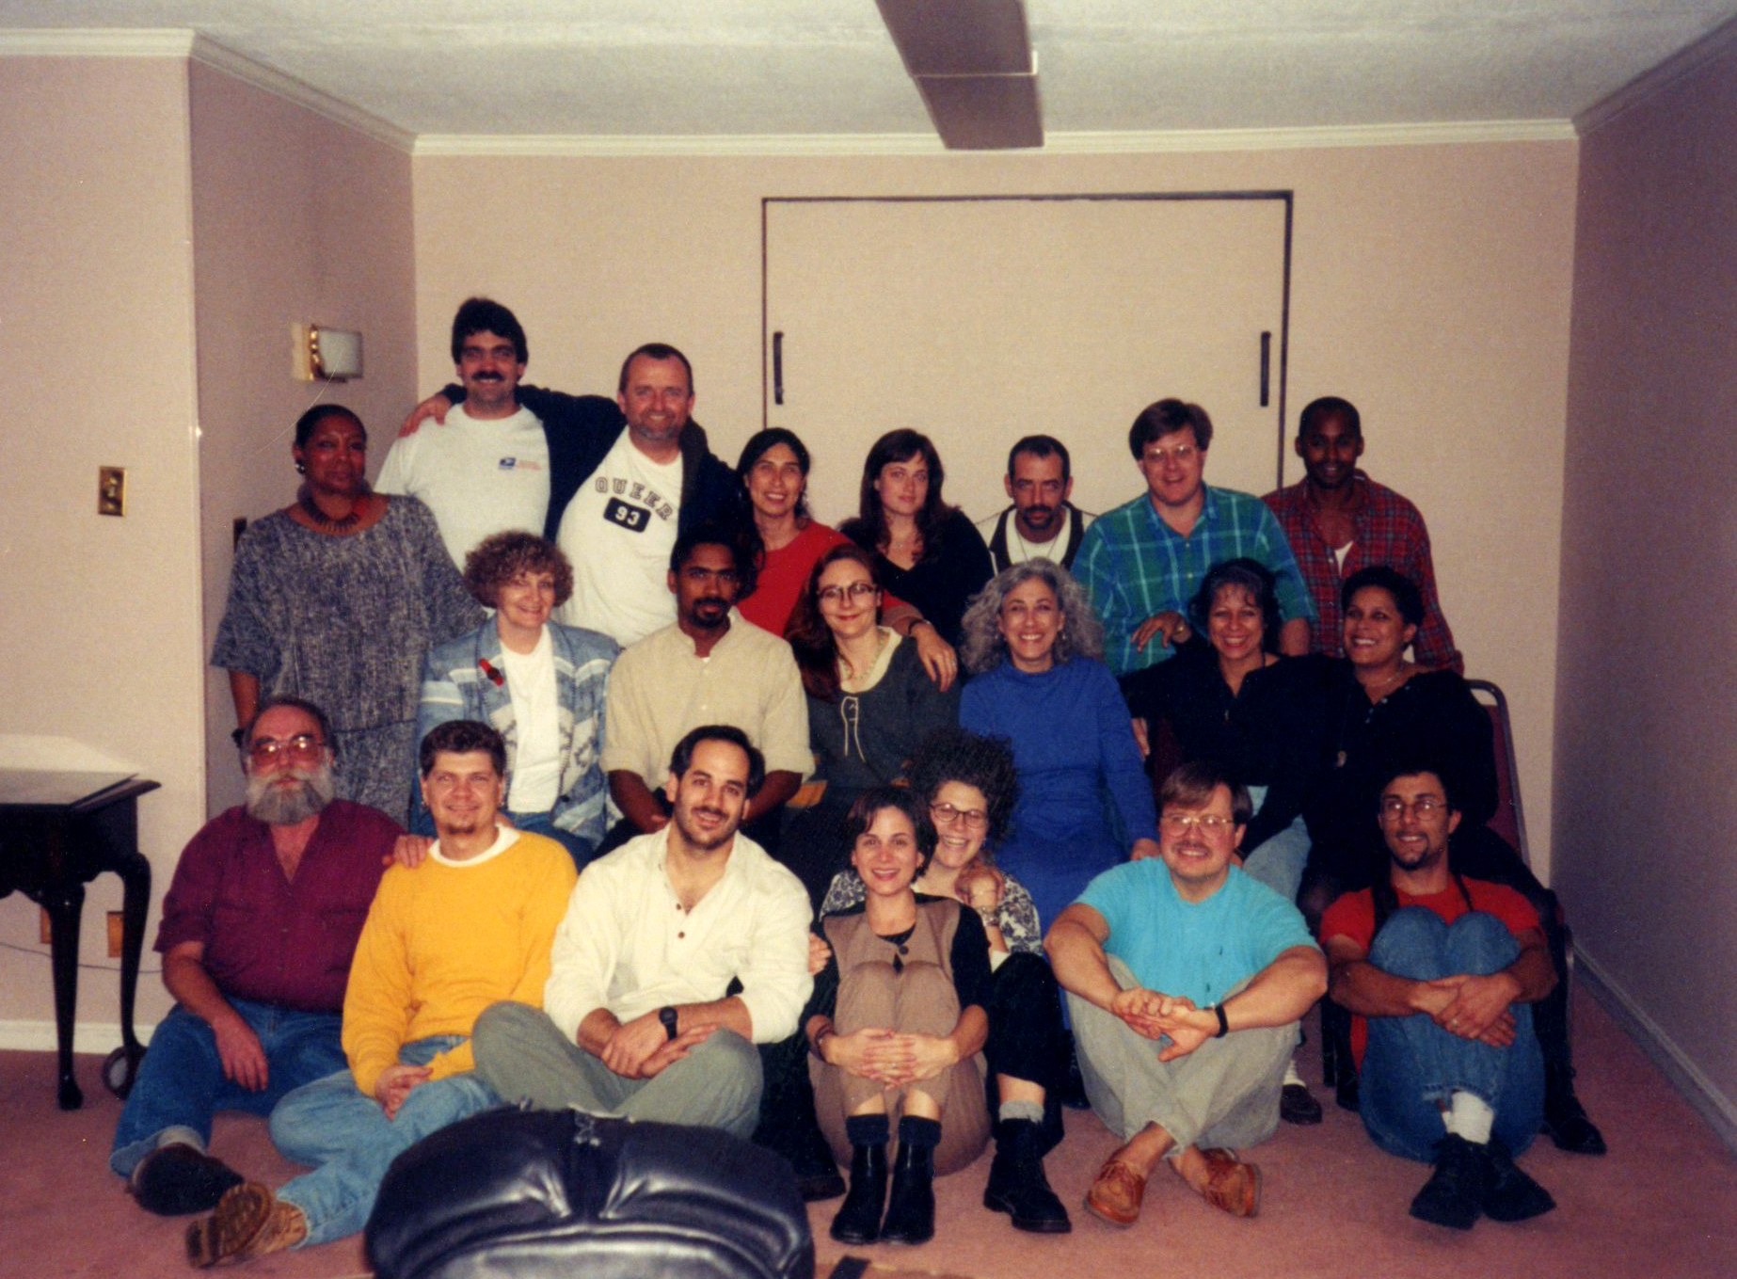
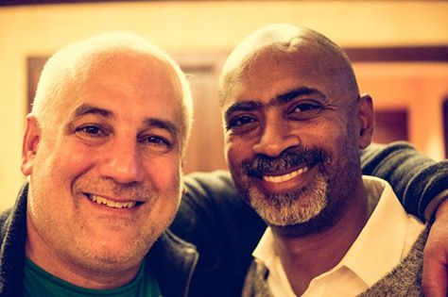
Life is precious. Let’s educate, research, and mobilize in its defense
Notes:
Pictured, me with my mentor John Watters, the Harm Reduction Working Group circa 1993, and me with Dan Biggs.
Among my many colleagues at least 4 have died from injected related health risk.

