Slide 1
Care of the Hospitalized Patient with Substance Use Disorder
Rich Saitz “What’s the Evidence?”
endowed plenary
Theresa Rolley, Ashish Thakrar MD, Elaine Hyshka PhD
Honora Englander MD
45th National AMERSA Conference
November 2022, Boston MA, USA

Slide 2
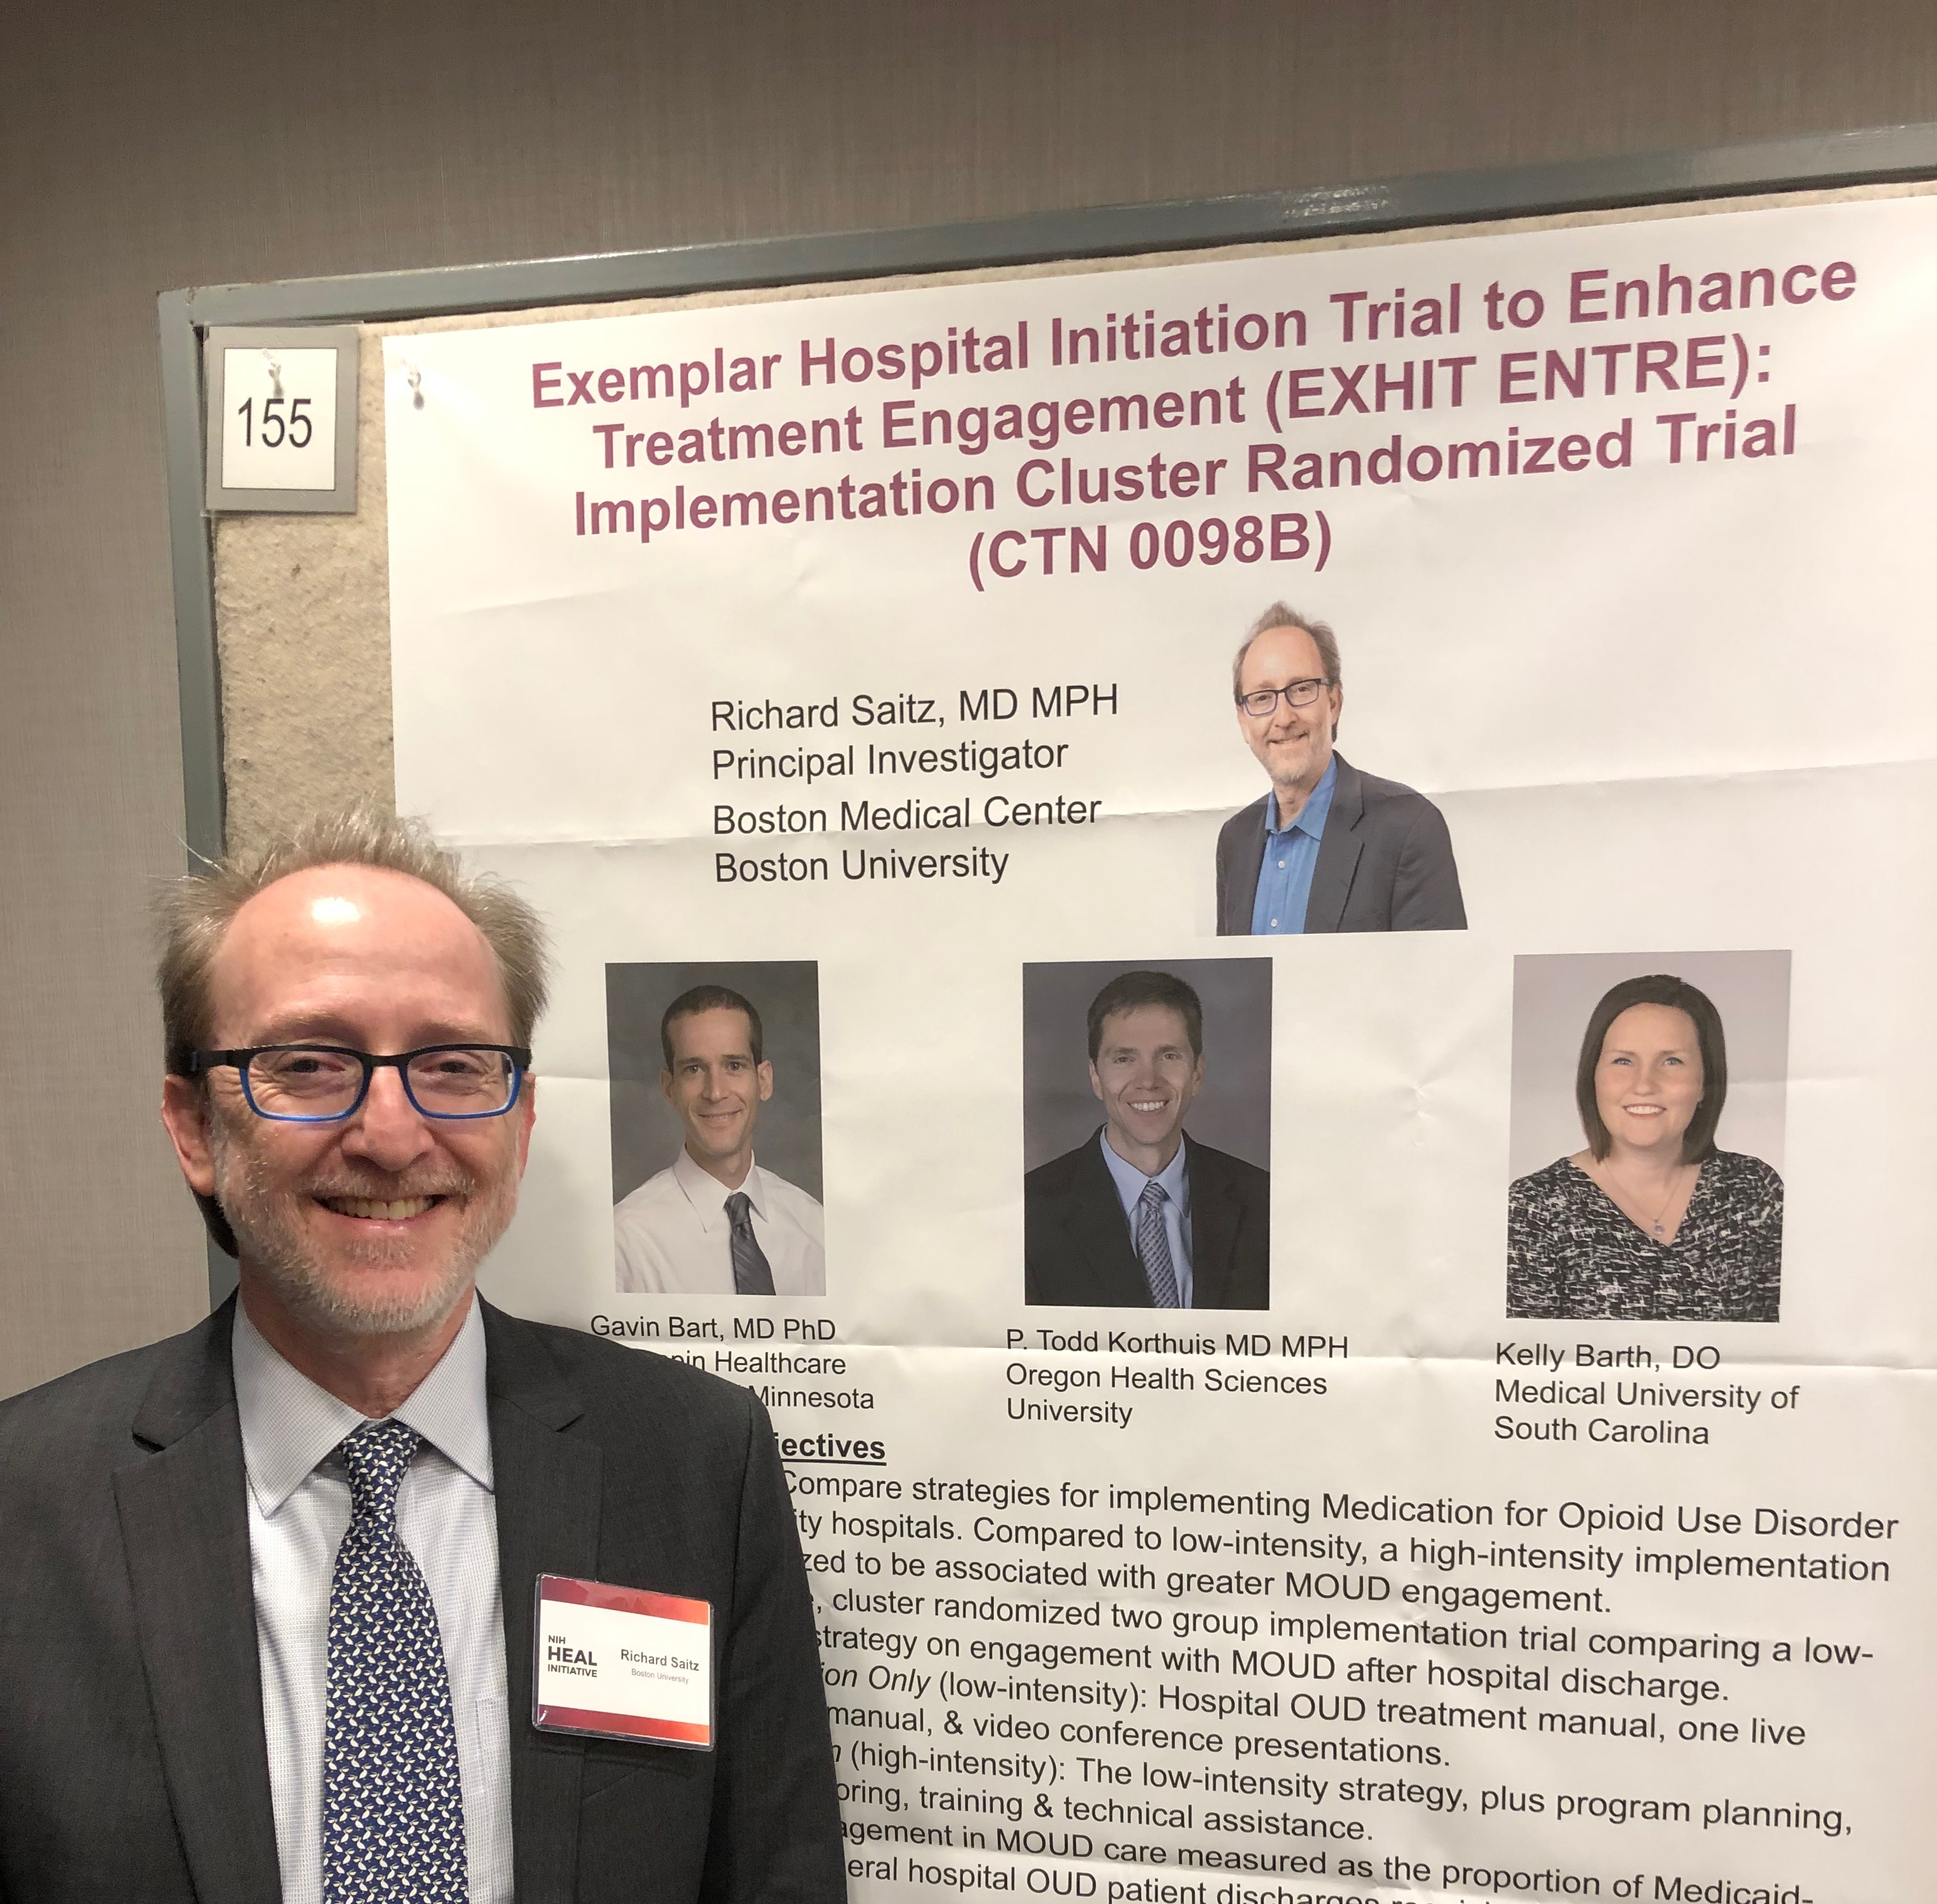
In rich’s words
Plenary should provide a critical appraisal of the evidence for a clinical practice:
“Without evidence, we don’t know what works or what the risks are… Evidence is necessary, even if not sufficient.”
“Continuation of practices not supported by evidence has served to separate addiction care from the rest of healthcare to its detriment.”
Photos courtesy of Jennifer McNeely, Zoe Weinstein
Notes:
To begin, I want to ground today's presentation in the instructions that Rich left to guide the annual Saitz, “what's the evidence” endowed plenary.
[read text]
Fundamentally, Rich believed that our patients deserve the best evidence.

Slide 3
Scientific rigor is a hallmark of Rich’s work, driven by a fundamental belief in health equity, that our patients deserve highest quality care.
Published many influential studies, including robust intervention studies with negative findings. Not afraid to challenge popular beliefs “to both the admiration and the dismay of colleagues.”
The Brink, Nov 2013 https://www.bu.edu/articles/2013/addiction-research-richard-saitz/

Slide 4
How we approached Critical appraisal of the evidence
Medication management
Strongest evidence
Harm reduction
Practice innovation
Implementation and system transformation
Practice innovation
Standard model definitions
Peer perspective
Aim to lay a foundation; stimulate work to advance the field of
hospital-based addiction care.
Notes:
We put considerable thought into how to marry Rich’s directive with today’s topic. Hospital addiction care is a rapidly emerging but young research area with a relatively small evidence base.
We’ve organized today’s talk in 4 main sections, with intention.
We start with a Peer perspective; largely because the voices of people with lived experience are often excluded in hospital settings, and they are critical to understanding gaps and opportunities.
Next, we move from areas with the strongest evidence – medication management – to areas where there are examples of practice innovation and descriptive or qualitative studies (harm reduction and system transformation).
Ultimately our goal is to lay a foundation that can be a starting point for broader conversation about how to best advance the field

Slide 5
Outline for today’s session
Introduction:
Why treat addiction in hospitals?
Peer perspectives
What is the evidence, and where are there gaps?
Medication management
Harm reduction
Transforming systems
Q&A: Panel and audience discussion
Notes:
Acknowledge Theresa as panelist

Slide 6
SUD-related hospitalizations are common, costly
At least 1 in 9 hospitalized adults in the US has substance use disorder (SUD), higher in many settings
Rising rates of opioid-, methamphetamine-, and alcohol-related admissions
People with SUD are at high risk for repeat ED visits, readmissions, and death
Suen JGIM 2021, Singh PLOS 2020, Winkelman JAMA Open 2018,
Hirode JAMA Open 2020, Peterson JAMA Open 2021
Notes:
Prevalence often higher in large urban hospitals; as many as 1 in 4

Slide 7
Hospitalization is a high risk touchpoint
MA statewide study: Residents hospitalized with injection-related infection in 2014 had 54-fold increased risk of fatal opioid overdose compared to general population
Despite comprising small percent of overall population, disproportionate number of overdose deaths
OR statewide study: Among adults with OUD hospitalized between April 2015-Dec 2017, 7.8% died within 12 months of discharge
Mortality similar to acute myocardial infarction (5-9%)
13% died from overdose; 42% from non-drug related causes
Overdose represents the tip of the iceberg
Larochelle, DAD 2019
King CA, JAM 2021
Notes:
In one Massachusetts study by Dr Larochelle and colleagues found that residents (ages 11 and older) hospitalized for injection related infection had a SMR of 54 for fatal opioid overdose, meaning that they had 54 fold increased likelihood of overdose mortality compared with the general population.
And that despite representing a small fraction of the population, patients who had a critical encounter touchpoint such as acute hospitalization represented a disproportionately large percent of overall overdose deaths.
OR study, our team found that 7.8% of hospitalized adults admitted from April 2015-Dec 2017 with OUD died within 12 months of hospital discharge

Slide 8
Most hospitals do not offer evidence-based addiction care
National VA study: only 15% of admissions with OUD received opioid agonist therapy (OAT)
Most commonly, withdrawal management only
Only 2% of admissions started OAT with linkage to care after discharge
Racial differences in MOUD prescribing observed in community settings persist in hospitals
Black patients more likely to receive methadone, whereas white patients more likely to receive buprenorphine
Hospitals are unprepared to treat addiction
46% of NM hospitals lack buprenorphine-naloxone on formulary
Priest JGIM 2020
Priest SAj 2022
Pham JAM 2022
Notes:
Despite being common, costly, and associated with disproportionately high mortality from overdose and other drug- and non-drug related causes, most hospitals do not offer evidence-based addiction care.
A nationwide study in VA estimated that only 15% of patients who had OUD received any OAT, which was most commonly administered for withdrawal management only.
Only 2% of admissions initiated MOUD with linkage to care after discharge
Subsequent analysis from this same cohort found that racial differences that are observed in community settings persist in hospitals.
Black pts more likely to receive methadone which is highly regulated, restrictive, and difficult to access; whereas white patients were more likely to receive buprenorphine (which can be administered in primary care and generally is much less disruptive to patients’ lives.
Generally, hospitals are unprepared to treat SUD.
In one statewide New Mexico study, 46% of hospitals lacked bup-nx on formulary,

Slide 9
Hospital setting
Unique considerations:
Hospitals are highly hierarchical systems, often harmful to people who use drugs
Hospitalized patients are acutely ill, and most people do not come to hospital seeking addiction care
Hospitalization as a reachable moment, can be a ‘wakeup call’
ED initiatives are different, inpatient hospitalization presents unique needs/ opportunities
Hospital-based SUD care draws on larger body of evidence, mostly in ambulatory settings
Changing acute care requires more than training clinicians about a new clinical practice
Heller Public Health Rep 2004; McNeil Social Sci & Med 2014;
Biancarelli DAD 2019; Simon Saj 2020; Velez JGIM 2017

Slide 10
Why treat addiction in hospitals?
Avoid harms
People with SUD to avoid/ delay care
Benefits
Reachable moment to engage in SUD care
Can improve SUD and other health outcomes
Transform systems
Hospitals have power, influence, resources
Hospitals are where we train workforce
Patient-directed discharge
Withdrawal, pain, stigma
Opportunity to address inequities

Slide 11
Peers can play critical role in hospital care
“This is an institution, and so often I feel like the peers will show us the ways in which institutions can either harm patients or not hear patients… those are the conflicts that our patients also experience. We just don’t have to see it when we’re the ones with the power.”
- Interprofessional Addiction Consult Service physician
Collins et al., JGIM 2019
Englander SAj 2019
Notes:
Substance use has relied heavily as a field on lived experience, because of that, want to start with perspective of someone with lived experience

Slide 12
Theresa
Why is it important to improve hospital care for people with substance use disorder?
Notes:
Theresa has 5 min, give her a small wave if needed

Slide 13
What’s the evidence for medications?
Ashish Thakrar, MD
National Clinician Scholars Program
University of Pennsylvania
Rich Saitz “What’s the Evidence?” Plenary
45th National AMERSA Conference
November 2022, Boston MA, USA
Notes:
Good morning, everyone. My name is Ashish Thakrar. I’m an internist and addiction medicine physician
I’m excited to present on “What’s the evidence for medications” in treating substance use disorders in the hospital

Slide 14
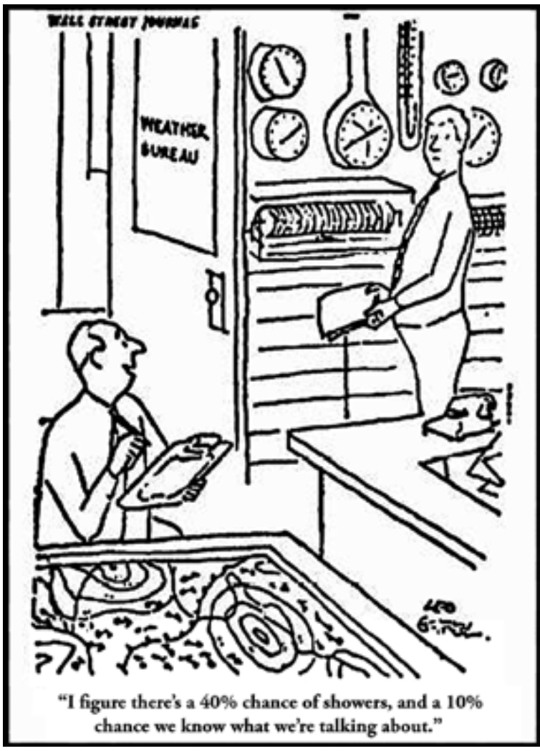
Work Room
“I figure there’s a 40% chance of showers, and a 10% chance we know what we’re talking about.”
success with this approach
Guyatt et al BMJ 2008
Notes:
Old cartoon but pertinent. One meteorologist…
Starting not just because of actual weather forecast (last I checked…40%?)
But because it’s worth considering whether this could apply to us as clinicians in any discipline
How much confidence do we have in the approaches we’re using?

Slide 15
Hospital-Based Interventions for SUDs
Opioids
Alcohol
Stimulants
Benzodiazepines
Cannabis
Nicotine
Polysubstance
Starting Pharmacotherapy
Managing Withdrawal
Harm Reduction
Psychosocial Interventions
Hospital Systems & Care Transitions
Notes:
For this section, we focused on opioid and alcohol and on the use of medications to start pharmacotherapy and to manage withdrawal
Before we dive in, I want to emphasize that these are not the only substance/interventions that matter
But for this section, focused on opioids & alcohol because bulk of existing evidence and large burden of use disorders for hospitalized patients
.

Slide 16
Our Approach
Goal: Describe the highest level of evidence for practices in the hospital
Bottom-line: Recommendations for clinical practice
Gaps in evidence: Remaining questions for research
Key Themes
Are we balancing innovation & rigor for a poisoned drug supply?
Are these the outcomes that matter to patients?
How do we implement & scale what works?
How can we build evidence for polysubstance and other use disorders?
Notes:
We conducted lit review with goal of highest level of ev
Traditional evidence hierarchy: randomization, control groups, prospective designs
Evidence IN THE HOSPITAL: hospitalized patients are different (acutely ill, multiple co-morbidities, not nec treatment-seeking for SUD)
Four themes I’d invite you to mull over as we review existing evidence:
1. In a crisis. There are many exciting new approaches. At the same time, patients deserve high quality evidence on safety & efficacy.
2. As Elaine will describe next, many patients avoid the hospital or leave early because they’re needs aren’t being prioritized.
3. There’s a lot that works! It’s not all bad news! The next step beyond efficacy can we implement what works at scale?
4. Not the focus, but worth thinking through how we can develop a robust evidence base for using medications for these other substance use disorder.

Slide 17
Starting Medications for OUD
Context: Methadone, buprenorphine, and XR-naltrexone are safe and highly effective across settings.
[Meta-analyses of RCTs]
Evidence in the hospital: RCT (buprenorphine) & Case Series (others)
Buprenorphine maintenance (vs. detoxification) increases linkage to treatment & reduces self-reported illicit opioid use. [2 RCTs, n=474]
Initiating methadone maintenance is legal & feasible and likely assists with linkage and retention to outpatient treatment. [Case reports]
It is feasible to start other forms of medications for OUD (SROM, iOAT). [Case series]
Evidence summary: mixed rigor for evidence in the hospital, but high across settings
Bottom-line: offer medications for OUD and treatment linkage
Notes:
For this audience, I don’t need to belabor this point.
Less work has been done in the hospital…
2 RCTs
Case reports
Case series
Evidence summary…
…because so high across settings, Bayesian perspective that takes into account the evidence from these other settings
Bottom-line: …
…non-controversial

Slide 18
New Approaches to Starting Medications for OUD
Evidence in the hospital: Retrospective Cohorts & Case Series
Low-dose initiation of buprenorphine with overlapping full-agonist opioids can be completed without significant withdrawal for some patients. [3 retrospective cohorts, n= 189]
Rapid buprenorphine titration to therapeutic doses (“high-dose”) can be completed safely for some patients already in withdrawal. [Case series, n=391]
Rapid methadone titration to therapeutic doses in ~5-7 days can be safe. [Case series]
Evidence summary: low level of evidence for safety and efficacy
Bottom-line: promising, but very high risk of bias
Bhatraju et al. (2021), Button et al (2022), Jablonski et al. (2022), Herring et al. (2021), Hemmons et al. (2019), Ickowicz et al. (2021)
Notes:
-

Slide 19
Opioid Withdrawal Management
Evidence in the hospital: Systematic Reviews/Meta-Analyses of RCTs
For withdrawal from organic & semi-synthetic short-acting opioids or methadone…
…the alpha₂-agonists clonidine & lofexidine (vs. placebo) reduce withdrawal. [3 RCTs, n=148]
…buprenorphine is superior to alpha₂-agonists. [7 RCTs, n=902]
…methadone is likely as effective as buprenorphine, but symptoms may resolve more quickly with buprenorphine. [2 RCTs, n=82]
Evidence summary: very high level, variable relevance to high-potency synthetics
Bottom-line: offer to all, but acknowledge limitations

Slide 20
Medication for Opioid Use Disorder & Withdrawal
Key Gaps in Evidence
Safety & efficacy of new ways of starting buprenorphine & methadone for patients with fentanyl dependence?
Safety & efficacy of novel approaches to treating opioid withdrawal from high-potency synthetic opioids?
Management of co-occurring withdrawal syndromes?
How to implement medications for OUD across hospitals?
Notes:
Engagement in care after XR-BUP vs. SL buprenorphine on discharge? [EXHIT ENTRE]
Patient-centered and safe initiation of medications for OUD in patients with concurrent acute pain?

Slide 21
Starting Medications for AUD
Context: XR-naltrexone and other medications are safe and effective in most settings.
[Meta-analyses of RCTs]
Evidence in the hospital: single pilot RCT & two pre-post QI studies
Patients discharged with XR & PO NTX both had significant reductions in alcohol consumption after discharge. [1 pilot RCT, n=35]
Counseling for hospitalized patients can increase NTX prescriptions and has unclear effects on 30-day ED revisits & hospital readmissions. [2 QI studies, n=355]
Evidence summary: limited in the hospital, but high level across settings
Bottom-line: offer medications for AUD and treatment linkage
Busch (2017), Wei (2014), Stephens (2018), Kirchoff (2021)
Notes:
Wei 2008 JGIM: Pre/Post QI
Busch 2017 Alc Clin & Exp Res
Two trials on ClinicalTrials.gov:
Pragmatic RCT of XR-NTX vs. PO-NTX for hospitalized patients with AUD; primary outcome: alcohol consumption (PI: Saitz)
Pilot Comparative Effectiveness RCT of XR-NTX vs. PO-NTX (PI: Calcaterra)

Slide 22
Benzodiazepines for alcohol withdrawal
Level of evidence in the hospital: Systematic Reviews/Meta-Analyses of RCTs
Benzodiazepines (vs. placebo) protect against alcohol withdrawal symptoms, seizures, and delirium. [>60 RCTs, n>4000 participants]
Symptom-triggered (vs. fixed-schedule) protocols reduce duration of treatment. [3 RCTs, n=281]
Symptom-triggered (vs. fixed-schedule) protocols lower total benzodiazepine dosage. [6 RCTs, n=676 patients]
Evidence summary: very high level
Bottom-line: the evidence-based standard of care

Slide 23
Adjuvants to benzodiazepines for alcohol withdrawal
Evidence in the hospital: Systematic reviews of observational studies and a few RCTs
Phenobarbital likely reduces ICU admissions, might reduce the need for MV, and might lower benzodiazepine requirements [1 RCT, n=102; 3 retrospective cohort studies]
Propofol might reduce refractory symptoms for patients already on mechanical ventilation [1 systematic review of observational studies]
Dexmedetomidine likely reduces agitation & benzodiazepine use among ICU patients but increased bradycardia [2 RCTs, 3 systematic reviews of observational studies]
Summary: moderate quality evidence for safety & efficacy
Clinical bottom-line: promising for certain patients
Notes:
Benzodiazepine loading (vs. ***) reduces duration of treatment and lowers incidence of seizures & duration of delirium [***]

Slide 24
Medication for Alcohol Use Disorder & Withdrawal
Key Gaps in Evidence
Dosing & timing of benzodiazepine adjuvants for resistant alcohol withdrawal?
Safety & comparative efficacy of benzodiazepine-sparing protocols for alcohol withdrawal?
Comparative efficacy and cost-effectiveness of different medications (formulations) for AUD?
How to implement medications for AUD across hospitals?
Notes:
Two trials on ClinicalTrials.gov:
Pragmatic RCT of XR-NTX vs. PO-NTX for hospitalized patients with AUD; primary outcome: alcohol consumption (PI: Saitz)
Pilot Comparative Effectiveness RCT of XR-NTX vs. PO-NTX (PI: Calcaterra)

Slide 25
What’s the evidence for medications?
Key Themes
Are we balancing innovation & rigor for a poisoned drug supply?
Are these the outcomes that matter to patients?
How do we implement & scale what works?
How can we build evidence for polysubstance and other use disorders?
“We don’t do belief-based medicine in cardiology, and we shouldn’t do it here.”
Rich Saitz
Notes:
Many trials on ClinicalTrials.gov
-:RCT Engagement in care after XR-BUP vs. SL buprenorphine on discharge? [EXHIT ENTRE]
Patient-centered and safe initiation of medications for OUD in patients with chronic pain?
- Pragmatic RCT of XR-NTX vs. PO-NTX for hospitalized patients with AUD; primary outcome: alcohol consumption (PI: Saitz)
Pilot Comparative Effectiveness RCT of XR-NTX vs. PO-NTX (PI: Calcaterra)

Slide 26
Integrating harm reduction into hospitals:
Need, current evidence, and knowledge gaps
Elaine Hyshka, PhD
Associate Professor and Canada Research Chair in Health Systems Innovation, School of Public Health, University of Alberta; Scientific Director, Inner City Health and Wellness Program, Royal Alexandra Hospital
Rich Saitz’s ‘What’s the Evidence’ Endowed Plenary
AMERSA Conference; Boston, USA
November 11 2022
Notes:
Today I will be discussing integrating harm reduction strategies in hospitals with a focus on inpatients and those who use illegal drugs

Slide 27
Main points
Need to improve hospital care for all patients with substance use disorder
Harm reduction practices could improve patient care and outcomes
Implementation research shows harm reduction in hospitals is feasible
Focus future research on measuring effectiveness + optimizing for different contexts and patient populations
Notes:
The four key takeaways I want to leave you with are:
Current evidence tells us we have to do more to support all patients with substance use disorders, not just those pursuing abstinence.
Harm reduction is evidence-based and could help improve hospital care and outcomes
Research from Canada and the US is showing that implementing harm reduction in hospitals is feasible
Future research should prioritize measuring patient outcomes across different hospital contexts and patient populations

Slide 28
Providing substance use treatment is critical but not sufficient for improving hospital care.
Notes:
So why do we need harm reduction in hospitals?
delivering substance use treatment to inpatients is important but not sufficient for improving care

Slide 29
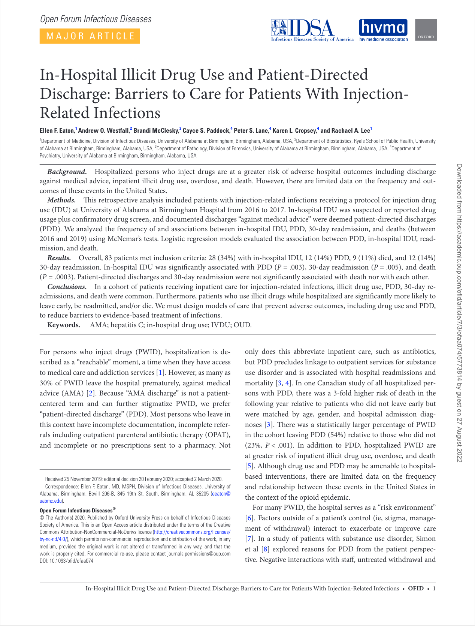
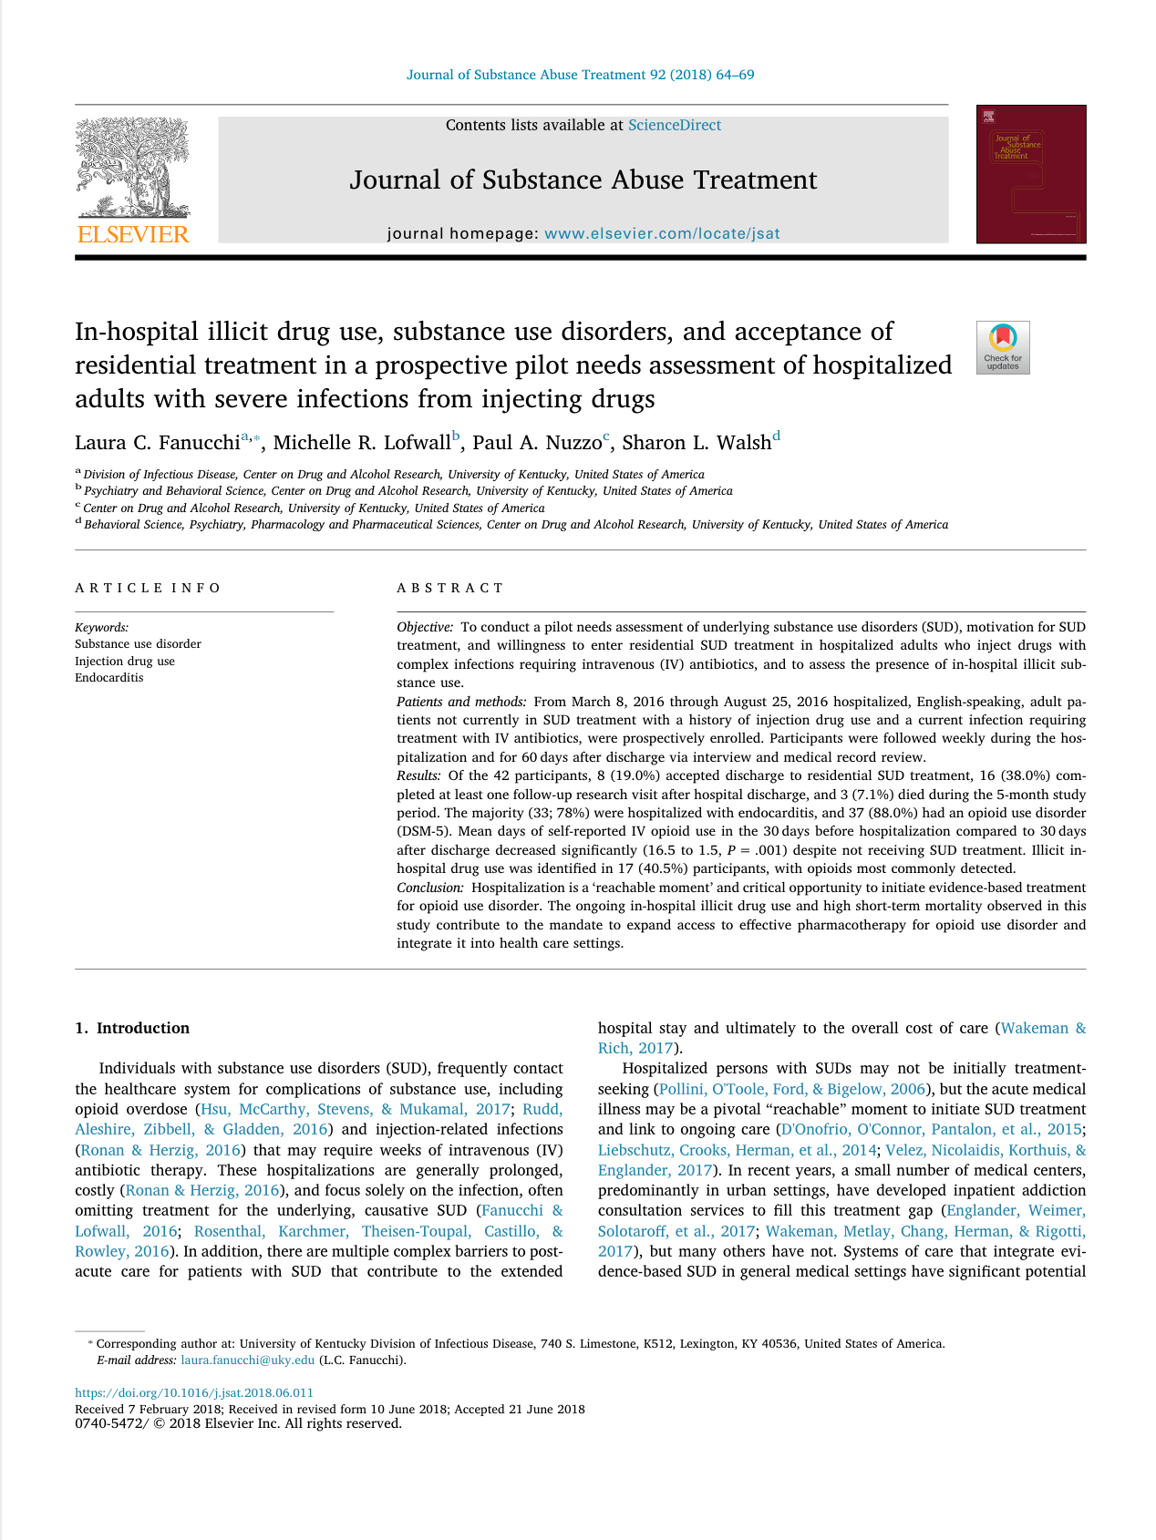
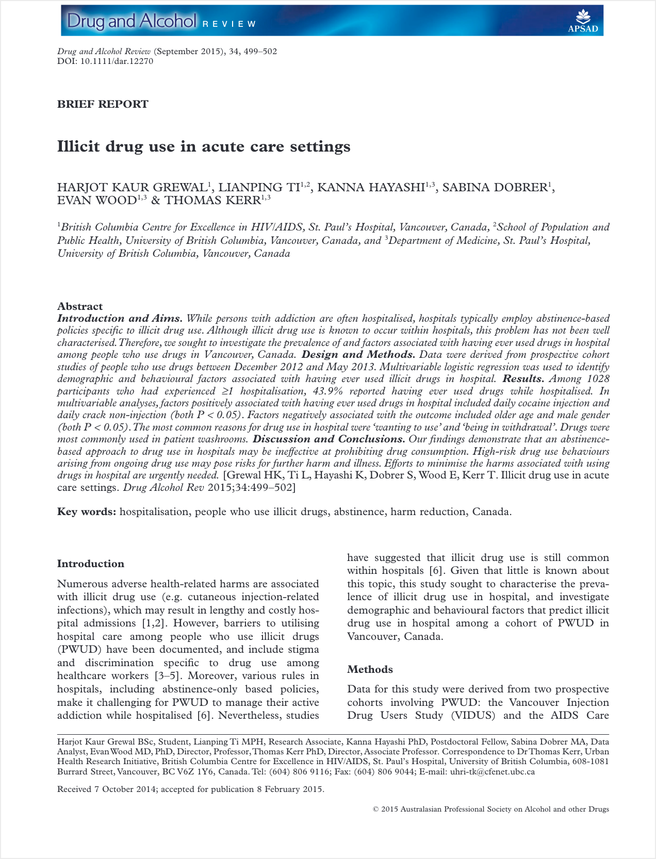
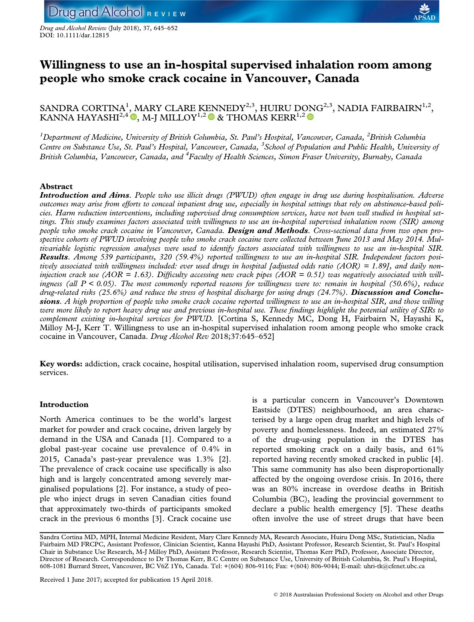
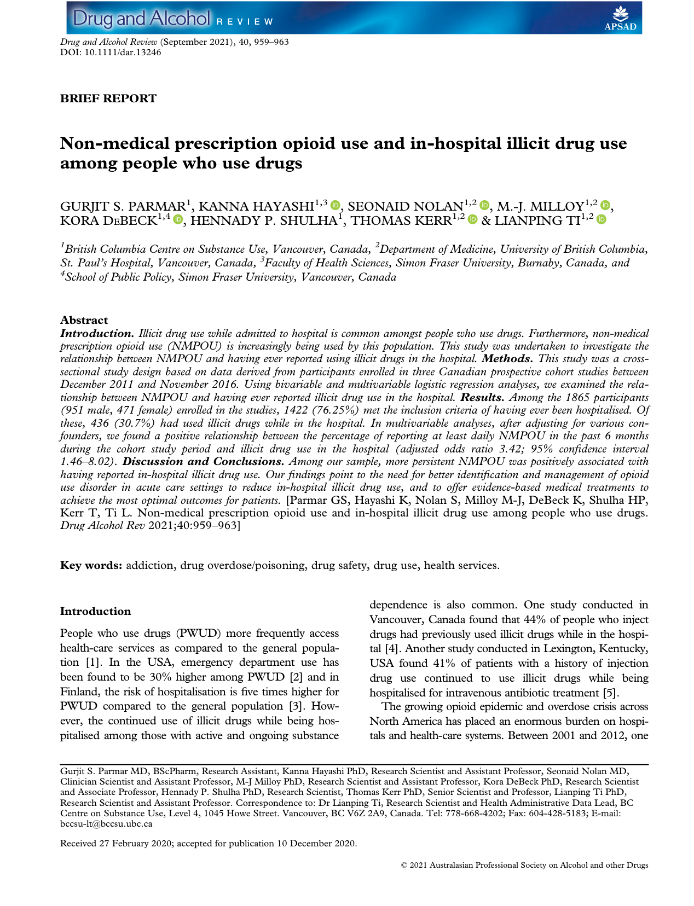
Prevalence estimates of in-hospital substance use range from 30 to 49% amongst patients who use drugs
Notes:
While treatment is important focusing solely on it ignores the reality that many patients who use drugs are not seeking to abstinence, and some will continue to use while hospitalized.
Estimates from the United States and Canada suggest that as many as 30-49% of patients who use drugs continue to use while hospitalized

Slide 30
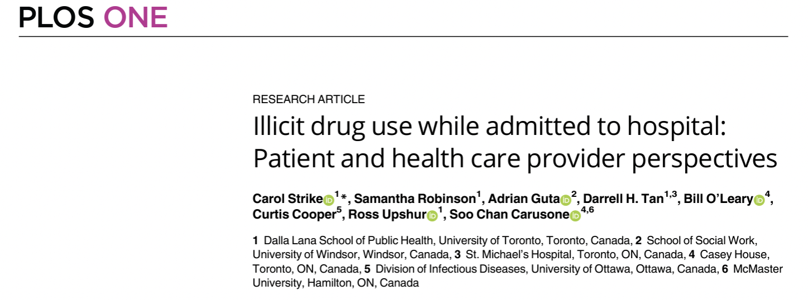
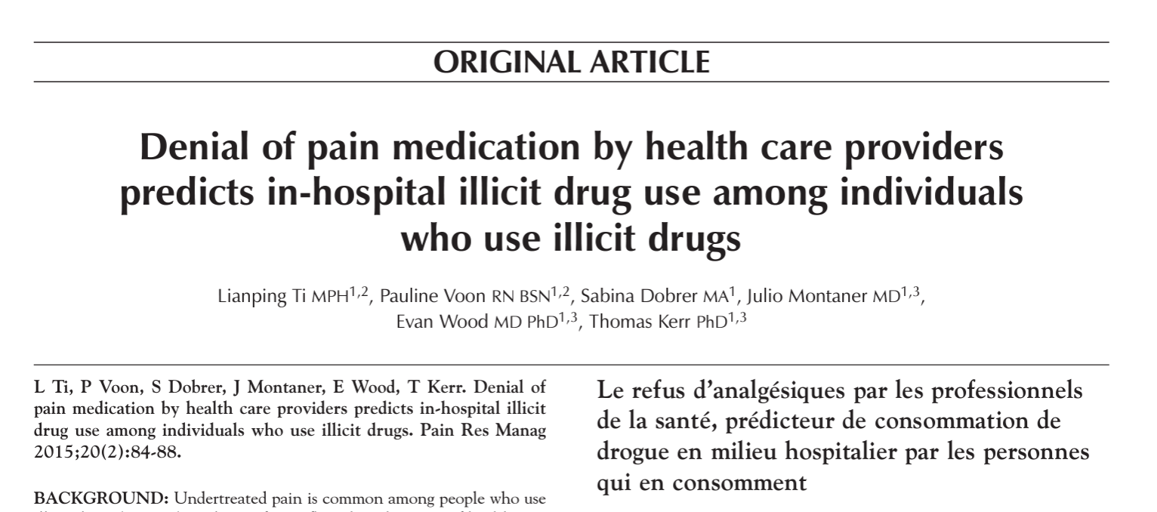
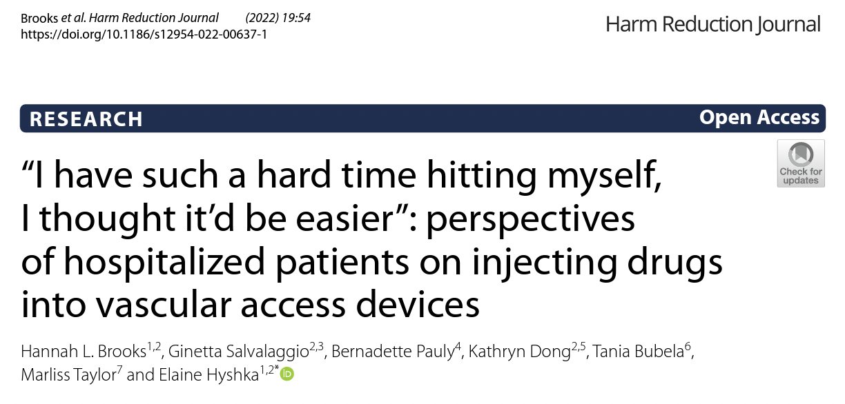
Why do patients use drugs in hospitals?
Inadequate pain or withdrawal management
Anxiety, stress, and boredom
Stigma and discrimination
Use during treatment stabilization
McNeil 2014 SSM; McNeil 2016 Addiction; Pauly 2015 Adv Nurs Sci; Szott 2014 IJDP; Strike 2020 PLoS One; Brooks 2022 HRJ; Ti 2015 Pain Res Mang.
Notes:
In-hospital substance use is driven by multiple factors
Going untreated or undertreated for pain and withdrawal is obviously an important driver
But even when effective pain and withdrawal management is available, some patients continue to use substances due to
stress, anxiety, or boredom,
stigma and discrimination from staff
or psychiatric comorbidities that make it harder to abstain

Slide 31
Hospitals are high risk environments for inpatients who use substances
Notes:
Rather than being a place of healing and safety, hospitals are often high risk environment for inpatients who use substances

Slide 32
Hospitals as risk environments
Formal and informal bans on substance use; stigma; fear of criminalization
High risk substance use; patient-directed or involuntary discharge
Increased morbidity and mortality
Increased morbidity and mortality
Staff ‘turn a blind eye’ to substance use or police patients, fueling mistrust + missing opportunities to engage patients in addiction care
McNeil 2014 SSM; McCall 2019 JMHAN
Notes:
Formal and informal bans on substance use, stigma and surveillance can result in patients using substances alone in locked washrooms, stairwells, parkades or other unsterile and unsafe spaces increasing the risk of overdose and premature discharge.
Beyond these negative health outcomes, abstinence-only policies position hospital staff in opposition to patients, by requiring them to choose between either ‘turning a blind eye’ to in-hospital substance use, or actively policing patients.
Ignoring ongoing drug use represents a missed opportunity to engage patients in substance use care, while surveilling patients fuels mistrust and jeopardizes the therapeutic relationship between patients and staff.

Slide 33
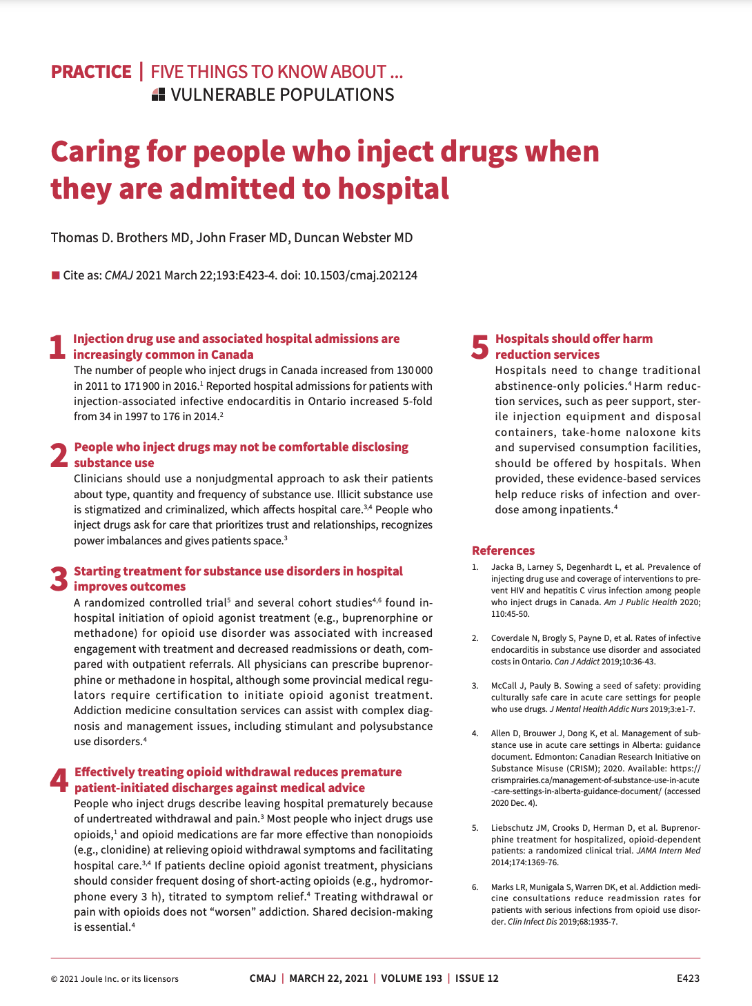
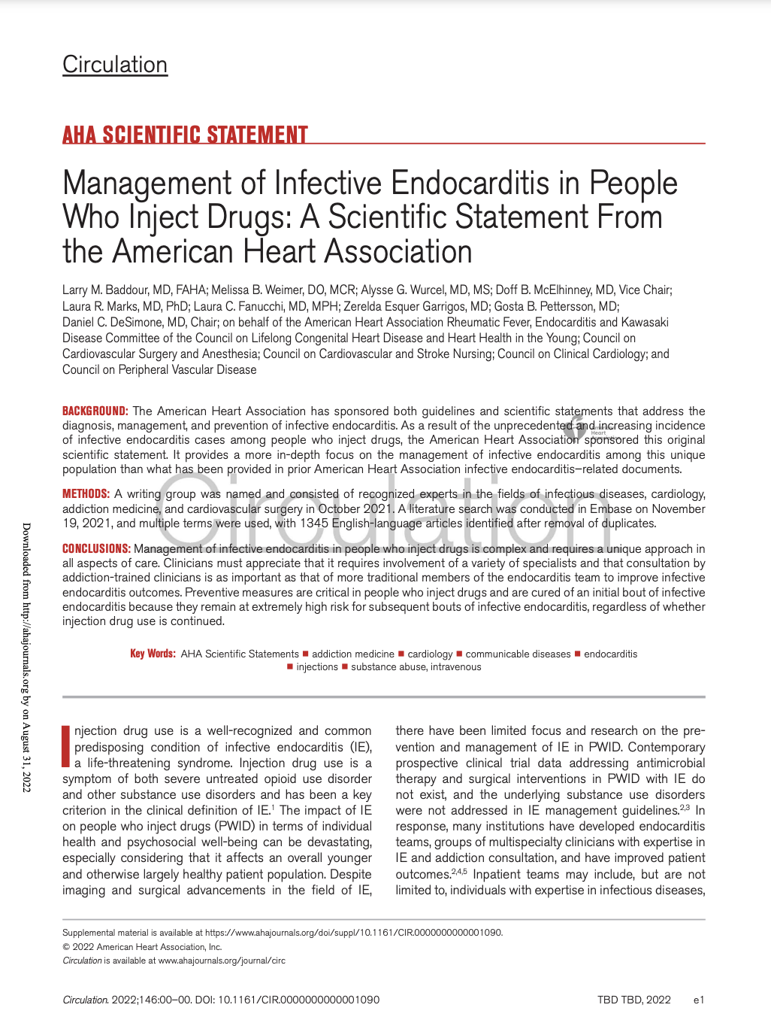
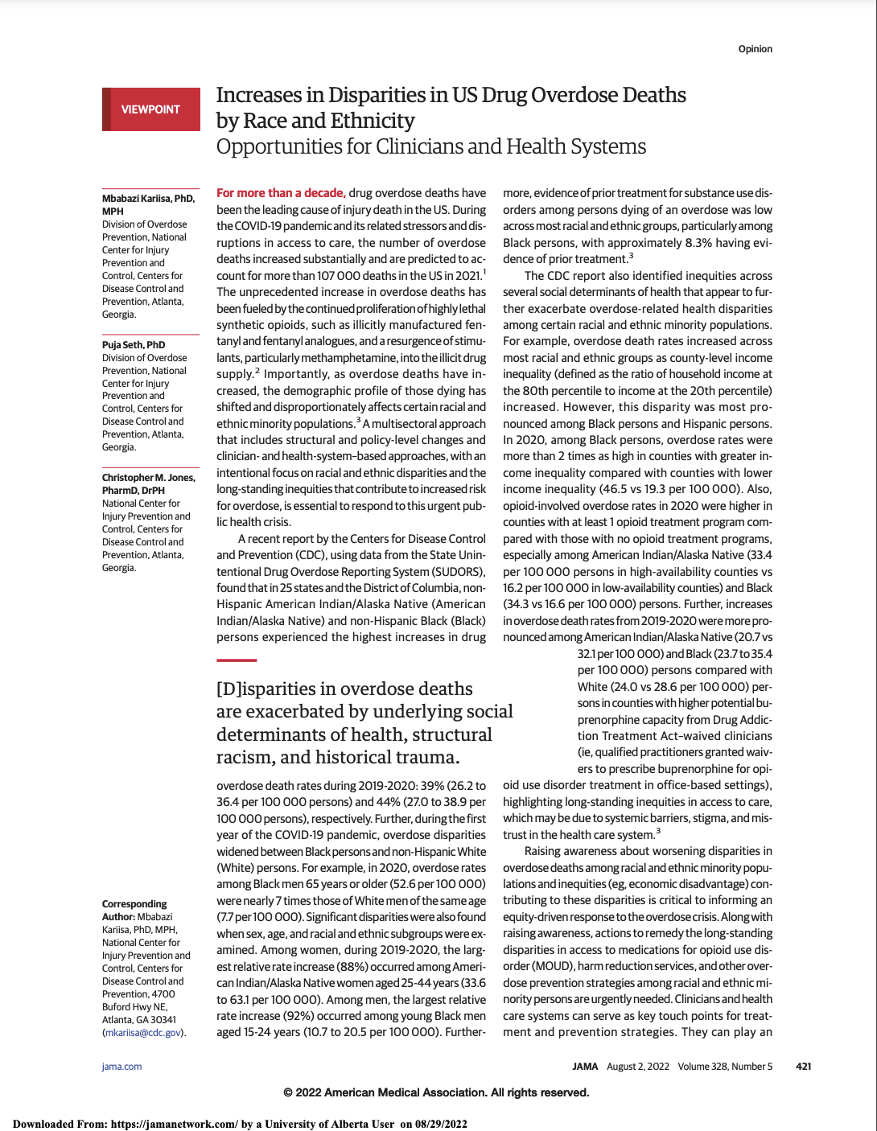
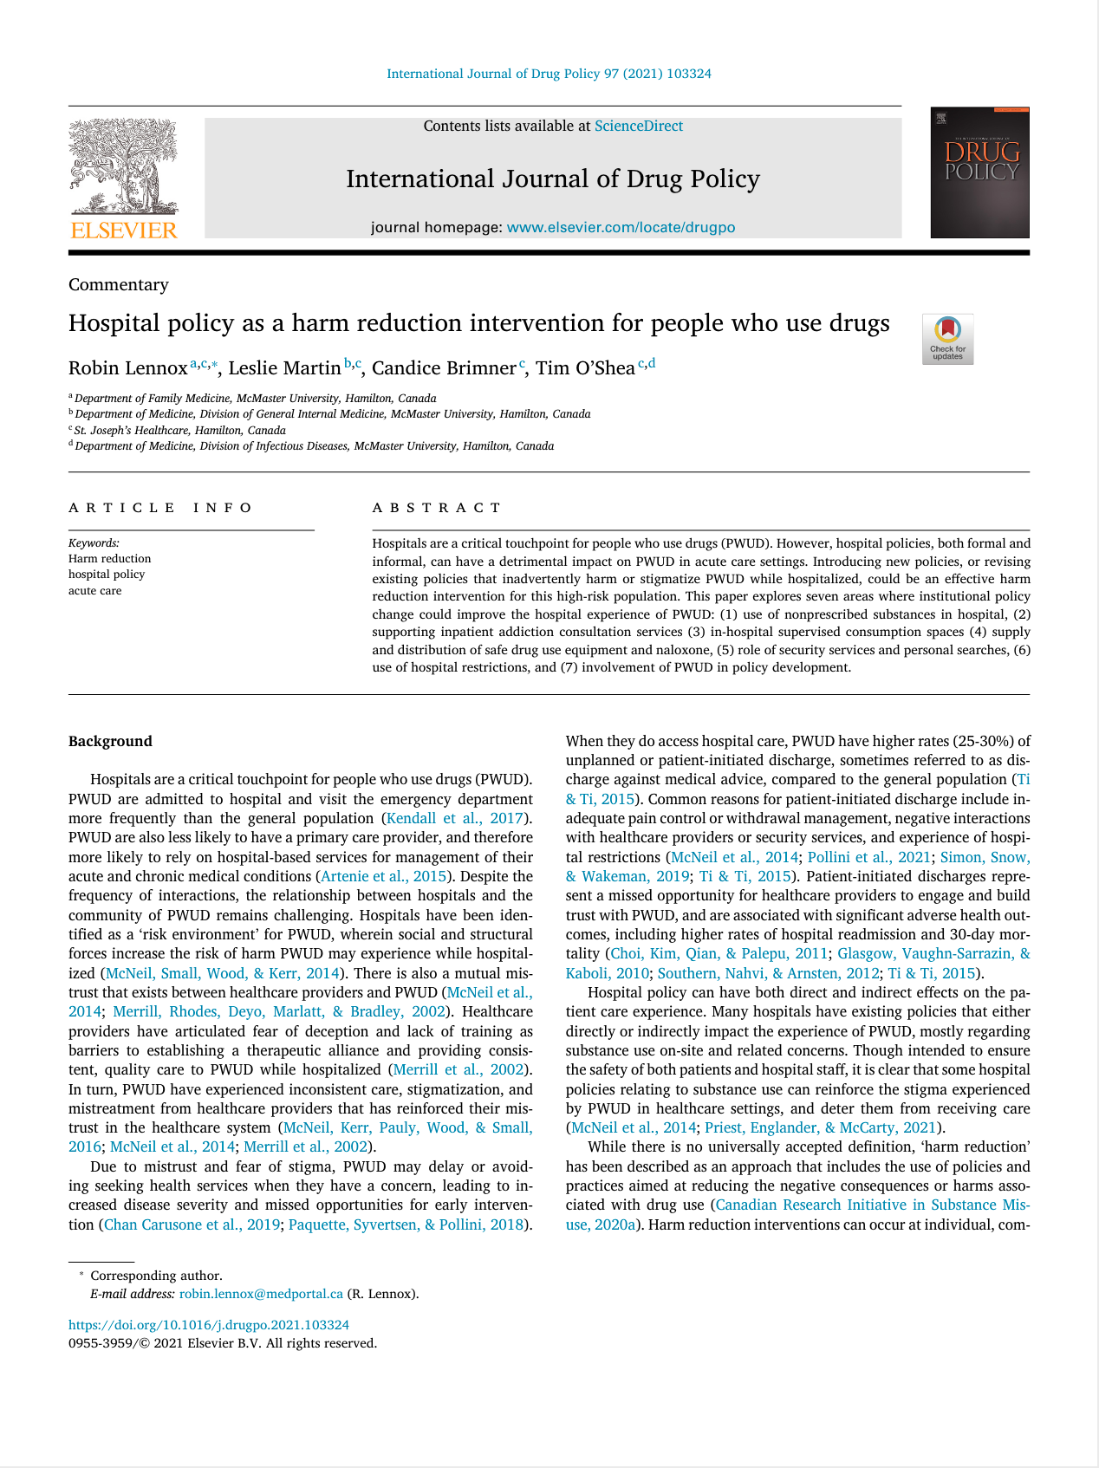
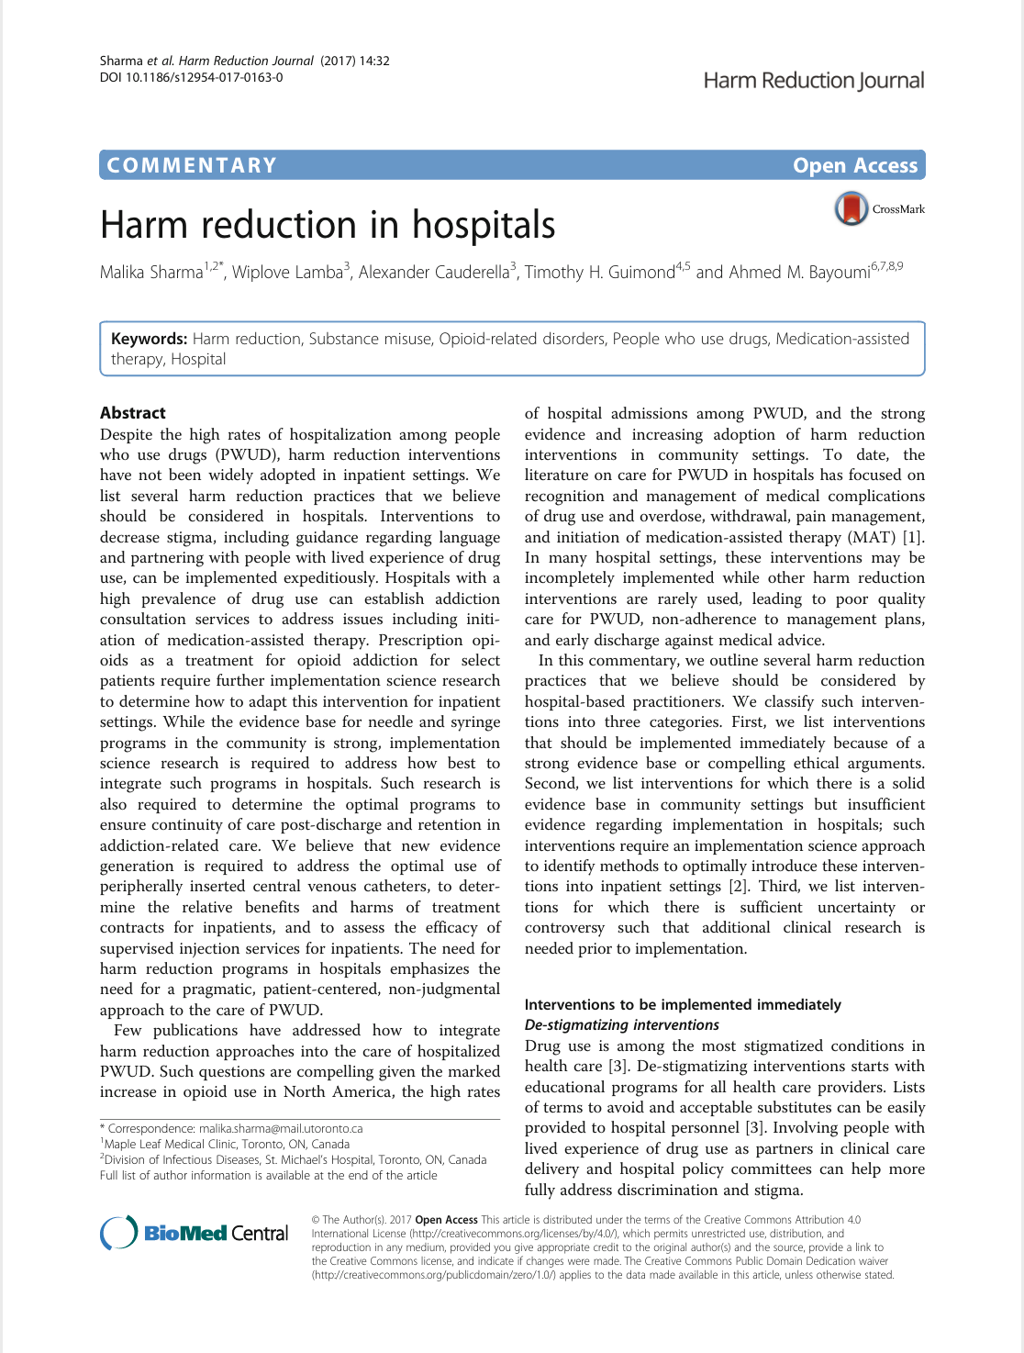
Experts are increasingly recognizing a need to bring harm reduction to the hospital bedside
Notes:
experts are increasingly calling for harm reduction approaches in hospitals to reduce health risks and ensure all patients with substance use disorders have equitable access to acute medical care

Slide 34
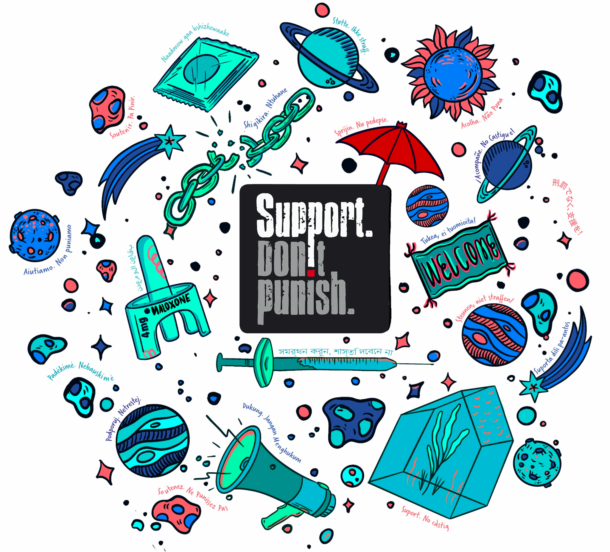
What is harm reduction?
Both a philosophy of care and pragmatic set of strategies that helps people who use drugs be safer and healthier, have more autonomy over their lives, and take protective and proactive measures for themselves, their families and communities. *
*Adapted from Streetworks Edmonton
Image from suppordontpunish.org
Notes:
Harm reduction is both a philosophy of care and pragmatic set of strategies that helps people who use drugs be safer and healthier, have more autonomy over their lives, and take protective and proactive measures for themselves, their families and communities.

Slide 35
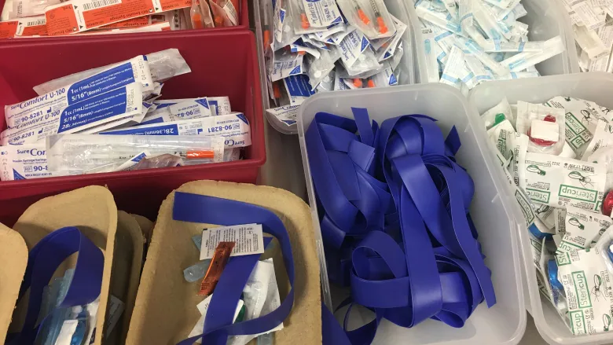
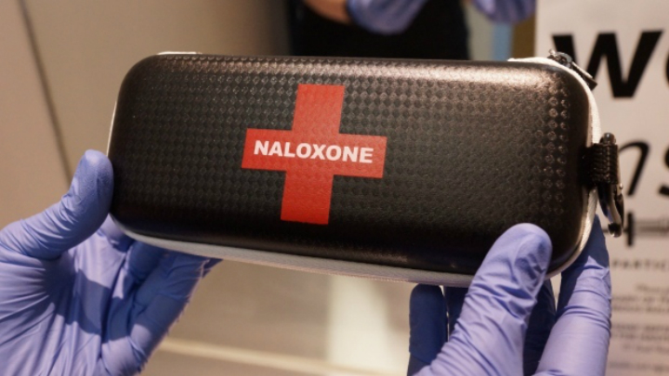
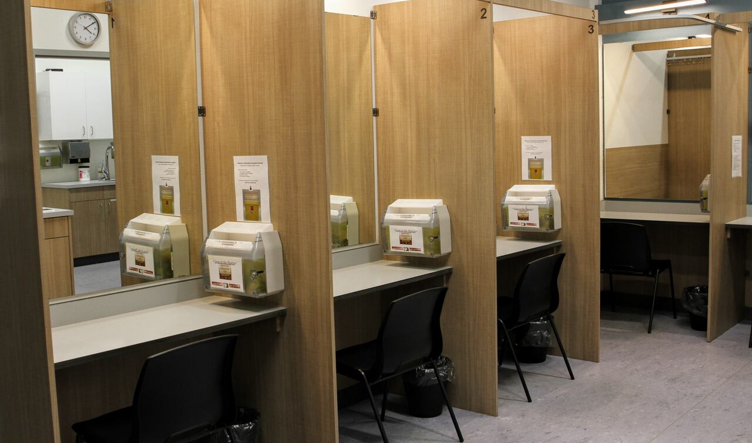
Syringe services programs
2017 review of 13 systematic reviews; 133 studies
↓ injecting risk behaviour
↓ HIV and HCV* transmission
Fernandes 2017 BMC PH
Naloxone kit programs
2021 review of 6 systematic reviews; 87 studies
↑ overdose prevention knowledge
↓ opioid-related mortality
Razaghizad 2021 AJPH
Supervised consumption sites
2021 systematic review of 22 effectiveness studies
↓ overdose mortality
↑ access to treatment
Levengood 2021 AJPM
Evidence supports harm reduction in community settings
Notes:
A large international body of research has evaluated a range of harm reduction programs and interventions in community or outpatient settings
Syringe services programs, naloxone distribution and supervised consumption services have been shown to reduce drug-related morbidity and mortality

Slide 36
Hospitals are extrapolating evidence from community settings to adapt harm reduction approaches into inpatient care
Notes:
In this next section, I will go over some of the early research on these practice innovations

Slide 37
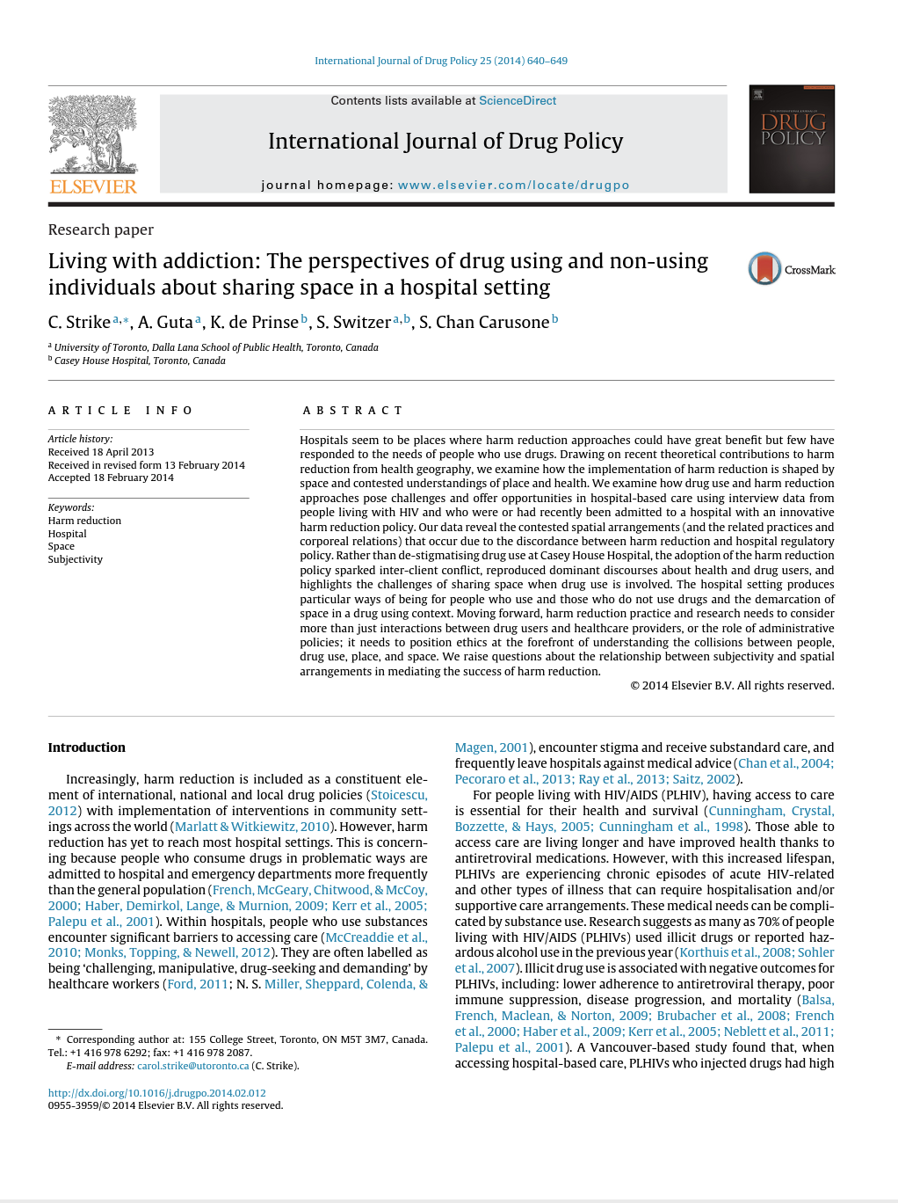
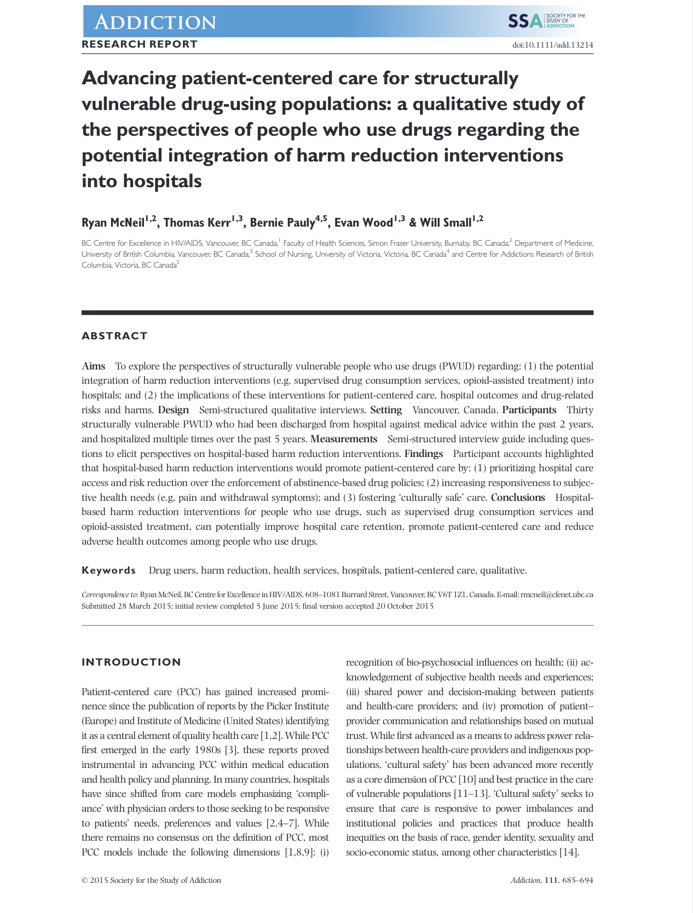
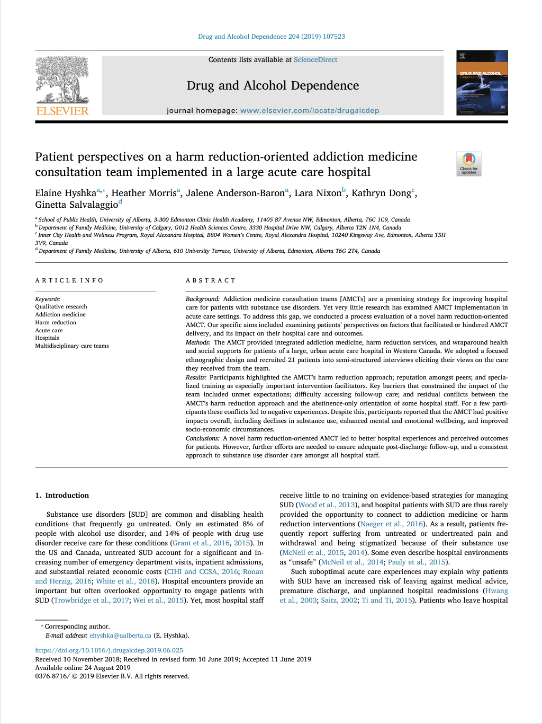
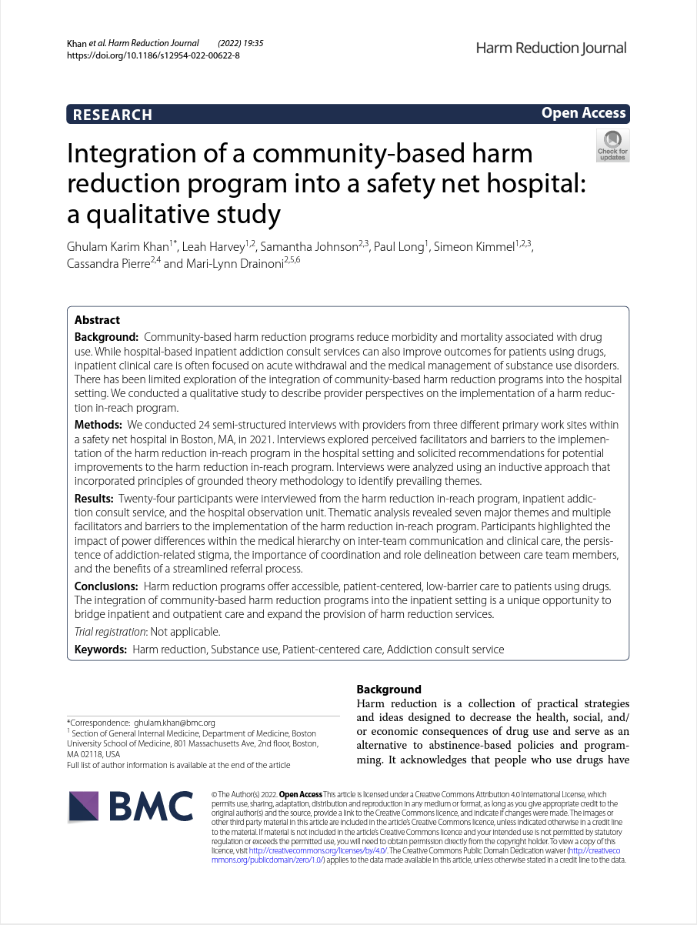
Adopting a harm reduction approach is potentially feasible and acceptable to patients and staff
Notes:
As a more and more hospitals consider the merits of harm reduction, a growing body of research is documenting that shifting from zero tolerance to a harm reduction approach to patient care is potentially feasible and acceptable to both patients and staff

Slide 38
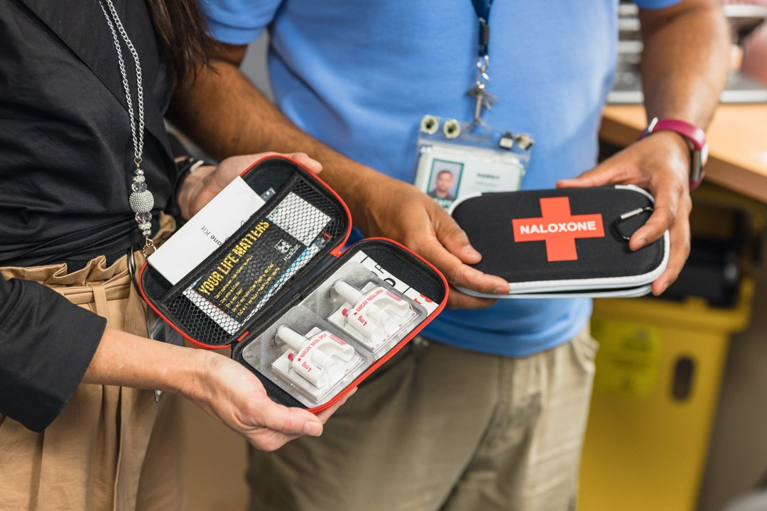
Inpatient naloxone programs
Zschoche 2018 AJHP
Mahgoub 2019 Psych Serv
Van 2019 Arch Phys Med Rehabil
Prach 2019 Res Soc Admin Pharm
Jakubowski 2019 Sub Abuse
Train 2020 AJN
Nguyen 2022 AM J Health-Syst Pharm
Notes:
Research has also looked at specific harm reduction interventions in hospitals
The most widely studied to date is inpatient naloxone programs which train patients on overdose prevention and response and facilitate access to naloxone by dispensing a kit or writing a prescription.
To date these programs have been delivered by addiction medicine teams, pharmacists and pharmacy trainees, unit physicians, nurses and residents, social workers and other hospital staff and
implemented for general acute care, subacute, rehabilitation, and psychiatric patient populations.

Slide 39
Key findings - inpatient naloxone programs
↑ patient knowledge and naloxone access
Important adjunct to outpatient programs
Engage multiple disciplines + trainees
Deliver during admission
Train visitors
Address cost
?? posionings; reversals; deaths; other impacts
Notes:
these programs have been found to increase inpatients’ naloxone access and reach patients who are otherwise missed by community or ED-based programs naloxone programs
Enabling multiple disciplines and trainees to deliver kits keeps workload manageable and facilitates staff and student capacity building
Important to offer prior to discharge to catch those who may leave prematurely
Train patients’ visitors as they are potential bystanders
Work with hospital pharmacy to deliver kits free of charge where feasible to maximize uptake
To date no studies have assessed the impact of these programs on poisonings, reversals or other health outcomes
The cover a variety of different models that provide digital, in-person, or paper-based instruction on opioid overdose recognition and reversal, all provide an opportunity for patients to ask follow up questions
Nalxone kits are typically delivered at the point of care either through a prescription filled by the hospital or kits obtained through state-wide distribution programs. Kits are typically low or no cost though some programs have funded kits via patients’ insurance, a co-pay and/or out-of-pocket expense.
A wide range of staff have been involved in these initiatives. Some use AMCTs to identify eligible patients and deliver kits, while other rely on unit staff to screen patients and either deliver training and kits directly or connect with a specialized care provider via consult. Physicians, nurses, pharmacists, social workers and trainees have all successfully delivered kits and training to a variety of patient populations at risk of overdose including general medical inpatients, those on inpatient detox or withdrawal management units, psychiatric patients, and rehabilitation paitents.
This literature has documented increases in the likelihood of patients receiving kits after implementation of these programs however to date, no studies have assessed the impact of these programs on opioid-related morbidity or mortality either for participating patients or other people who use drugs.
Future research should investigate overdose reversals resulting from the initiative as well as behaviour changes and health outcomes of participating patients.

Slide 40
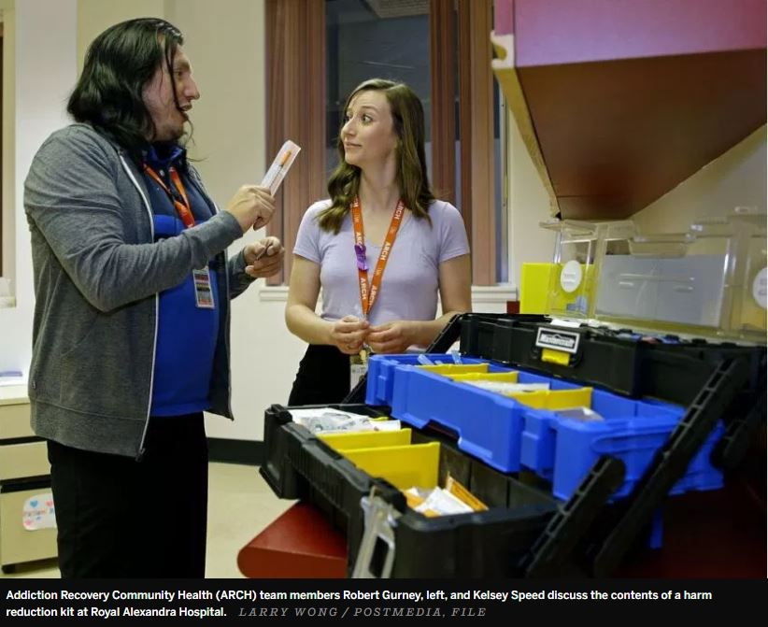
Inpatient syringe services
Brooks 2019 DAR
Brothers 2022 PLoS One
Miskovic 2018 AJPH
Perera 2022 HRJ
Notes:
Four quantitative studies have evaluated the provision of harm reduction supplies to hospital inpatients
Collectively they describe implementation of syringe services as part of specialized addiction medicine, HIV, and infective endocarditis care.
These studies report that implementing syringe services programs for hospital inpatients who inject drugs is feasible and that these programs have distributed hundreds of either pre-assembled kits or loose supplies to admitted patients

Slide 41
Key findings - inpatient syringe services
1000s of supplies distributed
~ ½ eligible addiction medicine consult patients offered supplies, ~⅓ accepted supplies,
Females more likely to accept
Supportive policy necessary but not sufficient
Need to expand to serve all inpatients
?? risk behaviours, hospital acquired infections, care completion, treatment uptake
Notes:
Only two studies assess the proportion of eligible patients accessing supplies. In the larger of the two, published by my team, we found that Injecting supplies were offered in 56% of 597 AMCT consults where the patient reported IDU, and the patient accepted supplies in 37% of these encounters. Supplies were offered to patients regardless of age or sex but in multivariate analyese, females were more likely to accept supplies when offered.

Slide 42
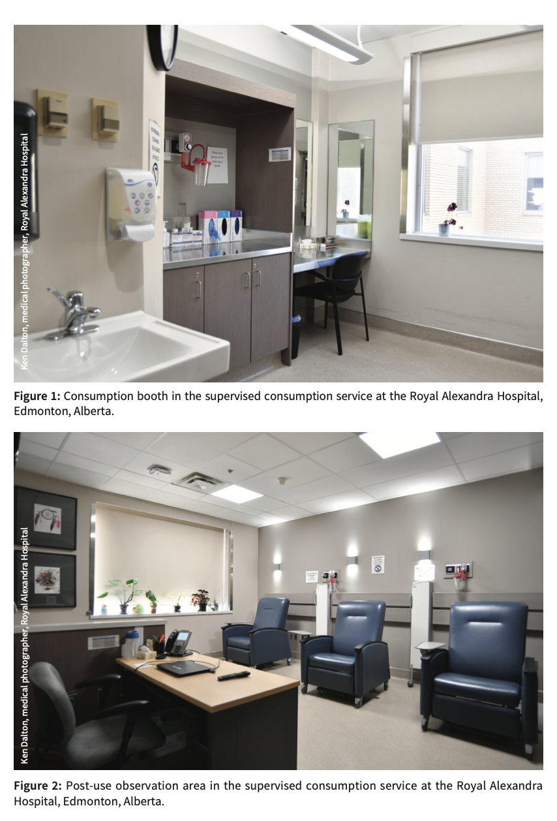
Supervised consumption services for hospital inpatients
Dong 2020 CMAJ
Kosteniuk 2021 IJDP
Dogherty 2022 HRJ
Nolan 2022 DAD
Notes:
Finally four papers have described three supervised consumption services for hospital inpatients in Canada.
These include two nurse-led services for hospital patients, and a peer-led overdose prevention site in a trailer on the grounds of hospital which served both patients and people from the surrounding community.

Slide 43
Key findings - hospital supervised consumption services
1000s of visits with no deaths
Patients 3x more likely to experience overdose compared to community clients
Low rate of injecting into vascular access devices
Reduce health risks and avoid negative sanctions
No inhalation; privacy, fear of care changes; criminalization
?? high risk substance use; overdose morbidity + mortality; treatment engagement
Notes:
Program statistics show that despite thousands of visits no deaths have occurred in these facilities. This is particularly significant given research showing that hospital patients accessing supervised consumption services are three times more likely to experience an overdose event compared to non-hospitalize people who use drugs.
Qualitative research shows that patients are motivated to attend the survey to avoid overdose or negative sanctions from staff. Barriers to access include not accommodating drug smoking, being concerned about privacy and fear that unit staff will change their medications or care plans if they attend the service.

Slide 44
Knowledge gaps

Slide 45
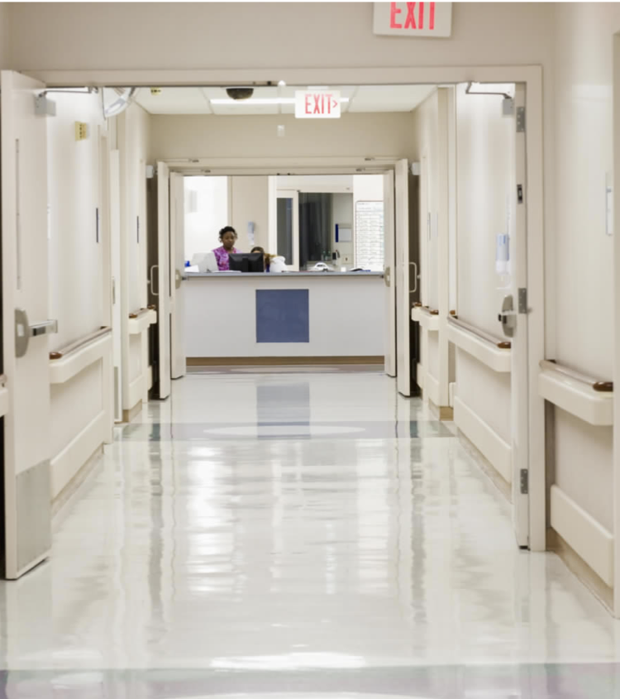
Research priorities
Rigorous outcomes research
‘Nothing about us without us’
Optimize w/ intersectional lens
How can harm reduction support hospital culture change?
Notes:
This is an emerging and exciting area of research but we won’t see widespread adoption of these practices requires rigourous research measuring patient health outcomes
Novel study designs are needed that allow for causal inference and isolate the impact of harm reduction services relative to other available substance use supports
Robust and ethical research in this area includes patients in all phases, and measures outcomes relevant to them.
More implementation science research is needed to identify optimal models of harm reduction strategies in the hospital settings, and ensure equitable access regardless of gender, race, substances used
More attention to how integration of harm reduction philosophy and approaches can shift policy and practice, change the hospital risk environment, and promote health and healthcare equity for PWUD.

Slide 46
Thank you! ehyshka@ualberta.ca @ehyshka www.ichwp.ca

Slide 47
Outline for today’s session
Introduction
What is the evidence, and where are there gaps?
Medication management
Harm reduction
Transforming systems
Notes:
Acknowledge Theresa as panelist

Slide 48
The need: Current context
Workforce gaps:
- Staff lack SUD knowledge and skills
- Moralize drug use
- Mutual mistrust between patients and staff
Care Fragmentation:
- Interprofessional siloes
- Hospital & community siloes
- SUD segregated from general healthcare
System lacks key components:
- Medications on formulary
- Metrics, incentives
- Funding
- Leadership commitment
- Community treatment
Pervasive stigma, discrimination, criminalization of drug use
Lack of hospital-specific research and clinical guidance
Notes:
To begin, I want to frame some of the current context. These needs inform the opportunity to improve care and transform systems.
In current context in N. America:
First is that there are widespread workforce gaps. Hospital staff lack SUD knowledge and skills, for example, clinicians may lack knowledge about evidence-based treatment or be insure how to talk with patients about their use
Next there is widespread care fragmentation, including interprofessional siloes within hospital systems (for example, limited communication between social workers, case managers and physician staff); vast siloes between hospital and community care; and SUD is segregated from general healthcare across all settings
Finally, hospital systems lack key components to deliver
Underpinning these gaps are widespread stigma, discrimination, and lack of….

Slide 49
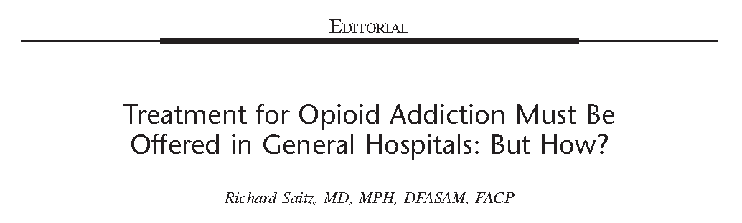
“On the basis of what we know, simply issuing an edict or guideline promulgating initiation of OUD treatment… would seem to be akin to picking low hanging fruit. But it appears not to be the case. ….”
Saitz, JAM 2019
Notes:
As we frame these challenges, I found myself revising an editorial that Rich wrote an editorial in JAM in 2019 that reflected some of these underlying challenges. Entitled, Treatment for opioid addiction must be offered in general hospitals, but how? He wrote:

Slide 50
Transforming Hospital Systems
The evidence
What care models exist for hospital-based addiction treatment?
How can hospital-based addiction care transform systems?
The gaps

Slide 51
Multiple ways to implement
Scoping review of US models including gray and published literature 2000-2021
2849 abstracts → 80 full text → 76 included papers
Key informant interviews (n=15)
Taxonomy: 6 distinct model types
Consult
Practice-based
In-Reach
Interprofessional Addiction Consult Service
Psychiatry Consult Liaison
Individual Consultant
Hospital-based opioid treatment (HBOT)
Hospital-based alcohol treatment (HBAT)
Community in-reach
Englander et al, JGIM 2022
Notes:
There are multiple ways in which SUD care is currently delivered in hospitals
A study that our research team did in collaboration with NYU to develop a taxonomy.
Limited to US because of governmental and unique payer structures to the US environment, however my conversations with colleagues in Canada and Europe – including our Swiss AMERSA contingent – suggests that similar models may exist in other countries.
It is critical to advancing the field to utilize common model definitions so that we can effectively study implementation and outcomes, guide policy, and promote adoption of hospital-addiction care - our research team developed a taxonomy of hospital-based addiction care models.
We performed a scoping review of US models including gray and published literature from 2000-2021, and 15 KIIs
Defined 6 distinct model types, categorized as…
Though we defined 6 distinct model types, these models can work in conjunction – e.g. ACS + HBOT, HBOT + in-reach

Slide 52
Addiction Consult Service Outcomes
Initiate medication for OUD/ AUD
↑ post-discharge SUD treatment engagement
↑ trust in physicians
↓ substance use and ↓ SUD severity after discharge
↓ mortality
Improve hospital settings that care for people who use drugs
Nordeck DADR 2022, Englander JAM 2019, Trowbridge JSAT 2017, Wakeman JGIM 2017, Englander JGIM 2019,
King JSAT 2020, King JAM 2021, Wilson JGIM 2022, Englander JHM 2018, Collins JGIM 2019, Hoover JSAT 2022
Notes:
ACS are by far most well-studied of the 6 model types.
Though many studies are observational, emerging body of evidence suggesting that hospital interprof ACS can [read list]
Cohort descriptions (MOUD initiation)
Some propensity-matched control designs (Englander tx linkage, Wilson mortality)
Some pre-post study designs (substance use, trust)
Some qualitative (trust, harms, hospital setting)

Slide 53
Addiction consult services are platform for change
Care redesign
Build responsive systems
Medication protocols
Post-acute care transitions, SNF
Transform culture
Trauma-informed policies (e.g. hospital drug use, visitor)
Workforce education
Community treatment pathways
Emerging population needs (e.g. COVID, fentanyl)
Address individual and structural stigma
Approaches to serious infections, endocarditis care
Englander JGIM 2022, Weimer JAM 2021, Sikka BMC ID 2021, Gryzinski Annals 2021, Tassey JSAT 2022,
Martin JAM 2022, Collins JGIM 2019, Englander JHM 2018, Hoover JSAT 2022, Callister SAj 2021,
Wakeman JAM 2017, King PLOS 2022, Harris ASCP 2022
Notes:
Evidence also supports that interprofessional ACS are a platform for change across hospitals and health systems, and that it is about more than delivering evidence-based medication.
Specifically,
ACS support care redesign, including implementing medication protocols, redesigning care for specific subsets of the population or for specific health conditions (for example, endocarditis), and redesigning systems around hospital-to-home care transitions, including transitions to SNF
ACS can also transform hospital culture through….
Build responsive systems, sometimes serving as the sole voice dedicated to anticipating population health needs among adults with serious illness and SUD. This includes…

Slide 54
Path forward
How do we change the standard of care so all hospitals deliver evidence-based addiction care?
Notes:
As I close the prepared remarks for today’s plenary, we wanted to describe the path forward, and ask the question:

Slide 55
Emerging evidence
Multi-site Med RCTs (XR bup; EXHIT- ENTRE)
HBOT randomized trial (EXHIT-ENTRE)
Growing interest and awareness
ACS randomized trial (CATCH)
New medication protocols
Innovative model descriptions
Large observational studies (e.g. claims)
McNeely ASCP 2019
CTN-98 (EXHIT-ENTRE, Saitz, Bart)
Notes:
The emerging evidence is an important piece of changing the field.
Attending the abstracts and poster sessions yesterday was inspiring.
Remarkable and growing energy around these unexplored and practice changing topics at AMERSA
Single site Medication studies – for example, describing new approaches to hospital-bup initiation or methadone up titration.
Describe Innovative models that we are developing and adapting, and share them so that others can replicate or adapt them (Dr Buresh - hospital-OTP-and SNF)
Large observational studies which can describe existing patterns, risks and needs and disparities that can be targets for improvement and policy change
Multisite medication trials, for example EXHIT ENTRE in which hospitalized adults randomize to XR bup (vs sublingual)
Implementation studies including
HBOT cluster RCT that randomized 24 US hospitals to low vs. high intensity intervention, where HI includes TA and practice facilitation
ACS RCT- CATCH: Dr McNeely: stepped-wedge cluster randomized trial of ACS across 6 NYC hospitals

Slide 56
Research Priorities
What are the effects of hospital-based addiction care?
Describe outcomes using standard model definitions
How do we improve care models?
Racial disparities; transitional care gaps; population-specific needs (e.g. end of life, rural, pregnancy); specific health conditions (e.g. endocarditis, transplant)
How do we implement across diverse settings?
Integrate peers; Compare different model types/ combinations; explore role for telehealth/ tele-ACS
How do we promote broad adoption and diffusion of innovation?
Explore clinician, hospital, health system, and policy-factors, including metrics and incentives
Notes:
Racial disparities:
- How do the choices we make about prioritizing certain substances effect these disparities

Slide 57
Amersa Mission: improve health and well-being through leadership and advocacy in substance use
Education
Clinical Care
Policy
Research
Address interprofessional hospital workforce education
Lead practice- and policy-changing research focused on hospital setting
Continue to innovate, share experiences
Advocate for hospital standards, metrics, incentives, payment reform
Ambitious, multipronged agenda to improve hospital-based addiction care
Englander NEJM 2022
Notes:
AMERSA is the place that many leaders in hospital-based addiction care consider their professional home. And, as Rich so deeply believed - AMERSA is a supportive and powerful organization
This work aligns with AMERSA’s interprofessional mission to improve health and well-being through leadership and advocacy in substance use education, research, clinical care and policy.
Those of us in the audience here today hold great potential together to advance the field.
Specifically, we can (read boxes)
Shout out to advocacy task force, acute care interest group

Slide 58
Acknowledgments
Sarah Bagley, MD and the AMERSA conference planning committee
Jennifer McNeely, MD
Susan Calcaterra, MD
Marlene Martin, MD
Rich’s family and legacy

