Slide 1
AMBULATORY MANAGEMENT OF ALCOHOL WITHDRAWAL
Dr. Alyssa Peterkin, Dr. Shawn Cohen, Dr. Stephen Holt
Friday, November 11, 2022

Slide 2
DISCLOSURES
Dr. Holt: No disclosures
Dr. Peterkin: No disclosures
Dr. Cohen: No disclosures

Slide 3
OBJECTIVES
Explain pathophysiology of alcohol withdrawal and how it impacts severity of withdrawal
Identify patients suitable for ambulatory management based on comorbidities and other patient characteristics
Utilize ambulatory management strategies including the selection of appropriate pharmacotherapy and monitoring of patient progress.

Slide 4
EPIDEMIOLOGY
30 million people in the US have AUD (10.2%)
5% of hospital inpatients experience alcohol withdrawal
400K hospitalizations, $3.5 billion
NSDUH 2021
Steele, J Addict Med, 2020
Owens, HCUP #249
Notes:
SC

Slide 5
DISPARITIES IN AUD
Prevalence of AUD higher in
18-25yo
Men
Identify as American Indian or Alaska Native
Non hispanic White
Alcohol-related deaths increasing fastest in women and AI/AN
Stigma, systemic inequality, systemic racism are drivers
NSDUH 2020
Spillane, JAMA Network Open, 2020
Williams Drug Alcohol Depend. 2017
Owens Drug Alcohol Depend. 2018
Notes:
SC
Williams Drug Alcohol Depend. 2017
Among patients with unhealthy alcohol use, those with HIV are less likely than those without to receive all aspects of alcohol-related care
Owens Drug Alcohol Depend. 2018
those with Hepatitis C are less likely than those without to receive brief intervention and pharmacotherapy but more likely to receive specialty addictiosn treatment.
Williams Drug Alcohol Depend. 2017
Black and Hispanic patients were both more likely than White patients to initiate specialty addictions treatment, whereas Black patients were less likely than white or Hispanic patients to receive pharmacotherapy for alcohol use disorders.

Slide 6
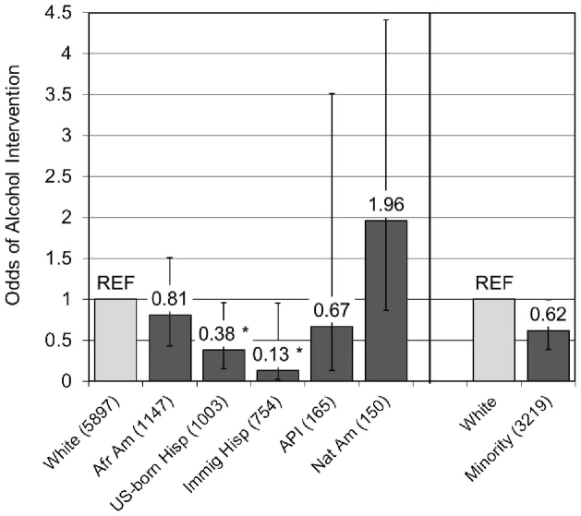
DISPARITIES IN TREATMENT
Disparities in who is offered information, brief intervention and treatment
Racial/ethnic minorities more likely mandated to addiction treatment via criminal legal system
Use of medications for AUD abysmally low for all groups
Stigma, systemic inequality, systemic racism are drivers
Racial/ethnic differences in the odds of receiving an alcohol intervention over 3 years
NSDUH 2020
Pinedo. DAD. 2021
Mulia et al Psychiat Serv. 2014
Notes:
SC
Latinx individuals are less likely to be offered information about alcohol treatment
Graph on R shows who recieves brief interventions
Pinedo M. Missed opportunities by health care providers to reduce racial/ethnic disparities in the use of alcohol treatment services. Drug Alcohol Depend. 2021;226:108851. doi:10.1016/j.drugalcdep.2021.108851 - Latinos were less likely to receive information on alcohol treatment services than Whites, but no White-Black differences were documented. When analyses were restricted to those who had received information on alcohol treatment options, no racial/ethnic differences in the use of alcohol treatment services were found.
Mulia N, Tam TW, Schmidt LA. Disparities in the use and quality of alcohol treatment services and some proposed solutions to narrow the gap. Psychiatr Serv. 2014 May 1;65(5):626-33. doi: 10.1176/appi.ps.201300188. PMID: 24487667; PMCID: PMC4008705.
Owens Drug Alcohol Depend. 2018
those with Hepatitis C are less likely than those without to receive brief intervention and pharmacotherapy but more likely to receive specialty addictiosn treatment.
Williams Drug Alcohol Depend. 2017
Black and Hispanic patients were both more likely than White patients to initiate specialty addictions treatment, whereas Black patients were less likely than white or Hispanic patients to receive pharmacotherapy for alcohol use disorders.

Slide 7
PATHOPHYSIOLOGY
GABA
GLUTAMATE
CONSCIOUSNESS
Notes:
SC

Slide 8
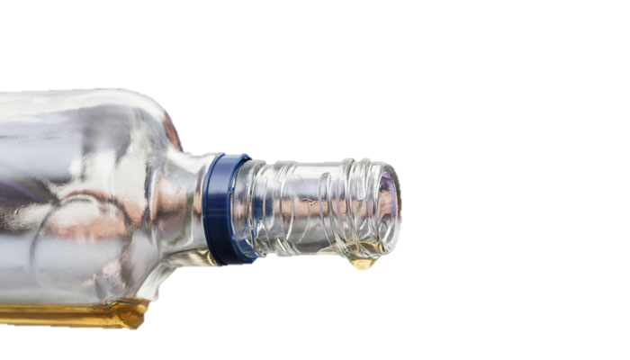
GLUTAMATE
GABA
Alcohol Use
Notes:
SC

Slide 9
GABA
GLUTAMATE
Long term compensation
Dixit, Pharmacotherapy, 2016
Notes:
SC

Slide 10
GABA
GLUTAMATE
ALCOHOL WITHDRAWAL
Notes:
SC
Clapp, How Adaptation of the Brain to Alcohol Leads to Dependence, Alcohol Res Health. 2008; 31(4): 310–339.

Slide 11
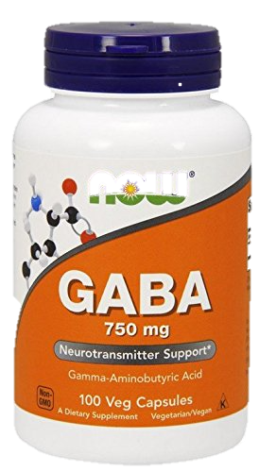
UNCOMPLICATED WITHDRAWAL
Early sx
Anxiety, diaphoresis, nausea, vomiting, tremor, nystagmus
Early hallucinations
Notes:
SC
Early hallucinations means alcoholic hallucinosis in about 10%
24-48hrs typically, often aware of hallucinations and distressing
95 %

Slide 12
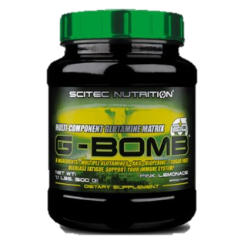
COMPLICATED WITHDRAWAL
5% of withdrawal
3-5 days
SIRS
Disorientation, paranoia, psychosis
Seizures peak 24hrs
Notes:
SC
Unopposed glutamate leads to increased NE and dopamine
-explains SIRS criteria, dopamine for hallucinations
-hyperventilation
Truth is that this isn’t black or white, patients aren’t usually uncomplicated or complicated so there’s a lot of in between and gray zone
-3-5% with DTs during hospitalization
Mortality was about 40% in 1900s, now around 5% from arrythmia, complicating illness

Slide 13
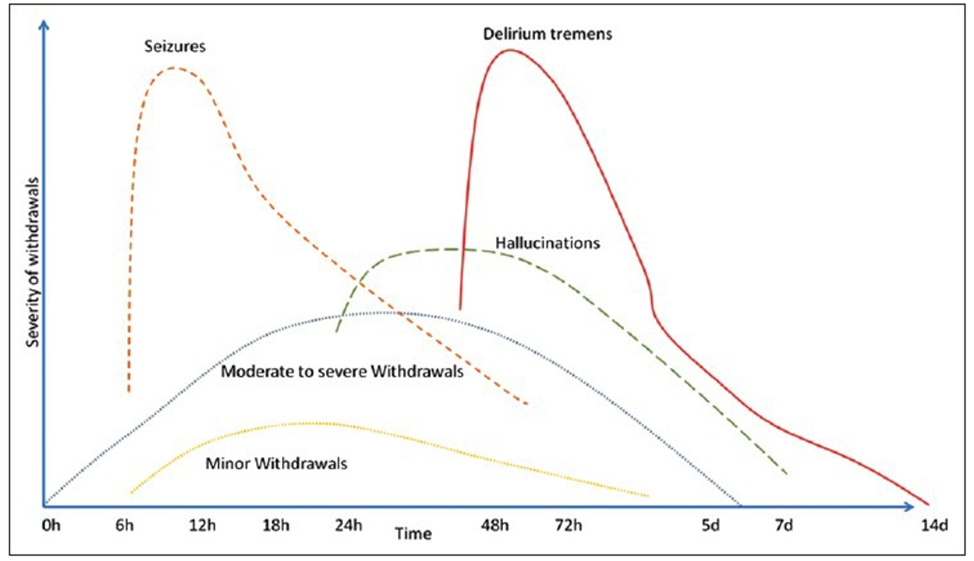
TIMELINE OF WITHDRAWAL SYMPTOMS
Kattimani, Ind Psychiatry J, 2013
Notes:
SC

Slide 14
WHERE IS ALCOHOL WITHDRAWAL TREATED?
Outpatient clinic
Short term medically managed withdrawal “detox”
Hospital
Notes:
SC
Ask everyone to raise hands about how many have treated alcohol withdrawal in the outpatient setting? Ask a few people how it went

Slide 15
BENEFITS OF AMBULATORY TREATMENT
Safe
Patient preference→TRUST
Cheaper
Decrease hospital burden
Hayashida, NEJM 1989
Notes:
SC

Slide 16
OUR CASE
Ms R is a 39 year old woman, presents to your office for a routine follow-up. Review of her chart reminds you that she has a history of diet controlled diabetes, gastroesophageal reflux disease (GERD), and major depressive disorder.
While you start the visit intending to address these issues, the patient interjects to say, "I need help with my drinking."
Notes:
AP

Slide 17
CASE CONTINUED
After discussing her alcohol use you diagnosed her with severe alcohol use disorder. Her goal is to stop using alcohol but she hasn’t been able to go 24 hours without alcohol use in 6 months as she begins to feel anxious and “shaky” around that time.
Notes:
AP

Slide 18
TABLE DISCUSSION ACTIVITY
At your tables discuss what more information would you want to inform your discussion with her about ambulatory management of her alcohol withdrawal?
Additional history?
Labs?
Notes:
AP
Give them 5-10 minutes to discuss and then share in the large groups

Slide 19
Principles of Triage
Historical
Social & Environmental
Physical Exam
Labs
Notes:
AP

Slide 20
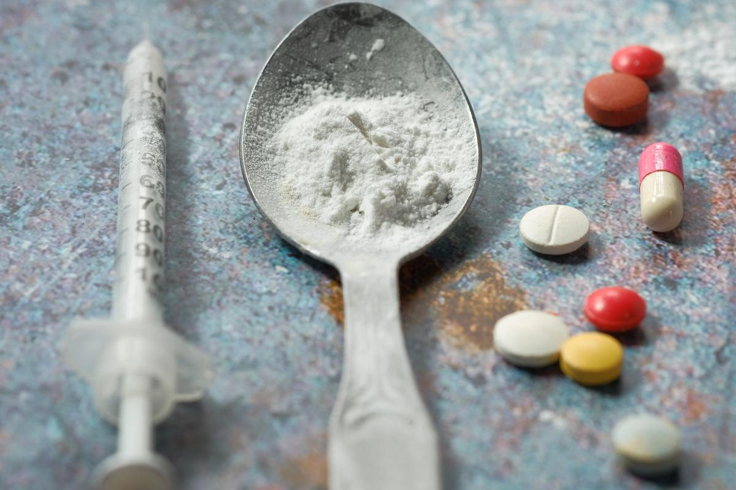
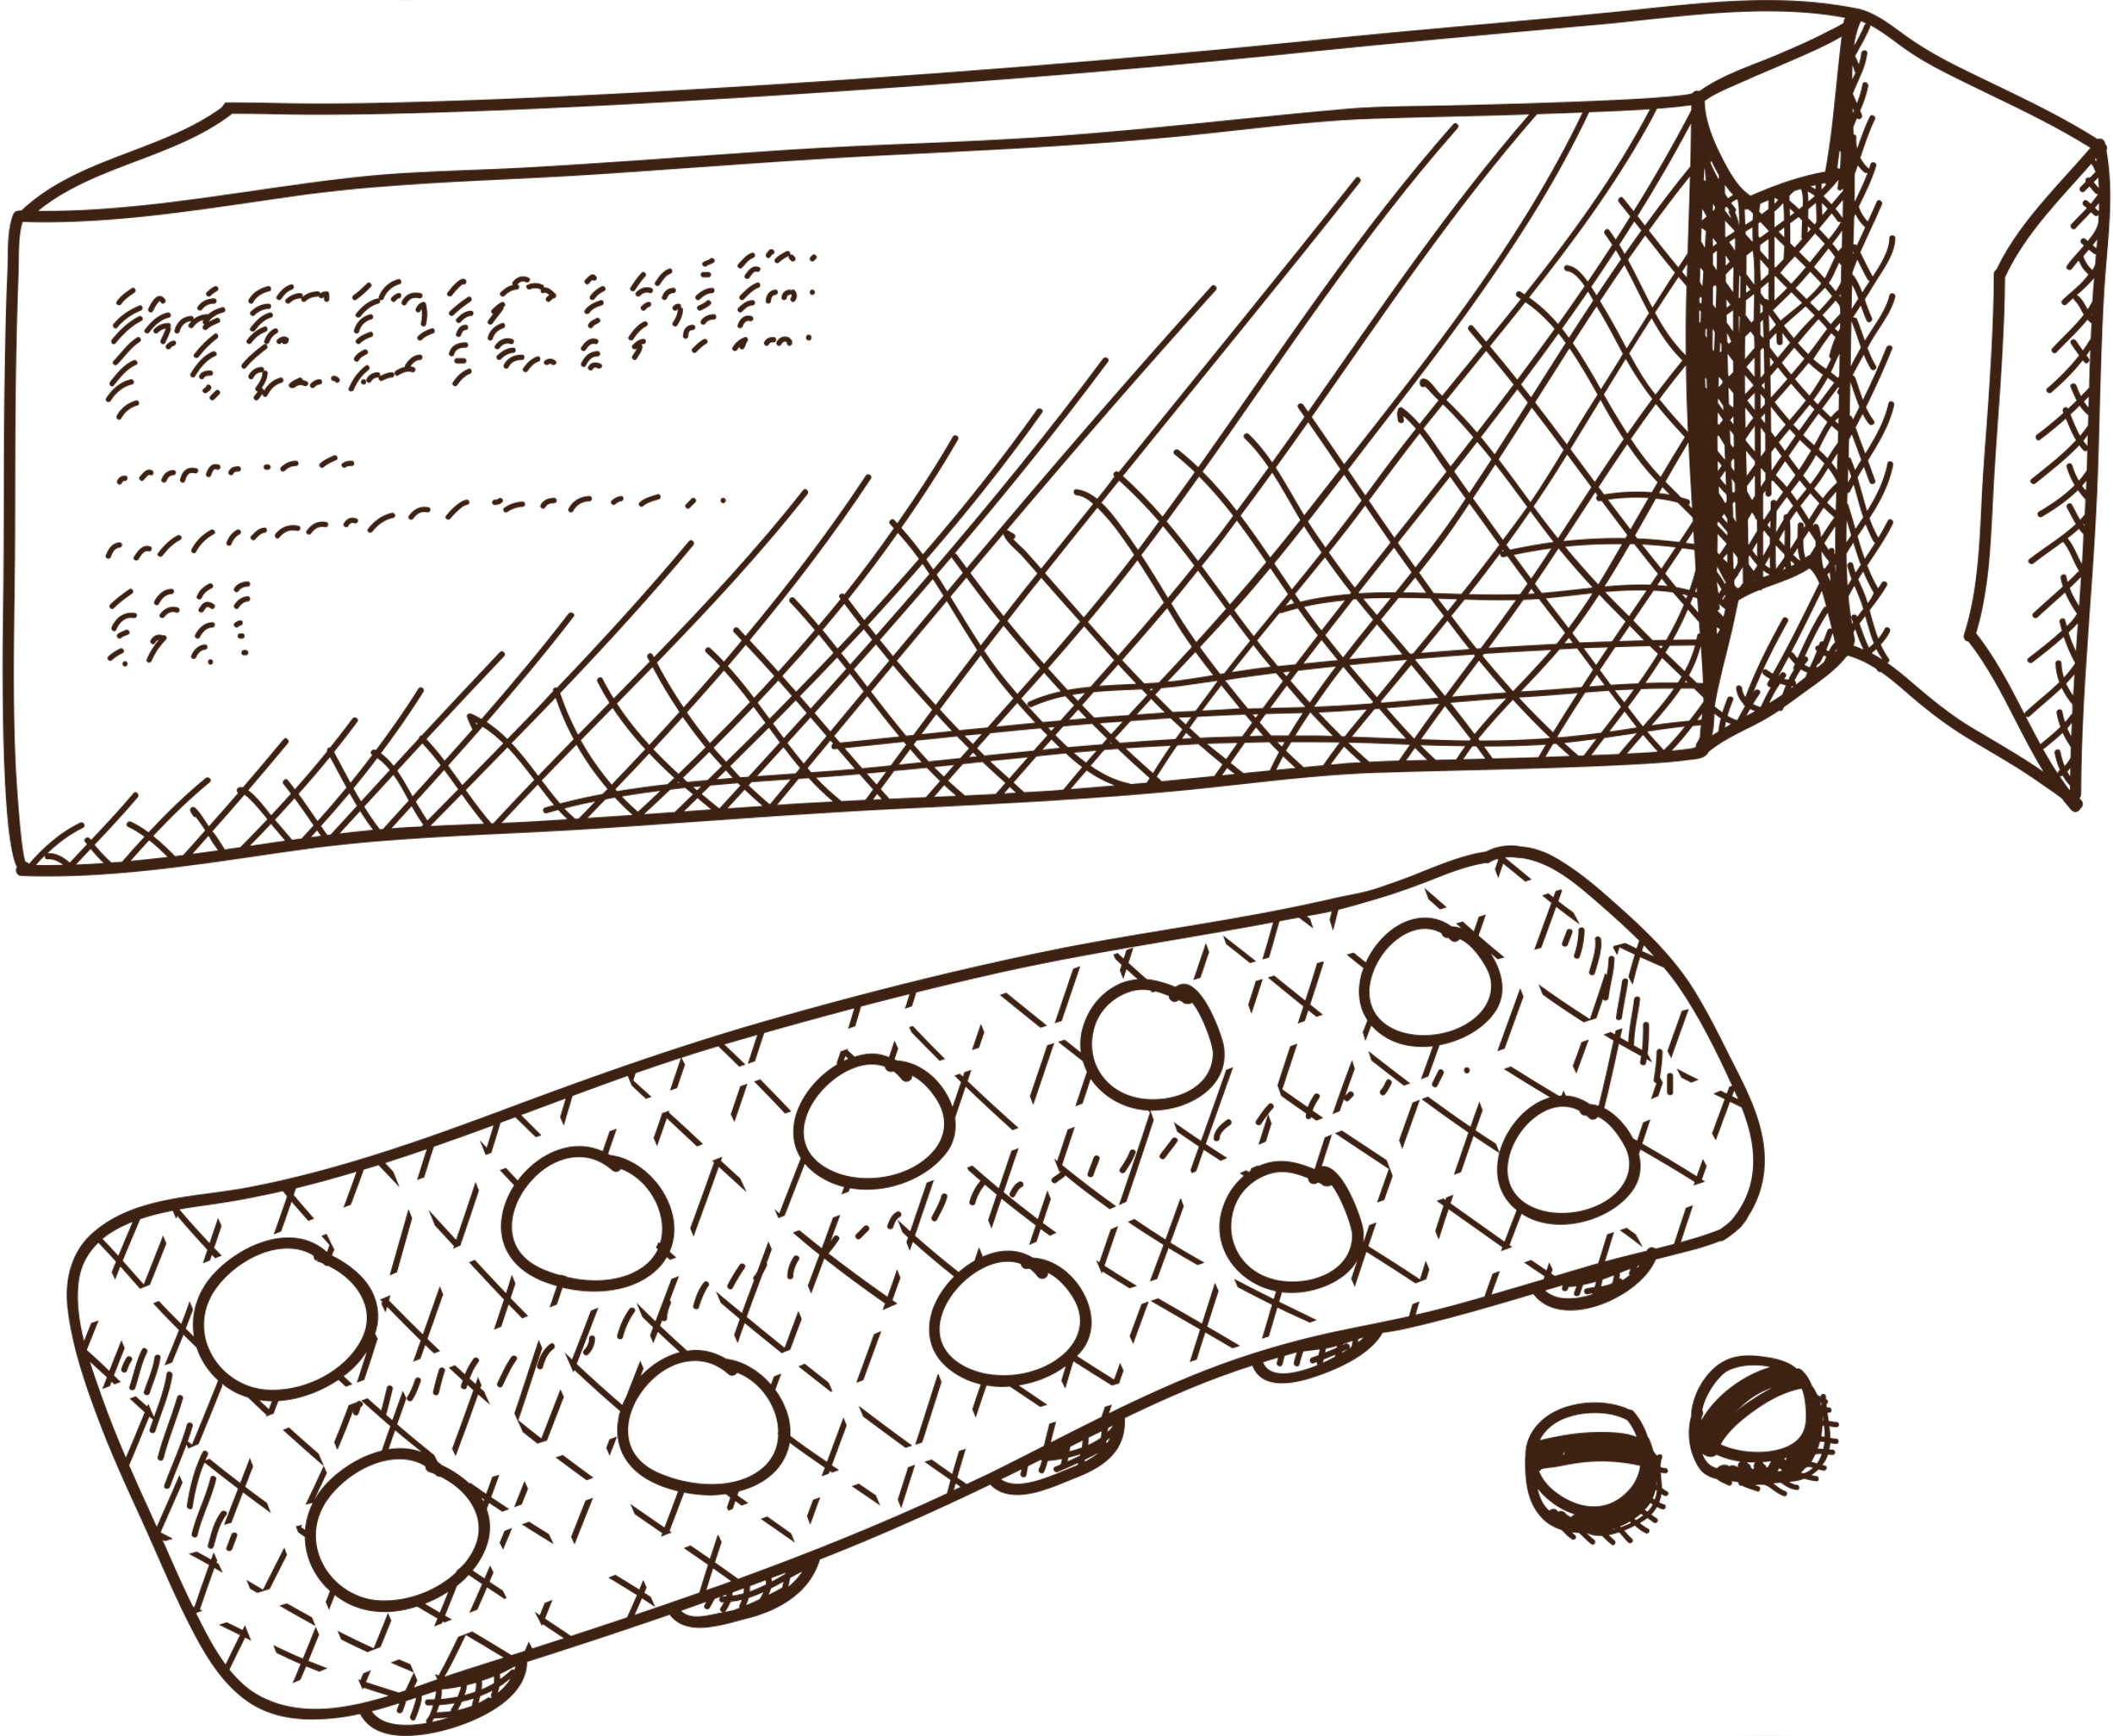
Historical

Slide 21
Social & Environmental

Slide 22
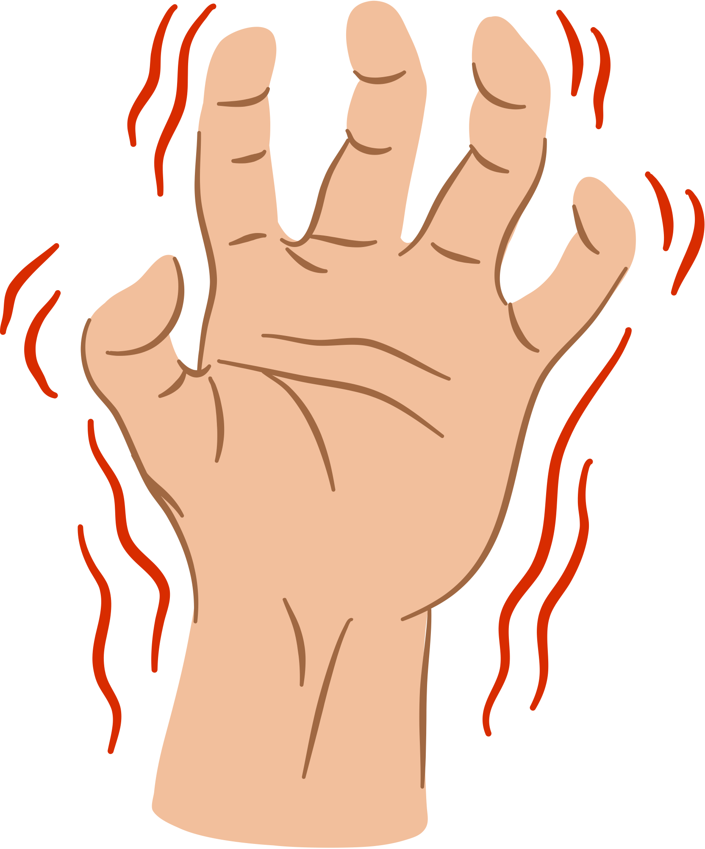
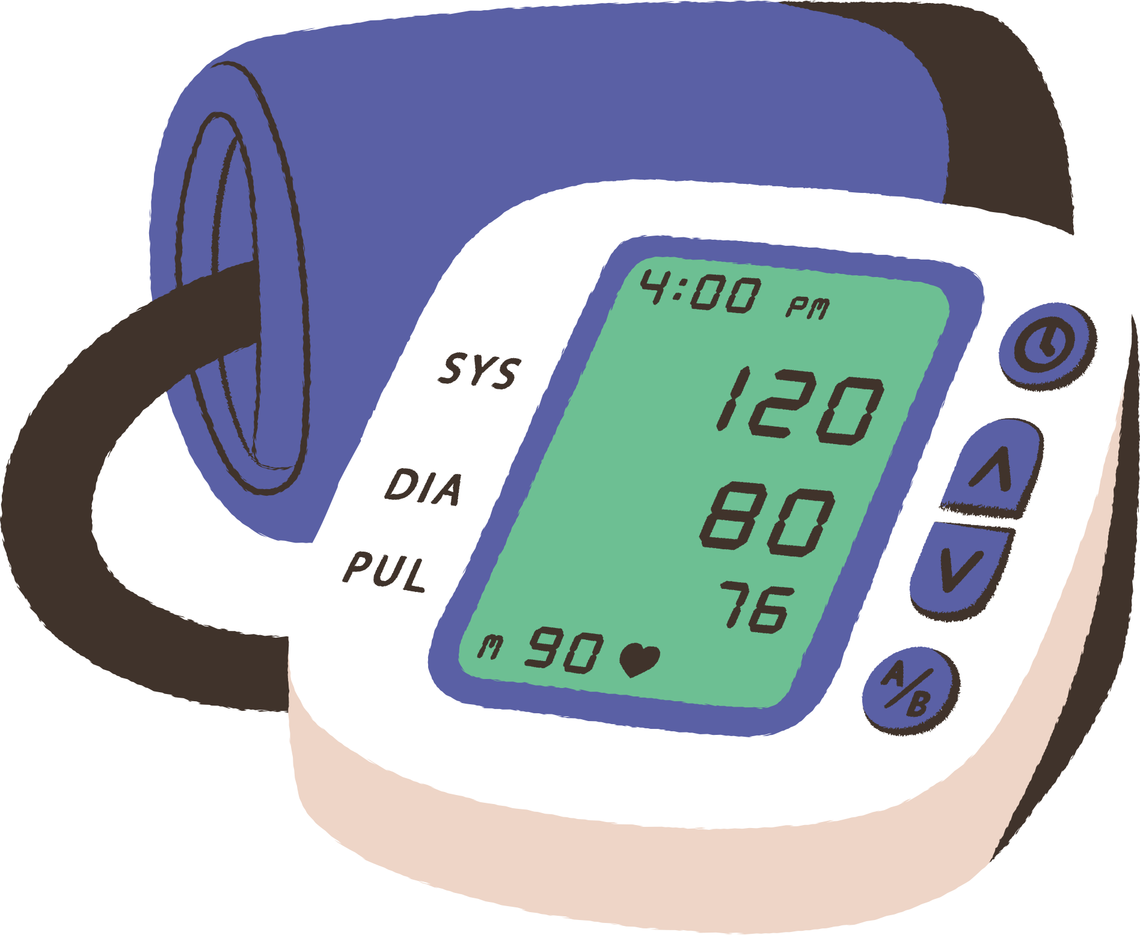
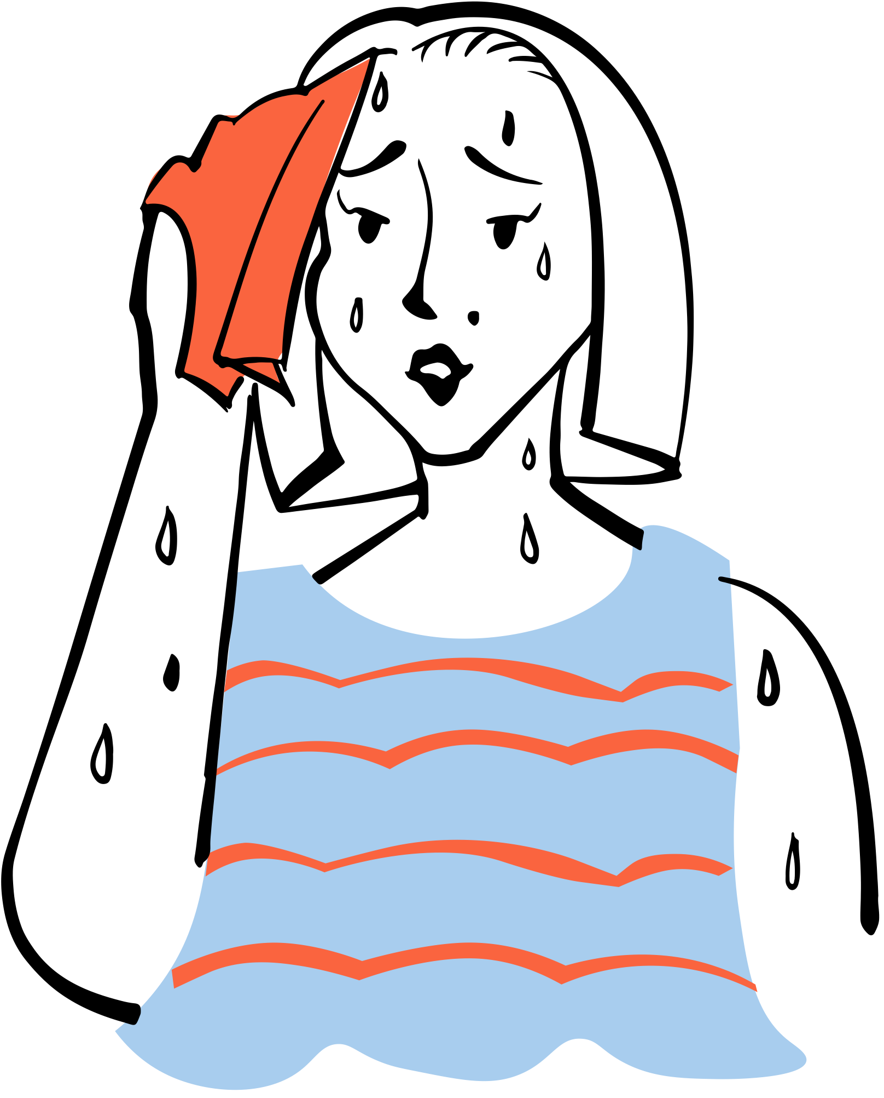
Physical Exam

Slide 23
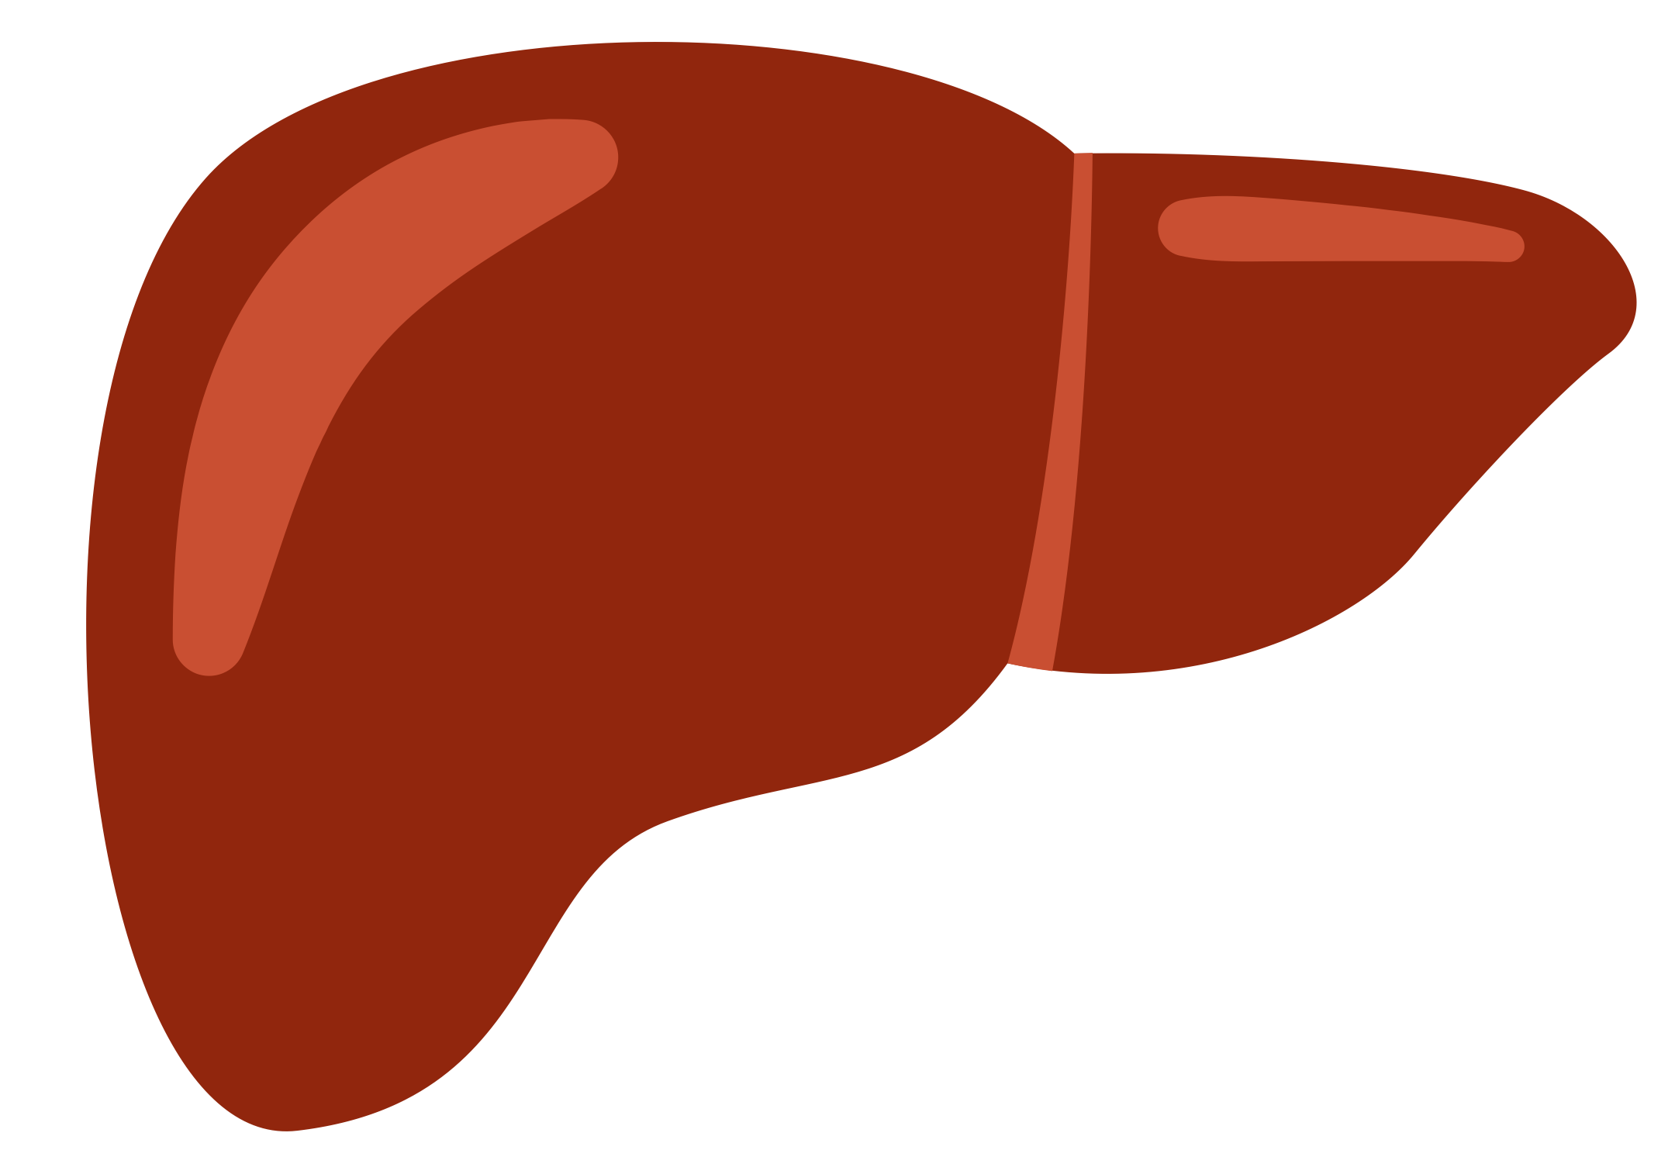
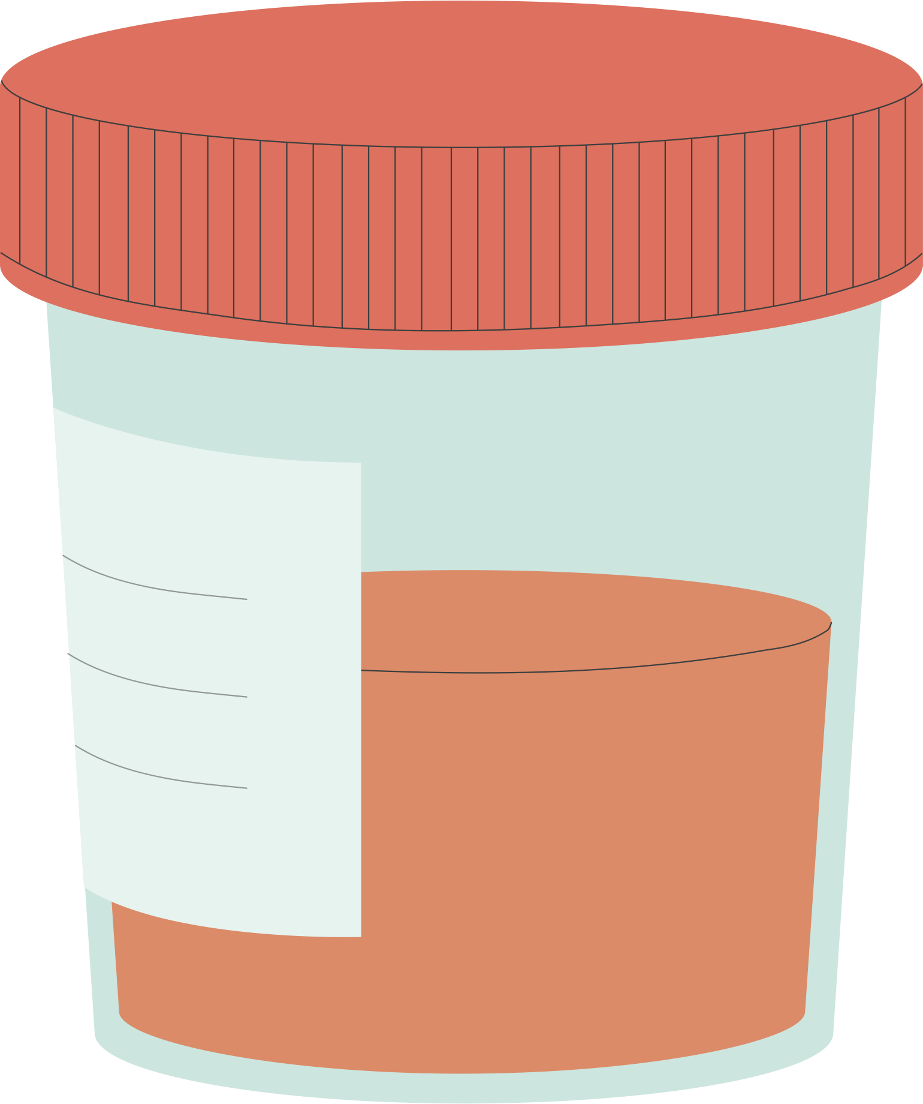
Labs

Slide 24
WHO CAN BE MANAGED IN THE CLINIC
Support system
Only mild or
moderate symptoms
Frequent check ins
No history of
severe withdrawal
No significant
comorbidities
Notes:
AP
Speak about absolute and relative contraindications
Only absolute is history of severe withdrawal
Being person centered with relative contraindications if preference is outpatient management

Slide 25
CASE CONTINUED
She has no history of severe withdrawal but since her last visit with you years ago she was diagnosed during an admission to another hospital with compensated cirrhosis
Collateral - Wife at home is ”fed up” with her drinking and willing to help with ambulatory alcohol withdrawal monitoring if needed
Notes:
SH
Add more details and ask how this changes their discussion

Slide 26
PUZZLE PIECE ACTIVITY
Together decide to attempt ambulatory alcohol withdrawal management
benzodiazepine piece
gabapentin piece
benzodiazepine vs gabapentin piece
f/u strategy and detecting red flags piece
Notes:
SH

Slide 27
LONG VS SHORT-ACTING BENZODIAZEPINES
Long-acting preferred
Diazepam vs chlordiazepoxide
50mg chlordiazepoxide = 10mg diazepam
Perry, CNS Drugs. 2014
Notes:
SH

Slide 28
BENZODIAZEPINES VS GABAPENTIN
Safety?
Sedation?
"Kindling phenomenon"?
Higher risk patients?
Active withdrawal symptoms?
Myrick et al, Alcohol Clin Exp Res. 2009
Stockj, Ann Pharmacother. 2013
Notes:
SH

Slide 29
MONITORING
Daily or every other day check-ins
In-person or telemedicine
Notes:
SH

Slide 30
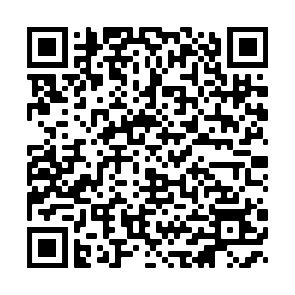
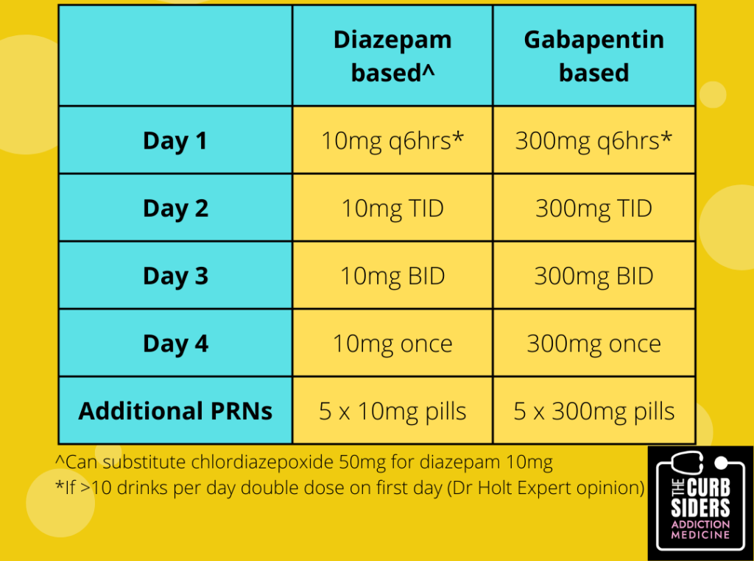
AMBULATORY ALCOHOL WITHDRAWAL REGIMENS
Amato, Cochrane 2010
Holbrook, CMAJ 1999
Mayo-Smith, JAMA 1997
Leung, Ann Pharmacother, 2015
Curbsiders Addiction Medicine, Episode 2
Notes:
SH
Carbamazepine fixed dose starting at 800 mg/day tapered over 4, 7, 9, or 12 days; symptom-triggered dosing (≤1200 mg/day)

Slide 31
CASE 2
Your second patient, seen at 10am on a Monday morning, is a 38 year old man with a 20 year history of generalized anxiety, PTSD, and AUD. He has a history of multiple prior ED visits for alcohol withdrawal or intoxication, though typically leaves prematurely before treatment is completed as hospital settings make him exceedingly anxious.
He has no history of cardiac, pulmonary, or renal disease. He has elevated transaminases, but no evidence of cirrhosis. He drinks 6-8 beers daily over the past 3 years, and his last drink was earlier this morning. He does not use any other substances, and exhibits no withdrawal symptoms in the office. Three years ago, during an admission for pancreatitis, he developed DTs and required a brief ICU stay.
He lives with two other male roomates, who he considers friends, one of whom does not drink alcohol. Would you consider this patient a candidate for ambulatory withdrawal management? Why or why not? What would be your initial treatment plan?
Notes:
SH

Slide 32
CASE 3
It’s now 11am, and your third patient also presents for alcohol withdrawal management. She is a 58 year old woman with a history of panic disorder, mild benzodiazepine use disorder, and AUD. She has never been hospitalized for alcohol complications, though had a psychiatric admission 15 years ago for suicidal ideation.
She has no history of cardiac, pulmonary, or renal disease. She drinks 1-2 bottles of wine daily, and feels “jittery” on the rare days when she doesn’t have any alcohol. She often takes 1-2mg of alprazolam that she gets from “a friend” when she feels “panicky”. While she was able to make her appointment with you today, she has a history of many missed appointments due to transportation issues - she does not have a car. Her son would be able to check up on her after work each day, as needed. Her last drink was late last night. She hasn’t had any alcohol yet today and looks anxious.
Would you consider this patient a candidate for ambulatory withdrawal management? Why or why not? What would be your initial treatment plan?
Notes:
SH

Slide 33
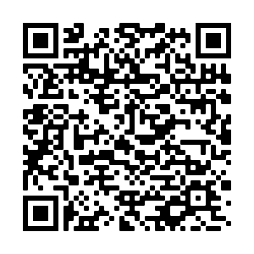
TREAT AUD!!!!
Harris, Psychiatry Serv, 2012
Joudrey, Addict Sci Clin Pract, 2019
Mark, Drug Alcohol Depend, 2003
Stephens, J Hosp Med, 2018
Wei, JGIM, 2015
Curbsiders Addiction Medicine, Episode 4
Notes:
SC
Compare not treating AUD in alcohol withdrawal to not treating DM in DKA, HLD in ACS

Slide 34
QUESTIONS?
Alyssa.Peterkin@bmc.org
Stephen.Holt@yale.edu
Shawn.Cohen@yale.edu

