Slide 1
A Qualitative Assessment of the Care Transition Experience of Patients with Substance Use Disorders After Hospital Discharge
Michael Incze, MD MSEd
Primary Care/Addiction Medicine
University of Utah

Slide 2
No conflicts of interest
Some quotations use brand names to refer to certain medications

Slide 3
Background
Substance Use Disorders (SUD) are Common Among Hospitalized Patients
Medical hospitalizations are opportunities to engage people with SUD and offer treatment
Destabilizing events
Few evidence-based models to support post-hospitalization transitions to community care
Little is known about patient experience during these care transitions

Slide 4


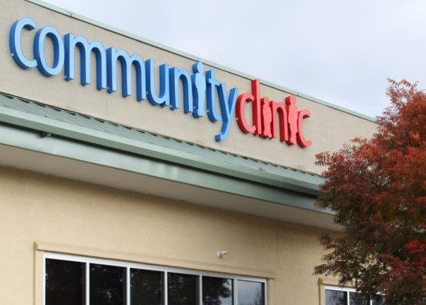
Objective
Understand Patient Experiences With Post-Hospitalization Care Transitions
Experience In The Hospital
Experience At Discharge
Experience in The Community

Slide 5
Methods
n=25 hospitalized adults with documented SUD
Currently undergoing medical hospitalization for any reason
Enrolled in the hospital
Contacted by telephone between 7-21 days after discharge date
~30 min semi-structured interviews
Rapid qualitative analysis of 10 interviews for interim results

Slide 6
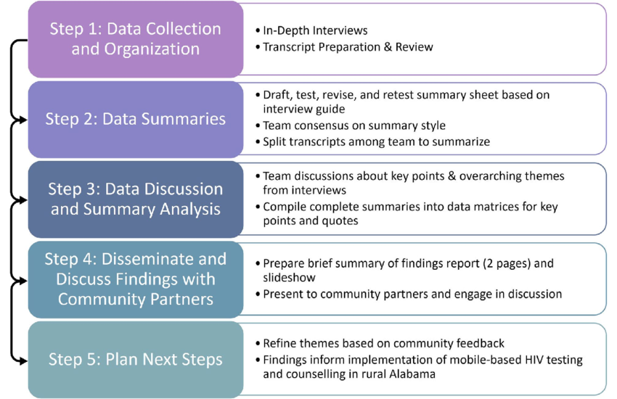
Methods
Rapid Qualitative Analysis
  Deductive
  Fast
  Exploratory
  Iterative
Pratt, et al 2023

Slide 7
Results
Sample Characteristics (n=10)
  Mean Age = 47yo
  50% Male
  Avg LOS = 7.5 days
  80% Medicaid
  Alcohol most common
  50% had >3 medical Dx
Six Themes

Slide 8
Results
Theme 1: Unpredictability Around the Time of Discharge
Timing of discharge and key elements of the discharge plan often changed right before leaving the hospital.
“So it was like everything went out the window… It was everything he was saying on Sunday it was like it was a different person and he didn’t even remember what he said on Sunday. ‘Cause Sunday he was like, I’m really concerned for falling risk and I really think that you need to go—after you leave us, you need to go to this skilled nursing facility for maybe a week or two just for getting your strength back… And then Monday he waltz’s in there like he didn’t even say anything on Sunday and is like, which I was okay, discharge me, that’s great, but it was just weird… And I was taken off guard…. He’s like going against what he said the day before and definitely going against what the physical therapists were saying.”

Slide 9
Results
Theme 2: Communication by the Hospital Medical Team:
Bidirectional communication, mutually agreeing upon a discharge plan, and written discharge instructions were identified as important but happened inconsistently.
“a couple days before I got discharged, I was told that I was gonna be continued on my Oxy’s for a couple of weeks… that they’ll wean me off of those as they bump up my suboxone use. And then when they discharged me, they just straight cut me out of it and then bumped up my suboxone use which is not a good idea because, for some people, it could push you into a withdrawal and it will just—that will scare somebody right out of wantin’ to use suboxone and go right back to using what they were using. And so it kind of irritated me that they did that to me. Kind of felt like I was being lied to.”
“I had told my doctor that I, I wanted to leave but I wanted to do it safely and not have to do like an AMA [against medical advice] or anything like that, and he got it all set up. And the pharmacy had come up and brought me my meds I was taking home, like an hour before I was discharged. So it just went really smoothly.”

Slide 10
Results
Theme 3: SUD Treatment
SUD treatment was addressed with all participants. Most were offered medication and/or community treatment resources. Participants highlighted adequate medication dose and rapid linkage to care as being important.
“They made sure I had all my meds and understood ‘em all and understood the suboxone and raised me up to what I asked them to, they had me on 4 milligrams every 12 hours. and I was like, that’s just not cuttin’ it so they raised me up to 8 every 12 hours. And that was okay and I didn’t have to wait for long. Then they still said [it] wasn’t workin’ and then they still raised it up so it seems to be holdin’ now.”
“Being able to get in to see somebody in mental health, addiction, or a primary care physician faster would, for sure, be more beneficial when we’re coming out of the hospital with an addiction ‘cause the more days you can get removed from that, the easier it gets. And so the trigger—that faster the trigger for that to take place, the better”

Slide 11
Results
Theme 4: Challenges after Discharge
These included managing new medications and their side effects, returning to unsafe environments in a debilitated state, triggers for substance use, and inability to attend to basic daily needs.
“My Medicaid run out and I don’t have insurance and it’s kind of a pain in the butt when you don’t have—when you haven’t worked for a couple weeks in order to fill that prescription. I mean I just went right back to work the day after I got discharged.”
“I live on the fourth floor of my apartment building and I couldn’t get up the stairs—and I didn’t have a phone, I didn’t have—I told ‘em I had a safe place to go but it was just really hard gettin’ up the stairs and I couldn’t get down the stairs with my dog when he needed to go out. I had to flag down a cop so he would call the ambulance to take me up there (to the ED).”

Slide 12
Results
Theme 5: Facilitators of Care
Family and friends were key in providing basic support after discharge. Case managers were effective at facilitating post-hospitalization care.
“I have a lady from [nonprofit] that calls me, a nurse, and makes sure to see if I need a homecare or anything like that. I have a case manager from [nonprofit]…They call me and they talk to me and see how I’m doing and if I need help. They help me get like for it, you know? They help me do whatever I need to do.”
“…because of my foot. I’m supposed to be absolutely no weight bearing but that’s kind of impossible. But my sister brought up me up a knee scooter… I just put my knee on the thing and scoot around which helps a lot.”

Slide 13
Results
Theme 6: Ideal Discharge
Elements included outreach/check-ins from care team, supportive housing, and provision of basic needs like food and transportation. Solutions must be individualized.
“So in my perfect world… my discharge would be definitely different from other people so. And especially somebody who is suffering from addiction, I mean, I would love to come home and have a whole team come to my home.”

Slide 14
Discussion
People with SUD face multifarious barriers to continuing care after hospitalization
  promote health inequity by disproportionately impacting marginalized groups
Clear communication and shared decision-making around the time of discharge can improve the experience for patients
Material supports like phone access, individualized transportation resources, and housing are crucial to support linkage to community care
Individualized and proactive psychosocial supports are often needed immediately after discharge

Slide 15
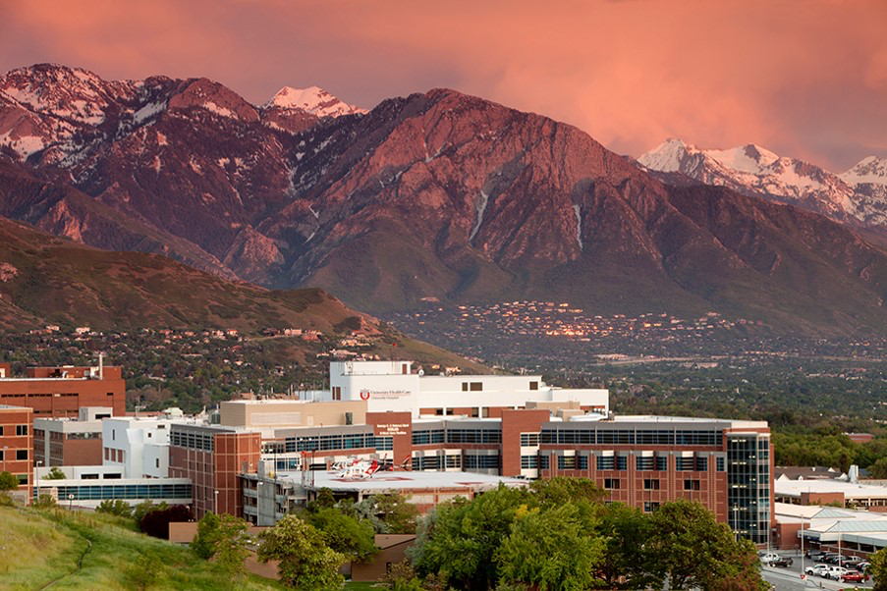
Thank You!
Thanks to Annika Hansen, Shanaya Fox, Dani Babbel, Carolyn Bell, Kathryn Szczotka, Jake Foringer, Patrick Galyean, Susan Zickmund, and Adam Gordon for their support
Funded by a U of U Department of Internal Medicine Seed Grant
Questions?
michael.incze@hsc.utah.edu

