Slide 1
A qualitative exploration of the substance use impacts of a large-scale hoteling intervention for people experiencing homelessness in NYC during the COVID-19 pandemic
Presented by: Hannah Passmore, MPH
AMERSA 2024
Co-Authors: Kelly M. Doran, Stephanie Blaufarb, Robin Freeman, Carolyn Berry, Christiana Gozo, Jocelyn Moran, Iris Rodriguez, Reesa Henderson, Fabienne Laraque
Notes:
Greeting
I’ll be presenting on our qualitative analysis of substance use impacts of COVID-19 protective hotels in NYC

Slide 2
Funding
This study was funded by the National Institute on Drug Abuse of the National Institutes of Health (R01DA054956, PI: Doran).
The views presented here are my own and do not represent those of the NIH, NYC DHS, or any other organization.
Notes:
Briefly – our funding, disclaimer on views

Slide 3
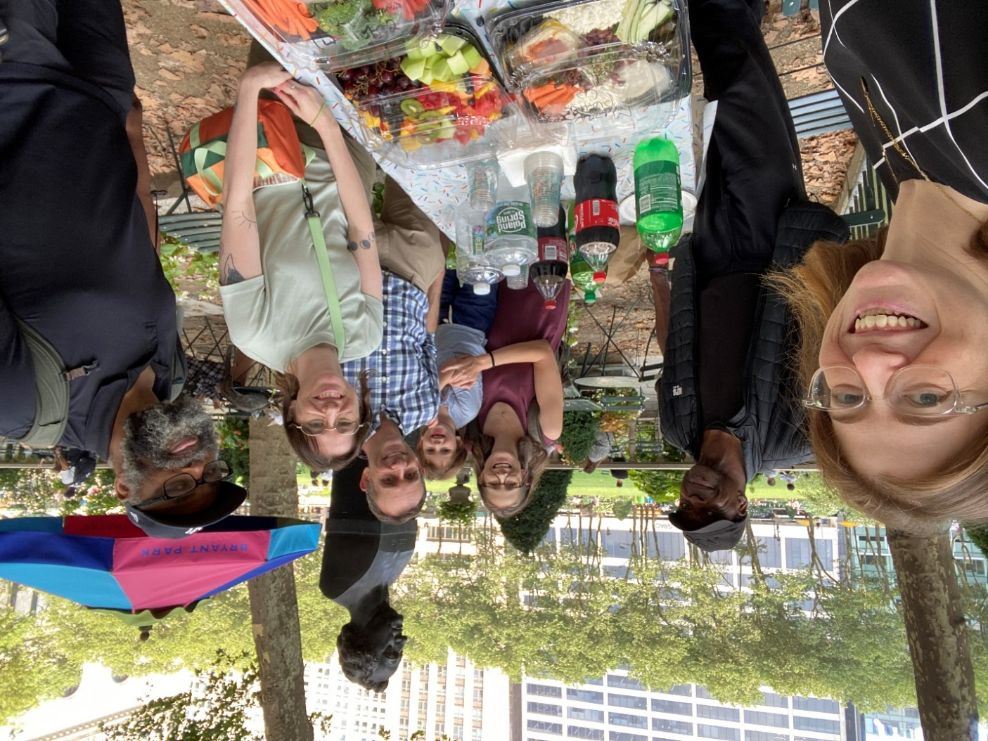
COVID-19 Hotel Intervention for People Experiencing Homelessness (CHIP) Study
CHIP Study Advisory Board Members
Notes:
What I’m presenting on now is part of a larger study entitled the COVID-19 hotel intervention for people experiencing homelessness (CHIP) study, for which I am the research coordinator. After I wrap this up, I’ll be presenting on another part of the CHIP study, so I wanted to provide some context here. I’ll answer questions at the end of both parts!
The CHIP study has two main goals: to explore how substance use behaviors and treatment access changed for people experiencing homelessness who were placed into hotels during the COVID-19 pandemic in New York City AND to explore other pandemic-related innovations at the intersection of substance use and homelessness. As I said before, I’ll first be talking about our qualitative exploration of the protective hoteling, but later on I will talk about the environmental scan.
Also shown here are our study partners: New York City DHS/DSS, Project Renewal.
And crucial to the study is the 18-member external Study Advisory Board (SAB) (some of them pictured here with study team members at our Year 1 celebration picnic), which is made up of individuals with lived experience of homelessness and drug use, including some who had lived in a COVID-19 protective hotel, homeless services providers who were directly involved with the pandemic hotel initiative, and relevant governmental agencies and advocacy organizations. The SAB is instrumental in study design, recruitment, and thematic analysis, and the SAB members with lived experience have been an especially integral part of the study, providing feedback at every step of the process. SAB members are paid for their time (both for our regular meetings and for any dissemination activities).

Slide 4
Background
“Density” hotels to protect PEH during COVID-19 pandemic
In NYC, over 9,500 individuals were moved into 45+ hotels
Little is known about the impact of these initiatives on substance use
Notes:
And now diving back in to this first part of the study: our qualitative exploration of the hoteling initiative
Hotels were used in many jurisdictions across the US and world to protect PEH from COVID-19 infection, given the difficulty social distancing in congregate settings, in which people stay in shared, dorm-like rooms with anywhere from 6 to 50 other people with shared bathrooms. In NYC, over 9,500 individuals of the single adult shelter population were moved from congregate shelters to hotels. For context, NYC has a very large shelter system, with over 300 shelters, in which over 37,000 single adults are sheltered each month.
Little is known so far about the impact of hoteling particularly on substance use. This is important, because it can inform homeless services / interventions in the future, especially as cities are thinking about moving away from congregate models of shelter. The pandemic hoteling, as well as protecting people from COVID, also offered an opportunity to look at how a non-congregate shelter system might work, and lets us see what does and does not work well.

Slide 5
POP Study Aims
Aim 1 Qualitative Interview Methods
Semi-structured phone interviews with staff and clients who worked and stayed at density hotels in NYC
Clients had to have used drugs and/or alcohol while in hotel
Purposeful sampling with assistance from community partners
Notes:
We conducted in-depth, one-on-one, semi-structured interviews over the phone with clients and staff who had stayed and worked in NYC density hotels. To be eligible, clients had to have used drugs or alcohol while staying at the hotel. We used purposeful sampling until we reached theoretical saturation. Worked with our study partners including Project Renewal and other homeless services organizations that ran hotels for recruitment – using separate client and staff flyers that we designed with input from our SAB. The semi-structured interview guide was tailored for staff vs. client; SAB also helped.
Participants were given $50 gift cards for their time, and all participants provided verbal consent
All interviews were audio recorded and professionally transcribed & checked for accuracy by study team
Conducted interviews between Feb and Dec 2023

Slide 6
POP Study Aims
Methods
Rapid qualitative analysis:
Template summaries
Summary matrices
Line-by-line coding
Deductive (a priori codes) & inductive (grounded theory)
Thematic analysis with input from PEH and other community partners
Notes:
We completed rigorous rapid qualitative analysis using template summaries and summary matrices (which were reviewed by a minimum of 2 researchers with results triangulated).
The line-by-line coding was done by 2-3 researchers individually, who met to discuss and reconcile coding and finalize the codebook.
Our methods and interpretation of results were guided by the SAB.

Slide 7
Client participant characteristics (n=29)
Gender: 25 men, 4 women
Race: 21 Black, 1 White, 1 American Indian/Native Hawaiian, 6 other
Ethnicity: 11 Latinx, 18 not Latinx
Age: Range 24 – 64 years
Notes:
During the presentations likely will go through the next few slides very quickly – don’t read every single thing
FAST
In total, we spoke with 29 clients
The race/ethnicity breakdown is reflective of the NYC single adult shelter population – Black and Latine New Yorkers are disproportionally affected by homelessness, due to historic and current systems of racism in the US, making shelter conditions and the impact of policies around shelter and homelessness an important issue of equity.

Slide 8
Client participant characteristics (n=29)
3 used only drugs, 3 only alcohol, 23 both
Had stayed in hotels run by 12 different agencies
15 still in shelter, 8 still in hotels, 6 housed
Notes:
As stated before, clients had to use drugs and/or alcohol to be eligible
For those still in hotels, it was likely that they required reasonable accommodations due to medical issues

Slide 9
Staff participant characteristics (n=23)
Gender: 9 men, 14 women
Race: 12 Black, 9 White, 1 Asian, 1 American Indian/Native Hawaiian, 6 other
Ethnicity: 1 Latinx, 22 not Latinx
Age: Range 28 – 69 years
Notes:
FAST
Spoke with 23 staff

Slide 10
Staff participant characteristics (n=23)
Represented 9 different agencies
Roles included organization leadership, shelter directors, case managers, healthcare workers, security, residential aides, and others
Notes:
Staff roles ranged from frontline workers, like residential aides and security to organization leadership, including CEOs and presidents; this offered us a variety of perspectives to better understand all elements of the initiative.
20 still working at same agency as during hoteling, 3 had moved to different agencies – all staff were still working for a homeless services agency at the time of the interviews

Slide 11
Theme 1: Overdose Prevention Challenges
Hotel environment presented new challenges for overdose prevention vs. congregate shelters – primarily related to people having private rooms vs. being in a congregate setting
Notes:
Now I’ll be walking through some themes that we developed through our rapid analysis process
Hotel environment presented new challenges for overdose prevention vs. those in congregate shelters – these were primarily related to people having private rooms, in which there were fewer eyes on people compared to in congregate settings

Slide 12
Theme 1: Overdose Prevention Challenges
“Overdose was a little prominent, mainly because some clients have only single rooms. The most people in a room is two people. Compared to the congregate setting [where] we have dorm style. So, what I’m saying is the hotel had its advantages and disadvantages. That’s one of the disadvantages of the hotel. ‘Cause now, people are isolated behind their doors...” (26S, Staff)

Slide 13
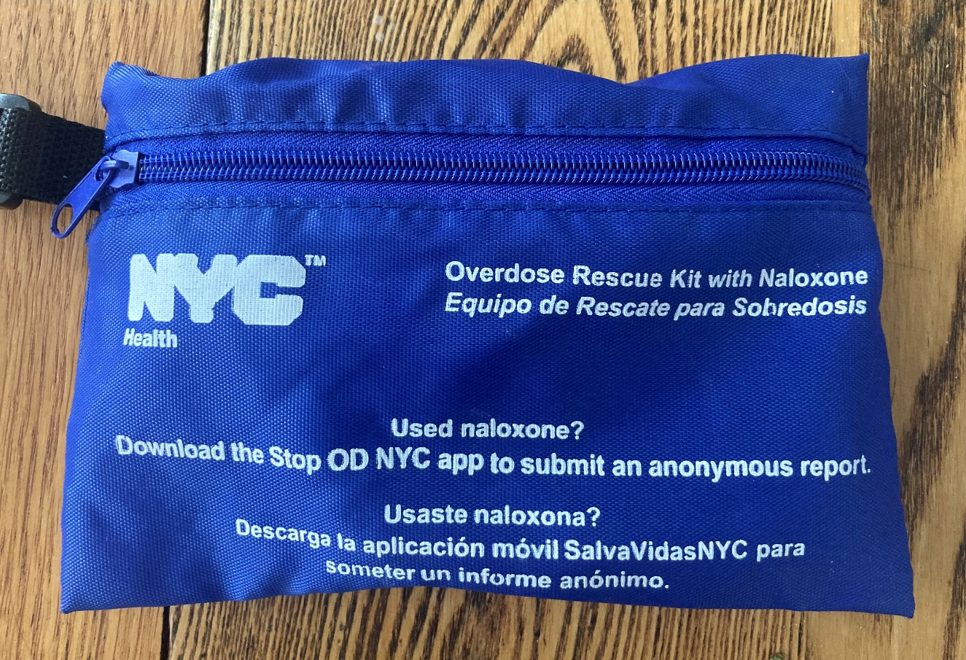
Theme 1: Overdose Prevention Challenges
Mitigation strategies included “wellness checks” and naloxone distribution
Notes:
Mitigation strategies included “wellness checks”, in which staff would knock on doors (in some cases, every hour even throughout the night) and naloxone distribution for staff, clients, and throughout the hotel.
It was mixed though whether staff reported more or fewer overdoses in their hotels – some reported that there were fewer ODs at hotel vs congregate shelter
Also unclear how effective the strategies (particularly wellness checks) were (important to note especially given the disruptive nature of the checks)

Slide 14
Theme 1: Overdose Prevention Challenges
“So, we do wellness checks every hour, but the reality of it was in those situations, we just didn’t catch it [overdose] in time.” (28S, Staff)

Slide 15
Theme 2: Mixed Impact on Substance Use
Some clients increased use, some decreased
Micro-environmental:
Privacy in hotel rooms & availability of drugs
Less stress / improved well-being
Macro-environmental: Pandemic-related stress, isolation, boredom
Notes:
There appeared to be a mixed impact of the hotel on substance use behaviors and patterns. Clients and staff attributed these changes to a variety of micro and macro environmental factors.
Micro-environmental factors were those really related to the hotels, neighborhoods, etc. themselves
Macro-environmental: Were more of the global stress, isolation, boredom we saw during the pandemic, and not necessarily related directed to the hotel or homelessness

Slide 16
Theme 2: Mixed Impact on Substance Use
“It [using drugs] was easier, you understand, because I can sit in my room and I knew what time they coming through to do the wellness check. So, around about that time, I sprayed my little spray that I had where they couldn’t smell nothing.” (50C, Client)

Slide 17
Theme 2: Mixed Impact on Substance Use
“It’s just during COVID, it was nothing else to do. I’m not saying a hotel is what made everybody go crazy in drug [use]. … it’s really not the impact of the hotel itself.” (69C, Client)
Notes:
This quote showing more macro-level impacts

Slide 18
Theme 2: Mixed Impact on Substance Use
“I would say because of the isolation, and being in a hotel, and being so far away from where the population really is, a lot of people tend to be by themselves…I think when you isolate, substance abuse it does come – and that includes alcohol – it comes into play. I think it’s increased, especially with the pandemic; the pandemic didn’t help neither.” (25C, Client)
Notes:
This quote showing more macro-level impacts

Slide 19
Theme 3: Benefits from ↑Privacy & ↓Stress
Increased privacy and decreased stress at hotels allowed some clients to better meet substance use-related and other life goals
Notes:
Theme 3 – benefits from increased privacy and decreased stress
Increased privacy and decreased stress at hotels allowed some clients to better meet substance use-related and other life goals

Slide 20
Theme 3: Benefits from ↑Privacy & ↓Stress
“I think when folks have their privacy, and their sense of safety restored…then folks were better able to meet their goals. It certainly was not everyone’s goal to stop using, or to decrease using, but the folks who it was in line with their goals, they were better able to do that, and maintain that, and be able to kind of relax, which helps people more meaningfully engage in mental health, physical health, in all of those services to help folks get into housing.” (3S, staff)
Notes:
Clients themselves also noted the wellbeing of being in hotels and how this impacted them

Slide 21
Theme 3: Benefits from ↑Privacy & ↓Stress
“People have more dignity. They have more pride. They have privacy. ... That doesn't exist in the traditional congregate setting. … When you're in a setting that…looks like a prison, you feel like a prisoner. When you're in your own room, even if you have a roommate, you feel better about your situation. … Now you got the population in a better environment where I can close the door, I can lay down, and I can know that I'm relatively safe right here. That changes everything.” (5C, client)
Notes:
Clients themselves also noted the wellbeing of being in hotels and how this impacted them

Slide 22
Qualitative Interviews: Key Lessons / Next Steps
Non-congregate sheltering may have benefits for mental and physical health, but environmental risks for overdose need to be addressed
Next steps: Ongoing thematic analysis; difference-in-difference analyses using linked housing & healthcare data
Notes:
Hotels may have some benefits for mental and physical health, but overdose risks need to be addressed
Overall challenging to separate out the unique impact of hotels / non-congregate sheltering vs the impact of the pandemic itself
Next steps: ongoing thematic analysis; quantitative analysis of health impacts (including substance use) of the hotels: difference-in-difference analyses using linked housing & healthcare data

Slide 23
The Big Picture
Notes:
What should you take home from this study?
This study only evaluated the impact of hoteling on substance use
Impact of moving people from congregate shelters to hotel rooms complex when it comes to substance use
The big picture – and what we heard over and over again in our interviews – is that homelessness itself is very detrimental to people’s health, including as related to substance use
But the solution isn’t related to what environments we should be using as shelters while people are homeless – environment is important and should be considered -- but the solution is not using hotels as shelter permanently.
The take home point then is that we need to be doing more to prevent and end homelessness; homelessness is largely a problem of lack of enough affordable housing (as well as racism, and economic and educational inequity), and thus the solutions also revolve around housing , economic growth or support, better education and job training, and better paying jobs. Some people need just rental subsidies, which could occur via an expansion of Housing Choice Vouchers in the U.S. Other people may need more health-related and life supports – the gold standard evidence-based model for this is permanent supportive housing provided using a Housing First approach where people have permanent apartments of their own and are provided with supportive services. We also need to do more to prevent homelessness from occurring in the first place. These are the sorts of upstream interventions that we will need to prevent the downstream health consequences of homelessness.
https://pixabay.com/en/housing-buildings-city-154839/

Slide 24
Innovations at the intersection of homelessness and substance use during the COVID-19 pandemic: a scoping review
Presented by: Hannah Passmore, MPH
AMERSA 2024
Co-Authors: Rachel Krieger, Sunny Tang, Emily Lumbis, Sofia Sacerdote, Stephanie Blaufarb, Kelly M. Doran
Notes:
And now I’m going to transition to another part of our CHIP study. As I said before, one of the aims of the CHIP study was to investigate the other innovations at the intersection of substance use and homelessness that emerged during COVID, which we did partially through conducting a scoping literature review

Slide 25
Background
Bi-directional relationship between homelessness and substance use
Impacts of pandemic on substance use felt more strongly among PEH
Higher rates of overdose and risky SU behaviors among PEH during pandemic
Pandemic as a catalyst for innovation
Notes:
Well documented bi-directional relationship between homelessness and SU.
The pandemic impacted SU behaviors and risks in a variety of ways, including changes in drug supply, where people were using, if people were using in isolation, as well as impacting treatment access. These impacts were felt strong among PEH. Drug overdoses are already a leading cause of death among PEH, and during the pandemic, PEH experienced overdose at higher rates than their housed counterparts.
While the pandemic led to massive morbidity and mortality, it also served as an impetus to find creative solutions to protect people experiencing homelessness from the impacts of COVID-19 and to adapt substance use disorder treatment to new pandemic-appropriate models.

Slide 26
Goal of scoping review of the literature
Identify, catalog, and summarize innovations and programs related to the intersection of homelessness and substance use that were enacted during the COVID-19 pandemic.
Notes:
Goal of review: to identify, catalog, and summarize these innovations that emerged during the pandemic
We did not seek to evaluate effectiveness of the interventions and programs we found, just to provide a snapshot of innovations that came out of the pandemic, with the ultimate goal of providing actionable information to guide responses to future pandemics + to address current crises of homelessness and substance use

Slide 27
Methods – search strategy
Searched 5 databases (CINAHL, PubMed, PsycINFO, EMBASE, and World of Science), 3 gray literature databases (OAIster, NYAM, and OpenGrey), and Google
Conducted search in November 2022, and a follow up search in September 2023
Notes:
Searched 5 academic, 3 gray lit databases and google for papers relating to substance use, homelessness and COVID-19
Research librarian helped us determine search strategy
Conducted initial search in Nov 2022 and a follow up in Sept 2023 to ensure inclusion of recently published articles, since this is a continually evolving field

Slide 28
Methods – inclusion and exclusion criteria
Inclusion criteria:
Involved a new or expanded intervention addressing drug and/or alcohol use among PEH that emerged during COVID-19 pandemic
Interventions could be from any country but had to be published in English
Exclusion criteria:
Published before February 2020
Only addressed nicotine or tobacco use
Did not describe any intervention and/or intervention did not directly address substance use
Did not meaningfully discuss the needs of PEH
Review article or abstract
Notes:
Inclusion/exclusion criteria was developed iteratively as a team – ultimately we wanted to include articles that discussed a pandemic-related substance use focused intervention that meaningfully included PEH
Screened titles/abstracts, then full text – each title/abstract and full text were screened by at least 2 members of the study team

Slide 29
Methods – data extraction and analysis
Data extraction completed in Covidence
Relevant information was extracted and organized
Notes:
Data extracted: location, intervention type, setting, substance addressed by intervention, methodology, participant information, and outcomes
Extraction completed by one person, with a second checking for accuracy
We used Covidence, an online software for systematic review management, to organize/streamline the review. Happy to talk more about Covidence later if people are interested in it as a tool
Covidence flagged/removed duplicates, and has a user friendly platform for screening and data extraction – you can put your inclusion/exclusion in, and keep track of reasons for exclusion, set it so that each article needs to be screened by 2+ people, etc. Built a data extraction template with similar settings – needed to be checked by a separate user. Also keeps track of how many studies each user screened/extracted.
No quality assessment of the included literature was completed, in keeping with standard scoping review methodology and due to the wide range of design of included articles.

Slide 30
Articles identified in November 2022 search (n = 1021)
Articles identified in September 2023 search (n = 526)
Articles identified from other sources (n = 10)
Duplicates removed (n = 745)
Abstracts and titles screened (n = 812)
Articles excluded (n = 664)
Full text articles assessed for eligibility (n = 148)
Articles excluded (n = 80)
Articles included in review (n = 68)
Notes:
Our PRISMA flowchart – ultimately found 68 articles eligible for inclusion
Reasons for exclusion: no intervention, no inclusion of PEH, not in response to COVID, no full text/abstract only
Reasons for exclusion:
Review article (n = 2)
No intervention / no details about intervention (n = 30)
Intervention not about substance use (n = 11)
Intervention not in response to COVID (n = 10)
Abstract only / no full text published (n = 8)
No significant discussion of people experiencing homelessness (n = 17)
Updated version of the same article available for review (n = 2)

Slide 31
Article characteristics
72.1% in North America
83.8% in urban settings
57.4% focused on opioids
50.0% specific to PEH
Observational methods were most common
73.5% published in 2021 or 2022
Notes:
Characteristics of included articles:
While most studies discussed interventions in North America, there were 14 countries represented overall.
57% of studies focused on opioids alone, but 65 out of the 68 studies addressed opioids in some capacity. The remaining three were focused on alcohol
72.1% (n=49) discussed interventions in North America; 14 countries were represented total
83.6% (n=57) were located in urban settings
57.4% (n=39) were focused on opioids only, but 65 (95.6%) overall discussed opioids
50%% (34) articles discussed interventions specific to PEH
The most common methods were observational
program descriptions (n=26), qualitative methods (n=16), quantitative analytic studies (n=14), case series and reports (n=8), and mixed methods (n=4)
Most articles were published in 2021 (n=24) and 2022 (n=26)

Slide 32
Interventions described in the articles
Substance use disorder treatment:
Telemedicine-based medication for OUD (n=24)
Outreach-based medication for OUD (n=7)
Methadone take home doses (THDs) (n=12)
Notes:
Interventions described in the articles fell into two broad buckets – those focused on SUD treatment (including medication and/or counseling based treatment) and those focused on harm reduction (including preventing overdose and/or withdrawal)
SUD treatment – mostly goal to continue/expand treatment access while preventing COVID. Here are some of the top SUD treatment related interventions. Most commonly reported on intervention was telemedicine based MOUD prescribing and maintenance

Slide 33
Interventions described in the articles
Harm reduction:
Managed alcohol programs (MAPs) (n=9)
Supervised consumption services (n=4)
Safer supply (n=4)
Notes:
Harm reduction – goal to prevent overdose/withdrawal, facilitate isolation, prevent COVID
All but one of the managed alcohol, supervised consumption, and prescribed safer supply interventions in the articles were focused specifically on PEH, and all were located in shelters, I&Q sites, or protective hotels

Slide 34
Discussion
Telemedicine-based SUD services could lower barriers to treatment
Lowered barriers to methadone appeared to successfully connect PEH to treatment
Harm reduction interventions like managed alcohol programs, supervised consumption services, and safer supply prescribing appeared to be safe and effective
Notes:
Evidence from the articles suggest that telemedicine-based SUD services could lower barriers to treatment, but there are real challenges including inequitable access to tech for PEH.
Articles described mitigation strategies: audio-only telehealth, phone provision, “facilitated” telehealth (which could look like a support worker on the street using their own device to connect someone to a provider at a clinic).
Lowered barriers to methadone, including take home doses and methadone provision at shelters, protective hotels, isolation sites, etc. appeared to connect people experiencing homelessness to care and helped retain people in care. Remaining challenge – still not a lot of research on lowering barriers to methadone specifically focused on PEH, those this is changing!
Finally, harm reduction interventions like managed alcohol programs, supervised consumption services, and safer supply prescribing appeared to be safe and effective, with very few adverse events reported in the included articles.
Harm reduction interventions, particularly those in place in homeless services settings (like shelters, hotels, isolation sites, etc.) were also effective in retaining people – people completed their isolation, stayed sheltered, etc. – suggesting a potential for use in settings where people might discharge due to inadequately managed withdrawal, substance dependence (like inpatient settings)

Slide 35
Conclusions
Quality of evidence overall low (not surprising given pandemic context)
Existing evidence suggests feasible innovations that may benefit PEH, without evidence of harm
Future research needs to focus on interventions for PEH specifically
Notes:
Overall, the quality of the evidence was low, which isn’t surprising due to the pandemic context, which made rigorous studies much more difficult.
Existing evidence suggests feasible innovations that may benefit PEH, without evidence of harm
Future research needs to focus on interventions for PEH specifically to figure out which of these interventions should be prioritized going forward
Some of our next steps include analysis of qualitative interviews we conducted qualitative interviews with folks across the US and Canada who implemented innovations at the homelessness/SU intersection during COVID – some of which are also included in the lit review – to better understand barriers, facilitators, how these worked on a more detailed level. Thanks to anyone in the room who we’ve spoken with for this project. We’ve rapped up interviews, working on analysis now. Plan to create a resource repository website with information on these incredible interventions

Slide 36
Thank you!
Hannah.Passmore@nyulangone.org

Slide 37
Supplemental slides

Slide 38
A community-academic partnership to develop an implementation support package for overdose prevention in permanent supportive housing
Notes:
Interventions were effective at preventing overdose and/or withdrawal among PEH
Successes in allowing folks to safely isolate could be translated into other settings, including ones in which patients may discharge due to inadequately controlled withdrawal or substance dependence

