Slide 1
A Qualitative Investigation of Methadone Treatment Experiences, Facilitators, and Barriers Among People Experiencing Homelessness with Opioid Use Disorder
Presented by: Marina Gaeta Gazzola, MD
Resident Physician, NYU Grossman School of Medicine/Bellevue Hospital Department of Emergency Medicine
The APT Foundation, Inc. & Yale School of Medicine
Thursday, November 14, 2024
Co-Authors: Emma Thompson BS, Kim Hoffman PhD, Gul Saeed MD, Colin Baylen MD, Lynn M. Madden PhD, Kathryn F. Eggert PhD, Mark Beitel PhD, Declan T. Barry PhD

Slide 2
Disclosures
The study team has no conflicts of interest to report.

Slide 3
BACKGROUND

Slide 4
Homelessness and Opioid Use Disorder
Overdose leading cause of death among people experiencing homelessness (PEH)
PEH less likely to receive treatment for substance use disorders, including OUD
PEH less likely to receive evidence-based treatments (i.e., methadone or buprenorphine)
Limited research on experiences and outcomes in evidence-based treatments for OUD among PEH
Homelessness is an independent predictor of shorter time in treatment and lower completion

Slide 5
Study Objective
Examine methadone treatment experiences, facilitators, and barriers among people with homelessness experience enrolled in low-barrier outpatient methadone treatment

Slide 6
METHODS

Slide 7
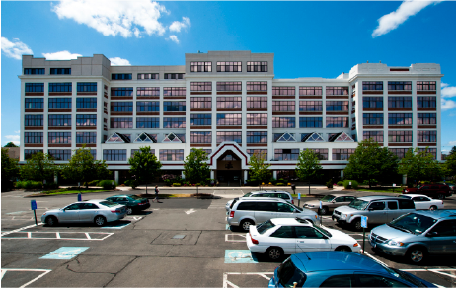
Setting – APT Foundation
Low-barrier, not-for-profit addiction treatment program in greater New Haven, CT area
Open-access Model:
Aims to reduce common barriers to MT
Same-day enrollment/dosing
No wait list
No administrative (program-directed) discharges
No mandated individual counseling - patients choose from groups with optional individual counseling

Slide 8
Recruitment & Population
Time: December 2022-May 2023
Sampling Method: mix of passive sampling (fliers) and purposeful sampling (counselors and research team)
Inclusion Criteria:
English-speaking adults (18+ years)
Enrolled in outpatient methadone treatment at one of APT’s 4 OTPs
Current or prior experience of homelessness while enrolled in methadone treatment

Slide 9
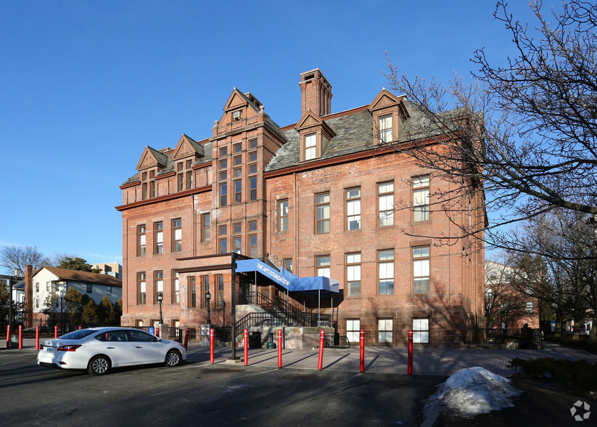
Procedure

Slide 10
RESULTS

Slide 11
Sample Characteristics
Enrolled 31 current PEH, 15 people at risk of losing housing, 4 people securely housed
31 men, 19 women, most never married (62%), not currently working (88%), identified as white (78%)
Most (80%) had ≥1 year of homelessness
Median 24 months without stable housing (IQR 6.5-66)

Slide 12
Major Themes
Theme 1: Individual-level barriers and facilitators
Theme 2: Program-level barriers and facilitators
Theme 3: Perceptions of low barrier treatment

Slide 13
Theme 1: Individual-level Facilitators
Patients expressed distinct preferences for methadone
And most viewed taking methadone and staying in treatment as very important
“Methadone has made me feel more comfortable. And like I said, I'm not craving as I was when I was on Suboxones. It's a more steady lifestyle.”
- Participant 8
“If I don’t take methadone… I will die, I will overdose on fentanyl or I will end up in prison for the rest of my life.”
– Participant 45

Slide 14
Theme 1: Individual-level Barriers and Facilitators
Participants often cited attitudinal barriers and facilitators as critical to impacting treatment engagement
“Oh man, listen, APT can't do anymore than, than they already done. And that's the truth. They giving you all the resources, they gimme all the options, and it's up to me.”
–Participant 14

Slide 15
Theme 1: Individual-Level Barriers
Transportation was considered a major barrier by nearly all participants
”It’s tough when it's cold out and it's hard getting here. You have to take two buses to get here and I mean, I'm not a spring chicken… now that means [in] my sixties, it's harder.”
–Participant 10
“It’s hard.. if you don't have any… where to shower or your hygiene, it's hard to get here every day. If you live far, you don't have bus transportation.”
-Participant 43

Slide 16
Theme 1: Individual-Level Barriers
Ongoing substance use impacts treatment engagement for PEH
Resource scarcity among PEH impacts treatment engagement
“It’s hard to not get high when I'm homeless.. When I'm waking up on the sidewalk being kicked by someone, you're telling 'em to leave, it makes me so depressed. I want to go get high.”–Participant 13
“A lot of homeless people don't have phones with alarms and things like that, so it can make it harder that way.” –Participant 11
“If you have a phone, it's easy.” –Participant 12
Notes:
Maybe cut

Slide 17
Theme 2: Program-Level Barriers and Facilitators
Participants considered staff to be a positive resource
But desired greater facilitation from APT to assist with securing housing
“A lot of the counselors actually understand what I've gone through. and actually get me and don't judge.”
–Participant 9
“I wish they had like maybe somebody inside of the building that just worked with, just for helping people find housing.”
–Participant 16

Slide 18
Theme 2: Program-Level Barriers and Facilitators
Many participants discussed how dosing impacted their engagement
“Another positive about this clinic is if you have a job or something, they will work with you with giving you bottles.” –Participant 40
“If you are already sick that 30 milligrams they give you at first might not be enough for what you're getting high to. So it is kind of rough in the beginning.” –Participant 8
“My biggest concerns is when am I gonna find a dose that’s good for me… I want something to take away the urge for me not to use on in between.”
-Participant 49

Slide 19
Theme 3: Perceptions of Low-Barrier Methadone
Participants acknowledged the ease of same-day enrollment
“It's not very hard. It takes one day...[describes enrollment steps]. it's pretty easy to get on the program.” –Participant 22
“We went fairly quickly. People were nice to me. The doctors were nice to me over there and I was medicated that day.” –Participant 44

Slide 20
Theme 3: Perceptions of Low-Barrier Methadone
Participants appreciated integrated services for PEH
“You can always go to a doctor here as long as you sign up, you can see a psychiatrist, you can see a regular doctor.” –Participant 47
“The fact that they do allow me to stay here for a couple hours after I get dosed. So that's good because it's really cold out. They give you a snack and they give you coffee. They don't understand how much that means to a lot of us cause we didn't eat, so that snack is our breakfast. There is a few people here that will go, ‘Hey, you need a shirt, you need pants.’” –Participant 13

Slide 21
Theme 3: Perceptions of Low-Barrier Methadone
Flexibility with difference aspects of treatment (e.g., attendance, substance use) benefitted PEH
“I come Monday, Wednesday, Friday, and I'm able to do that and, and it works for me. And if I miss a day, I'll come the next day and it's no big deal.” –Participant 37
“With a lot of the other ones, they're much more strict about you either cutting down or quitting using in an amount of time. Which for every individual might not be the case. You can be kicked out of a program as opposed to APT, where the recovery is basically based off of you. So even if you want to keep using for the rest of your life, it's fine as long as you check in, monitor, keep doing your doses.” –Participant 4

Slide 23
Limitations
Response bias: some people with this experience may not have wanted to discuss it, and those with positive experiences may be overrepresented
Low-barrier clinic, may not generalize to other treatment settings.

Slide 24
Discussion
Participants highlighted barriers and facilitators that are both unique to PEH and echo concerns from housed individuals enrolled in methadone treatment.
Policies at the clinic (and national) level that increase flexibility benefit PEH.
PEH view integrated services, resource navigation, and longitudinal relationships with staff very positively.

Slide 25
Conclusions
PEH enrolled in methadone treatment have unique experiences, facilitators, and barriers that impact their treatment engagement and experience.
Understanding methadone treatment experiences among PEH is an important first step in improving treatment systems to better serve this important population who is at high risk for overdose yet underrepresented in research.
Future directions include directly addressing patient concerns related to their housing status, resource limitations, and

Slide 26
QUESTIONS?
Thank you!
Marina.Gazzola@nyulangone.org

