Slide 1
AMERSA Discourse 2024
The Role of Drug Testing in Clinic Addiction Care
“To test or not, that is the question …”
Annie Potter, NP
Participant
Clinical Nurse Educator
Boston Medical Center
Grayken Center for Addiction TTA
Assistant Professor
Boston University Chobanian & Avedisian School of Medicine
Phillip Reason, MSW, MPH
Moderator
Researcher
Grayken Center for Addiction
Boston Medical Center
Stephen Martin, MD
Participant
Professor
UMass Chan Medical School
Barre Family Health Center
Medical Director for Research
Boulder Care
AMERSA 48th Annual Annual Conference
Chicago, Illinois | November 15, 2024

Slide 2
Disclosures
The presenters have no related conflicts of interest.
P

Slide 3
Introductions
P

Slide 4
Objectives
Analyze the potential benefits of drug testing.
Analyze the potential harms of drug testing.
Evaluate the balance of patient autonomy and the necessary clinical information yielded in performing drug testing.
P

Slide 5
Context for Drug Testing During SUD Treatment
There are no randomized controlled trials on the outcomes related to drug testing in substance use treatment.
There is no universal standard for clinical drug testing during treatment.
The first US national guideline for testing was issued in 1993 by SAMHSA as TIP #1 for State Methadone Treatment Guidelines; this is the origin of the SAMHSA requirement for 8 tests a year for methadone treatment.
There is no federal testing requirement for buprenorphine treatment.
Guidelines from SAMHSA, ASAM, ACMT, have since been issued.
The 2017 ASAM guidance is in active revision.
P

Slide 6
Proposition #1
Standardized drug testing should be required by clinical providers as part of outpatient MOUD treatment.
Yes, it should be required: Annie [10 min]
No, it should not be required: Steve
P

Slide 7
7
A

Slide 8
Yes, standardized drug testing should be required
Patient Level Benefits
With the toxic, unregulated drug supply, people who use drugs should know what is in their drug supply
Drug checking is not widely available
Frames discussions to offer support with a focus on harm reduction
Standardization provides an opportunity to implement a consistent, trauma-informed approach across all settings
Implement supervised, not observed drug testing
Promotes shared-decision making around treatment plan
Avoids unnecessary over-testing
8
A

Slide 9
Yes, standardized drug testing should be required
Organization Level Benefits
Standardization allows for testing to be done with purpose throughout outpatient treatment settings
Provides guidance for monitoring of patients prescribed medications
Reduce bias, improve equity of care among patients
9
A

Slide 10
Yes, standardized drug testing should be required
Population Level Benefits
Provides important information about drug trends
Drug testing has aided in informing our practice
Affects the selection of MOUD
Impacts MOUD initiation strategies
The test is imperfect but allows us to better serve our communities and protect people from overdose
10
A

Slide 11
Proposition #1
Standardized drug testing should be required by clinical providers as part of outpatient MOUD treatment.
Yes, it should be required: Annie
No, it should not be required: Steve [10 min]
P

Slide 12
No, standardized drug testing should not be required
Reason #1
Testing causes harm and is not known to provide benefit
S

Slide 13
https://www.youtube.com/watch?v=aM9Apqxiiug&embeds_referring_euri=https%3A%2F%2Fwww.statnews.com%2F&source_ve_path=OTY3MTQ&feature=emb_imp_woyt
Notes:
https://www.youtube.com/watch?v=aM9Apqxiiug&embeds_referring_euri=https%3A%2F%2Fwww.statnews.com%2F&source_ve_path=OTY3MTQ&feature=emb_imp_woyt

Slide 14
No, standardized drug testing should not be required
Reason #2
Testing embeds distrust into the clinician-patient relationship
S

Slide 15
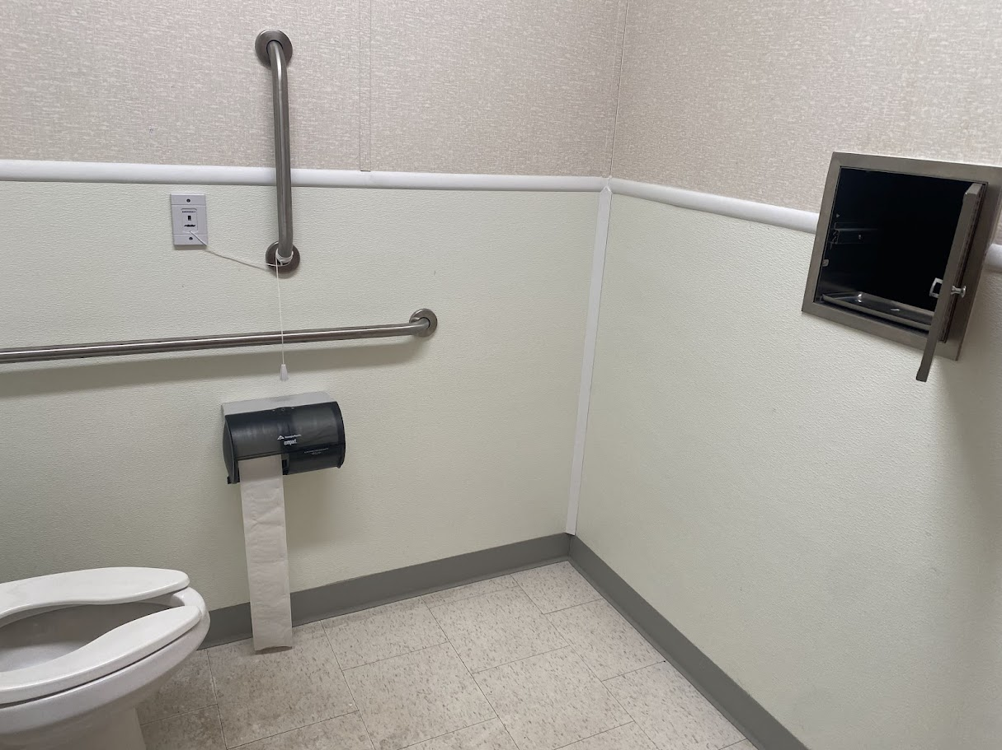

Slide 16
No, standardized drug testing should not be required
Reason #3
Clinicians and their organizations continue to demonstrate:
They cannot accurately interpret drug tests
They do not order confirmatory testing when required for clinical decision-making
They have an untenable ethical quandary because more accurate testing increases costs and inaccurate testing is cheaper
Power corrupts
S

Slide 17
No, standardized drug testing should not be required
Reason #4
Drug testing is the opposite of low-threshold, harm reduction and is a barrier to life-saving treatment in the midst of an epidemic of lethal synthetic opioids.
S

Slide 19
Harm Reduction Approach
Trauma-Informed
Environment
Meet People
Where They Are
Notes:
The Role of Low-Threshold Treatment for Patients with OUD in Primary Care. Accessed September 12, 2024. https://integrationacademy.ahrq.gov/products/topic-briefs/oud-low-threshold-treatment
Jakubowski A, Fox A. Defining Low-threshold Buprenorphine Treatment. J Addict Med. 2020;14(2):95-98. doi:10.1097/ADM.0000000000000555

Slide 20
No, standardized drug testing should not be required
Reason #5
Because of the preceding reasons, drug testing is unethical according to international and national principles of clinical care.
S

Slide 21
Baud, C.-A., Schmitt-Koopmann, C., Junod, V., Dickson, C., Brulisauer, L., Broers, B., & Simon, O. (2023). Are urine tests within opioid agonist treatment a justified practice? Heroin Addiction and Related Clinical Problems, 25(6), 25–28. https://www.heroinaddictionrelatedclinicalproblems.org/harcp-archives-doi-articles.php
S
Notes:
Baud, C.-A., Schmitt-Koopmann, C., Junod, V., Dickson, C., Brulisauer, L., Broers, B., & Simon, O. (2023). Are urine tests within opioid agonist treatment a justified practice? Heroin Addiction and Related Clinical Problems, 25(6), 25–28. https://www.heroinaddictionrelatedclinicalproblems.org/harcp-archives-doi-articles.php

Slide 22
Rebuttal Proposition #1
Standardized drug testing should be required by clinical providers as part of outpatient MOUD treatment.
No, it should not be required: Steve
Rebuttal: Annie [5 minutes]
P

Slide 23
Yes, standardized drug testing should not be required
Reason #3
Clinicians and their organizations continue to demonstrate:
They cannot accurately interpret drug tests
They do not order confirmatory testing when required for clinical decision-making
They have an untenable ethical quandary because more accurate testings increases costs
Power corrupts
A

Slide 24
Yes, standardized drug testing should be required
Reason #4
Drug testing is the opposite of low-threshold, harm reduction and is a barrier to life-saving treatment in the midst of an epidemic of lethal synthetic opioids.
Drug testing is not the barrier to life-saving treatment, rather it is people’s impression of the test and the weaponization of results.
A

Slide 25
Rebuttal Proposition #1
Standardized drug testing should be required by clinical providers as part of outpatient MOUD treatment.
Yes, it should be required: Annie
Rebuttal: Steve [5 minutes]
P

Slide 26
Proposition #2
Drug testing should be opt-out rather than opt-in.
[Everyone is tested unless they actively decline.]
Yes, it should be opt-out: Steve [8 minutes]
No, it should be opt-in: Annie
P

Slide 27
Yes, drug testing should be opt-out
Reason #1
Testing should be the default practice. Otherwise, people with a lower perception of agency will feel more compelled to “opt-in” by clinicians and organizations.
S

Slide 28
Yes, drug testing should be opt-out
Reason #2
We are giving a medical treatment and people should expect to have an objective test.
We don’t allow patients to receive ongoing blood transfusions without a hematocrit, antihypertensive medication without a blood pressure measurement, or chemotherapy without cancer staging and surveillance.
S

Slide 29
Yes, drug testing should be opt-out
Reason #3
If testing is not the default practice, patients will have vastly different care experiences depending on their clinic’s culture and expectations.
S

Slide 30
Yes, drug testing should be opt-out
Reason #4
Without initial testing, patients could enter care without an objective measure of current drug use.
S

Slide 31
No, drug testing should be opt-in (ask to be tested)
Patient Level Benefits
Offer drug testing as one of the many menu options for treatment recovery
Empowers the patient and gives them autonomy
Positive reinforcement
Evidence of their recovery for non-medical agencies
Allows for an opportunity to discuss the benefits and drawbacks of testing
Reduces feelings of judgment
Decreases stress and anxiety
What will happen to me if I don’t test?
31
A

Slide 32
No, drug testing should be opt-in (ask to be tested)
Organization Level Benefits
Drug testing does not diagnose a substance use disorder
Drug testing is not necessary to determine a patient’s treatment needs
It does not accurately depict a patient’s recovery process or risk for overdose
Little evidence on the effectiveness of drug testing on patient outcomes
Moves addiction treatment towards a patient-centered, shared decision-making model of care
32
A

Slide 33
No, drug testing should be opt-in (ask to be tested)
Population Level Benefits
Expands treatment as part of a comprehensive, supportive care model
Directs the focus away from drug testing which can be a barrier for many seeking care
Moves addiction treatment away from it’s punitive criminal-legal origins and towards evidence-based medical treatment
Reduces the burden of cost and waste
33
A

Slide 34
Rebuttal Proposition #2
Drug testing should be opt-out rather than opt-in.
[Everyone is tested unless they actively decline.]
No, it should be opt-in: Annie
Rebuttal: Steve [4 minutes]
34
S

Slide 35
Rebuttal Proposition #2
Drug testing should be opt-out rather than opt-in.
[Everyone is tested unless they actively decline.]
Yes, it should be opt-out: Steve
Rebuttal: Annie [4 minutes]
35
A

Slide 36
No, Drug testing should be opt-in (ask to be tested)
Reason #1
Testing should be the default practice. Otherwise, people with a lower perception of agency will feel more compelled to “opt-in” by clinicians and organizations.
Allowing patients to opt-in for testing will empower those with a lower perception of agency, giving them more control over their decisions and fostering a sense of autonomy.
36
A

Slide 37
No, Drug testing should be opt-in (ask to be tested)
Reason #2
We are giving a medical treatment and people should expect to have an objective test.
Not all conditions require individuals to undergo objective testing before receiving medical care.
Objective testing prior to prescribing psychiatric medications (e.g., antidepressants, antipsychotics) is not required as these conditions are treated based on clinical evaluation, symptoms, and patient history.
37
A
Notes:
Testing prior to prescribing psychiatric medications (e.g., antidepressants, antipsychotics, mood stabilizers) is not required as they are treated based on clinical evaluation, symptoms, and patient history.

Slide 38
Joint Summary
38

Slide 39
Patients have a right to refuse any treatment service, including drug testing. Treatment programs should not attempt to coerce patients into participating. Admission and discharge decisions should not be based solely on drug test results or refusal of drug testing.
Drug test refusal should be well documented, along with the clinician’s interpretation of its clinical relevance for the given patient.
ASAM Clinical Considerations for Engagement and Retention of Non-Abstinent Patients in Substance Use Treatment. 2024 Final Version. https://www.asam.org/quality-care/clinical-recommendations/asam-clinical-considerations-for-engagement-and-retention-of-non-abstinent-patients-in-treatment
Notes:
https://www.asam.org/quality-care/clinical-recommendations/asam-clinical-considerations-for-engagement-and-retention-of-non-abstinent-patients-in-treatment

Slide 40
AMERSA Discourse 2024
The Role of Drug Testing in Clinic Addiction Care
“To test or not, that is the question …”
Phillip Reason, MSW, MPH
Moderator
Researcher
Grayken Center for Addiction
Boston Medical Center
Annie Potter, NP
Participant
Clinical Nurse Educator
Boston Medical Center
Grayken Center for Addiction TTA
Assistant Professor
Boston University Chobanian & Avedisian School of Medicine
Stephen Martin, MD
Participant
Professor
UMass Chan Medical School
Barre Family Health Center
Medical Director for Research
Boulder Care
AMERSA 48th Annual Annual Conference
Chicago, Illinois | November 15, 2024

