Slide 1

Babalola Faseru, MBChB, MPH, CPH; MaryAlice Kelly RN, BSN; Eleanor Leavens, PhD; Shelby C. Rowell, MPA; Robyn Kelso, PhD
2024 AMERSA National Conference
Adaptation, Implementation and Evaluation of Telementoring Echo Series to Address E-Cigarette Use Among Middle and High School Students in Kansas
17
Notes:
I want to thank AMERSA for giving me the opportunity to present at this session on behalf on my colleagues from the State of Kansas. I will talk about the telementoring echo project to address vaping among middle and high school students in Kansas.

Slide 2
Disclosure
No relevant financial relationships to disclose
Notes:
I have no relevant financial relationships to disclose

Slide 3

Outline
Background Information about the Vaping ECHO for Education Pilot Initiative in Kansas
Adaptation of the Project Echo model to promote equity in capacity building
Program Implementation and action plans
Evaluation
Notes:
In this short time that I have, I will briefly describe what prompted action about e-cigarette use in Kansas Schools, I will describe the pilot ECHO project and the outcomes.

Slide 4
Percentage of High School Students Who Currently Used an Electronic Vapor Product,* 2017-2021
*Including e-cigarettes, vapes, vape pens, e-cigars, e-hookahs, hookah pens, and mods [such as JUUL, SMOK, Suorin, Vuse, and blu], on at least 1 day during the 30 days before the survey
Kansas - YRBS, 2017-2021 - QN35
Notes:
This diagram shows the prevalence of the use of electronic vapor products among High school students in Kansas in 2017, 2019 and 2021. The rapid increase from 10.6 % in 2017 to 22% in 2019 called for urgent intervention

Slide 5

Concerted Effort
Educators
and Coaches
In June 2019, the Kansas State Board of Education formed the E-Cigarette/Vaping Task Force
Project ECHO® - Vaping ECHO for Education
Whole School, Whole Community, Whole Child Model (WSCC)
Public Health Professionals
Parents and Students
Everyone can play an important role.
Health Care
Providers
School
Administrators
School Health Professionals
Credit: Dr. Brenna Van Frank, CDC
Notes:
Unfortunately, schools were not well equipped and had limited access to evidence-based resources for addressing e-cigarette use, particularly in rural communities. In June 2019, Kansas Vaping Task Force, led by the Kansas State Board of Education was formed. The Vaping Task Force cessation subgroup recommended a Pilot project that would adapt and implement the Project Extension for Community Healthcare Outcomes (ECHO). The Vaping ECHO for Education is a collaborative blended learning approach to equip critical personnel with e-cigarette cessation resources, tools, using the concept of Whole School, Whole Community, Whole Child Model (WSCC) which calls for greater alignment between the public health and education sectors and emphasizes the importance of evidence-based school policies and practices. Our pilot project was built on the premise that everyone can play an important role. These include school administrators, parent and students, school health professional, health care providers, public health professionals, educators, and coaches.

Slide 6
Vaping ECHO for Education Learning Objectives
To develop a network of stakeholders to help design, tailor, implement and evaluate strategies and interventions to reduce vaping in schools.
To build capacity to increase the confidence of schools and school personnel to address vaping cessation.
To develop skills of school health professionals to provide support and referrals for vaping cessation.
To evaluate the quality, effectiveness and impact of the program on schools.
Notes:
These are the learning objectives for the Vaping ECHO for Education. We put together a network of stakeholders to jointly plan and implement the program to build capacity to increase the confidence of schools to address vaping cessation, and also develop the skills for support and referral to resources and to evaluate the quality, effectiveness and the impact of the program

Slide 7
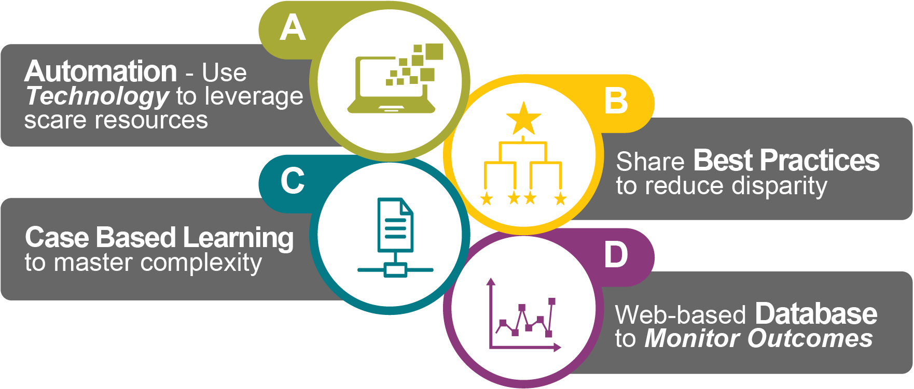
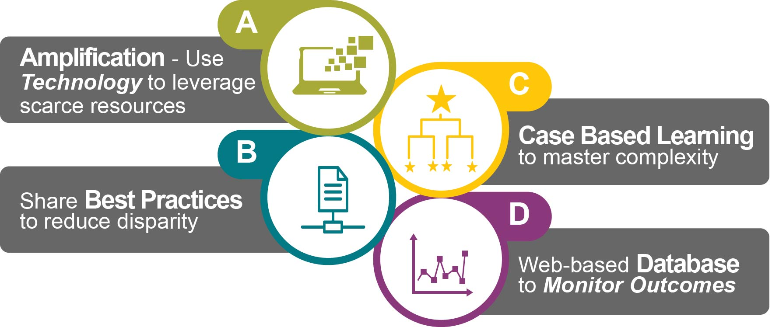
Project ECHO’s ABCD(E) Model
E Effective Implementation to execute strategic action steps
Notes:
Project ECHO was developed by Dr. Aurora at the University of New Mexico (UNM), the model is built upon four principles: use of technology to leverage scarce resources; dissemination of best practices to address the needs of the most vulnerable population and reduce disparities, the use of case-based collaborative learning to master complexity and web-based database to monitor outcomes. We adapted features of the Project ECHO model to develop and effectively implement the pilot project to build capacity of the schools to address e-cigarette use in Kansas.

Slide 8
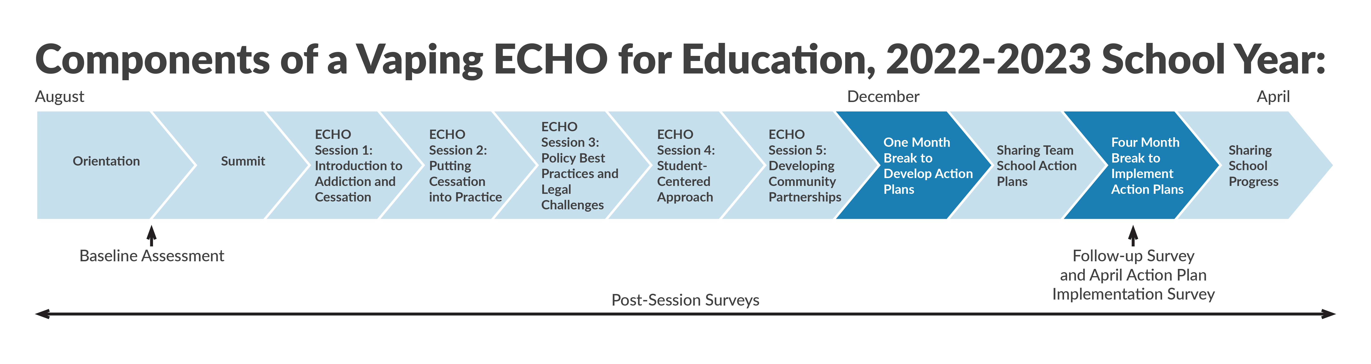
Notes:
Let me briefly describe the program which was fully implemented online. This presentation will focus on the second cohort. We had presented the results of the first cohort at the Society for Research on Nicotine and Tobacco. The application opened in May 2022. Selection criteria included school location, (urban, rural or frontier), Social economic status (percent free and reduced lunch) and racial ethnic composition of the student body. Motivation of team and previous efforts toward e-cigarette prevention and/or intervention in their school, willingness to fully participate in the Project ECHO sessions. At a minimum, the team must include a school health champion (e.g., school nurse, counselor) and a school administrator. Other members of the team could include teachers, social workers, athletic trainers, health teachers, coaches, and student resource officers. Schools were notified in June and Orientation was held in August to introduce the Project ECHO procedures, timeline, and expectations (e.g., number of ECHO sessions, deliverables, assessments). Next, a three-hour kickoff summit was held on August, with a keynote address from Medical Officer in the Office of Smoking and health in CDC, followed by a Public Health Law Center policy presentation and a panel discussion. The panelists included an associate school superintendent, a pediatrician, an attorney and a school nurse. They discussed the magnitude, dimensions, challenges, barriers and strategies for successful implementing of e-cigarette use prevention and cessation. We developed a web-based toolkit that housed resources for implementation. Toolkit chapters included a brief introduction to the topic, links to resources and an introductory video. Core ECHO sessions were held from Sept to November. School teams were required to develop their action plan with technical assistance from the hub team member. School team presented their action plan in December, went to work and came back for the debrief session in April 2023.

Slide 9

Vaping ECHO Series
School Year Roadmap
PRE-SESSIONS (Aug.)
  Orientation
  Kickoff Event - Summit
ECHO CORE LEARNING SESSIONS (Sept.-Nov.)
  Session 1 | Introduction to Addiction and Cessation
  Session 2 | Discussing Cessation: Putting Cessation into Practice
  Session 3 | Policy, Best Practices, and Legal Challenges
  Session 4 | Student-Centered Approach
  Session 5 | Developing Community Partnerships
ACTION PLANNING (Dec.-April)
  School Action Plan
  Schools’ Sharing Progress
Notes:
The core ECHO sessions consisted of five 90-minute collaborative learning sessions. 20 minute-Didactics were provided to the whole group by a content expert followed by questions and answer. The topics of the didactics covered, are listed on this slide. The teams were then sent into breakout rooms where they presented and discussed cases prepared by one of the schools. These cases could be system-wide or student-centered challenges. Each breakout has a trained facilitator, a recorder/timekeeper, a content expert and school teams.

Slide 10
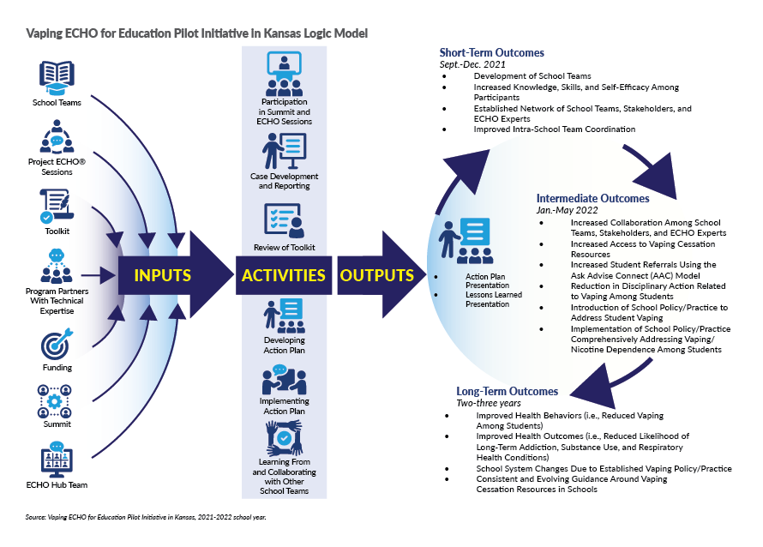
Notes:
The evaluation team and the Hub team, developed a logic model to guide the evaluation process with inputs, activities and short-term, intermediate and long-term outcomes well laid out

Slide 11
Evaluation Methods
Mixed methods – Quantitative and Qualitative
RedCap for data collection
  Baseline assessment
  Post session surveys for each ECHO session
  Follow-up survey in April
SASv9.4 for quantitative data analysis
NVivo for qualitative data analysis
Notes:
We used mixed methods with appropriate data analysis software for the program evaluation.

Slide 12
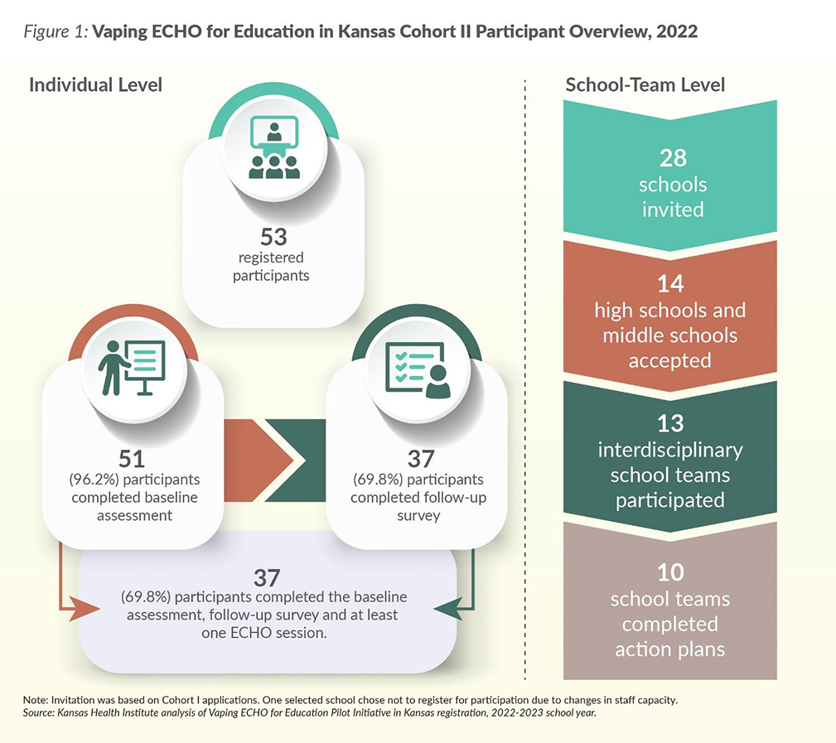
Notes:
We invited 28 schools, and 14 schools accepted our invitation, and 13 interdisciplinary school teams participated and 10 completed action plans. On the individual level, there were 53 participants, 51 completed the baseline assessment (96.2%), 69.8% completed the follow-up survey, 37 completed both baseline and follow-up surveys. By and large, we observed high participation rates. All teams were present at 4 of 5 echo sessions, 12 of 13 teams attended the 5th echo session.

Slide 13
Geographic Spread and School Grade levels
Notes:
This slide shows the geographic spread of the schools. 7 high schools and 6 middle schools participated. In terms of population density classification 2 were frontiers (less than 6 persons per square mile), 3 Rural (6-19.9 PPsm), 4 densely rural (20.0-39.9 ppsm), 3 semi-urban (40.0-149.9 ppsm) and 1 urban (150 or more) ppsm

Slide 14
Participant Characteristics (n=53)
Demographics
  Age
    18-24 years: 1.9%
    25-44 years: 54.7%
    45 and older: 43.4%
  Sex
    Female 66.0%
    Male 34.0%
  Race
    White 92.5%
    AI/AN 7.5%
    Black 3.8%
    Missing 1.9%
  Ethnicity
    Not Hispanic 94.3%
    Hispanic 5.7%
Professional Roles
  Teacher 26.4%
  Nurse 20.8%
  Principal 18.9%
  Coach 7.5%
  Counselor 7.5%
  Superintendent 5.7%
  Asst. Principal 5.7%
  Law Enforcement Officer/
  School Resource Officer 1.9%
  Athletic director 1.9%
  School Board Member
  Social Worker 1.9%
  Other 15.1%
* Total not 100% because of missing values/multiple identity or role /rounding
Notes:
Most of the participants were between age 25-44, predominantly non-Hispanic white and female. Several professional roles were represented. 26% were teachers, 21% Nurses, 19% Principal, 7.5% Coaches

Slide 15
Individual Level Outcomes:
Capacity and Skill Building
Domain | Percentage
Increase in knowledge | 86.5
Confidence in ability to apply knowledge | 75.7
Acquisition of strategic implementation skills | 64.9
Note: Total number of follow-up survey respondents = 37. Because participants could select more than one type of
domain as a response, percentages may not sum to 100 percent.
Notes:
Let’s look at the results. 87% reported increase in knowledge, 76% expressed confidence in their ability to apply the knowledge and 65% reported they have acquired the necessary skills for implementation of their action plans

Slide 16
Individual Level Outcomes : Changes in Behaviors
Domain | Percentage
Increase in confidence in addressing vaping with students | 59.5
Increase in quit line referrals | 40.5
Increase in referral to vaping cessation counseling | 37.8
Willingness to recommend program to others | 81.0
Note: Total number of follow-up survey respondents = 37. Because participants could select more than one type of
domain as a response, percentages may not sum to 100 percent.
Notes:
More than half (59.5 percent) of participants had an increase in the overall confidence to address vaping with students. Among the actions related to student intervention, the biggest increases were for non-punitive actions such as student referral to a toll-free tobacco or vaping Quitline (40.5 percent) and referral of students to tobacco or vaping counseling (37.8 percent).

Slide 17
Individual Level Outcomes : Changes in Perceived Barriers
Domain | Baseline | Follow-up
One or more barriers to effective vaping practice or policy change | 94.6% | 70.3%
NO barriers to effective vaping practice or policy change | 5.4% | 29.7%
Lack of knowledge as a barrier | 59.5% | 13.5%
Note: Total number of follow-up survey respondents = 37. Because participants could select more than one type of
domain as a response, percentages may not sum to 100 percent.
Notes:
There was a reduction in the perceived barriers to effective vaping practice and policy change and lack of knowledge

Slide 18
School-Team Level Outcomes: Action Plan Implementation
Fours months after implementation, an average of 61% of the action plans were achieved
Action Plan Objectives | Number of School Action Plans | Description
Education initiatives | 7 of 10 | Education or awareness building activities across stakeholders including students, teachers, staff, parents and community members
Cessation strategies | 6 of 10 | Efforts to reduce vaping use through cessation programs, individual student interventions or other means
Policy change | 5 of 10 | Efforts to change their school policy, particularly related to reducing punitive approaches in disciplinary policy
Staff capacity | 4 of 10 | Efforts to increase staff capacity through training around best practices such as learning or implementing motivational interviewing techniques, compilation of information and resources related to cessation
Student engagement | 3 of 10 | Student engagement either through building a Resist chapter or other means of achieving student buy in and involvement
*10 of 13 school action plans submitted for review. 3 schools did not provide action plans due to staff shortages, competing priorities or technical issues. Additional objectives included community support (1) and hosting an assembly with professional speakers (1).
Notes:
The evaluation of the objectives of the action plans developed by the schools are on this slide. Most the plans were focused on Education initiatives, development of cessation strategies, policy change, staff capacity building and student engagement.

Slide 19
Feedback for Program Improvement
Qualitative Themes | Descriptive quotations
Positive feedback | “I learned so much; not sure I could have handled more info. :)” “It was a great session. Thank You!” “I don't feel there needs to be improvement for session.”
The session times were challenging for participants. | “A time that is not so busy in the school day. It’s so hard to attend the entire session without interruptions. - “Had to step away to handle a student situation. Sometimes it is difficult to provide full attention to the sessions since they are during the school day.”
Requested changes to facilitation or ECHO structure. | “Too many case studies for one session”
Wanted more participant involvement. | “I wish the group would ask more questions of the presenters; I wish I had more participants on my team; I wish my nurse would be active in this area. I wish my PE teacher was able to attend and was on board. This is a WONDERFUL opportunity and resource tool for our school. Thank you!!”
Notes:
Selected feedback across all the sessions are displayed on this slide. Some participants shared concern about the ECHO session being held during the school day and the impact of conflicting responsibilities and interruptions on their participation. Some participants requested changes to the ECHO structure or facilitation during the core sessions, including reducing the number of case studies covered in each session. Some participants said the ECHO sessions could be improved with more participation of schools and school participants. All these suggestions were implemented in the development of the program for cohort 3

Slide 20
Acknowledgment
ECHO Hub Team - Karin Denes-Collar, LSCSW, Eleanor L. S. Leavens, PhD, Jordan Roberts, MPH, Mark Thompson, PhD, Shelby Rebeck, MSN, Alicia Jackson, Mary Beth Warren, Babalola Faseru, MD, MPH
KHI Team — Rebecca Andrade, MA, Shelby C. Rowell, MPA, Hina Shah, MPH, Emma Uridge, MPH, Angela Wu, MS, Samiyah Para-Cremer Moore, MSc, Cynthia Snyder, MA, Valentina Blanchard, M.P.H., L.M.S.W, and Wen-Chieh Lin, Ph.D.
Content Experts – Mike Friberg, JD, Nicole Nollen ,PhD, Amanda Olinger, DO, Thuylinh Pham ,MD, Angie Stallbaumer, JD, Kevin Kufeldt, LCPC, LCAC, Bill Faflick, Anthony Woolen (Student Resource Officer)
Facilitators and Program Support - Tresza Hutcheson, PhD, Lisa FreyBlume, BA, Chrissy Mayer, Brooke Miller, Leah Sandburg, Karla Van Goethem, Traci McCarty
Participating Schools and Partners
Notes:
I want to thank the multidisciplinary team, the great partners and the schools that participated in the pilot.
This pilot was developed by a Kansas collaborative, cross-sector partnership, including academia, non-profit, state agency, and other organizations. These include Kansas State Department of Education, the Kansas Department of Health and Environment, the University of Kansas Medical Center, the University of Kansas Cancer Center, Children’s Mercy Kansas City, the Kansas Health Institute, Kansas Association of School Boards, Kansas Nursing Association, Developing Caring Communities Committed to Action (DCCCA), Kansas Attorney General’s office, and youth programs such as Kansas RESIST, and other stakeholders. Of course, I want to thank the ECHO hub Team, the Evaluation team, Facilitators, Content experts and participating schools

Slide 21
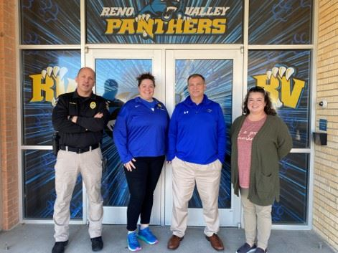
Multidisciplinary Team
School Resource officer, School nurse, School principal and a teacher.
Notes:
This is an example of the multidisciplinary team

Slide 22




Project Partners
Notes:
The project was supported by multiple agencies and organizations in Kansas.

Slide 23

Thank you
Notes:
Thank you for your attention. I am happy to take questions.

