Slide 1



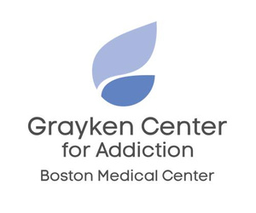


Adaptations Made by Post-Overdose Outreach Programs in MA Since the Onset of COVID-19
Presented by Ally Cogan
Co-Author(s):
Moriah Wiggins, BS; Andrew Rolles, BA; C To, MSPH; Erin Majors, PhD(c); Sarah Kosakowski, MPH; Jiayi Wang, MS; Shapei Yan, MPH; Stephen Murray, MPH; Sarah M. Bagley, MD, MSc; Ziming Xuan, ScD; Scott W. Formica, PhD; Alexander Y. Walley, MD, MSc; Justeen Hyde, PhD

Slide 2
Conflicts of Interest
  There are not conflicts of interest .
  This study is funded by the National Institute of Drug Abuse (R21DA053307).

Slide 3
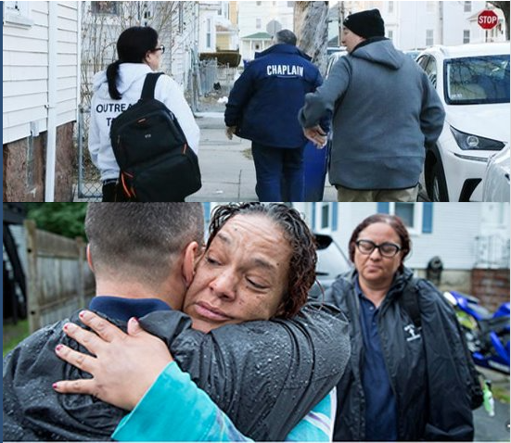
What is Post-overdose outreach?
Post-overdose outreach is supportive, informational encounter with individuals who have overdosed and/or their social network conducted by multi-disciplinary teams.

Slide 4

Study Rationale
To identify post-overdose outreach program practices and adaptations during COVID-19 pandemic.
NIH MedlinePlus Magazine. “SARS-CoV-2: Up Close.” Accessed November 12, 2024. https://magazine.medlineplus.gov/article/sars-cov-2-up-close.

Slide 5
We knew programs continued to function but were interested in what this meant in practice:
1
2
3
How were they reaching people?
What was staffing like?
Did process change?

Slide 6

Methods
Eligible participants included either a) staff from 11 Post-Overdose programs in Massachusetts or b) Post-Overdose program recipients/survivors
Conducted 30 semi-structured qualitative interviews in 2023
N=17
Post-overdose program staff
Note: the remainder of the presentation will describe findings from the staff interviews
N=13
Post overdose survivors

Slide 7
Methods: Themes Explored
  Adaptations:
    Outreach approach
    Programmatic process
    Resources provided
  COVID-19 Impact:
    Programmatic process
      Post specific
      Agency wide
    Survivors served

Slide 8
Methods: Analytic Approach
Transcripts were organized using inductive and deductive codes.
Coding team of 5:
  2 coders per transcript
    coded transcripts reviewed by additional coder to assist with consensus tie breaks and ensure fidelity of codebook application

Slide 9
Initial Results:
  Post Programs pivoted to physical distancing
    outdoor outreach
    driving separately
    contactless delivery of harm reduction supplies
  Infrequent suspension of services

Slide 10







Methods: Process Maps
Impacts
Adaptations
Catalyst
  Positive Impacts
  Negative Impacts
XXX
YYY
Challenge
ZZZ

Slide 11
Physical Distancing Process Map:
Impacts
Adaptations
COVID-19
  Reduction in risk of exposure to COVID
  Less informal opportunities for relationship building
  Case Planning disrupted
Team drives separately to survivor’s residences
Conversations with survivors outside
  Reduction in risk of exposure to COVID
  Potential loss of privacy for survivor, especially in dense settings
Physical Distancing
Contactless delivery of harm reduction supplies
  Potential loss of privacy
  Limited opportunity to build relationships
  Continuity of resources getting to survivors

Slide 12
Social Unrest Process Map:
COVID-19
Adaptations
Impacts
  Increased training for POST staff and community partners around cultural responsiveness
Cultural responsiveness and DEI trainings
Protests recognizing co-existing disparities & violence
  Reduction in risk of exposure
  Services maintained
  Unable to track if team was reaching people post reported overdose
Police diverted to Covid response and unable to provide consistent data
Transitioned to street outreach

Slide 13
Conclusions:
  Post-overdose outreach programs experienced expected challenges following the onset of the COVID-19 pandemic.
    In response programs adapted their normal protocols and operations.
    Adaptations had downstream impacts but allowed most outreach operations to continue and some to make adaptations permanent.

Slide 14
Thank you!
Questions?

