Slide 1
An Interprofessional Case-Based Discussion on Opioid Use Disorder: Influencing Knowledge, Confidence and Stigma Among Future Prescribers
Katherine Grandinetti, MPH; Whitney Ludwig, MPH;
Mary Dwan, BA; Colin Macleod, MA; Chasity Falls DMSc, PA-C; Christopher J. Frank, MD, PhD; Elizabeth K. Kuzma, DNP, FNP-BC; Pooja Lagisetty, MD, MSc; Gina Dahlem, PhD, FNP-C, FAANP
Notes:
"Good afternoon! I’m Katie, and it’s great to see everyone here. Today, I’ll share our team’s work at the University of Michigan School of Nursing, where we’re building a strong educational foundation for early-career prescribers through an Interprofessional Case-Based Discussions workshop for health students."

Slide 2
Disclosures
This project is supported by funds from the Department of Health and Human Services Substance use And Mental Health Services Administration (SAMHSA) Center for Substance Abuse Treatment: Promoting Advance Practice Registered Nurse and Medical School Education on Medications for Addiction Treatment (Award Number 1H79TI083999-01)
Dr. Gina Dahlem receives royalties as a co-inventor of the Rapid Assessment for AdolescentPreventive Services (RAAPS)
All other authors have no financial disclosures
Notes:
This project is supported by a SAMHSA grant to promote addiction treatment education for healthcare students. Dr. Gina Dahlem, our PI, receives royalties as co-inventor of the Rapid Assessment for Adolescent Preventative Services (RAAPS). The rest of the team has no financial disclosures.

Slide 3
Integral to Our Work
We are dedicated to fostering diversity, equity and inclusion in our opioid use disorder (OUD) education initiatives.
By integrating DEI principles into our training, we aim to equip future healthcare providers with the skills to deliver compassionate, culturally responsive care and reduce stigma associated with OUD.
Notes:
I want to emphasize our commitment to continuous improvement and fostering DEI in all our opioid use disorder education. By integrating these principles, we aim to equip future providers with the skills to deliver compassionate, culturally responsive care and reduce stigma. These values are at the core of our work

Slide 4
The OUD Crisis & Role of Providers in MOUD Treatment
Public Health Crisis & Call for Response
2022 Data: 76% of the 108,000 drug overdoses in the U.S. involved opioids¹
Call for action: Multi-disciplinary, patient-centered education for healthcare students to reduce stigma & foster collaboration early in their careers^{2,3}
Current State of Care for OUD Patients​
Providers play a critical role
OUD patients often have complex co-occurring conditions (e.g. chronic pain, mental health disorders)⁴ ​
Medications for Opioid Use Disorder (MOUD) Treatment
Effective medications are underutilized, fewer than 20% of patients receive them​⁵
⁶
¹CDC "Understanding the Opioid Overdose Epidemic". (2024); ²AMA, (2020); ³SAMHSA. (2024); ⁴MacLean et al. (2023); ⁵Wakeman SE, et al. (2023); ⁶NIDA "Medications for Opioid Overdose, Withdrawal, and Addiction" (2023).
Notes:
Many of us are aware of the opioid use disorder epidemic's impact on public health. In 2022, the CDC reported that opioids accounted for 76% of 108,000 drug overdose deaths, highlighting the need for early-career education for prescribing providers. (CLICK) Now, Providers themselves are essential in treating OUD, as these patients often require more visits due to co-occurring conditions. They can give them medications for opioid use disorder (MOUD), like methadone, buprenorphine, and naltrexone, are highly effective, yet less than 20% of those with OUD receive them. Despite their FDA approval, these treatments remain underused.
[old] This highlighted the urgent need for improvement and call for action, we saw this from many health organizations for a multi-disciplinary, patient-centered education targeting healthcare students early in their careers. By educating these emerging professionals, we aim to reduce stigma and increase interprofessional education (IPE) before they fully enter practice

Slide 5
Provider Barriers & Myths
Barriers⁷​
Concerns about diversion
Limited patient support
Lack of confidence
Myths and stigma⁸
Misconceptions that MOUD replaces one opioid for another
Patients may become "addicted" to MOUD
⁷Chhatwal, J., et al. (2023); ⁸Wakeman SE & Barnett ML. (2018).
Notes:
So why does underutilization persist? Research shows that provider experiece barriers like concerns about diversion, limited patient support, and low confidence in prescribing MOUDs. (CLICK) Myths also contribute to stigma—for example, the idea that MOUDs just replace one opioid with another or that patients may become addicted to them.

Slide 6
The Role of Interprofessional Education (IPE) in Healthcare
IPE integrates knowledge, skills and attitudes from more than 2 disciplines⁹
Enhances interaction across healthcare professions
Provider collaborations improve the quality of care for patients & their communities¹⁰
⁹Huber MJ, & Barbara F. (2020); ¹⁰Hammick M, et al. (2007).
Notes:
What is Interprofessional Education, or IPE, and how does it work in healthcare? IPE brings together knowledge and skills from two or more disciplines, improving communication and teamwork. For instance, a physician might collaborate with a patient’s social worker or pharmacist to create a comprehensive treatment and follow-up plan. (CLICK) This teamwork broadens each provider's perspective, reduces prescriber burden, and, most importantly, improves patient care. Ultimately, it’s a win-win that benefits both providers, their patients and the communities they serve.
OLD: Interprofessional education, or, IPE? And What does this look like within healthcare system?
IPE combines the knowledge, skills and attitudes from 2 or more disciplines. It has been shown to improve interaction and communication across healthcare professions. So for example, this would be a physician working with a patient’s assigned Social Worker to create a plan of treatment and follow-up. These collaborations therefore improve the providers’ pool of knowledge from having multiple opinions and evidence, and increasing support for this provider through teamwork and communication, just knowing someone is on this team, caring for this patient can help decrease prescriber burden. And most importantly, though, this results in the improvement of care for the patients and trickles down into their communities. So it's, a win-win for prescriber and patient

Slide 7
The Need for Enhanced Prescriber Training
Critical Gap: IPE-MOUD education & training through IPE curricula¹⁵
Enhancing SUD education/training & expanding IPE content improves learning outcomes related to SUD¹¹
Limited SUD/OUD education and training across most health professional programs^{12, 13,14}
¹¹Muzyk A, et al. 2020; ¹²Ojeda MS, et al. 2022; ¹³AMA "More Training Needed to Address Adiction Workforce Shortage"(2019). ¹⁴Walsh L, et al. 2024; ¹⁵Gugala E, et al. (2022).
Notes:
(CLICK) Research shows that when students learn about substance use disorders through IPE, including harm reduction, MOUD treatment, and collaboration, their learning outcomes improve.
(CLICK) Yet, as of 2023, most health programs offer limited SUD/OUD training.
(CLICK) This gap gives us a chance to expand multidisciplinary education, preparing future providers to better meet SUD/OUD patient needs.
----------------------------
OLD (CLICK) On one hand, research clearly shows that when students receive enhanced education with IPE, on substance use disorder topics—like harm reduction strategies, MOUD treatment, and interprofessional collaboration—their learning outcomes improve significantly.
(CLICK) On the other hand, as of 2023, despite this positive impact, there’s currently limited SUD/OUD training across most health professional programs.
(CLICK) This is a critical gap that we can lean into and expand upon. By integrating more comprehensive, multidisciplinary care and treatment education into these programs, we have an opportunity to better prepare future providers to meet the needs of SUD/OUD patients.

Slide 8
Objective
To evaluate healthcare students':
Medical doctorate (MD)
Nurse Practitioner (NP)
Physician Assistant (PA)
Acceptability of IPE curricula
& the resulting impact on their knowledge, confidence and stigma related to treating patients with SUD/OUD
Notes:
That takes us to our objective of our project, which was to: evaluate (CLICK) NPs, MDs and PA’s and their acceptability of IPE curricula that we designed and it’s impact on knowledge, confidence and stigma related to treating patients with SUD/OUD.

Slide 9
Methods: 2022-2023 Workshop Structure
When: Both workshops took place on a pre-selected day in April over Zoom
Participants: 3rd-year MD, final-year NP students, 1st-year PA students at the University of Michigan
Step 1:
Required Asynchronous Learning & Pre-test survey (2.5 hrs)
(Students complete individually up to 2 weeks before)
Step 2:
Synchronous Case-Based Discussion (1.5 hrs)
(Students placed in groups of 12-15 with OUD/SUD expert facilitator)
Step 3:
Post-test survey and Workshop Evaluation
Incentives: $5 coffee shop gift card per Qualtrics survey ($10 total)
Notes:
In both our 2022 and 2023 virtual spring workshops, students from various University of Michigan professional schools participated. The setup included two and a half hours of required asynchronous material, a pre-survey. Following that was a one-and-a-half-hour live session (the workshop). Students were randomly assigned to groups with a buprenorphine-waivered facilitator, with about 12-15 students per group. Lastly, students were asked to complete and a post-test survey and evaluation. Surveys were distributed through Qualtrics and were incentivized for students with $5 coffee shop gift cards. we've learned that there's no faster way to a student's heart than through coffee – so these ended up being a very popular and effective incentive

Slide 10
Methods: 2022-2023 Workshop Content
Asynchronous Content (2.5 hrs)
Synchronous IPE Content (1.5 hrs)
5 Pre-recorded lectures
History of the Opioid Epidemic and Treatment Legislation, and buprenorphine
Stigma and Treatment Access for patients with chronic pain
Introduction to Addiction
Exploring behavioral therapies, screening, brief intervention, referral to treatment (SBIRT)
Buprenorphine effectiveness, utilization of MOUD, harm reduction strategies
Slide deck of 3 complex patient management scenarios & interactive questions/prompts
#1- Abstinence vs OUD
#2- Buprenorphine vs Methadone (Polysubstance Use)
#3- Pain or OUD?
Notes:
For our asynchronous content, students accessed pre-recorded lectures from University of Michigan faculty on key SUD/OUD topics like history, stigma, addiction, and treatment options. Optional readings were also provided.
During the synchronous session, students engaged in interactive discussions based on three case studies, designed by our team, with prompts to guide the conversation.

Slide 11
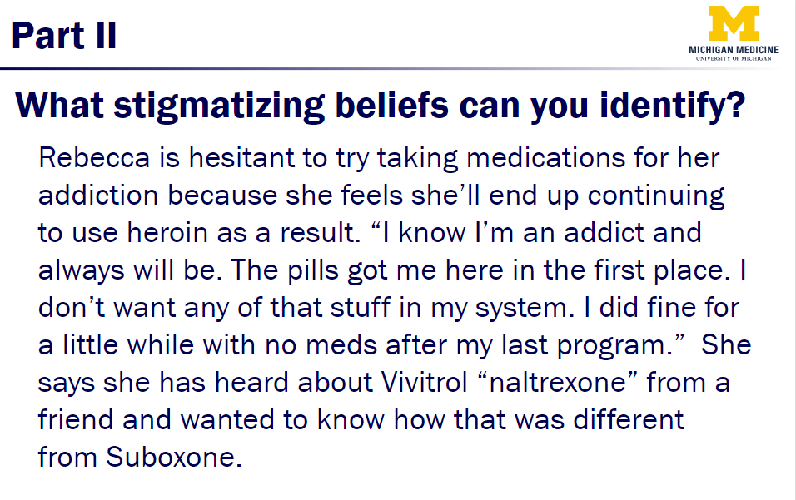
Case Example: Case #1 Abstinence vs MOUD
Students to discuss and select the most beneficial medication while addressing potential bias for OUD and its treatment.
Notes:
Here’s an example of the slides we provide facilitators with during their group discussions. On the left is the case, and on the right would be the accompanying question or prompt, showing the answers after students had the opportunity to share. (CLICK) so here you can see a part of a patient case on the left, which includes stigmatizing language regarding the patient, and then the facilitator would ask students to identify the language and implications

Slide 12
Case Example: Case #1 Abstinence vs MOUD
Notes:
Here’s an example of the slides we provide facilitators with during their group discussions. On the left is the case, and on the right would be the accompanying question or prompt, showing the answers after students had the opportunity to share. (CLICK) so here you can see a part of a patient case on the left, which includes stigmatizing language regarding the patient, and then the facilitator would ask students to identify the language and implications

Slide 13
Methods: Pre-survey
Variables:
Demographic (gender, race/ethnicity, highest degree)
Confidence, knowledge, stigma around MOUD (Likert scale)
Future Practice: i.e. buprenorphine prescription plans
Knowledge/
Stigma
I think using an opioid-based medication like methadone or buprenorphine for treatment is just substituting one opioid for another
How confident do you feel diagnosing patients with OUD?
(Confidence)
How interested are you in prescribing buprenorphine following graduation?
Notes:
Now to get into how we measured student’s perceptions regarding SUD topics and of the IPE curricula itself. For our pre-survey test, we collected demographic variables, and then asked students multiple questions regarding confidence, knowledge and stigma, like, do they think that MOUD is replacement for opioids, and their confidence in diagnosis. Additionally, we asked about their interest in prescribing MOUD following graduation.

Slide 14
Methods: Post-survey
Repeated Pre-survey knowledge/confidence questions
Added a 10 –item Student Perceptions of Interprofessional Clinical Education Revised Instrument (SPICER-2)
Likert-scale
Due to this workshop, my role in an interprofessional team caring for an OUD patient is now clearer to me
My facilitator provided sufficient opportunities for interprofessional exchange between students
Interprofessional roles & approaches
How satisfied were you with the overall quality of this training?
Free response questions (additional feedback)
American Journal of Emergency Medicine
Notes:
For our post-survey assessments, we repeated the pre-survey questions and then added an additional instrument (the SPICER-2) to measure student’s perception and utilization of the IPE curriculum and discussion format. Some examples of these include asking students about their clarified role on the team, evaluating their facilitators, and their overall satisfaction of the quality of this training.

Slide 15
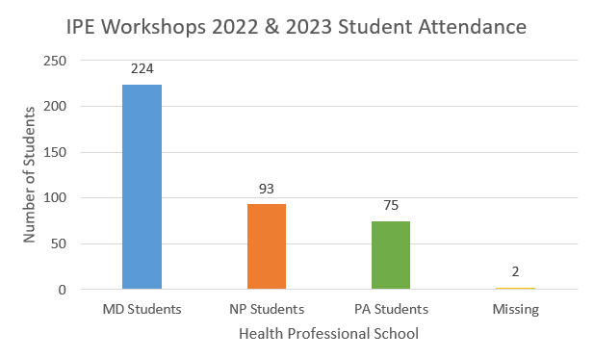
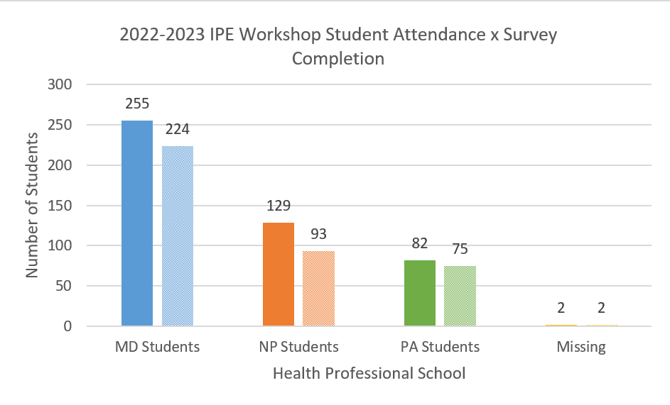
Results: Student Attendance & Participation
Demographics/Attendance (pre-survey completion): 459 Students
Post-Survey Completion: 394 Students
Notes:
We had 459 students that completed their pre-attestation/survey and therefore could attend the synchronous workshop, (CLICK) you can see in red, for the number of students who completed the post survey, that we have very close number match, which is great for our measuring of student’s pre-post survey results

Slide 16
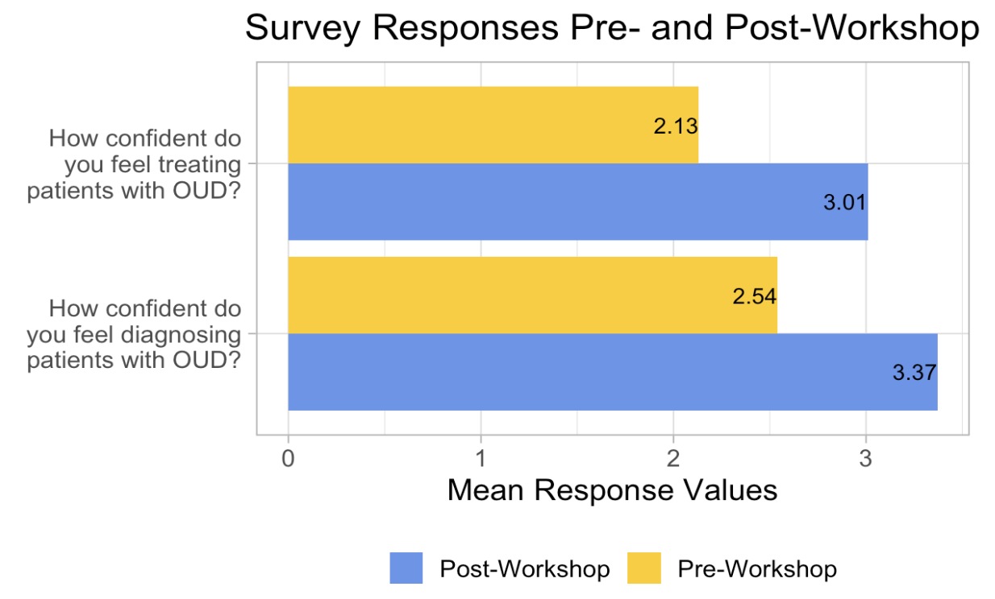
Analyzing Pre-Post Surveys: Confidence
N | p-value | Effect Size (Cohen's d; r) | Effect Size Magnitude
383 | <0.001 | 0.75 | Large
383 | <0.001 | 0.70 | Large
ªVariables were reverse coded for consistency in valence.; ^{b}Overall knowledge score was composed of the following measures: "Which of the following are evidence-based medications for opioid use disorder?"; "How does Buprenorphine work?"; "Moderate to severe opioid use disorder is different from simple physical dependence because:" *Moderate Effect Size Magnitude; **Large Effect Size Magnitude
Notes:
We ran a t-test on the paired data from both 2022 & 2023. So in looking at confidence, we saw a significant difference across our pre and post survey results from students who completed the workshop, specifically regarding confidence in diagnosis and treatment. Due to the larger effect size, we can say that based on these results, material targeting student’s confidence would have meaningful implications in student’s future practice
(1) Not confident at all – (5) Extremely confident

Slide 17
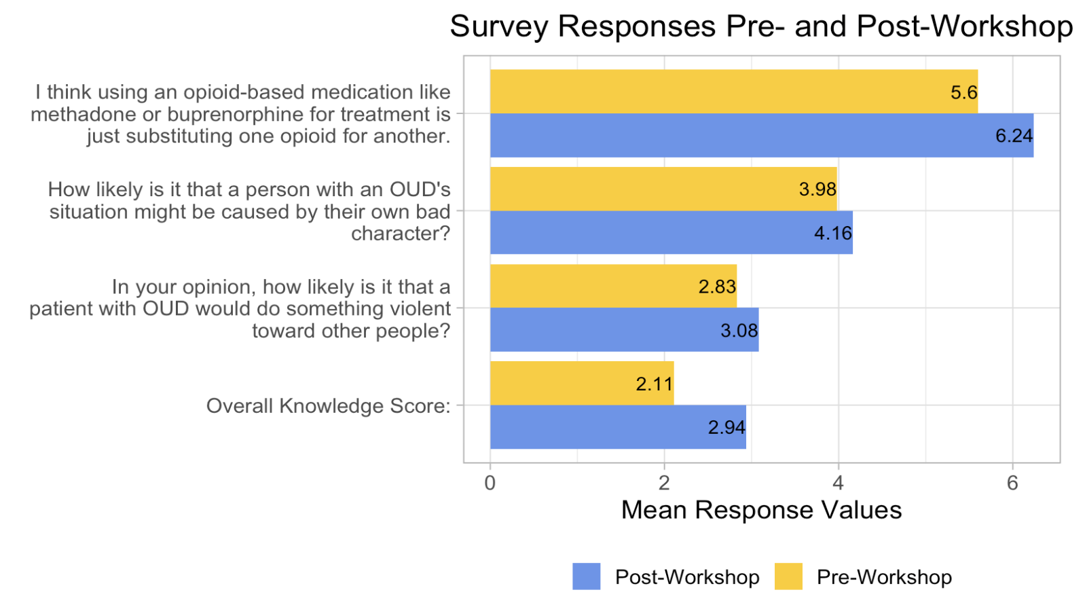
Analyzing Pre-Post Surveys: Knowledge/Attitudes (Stigma)
N | P-value | Effect Size (Cohen's d; r) | Effect Size Magnitude
378 | <0.001 | 0.36 | Moderate
330 | <0.001 | 0.26 | Small
370 | <0.001 | 0.49 | Moderate
374 | <0.001 | 0.64 | Large
ªVariables were reverse coded for consistency in valence.; ^{b}Overall knowledge score was composed of the following measures: "Which of the following are evidence-based medications for opioid use disorder?"; "How does Buprenorphine work?"; "Moderate to severe opioid use disorder is different from simple physical dependence because:" *Moderate Effect Size Magnitude; **Large Effect Size Magnitude
Notes:
Similarly with knowledge and attitudes, we had a significant difference with these questions specifically, regarding views of patients with OUD. This indicates that when students come out of this workshop, their perceptions towards patients with a use disorder may be positively increased, resulting in breaking down some of the myths and stigmas we talked about earlier
(1) Very likely – (4) Very unlikely
(1) Highly likely – (5) Highly unlikely
(1) Strongly agree – (7) Strongly disagree

Slide 18
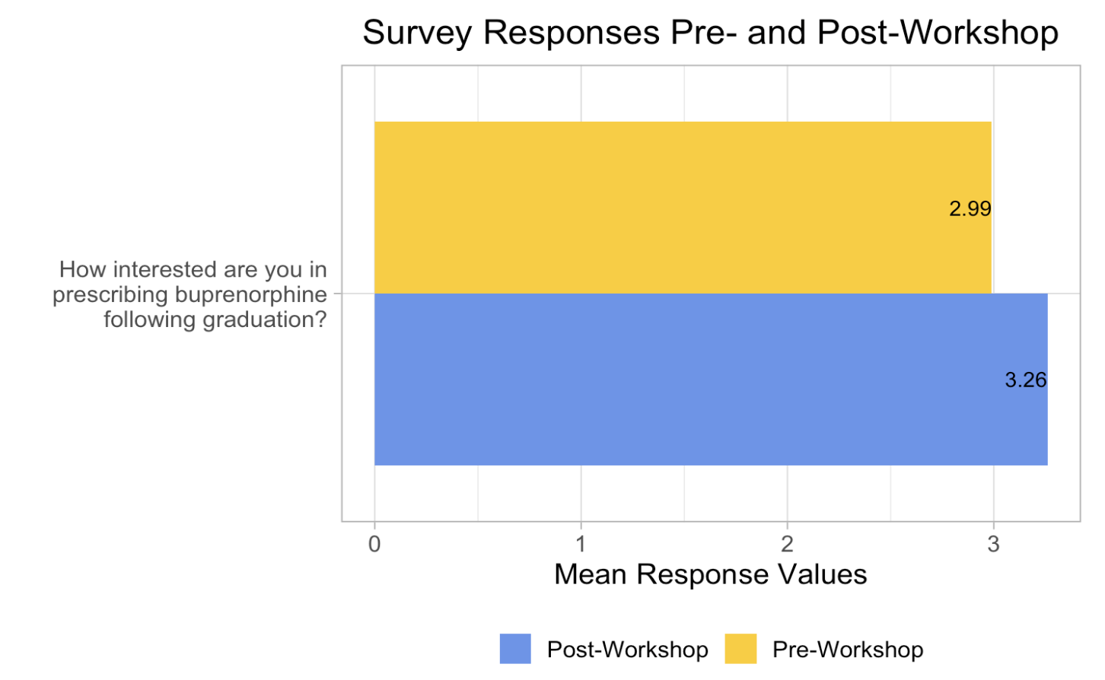
Analyzing Pre-Post Surveys: Prescribing
N | P-value | Effect Size (Cohen's d; r) | Effect Size Magnitude
375 | <0.001 | 0.29 | small
ªVariables were reverse coded for consistency in valence.; ^{b}Overall knowledge score was composed of the following measures: "Which of the following are evidence-based medications for opioid use disorder?"; "How does Buprenorphine work?"; "Moderate to severe opioid use disorder is different from simple physical dependence because:" *Moderate Effect Size Magnitude; **Large Effect Size Magnitude
Notes:
Our survey asked students about their interest in prescribing buprenorphine after graduation. The p-value was significant, indicating that the intervention had a meaningful effect. However, the effect size was small, meaning the change in interest was modest. This suggests that while the educational intervention made a difference, it wasn’t enough to cause a large shift in attitudes. To see more substantial changes, we may need to intensify the training or pair it with additional support, like hands-on experience or mentorship. This finding highlights the need for further exploration of how to best address factors like stigma and confidence in prescribing MOUDs.
(1) Not interested at all – (5) Extremely interested

Slide 19
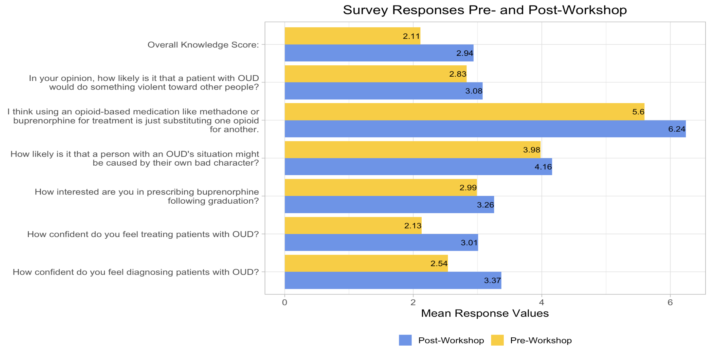
Analyzing Pre-Post Surveys
ªVariables were reverse coded for consistency in valence.; ^{b}Overall knowledge score was composed of the following measures: "Which of the following are evidence-based medications for opioid use disorder?"; "How does Buprenorphine work?"; "Moderate to severe opioid use disorder is different from simple physical dependence because:" *Moderate Effect Size Magnitude; **Large Effect Size Magnitude
Notes:
Similarly with knowledge and attitudes, we had a significant difference with these questions specifically, regarding views of patients with OUD. This indicates that when students come out of this workshop, their perceptions towards patients with a use disorder may be positively increased, resulting in breaking down some of the myths and stigmas we talked about earlier
(1) Very likely – (4) Very unlikely
(1) Highly likely – (5) Highly unlikely
(1) Strongly agree – (7) Strongly disagree

Slide 20
Results: Positive Feedback
94.49% would recommend this training to a colleague
81.89% noted the training clarified their individual roles in interprofessional teams caring for and treating patients with OUD
“I really didn't know much about MOUD. While I still will need help should I have to manage a patient with a substance use disorder, I now feel much more knowledgeable regarding the topic. ”
“I didn't know the specifics of each medication and urine drug screening. I feel way more confident prescribing these medications now.”
“I didn't know it was safe to use suboxone or other OUD medications in pregnancy”
Notes:
We had about 95% of students recommend this training to a colleague and about 82% feel that following the workshop, they felt their role on an interprofessional team was clarified, along with how they can best treat and care for patients with OUD. (CLICK) through quotes

Slide 21
Implications
+
Growing an Enhanced Clinical Practice
It takes a village
Educating the next generation of providers
Stigma reduction
A positive shift in attitudes and knowledge
Reducing stigma among healthcare providers enhances care for people with SUD
Notes:
Treatment for SUD does not occur in isolation—it requires a team of various health professionals. Workshops like these, along with other educational opportunities, help train the next generation of providers caring for SUD/OUD patients.
(CLICK) By transforming attitudes and knowledge, IPE workshops play a key role in reducing stigma, leading to better care for patients with SUD/OUD.

Slide 22
Future Direction
Curriculum Development & Measures:
Revision of IPE curricula to reflect evolving best practices & the needs of SUD/OUD patients
Include additional implementation of SPICER-2 questions in pre-survey
Notes:
Where do we go from here? These workshops began in 2021, and we revise them annually to keep up with progress in the field and reflect evolving best practices for SUD/OUD patients. This will be an ongoing effort. In our next workshop, we plan to include the SPICER-2 questions in both the pre- and post-surveys to better measure the effectiveness of IPE, since they were added on into our post survey.
https://meraki.cisco.com/blog/2023/01/patient-engagement-technology-is-revolutionizing-healthcare/

Slide 23
Future Direction
Increase Accessibility
"During each patient case, perhaps have one person from each medical background provide input, that way we get more of a diverse conversation"
Expand access to IPE workshops
Continue to create dynamic workshop material to allow for rich discussion
Aim to include other departments of student health professionals (i.e. Social Work, Pharmacy)
Increase tailored content for special populations (i.e. rural, & AI/AN)
Notes:
A key step is making workshops more accessible. One student’s feedback highlighted the importance of diverse input from different medical backgrounds for richer conversations well. Our goal is to expand partnerships across the university. For last year’s 2024 workshop, we had graduate students join us from the School of Social work. Our goal is to increase their participation even more, and then also work to get additional health professional schools to be we are currently working to have students from the School of Pharmacy join us and in the future, maybe even the School of Dentistry. Additionally, we aim to tailor our content for often-overlooked populations, including those in rural communities and American Indian and Alaskan Native populations and then incorporate this content into our IPE curricula, while also publicly sharing this to disseminate this education for other health professional schools to use
-------------------------------------------------------
A final significant step is to increase workshop accessibility. One student's feedback from our post-survey summed it up well: “During each patient case, have one person from each medical background provide input for a more diverse conversation.” This reflects our goal for the future of IPE workshops—not only creating a more open space for current attendees but also expanding our partnerships across the university.
How can we increase current participation even more? and some examples here are the school of social work, so we had some participation last year, but a very small number of students, and so we’d like to increase tenfold, and then who else can we partner with, that would play and important role in a patient’s care team. And so, we are having conversation and looking involve the school of pharmacy and even you know the school of dentistry. I truly don’t think you can have enough healthcare professionals “in” on this.
Lastly, how can we tailor this content to be inclusive and educational for the often-overlooked populations are inequitably impacted by this epidemic. In our future workshops, we will be conducting research to tailor some of this content to special populations such as OUD patients in rural communities and American Indian and Alaskan Native populations. And then spreading this for all.

Slide 24
Thank you! Special thanks to our team at the University of Michigan & to our facilitators each year. Katie Grandinetti kmgrand@umich.edu
Notes:
It was a pleasure to talk about this work here at AMERSA, and to be a part of this project. Thank you so much for listening!

Slide 25
References
Center for Disease Control (CDC). “Understanding the Opioid Overdose Epidemic”. https://www.cdc.gov/overdose-prevention/about/understanding-the-opioid-overdose-epidemic.html
National Roadmap on State-level Efforts to End the Nation's Drug Overdose Epidemic. American Medical Association. December 2020. https://www.ama-assn.org/system/files/2020-12/ama-manatt-health-2020-national-roadmap.pdf. Accessed August 4, 2024
Core Curriculum Elements on Substance Use Disorder for Early Academic Career. SAMHSA. April 2024. https://www.samhsa.gov/sites/default/files/core-curriculum-report-final.pdf. Accessed August 4, 2024.
MacLean RR, Sofuoglu M, Stefanovics E, et al. Opioid use disorder with chronic pain increases disease burden and service use. Psychological Services. 2023;20(1):157–165. doi.org/10.1037/ser0000607
Wakeman SE, Larochelle MR, Ameli O, et al. Comparative Effectiveness of Different Treatment Pathways for Opioid Use Disorder. JAMA Netw Open. 2020;3(2):e1920622. doi:10.1001/jamanetworkopen.2019.20622
National Institute on Drug Abuse. “Medications for Opioid Overdose, Withdrawal, & Addiction”. https://nida.nih.gov/research-topics/opioids/medications-opioid-overdose-withdrawal-addiction-infographicChhatwal,
Chhatwal J, Mueller PP, Chen Q, et al. Estimated Reductions in Opioid Overdose Deaths with Sustainment of Public Health Interventions in 4 US States. JAMA Netw Open. 2023;6(6):e2314925. doi:10.1001/jamanetworkopen.2023.14925
Wakeman SE, Barnett ML. Primary Care and the Opioid-Overdose Crisis — Buprenorphine Myths and Realities. N Engl J Med. 2018;379(1):1-4. doi:10.1056/NEJMp1802741.
Huber MJ, Barbara F. The changing context of education: The need for interprofessional education teaching. J Addict Res. 2020;4(2):63-69. doi.org/10.33140/jar.04.02.11
Hammick M, Freeth D, Koppel I, et al. (2007). A best evidence systematic review of interprofessional education: BEME Guide no. 9. Medical Teacher. 2007;29(8):735–751. doi.org/10.1080/01421590701682576
Muzyk A, Smothers ZPW, Andolsek KM, et al. Interprofessional Substance Use Disorder Education in Health Professions Education Programs: A Scoping Review. Acad Med. 2020;95(3):470-480. doi:10.1097/ACM.0000000000003053
Ojeda MS, Chen AMH, Miracle T, et al. HealthCare educational differences in pain management, adverse childhood experiences and their relationship to substance use disorder education. Subst Abuse Treat Prev Policy. 2022;17(1). https://doi.org/10.1186/s13011-022-00436-8
American Society of Addiction Medicine. More Training Needed to Address Addiction Workforce Shortage. Published online 2019. https://www.asam.org/docs/default-source/advocacy/asam-training-demo-one-pagerb1ff289472bc604ca5b7ff000030b21a.pdf?sfvrsn=264348c2_2.
Walsh L, Chapman B, Carey J, et al. Opioid Overdose Recognition: A Survey of Perceived Preparedness and Desire for Curricular Integration Among Current US Medical Students. J Med Educ Curric Dev. 2024 ;11. doi:10.1177/23821205231225923
Gugala E, Briggs O, Moczygemba LR, Brown CM, Hill LG. Opioid Harm Reduction: A Scoping Review of Physician and System-Level Gaps in Knowledge, Education, and Practice. Substance Abuse. 2022;43(1):972-987. doi:10.1080/08897077.2022.2060423

