Slide 1
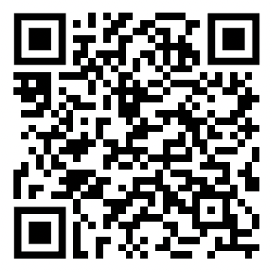
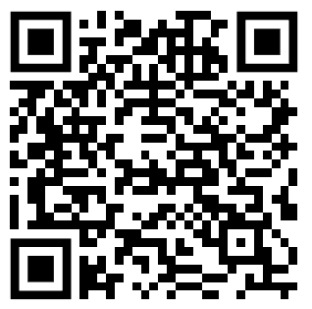
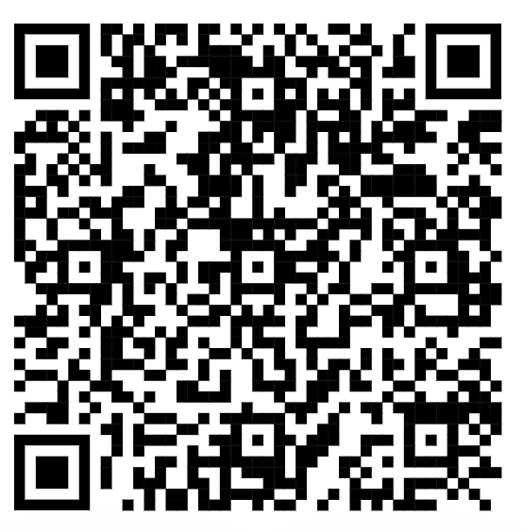
As you come in, please download these on your phones
Ethics case
Scavenger Hunt
Resources

Slide 2
Applying Geriatric Principles to the Delivery of Equitable and Evidence-based Care to Patients with Substance Use Disorders and Multimorbidity
AMERSA’s 47th Annual Conference
Washington, D.C. November 2-4, 2023
Mim Ari, MD
Kimberly J. Beiting, MD
Justina L. Groeger, MD, MPH
Benjamin H. Han, MD
A. Justine Landi, MD
Ajay Manhapra, MBBS
Vassiliki Pravodelov, MD FACP
Notes:
• Part 1:0-5minutes. Introduction and review of Learning Objectives [INA]
• Part 2: 6-25 minutes: We will describe the epidemiology and pathophysiology behind the high prevalence of accelerated aging leading to age-related conditions like frailty,falls, cognitive impairment,and multimorbidity. (Learning Objective 1)During this portion, we will encourage participant engagement via interactive polling to reinforce key points. We will conduct a Q+A at the end of the presentation. Participants will gain foundational knowledge regarding age­ related conditions and related health disparities among this patient population.
• Part 3: 26-45 minutes: We will facilitate guided discussion using 2 clinical vignettes in small group breakout sessions to reflect on the ethical implications of the health inequities that complex patients with multimorbidity and SUDs face across care settings. Each group will then report their findings back to the larger group for additional discussion and summary didactics. Participants will gain skills in referring and coordinating care across settings to minimize such inequities. (Learning Objective 2).
• Part 4:46-65 minutes. We will identify the frameworks and practical tools that can aid in the care of complex adults with multimorbidity and age-related conditions in the context of SUD treatment (Learning Objective 3). Participants will break into small groups to practice skills in screening and evaluation of age-related syndromes of frailty, fall, delirium, and cognitive impairment through role play as patients and providers. Participants will be able to practice the administration of such tools as the FRAIL scale, CDC STEADI protocol, bCAM, 4AT, PMIS, MOCA, RUDAS, Katz ADLs, and OARS IADLs. Participants will be able to apply these learned skills to their own practice of SUD treatment.
• Part 5:66-80 minutes. We will conduct an interactive, didactic presentation reviewing models of care that successfully integrate treatment for patients with SUDs and age-related conditions (Learning Objective 4). Examples of such care models will include those that integrate SUD treatment within skilled nursing care settings, home care, and outpatient geriatric medicine clinics as well as integrating geriatric-based care in SUD treatment settings. Participants will be asked to write down a behavior change they can implement in their own practice and participants will be invited to share their committed change with the group.
• Part 6: 81-90 minutes: Discussion and Wrap-Up
ensure that the content is aligned with the overall goals of the program and the interests of the public and that no potential commercial bias exists.
Please also declare any conflict of interest or lack thereof on one of your slides.
In addition, presentations that are part of a CME activity must not contain any advertising, trade name or a product-group message.
Thus, we ask that every conference presenter address DEI content in their presentation with a minimum of 1 slide dedicated to this topic.
incorporation of photographs (with permission) that show individuals of varying skin tones, race/ethnicities, genders and ranges of gender expression, and including patients who are trans or non-binary in case scenarios.

Slide 3
Part 1: Introduction

Slide 4
Learning Objectives
1. Describe the epidemiology and pathophysiology behind the high prevalence of frailty, falls, cognitive impairment, multimorbidity, and other age-related conditions among patients with SUDs.
2. Assess the health inequities and ethical implications that complex patients with multimorbidity and SUDs face across care settings and how to appropriately provide referral and care coordination.
3. Identify the frameworks and tools that can aid in the care of complex patients with multimorbidity and age-related conditions (e.g. frailty, fall, delirium, cognitive impairment) in the context of SUD treatment.
4. Utilize models of care that successfully integrate treatment for SUDs and age-related conditions to address multiple health inequities.

Slide 5
Diversity, Equity, and Inclusion
Inequities exist across a range of chronic diseases and disease-related complications by race and ethnicity due to long-standing barriers in health care rooted in structural racism, especially substance use disorders.
However, discussions related to health equity often do not include older adults when in fact, specific populations of older adults have experienced lifelong discrimination, racism, and systemic injustices that are compounded over time.
What do we do to achieve health equity for this population made vulnerable through a lifetime of health and social disparities?

Slide 6
Disclosures
Drs. Ari & Landi are supported by AHRQ under grant number R18HS027910-01.
Dr. Landi is supported by the Health Resources and Services Administration (HRSA) of the U.S. Department of Health and Human Services (HHS) under grant numbers K01HP49062 & U1QHP28728.
Dr. Beiting receives support from the Health Resources and Services Administration (HRSA) of the U.S. Department of Health and Human Services (HHS) under grant number K01HP49070.
Dr. Groeger is a member of the HRSA's Technical Advisory Panel on Opioids and Older Adults and is supported by the National Institute on Drug Abuse (NIDA) under grant number K23DA055752.
Dr. Han is supported by the following grants from the National Institutes of Health: K23DA043651 (NIDA) and R21DA058404 (NIDA). This presentation proposal was also made possible with help from the San Diego Center for AIDS Research (SD CFAR), an NIH-funded program (P30 AI036214).
We have no conflicts of interest to disclose.
This information or content and conclusions are those of the author and should not be construed as the official position or policy of, nor should any endorsements be inferred by HRSA, AHRQ, NIDA, HHS or the U.S. Government.

Slide 7
Part 2: Substance Use Disorders and Accelerated Aging

Slide 8
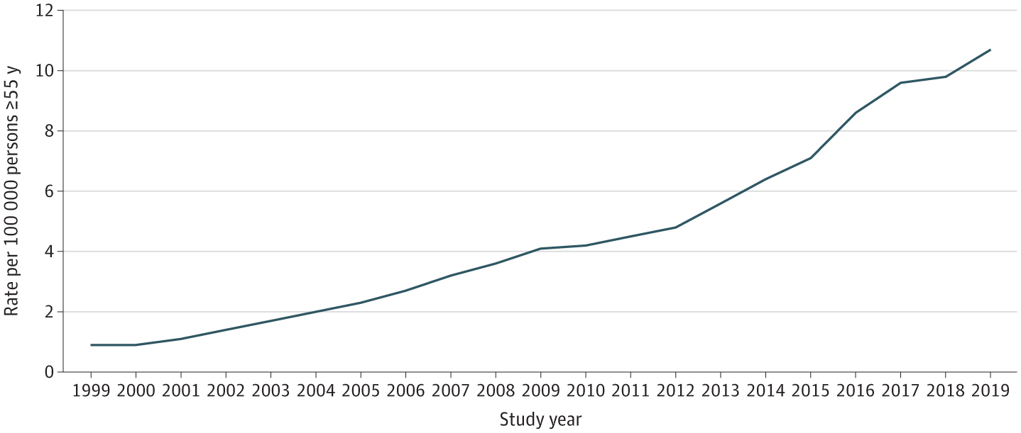
Background
Rates of Opioid Overdose Deaths per 100,000 Persons 55 Years and Older, 1999 to 2019
Opioid-related overdose deaths in adults 55+ years increased from 518 deaths in 1999 to 10,292 deaths in 2019 (1,886%).
Deaths among non-Hispanic Black men were disproportionally represented in the overall increase in opioid overdose deaths among older adults.
Mason M, Soliman R, Kim HS, Post LA. Disparities by Sex and Race and Ethnicity in Death Rates Due to Opioid Overdose Among Adults 55 Years or Older, 1999 to 2019. JAMA Netw Open. 2022 Jan 4;5(1):e2142982. .

Slide 9
Increased number of older adults entering opioid treatment programs
41.2% increase between 2004 to 2013 and a 53.5% increase from 2013 to 2015 including a 110% increase with heroin as the primary drug between 2012-2015.
Sharp increases among older females, Black/African Americans, and non-urban areas.
Huhn AS, Strain EC, Tompkins DA, Dunn KE. A hidden aspect of the U.S. opioid crisis: Rise in first-time treatment admissions for older adults with opioid use disorder. Drug Alcohol Depend. 2018 Dec 1;193:142-147.

Slide 10
What is Accelerated Aging?
Aging (definition)
progressive process spanning from peak performance of a person to gradual diminishing function over time
impacts physiologic, functional and clinical factors
Chronological aging
A number, a rough estimate
Biological aging
Results of interaction of genetic, environmental, behavioral factors, and disease
Accelerated aging
Biological aging outpaces chronological aging
Age-related phenotypes/diseases occur earlier than expected
Bachi K, Sierra S, Volkow ND, Goldstein RZ, Alia-Klein N. Is biological aging accelerated in drug addiction? Curr Opin Behav Sci. 2017 Feb;13:34-39. doi: 10.1016/j.cobeha.2016.09.007. PMID: 27774503; PMCID: PMC5068223.

Slide 11
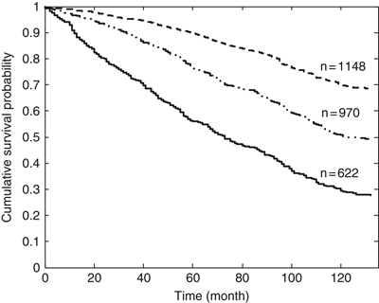
What is Frailty?
Comorbidity
Frailty
Disability
Age-associated, not age-specific
Overlap with disability, comorbidity
Increased vulnerability to stressors
Decreased physiologic reserve
Associated with several adverse outcomes
Decreased quality of life
Functional decline
Hospitalizations
Long-term care facility
Death
Non-frail
pre-frail
frail
Fried LP, Tangen CM, Walston J, et al. Frailty in older adults: evidence for a phenotype. J Gerontol A Biol Sci Med Sci. 2001;56(3):M146-M156. doi:10.1093/gerona/56.3.m146
Song X, Mitnitski A, Rockwood K. Prevalence and 10-year outcomes of frailty in older adults in relation to deficit accumulation. J Am Geriatr Soc. 2010;58(4):681-687. doi:10.1111/j.1532-5415.2010.02764.x

Slide 12
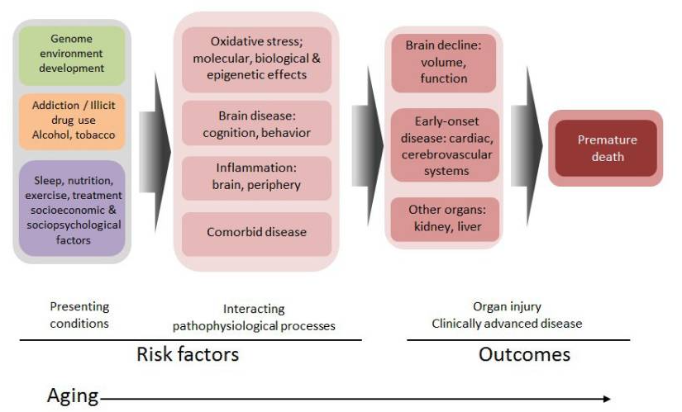
Conceptual Model: Aging and Addiction
Bachi K, Sierra S, Volkow ND, Goldstein RZ, Alia-Klein N. Is biological aging accelerated in drug addiction? Curr Opin Behav Sci. 2017 Feb;13:34-39. doi: 10.1016/j.cobeha.2016.09.007. PMID: 27774503; PMCID: PMC5068223.
Notes:
This figure illustrates the progression of disease among drug addicted individuals, from presenting phenotypic conditions constituting risk factors, through interacting with pathophysiological processes to cumulative organ system injury, and outcome of advanced clinical disease and eventually death.
***

Slide 13
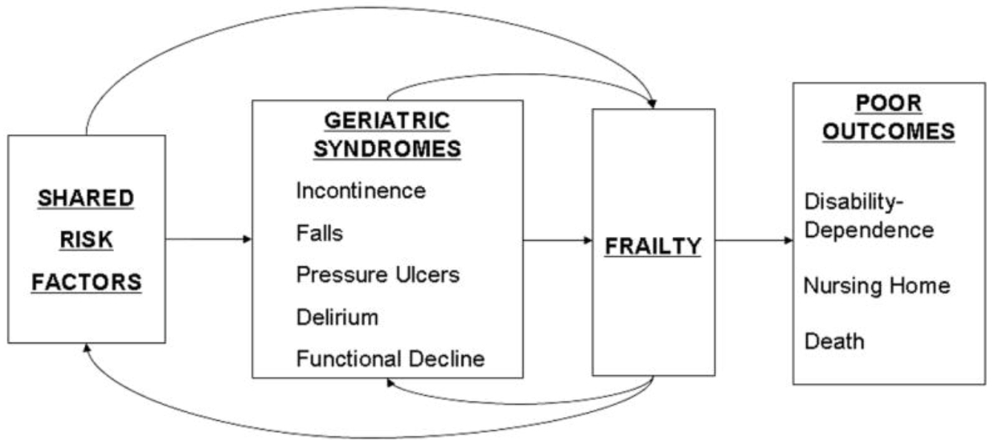
Geriatric Conditions
Tend to appear in old age or among adults with multiple chronic conditions and are common among populations who have been made vulnerable.
Multifactorial and predictors for disability and mortality.
Common geriatric conditions: falls, frailty, gait disorders, cognitive impairment, urinary incontinence, sleep problems, chronic pain, weight loss, osteoporosis, low body mass index.
Shared Risk Factors
Older age
Baseline cognitive impairment
Baseline functional impairment
Impaired mobility
Inouye SK, Studenski S, Tinetti ME, Kuchel GA. Geriatric syndromes: clinical, research, and policy implications of a core geriatric concept. J Am Geriatr Soc. 2007;55(5):780-791. doi:10.1111/j.1532-5415.2007.01156.x
Notes:
This figure illustrates the progression of disease among drug addicted individuals, from presenting phenotypic conditions constituting risk factors, through interacting with pathophysiological processes to cumulative organ system injury, and outcome of advanced clinical disease and eventually death.
***

Slide 14
High burden of geriatric conditions
Han BH, Cotton BP, Polydorou S, et al. Geriatric Conditions Among Middle-aged and Older Adults on Methadone Maintenance Treatment: A Pilot Study. J Addict Med. 2022;16(1):110-113.
Notes:
This figure illustrates the progression of disease among drug addicted individuals, from presenting phenotypic conditions constituting risk factors, through interacting with pathophysiological processes to cumulative organ system injury, and outcome of advanced clinical disease and eventually death.
***

Slide 15
Aging and Increased Risk of Harm
Physiology
Changes in percent body fat, decreased renal function, decreased liver function leads to increased vulnerability to drugs and alcohol
Increased medical complexity
Chronic medical conditions (drug-disease interactions)
Drug-drug interactions
Chronic pain
Increased harm
Falls
Overdoses and use-associated diagnoses in the setting of chronic medical conditions
Delirium
Hospitalization/Transitions of care/Skilled Nursing Facility
Withdrawal
Patient-directed discharge/Readmissions
Notes:
In addition to increasing risk of a use disorder, aging can contribute an increased risk of harm from substance misuse or a substance use disorder.
The physiologic changes that come with aging, including change in percent body fat, kidney function, and liver function can all alter the way the body processes substances like opioids. Increased medical complexity including multiple chronic medical conditions like chronic pulmonary or cardiac disease can complicate the use of opioids (for example, insufflating heroin with COPD or an opioid overdose in the context of cardiac disease). Polypharmacy is unfortunately common in the geriatric population, and opioids (prescription or not) may lead to drug-drug interactions. In addition, the chronic pain that may come with osteoarthritis, degenerative disc disease, cancer pain, may also warrant appropriate pain treatment that may include opioids but can put a patient at increased risk of overdose if they are using on top of these prescribed medications. A long history of opioid use may also may make chronic pain more difficult to treat appropriately due to tolerance. Opioid use can lead to falls, complex hospitalizations in the setting of overdose and chronic medical conditions, and delirium associated with both opioid use and opioid withdrawal in a hospitalized patient. Finally, if a hospitalized older adult with a use disorder is discharged to a nursing facility or to home there is increased risk of withdrawal, leaving AMA, and hospital readmissions for patients with a use disorder especially if they are not appropriately treated.

Slide 16
Question #1: Which of the following best defines frailty? A. Age-specific B. Multimorbidity C. Decreased physiologic reserve D. Weight loss

Slide 17
Question #1: Which of the following best defines frailty? A. Age-specific B. Multimorbidity C. Decreased physiologic reserve D. Weight loss

Slide 18
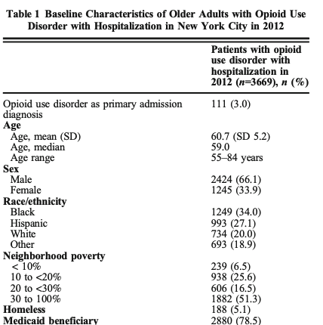
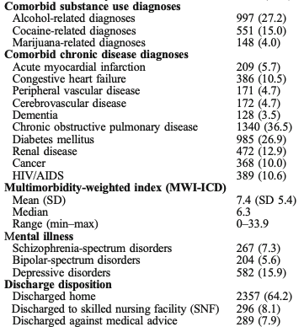
Multimorbidity and Acute Care Utilization
Han BH, Tuazon E, Y Wei M, Paone D. Multimorbidity and Inpatient Utilization Among Older Adults with Opioid Use Disorder in New York City. J Gen Intern Med. 2022;37(7):1634-1640.

Slide 19
Multimorbidity and Acute Care Utilization
N=3,669 individuals age 55+ with opioid use disorder with hospitalization in 2012
Number of individuals with 2+ hospitalizations:
N=2,225 (60.6%)
Number of individuals with 7+ hospitalizations:
N=906 (24.7%)

Slide 20
Living with multimorbidity is challenging
Time | Medications | Non-pharmacologic Therapy | All Day | Periodic
7 AM | Ipratropium MDI Alendronate 70mg weekly | Check feet Sit upright 30 min. Check blood sugar | Joint protection Energy conservation Exercise (non-weight bearing if severe foot disease, weight bearing for osteoporosis) Muscle strengthening exercises, Aerobic Exercise ROM exercises Avoid environmental exposures that might exacerbate COPD Wear appropriate footwear Albuterol MDI prn Limit Alcohol Maintain normal body weight | Pneumonia vaccine, Yearly influenza vaccine All provider visits:Evaluate Self-monitoring blood glucose, foot exam and BP Quarterly HbA1c, biannual LFTs Yearly creatinine, electrolytes, microalbuminuria, cholesterol Referrals: Pulmonary rehabilitation Physical Therapy DEXA scan every 2 years Yearly eye exam Medical nutrition therapy Patient Education: High-risk foot conditions, foot care, foot wear Osteoarthritis COPD medication and delivery system training Diabetes Mellitus
8 AM | Eat Breakfast HCTZ 12.5 mg Lisinopril 40mg Glyburide 10 mg ECASA 81 mg Metformin 850mg Naproxen 250mg Omeprazole 20mg Calcium + Vit D 500mg | 2.4gm Na, 90mm K, Adequate Mg, ↓ cholesterol & saturated fat, medical nutrition therapy for diabetes, DASH
12 PM | Eat Lunch Ipratropium MDI Calcium+ Vit D 500 mg | Diet as above
5 PM | Eat Dinner | Diet as above
7 PM | Ipratropium MDI Metformin 850mg Naproxen 250mg Calcium 500mg Lovastatin 40mg
11 PM | Ipratropium MDI
Comorbid
disease
Comorbid
disease
condition
condition
condition
Index disease
condition
Index disease
condition
Comorbid
disease
condition
Comorbid
disease
condition
condition
Patient
Comorbid
disease
Patient
Comorbid
disease
Boyd CM, Darer J, Boult C, Fried LP, Boult L, Wu AW. Clinical practice guidelines and quality of care for older patients with multiple comorbid diseases: implications for pay for performance. JAMA. 2005;294(6):716-724. doi:10.1001/jama.294.6.716

Slide 21
Question #2: What is the largest driver for high acute health care utilization rates among older adults with opioid use disorder? A. Age B. Multimorbidity C. Gender D. Neighborhood poverty

Slide 22
Question #2: What is the largest driver for high acute health care utilization rates among older adults with opioid use disorder? A. Age B. Multimorbidity C. Gender D. Neighborhood poverty

Slide 23
Conclusions
The aging population is at risk of harm related to substance use.
Physiological changes related to aging
High prevalence of geriatric conditions & multimorbidity
Drug-disease and drug-drug interactions
Cognitive impairment and shrinking social support
Many challenges in managing patients with SUD and multimorbidity.

Slide 24
Part 3: Ethical Implications & Health Inequities Across Care Settings

Slide 25
The Multicomplexity of SUD Management
Approaching Multicomplexity
A whole person approach when caring for a patient with multiple chronic conditions, advanced illness, and/or complex biopsychosocial needs.
This approach requires us to utilize:
A biopsychosocial approach
Interprofessional education and collaboration
Ethical principles as a guide for what ought to be done in the care for people with SUD
Transitions of Care
Health Equity
Patient
Priorities
Social Determinants of Health
Caregivers
Comorbidities
Atypical Presentations
Hazards of Hospitalization
Urinary Incontinence
Cognitive Impairment
Mental Health
Nutritional
Status
Functional Impairment
Sensory Impairment
SUD
Safety and Autonomy
Lack of social support
Age-related syndromes
Ethical
Challenges
Frailty
Wounds
Prognosis
Notes:
MA: agrees we should add extra animation→ Highlight ethical challenges from puzzle to make sure clear that this section is about ETHICS and SUD – animation; and agree with giving 2 specific examples of how we see this play out (TOC, naloxone)
TOC – slide 5
Health Equity - naloxone

Slide 26
Clinical Medical Ethics: What ought to be done and a practice
The practice and application of ethical principles by clinicians in routine, daily encounters with patients across care settings.
Beneficence
Non-maleficence
Justice
Autonomy
The duty to try to bring about improvements in physical and psychological health that medicine can achieve.
Diagnosing and treating conditions in ways that prevent further injury or reduce its risk.
The ways in which professional, family, religious, financial, legal, and institutional factors influence clinical decisions.
Equitable distribution of benefits and burdens to individuals in social institutions.
The moral right of every competent individual to choose and follow his or her own plan of life and actions.
It is one aspect of the larger principle of Respect for Persons
(Jonsen et al, 2022)
Notes:
Jonsen AR, Siegler M, Winslade WJ. (Eds.), (2022). Clinical Ethics: A Practical Approach to Ethical Decisions in Clinical Medicine, 9e. New York, NY: McGraw-Hill
MA edits: I think you want to say something here like “I want to give you a very high level overview of clinical medical ethics and how to apply it to multmorbid and older adults with SUD”

Slide 27
The Four Topics Chart: An Approach to Ethical Decision Making
A practical process to sort out facts and values and facilitate a discussion and resolution of an ethical dilemma.
Medical Indications
Preferences of Patients
Quality of Life
Contextual Features
Beneficence
Non-Maleficence
Autonomy
Beneficence
Non-Maleficence
Autonomy
Justice
Developed by Drs. Albert Jonsen, Mark Siegler, and William Winslade
You can find the Four Topics Chart (with the questions that can be raised about each topic) in our resources guide.
(Jonsen et al, 2022; Canadian Association of Schools of Nursing, 2017)
Notes:
Jonsen AR, Siegler M, Winslade WJ. (Eds.), (2022). Clinical Ethics: A Practical Approach to Ethical Decisions in Clinical Medicine, 9e. New York, NY: McGraw-Hill
Canadian Association of Schools of Nursing. 2017. Module 1: Professional Accountability and Prescribing - Clinical Ethics: The Four Topic Approach. http://nperesource.casn.ca/modules/module-1/lesson-6-clinical-ethics-the-four-topic-approach/

Slide 28
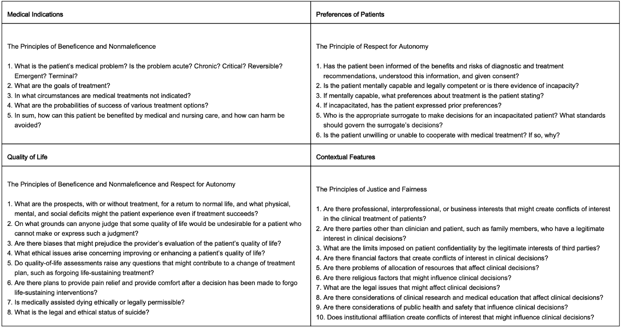
The Four Topics Chart: An Approach to Ethical Decision Making
Jonsen AR, Siegler M, Winslade WJ. (Eds.), (2022). Clinical Ethics: A Practical Approach to Ethical Decisions in Clinical Medicine, 9e. New York, NY: McGraw-Hill
Notes:
MA: maybe put a repeat of this slide after 7 so that it can be up while people are working.

Slide 29
Our Ethical Obligation in the Treatment of SUD
To further our knowledge in complex chronic disease management and SUD care as individual and yet overlapping and interconnected issues.
To continue to engage patients through provider-patient relationship development and shared-decision making.
Provide the evidence-based, standard of care for SUD that promotes autonomy, beneficence, and justice while minimizing harm across care settings.
Strive to provide the same quality and range of SUD care services across all care settings.
To create facility policies and protocols across care settings that support the ethical and evidence-based SUD treatment of individuals with multiple age-related and chronic diseases.

Slide 30
Putting It Into Practice
There is one vignette.
Approach the vignette using one of the four topics to ethical decision making:
Medical Indication
Preference of Patients
Quality of Life
Contextual Features
Report back to the larger group on the highlights of your discussion.

Slide 31
The Four Topics Chart: An Approach to Ethical Decision Making
Jonsen AR, Siegler M, Winslade WJ. (Eds.), (2022). Clinical Ethics: A Practical Approach to Ethical Decisions in Clinical Medicine, 9e. New York, NY: McGraw-Hill
Notes:
MA: maybe put a repeat of this slide after 7 so that it can be up while people are working.

Slide 32
Part 4: Helpful Age-Friendly Tools to Use in Clinical Practice

Slide 33
Framework: Geriatric 5Ms ¹
MIND
MOBILITY
MEDICATIONS
MULTI
COMPLEXITY
WHAT MATTERS
Notes:
What Matters
Current care planning: Identifying health goals and healthcare preferences
Advance care planning
Mind
Addressing cognition and mental health
Mitigating sensory impairment
Mobility
Optimizing functional status
Maintaining safe mobility
Medications
Tailoring medications to meet goals and preferences
Avoiding high-risk medications
Multicomplexity
Navigating health care settings and transitions
Balancing multiple chronic conditions
Addressing equity and social determinants of health

Slide 34
Mind ²
Assess baseline cognition
Assess for changes in cognition
Assess for depression
Assess for sensory impairment (hearing, vision)

Slide 35
Mind: Cognitive Evaluation Tools ¹¹
Screening: Mini-Cog ³ or PMIS ⁴
If Mini-Cog is abnormal, select an appropriate cognitive test:
MoCA (abnormal <26/30) ⁵
Training encouraged
Detects mild cognitive impairment
MoCA-Blind and MoCA-Basic variations
RUDAS (abnormal <23/30) ^{9,10,11}
Designed to minimize the effects of cultural learning and language diversity on the assessment of baseline cognitive performance
Easy to administer with phone/video interpreter
Notes:
Minicog sensitivity is ∼76% to 99% and specificity is ∼89% to 93%
PMIS had positive predictive value of 77%, negative predictive value of 73%, sensitivity of 68%, and specificity of 81% to detect all-cause dementia in ethnically diverse population of individuals with cognitive complaints Malik R, Weiss EF, Gottesman R, Zwerling J, Verghese J. Picture-Based Memory Impairment Screen: Effective Cognitive Screen in Ethnically Diverse Populations. J Am Geriatr Soc. 2018 Aug;66(8):1598-1602. doi: 10.1111/jgs.15422. Epub 2018 May 29. PMID: 29808583; PMCID: PMC6584027.
MoCA – MCI sensitivity of 90% and a specificity of 87%.
RUDAS high specificity across cultures in immigrant populations (91.4%). The RUDAS performed similarly to the MMSE, and results may be less affected by education and language. Naqvi RM, Haider S, Tomlinson G, Alibhai S. Cognitive assessments in multicultural populations using the Rowland Universal Dementia Assessment Scale: a systematic review and meta-analysis. CMAJ. 2015 Mar 17;187(5):E169-75. doi: 10.1503/cmaj.140802. Epub 2015 Feb 17. PMID: 25691786; PMCID: PMC4361127.
Borson S, Scanlan JM, Chen P, Ganguli M. The Mini-Cog as a screen for dementia: validation in a population-based sample. J Am Geriatr Soc. 2003;51(10):1451-1454.
Molnar FJ, Benjamin S, Hawkins SA, Briscoe M, Ehsan S. One size does not fit all: Choosing practical cognitive screening tools for your practice. J Am Geriatr Soc. 2020;68(10):2207-2213.
https://www.slu.edu/medicine/internal-medicine/geriatric-medicine/aging-successfully/assessment-tools/mental-status-exam.php
Verghese J, Noone ML, Johnson B, Ambrose AF, Wang C, Buschke H, Pradeep VG, Abdul Salam K, Shaji KS, Mathuranath PS. Picture-based memory impairment screen for dementia. J Am Geriatr Soc. 2012 Nov;60(11):2116-20. doi: 10.1111/j.1532-5415.2012.04191.x. Epub 2012 Oct 5. PMID: 23039180; PMCID: PMC3679906.
SH Tariq, N Tumosa, JT Chibnall, HM Perry III, and JE Morley. The Saint Louis University Mental Status (SLUMS) Examination for detecting mild cognitive impairment and dementia is more sensitive than the MiniMental Status Examination (MMSE) - A pilot study. Am J Geriatr Psych 14:900-10, 2006
https://www.parinc.com/Products/Pkey/238
https://mocacognition.com/
Lam, K., Wang, M., Smith, E., Ismail, Z., & Ganesh, A. (2023). P.004 Comparison of the Montreal Cognitive Assessment (MoCA) and Rowland Universal Dementia Assessment Scale (RUDAS) for identification of mild cognitive impairment and dementia. Canadian Journal of Neurological Sciences, 50(S2), S58-S58. doi:10.1017/cjn.2023.109
Lam, K., Wang, M., Smith, E., Ismail, Z., & Ganesh, A. (2023). P.009 Comparison of Montreal Cognitive Assessment (MoCA) and Rowland Universal Dementia Assessment Scale (RUDAS) scores in diverse populations. Canadian Journal of Neurological Sciences, 50(S2), S59-S60. doi:10.1017/cjn.2023.114
https://www.dementia.org.au/resources/rowland-universal-dementia-assessment-scale-rudas

Slide 36
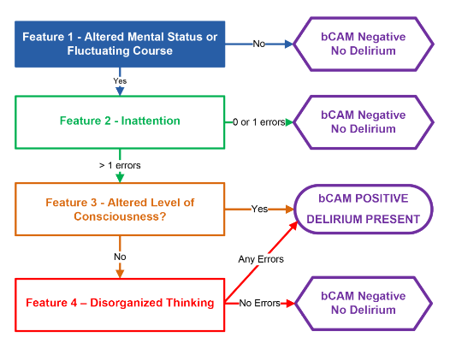
Mind: Delirium Screening
bCAM Brief Confusion Assessment Method ^{12, 13}
Delirium:
Acute brain failure leading to confusion, inattention, and altered mental status, often in a hospitalized or ill older adult.
Notes:
Contributors: DELIRIUM mnemonic⁹
Drugs
Electrolyte disturbances
Lack of drugs
Infection
Reduced sensory input
Intracranial disorders
Urinary and fecal disorders
Myocardial and pulmonary disorders
Marcantonio ER, Ngo LH, O’Connor M, et al. 3D-CAM: derivation and validation of a 3-minute diagnostic interview for CAM-defined delirium: a cross-sectional diagnostic test study. Ann Intern Med. 2014;161(8):554-561
Marcantonio ER. Delirium in Hospitalized Older Adults. N Engl J Med. 2017;377(15):1456-1466.

Slide 37
Mobility ²
Assess baseline mobility and activity level
Assess mobility goals
Assess for falls / fear of falling
Assess for mobility aid / assistive device
Notes:
What is the older adult’s baseline mobility? Level of activity?
What does a typical day look like for the older adult in terms of mobility?
What are their goals for mobility?
Any recent falls or fear of falling? Are they unsteady when standing/walking?
Does the older adult use a mobility aid or assistive device?

Slide 38
Mobility: Functional Assessment ^{17, 18, 19}
Activities of Daily Living
Instrumental Activities of Daily Living
Bathing
Dressing
Feeding
Toileting
Transferring
Telephone use
Shopping
Meal preparation
Housekeeping / laundry
Transportation
Taking medications
Handling finances
Notes:
Katz S. Assessing self-maintenance: activities of daily living, mobility, and instrumental activities of daily living. J Am Geriatr Soc. 1983;31(12):721-727.
Katz Activities of Daily Living: https://www.alz.org/careplanning/downloads/katz-adl.pdf
Lawton-Brody Instrumental Activities of Daily Living: https://www.alz.org/careplanning/downloads/lawton-iadl.pdf

Slide 39
Mobility Assessment: CDC STEADI Algorithm ²⁰
Screen
Do you feel unsteady when standing or walking?
Have you fallen in the past year?
Assess
Evaluate gait, strength, and balance
Assess orthostatic blood pressure
Intervene
Refer to Physical/Occupational Therapy
Refer patient for home safety evaluation (home PT/OT)
Are you worried about falling?
Ask for potential environmental hazards (extrinsic factors)
Optimize medications
Refer to eye clinic, podiatry clinic
Assess for intrinsic factors
Notes:
https://www.cdc.gov/steadi/pdf/steadi-algorithm-508.pdf

Slide 40
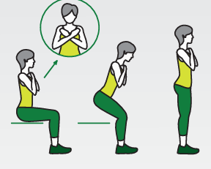
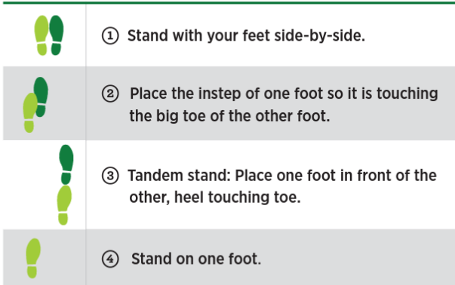
Mobility: Evaluate Gait, Strength, Balance ²⁰
30-second Chair Stand ²¹
Able to stand from a chair without using arms?
Timed Up & Go Test ²²
Stand up from seating, walk 10 feet and back
If ≥12 sec is at risk for falling
4-stage Balance Test ²³
Positive if cannot hold a position
for 10 seconds
Notes:
https://www.cdc.gov/steadi/pdf/STEADI-Assessment-30Sec-508.pdf
https://www.cdc.gov/steadi/pdf/TUG_test-print.pdf
https://www.cdc.gov/steadi/pdf/4-Stage_Balance_Test-print.pdf

Slide 41
Medications ^{2, 25, 26, 27, 28}
Complete Medication Reconciliation
Brown bag review
Who manages the medications?
Assess for Polypharmacy
5 or more medications
Assess for Prescribing Cascades
Assess for Potentially Inappropriate Medications (PIMs)
Intervention: Deprescribing
Notes:
Who manages the medications? How are the medications organized?
What prescription medications and nonprescription medications or health supplements is the older adult taking?
How many medications is the patient taking? How many times per day?
How many prescribers/pharmacies?
Medication Assessment
Does each medication have an indication? (e.g., consider stopping medication(s) that was started for a problem that has since resolved) ²⁴
Are any conditions lacking indicated medications? (e.g., consider calcium and vitamin D supplementation for those with osteoporosis)²⁵
Is each medication still indicated given individualized treatment goals, the patient’s goals of care, and prognosis (e.g., A1c, blood pressure goals)?²⁶
What concerns does the patient have (e.g., cost, opening pill bottles, swallowing pills, forgetting doses, adverse effects)?
Any difficulty taking medications (e.g., reading labels; administering patches, ointments, injections, or eye drops; keeping track of changes)?
Aging physiology changes that affect medications: start low, go slow (but get there)²⁷
↓ GFR/creatinine clearance (with normal creatinine since decreased lean body mass) = ↑ accumulation/risk of toxicity
↓ Liver clearance = ↑ in bioavailability, longer half-life
↓ Baroreceptor responsiveness = ↑ risk of orthostasis/falls
↑ Proportion of body fat = lipophilic drugs last longer
↑ Permeability of blood-brain barrier = ↑ risk of central nervous system effects
Remember: Slowly titrate until reach therapeutic dose, and deprescribe medications that are no longer needed.
Endsley S. Deprescribing Unnecessary Medications: A Four-Part Process. Fam Pract Manag. 2018 May/Jun;25(3):28-32. PMID: 29989773.
Rochon PA, Gurwitz JH. Optimising drug treatment for elderly people: the prescribing cascade. BMJ 1997;315(7115):1096–9.
Scott IA, Hilmer SN, Reeve E, et al. Reducing inappropriate polypharmacy: the process of deprescribing. JAMA Intern Med 2015;175(5):827.
By the 2023 American Geriatrics Society Beers Criteria® Update Expert Panel. American Geriatrics Society 2023 updated AGS Beers Criteria® for potentially inappropriate medication use in older adults. J Am Geriatr Soc. 2023 May 4. doi: 10.1111/jgs.18372. Epub ahead of print. PMID: 37139824.
Pravodelov V. Thoughtful Prescribing and Deprescribing. Med Clin North Am. 2020 Sep;104(5):751-765. doi: 10.1016/j.mcna.2020.06.001. PMID: 32773043.

Slide 42
Medications: Potentially Inappropriate Medications
Beers Criteria ²⁹
Medstopper ³¹
Risk stratification, tapering tool
Notes:
the Beers Criteria was first published in 1991 and it includes medications that can cause adverse effects in the geriatric population and therefore, should be avoided or used with caution. The most recent update, the 2019 AGS Beers Criteria – update coming out soon
Where can you find them? JAGS article, AGS pocket list, Uptodate
for Potentially Inappropriate Medication Use in Older Adults, includes a comprehensive list of medications and drug classes whose risks may outweigh their benefits in older adults in general and in conjunction with specific comorbidities
PIM – common in older adults because polypharmacy is common
As patients age, their physical and functional condition may change, as do their goals of treatment or what matters to them most. Therefore, a medication that had been appropriately prescribed in the past may
become inappropriate later in life because of its risks outweighing any potential benefits for the particular patient. Polypharmacy and the use of PIM is harmful in older adults with studies showing its
association with decreased quality of life and increased adverse drug reactions, falls, hospitalizations, and mortality
Budnitz and colleagues (Budnitz DS, Lovegrove MC, Shehab N, et al. Emergency hospitalizations for adverse drug events in older Americans. N Engl J Med 2011) identified the medications and medication classes accounting for the most emergency department visits for adverse drug events among older adults in the United States. Warfarin, insulin, oral antiplatelet agents, and oral antihyperglycemics topped the list
Medstopper: §Input medications on med list and indication for each med
§Lists medications by stopping priority
§Improve symptoms?
§May reduce risk for future illness?
§May cause harm?
§Taper approach, symptoms to watch
https://www.cgakit.com/m-2-stopp-start
https://medstopper.com/
Avoid High-Risk Medications
Which of the patient’s medications are on the AGS Beers Criteria for Potentially Inappropriate Medication Use in Older Adults?
Which safer alternatives may be appropriate? (e.g., Consider nonpharmacologic therapy for pain, sleep, incontinence, depression.)
Avoid anticholinergic medications if possible.²⁸
Look out for prescribing cascades, especially with anticholinergic drugs: drug 🡪 adverse effect 🡪 new drug²⁹ (e.g., oxybutynin 🡪 constipation 🡪 stool softener)

Slide 43
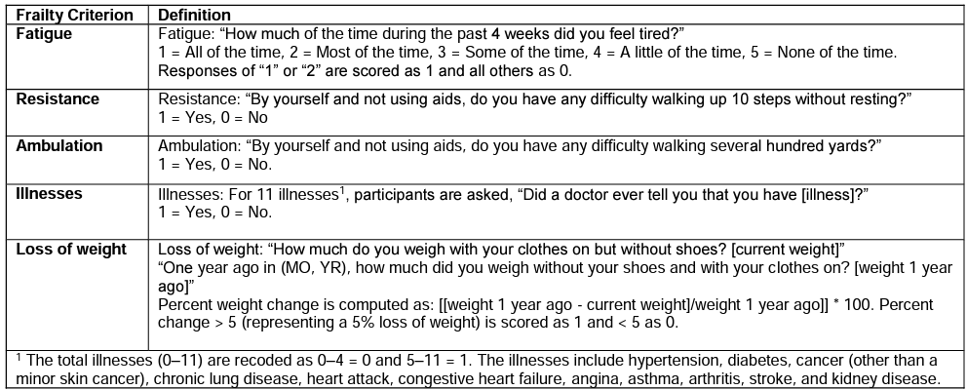
Multicomplexity: Assess Frailty
Frail Scale ^{33, 34, 35, 36, 37}
≥3 → frailty
1-2 →pre-or-intermediate frailty
0 → non-frail
Notes:
defined as either accumulation of deficits or biologic syndrome of decreased resilience and reserve resulting from cumulative declines across multiple physiologic systems. Frailty predicts adverse outcomes better than age alone
Clegg A, Young J, Iliffe S, Rikkert MO, Rockwood K. Frailty in elderly people. Lancet. 2013;381(9868):752-762.
Abellan van Kan G, Rolland YM, Morley JE, Vellas B. Frailty: toward a clinical definition. J Am Med Dir Assoc. 2008;9(2):71-72.
https://frailtyscience.org/sites/default/files/2020-09/Frailty%20Assessment%20Definition%20Sheet%20-%20FRAIL%20Scale.pdf
Morley JE, Malmstrom TK, Miller DK. A simple frailty questionnaire (FRAIL) predicts outcomes in middle aged African Americans. J Nutr Health Aging. 2012;16(7):601-608.
Morley et al. Frailty consensus: a call to action. J Am Med Dir Assoc. 2013;14(6):392-397.
Frailty Consensus Definition
Medical syndrome
Multiple causes & contributors
Manifest by:
↓ Strength
↓ Endurance
↓ Physiologic function
Detects vulnerability:
Dependency
Death

Slide 44
Multicomplexity: Assess Prognosis ^{2, 38}
Notes:
Help w decision making
https://eprognosis.ucsf.edu/

Slide 45
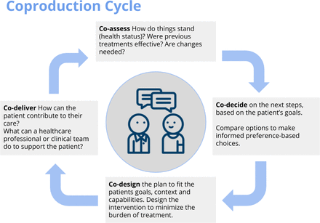
Matters Most ²
Patient-oriented tools:
My Health Priorities ³⁹
The Conversation Project ⁴⁰
Plan Your Lifespan ⁴¹
Prepare for your care ⁴²
Clinician-oriented tools:
Serious Illness Conversation Guide ⁴³
Identify what matters most to the patient
Identify health outcome goals based on what matters most
Align care with the patient’s health goals and healthcare preferences
Notes:
Current Care Planning: Align Care with What Matters Most (adapted from Patientprioritiescare.org)⁴
Identify what matters most to each older adult.
Identify health outcome goals based on what matters most.
Discuss medications, treatments and healthcare tasks that are helpful or burdensome.
Align care with the older adult’s health goals and healthcare preferences.
These goals of care discussions are relevant to all care and treatment planning, particularly for older adults with multiple chronic conditions.
Advance Care Planning: clarify wishes regarding life-sustaining medical treatment in case of serious illness or end of life.
POLST (Portable Orders for Life-Sustaining Treatment)
An outpatient medical order for patients with advanced serious illness and limited prognosis that documents a patient’s preferences for CPR, intubation, hospital transfer, artificial nutrition, and more (polst.org)
Living will
An advance directive document signed by a patient that provides guidance for care preferences (such as withholding or withdrawing life support) in the event of future incapacity; may not be legally binding in some states
Health care proxy / Medical power of attorney
Designates a surrogate decision-maker to make health care decisions on the patient’s behalf if they become incapacitated
Helpful Mnemonics for Communication
“GOOD” for approaching life sustaining treatment conversations with older adults^{5,6}
Goals: Start with patient’s understanding and their goals. Options: Review treatment options and expected outcomes. Opinions: Elicit patient opinion. Document: Consider advanced care planning documentation if appropriate.
“REMAP” for goals of care conversations with older adults with serious illness⁷ (from vitaltalk.org)
Reframe: Assess patient understanding; if applicable, “We’re in a different place now.” Expect emotion: Make space for patient’s reaction and respond to it. Map goals: Elicit goals and desired outcomes. Align with goals: Validate patient goals. Plan: Medical care and treatment should align with goals.
Patient-oriented tools:
My Health Priorities: https://myhealthpriorities.org/
The Conversation Project: https://theconversationproject.org/
Plan Your Lifespan: http://www.planyourlifespan.org/
Prepare for your care: https://prepareforyourcare.org/
Provider-oriented tools:
Serious Illness Conversation Guide: https://www.ariadnelabs.org/resources/downloads/serious-illness-conversation-guide/

Slide 46
Matters Most: Advance Care Planning ²
Healthcare Proxy / Healthcare Power of Attorney
Living Will
Portable Medical Order (POLST) ⁴⁴
Intended for patients with advanced illness or frailty and when death is likely in the foreseeable future
Notes:
AGS Working Group, n.d.; POLST Program, 2021
These goals of care discussions are relevant to all care and treatment planning, particularly for older adults with multiple chronic conditions.
Advance Care Planning: clarify wishes regarding life-sustaining medical treatment in case of serious illness or end of life.
POLST (Portable Orders for Life-Sustaining Treatment)
An outpatient medical order for patients with advanced serious illness and limited prognosis that documents a patient’s preferences for CPR, intubation, hospital transfer, artificial nutrition, and more (polst.org)
Living will
An advance directive document signed by a patient that provides guidance for care preferences (such as withholding or withdrawing life support) in the event of future incapacity; may not be legally binding in some states
Health care proxy / Medical power of attorney
Designates a surrogate decision-maker to make health care decisions on the patient’s behalf if they become incapacitated
Helpful Mnemonics for Communication
“GOOD” for approaching life sustaining treatment conversations with older adults^{5,6}
Goals: Start with patient’s understanding and their goals. Options: Review treatment options and expected outcomes. Opinions: Elicit patient opinion. Document: Consider advanced care planning documentation if appropriate.
“REMAP” for goals of care conversations with older adults with serious illness⁷ (from vitaltalk.org)
Reframe: Assess patient understanding; if applicable, “We’re in a different place now.” Expect emotion: Make space for patient’s reaction and respond to it. Map goals: Elicit goals and desired outcomes. Align with goals: Validate patient goals. Plan: Medical care and treatment should align with goals.

Slide 47
Scavenger Hunt Activity Resources
Scavenger Hunt
Resources
https://vanderbilt.box.com/s/4p5kpcitu77g7rsqowx5e1u8kettwvhs

Slide 48
Part 5: Models of care that successfully integrate treatment for patients with SUDs and age-related conditions

Slide 49
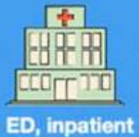
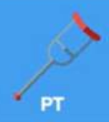
Recap: Barriers to Integrated Care
SUD
Notes:
Applying Geriatric Principles to Transitions of Care in the Emergency Department - PMC (nih.gov)

Slide 50
Recap: Barriers to Integrated Care
Lack of historical models
Limits on Meds on doses, duration,
PAs
Transitions of Care
Time Pressures
X waiver
Stigma
Provider
gaps in knowledge
& experience
Few specialists in addiction and geriatrics
Co-occurring
mental
health
diagnoses
Ageism
Mistrust
Notes:
Recap: Barriers to Integrated Care:
Lack of historical infrastructure and models
Transitions of Cares
Limited Availability of Medications
Including on doses, duration
Prior authorization
Regulatory barriers (X waiver removed!)
Provider gaps in knowledge & experience, time pressures
Paucity of geriatric and addiction medicine specialists
Stigma, ageism, and patient mistrust of healthcare
Co-occurring mental health diagnoses (.e.g. complex PTSD, anxiety, cognitive impairment)

Slide 51
Ambulatory Primary Care
Primary care models can integrate
Medication treatment for substance use
Harm reduction strategies
Principles of age-friendly care
Patients can also access
behavioral health counseling and treatment
Individual and group counseling including NA/AA
Notes:
Many primary care models of primary care which integrate
medication treatment for OUD (buprenorphine), AUD (naltrexone), and tobacco (NRT/varenicline)
Harm reduction counseling, fentanyl and xylazine test strips, naloxone, safer alcohol use
Screening and treatment for HIV and viral hepatitis
Principles of age-friendly care
Patients can also access
behavioral health counseling and treatment
Individual and group counseling including NA/AA

Slide 52
OTP/ Recovery Center
Onsite geriatric care
Vanderbilt BRIDGE clinic: internal medicine geriatric care within the context of treatment and stabilization with buprenorphine-naloxone and other SUD treatment
OTPs have programming specifically for older adults (https://americanaddictioncenters.org/rehab-guide/elderly, https://www.northernillinoisrecovery.com/programs/seniors/)
Notes:
Geriatricians can provide onsite primary care and/or geriatric consults in OTP setting
Vanderbilt BRIDGE clinic: internal medicine and geriatricians provided “flipped primary care” within the context of treatment and stabilization with buprenorphine-naloxone and other SUD treatment after hospital discharge (Kimberly does this)
OTPs have programming specifically designed for older adults (https://americanaddictioncenters.org/rehab-guide/elderly, https://www.northernillinoisrecovery.com/programs/seniors/)

Slide 53
Home Care Services
Underutilized resource for SUDs
Pilot programs to assist with successful community transitions
Patients with SUDs including co-occurring mental health diagnoses
Programs last up to 12 months
Services
Meet before hospital discharge
Appointment reminders
Transportation
Resources
Case Manager, SW, CASAC
NP with psychiatry training
Intense Case management
Notes:
Pilot programs to assist with successful community transitions,
Patients with substance use d/o and chronic illness
Meet patient before hospital discharge
Appointment reminders
Transportation
Health First Medicare / Medicaid
Patients with mental illness and substance use
Case Manager
Social worker
CASAC
NP with psychiatry training
Intense Case management

Slide 54
Acute Care Settings
Onsite Geriatric Care
ICU, medical floor, OB, Addiction Medicine
Geriatric Principles of Care
4M Approach
Comprehensive Geriatrics Assessment
Frailty and age-related resources (e.g. SNF, MLTC, PACE, DFTA)
Anticipating and coordinating care transitions
Notes:
Geriatricians can provide onsite care and/or consults
ICU, medical floor, OB
Geriatricians on the inpatient Addiction Medicine Consult service
4M Approach
Applying relevant aspects of a Comprehensive Geriatrics Assessment
Frailty and multiple age-related resources (e.g. SNF, MLTC, PACE, DFTA) to improve support/safety outside of the acute care
Anticipating and coordinating care transitions

Slide 55
Skilled Nursing Facilities
SNF Prescribers can continue medication treatment for AUD, TUD, OUD, and stimulant use
Documentation is key to ensuring SNF providers know the SUD history as well as pharm and non-pharm treatment for the SUD
Management and medication mood and pain symptoms can usually also be provided on site
Notes:
SNF Prescribers can continue to provide medication treatment for AUD, TUD, OUD, and stimulant use for patients who are medically stable
Documentation in discharge/admission paperwork is key to ensuring SNF providers know the SUD history as well as pharm and non-pharm treatment for the SUD
Management and medication mood and pain symptoms can usually also be provided on site
LTC: providing patients who can no longer be cared for at home or in assisted living with support for both daily living activities and complex medical problems.
PCA: care provided to patients recently released from the hospital, and can take place in many settings including nursing homes and rehabilitation centers.
Skilled Nursing Facility Care is care ordered by a physician, delivered by skilled nursing or therapy staff, and paid for by Medicare Part A for a fixed period of time (up to 100 days). Skilled care takes place in a nursing home, and may or may not be the same as post-acute care.
https://paltc.org/content/about-post-acute-and-long-term-care

Slide 56
Skilled Nursing Facilities
Addiction medicine specialists are available via
Healthcare system (e.g. Montefiore SNF Collaborative)
Local public health resources and programs
Off-site specialty appointments
Notes:
Addiction medicine specialists are available via
Healthcare system (e.g. Montefiore SNF Collaborative)
Public Health (local mentorship and/or access lines for SUD specialty consultation and resource availability
Off-site specialty appointments (similar to traveling off site or using telemed to access other specialty care like renal or cardiology)
LTC: providing patients who can no longer be cared for at home or in assisted living with support for both daily living activities and complex medical problems.
PCA: care provided to patients recently released from the hospital, and can take place in many settings including nursing homes and rehabilitation centers.
Skilled Nursing Facility Care is care ordered by a physician, delivered by skilled nursing or therapy staff, and paid for by Medicare Part A for a fixed period of time (up to 100 days). Skilled care takes place in a nursing home, and may or may not be the same as post-acute care.
https://paltc.org/content/about-post-acute-and-long-term-care

Slide 57
SUD treatment within SNFs: Methadone Workflows
Transfer medication dispensed at home OTP to SNF
Via patient (or surrogate)
OTP can deliver to SNF
Securely with chain of custody
At facility
appropriate labeling, storage in a double-locked secure area
administer medication as prescribed and document
All take-home bottles must be returned to OTP
On discharge from SNF,
Resident may take remaining doses if written order by OTP
If not, must be destroyed
Notes:
Various strategies for patients who not already established with OTP but on stable methadone dose
Requires coordination between primary team, addiction med, OPT, and SNF
Have done phone intakes, go on day of discharge or on discharge, if use 3 day exemption
At Monte: Melissa does intake on Addiction Med service!!
Transfer medication dispensed at home OTP to PA/LTCFs
Patient can be transferred directly to OTP for medication dispensation (considered a specialty visit)
A designee/surrogate from the PA/LTCF can be named to pick-up medication from OTP
OTP can coordinate delivery to PA/LTCF
Must secure transport of medication and complete chain of custody forms as needed
Once medication has arrived to facility, must ensure appropriate labeling, packaging, and storage (stored in a double-locked secure area with other controlled substances)
Administer medication as prescribed and document each administration to resident
All take-home medication bottles must be returned to OTP for next dispensation
On discharge from PA/LTCF, resident may take remaining doses if there is a written order by OTP physician. If not, medication shall be destroyed in compliance with the DEA rules and regulations.

Slide 58
SUD treatment within SNFs: Buprenorphine-naloxone workflows
PA/LTCF coordinates with off-site prescriber
e.g. transportation as a specialty visit
buprenorphine-naloxone is prescribed to SNF’s pharmacy
PA/LTCF has on-site prescriber (or treatment program) continuing already prescribed medication
Duet program for duel diagnoses (https://symphonynetwork.com/levels-of-care/)
Notes:
PA/LTCF has established treatment program with prescribers on site
Example: Duet psychiatric program for dual diagnoses. https://symphonynetwork.com/levels-of-care/
PA/LTCF coordinates with off-site prescriber (e.g. transportation as a specialty visit) and buprenorphine-naloxone is prescribed electronically to the facility network pharmacy
PA/LTCF has on-site prescriber continuing already prescribed medication

Slide 59
Discussion
How are you providing age-friendly care to patients with SUDs?
What is difficult about providing age-friendly care for this population?
How have you supported providers in SNFs and other settings in providing SUD treatment?
How do you involve the inter-disciplinary care team?
What are successful models of integrated care you have experienced?
What barriers to integrated care do you still encounter?

Slide 60
Part 6: Discussion and Wrap Up

Slide 61
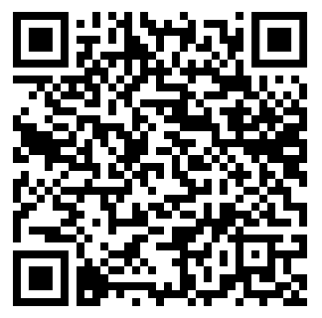
Reflection
Type up your reflection here
Please take a moment to write down a personal commitment in the coming year:
What can you do to make your OUD care more age-friendly?
What can you do to integrate OUD care into your care for older adults?
What is one tool you want to start using in your practice?
After a few minutes we will invite you to share your committed change with the group
Notes:
https://docs.google.com/document/d/1EzQX0ihI9Je2Dt6ALys4AFhGCaSgf0ihhItIrLWh2a4/edit?usp=sharing

Slide 62
Take Home Points
Acknowledge SUD and chronic disease care as individual yet overlapping and interconnected issues to ensure person-centered, goal-concordant care.
Empower clinicians to integrate age-friendly care into their SUD management.

Slide 63
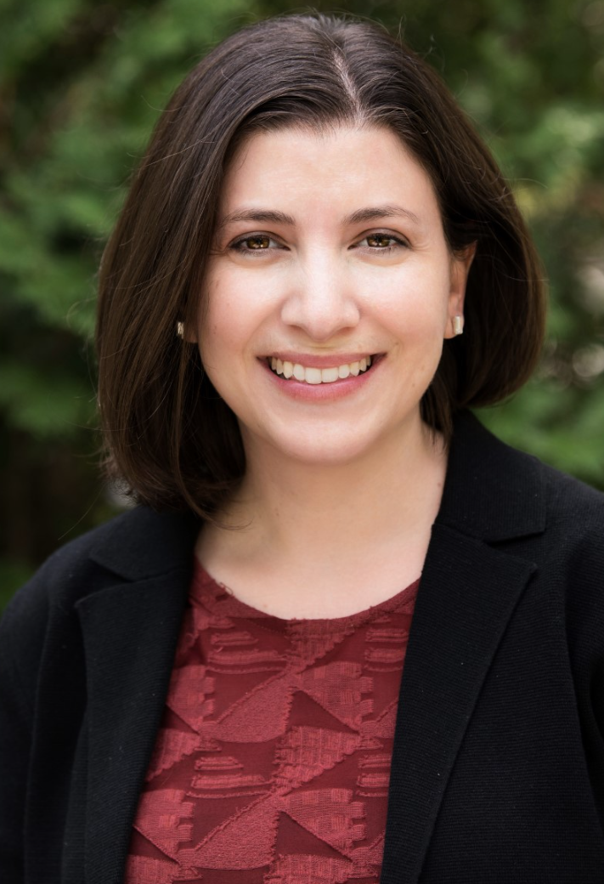
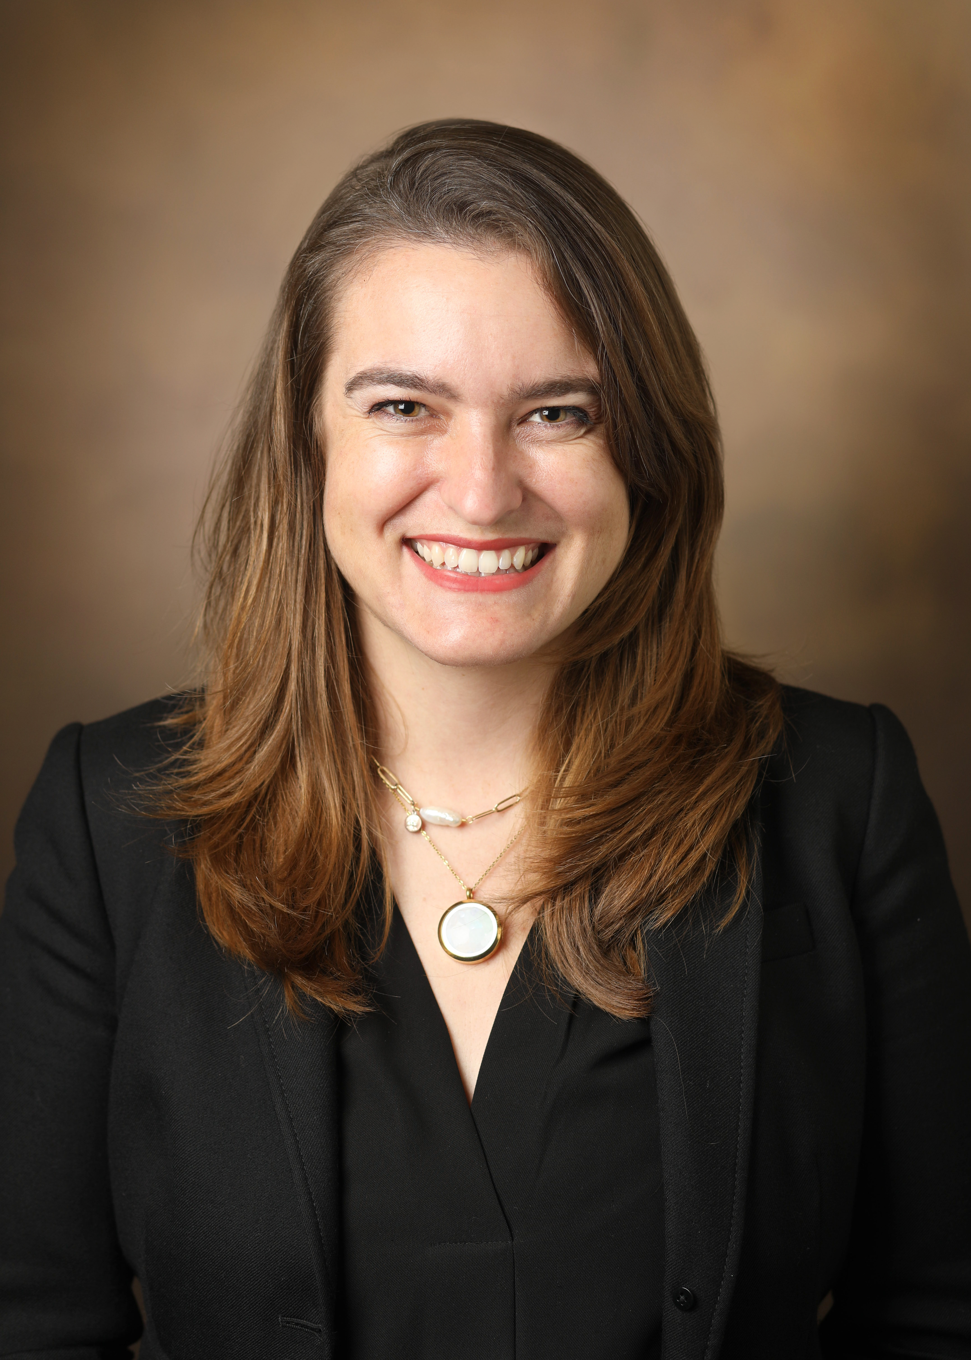
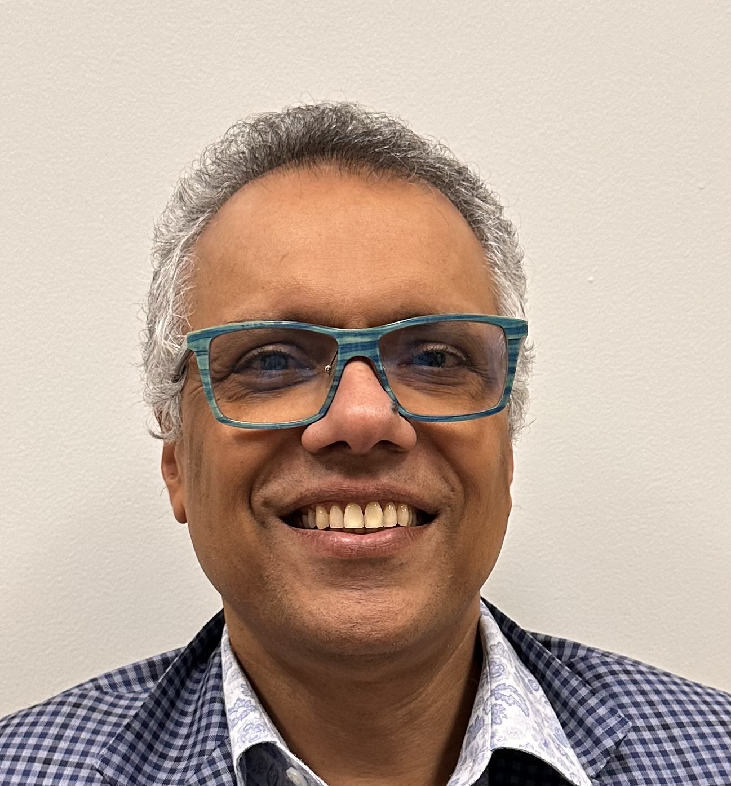
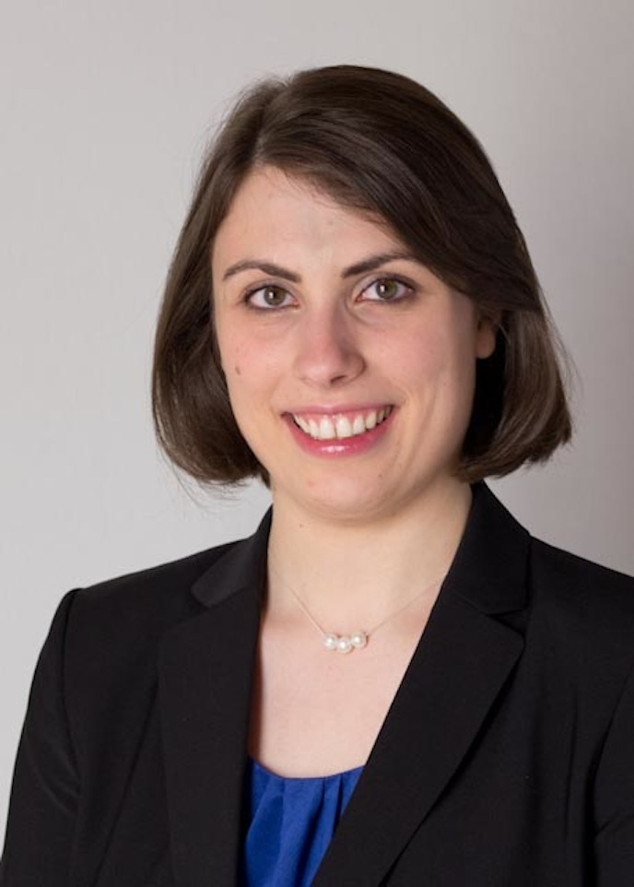
Questions?
Mim Ari, MD
University of Chicago
Mim.ari@bsd.uchicago.edu
@Mim_Ari
Kimberly Beiting, MD
Vanderbilt University
kimberly.beiting@vumc.org
@kimberlybeiting
Benjamin Han, MD MPH
UC San Diego b2han@ucsd.edu
@benhhan
Justina Groeger, MD
Montefiore Medical Center
jugroege@montefiore.org
A. Justine Landi, MD
University of Chicago
alandi@bsd.uchicago.edu
@Justine_Landi
Ajay Manhapra, MBBS
Hampton VA Medical Center
Yale School of Medicine
ajay.manhapra@yale.edu
@AjayManhapra
Vassiliki Pravodelov, MD, FACP
Boston University
Boston Medical Center
Vassiliki.pravodelov@bmc.org

Slide 64
Citations
ASAM. Treating Opioid Addiction as a Chronic Disease. https://www.asam.org/docs/default-source/advocacy/cmm-fact-sheet---11-07-14.pdf. Accessed 1-28-18.
Birnbaum HG, White AG, Schiller M. Societal costs of prescription opioid abuse, dependence, and misuse in the United States. Pain Med. 2011; 4: 657-67. Available at: http://www.asam.org/docs/advocacy/societal-costs-of-prescription-opioid-abuse-dependence-and-misuse-in-the-united-states.pdf
Blazer DG and Wu LT, The Epidemiology of Substance Use and Disorders Among Middle Aged and Elderly Community Adults: National Survey on Drug Use and Health. Am J Geriatr Psychiatry. 2009 Mar;17(3):237-45.
Blow FC. Special issues in treatment: old adults. In: Graham AW, Schultz TK, May-Smith MF, Ries RK, Wilford BB, eds. Principles of Addiction Medicine, 3rd ed. Chevy Chase, Md: American Society of Addiction Medicine. 2003. Available at: https://www.barnesandnoble.com/w/principles-of-addiction-medicine-american-society-american-society-of-addiction-medicine/1015772450?ean=9781880425084
Colliver JD, Compton WM, Gfroerer JC, Condon T. Projecting Drug Use Among Aging Baby Boomers in 2020. Annals of Epidemiology. 2006; 16(4): 257-265. Available at: http://www.ncbi.nlm.nih.gov/pubmed/16275134
Dineen, Kelly. Disability discrimination against people with substance use disorders by post-acute care nursing facilities: it is time to stop tolerating civil rights violations. Journal of Addiction Medicine. 2020. doi:10.1097/ADM.000000000000069
Han et al. Trends in inpatient discharges with drug or alcohol admission diagnoses to a skilled nursing facility among older adults, New York City 2008-2014. Harm Reduction Journal (2020) 17:99. https://doi.org/10.1186/s12954-020-00450-8
Cigolle CT, Langa KM, Kabeto MU, Tian Z, Blaum CS. Geriatric conditions and disability: the Health and Retirement Study. Ann Intern Med. 2007;147(3):156-164.
Hughes A, Williams MR, Lipari RN, et al. Prescription Drug Use and Misuse in the United States: Results from the 2015 National Survey on Drug Use and Health. SAMHSA. 2016. Available at: http://www.samhsa.gov/data/sites/default/files/NSDUH-FFR2-2015/NSDUH-FFR2-2015.htm
McLellan AT, Lewis DC, O'Brien CP, Kleber HD. Drug dependence, a chronic medical illness: implications for treatment, insurance, and outcomes evaluation. JAMA. 2000 Oct 4;284(13):1689-95. doi: 10.1001/jama.284.13.1689. PMID: 11015800.
NIDA. (2007, January 2). The Neurobiology of Drug Addiction. Retrieved from https://www.drugabuse.gov/neurobiology-drug-addiction on 2018, February 7. Available at: https://www.drugabuse.gov/publications/teaching-packets/neurobiology-drug-addiction/section-iii-action-heroin-morphine. Accessed 1-28-18.
SAMHSA. SAMHSA Bulletin - Sharp rise in buprenorphine-related emergency department visits from 2005 to 2010. samhsa.gov. 2013. Available at: http://www.samhsa.gov/newsroom/press-announcements/201301290645
SAMHSA. Clinical Guidelines for the Use of Buprenorphine in the Treatment of Opioid Addiction. TIP 40. SAMHSA/CSAT. Treatment Improvement Protocols. 2004; TIP 40. Available at: https://www.ncbi.nlm.nih.gov/books/NBK64245/
SAMHSA. Opioid Use Increases Among Older Adults. Available at: https://www.samhsa.gov/data/sites/default/files/report_3186/Spotlight-3186.html. Accessed 1-28-18.
SAMHSA. Results from the 2012 National Survey on Drug Use and Health: Summary of National Findings. NSDUH Series H-46, HHS Publication No. (SMA) 13-4795. Rockville, MD: Substance Abuse and Mental Health Services Administration. 2013. Available at: http://www.samhsa.gov/data/sites/default/files/NSDUHresults2012/NSDUHresults2012.pdf
Saloner B, Karthikeyan S. Changes in Substance Abuse Treatment Use Among Individuals With Opioid Use Disorders in the United States, 2004-2013. JAMA. 2015;314(14):1515–1517.
Sheehan E. 2016 Nov 15. Massachusetts Bureau of Health Care Safety and Quality. Circular letter: DHCQ 16-11-662-Admission of residents on medication assisted treatment for opioid use disorder. Retrieved from https://www.mass.gov/circular-letter/circular-letter-dhcq-16-11-662-admission-of-residents-on-medication-assisted

Slide 65
Citations
Bachi K, Sierra S, Volkow ND, Goldstein RZ, Alia-Klein N. Is biological aging accelerated in drug addiction? Curr Opin Behav Sci. 2017 Feb;13:34-39. doi: 10.1016/j.cobeha.2016.09.007. PMID: 27774503; PMCID: PMC5068223.
Han BH, Cotton BP, Polydorou S, et al. Geriatric Conditions Among Middle-aged and Older Adults on Methadone Maintenance Treatment: A Pilot Study. J Addict Med. 2022;16(1):110-113.
Substance Abuse and Mental Health Services Administration, Medication-Assisted Treatment: Retrieved at: https://www.samhsa.gov/medication-assisted-treatment
Substance Abuse and Mental Health Services Administration, Statutes, Regulations and Guidelines: Retrieved at: https://www.samhsa.gov/medication-assisted-treatment/statutes-regulations-guidelines
US Department of Justice, Drug Enforcement Agency-Diversion Control Division. Title 21CFR, §1306.07 Administering or dispensing ofnarcotic drugs. Retrieved from https://www.deadiversion.usdoj.gov/21cfr/cfr/1306/1306_07.htm
US Department Of Justice, Drug Enforcement Agency-Diversion Control Division
AGS Working Group. N.d. Minimum Competencies in Geriatrics for Medical Students. American Geriatrics Society. https://adgap.americangeriatrics.org/sites/default/files/media/files/AGS%20Geriatric%205Ms%20Competencies%20for%20Medical%20Students.pdf
Hughes, M., Edinoff, A., & Sue, K. L. (2023). Changing approaches to treating opioid withdrawal in the USA. The lancet. Psychiatry, 10(6), 378–380. https://doi.org/10.1016/S2215-0366(23)00145-1
Siegler M. (2019). Clinical Medical Ethics: Its History and Contributions to American Medicine. The Journal of clinical ethics, 30(1), 17–26.
Jonsen AR, Siegler M, Winslade WJ. (Eds.), (2022). Clinical Ethics: A Practical Approach to Ethical Decisions in Clinical Medicine, 9e. New York, NY: McGraw-Hill
Lagisetty, P. A., Healy, N., Garpestad, C., Jannausch, M., Tipirneni, R., & Bohnert, A. S. B. (2019). Access to Primary Care Clinics for Patients With Chronic Pain Receiving Opioids. JAMA network open, 2(7), e196928. https://doi.org/10.1001/jamanetworkopen.2019.6928
Rieder T. N. (2020). Is Nonconsensual Tapering of High-Dose Opioid Therapy Justifiable?. AMA journal of ethics, 22(1), E651–E657. https://doi.org/10.1001/amajethics.2020.651
Quinn, K., Kumar, S., Hunter, C. T., O'Donnell, J., & Davis, N. L. (2022). Naloxone administration among opioid-involved overdose deaths in 38 United States jurisdictions in the State Unintentional Drug Overdose Reporting System, 2019. Drug and alcohol dependence, 235, 109467. https://doi.org/10.1016/j.drugalcdep.2022.109467
Yang M, Beiting KJ, Levine S. Barriers to Care for Nursing Home Residents With Substance Use Disorders: A Qualitative Study [published online ahead of print, 2022 Aug 31]. J Addict Med. 2022;10.1097/ADM.0000000000001061. doi:10.1097/ADM.0000000000001061
Appold, K. Ready for post-acute care? The Hospitalist (2017). https://www.the-hospitalist.org/hospitalist/article/128764/transitions-care/ready-post-acute-care
AMA J Ethics. 2020;22(8):E647-650. https://journalofethics.ama-assn.org/sites/journalofethics.ama-assn.org/files/2020-07/fred1-2008.pdf
Fabrice Jotterand & Tenzin Wangmo (2014) The Principle of Equivalence Reconsidered: Assessing the Relevance of the Principle of Equivalence in Prison Medicine, The American Journal of Bioethics, 14:7, 4-12, DOI: 10.1080/15265161.2014.919365
Tinetti M, Huang A, Molnar F. The geiratrics 5M’s: a new way of communicating what we do. J Am Geriatr Soc. 2017;65(9):2115-2115.

Slide 66
Citations
From the American Geriatrics Society: The Geriatrics 5Ms Quick Guide https://geriatricscareonline.org/application/images/pdf/5Ms_Quick_Guide.pdf
Borson S, Scanlan JM, Chen P, Ganguli M. The Mini-Cog as a screen for dementia: validation in a population-based sample. J Am Geriatr Soc. 2003;51(10):1451-1454.
https://mocacognition.com/
https://www.parinc.com/Products/Pkey/238
https://www.slu.edu/medicine/internal-medicine/geriatric-medicine/aging-successfully/assessment-tools/mental-status-exam.php
SH Tariq, N Tumosa, JT Chibnall, HM Perry III, and JE Morley. The Saint Louis University Mental Status (SLUMS) Examination for detecting mild cognitive impairment and dementia is more sensitive than the MiniMental Status Examination (MMSE) - A pilot study. Am J Geriatr Psych 14:900-10, 2006
Lam, K., Wang, M., Smith, E., Ismail, Z., & Ganesh, A. (2023). P.004 Comparison of the Montreal Cognitive Assessment (MoCA) and Rowland Universal Dementia Assessment Scale (RUDAS) for identification of mild cognitive impairment and dementia. Canadian Journal of Neurological Sciences, 50(S2), S58-S58. doi:10.1017/cjn.2023.109
Lam, K., Wang, M., Smith, E., Ismail, Z., & Ganesh, A. (2023). P.009 Comparison of Montreal Cognitive Assessment (MoCA) and Rowland Universal Dementia Assessment Scale (RUDAS) scores in diverse populations. Canadian Journal of Neurological Sciences, 50(S2), S59-S60. doi:10.1017/cjn.2023.114
https://www.dementia.org.au/resources/rowland-universal-dementia-assessment-scale-rudas
Molnar FJ, Benjamin S, Hawkins SA, Briscoe M, Ehsan S. One size does not fit all: Choosing practical cognitive screening tools for your practice. J Am Geriatr Soc. 2020;68(10):2207-2213.
Marcantonio ER, Ngo LH, O’Connor M, et al. 3D-CAM: derivation and validation of a 3-minute diagnostic interview for CAM-defined delirium: a cross-sectional diagnostic test study. Ann Intern Med. 2014;161(8):554-561
Marcantonio ER. Delirium in Hospitalized Older Adults. N Engl J Med. 2017;377(15):1456-1466.
Kroenke K, Spitzer RL, Williams JBW. The Patient Health Questionnaire-2: validity of a two-item depression screener. Med Care. 2003;41(11):1284-1292.
https://www.apa.org/depression-guideline/patient-health-questionnaire.pdf
https://integrationacademy.ahrq.gov/sites/default/files/2020-07/Update_Geriatric_Depression_Scale-15.pdf
Katz S. Assessing self-maintenance: activities of daily living, mobility, and instrumental activities of daily living. J Am Geriatr Soc. 1983;31(12):721-727.
Katz Activities of Daily Living: https://www.alz.org/careplanning/downloads/katz-adl.pdf
Lawton-Brody Instrumental Activities of Daily Living: https://www.alz.org/careplanning/downloads/lawton-iadl.pdf
https://www.cdc.gov/steadi/pdf/steadi-algorithm-508.pdf
https://www.cdc.gov/steadi/pdf/STEADI-Assessment-30Sec-508.pdf
https://www.cdc.gov/steadi/pdf/TUG_test-print.pdf
https://www.cdc.gov/steadi/pdf/4-Stage_Balance_Test-print.pdf
https://www.cdc.gov/steadi/pdf/STEADI-Assessment-MeasuringBP-508.pdf
Endsley S. Deprescribing Unnecessary Medications: A Four-Part Process. Fam Pract Manag. 2018 May/Jun;25(3):28-32. PMID: 29989773.
Rochon PA, Gurwitz JH. Optimising drug treatment for elderly people: the prescribing cascade. BMJ 1997;315(7115):1096–9.

Slide 67
Citations
Scott IA, Hilmer SN, Reeve E, et al. Reducing inappropriate polypharmacy: the process of deprescribing. JAMA Intern Med 2015;175(5):827.
Pravodelov V. Thoughtful Prescribing and Deprescribing. Med Clin North Am. 2020 Sep;104(5):751-765. doi: 10.1016/j.mcna.2020.06.001. PMID: 32773043.
By the 2023 American Geriatrics Society Beers Criteria® Update Expert Panel. American Geriatrics Society 2023 updated AGS Beers Criteria® for potentially inappropriate medication use in older adults. J Am Geriatr Soc. 2023 May 4. doi: 10.1111/jgs.18372. Epub ahead of print. PMID: 37139824.
https://www.cgakit.com/m-2-stopp-start
https://medstopper.com/
Deprescribing.org
Clegg A, Young J, Iliffe S, Rikkert MO, Rockwood K. Frailty in elderly people. Lancet. 2013;381(9868):752-762.
Abellan van Kan G, Rolland YM, Morley JE, Vellas B. Frailty: toward a clinical definition. J Am Med Dir Assoc. 2008;9(2):71-72.
https://frailtyscience.org/sites/default/files/2020-09/Frailty%20Assessment%20Definition%20Sheet%20-%20FRAIL%20Scale.pdf
Morley JE, Malmstrom TK, Miller DK. A simple frailty questionnaire (FRAIL) predicts outcomes in middle aged African Americans. J Nutr Health Aging. 2012;16(7):601-608.
Morley et al. Frailty consensus: a call to action. J Am Med Dir Assoc. 2013;14(6):392-397.
https://eprognosis.ucsf.edu/
https://myhealthpriorities.org/
https://theconversationproject.org/
http://www.planyourlifespan.org/
https://prepareforyourcare.org/
https://www.ariadnelabs.org/resources/downloads/serious-illness-conversation-guide/
National POLST Coalition: polst.org
Elwyn, G., Nelson, E., Hager, A., & Price, A. (2020). Coproduction: when users define quality. BMJ quality & safety, 29(9), 711–716. https://doi.org/10.1136/bmjqs-2019-009830
Canadian Association of Schools of Nursing. 2017. Module 1: Professional Accountability and Prescribing - Clinical Ethics: The Four Topic Approach. http://nperesource.casn.ca/modules/module-1/lesson-6-clinical-ethics-the-four-topic-approach/

