Slide 1
Applying a Naloxone Saturation Model in Missouri: Comparing Predictions to Reality
Ryan Smith, BA, Lauren Green, MSW, Zach Budesa, PhD,
Rithvik Kondai, BA, Sarah Phillips, MA, Kyle Vance, BA,
Rachel Winograd, PhD
Notes:
Good afternoon everyone, my name is Rithvik Kondai and I am coming from the Addiction Science team at UMSL-MIMH. I am excited to talk to you all today about Missouri’s naloxone distribution efforts and results over the last 5 years, and how our results chalk up when compared to a naloxone saturation model.
Describe Missouri’s naloxone distribution efforts from 2017 to 2022
Compare the need estimated by Irvine et al.’s model to reach naloxone saturation

Slide 2
Conflict of Interest
None to disclose
Notes:
I have no conflicts of interest to disclose

Slide 3
Background
Drug overdose mortality has been growing over the last decade
Overdose Education and Naloxone Distribution (OEND) efforts decrease overdose rates at a population level
Missouri started statewide naloxone distribution in 2017 with its first STR grant
Notes:
As we all well know, drug overdose mortality rates and counts have been on the rise over the larger part of a decade. Fentanyl and fentanyl analogues are the main drivers behind most of these deaths in Missouri. In 2017, Missouri began statewide OEND programs through the first STR grant in 2017. Since then, we have dedicated ourselves to building infrastructure to support low to no barrier naloxone accesss.

Slide 4
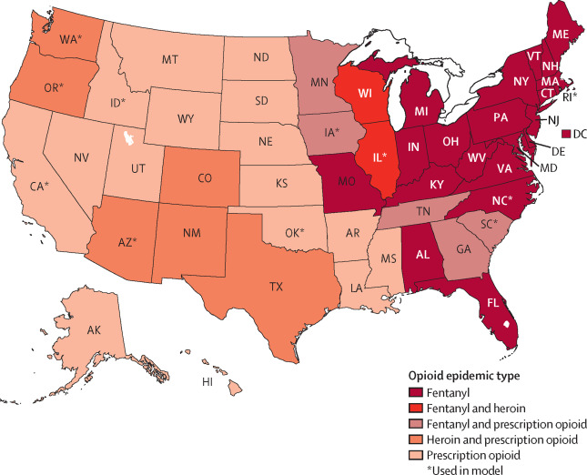
Irvine et al. (2022) Naloxone Saturation Model
Notes:
For this last round of SOR applications (SOR 3.0), SAMHSA asked grantees to use this model developed by Irvine and colleagues to develop a naloxone saturation plan and submit that as part of the grant proposal.
Click
Irvine and colleagues (2022) propose a “naloxone saturation model” to estimate state-specific naloxone need, or the amount of naloxone kits are needed annually to achieve a saturation threshold to avert 80% of witnessed opioid overdose-related deaths using naloxone. They first classified states by their opioid epidemic type to use as a variable in the model’s calculations.
Click
The model also describes naloxone needed to reduce opioid overdose-related deaths at community-based, provider-prescribed, or pharmacy-initiated naloxone access points. So you can see here, these are some estimates of the model for various states in various opioid epidemic type. For Missouri the model estimates, 60,000 community naloxone kits are needed annually to achieve a saturation threshold to avert 80% of witnessed opioid overdose-related deaths using naloxone.

Slide 5
Methods
Used descriptive statistics to evaluate naloxone distribution by region and agency sector
Compared actual output to need estimated by the Irvine et al. model and theoretical naloxone output based on the cost changes that occurred in 2022
Notes:
So we used descriptive statistics to describe our outputs and looked at the output under different variables such as region and agency type. Then, we compared our values to the model to see if meeting saturation actually meant decreased OD rates

Slide 6
Results - Naloxone Output
Over the six years, distribution efforts reached 104 of Missouri’s 115 counties (represents 98% of Missouri’s population)
33 counties only received mail-based naloxone
This is all nasal naloxone
 | 2017 | 2018 | 2019 | 2020 | 2021 | 2022
Naloxone Kits Distributed | 1,192 | 7,497 | 23,260 | 19,927 | 32,590 | 84,640
MO Overdose Death Counts | 1,367 | 1,610 | 1,583 | 1,875 | 2,155 | 2,173
Notes:
So lets talk about some of our results. We have distributed to 104/115 counties in MO which represents 98% of MO population. Due to our partnership with Next Distro, we are now able to reach 33 counties that we hadn’t reached before. As you can see in the last row of the table, our OD death counts still rose each year with a slight dip between 2018-19. We see somewhat of a plateau between 2021-22

Slide 7
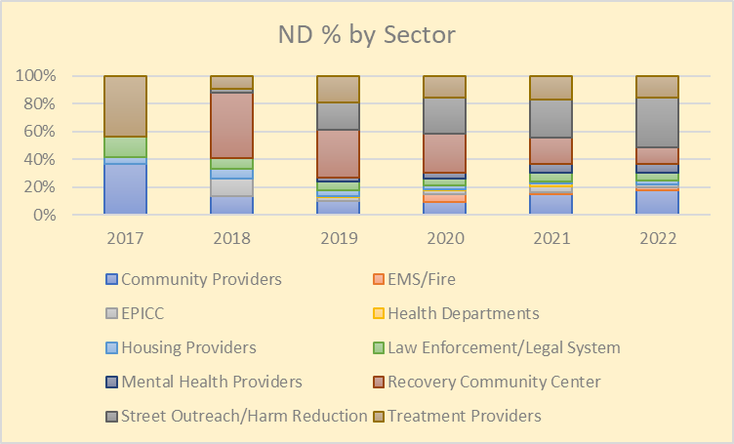
Results - Naloxone Output
Notes:
Here you can see how our distribution changed over time. Initially we started with a law enforcement focused grant and then quicly realized that we need to be prioritizing distribution in a way that naloxone reaches individuals who are most likely to witness or experience an OD. The best way to do that is through harm reduction or community agencies that serve as trusted individuals in their communities. As you can see in 2022, HR and street outreach orgs received the largest share of our naloxone distro.

Slide 8
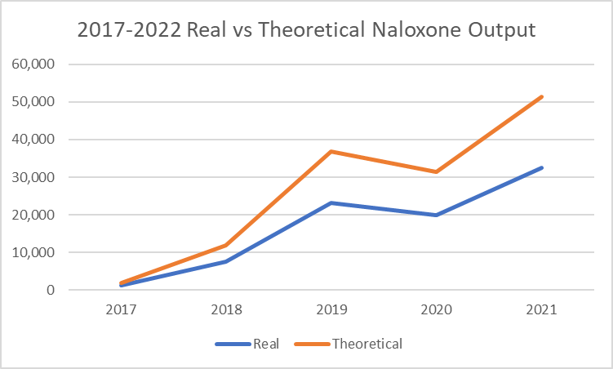
Thought Experiment - Impact of Cost Reduction
($75) ($47.5)
Notes:
I studied some philosophy in undergrad, so I will ask you all to humor me with a quick thought experiment. 2 slides back you may have noticed that our output went from almost 33k in 2021 to almost 85k in 2022. You may be wondering under what miraculous act of god were we able to more than 2x our output? 1) more grant money 2) more importantly, the price of naloxone dropped from $75 to $47.5 in Aug 2022. What if this happened in 2017? Of course we would have been able to distribute more naloxone, but also, we would have been closer to reaching saturation!

Slide 9
What Do We Make of This?
Distributed 170,000 units of naloxone from 2017-2022
Surpassed naloxone saturation point determined by Irvine et al. model (60,000 units thru community distribution)
Overdose rates still increased in MO
Notes:
So let’s bring it back to the model really quick. What do we make of all of our results when we compare it with the model? Well remember it said for MO, our saturation point was 60,000 kits. We reached it in 2022. Why did we not see OD rates change? You can see here, there’s a steady rise in deaths esp through COVID.

Slide 10
Racial Disparities in Overdose Mortality
Notes:
Really quickly, taking a closer look at the OD rates, we see Black people are disproportionately affected by overdose mortality. Specifically Black men in Missouri. A majority is driven by deaths in the STL metro region and then by the KC metro region. I bring up these disparities to say that this information helps us to know where we need to invest our energy when it comes to naloxone distribution so that the most affected people are being addequately served. I also bring these disparities to say that naloxone distribution alone is not sufficient to reduce these OD mortality rates.

Slide 11
Assessing the Model
What did we expect?
OD rates to decrease
What happened?
OD rates did not decrease
Strengths
For the first time, gave states an idea of the output they should be targeting
Says the ultimate goal of naloxone distribution should be saturation
Limitations
Model uses 2017 data
Lack of systematic data regarding unwitnessed overdose events
Increasing patterns of intentional polysubstance use
Introduction of novel substances in the illicit drug supply
Notes:
So what did we expect to happen? Bc we met saturation in 2022, we expected OD mortality to go down. That unfortunately did not happen. This is of course a hard pill to swallow doing this work, but I think it is actually a little freeing in that it shows us that as I mentioned before, naloxone distro alone is not enough! Without us reaching 85k units in 2022, part of me thinks the OD mortality would look a lot worse.
This model was really useful in that it gave states an idea of where to start when thinking about the question “how much naloxone do we need”. At the very least, it gave states a benchmark to hit that they hadn’t been given before. It also helped frame the goal around naloxone saturation and being clear about what that means.
The model though did fall short in estimating our need to bring down OD rates. Some reasons behind this could be that the model was developed using 2017 data. The model also only incorporated witnessed OD events. What about unwitnessed OD events? Because we don’t have really any monitoring on this, it’s possible that OD mortality didn’t decrease because the number of unwitnessed OD events rose. In addition, there has been a big rise in polysubtance use in MO. The model doesn’t take that or the ever-changing drug supply into question when determining the saturation point.

Slide 12
Assessing the Model
Notes:
Also, we are only able to speak on the community based programme aspect of the model. Maybe provider based and pharmacy initiated naloxone output also has to meet a certain level in parallel in order to see true saturation? Another question is if there is a time lag – it takes time for naloxone to get from the manufacturer to us to the org and then to the individual who needs it. Maybe there is a lag in which we are supposed to see the effects of saturation?

Slide 13
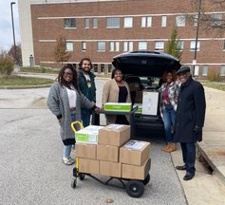
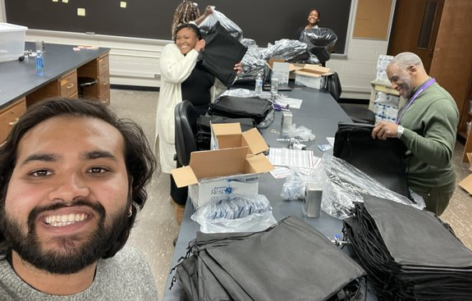
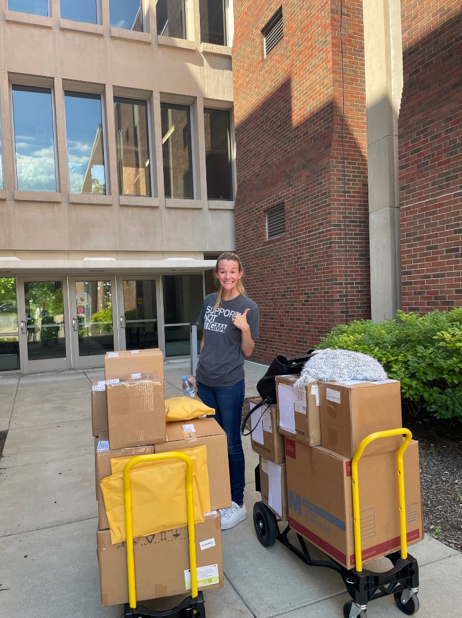
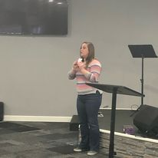
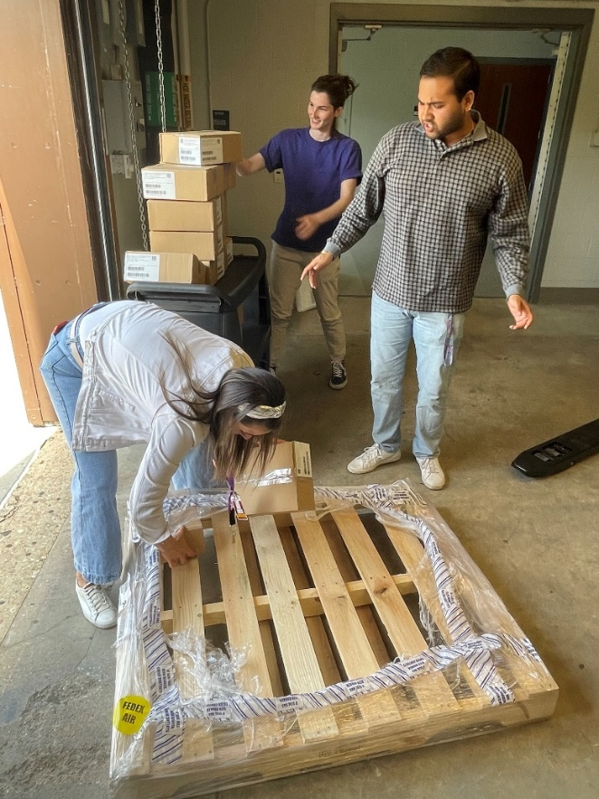
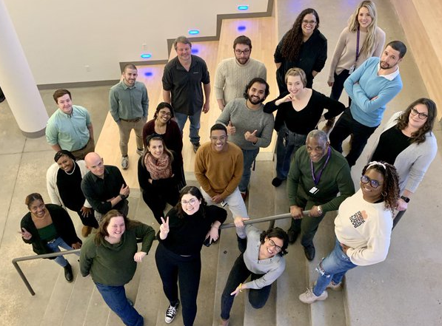
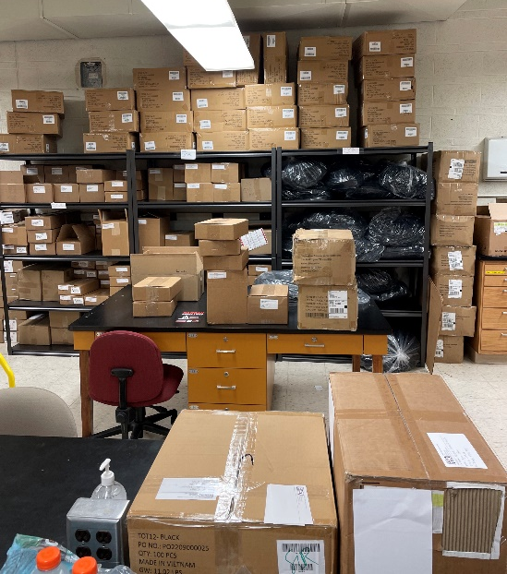
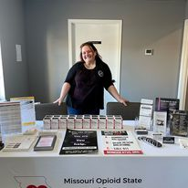
What’s gonna work? Teeeamwork (and Infrastructure)
Notes:
So I’ve talked a lot about money, cost, naloxone output. I don’t want to simplify this to “this would be solved if we just got more money for naloxone” One huge factor this model doesn’t take into account is the infrastructure needed to make an operation like this work.
Maybe it doesn’t matter if we had millions more dollars when we first started. If we still had just 2 people trying to do this for the whole state like in the early days of MO’s work, then it’s possible that you wouldn’t see the desired effect because you don’t have the infrastructure in place to support an operation of that size. Behind the scenes, our team is putting in the hard yards to pack and ship naloxone to all kinds of organizations over the state.
Saturation cannot happen without money, but it also can’t happen without the people.

Slide 14
Implications and future steps
The goal is not to have naloxone everywhere; the goal is to have naloxone at every potential overdose event
Initiatives toward accessible low-cost or no-cost naloxone must be prioritized → increase use and distribution of IM naloxone
Irvine et al. model falls short at estimating the amount of naloxone needed to saturate Missouri
Notes:
SAMHSA should reconsider the amount of emphasis they put on saturation plans or at least know that they need to be exceeding the need and not just meeting the supposed need.
The point is not to become the Amazon of naloxone and get it out to anyone and everyone. While there is more money being poured into harm reduction, naloxone is still a finite resource and we should be smart about how we try to reach saturation. IM naloxone is a great way to do so.
While the naloxone saturation model is a useful, evidence-based tool, Missouri as a case study suggests that it is inadequate on its own. An updated naloxone saturation model needs to adapt to emerging public health trends, enabling policymakers and naloxone distributors to make informed decisions.

Slide 15
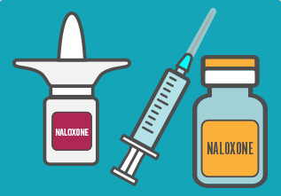
Thank You!
Rithvik Kondai
rithvik.kondai@mimh.edu
noMOdeaths@mimh.edu
https://www.mimhaddisci.org/

