Slide 1
Arts and Culture As Healing Methodologies for Navigating Trauma, Mental and Social-Emotional Health Challenges, and Use Disorders: The Existential Determinants of Health (E.D.O.H.) Initiative
David O. Fakunle, Ph.D.
Assistant Professor, Public and Allied Health
Morgan State University School of Community Health & Policy

Slide 2
Come for the Money, Stay for the Healing

Slide 3
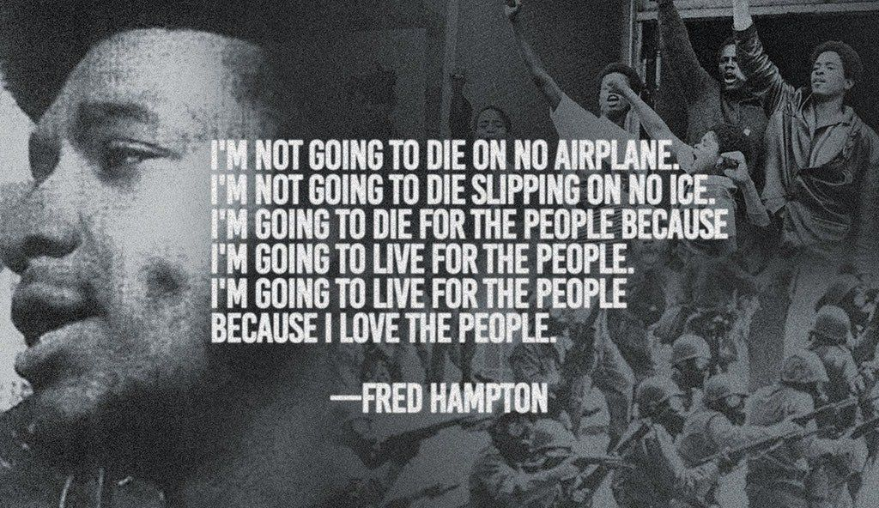

Slide 4
Why storytelling?

Slide 5
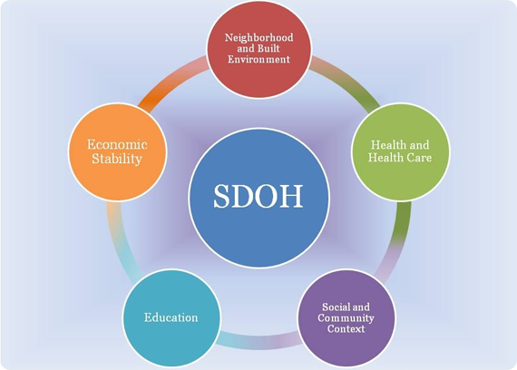
Social determinants of health
“The conditions in the places where people live, learn and work”
Wide range of effects on a wide range of health outcomes

Slide 6
What are the existential determinants of health?
Consistent across humanity – confirmed by storytelling
Acknowledgment
Appreciation
Respect
Understanding
Love
Constructivism/Transformational Grounded Theory/Epistemic Justice/Praxis

Slide 7
E.D.O.H. methodology
Focus on four core dimensions: mind, body, spirit, wallet
Consistent open connection – healing
Individual and collective storytelling
Facilitated learning and exploration – attuned to cohort
Creative expressions
Compensation for commitment
Personal growth leading to community impact

Slide 8
Why storytelling?
“The first step in the acquisition of wisdom is silence, the second listening, the third memory, the fourth practice, the fifth teaching others.”
- Solomon Ibn Gabriol
Universal art form and science
“Voice is power”
“Listening is acknowledgment”
Mutually beneficial exchange

Slide 9
E.D.O.H. year 1
March – June 2022
Location: Charm City Care Connection
~100 unique participants
Core cohort: ~15 participants
Health orientation: SUD/OUD
Theatrical performance at “Voices of History” Street Fair

Slide 10
E.D.O.H. year 2
March – June 2023
Location: The Mansion at The National Great Blacks In Wax Museum, Baltimore
Cohort: 20 participants (15 women, 5 men) – new and returning
Health orientation: any manifestation of trauma
Ages
25-39 years – 5
40-59 years – 5
Over 60 years – 4
Did not disclose – 6
Theatrical performance at E.D.O.H. community session (August 31st)

Slide 11
What the stories told us
100% of participants expressed being more comfortable with their personal stories and being their true self:
“I’m happy [my] take away today is loving on myself. I’m also taking away smiles from others, and nice conversation. How people shared part of themselves.”
“It was very [enlightening] today. I heard of writing stuff down. But not of the release you can get from it. I love it. It’s my new friend.”
Over 45% of the participants also expressed improvements in managing stress and anxiety and sleep:
“What you took from today’s meeting, is how to put your feelings in writing for yourself. You have to focus on the hand that was [given] to you and learn how to turn it into something positive. Your voice may be gone, but you have a kind heart and spirit that you can share with the world.”

Slide 12
What the stories told us
Over 80% of the participants felt more confident in their financial management skills:
“Had a great time with the business information that was given to us. Had a good time with beating the bucket. And the virtue for today was nice.”
“[Dave Feldman] learned how to start with an idea and develop it into a proposal and business. We shared ideas [and] feelings and gave each [other] acknowledgements on their growth in group or personalities. Just very glad to be a part of something positive.”
70% of the participants expressed that they are exercising regularly since participating in E.D.O.H.:
“[Ola] did exercise class today. I didn’t think I could participate because of my knee surgery. I did a lot more than I gave myself [credit for]. I feel relaxed, and calm. I feel loose.”
“This evening’s class I learned a lot about fitness, health, exercise and mental health that I am going to use in my everyday life.”

Slide 15
To keep the story going…
Website: edoh.org; discovermerecoverme.com
Email: david.fakunle@morgan.edu
Instagram: @discovermerecoverme

