Slide 1
Association of Surgery with Discontinuation of Medications for the Treatment of Opioid Use Disorder
Thuy Nguyen, PhD, MPA, Kyle Buchwalder, MD, Chloe Qi, MS, Kao-Ping Chua, MD, PhD, Pooja Lagisetty, MD, MSc, Vidhya Gunaseelan, MS, MBA, MHA, Jennifer F Waljee, MD, MPH, MS, Chad Brummett, MD, Yi Li, PhD, Mark C Bicket MD, PhD
Kyle Buchwalder, MD
PM-1, UM Preventive Medicine Residency
kylebuch@umich.edu

Slide 2
Disclosure
I have no relevant financial or non-financial conflicts of interest
Research reported in this presentation was supported by the National Institute on Drug Abuse of the National Institutes of Health under award number R01DA057943. 100 percent of costs related to this project are financed by this $3,347,729 award. The content is solely the responsibility of the authors and does not necessarily represent the official views of the National Institutes of Health.

Slide 3
Background
Individuals with opioid use disorder face disparities in surgical outcomes
Higher rates of postoperative complications
Longer hospital stays
Increased health care costs
Greater rates of readmission
Higher rates of patient directed discharge

Slide 4
Background
2004 CSAT Treatment Improvement Protocol
Discontinue buprenorphine when patients are on full mu-opioid agonists
2021 Multisociety Working Group on Opioid Use Disorder
Buprenorphine should not be routinely discontinued
2021 UCSF Perioperative Buprenorphine Guideline
Maintain chronic buprenorphine at established daily dose

Slide 5
Hypothesis
Among individuals on medications for the treatment of OUD, surgery is associated with an increase in medication discontinuation

Slide 6
Methods
Retrospective Cohort Study
Data Source: Merative Marketscan Commercial Claims database (2015-2022)
Participants: 18+ years of age with
◦ Surgery (Exposure) or doctor visit (Control)
◦ 90-day period of buprenorphine treatment
◦ ≥9 mos. of continuous claims
Outcomes: 1. Treatment Gap; 2. Time to first MOUD prescription fill
Notes:
Dates: October 1, 2015 – September 30, 2022

Slide 7
Methods
Exposure
Surgical Procedure
6 mos. continuous enrollment
3 mos. continuous enrollment
Outcomes
Primary
Treatment gap
Secondary
Time to first MOUD fill
MOUD treatment: ◦105–15 days before surgery ◦Without a treatment gap of > 15 days
Control
Doctor
Visit

Slide 8
Methods
Propensity Score Matching
No Surgery
N = 51,180
Surgery
N = 4,639
Stata V. 18 → teffects psmatch
No Surgery
N = 7,520
Surgery
N = 4,639
Notes:
propensity score = Conditional probability of a unit (e.g., person, classroom, school) being assigned to the treatment, given a set of observed covariates.

Slide 9
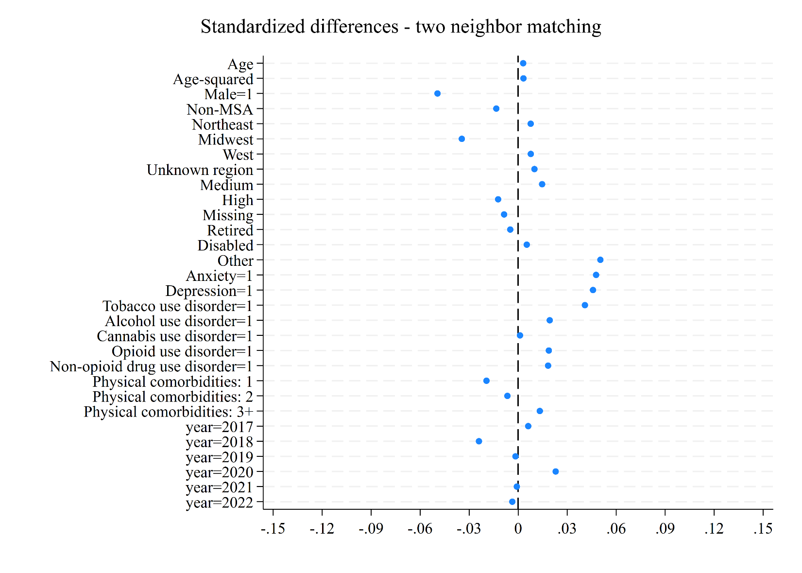
Results
Covariates are well balanced after propensity score matching

Slide 10
Results

Slide 11
Results

Slide 12
Results

Slide 13
Results

Slide 14
Results
Average Treatment Effect Estimates
 | Treatment gap (percentage) | Average time untreated (days) | Number of MOUD claims | Time to First Claim (days)
Surgery vs no surgery | 5.3% | 4.98 | -0.18 | 3.59
95% CI | 3% to 7% | 3.7 to 6.2 | -0.3 to -0.04 | 2.9 to 4.2
p-value | <0.001 | <0.001 | 0.012 | <0.001
Stata V. 18 → teffects psmatch
Notes:
Average Treatment Effect = Average causal effect of a binary variable on an outcome. In other words, it is the difference in mean outcome between units assigned to treatment and units assigned to control.
Note: The analytical model generated estimates by imputing missing potential outcomes for patients using an average of outcomes of similar patients in the other group.

Slide 15
Limitations
Prescription fills are a surrogate for actual use
Overlap between buprenorphine use for OUD and pain
Marketscan commercial claims may not reflect the experience of persons with Medicare, Medicaid, or non-private insurance

Slide 16
Conclusions
Among individuals on medications for the treatment of OUD, we found that surgery was associated with:
A greater risk of treatment gaps
Delays in time to first prescription fill
More untreated days
Fewer prescriptions for medications for OUD

Slide 17
References
Song Y, Tang R, Roses RE, et al. Opioid Use Disorder is Associated With Complications and Increased Length of Stay After Major Abdominal Surgery. Ann Surg. 2021;274(6):992-1000. doi:10.1097/SLA.0000000000003697
Dewan KC, Dewan KS, Idrees JJ, et al. Trends and Outcomes of Cardiovascular Surgery in Patients With Opioid Use Disorders. JAMA Surg. 2019;154(3):232-240. doi:10.1001/jamasurg.2018.4608
Kohan L, Potru S, Barreveld AM, et al. Buprenorphine management in the perioperative period: educational review and recommendations from a multisociety expert panel. Reg Anesth Pain Med. 2021;46(10):840-859. doi:10.1136/rapm-2021-103007
Center for Substance Abuse Treatment. Clinical Guidelines for the Use of Buprenorphine in the Treatment of Opioid Addiction. Rockville (MD): Substance Abuse and Mental Health Services Administration (US); 2004.
Dawson T, Liberto J, Gordon A, Saxon A, Hadidi D, Nazario M. Perioperative Pain Management and Guidance for Patients on Chronic Buprenorphine Therapy Undergoing Elective or Emergent Procedrues. Published Feb 2022. Accessed November 11, 2024. https://www.va.gov/formularyadvisor/DOC_PDF/CRE_Buprenorphine_Perioperative_Guidance _FEB2022.pdf
Mariano ER, Dickerson DM, Szokol JW, et al. A multisociety organizational consensus process to define guiding principles for acute perioperative pain management. Reg Anesth Pain Med. 2022;47(2):118-127. doi:10.1136/rapm-2021-103083
Department of Veterans Affairs. Guidelines for the Perioperative Management of Buprenorphine. Published February 2022. Accessed November 11, 2024. https://www.va.gov/formularyadvisor/DOC_PDF/CRE_Periop_BUPRENORPHINE _Algorithm_FEB2022.pdf.
Anderson TA, Quaye ANA, Ward EN, Wilens TE, Hilliard PE, Brummett CM. To Stop or Not, That Is the Question: Acute Pain Management for the Patient on Chronic Buprenorphine. Anesthesiology. 2017;126(6):1180-1186. doi:10.1097/ALN.0000000000001633

Slide 18
Thank you!

