Slide 1
Resident Perspectives of Access to Medications for Opioid Use Disorder within Harm Reduction Housing
Avik Chatterjee, MD, MPH; Sabrina S. Rapisarda, MA, MEd; Joseph Silcox, PhD, MA; Sofia Zaragoza, BA; Andrew Rolles, BA; Patricia Case, PhD, Charlie Summers, BA; Sarah Kosakowski, MPH; Traci C. Green, PhD, MSc

Slide 2
Disclosures
R21DA05858-02 Rapid measurement of novel harm reduction housing on HIV risk, treatment uptake, drug use and supply.
No COI

Slide 3
Background: People experiencing homelessness
Overdose is the leading cause of death among people experiencing homelessness (PEH)¹
Medications for Opioid Use Disorder (MOUD; methadone, buprenorphine, and naltrexone); can be life-saving, however only a fraction of eligible patients receive them²
The fraction is even lower for people experiencing homelessness³

Slide 4
Background: Encampments & sweeps
Tent encampments are an increasingly visible sign of policy failures regarding substance use and homelessness⁴
City government-led encampment “sweeps,” or removal of tents and belongings, are an increasingly popular policy approach to encampments that has been associated with increased overdose death⁵
In 2022, Boston pursued an innovative “harm reduction housing” (HRH) intervention in conjunction with an encampment sweep⁶

Slide 5
Background: Boston-based harm reduction housing sites
HRH sites offered a suite of harm reduction supplies and more permissive rules, as well as intensive case management and connection to treatment
HRH also offered innovative means of connecting patients to MOUD
Of the seven HRH sites, some had onsite connection to buprenorphine and/or methadone, and some offered linkage to offsite MOUD programs

Slide 6
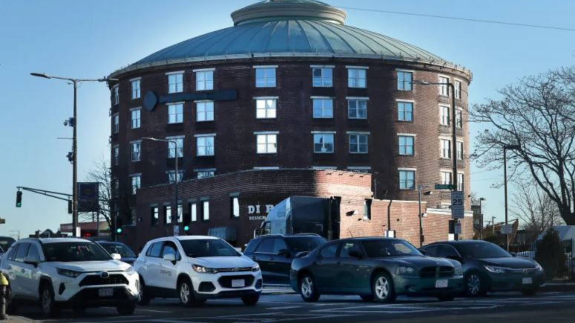

Slide 7
MOUD access and linkage by HRH site
Site | Description
1 | On-site buprenorphine induction and 72-hour methadone with opioid treatment program [OTP] linkage. Physician on-site 24/7. Site closed during data collection.
2 | Off-site methadone at a distance (3.2 miles, 20-40 minutes via rideshare/taxi or public transport to the clinic within the main service hub, most often frequented by Site 2 residents). A few residents reported walking, which estimated 60 minutes. Physician on-site twice per week and could prescribe and refill buprenorphine.
3 | Off-site methadone nearby at neighboring hospital in walking distance (0.1 mile distance, <5 minutes). For Site 3 residents who continued to access methadone via the clinic within the main service hub, the one-way trip (3.8 miles) approximated 20-40 minutes via rideshare/taxi or public transport.
4 | Off-site methadone nearby within the main service hub in walking distance (0.5 mile distance, 10-15 minutes).
5 | Off-site methadone nearby at neighboring hospital in walking distance (0.2 mile distance, 5 minutes).
6 | Off-site methadone nearby within the main service hub in walking distance (0.2 mile distance, <5 minutes). Physician or PA on-site four times per week and could prescribe and refill buprenorphine.
7 | Off-site methadone nearby within the main service hub in walking distance (0.4 mile distance, 10 minutes).

Slide 8
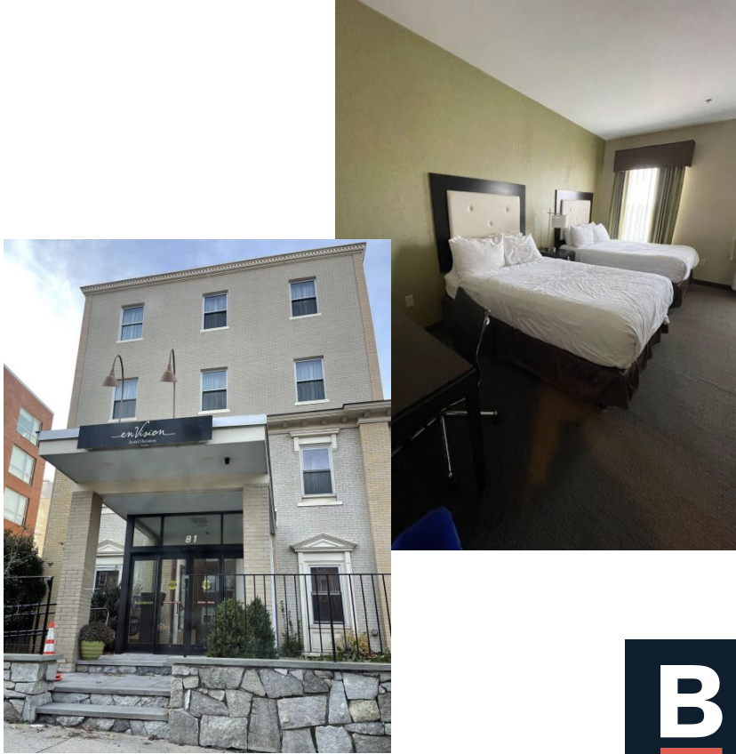

Slide 9
Methods
As part of a larger study, we recruited a cohort of 28 individuals in HRH sites who completed interviews at baseline, 3 months and 6 months
Topics covered in the interview guide explored participant experiences with housing, substance use patterns, witnessed or personal overdose, access to MOUD, and more
In a secondary analysis, we coded portions of interview transcripts related to experiences with MOUD

Slide 10
Participants Reflected the Diversity of PEH
Sociodemographic characteristics of interview cohort participants (N=28)
Variable | N (%)
Gender
Male | 15 (53.6)
Female | 13 (46.4)
Race-Ethnicity
White | 9 (32.1)
Black | 7 (25.0)
Hispanic | 6 (21.4)
Multiple races and/or ethnicities | 6 (21.4)
Age Range
26-40 years old | 11 (39.3)
41+ years old | 17 (60.7)
Highest Educational Attainment
Some high school or less | 4 (14.3)
High school graduate or GED | 14 (50.0)
Some college | 6 (21.4)
College graduate | 4 (14.3)

Slide 11
Methods
Two coders conducted thematic analysis on the MOUD-related transcript sections, applying inductive coding⁷
Coders met throughout the coding process to discuss questions or concerns and arrive at consensus when necessary
Aware of their positionality, coders were reflexive in their approach to the transcripts⁸

Slide 12
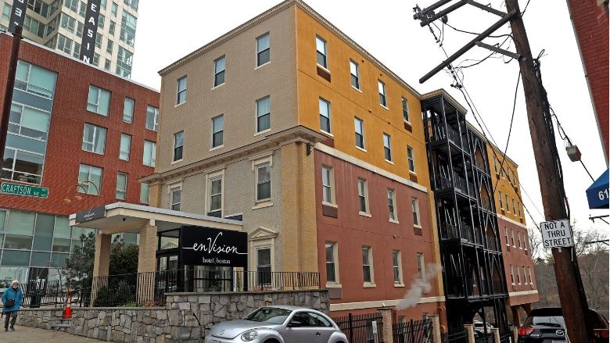

Slide 13
Results
Five themes emerged from the secondary coding process

Slide 14
Theme 1: On-site access and linkages facilitated MOUD initiation and retention
“They [Site 1] had the first floor…they had the doctors all down at the first floor. They had 24-hour access to like the doctors, they got me back on methadone over there.” (Camile, site 2)
[With Site 1 closing] “Now people are gonna have a harder time with the getting on the methadone, which could save a lot of lives and really help a lot of people.” (Lila, Site 4)

Slide 15
Theme 2: MOUD prescribing policies at HRH sites were uniquely low-threshold
“And I [advocated for myself] for a month <laugh> because my ex…he been on the clinic for six months. I'm like, why haven't you gone up? I'm like, 60 milligrams don't last long.” (Brooke, Site 2)
“Everything happens right away…You go that same day and you get dosed [with methadone], and then you go to Faster Paths for three days and then they send you to wherever [OTP] you're going.” (Eliza, Site 2)
“There, they bump, that's what I'm trying to say. They bump you up faster, the dose.” (Harper, Site 3)

Slide 16
Theme 3: Location, transportation and accessibility concerns limited MOUD access
“Yeah. [Site #2] is very far from all the services, it makes things a lot harder.” (Camile, Site 2)
“…A lot of things are not handicap accessible. Even going to the methadone clinic, it's not like to go this way to the methadone clinic, it would take me 30 seconds to get there and back. I can’t. It takes me seven minutes to get to the methadone clinic 'cause I have to walk around the entire building in this wheelchair. Doing that myself is exhausting. This wheelchair, doing it myself, forget about it. It's hard. It's really hard.” (Harper, Site 3)

Slide 17
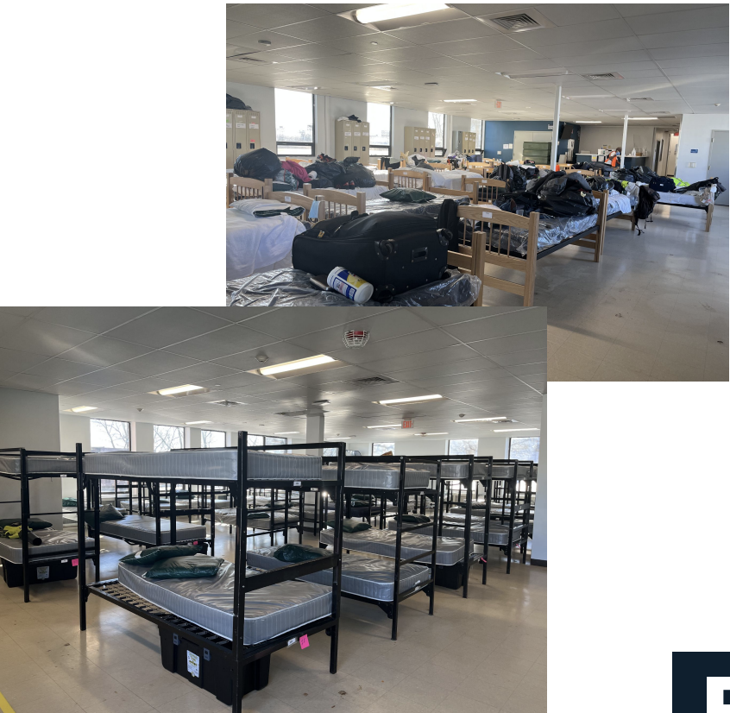

Slide 18
Theme 4: Preferences for specific medications based on specific needs
“Oh, I like methadone. Methadone is a life saver for me, I don't know what I would do without it. Kept me steady, works for me.” (Elena, Site 4)
“The suboxone is better for your body, but I don't see people taking it.” (Mateo, Site 6)

Slide 19
Theme 5: HRH-related MOUD engagement shaped substance use, health, and quality of life
“Drug use, same drugs, methamphetamines and heroin… It's been a lot less 'cause I've been just going to the [methadone] clinic and coming home.” (Elena, Site 4)
“See, the methadone, you gotta go no matter what. If you don't take it, you gonna get sick. Other than that, it’s something that I wake up, I got something to do early. Start a good routine through the day. It's working. I'm doing real good for two months. New at it. I'm new at it. First time too.” (Diego, Site 5)

Slide 21
Limitations
Participants from one U.S. city
Potential reluctance of participants to discuss sensitive issues

Slide 23
Conclusions
HRH with onsite or linkage to MOUD is a policy option that can improve initiation onto and retention of life-saving medications
HRH could be an alternative or adjunct to encampment sweeps, which are known to be harmful
In a population where overdose death risk is high and MOUD engagement is low, such innovative models could be life-saving

Slide 24
Questions?

Slide 25
References
¹ Fine DR, Dickins KA, Adams LD, et al. Drug Overdose Mortality Among People Experiencing Homelessness, 2003 to 2018. JAMA Netw Open. 2022;5(1):e2142676. doi:10.1001/jamanetworkopen.2021.42676
² Larochelle MR, Bernson D, Land T, et al. Medication for Opioid Use Disorder After Nonfatal Opioid Overdose and Association With Mortality: A Cohort Study. Ann Intern Med. 2018;169(3):137. doi:10.7326/M17-3107
³ Swartz N, Odayappan S, Chatterjee A, Cutler D. Impact of Medicaid expansion on inclusion of medications for opioid use disorder in homeless adults’ treatment plans. J Subst Use Addict Treat. 2023;152:209059. doi:10.1016/j.josat.2023.209059
⁴ Herring C, Lutz M. The Roots and Implications of the USA’s Homeless Tent Cities. City. 2015;19(5):689-701. doi:10.1080/13604813.2015.1071114
⁵ Barocas JA, Nall SK, Axelrath S, et al. Population-Level Health Effects of Involuntary Displacement of People Experiencing Unsheltered Homelessness Who Inject Drugs in US Cities. JAMA. 2023;329(17):1478. doi:10.1001/jama.2023.4800
⁶ Mayer M, Mejia Urieta Y, Martinez LS, Komaromy M, Hughes U, Chatterjee A. Encampment Clearings And Transitional Housing: A Qualitative Analysis Of Resident Perspectives: Study analyzes responses from former homeless encampment residents and their experiences with transitional housing. Health Aff (Millwood). 2024;43(2):218-225. doi:10.1377/hlthaff.2023.01040
⁷ Braun V, Clarke V. Using thematic analysis in psychology. Qual Res Psychol. 2006;3(2):77-101. doi:10.1191/1478088706qp063oa
⁸ May T, Perry B. Reflexivity and the Practice of Qualitative Research. In: The SAGE Handbook of Qualitative Data Analysis. SAGE Publications, Inc.; 2014:109-122. doi:10.4135/9781446282243.n8

