Slide 1
Attributes of Higher- and Lower-Performing Hospitals in the Consult for Addiction Treatment and Care in Hospitals (CATCH) Program Implementation: A Multiple-Case Study
Elizabeth R. Stevens, Adetayo Fawole, Yasna Rostam-Abadi, Jasmine Fernando,
Noa Appleton, Carla King, Medha Mazumdar, Donna Shelley, Luke Bergmann, Charles Barron, Samira Siddiqui, Daniel Schatz, Jennifer McNeely
AMERSA 2024

Slide 2
Disclosures
No conflicts of interest
Grant support: R01DA045669
P30DA040500 (CHERISH)
UL1TR001445 (NYU CTSI)

Slide 3
Effectiveness of addiction consult services for engaging patients in OUD treatment: Pragmatic Hybrid Type 1 Trial
Hybrid type 1 trial
Primary outcome: Post-discharge MOUD initiation and engagement
Research collaboration:
NYU School of Medicine – Dept. of Population Health
H+H – Office of Behavioral Health
NYC DOHMH – Bureau of Alcohol and Drug Use Prevention,
Care, and Treatment
First multi-site controlled trial of hospital
addiction consult services
Notes:
Submitted grant in 2017, when funding became available
Made feasible by CTSI: allowed us to access data from all 6 hospitals, single IRB for the 5 CTSI sites

Slide 4
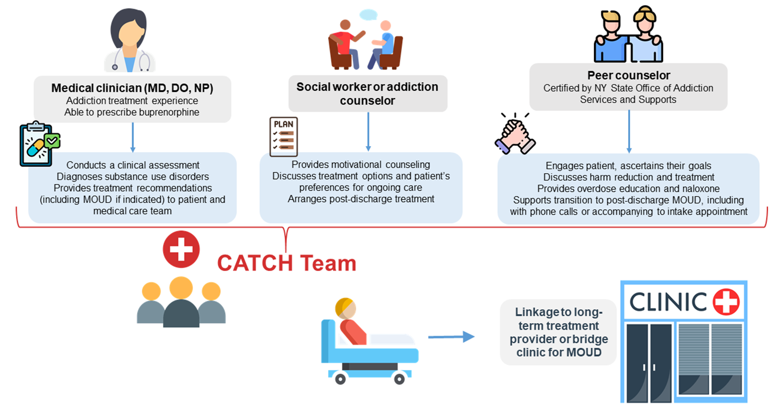
Consult for Addiction Treatment and Care in Hospitals (CATCH)
Notes:
Interprofessional team
Engage, assess, diagnose, treat in hospital
Make a discharge plan

Slide 5
McNeely et al., JAMA Int Med, Aug 2024

Slide 6
NYC Health + Hospitals
Largest municipal system in the US
11 acute care hospitals
1.4 million patients/year
Over 60% of the opioid-related ED visits in NYC

Slide 7
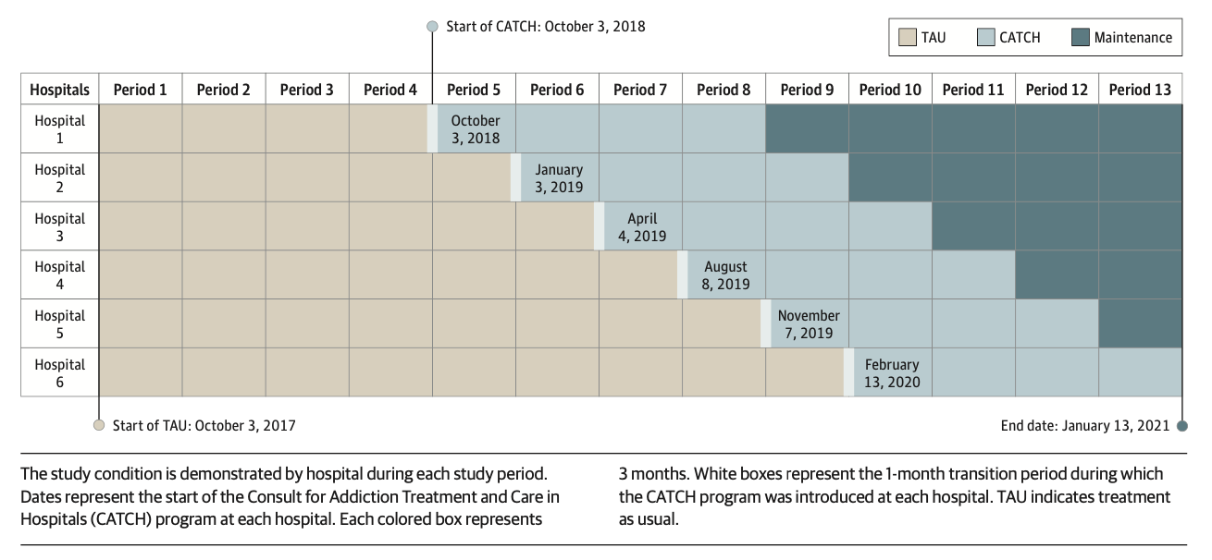
Stepped-wedge study design
McNeely et al., JAMA Int Med, Aug 2024
Notes:
6 hospitals, randomized in 2 groups
Sites randomized to a start date, rollout Oct 2018-Feb 2020
All sites receive intervention condition

Slide 8
Objective
What characteristics of CATCH hospitals are associated with high and low performance?
Performance defined by Reach: % of eligible admissions receiving a MOUD order in the hospital
Notes:
Note that this is different from the primary outcome for the effectiveness study – post-discharge

Slide 9
Stevens et al., JoSAT, Sept 2024

Slide 10
Methods
Multiple-case study
Mixed methods, convergence design
Hospital attributes were measured throughout the 1st year of the CATCH program at all 6 hospitals
Codebook of attributes and set cutoffs for performance
Data sources – EHR, meeting notes, CATCH staff interviews
Hospitals designated high or low performance
Reach: % of eligible admissions receiving a MOUD order
Cross-case comparison to evaluate patterns driving high and low performance
Notes:
concurrent analysis and interpretation of quantitative and qualitative data to explore the same phenomenon
1. Created codebook and set cutoffs performance category (blinded to REach)
2. Unblinded performance and used cross-case comparison to evaluate patterns driving high and low performance
Strength of influence:
Weakly (-/+, difference equal to 25%)
moderately (- -/++, difference equal to 50%)
strongly (- - -/+++, difference ≥75%) influencing performance

Slide 11
Hospital attributes
Attributes collected:
Adoption
Implementation fidelity
CATCH context
Hospital characteristics
Patient characteristics
Data sources:
H+H EHR
CATCH meeting notes
Interviews with CATCH staff
59 interviews
early implementation
end of year 1

Slide 12
Reach: Eligible admissions receiving MOUD order (N= 2,117)
60.9%
Any MOUD
*Includes the first hospitalization among patients aged ≥18 years with a length of stay ≥1 night and an opioid-related discharge diagnosis during the first year of CATCH
Notes:
Note - This slide represents patients on their first admission to the hospital (2117 patients, 2877 admissions)

Slide 13
Reach: Eligible admissions receiving MOUD order
Hospital | 1 | 2 | 3 | 4 | 5 | 6
MOUD ordered (%) | 71.8% | 61.9% | 49.1% | 49.7% | 61.5% | 70.3%
Performance category High ≥50% MOUD ordered | High | High | Low | Low | High | High
Eligible admissions are patients aged ≥18 years with a length of stay ≥1 night and an opioid-related discharge diagnosis during the first year of CATCH
Denominator = total number of eligible patients

Slide 14
Hospital attributes influence on reach
Measure |  |  |  | Reach
 |  |  |  | High (N=4) % | Low (N=2) % | Influence Strength
Adoption
 | High rate of ordered consults of all potential consults |  |  | 50 | 50 | =
Implementation Fidelity
 | High rate of completed consults of all ordered consults |  |  | 50 | 50 | =
 | High proportion of staff received formal training |  |  | 50 | 50 | =
 | Complete Staff coverage | CATCH lead | CATCH lead | 100 | 50 | + +
 |  | MD/NP | MD/NP | 100 | 0 | + + +
 |  | Peer counsellors | Peer counsellors | 75 | 50 | +
 |  | Social workers | Social workers | 75 | 100 | -
 | Ratio of encounters by staff type in balance |  |  | 75 | 50 | +
 | Regular use of CATCH report |  |  | 50 | 50 | =
 | Established bridge clinic |  |  | 100 | 100 | =
CATCH Context
 | Designated office space |  |  | 100 | 0 | + + +
 | Collaborative space available |  |  | 100 | 50 | + +
 | CATCH lead specialty in addiction |  |  | 50 | 50 | =
 | Experienced CATCH lead |  |  | 25 | 50 | -
 | Bridge clinic attributes |  | Designated space | 50 | 100 | - -
 |  |  | Location in existing OUD program | 50 | 50 | =
 |  |  | Fixed hours of operation | 0 | 50 | - -
Notes:
Adoption defined as: High (≥50% complete) vs. Low
Implementation Fidelity
Completed CATCH consults of all ordered consults (%)
High (≥50% complete) vs. Low
Staff participated in formal training (%)
High (≥75% trained) vs. Low
Staff coverage over implementation year (%)
Complete (2 out of 3 teams, ≥66.7% coverage) vs. Incomplete
CATCH lead
Advanced practice providers
Peer counsellors
Social workers
Ratio of encounters by staff type
Balanced (2 of 3 staff types are each approximately 33% of staff composition** and no one staff type is ≥2x another) vs. imbalanced
Regular use of CATCH report
Yes; regular use of at least 1x per week vs. No
Established bridge clinic
Yes vs. No
+/++/+++ Weakly (25% difference) / moderately (50% difference) / strongly (75%+ difference) influencing high performance
-/- -/- - - Weakly (25% difference) / moderately (50% difference) / strongly (75%+ difference) influencing low performance
= No variation
Full staffing of the CATCH team, including the CATCH lead physician and medical clinicians
Designated office and collaboration space for CATCH
Pre-existing OUD resources, including having a primary care buprenorphine clinic and an OTP
Implemented CATCH prior to the onset of the COVID-19 pandemic

Slide 15
Hospital attributes influence on reach
Measure |  |  |  | Reach
 |  |  |  | High (N=4) % | Low (N=2) % | Influence Strength
Hospital characteristics
 | Epic EHR throughout the CATCH period |  |  | 50 | 50 | =
 | Large Size (beds) |  |  | 25 | 50 | -
 | Active in COVID-19 |  |  | 25 | 100 | - - -
 | OUD treatment resources available | Primary Care Buprenorphine clinic | Primary Care Buprenorphine clinic | 75 | 0 | + + +
 |  | Medically Supervised Outpatient Program (MSOP) | Medically Supervised Outpatient Program (MSOP) | 100 | 100 | =
 |  | On campus MSOP location | On campus MSOP location | 50 | 50 | =
 |  | Opioid treatment program (OTP) | Opioid treatment program (OTP) | 25 | 100 | - - -
Characteristics of OUD patients
 | Higher proportion than system overall by: Sex (Female) |  |  | 0 | 0 | =
 | Age |  | 18-44 years | 25 | 50 | -
 |  |  | 45-64 years | 100 | 100 | =
 |  |  | 65-80 years | 100 | 100 | =
 | Race/ Ethnicity |  | Black | 50 | 50 | =
 |  |  | Hispanic | 25 | 0 | +
 |  |  | White | 75 | 100 | -
 |  |  | Other | 100 | 100 | =
 | Language |  | English | 100 | 100 | =
 |  |  | Spanish | 25 | 0 | +
 | Uninsured |  |  | 0 | 0 | =
Notes:
Full staffing of the CATCH team, including the CATCH lead physician and medical clinicians
Designated office and collaboration space for CATCH
Pre-existing OUD resources, including having a primary care buprenorphine clinic and an OTP
Implemented CATCH prior to the onset of the COVID-19 pandemic

Slide 16
Summary of attributes associated with high performance
Full staffing of the CATCH team, especially the CATCH medical clinicians
* importance of prescribers, working with medical care teams
Designated office and collaboration space for CATCH
* team communication and cohesion
Pre-existing OUD resources: having a primary care buprenorphine clinic (but not an OTP)
* integration of addiction services within medical care
Implemented CATCH prior to the onset of the COVID-19 pandemic
* stable environment

Slide 17
Limitations
Conducted in a large urban public hospital system
Small number of hospitals (N=6)
Focuses only on OUD patients, though CATCH delivers services for all types of substance use disorders
Performance defined by receipt of MOUD in the hospital, not post-discharge MOUD initiation

Slide 18
Contributors
Grant Support: NIDA R01 DA045669
NYU CTSA UL1TR001445
H+H
Charles Barron
Luke Bergmann
Marc Manseau
Noah Isaacs
Dan Schatz
Lynsey Avalone
Kayna Pfeiffer
Samira Siddiqui
Roopa Kalyanaraman Marcello Johanna Dolle
Caroline Cooke
All the CATCH staff
NYULH
Yasna Rostam-Abadi
Carla King
Liz Stevens
Donna Shelley
Jasmine Fernando
Noa Appleton
Thaddeus Tarpey
Medha Mazumdar
Charles Neighbors
John Billings
Scarlett Wang
Adetayo Fawole
Amanda Bunting
Lauren Textor
Kumar Vasudevan
Elaina Frantellizzi
NYC DOHMH
Hillary Kunins
Ellenie Tuazon
Gretchen Van Wye
Joe Kennedy
CHERISH
Bruce Schackman
Ali Jalali
Sean Murphy
Danielle Ryan
Boston Medical Center
Alex Walley
Zoe Weinstein
Todd Kerensky
Mary Tomanovich
Amy Fitzpatrick

Slide 19
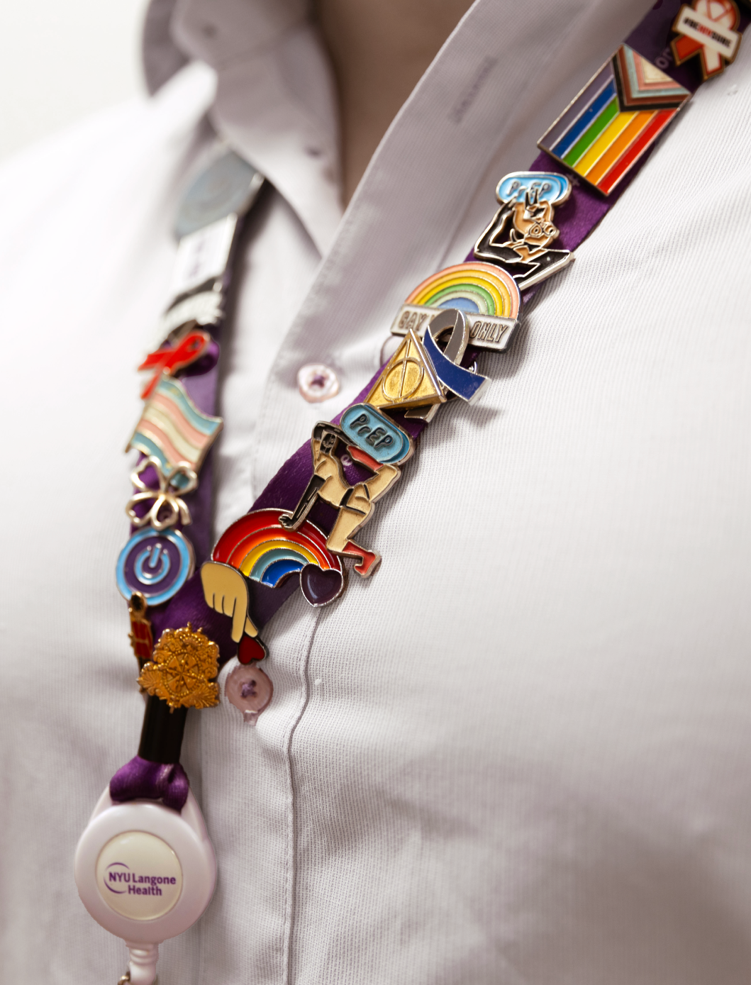
Thank you
carla.king@nyulangone.org

