Slide 1
Beyond the X-Waiver: Perspectives on buprenorphine access & barriers in outpatient settings
Maggie Lowenstein, MD, MPhil, MSHP
AMERSA Annual Meeting
November 16, 2024
Notes:
For my next talk, going to present a second abstract with results from this study
This time focused on policy and system factors
Titled”

Slide 2
I have no conflicts of interest
Notes:
Again, no COI

Slide 3
Barriers to buprenorphine
Notes:
Again, large literature on barriers to buprenorphine overall
A lot of this focuses on the first stage of getting providers and patients to adopt this

Slide 4
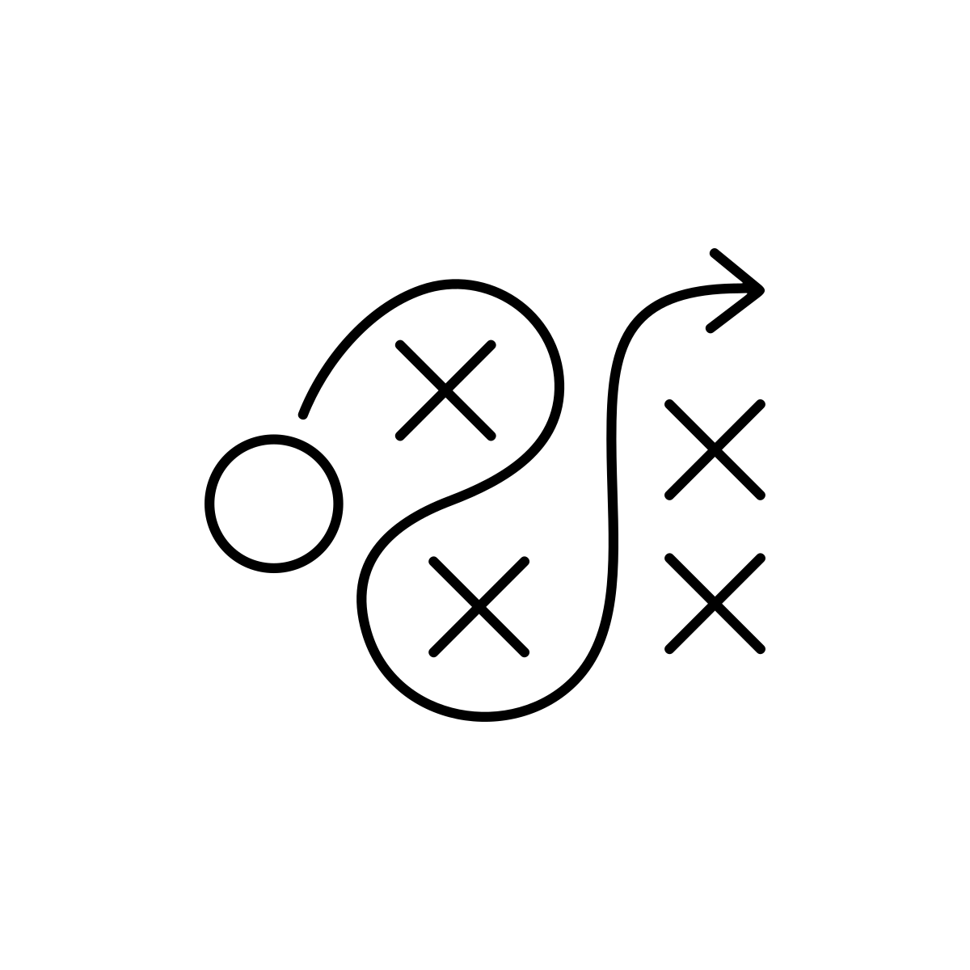
Lowering barriers to treatment
Rapid medication access
Flexible treatment model
Harm reduction approach
Jakubowski and Fox, 2019
Notes:
We’re also seeing practices shifting in ways that attempt to overcome these barriers
Promoting rapid medication access, flexible treatment models, harm reduction approaches
You heard in my last talk that some of the barriers to implementing these types of care relate to individual or organizational beliefs
But we were also curious about the ways in which systems and policies help or hinder our ability to practice in these ways
Beyond general barriers to bupe, Less is know about the ways in which policy or system factors influence our ability to put these practices into places

Slide 5
Study Aim
To explore perspectives among opioid use disorder (OUD) treatment providers about policy and system influences on adoption of low-barrier buprenorphine practices
Notes:
To get at this question, our aim was to …

Slide 6
Methods
Semi-structured interviews with OUD treatment clinicians and staff in Philadelphia
Time Period: 2/2022-7/2023
Participants: Purposive sample of clinicians and staff from longitudinal buprenorphine programs
Interviews focused on buprenorphine prescribing practices and factors influencing these practices
Thematic content analysis
Notes:
To do this …

Slide 7
Participant Characteristics (n=29)
Characteristic | %
Professional Role
Physician | 66%
Therapist | 14%
Administrator | 10%
APP | 3%
Other | 7%
≥5 years treating OUD | 85%
Age Range
<30 | 3%
31-40 | 40%
41-50 | 27%
>50 | 23%
Gender
Man | 60%
Woman | 40%
Race
White | 83%
Black/AA | 10%
Asian | 7%
Hispanic/Latinx Ethnicity | 0%

Slide 8
Key Themes
Notes:
This study spanned the period before and after the X waiver was eliminated, and back in the olden days 2 years ago this is often one of the big policy barriers that was cited
One thing we thought we would hear about was the x-waiver

Slide 9
X-Waiver
I think it's very good that it went away. It philosophically does not make sense that there should be a higher barrier to the prescription of buprenorphine than there is to the prescription of OxyContin. But I don't think it's going to make a lot of difference. I think that the people that are interested in addiction medicine will go into addiction medicine and see
patients with opioid use disorder.
Notes:
However, among this group of already engaged bupe prescribers, x-waiver was not the thing

Slide 10
Key Themes
Mismatched Payment Models
Payment constraints on practice
Rigid levels of care
Notes:
We heard a lot about barriers and system challenges in health care in general – not enough time, not enough staffing or support for social needs, not enough money
But we also heard about some more specific findings that influence peoples’ ability to provide more flexible, patient-centered and evidence-based care

Slide 11
Mismatched Payment Models
It’s not even so much a matter of whether the rates are sufficient, it's the fact that in Philadelphia the behavioral health insurance business is completely carved away. And our corporation runs on medical billing from the regular providers, not from the behavioral health side, so our company wasn't able to negotiate how to set up and be a biller within both of those universes.
Notes:
We heard a lot about reimbursement overall, but more specifically we heard about the mismatch between payment and reimbursement models and the care settings that were trying to access funding
One area was the separation of physical and behavioral health payment, esp in medicaid
Essentially these dispariate funding streams meant that many of the billing/funding models were inaccessible

Slide 12
Mismatched payment models
In value-based care, you’re getting paid for the population that you’re taking care of … [Patients with OUD] are so much more complicated, need to be seen so much more frequently …. if I were to say I just wanna do treatment for opioid use disorder and not see any regular patients, I mean, my practice would not be viable at [institution] because a full-time provider is supposed to be able to take care of 2,000 patients. And there’s no way that one could take care of 2,000 patients with opioid use disorder in your week.
Notes:
Mismatch between payment models
Primary care models
Vaule-based care models disincentivize this care

Slide 13
Payment constraints on practice
There’s all these additional requirements to go into a patient’s care as far as being seen three times a month. If they’re seen two times a month, we don’t get paid for those services at all … Or if they just come in once, we don’t get paid.
Notes:
We also heard about the ways in which requirements for reimburesemnet actually got in the way of practices
***
Reimbursement based on outdated notions of treatment – i.e. arbitrary numbers or types of visit meant that change was difficult to implement while remaining financially viable

Slide 14
Payment constraints on practice
We see a lot of issues with requiring prior authorization …. Once we do the prior-authorizations, most of the time it’s –it goes through. But it’s still unfortunate because then the patient waits and then if they were already trying to stop using the substance for a prolonged period of time, it’s just unfortunate because then that delays them by up to a week at a time.
Notes:
Pas

Slide 15
Rigid Levels of Care
Our therapy services are a little complicated, because it is a separate part of our health center … I think that a lot of this is because of state licensing issues. Certain people can be seen, whereas certain people cannot. So if someone has dual diagnosis, then they cannot be seen in our outpatient mental health clinic, but if somebody has a substance use issue and they want to do IOP, they can do that here but as long as they’re not actively using. So we have those services available, but a lot of our people end up not being a good fit for those services, unfortunately.
Notes:
We also saw the ways in which attempts to match people to “appropriate” levels of care meant that people actually did not access care at all
***
this is a long quote but I left it in because this just illustrates the ways in which the neat boxes of treatment and licensure lead us to totally losing the plot on the needs patient have

Slide 16
Rigid Levels of Care
Incorporating harm reduction into our program is difficult because they put all the programs into levels of care and boxes. So, our program is in that outpatient and intensive outpatient box, which is a 1.0 and 2.1 ASAM level of care, whereas harm reduction is like the 0.5 ASAM level of care.
Notes:
Here’s another example from an IOP
***
I don’t think this is what ASAM intended but the adherence to levels of care framework really interferd with with perceived ability to offer certain services

Slide 17
Study Limitations
Single city
Limited information about real-world practice
Social desirability bias
Notes:
Study has several important limitations
- single system, single city – as has been said in Philadelphia we may be a bellewather of some of the particular changes in the drug supply
- conducted while patients in the hospital – limited perspectives after discharge
- although interviewers not part of the care team, there is the potential for social desirability bias

Slide 18
Conclusions
It’s not the X-waiver
Many of the barriers related to policies
Reimbursement, licensure, program criteria
Future advocacy and dissemination efforts to promote medication access need to focus on these policies
Notes:
So to summarize – X waiver is not the issue. This will not shock many of us in this room
Instead – relates to small p policies
Some are philly specific but give me a show of hands if you’ve heard versions of these conversations
When it comes to reimbursement, etc how much are we getting in our own way
Room for advocacy with your state or local payors and regulatory/licensing agencies to influence this practice
Pew is going to help us disseminate this work in our context so will report back on that

Slide 19
Acknowledgements
Research Team
M Holliday Davis, MA Hons
Selena Suhail-Sindhu, MPH
Gary McMurtrie, BA
Shoshana Aronowitz, PhD, MSHP
Funding
Pew Charitable Trusts

Slide 20
Questions?
Lowenstm@pennmedicine.upenn.edu
Notes:
With that, thank you and I would love to take your questions

Slide 21
Clinic Structural Challenges
[Patients] do not come to any appointments on time, by and large. You can come between 8:00 in the morning or at 11:30, and as long as you're there in those timeslots you can come whenever … our regular clinic has a 15-minute grace window and if you come 15 minutes late you have to reschedule your appointment, and that would not work for buprenorphine patients because then they would be overdue on their medications and then they would need a bridge and then they would need rescheduling.
Notes:
Primary care model

Slide 22
Clinic Structural Challenges
In terms of making it low barrier in care, we have limitations from HRSA as an FQHC. So, we have to, for instance, someone has to have ID for us to be able to see them as a patient. And they need to become our primary care patient for us to see them. We get around that because Prevention Point, which is two blocks away from us, they can certify someone who doesn’t have ID. So, we send them down to their drop-in center. They get a piece of paper that somehow – I don’t know how they do it, but we go with it – that certifies that they are who they say they are. And then they come back to us, and then we can see them.

