Slide 1
Bridging to Better Substance Use Treatment
Scaling Emergency Department Opioid Use Disorder Treatment Across California, 2019-2023
Elizabeth A. Samuels, MD, MPH, MHS, Allison D. Rosen, PhD, Melissa Speener, MPH, John Kaleekal, MPH, MBA, Mariah M. Kalmin, PhD, MHS, David Goodman-Meza, MD, Steve Shoptaw, PhD, Serena Clayton, PhD, Chunqing Lin, PhD, Arianna Campbell, PA-C, Aimee Moulin, MD, Andrew Herring, MD
Elizabeth A. Samuels, MD, MPH, MHS
Associate Professor
UCLA Emergency Medicine
AMERSA 47th Annual Conference
November 4, 2023

Slide 2
CA Bridge is a program of the Public Health Institute and is funded by the California Department of Health Care Services.
The Public Health Institute promotes health, well-being, and quality of life for people throughout California, across the nation, and around the world.
© 2023, California Department of Health Care Services. Content available under Creative Commons Attribution-NonCommercial NoDerivatives 4.0 International (CC BY-NC-ND 4.0).
https://creativecommons.org/licenses/by-nc-nd/4.0/legalcode.

Slide 3
Dr. Samuels receives funding from CA Bridge and the Centers for Disease Control and Prevention.
No other financial conflicts of interest to disclose.

Slide 4
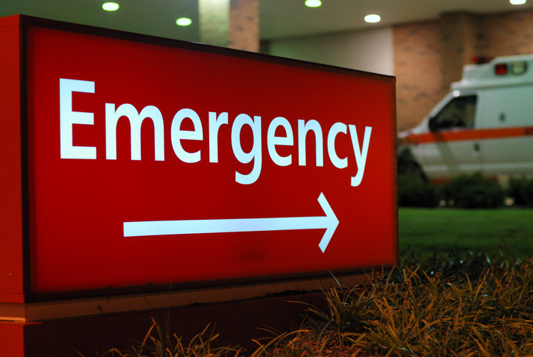
Notes:
The emergency department is increasinggly recognized as a critical component of the addiction care system. Provision of harm reduction, peer recovery, and evidence-based addiction treatment services is feasible and effective.

Slide 5
Buprenorphine | Treatment Referral | Brief Intervention
78% | 37% | 45%
95%CI 70%-85% | 95%CI 28%-47% | 95%CI 36%-54%
Notes:
ED buprenorphine in particular is feasible, safe, and effectively link people to follow up care. Initial RCT published in 2018 showed increased linkage to outpatient treatment compared to referral and BI. There have been significant efforts to expand buprenorphine nationally, but uptake has been slow.

Slide 6
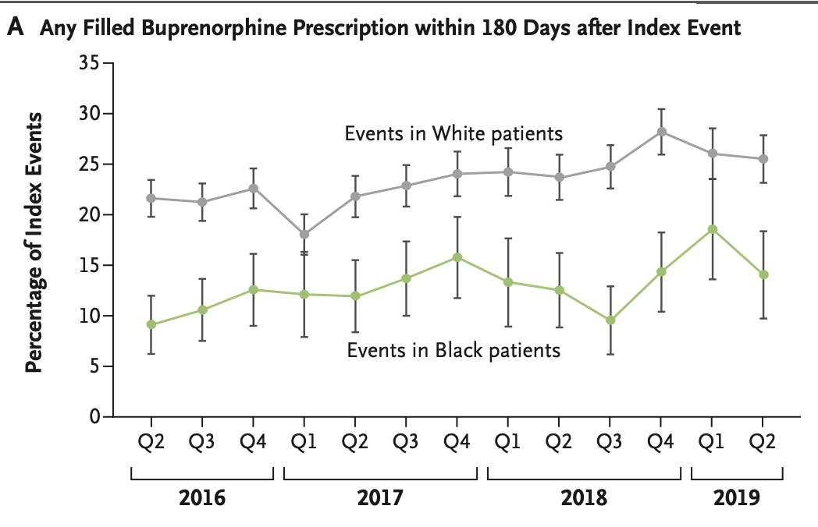
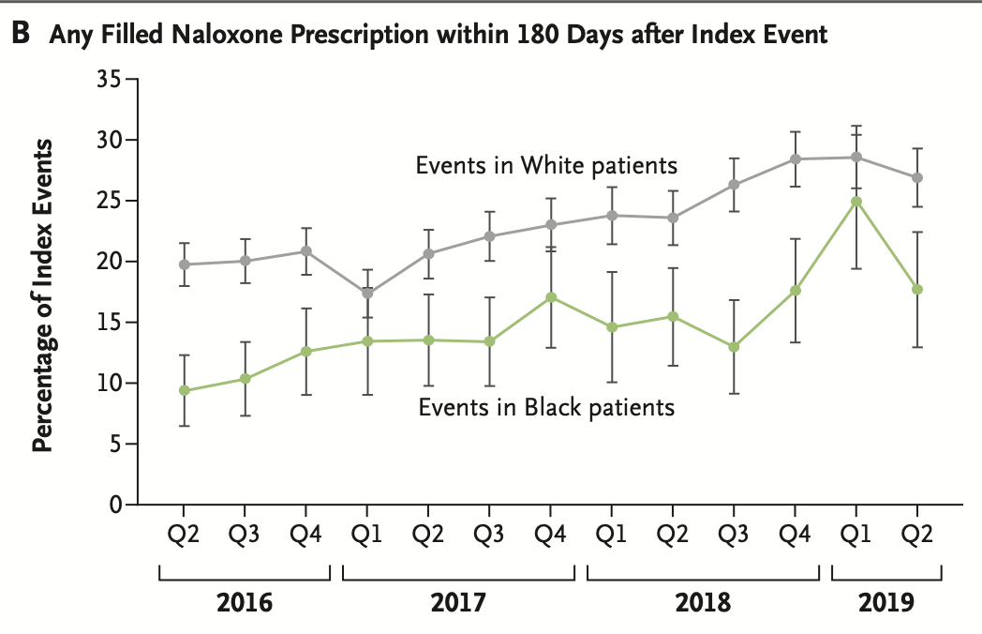
Treatment Access
Barnett ML, et al, NEJM, 2023
Notes:
We also know that there are significant inequities in the provision of medications for OUD and filling of naloxone prescription after nonfatal overdose treated in an emergency department or inpatient setting, hospitalization with injection drug use–related infection, or inpatient or residential rehabilitation or detoxification care. his study by Barnett et al demonstrated that among national Meidcare recipients, Black patients were 42% less likely to get buprenorphine compared ot white patients, Latino/Latina/Latinx patients were 22% less likely.
Barnett ML, Meara E, Lewinson T, Hardy B, Chyn D, Onsando M, Huskamp HA, Mehrotra A, Morden NE. Racial Inequality in Receipt of Medications for Opioid Use Disorder. N Engl J Med. 2023 May 11;388(19):1779-1789. doi: 10.1056/NEJMsa2212412. PMID: 37163624; PMCID: PMC10243223.
Among national Medicaid recipients, compared to non-Hispanic White people:
Black, non-Hispanic/Latino/a/e patients with OUD are 42% less likely to get buprenorphine
Hispanic/Latino/Latina/Latine 22% less likely
Native American, Alaska Native, and Asian, and Pacific Islander patients 12% less likely
Dunphy CC, Zhang K, Xu L, Guy GP Jr. Racial‒Ethnic Disparities of Buprenorphine and Vivitrol Receipt in Medicaid. Am J Prev Med. 2022 Nov;63(5):717-725. doi: 10.1016/j.amepre.2022.05.006. Epub 2022 Jul 6. PMID: 35803789; PMCID: PMC9588682.
In California, ZIP codes with white majority residents had higher rates of bup prescriptions compared to ZIP codes with more racially diverse populations.
The ED is an opportunity to address racial inequities in treatment initiation

Slide 7
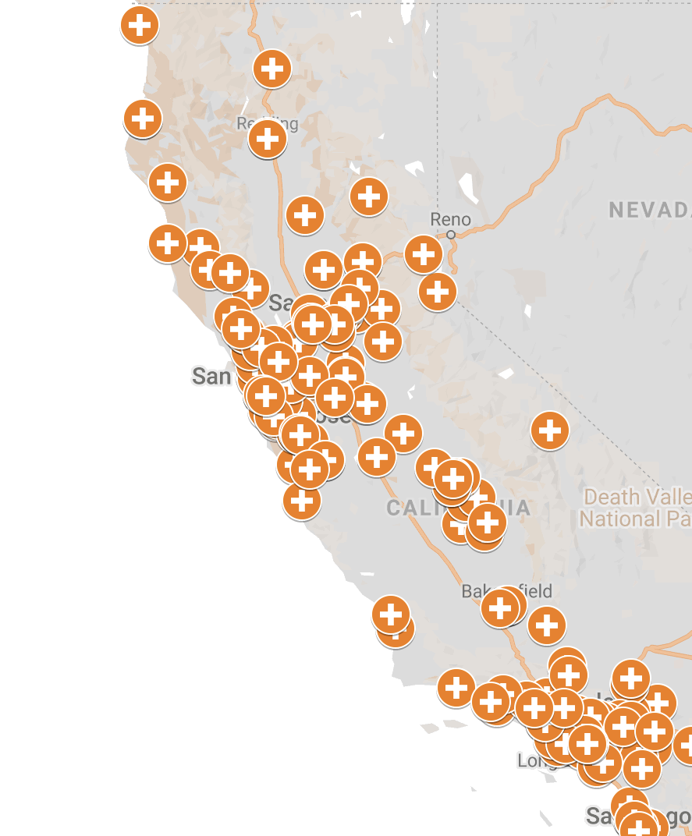
CA Bridge Goal
Goal: 24-7 access to high quality treatment of substance use disorders in all California hospitals by 2025.

Slide 8
CA Bridge Model
Low-Barrier Treatment
Buprenorphine
Connection to Care and Community
Patient Navigation
Culture
of Harm Reduction
Naloxone
Notes:
CA bridge works to implement low barrier addiction treatment with buprenorphine, connection and linkage to care using patient navigators, and cultivating a culture of harm reduction both through their education with front line providers, but also through provision of harm reduction education and services, including naloxone distribution.

Slide 9
Methods - Implementation
April 2019 - June 2023
3 Implementation Rounds:
Round 1: April 2019 - September 2020
Round 2: October 2020 - June 2022
Round 3: July 2022 - June 2023 (ongoing)
Programs funded through June 2024
Notes:
The bridge model was developed in a 2016 pilot funded by The California Health Care Foundation
With support of the Public Health Institute and federal funding, bridge was expanded in 3 rounds,

Slide 10
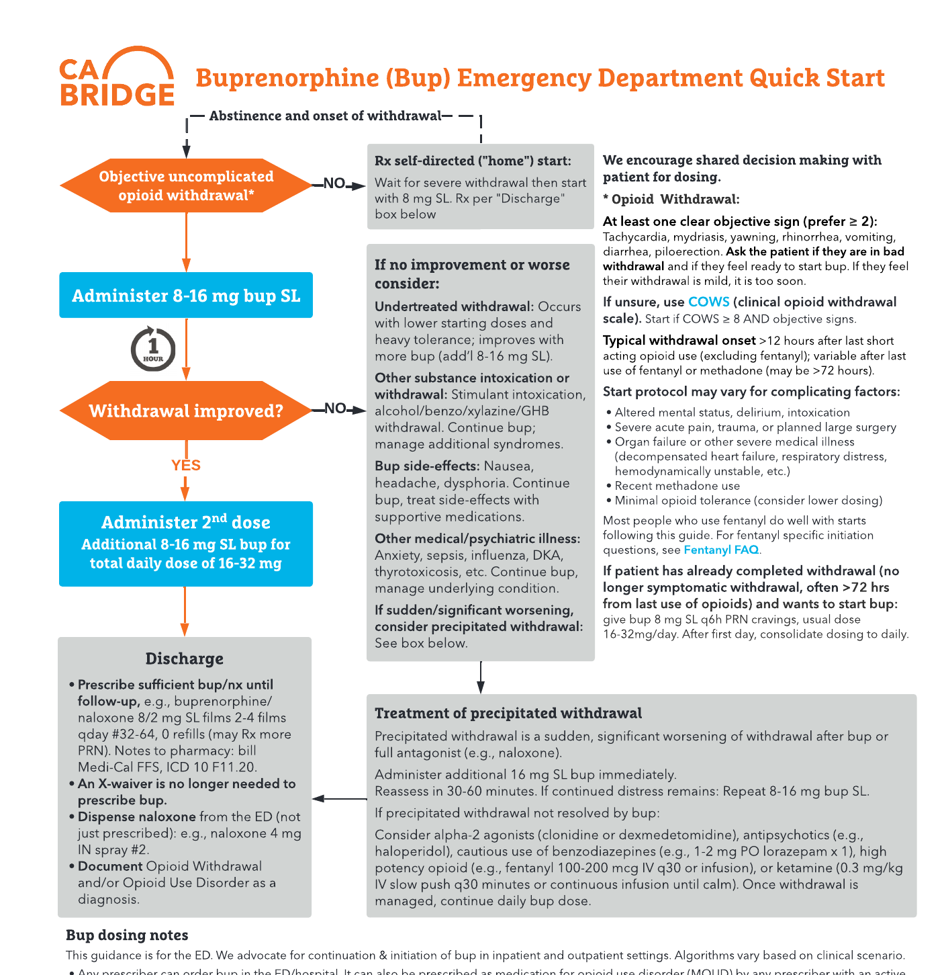
Methods - Implementation
Implementation:
Site patient navigators & clinical champion
Training
Technical Assistance
Direct funding to hospitals (hospitals could participate in multiple funding rounds)
Notes:
The bridge model was developed in a 2016 pilot funded by The California Health Care Foundation
With support of the Public Health Institute and federal funding, bridge was expanded in 3 rounds,

Slide 11
Methods - Analysis
POP: April 2019-June 2023 CA Bridge participating hospitals completing data reporting
DESIGN: Retrospective cross-sectional study
DATA: Aggregate program reported data
OUTCOMES:
CA Bridge implementation
ED buprenorphine provision
Patient navigation
ANALYSIS:
Median outcome comparisons,
first vs. last month
Wilcoxon Signed-Rank Sum Test
Round 1: 52 sites
Notes:
The bridge model was developed in a 2016 pilot funded by The California Health Care Foundation
With support of the Public Health Institute and federal funding, bridge was expanded in 3 rounds,

Slide 12
CA Bridge Reporting Hospitals
Round 2: 200 sites
Round 3: 241 sites
81.0% of California acute-care hospitals participated and reported data in ≥1 rounds (268/331)

Slide 13
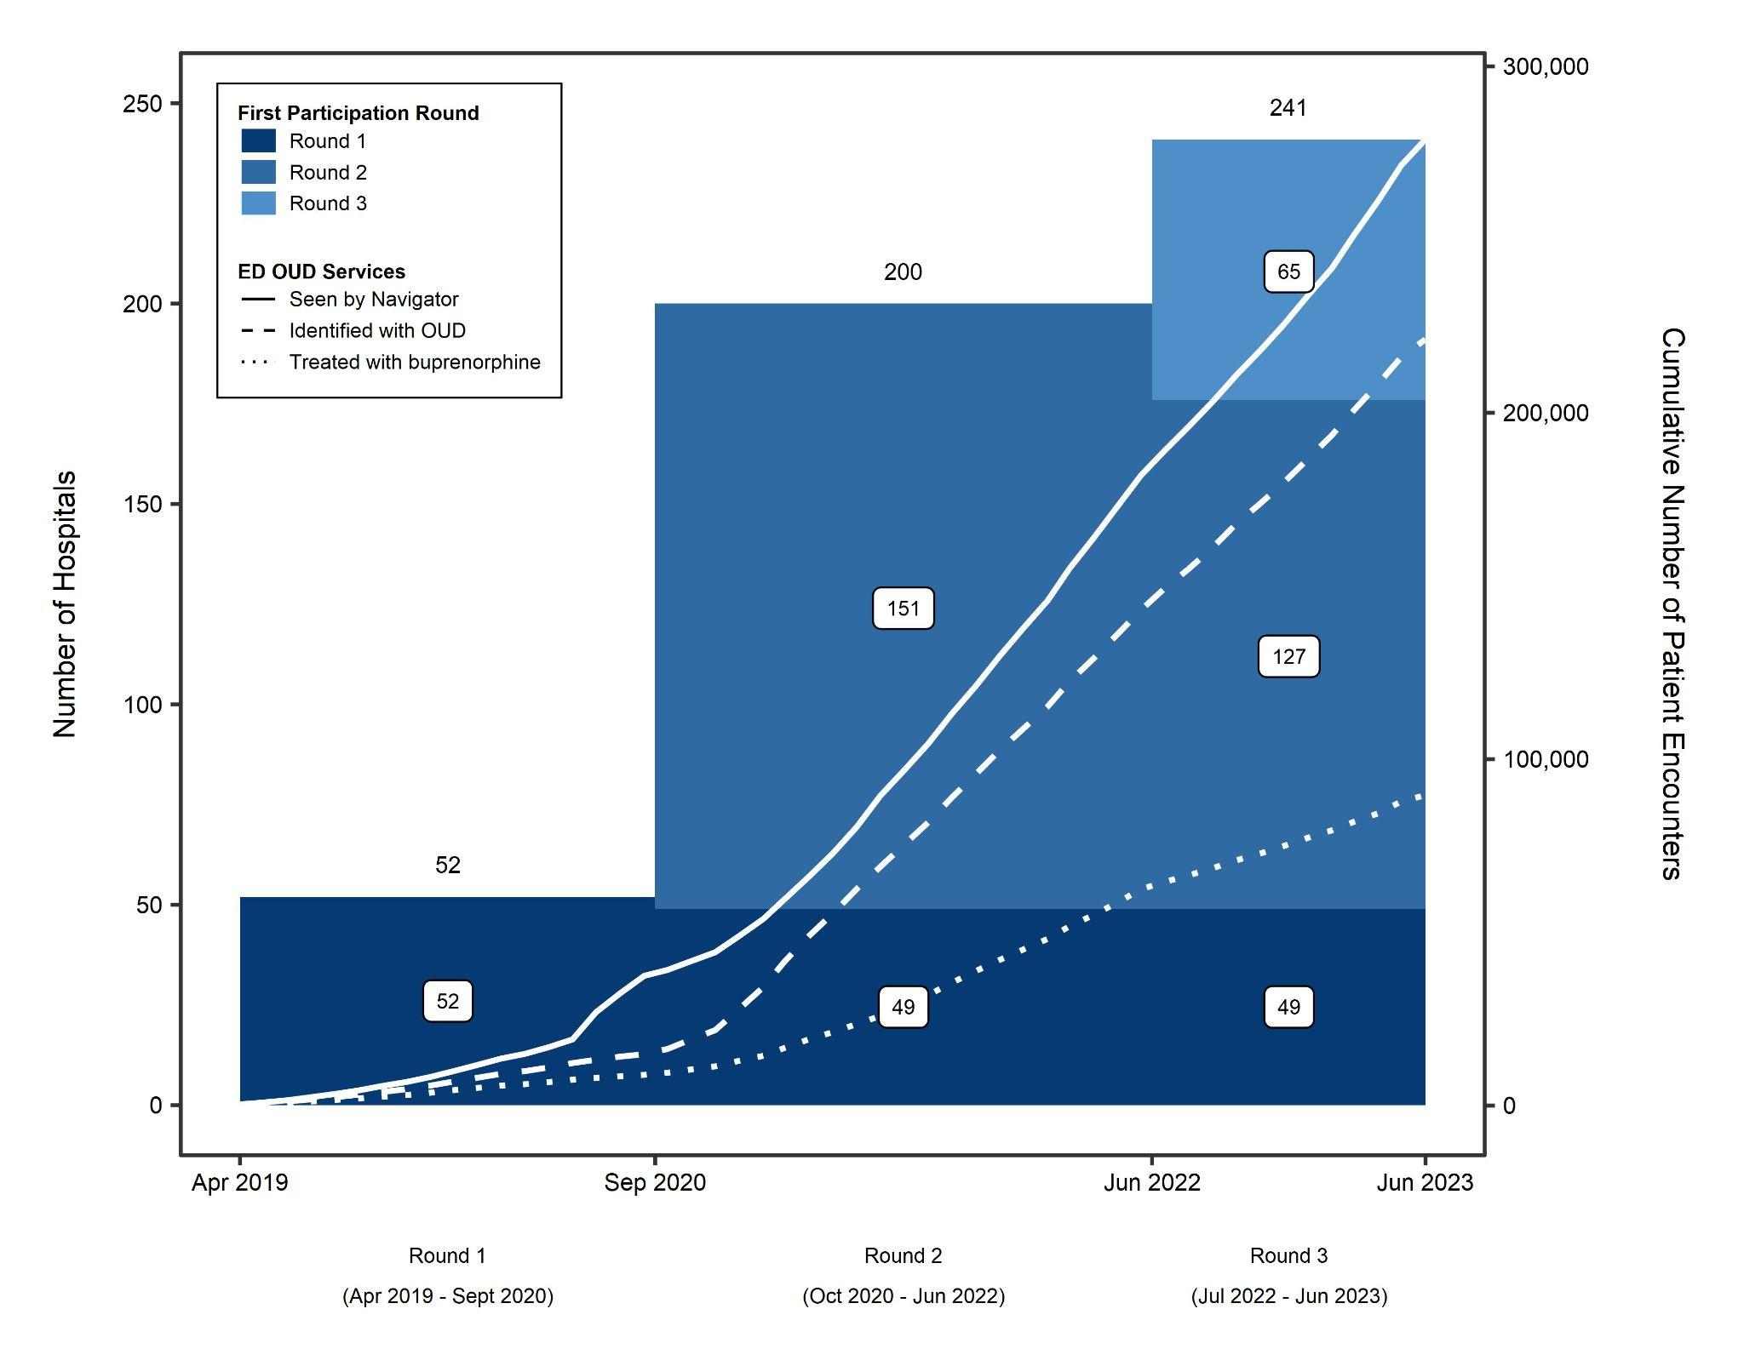
CA Bridge
reporting hospitals and services by funding round:
April 2019 to June 2023
86.7% of round 1 and 2 EDs
participated in a subsequent round
22.4% (54/241) of total round 3 participating EDs have sustained their patient navigator

Slide 14
Changes in ED OUD Care
First Implementation Month Median (IQR) | Final Implementation Month Median (IQR) | p
0 (0-1) | 24 (6-58) | <0.001
1 (0-5) | 5 (1-15) | <0.001
Patient Navigation
ED Buprenorphine

Slide 15
Equity & Treatment
CA Bridge Participating EDs:
One-third serve ED patient populations that are majority people of color
56 sites are public or district municipal public hospitals
36 sites are critical access hospitals
Greater odds of ED buprenorphine among:
People with unstable housing
Medicaid enrollees
Kalmin, et al Drug and Alcohol Dependence 2021
Notes:
Kalmin, et al Drug and Alcohol Dependence 2021
https://doi.org/10.1016/j.drugalcdep.2021.108673

Slide 16
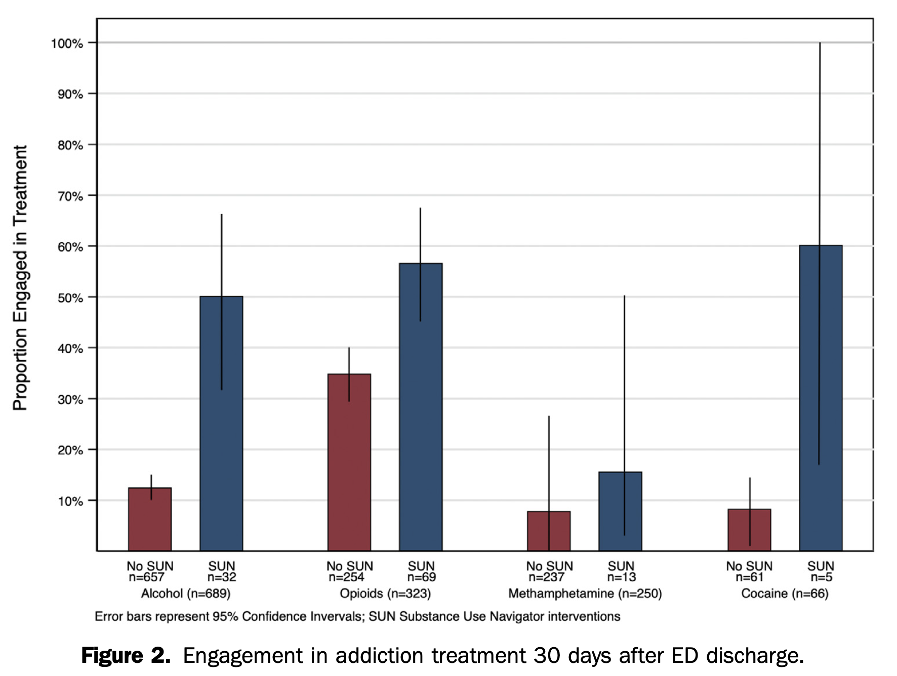
Effectiveness of
Substance Use Navigation
for Emergency Department Patients with Substance Use Disorders:
An Implementation Study
Anderson, et al Ann Emerg Med 2023

Slide 17
Conclusion
The emergency department (ED) is a critical part of the addiction care system
CA Bridge rapidly scaled ED buprenorphine and patient navigation across >80% California EDs with funding and technical assistance support
High program retention (86.7%)
22.4% of hospitals are currently able to sustain their patient navigator
Need hospital, payer, state, and federal level initiatives for implementation maintenance, sustainability, and dissemination

Slide 18
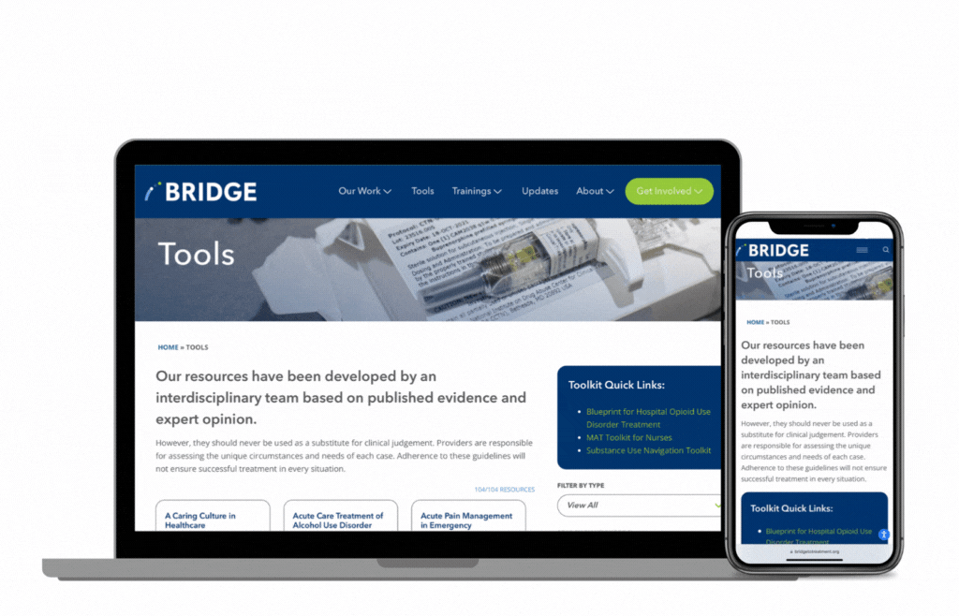
Resources

Slide 19
Elizabeth Samuels, MD, MPH, MHS
esamuels@bridgetotreatment.org
lizsamuels@ucla.edu
www.cabridge.org

