Slide 1
Buprenorphine Induction As a Support for Families with Child Protective Services (CPS) Involvement
Matthew Holm, MD & Zina Huxley-Reicher, MD

Slide 2
Conflicts of Interest
Holm - None
Huxley-Reicher - None

Slide 3
Objectives
Overview of MOUD barriers in birthing people
Review disparities in family policing involvement
Review of low dose induction in post-partum period
Discussion of medical legal partnerships and early involvement of family representatives

Slide 4
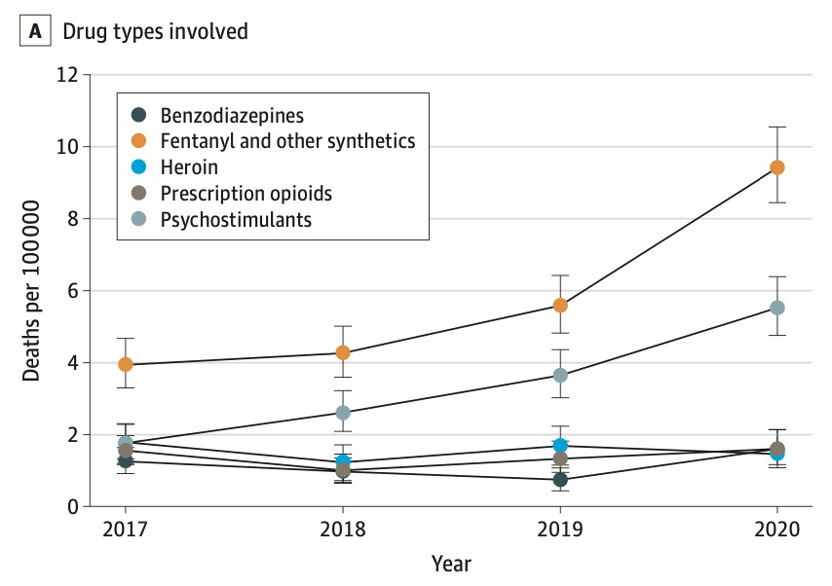
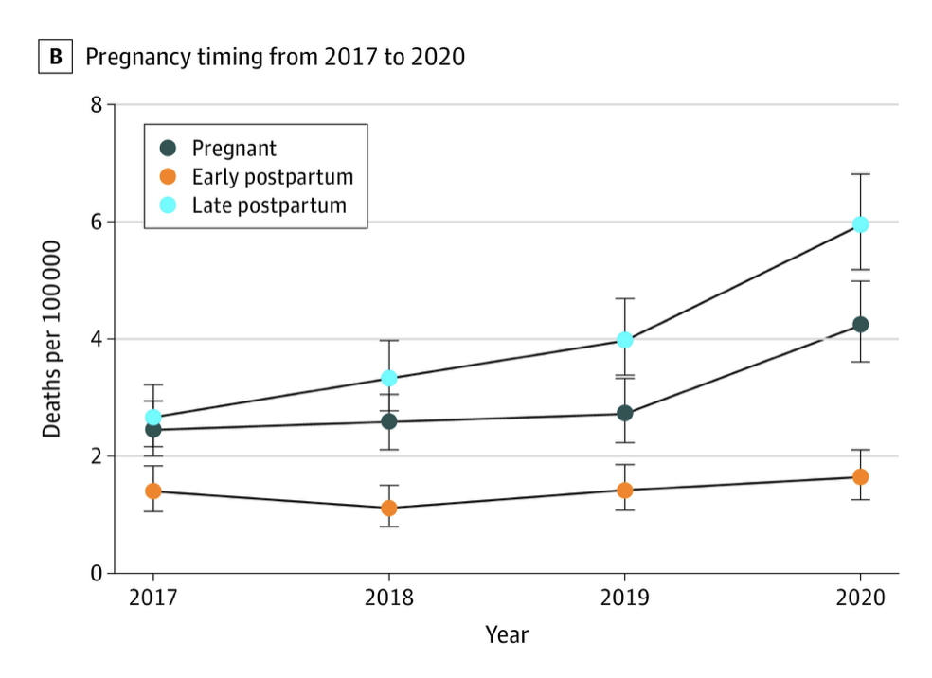
Health of Birthing People
Bruzelius 2022 - JAMA
2017-2020 Pregnant/postpartum persons, OD mortality increased approx 81%
Austin 2022 – JAMA Pediatrics
Mandated reporting policies associated with ↓ prenatal and postpartum care
Schiff 2022 - ↑ scrutiny/surveillance and potential loss of custody
Austin AE et al. JAMA Pediatr. 2022
Schiff DM et al. J Subst Abuse Treat, 2022
Bruzelius E et al. JAMA. 2022

Slide 5
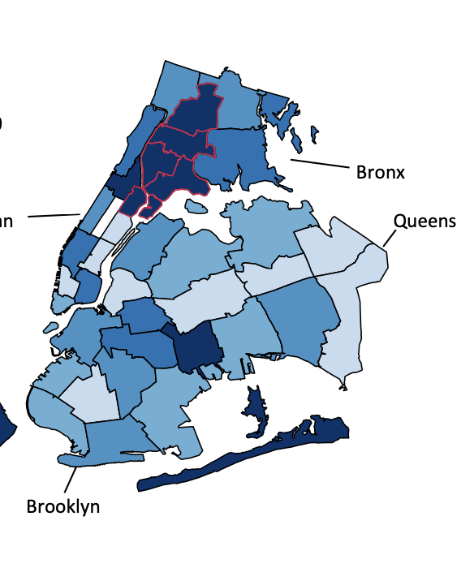
Family Policing Context
Butel, A. Data Brief Child Welfare Investigations and NYC Neighborhoods. The New School Center for NYC Affairs. 2019
Unintentional Drug Poisoning (Overdose) Deaths in New York City in 2023. NYC Health. October 2024
Notes:
Overdose map

Slide 6
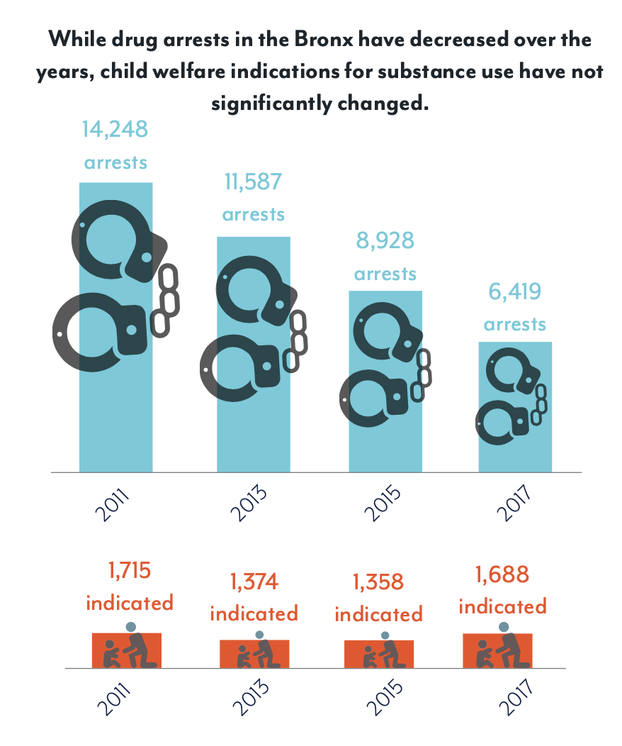
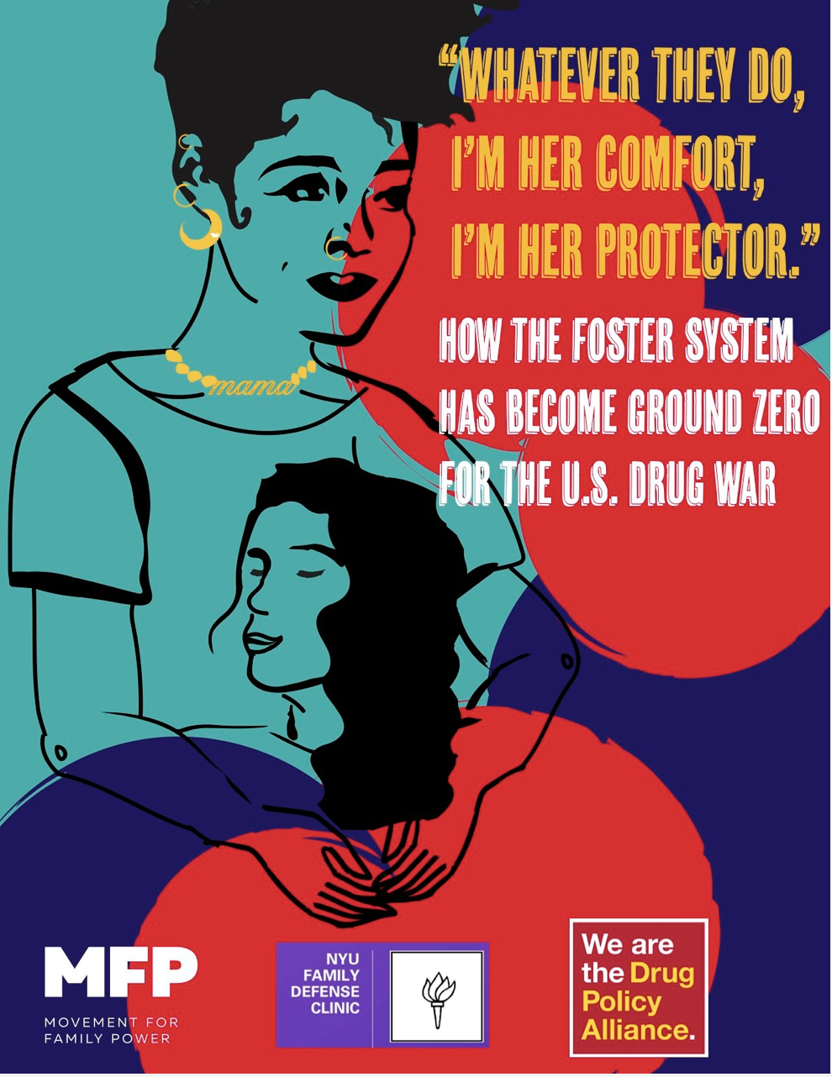
Lisa Sangol, Movement for Family Power. 2020.

Slide 7
Case
Presented to the hospital In active labor, requiring emergent Caesarian section; also noted to be in opioid withdrawal
Hx of intranasal heroin/fentanyl use for 1 year triggered by loss of housing
Noted success when given non-prescribed buprenorphine
Attempted to access care at an outpatient clinic, but was denied appointment due to lapse of Medicaid
Notes:
Clinical case
Slide 1 – presentation, no insurance poor tx access
Slide 2 – management of withdrawal, low dose protocol → tx and make sure they are comfortable, needs being met
Slide 3 – Role as advocates → utox (not fully informed), acs, SCR requirements, BxD, case conference, active if plan of safe care
Slide 4 – Current updates, CFCC
Resources
Toolkit for reporting requirements
Informed consent

Slide 8
Case
Day | Full opioid agonist | Buprenorphine dose
1 | Methadone 40mg + PRN oxycodone | 225mcg q6h Belbuca
2 | Methadone 40mg + PRN oxycodone | 450mcg q6h Belbuca
3 | Methadone 40mg + PRN oxycodone | 2mg q6h Suboxone
4 | STOP | Previous day Suboxone +2-4mg q4h PRN
Addiction Consult Service (ACS) consulted overnight
Withdrawal treated with methadone
Low dose transition to bupe with plan to transition to long acting injectable (LAI)
Initial evaluation by ACS included obtaining permission to advocate
Low dose Bupe initiation - Sample protocol
Notes:
Clinical case
Slide 1 – presentation, no insurance poor tx access
Slide 2 – management of withdrawal, low dose protocol → tx and make sure they are comfortable, needs being met
Slide 3 – Role as advocates → utox (not fully informed), acs, SCR requirements, BxD, case conference, active if plan of safe care
Slide 4 – Current updates, CFCC
Resources
Toolkit for reporting requirements
Informed consent
Proactive community care
https://harmreduction.org/wp-content/uploads/2023/04/APHR_ENGLISH_NHRC_UPDATE_PSU-2022_2.pdf
https://www.guttmacher.org/state-policy/explore/substance-use-during-pregnancy

Slide 9
Case
ACS noted concerns about urine drug screen consent being inadequately informed
Provided Bronx Defender’s contact and encouraged outreach by patient.
Communicated with pediatrics team about consent concerns
Participated in care conference for Plan of Safe Care (POSC) and noted willingness of patient to start buprenorphine and to be engaged in wraparound care for OUD
Notes:
Clinical case
Slide 1 – presentation, no insurance poor tx access
Slide 2 – management of withdrawal, low dose protocol → tx and make sure they are comfortable, needs being met
Slide 3 – Role as advocates → utox (not fully informed), acs, SCR requirements, BxD, case conference, active if plan of safe care
Slide 4 – Current updates, CFCC
Reached out to BxD’s contacts.
Resources
Toolkit for reporting requirements
Informed consent

Slide 10
Case
Initially discharged to a mother-baby substance use program
Per the POSC, transitioned care to Montefiore’s CFCC clinic where pediatrics, obstetrics, and addiction care are available
Transitioned to LAI bupe and remains engaged in care
CPS case closed after 21 days post-discharge
Notes:
Clinical case
Slide 1 – presentation, no insurance poor tx access
Slide 2 – management of withdrawal, low dose protocol → tx and make sure they are comfortable, needs being met
Slide 3 – Role as advocates → utox (not fully informed), acs, SCR requirements, BxD, case conference, active if plan of safe care
Slide 4 – Current updates, CFCC
Resources
Toolkit for reporting requirements
Informed consent

Slide 11
Takeaways
Addiction care providers, including consult services, should lean in when engaging with families affected by the family policing system
Build medical-legal partnerships
Role of ACS as a connector amongst inpatient teams
Post-discharge substance use or “Bridge” programs should serve as part of the Plan of Safe Care to maintain family unification
Notes:
Clinical case
Slide 1 – presentation, no insurance poor tx access
Slide 2 – management of withdrawal, low dose protocol → tx and make sure they are comfortable, needs being met
Slide 3 – Role as advocates → utox (not fully informed), acs, SCR requirements, BxD, case conference, active if plan of safe care
Slide 4 – Current updates, CFCC
Resources
Toolkit for reporting requirements
Informed consent
Build MLP – to advocate for families, but understand the legal landscape of your community
Family unification – better engagement in treatment, less traumatic for families

Slide 12
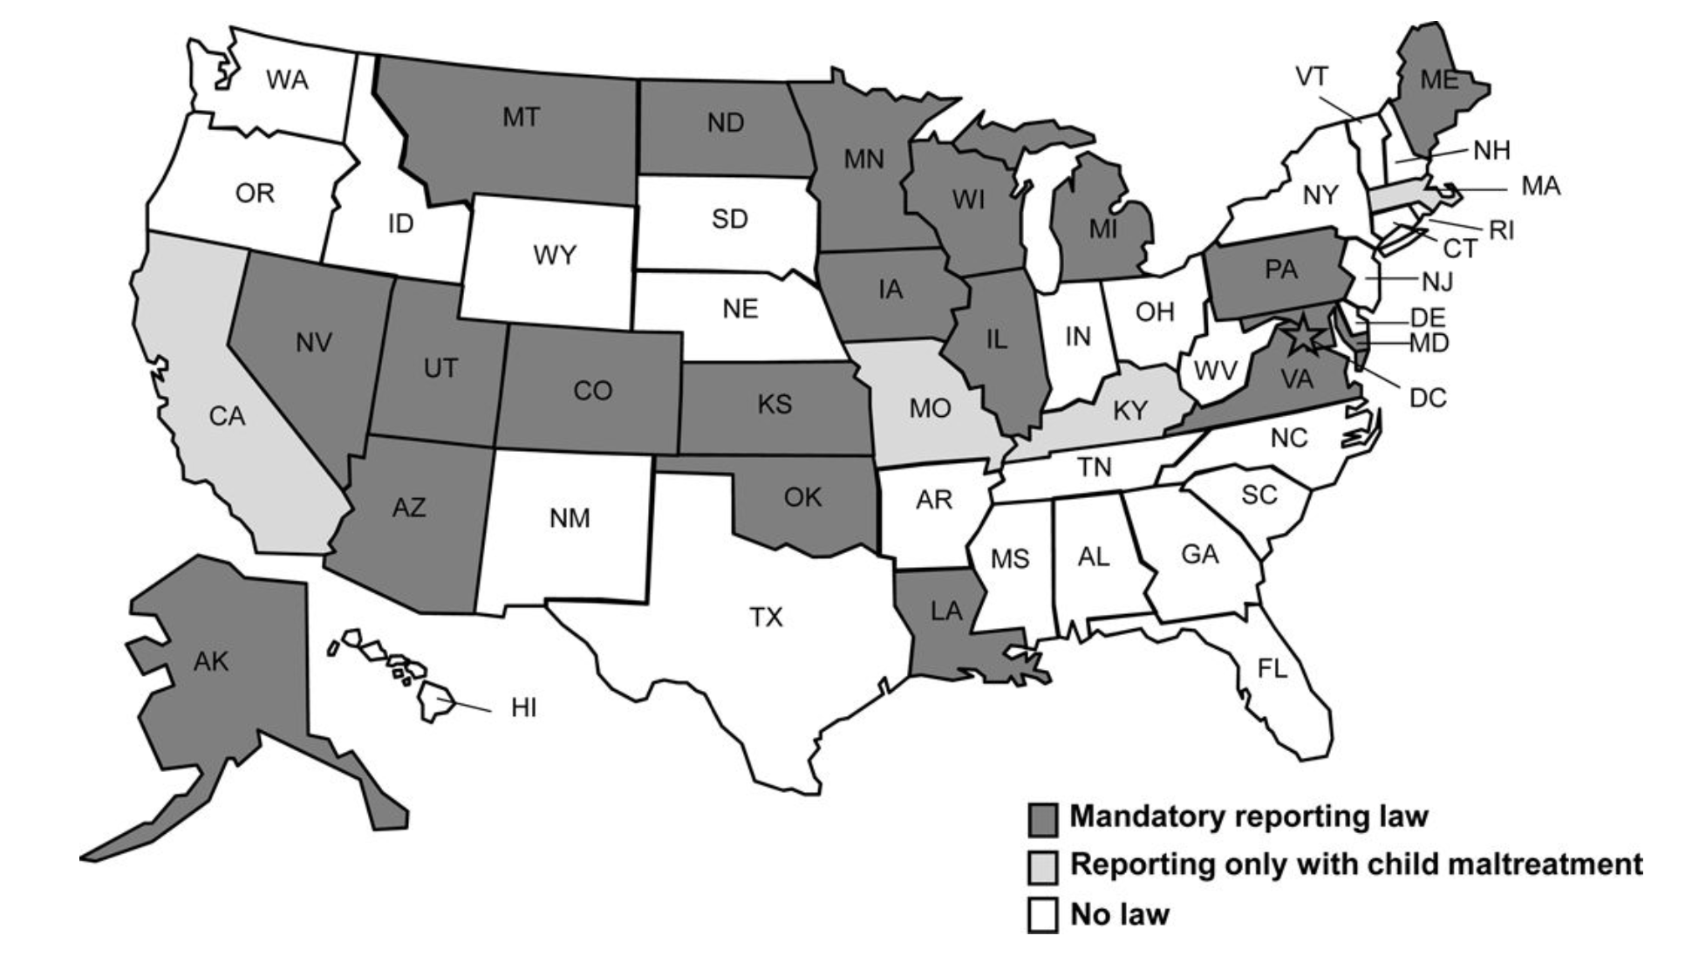
National Landscape
Jarlenski M et al. Womens Health Issues, 2017
Notes:
MLB - help us understand a complicated landscape of mandated reporting law

Slide 13
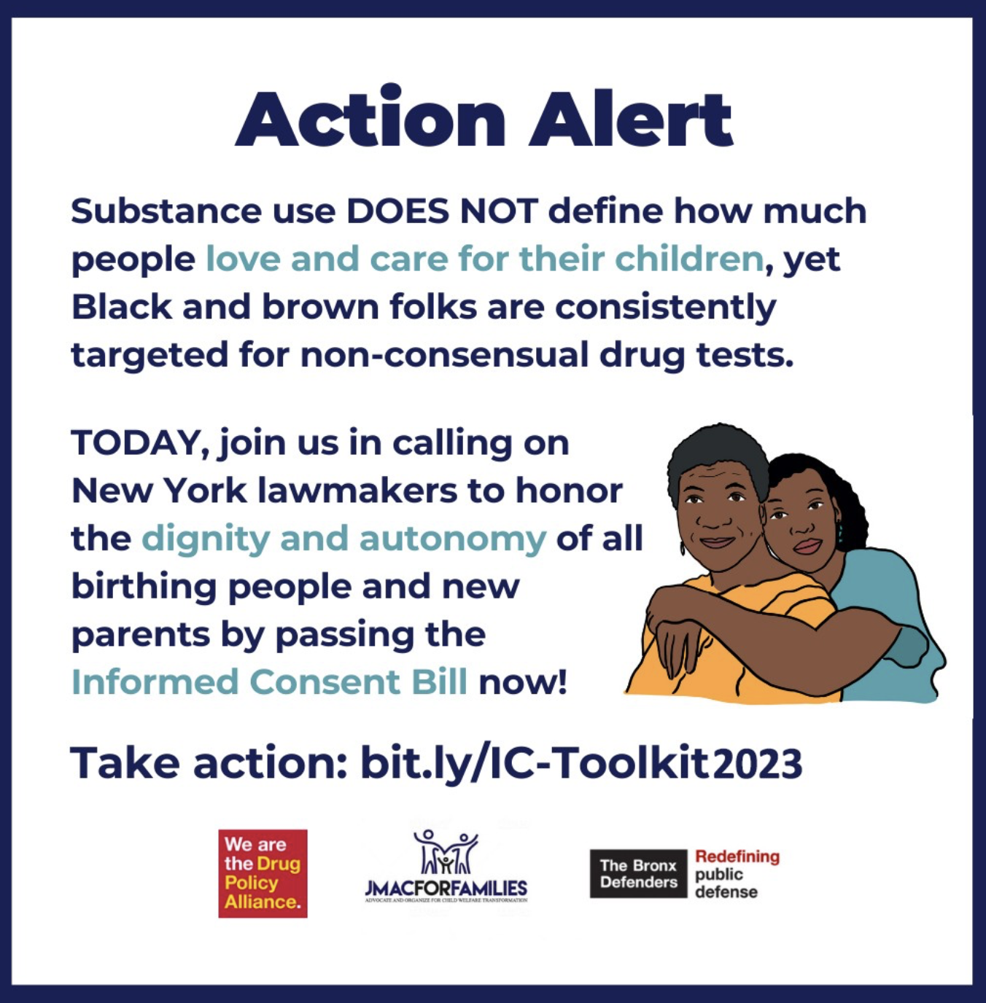
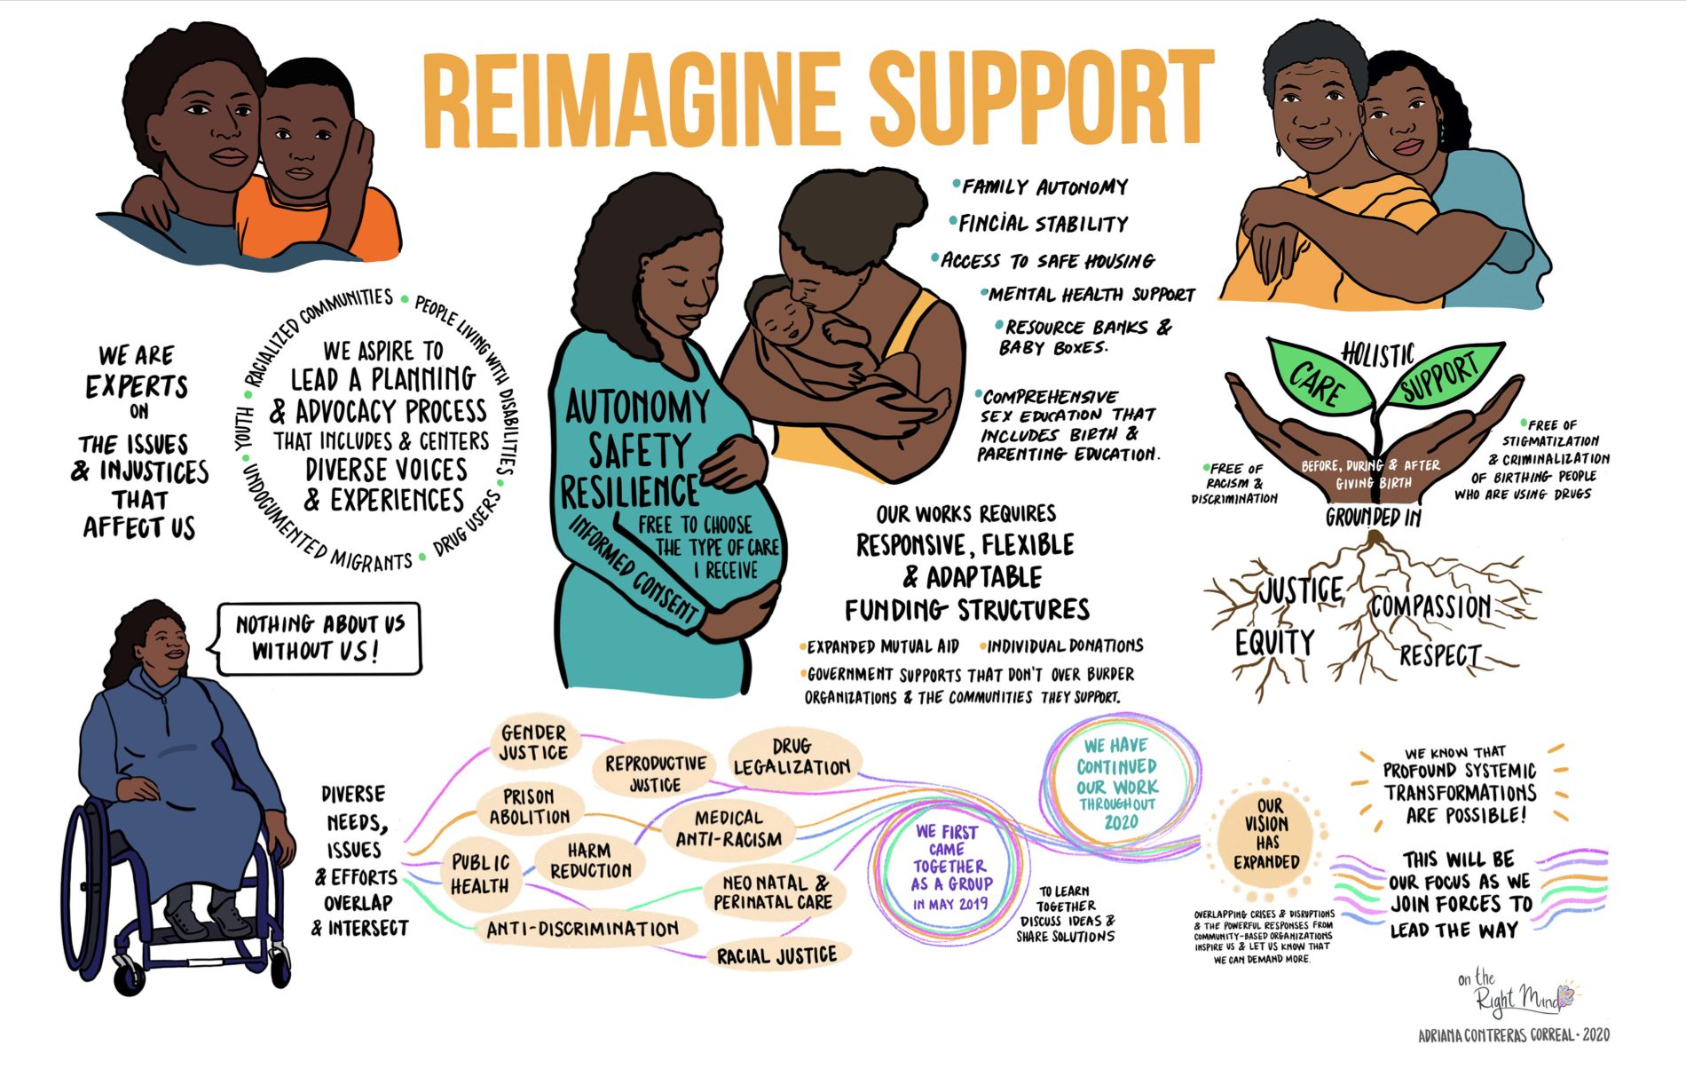
Advocacy
Informedconsentny.com
Notes:
Informedconsentny.com
Coalition of advicates, community members, attorneys and HCPs advocating for Informed Consent Bill that would mandate providers to obtain fully informed consent both written and verbal for the drug testing of birthing people and their newborns
https://www.informedconsentny.com/our-coalition
Next steps/opportunities
Mandated Support

Slide 14
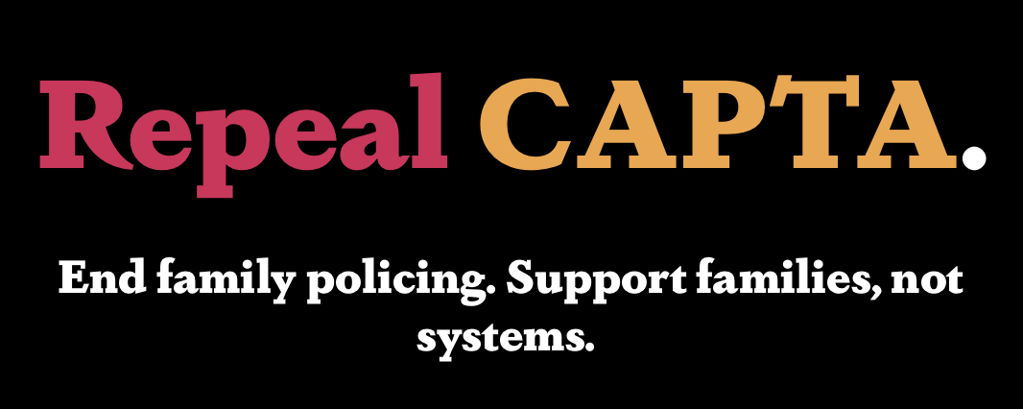
Community Supports
Notes:
Labor of love and justice with a number of groups in different spheres and expertise for decades, often led by folks with lived experience

Slide 15
Acknowledgments
Notes:
Black feminist movement

