Slide 1
Buy and Bill vs Patient Supplied XR BUP: a Nursing Administration Perspective
Charina Hanley, BSN, RN, CARN
Jacelyn Farmerie, CARN
Joseph Wright, MD

Slide 2
Disclosures
We have no conflicts of interest to disclose

Slide 3
Background
Since beginning XR BUP in March 2020, our healthcare for the homeless clinic has administered over 2,800 injections of XR BUP to over 370 outpatient clients. One concern that our program wanted to investigate is the potential effect on how a variety of billing streams for XR BUP could potentially delay care or administration patterns.
3 “champions”
Notes:
Federally Qualified Community Health Center with several locations throughout Boston, Healthcare for the Homeless Program
We work with two billing streams, buy and bill, and patient supplied. With buy and bill we can order “blank” (no name) doses that stay in stock in our fridge, and at the time of a visit the medication can be taken out of the fridge and administered to a patient. With patient supplied doses, the dose must be ordered specifically for that individual patient and delivered via specialty pharmacy. Which specialty pharmacy depends on which pharmacy that patients specific insurance plan is contracted with.

Slide 4
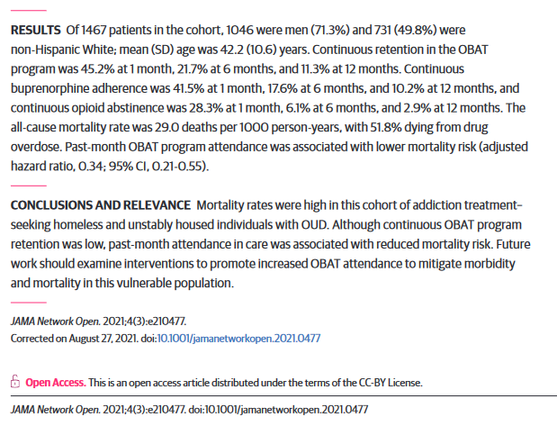
Fine DR, Lewis E, Weinstock K, Wright J, Gaeta JM, Baggett TP. Office-Based Addiction Treatment Retention and Mortality Among People Experiencing Homelessness. JAMA Netw Open. 2021;4(3):e210477. doi:10.1001/jamanetworkopen.2021.0477
“Past-month office-based addiction treatment attendance was associated with a 66% reduction in mortality risk.”
Notes:
Previous Research on our department conducted by Danielle Fine in a “retrospective cohort study of all adults (age ≥18 years) who had at least 1 OBAT program encounter at the Boston Health Care for the Homeless Program (BHCHP) from January 1, 2008, to December 31, 2018.”
BIGGEST takeaway- - “Past-month office-based addiction treatment attendance was associated with a 66% reduction in mortality risk.”
We’ve ben curious if patients on sublocade have improved retention in our program, and thus, reduced mortality risk. This presentation represents the beginning steps into that investigation.

Slide 5
As of 10/1/2024 :
138 clients have received at least one XR BUP injection in the past 4 months
+240 inactive clients
= 378 total clients served
Over 2800 injections since our start in 2020
XR BUP administered at Main outpatient clinic, Medical respite, MGH Street team clinic. St. Francis House clinic, NECHV clinic
Notes:
As of 10/1/2024 :
138 clients have received at least one sublocade injection in the past 4 months
+240 inactive clients
= 378 total clients served
Over 2800 injections since our start in 2020
Sublocade administered at Main outpatient clinic, Medical respite, MGH Street team clinic. St. Francis House clinic, NECHV clinic

Slide 6
Estimated Demographics
 | 208 patients total | # |  | %
Gender | Female | 52 |  | 25%
 | Male | 156 |  | 75%
Ethnicity | Hispanic or Latino/a | 58 |  | 28%
 | Non-Hispanic or Latino/a | 140 |  | 67%
 | Patient Refused | 1 |  | 0.5%
 | Unknown | 9 |  | 4%
Race | American Indian | 3 |  | 1.4%
 | Black/African American | 28 |  | 13%
 | Pacific Islander | 1 |  | 0.5%
 | Patient Refused | 4 |  | 2%
 | Unknown | 23 |  | 11%
 | White | 149 |  | 72%
Notes:
FROM 1/30/2020 TO 1/27/2023. Many more patients have been added to the program since our cutoff date. We’d love to further this research with our growing cohort. It would be interesting to also compare these demographic numbers to that of our OBAT clinic, and our organization as a whole.
Since the Fine et al study, efforts have been made to identify how our program can better serve patients of color, especially Black patients. We have created new outreach positions specifically to address this need in our community. We look forward to seeing if our demographic spread may shift in a few years due to these efforts.

Slide 7
Objective
Our aim was to investigate if a client’s insurance status, which determines the XR BUP revenue stream, has a measurable effect on overall revenue for the program as well as a patient’s ability to receive their XR BUP doses in a timely manner that promotes safety and best care practices.
Notes:
Our aim was to investigate if a client’s insurance status, which determines the XR BUP revenue stream, has a measurable effect on overall revenue for the program as well as a patient’s ability to receive their XR BUP doses in a timely manner that promotes safety and best care practices.

Slide 8
Methods
This research includes:
a retrospective review of reverse-distributed doses of XR BUP
profit margin reports from our billing team that include 340b revenue
distribution patterns for patients insurance plans
collection of supported clinical and financial benefits of same day “buy and bill” administration in comparison to benefits and risks associated with specialty pharmacy supplied doses.
Notes:
This research includes:
a retrospective review of reverse-distributed doses of XR BUP
profit margin reports from our billing team that include 340b revenue
distribution patterns for patients insurance plans
collection of supported clinical and financial benefits of same day “buy and bill” administration in comparison to benefits and risks associated with specialty pharmacy supplied doses.

Slide 9
Barriers with patient supplied dosing:
Time (4-7 days average)
Communication requirements directly with patient from certain specialty pharmacies
No same-day availability to start XR BUP, leading to patients getting lost to follow up before they can get XR BUP
Unexpected insurance changes or shut-offs
We do not have a statistical mortality analysis, but at least one patient died from an overdose while waiting for their patient-supplied sublocade to deliver
Notes:
Time is a huge barrier with patient supplied doses, with our closest partner, Cornerstone Health Solutions, we can sometimes get patient-supplied doses in as little as 4 days, but typically it takes at least 7 days for a dose to be ordered, processed, and delivered.
Some specialty pharmacies including CVS Specialty and Accredo require to speak directly with patient in order to obtain consent for OBAT office to manage sublocade prescription and set up an account
Many of our patients do not have reliable access to cell phones, and will not have medication delivered until this is done. Will sometimes have to return to clinic in order to call pharmacy directly to set up account and obtain consent.
We have experienced patients disconnecting from care, and even passing away, before they were able to receive their patient-supplied dose of XR BUP
The best time to administer sublocade is when the patient is ready for it!
A large majority of clients have within-ACO coverage, and are able to receive buy and bill doses
We are noting an increase trend in patients insurance getting shut off, or switched without patients knowledge.
We do not have a statistical mortality analysis, but at least one patient died from an overdose while waiting for their patient-supplied sublocade to deliver

Slide 10
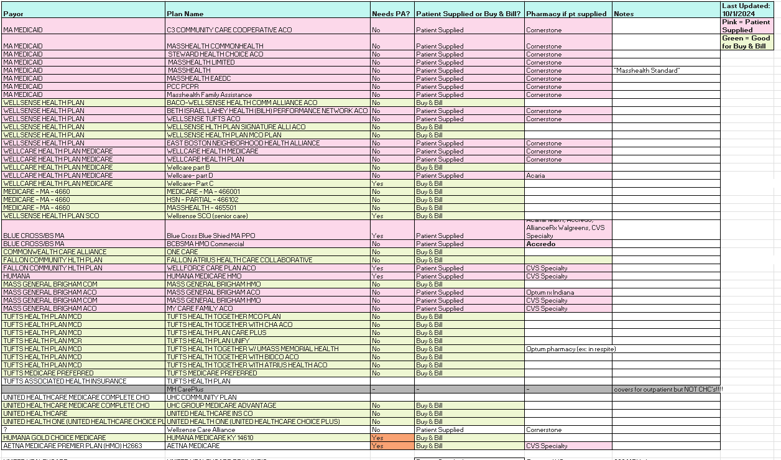
Notes:
This represents the most up-to-date understanding of insurance plans and their known revenue stream. This is within the context of our own ACO and CHC, and unfortunately often cannot translate to other sites. This chart represents hours of calls with insurance companies to extract information that is not readily available online.

Slide 11
Notes:
This is a recent de-identified table of all patient-supplied doses being tracked with various specialty pharmacies. The blue rows represent Active clients, the grey rows represent clients who have not returned in some time to deceive the dose that was delivered for them, so their account is on hold. Doses with patients names on them are sitting in the fridge, unused for months until the patient returns, the medication expires, or it gets reverse-distributed.

Slide 12
Reverse Distribtion
Reverse Distribution
Year | 300mg | 100mg
2021 | 6 | 3
2022 | 17 | 0
2023 | 18 | 1
2024 | 29 | 1
buy and bill | -2 | 0
Total | 68 | 5
Notes:
Our facility is unable to detroy XR bup in house, so the boxes must be managed by a third party to ensure safe and secure disposal. The number of patient supplied doses that have been reverse distributed vastly outweigh the amount of buy-and-bill doses, which were received damaged/faulty from the manufacturer.

Slide 13
XR BUP 340B financial report Jan 2021 to June 2023
Total payment | $1,684,168.41
Total cost | $1,331,922.05
Late fees | $809
Total | $351,437.36
Notes:
The 340B revenue stream utilized for buy-and-bill clients additionally creates incentive for clinics to provide this option for clients, as we have been able to demonstrate a significant revenue gain from insurance reimbursement using this method.
“If your higher-ups wont listen to the organizational hurdles, maybe they’ll hear out the financial argument”

Slide 14
Conclusion
Preliminary results suggest that it behooves our patients to have within-ACO insurance products as it allows for greater ease of access to XR BUP via buy and bill revenue stream, and less delays in patient care. We anticipate that ease of use and overall profit of 340b pricing will outweigh profit procured from patient-supplied dosing.
Further research is indicated to continue to identify why there is such a significant disparity in use of XR-BUP for our patients of color.
Information such as what was shared today is encouraged to be shared with insurance companies, stakeholders, and advocates. Our patients deserve access to life-saving medication in real time, and without excessive burden on clinic staff to organize.
Notes:
“Insurers who want to limit expense of XR-bup by insisting on specialty pharmacies, may be instead:
lowering adherence
decreasing ease of starting
increasing barriers to care
increasing wasted and unused doses
missing a chance to provide structural incentives for health centers to increase the uptake of this intervention.
but immediate treatment with BUP may keep heavy utilizers out of the ED, which is the purpose of all these health homes and CP programs.
Preliminary results suggest that it behooves our patients to have within-ACO insurance products as it allows for greater ease of access to XR BUP via buy and bill revenue stream, and less delays in patient care. We anticipate that ease of use and overall profit of 340b pricing will outweigh profit procured from patient-supplied dosing.
Further research is indicated to continue to identify why there is such a significant disparity in use of XR-BUP for our patients of color.
Information such as what was shared today is encouraged to be shared with insurance companies, stakeholders, and advocates. Our patients deserve access to life-saving medication in real time, and without excessive burden on clinic staff to organize.

Slide 15
References
Fine DR, Lewis E, Weinstock K, Wright J, Gaeta JM, Baggett TP. Office-Based Addiction Treatment Retention and Mortality Among People Experiencing Homelessness. JAMA Netw Open. 2021;4(3):e210477. doi:10.1001/jamanetworkopen.2021.0477

