Slide 1
Caring for Individuals with Substance Use Disorder during Childbirth: Experiences of Rural Healthcare Providers
Assumpta Nantume, MS;
Jami Baayd, MSPH; Olivia Hanson; Melissa Watt, MA, PhD; Susanna R. Cohen, DNP, CNM, CHSE, FAAN, FACNM
AMERSA Annual Conference| November 16, 2024
Notes:
Hello! I am Assumpta Nantume from the Elevate Center at the University of Utah, and I will be discussing our team’s findings about experience of rural healthcare providers who provide care for pregnant people with substance use disorder.

Slide 2
The ELEVATE Center
Mission: The ELEVATE Center aims to improve the safety and quality of care for pregnant people with substance use disorder in Utah and the intermountain west.
Funding Disclosure: The research described in this presentation was supported by the National Institutes of Health under Award Number U54HD113169.
Our team has no conflicts of interest to report.
Notes:
First, a bit of background.
The research I am presenting on today was conducted during the beginning phase of a seven-year project called INSPIRE.
INSPIRE is one of two research projects housed within an NIH-funded maternal health research center called ELEVATE. ELEVATE, housed at the University of Utah, is dedicated to improving the safety and quality of care for pregnant and birthing people with substance use disorder.

Slide 3
ELEVATE’s Commitment to DEI
ELEVATE Community Advisory Board
CEREMONY Project
Story Circles
Patient Interviews
Notes:
The ELEVATE Center is working towards inclusion of an oversight by many historically overlooked communities in Utah. From its beginning, ELEVATE has formed a DEI committee with members including: Utah Division of Indian Affairs, Urban Indian Center of Salt Lake, Rural Health Associations of Utah, Utah Harm Reduction Coalition, Community Faces of Utah and Black Birth workers of Utah Collaborative.
Further, one of ELEVATE’s other research projects, CEREMONY, is focused on adapting Utah’s University-based model of care for perinatal substance use disorder for Native mothers. The CEREMONY team is working closely with Native leaders in Salt Lake City and throughout the state to develop a care model that will amplify community, healthcare engagement, belonging, and trust in order to support recovery among Native pregnant people with SUD.

Slide 4
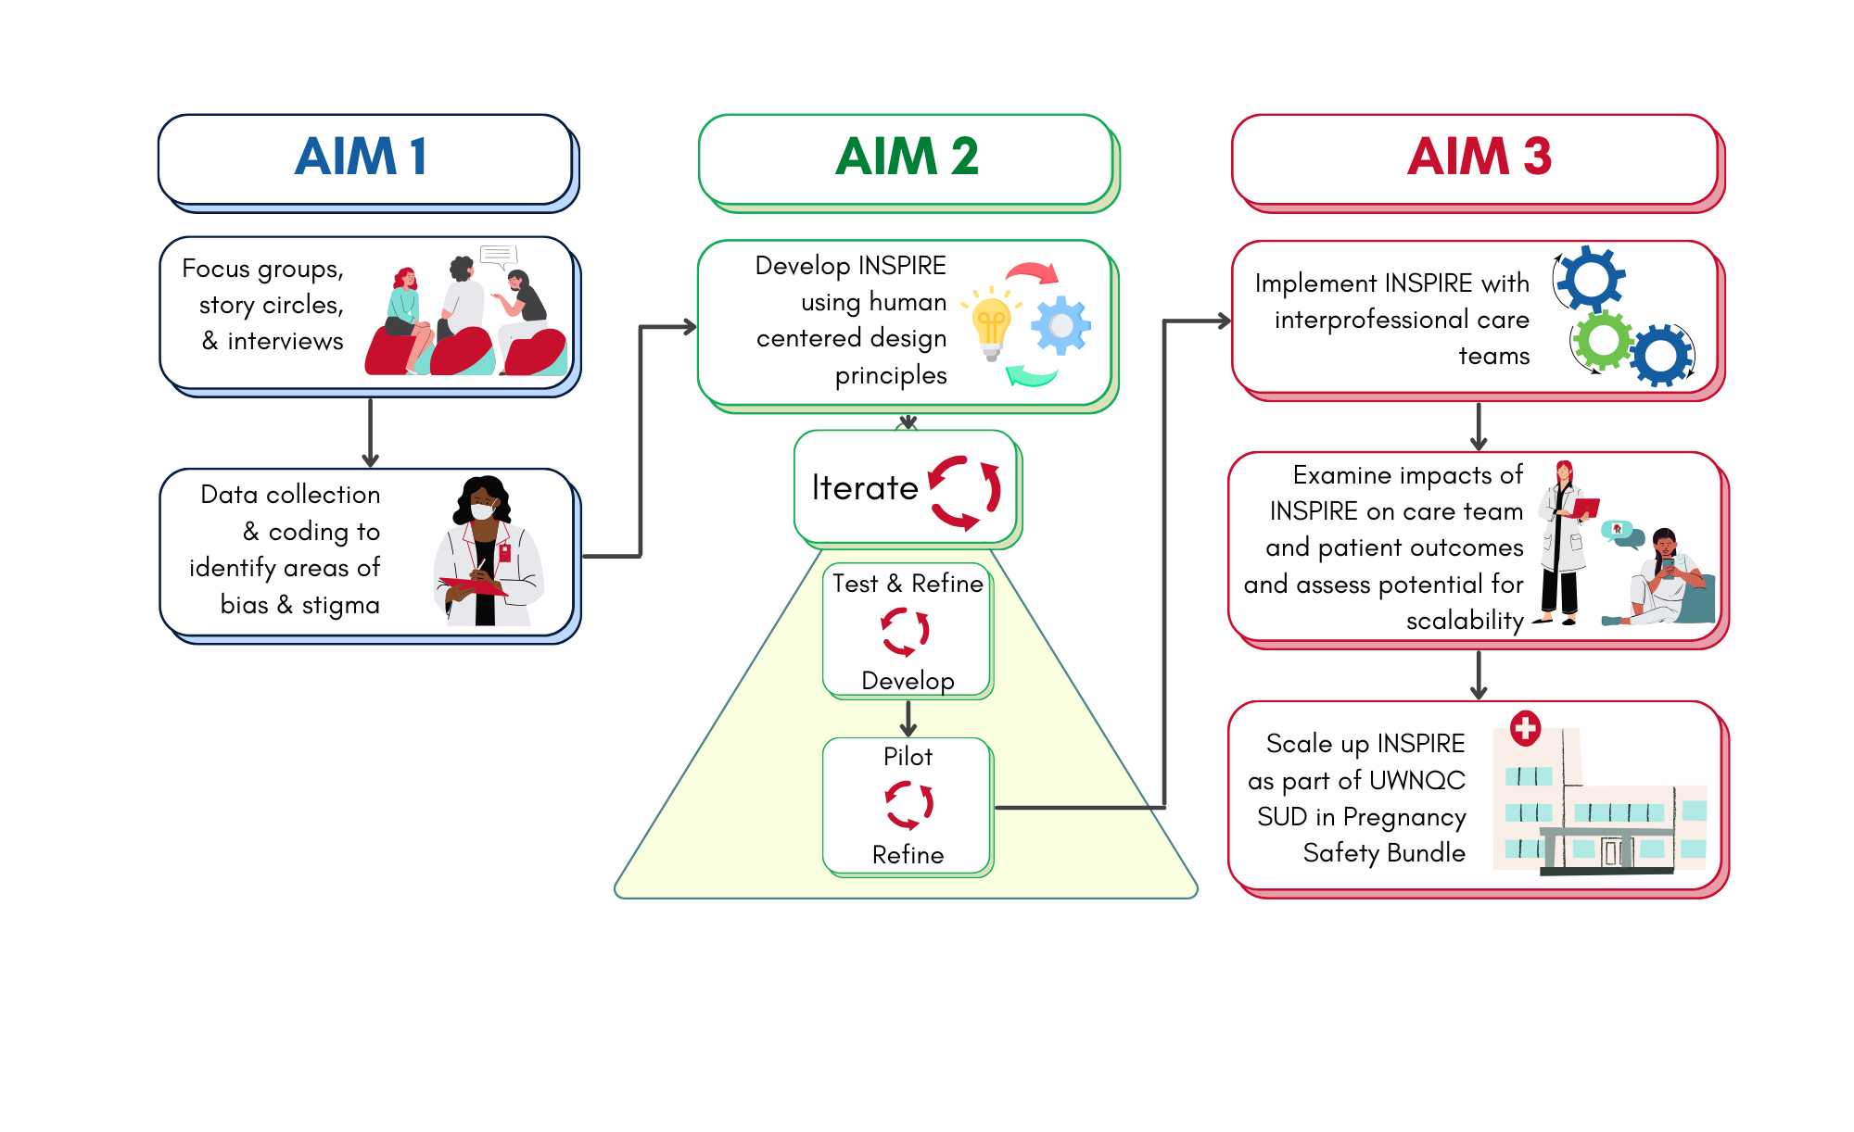
Overview of Project INSPIRE
The goal of INSPIRE study is to develop and evaluate a dynamic intervention for healthcare provider teams to help them deliver high-quality, respectful care for individuals with substance use disorder who are giving birth.
Notes:
Now, back to our project. Project INSPIRE is a seven year study with the goal to develop and evaluate an intervention for interdisciplinary healthcare teams to help them deliver high quality, respectful care for people with substance use disorder who are giving birth. To achieve this goal we are collaborating with healthcare providers across the state to understand their perspectives, challenges and needs.
This figure shows the three primary aims of our study. We are currently wrapping up AIM 1 and the research we share today is from our work on this aim. We are happy to discuss the next phases of our project if folks have questions during the Q and A period!

Slide 5
Methods
Focus groups at 6 rural hospitals
32 participants:
26 nurses, 5 doctors, and 1 social worker
Transcripts coded and analyzed using the Template Analysis approach
Brooks, J., McCluskey, S., Turley, E., & King, N. (2015). The Utility of Template Analysis in Qualitative Psychology Research. Qualitative Research in Psychology
Notes:
The research we are sharing today is a portion of the qualitative research we conducted for AIM 1. In addition to the focus groups we are discussing today, we also conducted individual interviews with providers, and storycircles with patients to hear their birth experiences.
The goal of our focus groups was to understand the experiences of the rural healthcare teams who provide intrapartum and immediate postpartum care to maternal-infant dyads affected by SUD. In Utah, and throughout the Intermountain West, rural hospitals are disproportionately caring for maternal-infant dyads affected by opioid and methamphetamine use. Thus, we wanted to understand the unique barriers and faciltators team in rural hospitals face when providing care to birthing people with SUD.
We conducted six focus groups in rural areas of Utah, with a total of 32 participants: 5 doctors, 1 social worker and 26 nurses. Five of the focus groups were conducted in person at the hospitals, and one on zoom. We selected hospitals based on their geographic location, to achieve a geographically representative sample. To be selected, hospitals needed to provide labor and delivery services and be willing to conduct a focus group. We were able to recruit participants thanks to the dedicated efforts of one of our research team members who teaches and practices nursing in one of Utah’s rural hospitals.
All focus transcripts were audio recorded and transcribed verbatim. For the analysis, four members of the research team first familiarized themselves with the data by reading through all focus group transcripts. Next, we conducted preliminary consensus coding, noting where the data clustered around particular concept, and identifying potential themes. Next, we met to develop an initial coding template using the Template Analysis method. Then, we consensus coded key quotes identified from the data and further revised the template. Finally, when we settled on a preliminary template for our coding, we analyzed remaining transcripts in pairs, adding to the template as we coded. If you are interested in learning more about the template analysis approach, I highly recommend this article [click] cited at the bottom of the slide, which we used as a guide for our analysis.

Slide 6
Results
Five themes:
Importance of resiliency strategies
Concerns about clinical management
Lack of resources
Bias (it’s not why you think)
Rural is different
Notes:
Our template analysis revealed seven main categories across the focus groups, I am going to focus on the five largest themes. (Read the themes). So, let’s dive a bit deeper into each of these.

Slide 7
Theme One
Importance of resiliency strategies
Strong sense of pride in their work
Support of their team
A deep commitment to their community
Notes:
Many providers highlighted the challenges of being exposed to high stress situations in SUD care. Along with these challenges, providers shared factors that helped them remain resilient despite high pressure work in low-resource environments [click through each one]: a strong sense of pride in their work, the support of their fellow team, and a deep sense of commitment to their community.
Providers shared a strong sense of pride and ownership– that their work is a calling, and a service to the community. One provider described their hospital as a sinking ship they won’t abandon. They valued the personal touch they can provide at a small, local hospital.

Slide 8
Theme Two
Concerns about clinical management
Frequency of birthing patients with SUD is low
Greatest concern around baby’s safety
Pain management during labor and postpartum
Confusion around testing and clinical protocols
Notes:
Providers expressed apprehension regarding their clinical skills and capacity to care for both mom and baby during delivery and postpartum. They explained:
They have a low number of L and D patients a year, and that number is lower for patients with SUD. Because they don’t frequently provide care in these circumstances, when they do have a patient in labor who has SUD they are underprepared and overly nervous. Some providers described how the case is blow out of proportion and treated like a medical emergency, when it doesn’t need to be.
Most of the clinical concern centered around management of the baby’s safety and concern about status immediately postpartum
Providers were also concerned about the best way to provide pain management for laboring individuals who either don’t want opioids or for whom opioids may not work as well. They also wanted specific strategies for managing postpartum pain, particularly in patients who delivered via c-section.
They also shared confusion around testing protocols & clinical protocols. For example, some providers were unsure if they hospital was– or should be– universally conducting urine tox screens. Additionally, providers wished for a standardized clinical approach to postpartum pain management.

Slide 9
Theme Three
Lack of resources
“There aren't any programs here; there aren't any places for them to go for help. So if this mom does have a history of using, maybe she's not currently using, what is going to be her likelihood that when she goes home, the stress of that baby that she's gonna start using again, and what resources do we have to give her? We have none, other than the social worker, and I have no idea what resources they have. But as far as I'm aware, I don't know of anything in our community of a support system for them, or anything other than trying to get them to go to counseling.”
Notes:
Every rural team shared a strong desire for better mental health and substance abuse treatment resources in their community. Providers noted gaps in mental health support, referral resources, and limited SUD-specific training. This quote from one of the rural nurses exemplifies concerns common throughout our focus group conversations.

Slide 10
Theme Four
Bias (it’s not what you think)
“I feel like we are pretty caring, but we just care in a different way. We're like, “Oh crap, we want to make sure you're alive. We want to make sure the baby is okay”. So our priorities aren't necessarily on emotional care. It's more of, “Okay, how are we gonna keep you and the baby alive?” “
Notes:
We titled this theme “bias, it’s not what you think” to indicate that we had our own biases leading into these interviews. Where we thought we might find providers who had strongly held bias towards pregnant people with substance use disorder, the reality was much more nuanced. When we asked questions designed to investigate bias, the respondents frequently directed us back to their primary concern: the wanted more training on how to provide clinical safe care to the mother-infant dyad during labor and postpartum. So while there was nervousness about caring for pregnant patients with SUD, most of the time the concern was due to lack of clinical confidence and knowledge, and much less to do with moral judgment towards the patient.
This shows up in the quote shown here (read quote)

Slide 11
Theme Five
Rural is different
Rural healthcare is based on building trusting relationships
Don’t bring big-city solutions to rural areas
Long distance to higher acuity care/resources
Need for Tailored Training
Notes:
Our final theme is, “Rural is different”: Rural providers emphasized the importance of trainings being tailored to the realities of rural hospitals (small staff,)
Importance of building trusting relationships: when you know people you know their stories, it makes you more understanding of their circumstances
Don’t bring big-city solutions to rural areas. Providers asked our INSPIRE team not to make the mistake they commonly see when trainings are designed at large, academic hospitals and then brought to rural areas. They reminded us that they have have smaller teams and fewer resources and need training that supports them in the reality of where they are.
Rural stoicism/lack of trust within the healthcare system
The longer distance to higher acuity care/resources means that the risk is greater for patients in rural areas
Need for Tailored Training: There was a strong desire for training that would be applicable in low-resource settings, emphasizing practical techniques like opioid-sparing pain management, the use of alternative medications like ketamine, and neonatal care for babies affected by SUD.

Slide 12
Positive Experiences Shared by Providers
"There's moments, of course, when this work is painful, but that's true in all clinical practice. But walking into a room and really working hard in those first few minutes to communicate that there is zero judgment and you're just there to help the patient. And it makes sense why they are in that situation. It's wonderful. It's really freeing."
"There's this bias that SUD patients don't get better, and it's just not true. They get better all the time. It's just so fun to see recovery at work."
Notes:
Now that I’ve reviewed the themes, I want leave with some high-level, final thoughts on what we found. First, some truly lovely quotes from providers about why they love what they do.

Slide 13
Difficult Experiences Shared by Providers
" Part of the challenge with this role is that is there's so many biases that clinicians bring to the table when they're treating somebody with a substance use disorder. There's this term we throw around, “med-seeking”, that I just think needs to go because when I go to my doctor, I'm usually med-seeking."
"One of the hardest parts is the lack of resources. It’s exhausting to know what patients need but be unable to provide it, whether it's mental health support or referrals."
Notes:
Of course, there are also real challenges in this work

Slide 14
Unexpected Findings
Participants did not view bias against SUD patients as a major obstacle in delivering care.
While providers acknowledged potential biases, majority emphasized their capacity to see their patients holistically and advocate for equitable treatment.
The ability of providers to navigate complex social contexts mitigated perceived biases within clinical environments.
Healthcare providers often feel uncertain about engaging DCFS, complicating the support framework for patients.
Unclear policies and poorly coordinated referral processes hinder comprehensive care for SUD-affected maternal-infant dyads.
Notes:
Finally, some findings that surprised us (read through bullets)

Slide 15
Next Steps
Y1
Y2
DEFINING the PROBLEM
Aim 1: UNDERSTAND
Aim 2: DEVELOP
Who is it for?
What is it about?
Interviews
Focus Groups
Story Circles
What is it?
Human-Centered Design
Community Engagement
IDEATE
PROTOTYPE
Notes:
Self-paced online training modules (potentially through an app); interactive; AI coach; tailored to individual needs
In-person 4-hour simulation training
Training of healthcare providers will focus on empathy and understanding SUD-related challenges faced by women. Integrating participant insights helps tailor healthcare practices, fostering systemic changes that prioritize women's needs.
Adaptive Healthcare Framework: A responsive healthcare system must adapt to evolving insights from patient narratives to optimize care delivery.
Training Enhancements: Integrating participant feedback into training programs equips providers with necessary skills for effective, empathetic care.
Evaluation of Long-Term Outcomes: Systematic assessment will measure the efficacy of the INSPIRE intervention, highlighting improvements in health outcomes and patient satisfaction.
Informing Future Policies: Insights garnered from Story Circles will refine healthcare policies, aligning them closely with patient experiences and needs.

Slide 16
Thank You

