Slide 1
A case-based curriculum to enhance attitude, competency, and knowledge of buprenorphine for treatment of opioid use disorder among internal medicine residents
Sebastian Suarez MD, MPH
Minaliza Shahlapour, MD; Alyssa F Peterkin, MD; Jessica L Taylor MD

Slide 2
I have no conflicts of interest
This is the capstone project for the CRIT Program in 2022,
which is funded by the National Institute on Drug Abuse
(NIDA R25DA013582)

Slide 3
Background

Slide 4
Obtained from: https://www.promises.com/addiction-blog/buprenorphine-long-term-side-effects/
Notes:
Buprenorphine is a life saving medication with evidence for fatal overdose prevention
The X waiver presented an additional barrier to prescribing it
X waiver was eliminated in December 29, 2022,
so can be prescribed by any physician with a DEA license
Therefore patients with OUD should be offered MOUD in all healthcare encounters

Slide 5
Barriers to buprenorphine prescribing
Insufficient education
Inadequate mentorship
Treatment protocols are variable, dynamic, and nuanced

Slide 6
Barriers to buprenorphine prescription
Insufficient education among IM physicians
Inadequate mentorship
Treatment protocols are variable, dynamic, and nuanced
Notes:
IM physicians are at the frontline when it comes to prescribing Buprenorphine
Thus, there remains a need for increased education on MOUD in IM residency programs.
There is abundant literature on training on opioid withdrawal but very little for MOUD

Slide 7
Objective
To develop a curriculum that aimed to improve IM resident comfort, attitude, and knowledge in prescribing buprenorphine using a case-based approach.

Slide 8
Educational Objectives
Describe
how to prescribe buprenorphine in hospitalized patients
Describe
how to prescribe buprenorphine in clinic
Compare and contrast
indications for low dose buprenorphine
Recognize
low dose vs. traditional buprenorphine
Notes:
The following objectives were developed based on perceived gaps in resident knowledge

Slide 9
Methods

Slide 10
Notes:
Largest safety net hospital in New England
Positioned at the epicenter of the opioid epidemic.
Every day, residents treat patients with OUD, including sequelae of IVDU, withdrawal symptoms, and MOUD

Slide 11
Diversity
Patient population
Equity
Curriculum emphasis in vulnerable populations
Inclusion
Residents who mirror our patient population
Notes:
~30% do not speak English as their primary language,
~30% have a substance use disorder,
~70% of our patients self identify as Black or Hispanic

Slide 12
WHO and WHAT
All PGY2s at BMC
90-min case-based session on buprenorphine prescribing
HOW
Developed by CMR and PGY3
Reviewed by Addiction Med faculty
WHEN and WHERE
Between 07/22-10/22
Academic half-day
Notes:
Second-year IM residents were selected since they had likely accrued some knowledge and skills to treat patients with OUD compared to interns.
Focus: appropriate use of traditional and low-dose buprenorphine in the inpatient setting, as well as buprenorphine initiation in clinic
academic half-day: a dedicated and mandatory educational block for all residents.
CMR and PGY3 spend extra time in residency learning about OUD
CMR participated in the Chief Resident Immersion Training (CRIT) program in addiction medicine, a 4-day immersion training in addiction medicine

Slide 13
Example slides of
educational session

Slide 14
HPI
Clinical case description
What is the first step in counseling this patient about MOUD?
What medication options would you offer this patient?

Slide 15
How will you initiate buprenorphine in this hospitalized patient?
Notes:
W

Slide 16
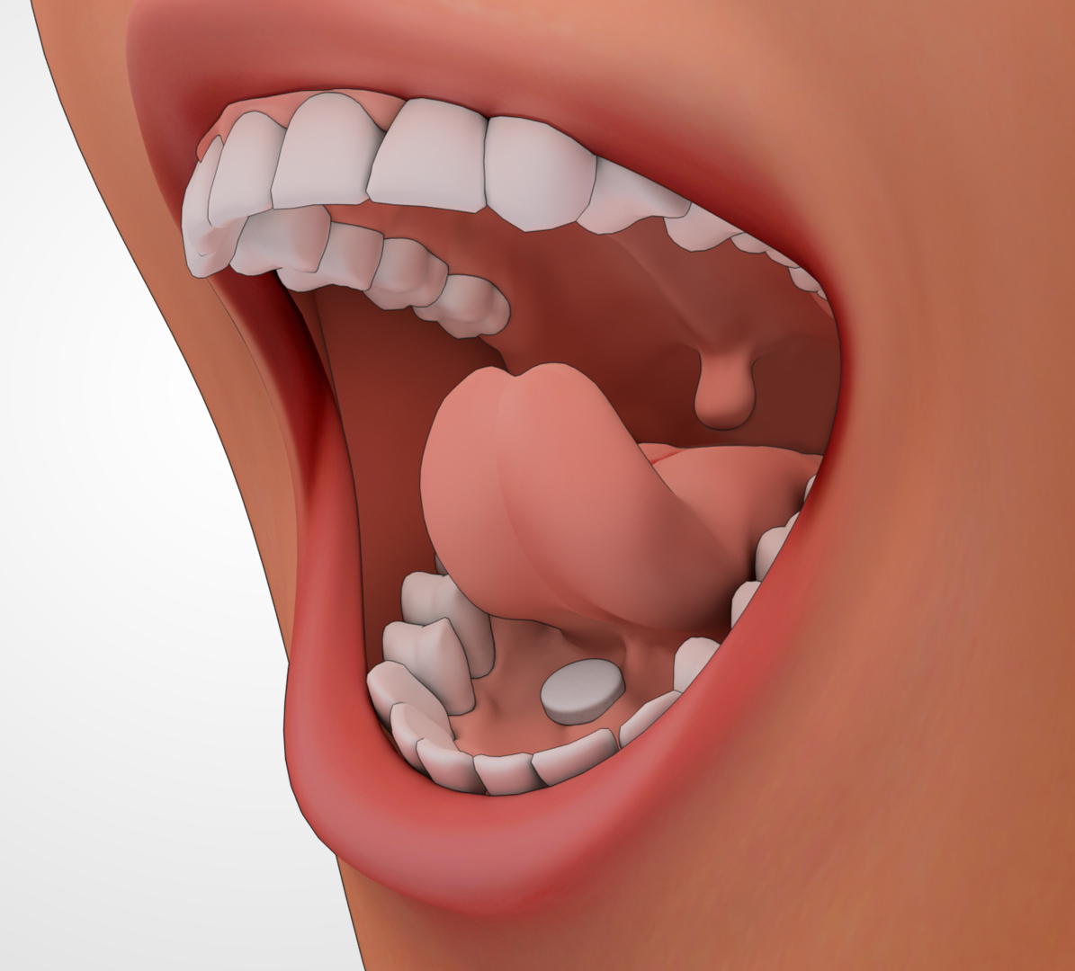
Day 1
4/1 mg
sublingual x1
Reassess
2-3 hrs later
No longer withdrawing
Persistent withdrawal, COWS ≥5
4/1 mg sublingual x1
Stop
Max day one: 16/4 mg
If considering more, consult Addiction
Notes:
We presented our protocol on how to prescribe buprenorphine in patients who were hospitalized

Slide 17
Low-dose buprenorphine?
Clinical Case
Substance Use History
Currently clinical presentation and COWS
Notes:
We presented cases of patients with OUD who were interested in MOUD and were in different situations such as recent opioid use and we asked the residents if the patients were appropriate for lo—dose buprenorphine.

Slide 18
Methods
Knowledge
Attitudes
Perception
3 days before
Beginning of
session
On prescribing
Buprenorphine
End of session
Notes:
Anonymous surveys (7 mins) were sent via email 3 days before session and QR codes given at the beginning of the session
Questions aimed at exploring: KAP
Statistical analysis: Wilcoxon signed rank test to compare the pre- and post-session median scores
Open-ended questions were analyzed using content and theme analysis
Deemed exempt by the IRB

Slide 19
Results and Discussion

Slide 20
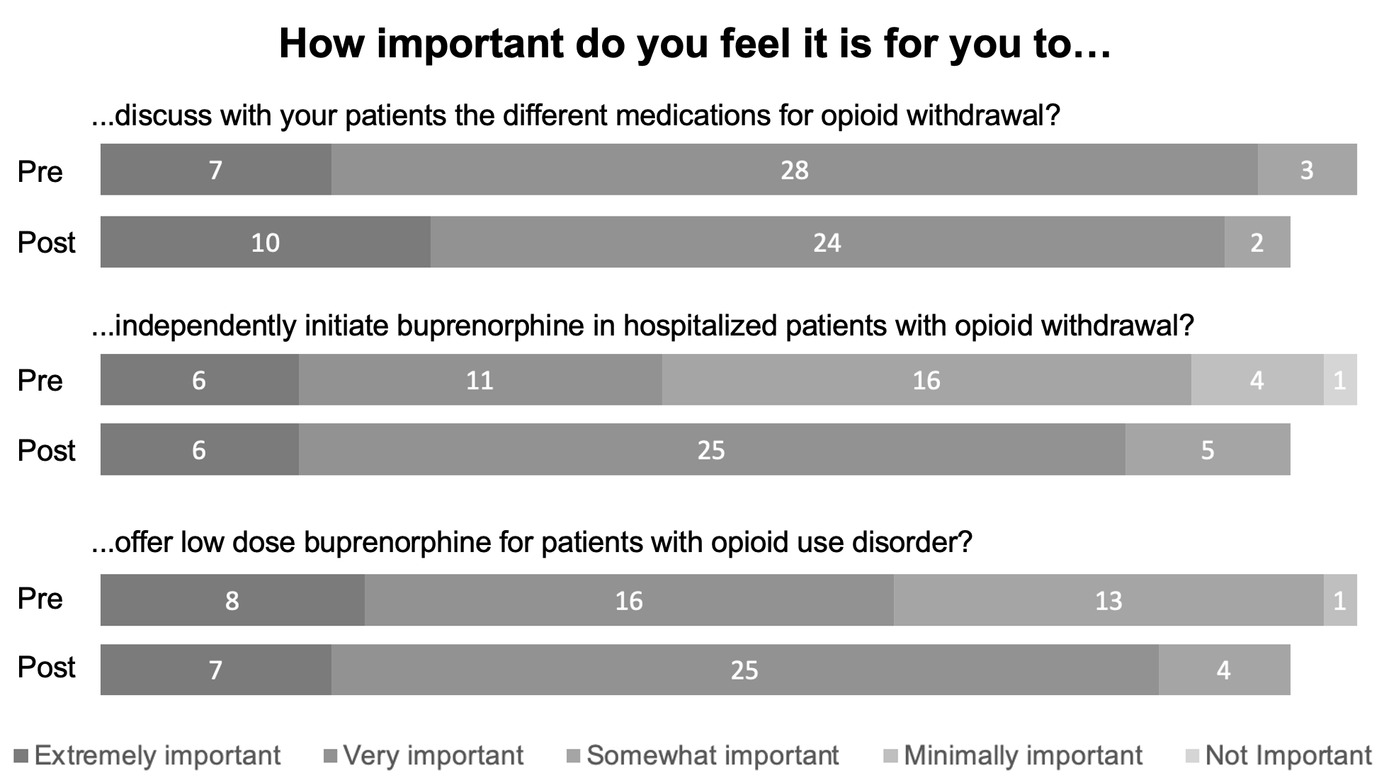
*
*
*Statistically significant (p<0.05)
Notes:
In the pre-session survey, most residents (n=35, 92.1%) thought it was either extremely important or very important to discuss different MOUD with their patients, and this did not significantly change after the session

Slide 21
Learning point 1
After the session, there was an increase in the perception of importance of independently initiating buprenorphine in hospitalized patients and offering low-dose buprenorphine for patients with OUD

Slide 22
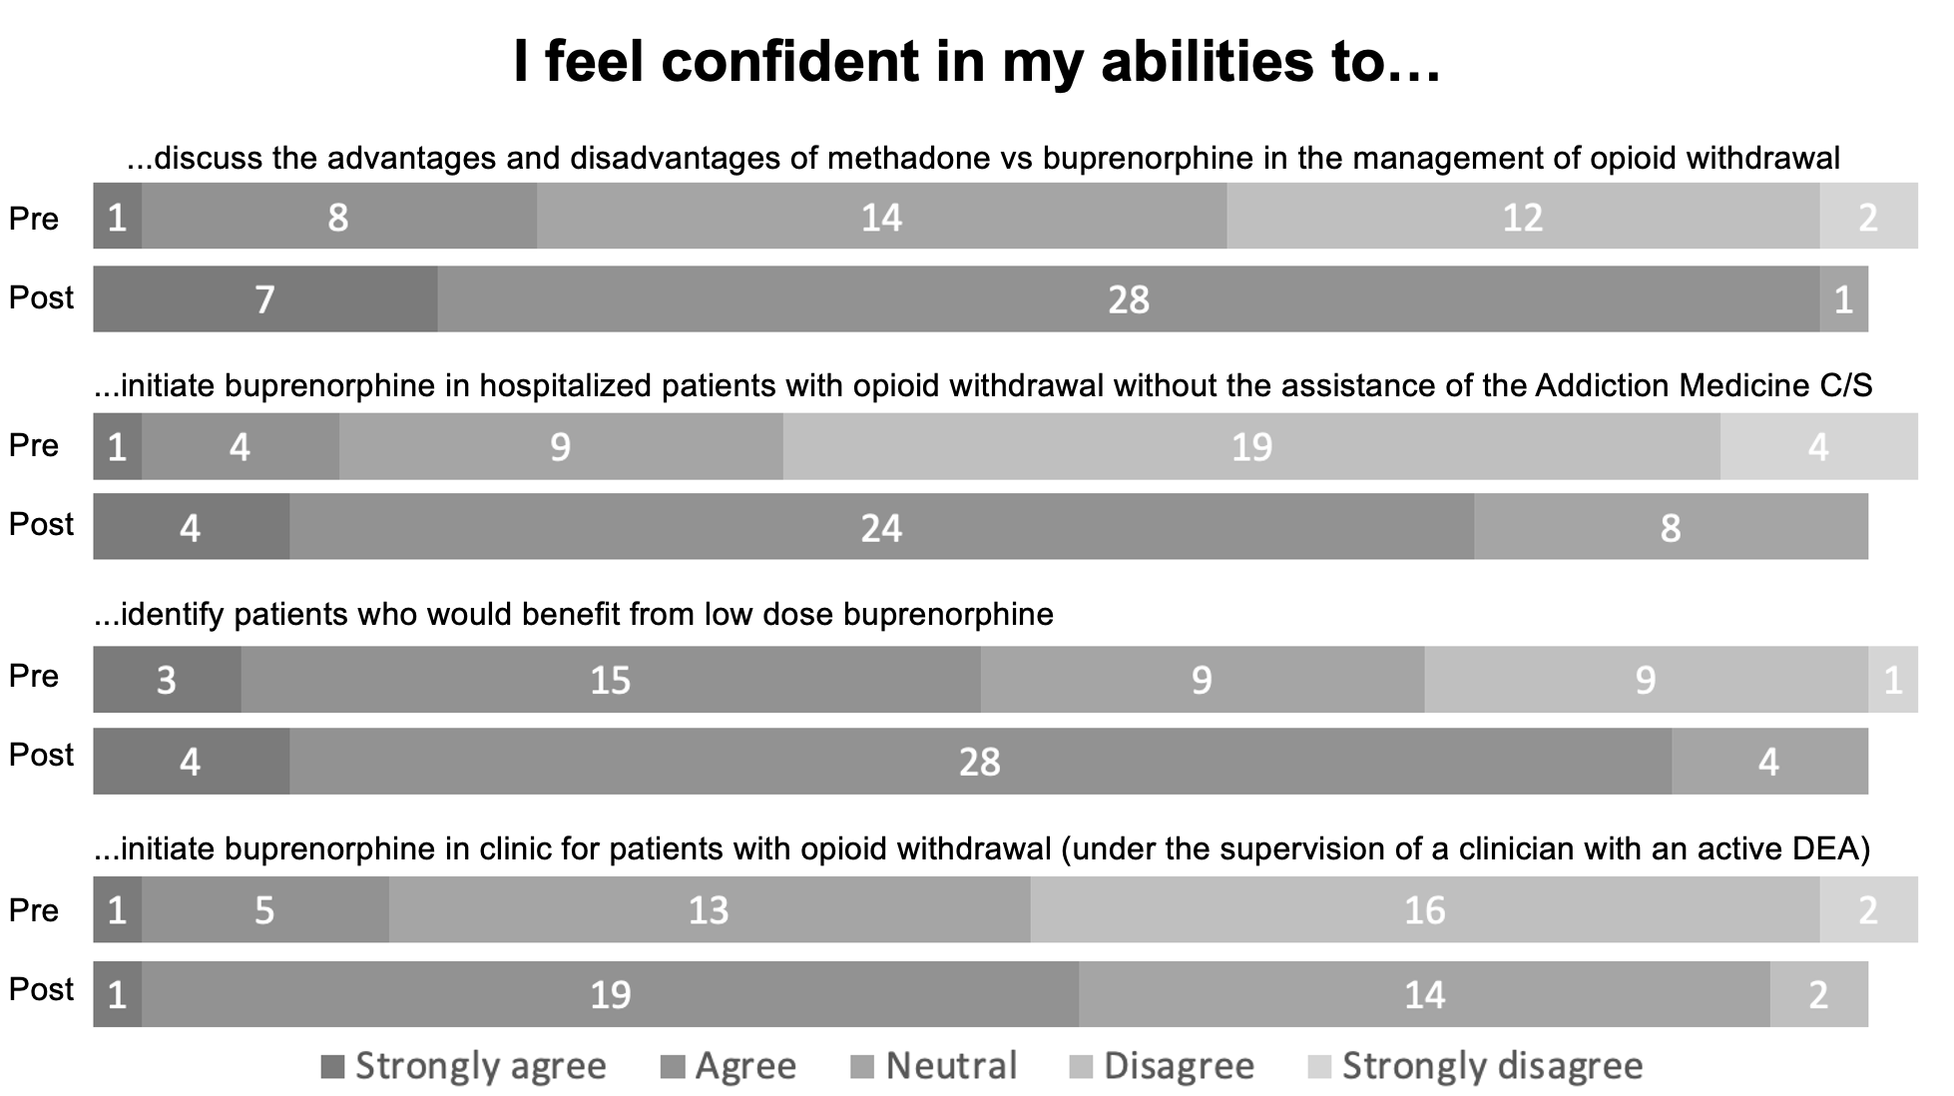
*
*
*
*
*Statistically significant (p<0.05)
Notes:
Before the session, there was a wide variability in the perception of competency in the management of patients with OUD.
Most residents did not feel confident in their abilities to prescribe buprenorphine independently for hospitalized patients (n=23, 62.2%) and about half did not feel confident to prescribe it in the outpatient setting (n=18, 48.6%).

Slide 23
Learning point 2
IM residents lacked confidence to initiate buprenorphine in the outpatient/inpatient setting.
Insufficient training, even at safety-net hospital?
Perception of competency increased after the session
Notes:
This may represent insufficient training, despite working at a safety-net hospital with regular exposure patients with OUD
Competency in all skills evaluated

Slide 24
 | Correct answers |  |  |  | p-value
 | Median |  | Mean
 | Pre | Post | Pre | Post
Knowledge (4 questions, 1 point each) | 1 | 3 | 1.55 | 3.33 | <0.001
Notes:
After the session, 36 (92.3%), 33 (84.6%), 31 (79.5%) and 20 (51.3%) residents answered correctly questions 4, 5, 6, and 7, respectively (see attached survey for question reference).

Slide 25
Knowledge questions
What is TRUE about buprenorphine?
In the outpatient setting, it can only be prescribed in a licensed program
It acts as a full µ-receptor agonist
It can cause precipitated withdrawal
It significantly increases the risk of QTc prolongation
Most patients need at least 36 mg/day to treat withdrawal
In a hospitalized patient with opioid withdrawal, what is the maximum dose of buprenorphine you can prescribe at BMC on the FIRST day?
8 mg
12 mg
16 mg
20 mg
24 mg
Notes:
After the session, 36 (92.3%), 33 (84.6%) residents answered correctly questions, respectively

Slide 26
Knowledge questions
A 37 y/o M with severe opioid use disorder is admitted for L foot osteomyelitis. He has been receiving hydromorphone 2mg every 3 hours for pain. What is the best way to prescribe buprenorphine in this patient?
Prescribe a lower dose of sublingual buprenorphine (4 mg)
Hold hydromorphone for 12 hours, then start buprenorphine at a usual schedule
Wait until after patient is no longer taking opioids for pain
Ask Addiction to prescribe buprenorphine patch for low dose buprenorphine induction
You are starting buprenorphine for a patient who is experiencing opioid withdrawal in the outpatient setting. What is TRUE about follow-up for this patient?
They should come back in 2 weeks, then every month
If buprenorphine is discontinued, risk of overdose is increased
All patients require urine testing
If they relapse, they will not be eligible for additional buprenorphine for at least 2 months
You should check kidney function now, then again in 6 months
Notes:
After the session, 31 (79.5%) and 20 (51.3%) residents answered correctly questions respectively

Slide 27
Learning point 3
This 90-minute session was effective at increasing immediate knowledge and comfort with prescribing buprenorphine
Notes:
At a historical time when access to buprenorphine has improved and OUD treatment remains essential to decrease mortality.

Slide 28
What could be improved?
more cases
treatment of pain in patients taking buprenorphine
physical sample of the buprenorphine film
more detail on low-dose buprenorphine
show buprenorphine order in EMR
Notes:
Residents mentioned that they learned:
When to prescribe low dose buprenorphine (n=22, 61.1%)
How to initiate buprenorphine in the inpatient setting (n=16, 44.4%)
when to consult addiction medicine for opioid withdrawal (n=5, 13.9%),
how to start buprenorphine in the outpatient setting (n=4, 11.1%),
the maximum dose of buprenorphine per BMC policy (n=4, 11.1%),
indications for buprenorphine (n=2, 5.6%),
and the physiology of precipitated withdrawal (n=2, 5.6%).

Slide 29
Strengths
All PGY2s
Short and highly engaging
Given by CMR/PGY3 + specialist guidance
Limitations
Single site
Did not assess long-term retention or practice change
Future directions:
Fixed curriculum
Expansion to faculty and other specialties
Monitor practice change
Notes:
Specialist guidance for content verification
Single site: caution with generalization

Slide 30
Conclusion
A CMR- and PGY3-led educational session increased IM residents’ attitude, self-perceived competency, and knowledge of prescribing buprenorphine in the inpatient and outpatient settings.

Slide 31
References
Dydyk AM, Jain NK, Gupta M. Opioid Use Disorder. [Updated 2022 Jun 21]. In: StatPearls [Internet]. Treasure Island (FL): StatPearls Publishing; 2022 Jan-. Available from: https://www.ncbi.nlm.nih.gov/books/NBK553166/
Hedegaard H, Miniño AM, Spencer MR, Warner M. Drug Overdose Deaths in the United States, 1999–2020. National Center for Health Statistics, December 2021.
(n.d.). Improving Access to Evidence-Based Medical Treatment for Opioid Use Disorder: Strategies to Address Key Barriers Within the Treatment System. National Academy of Medicine. Retrieved February 15, 2023, from https://nam.edu/improving-access-to-evidence-based-medical-treatment-for-opioid-use-disorder-strategies-to-address-key-barriers-within-the-treatment-system/
McCollum CG, Eaton E, Creger T, Lee A, Gagnon K, Li L. Physicians' experiences with buprenorphine: A qualitative study of motivations for becoming X waivered and barriers to and facilitators of prescribing the medication for opioid use disorder. Drug Alcohol Depend. 2023 Mar 1;244:109777
Taldone S, Lemmon S, Bianco S, Onge JS, Ford H, Cox L, Serota DP, Roy S, Onugha J, Forrest DW, Bartholomew T, Tookes HE. Opioid Use Disorder Curriculum: Preclerkship Pharmacology Case-Based Learning Session. MedEdPORTAL. 2022;18:11255.
Fujita AW, LaRosa A, Carter A. Treating Withdrawal and Pain in Inpatients With Opioid Use Disorder: A Brief Educational Intervention for Internal Medicine Residents. MedEdPORTAL. 2021;17:11123.
Wakeman SE, Pham-Kanter G, Donelan K. Attitudes, practices, and preparedness to care for patients with substance use disorder: Results from a survey of general internists. Subst Abus. 2016;37(4):635–641.
Alford, D.P., Bridden, C., Jackson, A.H. et al. Promoting Substance Use Education Among Generalist Physicians: An Evaluation of the Chief Resident Immersion Training (CRIT) Program. J GEN INTERN MED 24, 40–47 (2009).

Slide 32
*Publication with educational
resources coming soon!
THANK
Sebastian Suarez MD, MPH (sxs4395@med.miami.edu)
Minaliza Shahlapour, MD; Alyssa F Peterkin, MD; Jessica L Taylor MD

